Slide 1
Understanding God’s Will
A study of how the Scriptures should be interpreted and lived out in the life of every Human being.

Slide 2
Lesson | Title | Date
1 | Introduction: The Authority of God | Sunday, Nov 2, 2014
2 | The Scriptures & God’s Authority | Wednesday, Nov 5, 2014
3 | How Jesus Understood & Submitted to God’s Authority in the Scriptures, Pt. I | Sunday, Nov 9, 2014
4 | How Jesus Understood & Submitted to God’s Authority in the Scriptures, Pt. II | Wednesday, Nov 12, 2014
5 | How the Church Understood & Submitted to God’s Authority in the Scriptures | Sunday, Nov 16, 2014
6 | Alternative Uses of Authority in Religion part 1 | Wednesday, Nov 19, 2014
7 | Alternative Uses of Authority in Religion part2 | Sunday, Nov 23, 2014
 | Special Service | Wednesday, Nov 26, 2014
8 | Case Study: Personal Morality & Relational Ethics | Sunday, Nov 30, 2014
9 | Case Study: Worship Practices | Wednesday, Dec 3, 2014
10 | Case Study: Church Activity | Sunday, Dec 7, 2014
11 | Case Study: (cont. from previous) | Wednesday, Dec 10, 2014
12 | Tools & Skills for Personal Bible Study (or cont. CASE STUDIES if not completed) | Sunday, Dec 14, 2014
13 | Humility & Conviction: Essential Attitudes for Submitting to the Authority of God | Wednesday, Dec 17, 2014

Slide 3
Presuppositions
Possibility of the Supernatural
Supernatural Origin of the Universe
Intelligent, Personal Origin (of man)
Purpose for Creation
Possibility of Moral Law
Possibility of Supernatural Intervention
Possibility of Miracles, Divine Revelation…
The Bible contains information from God
All Information in the Bible is Truth
(II Pet 1:20-21)
History, commands, facts are authoritative throughout time
(II Tim 3:16,17)
Bible is exclusive Truth: no need to keep looking
(II Pet 1:3; Jude 3)
Bible has been preserved by God’s providence (I Pet 1:24,25)

Slide 4
How Jesus
Understood & Submitted to God’s Authority in the Scriptures
Lesson #3

Slide 5
What prevents us from understanding how important God’s will is?

Slide 6
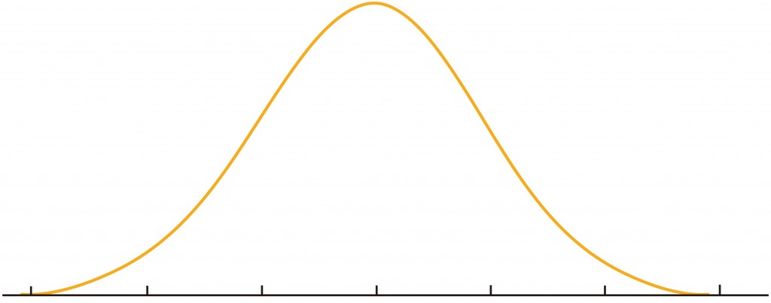
What prevents us from understanding how important God’s will is?
Jesus
Number of People
Evil Righteous

Slide 7
Jesus View of Scripture
Matthew 5: 17 “Do not think that I came to destroy the Law or the Prophets. I did not come to destroy but to fulfill. 18 For assuredly, I say to you, till heaven and earth pass away, one jot or one tittle will by no means pass from the law till all is fulfilled. 19 Whoever therefore breaks one of the least of these commandments, and teaches men so, shall be called least in the kingdom of heaven; but whoever does and teaches them, he shall be called great in the kingdom of heaven. 20 For I say to you, that unless your righteousness exceeds the righteousness of the scribes and Pharisees, you will by no means enter the kingdom of heaven.

Slide 8
What prevents us from understanding how important God’s will is?
Jesus
Number of People
Evil Righteous

Slide 9

1 Peter 2:21
For to this you were called, because Christ also suffered for us, leaving us an example, that you should follow His steps:

Slide 10
Matthew 4:1 Then Jesus was led up by the Spirit into the wilderness to be tempted by the devil. 2 And when He had fasted forty days and forty nights, afterward He was hungry. 3 Now when the tempter came to Him, he said, “If You are the Son of God, command that these stones become bread.”4 But He answered and said, “It is written, ‘Man shall not live by bread alone, but by every word that proceeds from the mouth of God.’”5 Then the devil took Him up into the holy city, set Him on the pinnacle of the temple, 6 and said to Him, “If You are the Son of God, throw Yourself down. For it is written:
‘He shall give His angels charge over you,’ and,
‘In their hands they shall bear you up,
Lest you dash your foot against a stone.’
7 Jesus said to him, “It is written again, ‘You shall not tempt the Lord your God.’”8 Again, the devil took Him up on an exceedingly high mountain, and showed Him all the kingdoms of the world and their glory. 9 And he said to Him, “All these things I will give You if You will fall down and worship me.”10 Then Jesus said to him, “Away with you, Satan! For it is written, ‘You shall worship the Lord your God, and Him only you shall serve.’”

Slide 11
Temptation | Nature of Temptation | Scriptural Arguments | Lessons on the Use of Scripture
Stones to Bread (v 2-4) | Do a "Good" but Unauthorized, work: Provide for Self during God's apparent lack of provision (see Mt 14:17) | Man shall not live by bread alone... Israelites, through hunger, were to have learned to trust in God's promises. (Dt 8:2,3) | •Similar Circumstances (examples) can be used to establish authority. • The apparent "goodness" of an action does not justify it. • God's law not to be judged by man's wisdom.
Jump from Temple (v 5-7) | Demonstrate God's Protection (Publicly?); Cause God to Verify His Messiahship | Satan: "Ps 91:11,12 appears to justify the action." Thou shall not make trial of the Lord... Israel made a similar mistake when they tested God at Massah: "Is God still with Us?"(Dt 6:16 Ex 17:3-7) | • Context of the passage, especially a promise, must be considered. • Demanding that God meet our own desires, plans, or expectations leads to error. - "I just think God would (or would not) ..."- "If God wants me to... then He should..."

Slide 12
Temptation | Nature of Temptation | Scriptural Arguments | Lessons on the Use of Scripture
Worship Satan in Return for Rule of the World (v 8-10) | A short-cut to the mission of Jesus (Matt 28:18): to be given all authority over the earth. | Thou shall worship the Lord thy God, and Him only... A clear violation of a specific command of Moses to the Israelites (Dt 6:13) | •The ends don't justify the means. • Compromise with evil for an apparently good purpose is not justified. • Obedience to God excludes subjection to other religious authority.

Slide 13
Additional Lessons on
Jesus’ use of Scripture:
All of the arguments are taken from words, spoken (and written) by Moses to Israel.
Each of the examples referred to were different from the circumstances of the temptation.
Each answer of Jesus is based on a specific principle

Slide 14
Other Potential Responses from Jesus’s:
Our Potential Responses
when facing questions:
I can do what I want… I have Authority Matthew 28:18
My very voice is Scripture…
why should I quote the old law?” John 1
I know what God would want
best for me John 10:30
‘I can do what I want…’
‘I’m pretty bright on my own and can figure this out’
‘I have a special relationship with God and know what he wants’

Slide 15
Other Examples of Jesus’ Use of Scripture:
Matthew 9: ⁹ As Jesus passed on from there, He saw a man named Matthew sitting at the tax office. And He said to him, “Follow Me.” So he arose and followed Him.
¹⁰ Now it happened, as Jesus sat at the table in the house, that behold, many tax collectors and sinners came and sat down with Him and His disciples. ¹¹ And when the Pharisees saw it, they said to His disciples, “Why does your Teacher eat with tax collectors and sinners?”
¹² When Jesus heard that, He said to them, “Those who are well have no need of a physician, but those who are sick. ¹³ But go and learn what this means: ‘I desire mercy and not sacrifice.’ For I did not come to call the righteous, but sinners, to repentance.”

Slide 16
Other Examples of Jesus’ Use of Scripture:
Matthew 22: ³⁴ But when the Pharisees heard that He had silenced the Sadducees, they gathered together. ³⁵ Then one of them, a lawyer, asked Him a question, testing Him, and saying, ³⁶ “Teacher, which is the great commandment in the law?”
³⁷ Jesus said to him, “‘You shall love the Lord your God with all your heart, with all your soul, and with all your mind.’ ³⁸ This is the first and great commandment. ³⁹ And the second is like it: ‘You shall love your neighbor as yourself.’ ⁴⁰ On these two commandments hang all the Law and the Prophets.”
Notes:
Matthew 22:37 Deuteronomy 6:5
Matthew 22:39 Leviticus 19:18

Slide 17
Other Examples of Jesus’ Use of Scripture:
Matthew 22: ³¹ But concerning the resurrection of the dead, have you not read what was spoken to you by God, saying, ³² ‘I am the God of Abraham, the God of Isaac, and the God of Jacob’? God is not the God of the dead, but of the living.”
Notes:
Exodus 3:6New King James Version (NKJV)
6 Moreover He said, “I am the God of your father—the God of Abraham, the God of Isaac, and the God of Jacob.” And Moses hid his face, for he was afraid to look upon God.
15 Moreover God said to Moses, “Thus you shall say to the children of Israel: ‘The Lord God of your fathers, the God of Abraham, the God of Isaac, and the God of Jacob, has sent me to you. This is My name forever, and this is My memorial to all generations.’

Slide 18
Temptation | Nature of Temptation | Scriptural Arguments | Lessons on the Use of Scripture
Stones to Bread (v 2-4) | Do a "Good" but Unauthorized, work: Provide for Self during God's apparent lack of provision (see Mt 14:17) | Man shall not live by bread alone... Israelites, through hunger, were to have learned to trust in God's promises. (Dt 8:2,3) | •Similar Circumstances (examples) can be used to establish authority. • The apparent "goodness" of an action does not justify it. • God's law not to be judged by man's wisdom.
Jump from Temple (v 5-7) | Demonstrate God's Protection (Publicly?); Cause God to Verify His Messiahship | Satan: "Ps 91:11,12 appears to justify the action." Thou shall not make trial of the Lord... Israel made a similar mistake when they tested God at Massah: "Is God still with Us?"(Dt 6:16 Ex 17:3-7) | • Context of the passage, especially a promise, must be considered. • Demanding that God meet our own desires, plans, or expectations leads to error. - "I just think God would (or would not) ..."- "If God wants me to... then He should..."

Slide 19
Temptation | Nature of Temptation | Scriptural Arguments | Lessons on the Use of Scripture
Worship Satan in Return for Rule of the World (v 8-10) | A short-cut to the mission of Jesus (Matt 28:18): to be given all authority over the earth. | Thou shall worship the Lord thy God, and Him only... A clear violation of a specific command of Moses to the Israelites (Dt 6:13) | •The ends don't justify the means. • Compromise with evil for an apparently good purpose is not justified. • Obedience to God excludes subjection to other religious authority.

