Slide 1
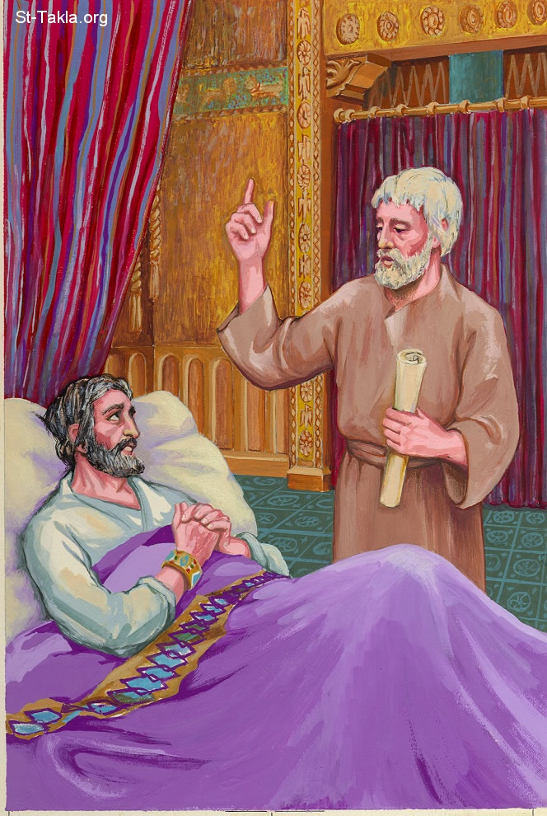
Isaiah the prophet, the son of Amoz, went to him and said to him, “Thus says the Lord: ‘Set your house in order, for you shall die and not live.’” Isaiah 38:1

Slide 3
Hebrews 9:27
“…it is appointed for men to die once, but after this the judgment.” Hebrews 9:27

Slide 4
“How do you plead: Guilty or Not?”
Looking at My Life
“But we see Jesus…”
GUILTY! I have broken the law.
“for all have sinned…”(Ro. 3:23)
“For the wrath of God is revealed from heaven against all ungodliness and unrighteousness of men.” (Romans 1:18)
“There is none righteous, no, not one;” (Rom. 3:10)
“The wages of sin is death” (Rom. 6:23)
LOST FOREVER!
“There is therefore now no condemnation to those who are in Christ Jesus…” (Ro.8:1)
“But now the righteousness of God apart from the law is revealed…²² the righteousness of God, through faith in Jesus Christ…” (Ro. 3:21-22),
“Therefore whoever confesses Me before men, him I will also confess before My Father who is in heaven. (Matt. 10:32)
John 3:16

Slide 5
Making this Relationship with Jesus
Calling Jesus “Lord” not enough (Matt. 7:21)
Good works not enough (Matt. 7:22-23).
Jesus said, ““But why do you call Me ‘Lord, Lord,’ and not do the things which I say? (Luke 6:46)
Jesus said “that repentance and remission of sins should be preached in His name to all nations, beginning at Jerusalem.” (Luke 24:47)
Jesus said, “He who believes and is baptized will be saved.” (Mark 16:16).

Slide 6
Making this Relationship with Jesus
“Or do you not know that as many of us as were baptized into Christ Jesus were baptized into His death? Therefore we were buried with Him through baptism into death, that just as Christ was raised from the dead by the glory of the Father, even so we also should walk in newness of life” (Romans 6:3-4).
“If we walk in the light as He is in the light, we have fellowship with one another, and the blood of Jesus Christ His Son cleanses us from all sin.” (1 John 1:7)
Seven Days or Seventy Years

Slide 7
Our House is “Set in Order” When we are obeying the words of Jesus!
“Therefore whoever hears these sayings of Mine, and does them, I will liken him to a wise man who built his house on the rock: and the rain descended, the floods came, and the winds blew and beat on that house; and it did not fall, for it was founded on the rock. (Matt. 7:24-25).

Slide 8
Hezekiah’s Illness Proved Not to Be Terminal!
God changed the prognosis!

Slide 9
What Hezekiah Did
He Prayed
He Used Medication

Slide 10
If I pray and use medication, will God reverse my terminal illness?
Never doubt that He is able to do so!
God had a special reason to heal Hezekiah.
“Hezekiah did not repay according to the favor shown him, for his heart was lifted up; therefore wrath was looming over him and over Judah and Jerusalem” (2 Chron. 32:25).
He fathered the worst king in Judah’s history.

Slide 11
Death is a blessing to those in Christ!
1 Kings 14:13
Faith changes ones attitude toward dying.
Paul wrote “For to me, to live is Christ, and to die is gain” (Philippians 1:21).
‘Blessed are the dead who die in the Lord from now on’” (Revelation 14:13).
When we pray for healing we should add, ”Not my will but Yours be done.”

Slide 12
Hezekiah was blessed to have a warning!
It is quite possible we will not have one.

