Slide 2
Names of God
El-Shaddai - The All Sufficient One, God is the all-sufficient source of all blessings. Nothing is too big for God. He is all you will ever need
Jehovah-jireh - The Lord will Provide, God will meet our needs, He provides a Substitute for our sins.
Jehovah-rohi (raah) - The Lord is My Shepherd, The Lord protects, provides, directs, leads, and cares for His people.
El Roi - The God Who Sees, Nothing escapes His Fatherly care. God knows us and our troubles.
Jehovah-rophe (rapha) – The God who Heals. He can take our bitter experiences and make them sweet

Slide 3
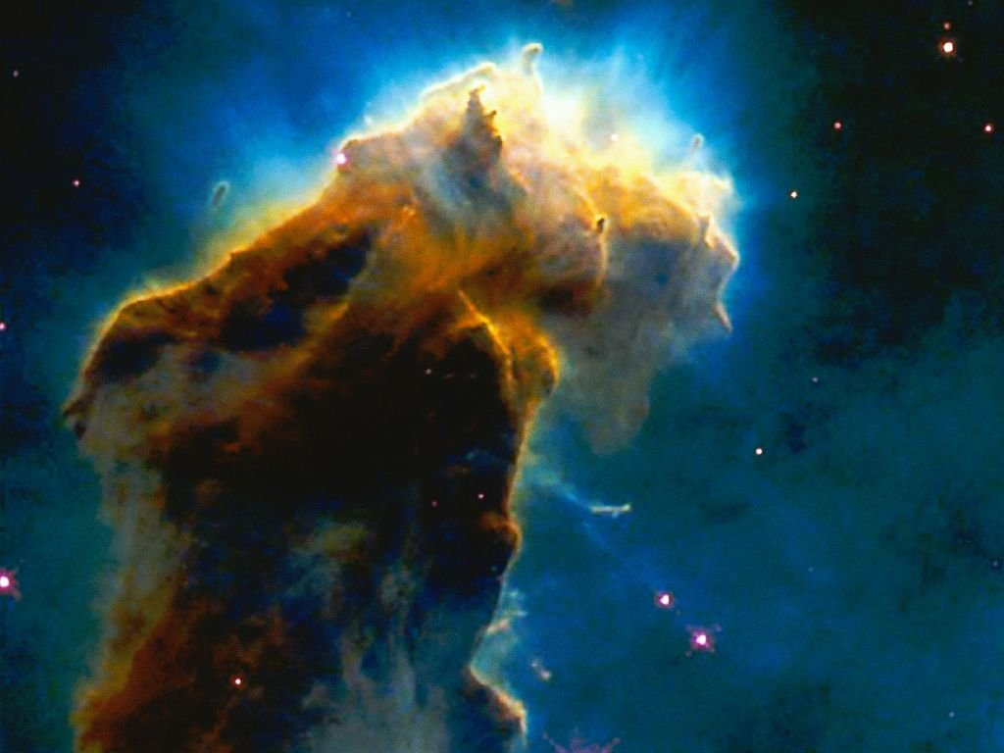
“In the beginning God
created the heavens and the earth” (Genesis 1:1)
Notes:
The Bible begins with this simple but profound declaration of faith – in the beginning there was only God, nothing else. Everything else that comes to be comes as the result of the activity of God.
The first name for God that is found in the Bible in Genesis 1:1 is Elohim.
What does this name mean? In the context of Genesis 1:1, it is a declaration that God (Elohim) alone is eternal.
In a humanistic system, the universe becomes god-like, creating life out of lifeless matter through some mindless random system.
By declaring that Elohim alone is eternal and is the Creator of all that exists, scripture gives dignity and meaning to our life and existence.
We can know that life has meaning and purpose. If we are to discover that purpose, we must know the one who alone is eternal, our Creator.
Further, it lays open the possibility that we can have eternal life. Mankind has always sought to find the secret to life after death, to eternal life.
But it’s no secret! Eternal life can only be found in a relationship to God, to Elohim, who is eternal.

Slide 4
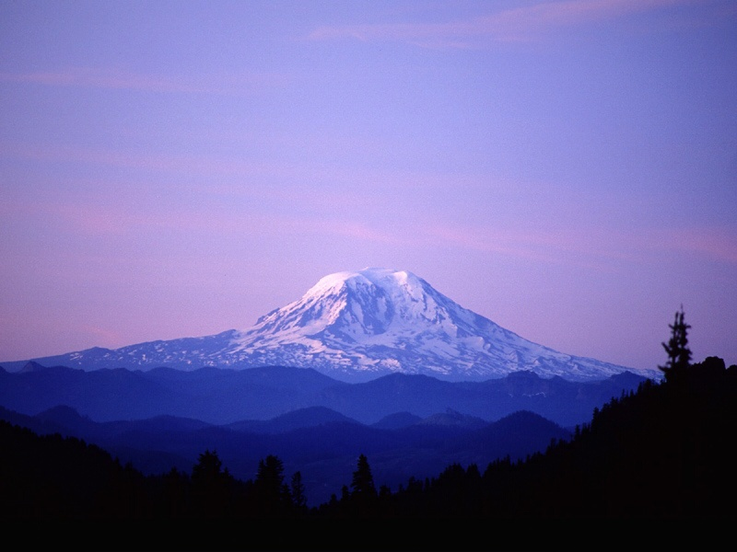
“Oh LORD (Jehovah) our Lord (Adonai) How majestic is your name in all the earth” Psalms 8:9
Notes:
While these names do imply or demand a responsibility on the part of man to conform to the Being in whose image we are made, the Adonai makes a definite claim for man’s obedience and service for He is Lord and Master. We studied the meaning of El Shaddai last time because it is easier call Him El Shaddai (that He is all you need) than it is to call Him Adonai (your Master). Yet you will never know His sufficiency apart from knowing Him as your Lord and Master.

Slide 5
God Almighty

Slide 6
And Abraham called the name of that place “The LORD will provide, as it is said to this day; on the Mount of the LORD it shall be provided. (Gen 22:14)

Slide 7
Jehovah-rophe (rapha) – The God who Heals. He can take our bitter experiences and make them sweet
Notes:
The name JEHOVAH-rophe means Jehovah heals. This is the second compound name of Jehovah (the first was Jehovah-jireh).
It seems there is a progressive revelation of Jehovah meeting every need as it arises in the experience of His redeemed people – saving, sustaining, strengthening, sanctifying, and so on.
Of course we should not be surprised, for the Apostle Paul tells us that the things that happened to Israel were for a reason – for our learning, they are examples for us today (1 Cor. 10:6; 10:11).
The name “Jehovah-rophe” occurs in Exodus 15. The children of Israel, after 400 years in Egypt, many of those years as slaves, working in the brick pits to make monuments to Pharaoh, were on their way to the Promise Land.
They watched the plagues descend from the LORD on Egypt, until finally the death of the first born of Egypt causes Pharaoh to let the Hebrews go. But soon after, Pharaoh changes his mind and he pursues the Israelites to the borders of the Red Sea.
The Children of Israel watch in amazement as the LORD parts the sea and they pass over on dry ground and to safety as the LORD then destroys the Egyptian army as the waters roll back to their place.
Israel began to sing praises to the LORD for His deliverance. This song of triumph (Exodus 15) is a glorious song of worship and trust.
I will sing to the LORD, for He is highly exalted; The horse and its rider He has hurled into the sea The LORD is my strength and song; And He has become my salvation;
This is my God, and I will praise Him; My father’s God, and I will extol Him.
The LORD is a warrior; The LORD is His name (vv. 2-3)

Slide 8
The Bright Morning Star

Slide 9
The Dayspring from on High
Psalms 27:1 The LORD is my light, and my salvation

Slide 10
In Whom We Hope
“but in your hearts honor Christ the Lord as holy, always being prepared to make a defense to anyone who asks you a reason for the hope that is in you …” 1 Peter 3:15
The God Who Makes and Keeps Promises

Slide 11
God said to Moses, “I am who I am. This is what you are to say to the Israelites: ‘I AM has sent me to you.’ ” —Exodus 3:14

Slide 12
In Whom We Hope
Exodus 5:22-6:8 ²²Then Moses turned to the Lord and said, “O Lord (Adonai – Master), why have you done evil to this people? Why did you ever send me? ²³For since I came to Pharaoh to speak in your name, he has done evil to this people, and you have not delivered your people at all.”
Exodus 6;1-8 ¹But the LORD (Jehovah) said to Moses, “Now you shall see what I will do to Pharaoh; for with a strong hand he will send them out, and with a strong hand he will drive them out of his land.”
²God spoke to Moses and said to him, “I am the LORD.
³I appeared to Abraham, to Isaac, and to Jacob, as God Almighty (El Shaddai – All Sufficient) , but by my name the LORD I did not make myself known to them. ⁴I also established my covenant with them to give them the land of Canaan, the land in which they lived as sojourners. ⁵Moreover, I have heard the groaning of the people of Israel whom the Egyptians hold as slaves, and I have remembered my covenant. ⁶Say therefore to the people of Israel, ‘I am the LORD, and I will bring you out from under the burdens of the Egyptians, and I will deliver you from slavery to them, and I will redeem you with an outstretched arm and with great acts of judgment. ⁷I will take you to be my people, and I will be your God, and you shall know that I am the Lord your God, who has brought you out from under the burdens of the Egyptians. ⁸I will bring you into the land that I swore to give to Abraham, to Isaac, and to Jacob. I will give it to you for a possession. I am the Lord.’”

Slide 13
In Whom We Hope
His Unchangeableness His Promises and Covenants
His Redeeming Mercy His Moral / Spiritual Attributes
God said to Moses, “I am who I am. This is what you are to say to the Israelites: ‘I AM has sent me to you.’ ” —Exodus 3:14
The God Who Makes and Keeps Promises

Slide 14
In Whom We Hope
Exodus 6:6-8 ⁶Say therefore to the people of Israel, ‘I am the LORD, and I will bring you out from under the burdens of the Egyptians, and I will deliver you from slavery to them, and I will redeem you with an outstretched arm and with great acts of judgment. ⁷I will take you to be my people, and I will be your God, and you shall know that I am the Lord your God, who has brought you out from under the burdens of the Egyptians. ⁸I will bring you into the land that I swore to give to Abraham, to Isaac, and to Jacob. I will give it to you for a possession. I am the Lord.’”

Slide 15
Jehovah – The God of Promise
I Will Bring You Out
I Rid You Separation
Matthew 11:28-30(ESV) ²⁸Come to me, all who labor and are heavy laden, and I will give you rest. ²⁹Take my yoke upon you, and learn from me, for I am gentle and lowly in heart, and you will find rest for your souls. ³⁰For my yoke is easy, and my burden is light.”
John 10:3(ESV) ³To him the gatekeeper opens. The sheep hear his voice, and he calls his own sheep by name and leads them out.

Slide 16
Jehovah – The God of Promise
I Rid You
I Will Bring You Out Separation
I Will Deliver You
I Release You Emancipation
Colossians 1:12-14(ESV)
¹²giving thanks to the Father, who has qualified you£ to share in the inheritance of the saints in light. ¹³He has delivered us from the domain of darkness and transferred us to the kingdom of his beloved Son, ¹⁴in whom we have redemption, the forgiveness of sins.
1 Samuel 17:34-37(ESV)
³⁴But David said to Saul, “Your servant used to keep sheep for his father. And when there came a lion, or a bear, and took a lamb from the flock, ³⁵I went after him and struck him and delivered it out of his mouth. And if he arose against me, I caught him by his beard and struck him and killed him. ³⁶Your servant has struck down both lions and bears, and this uncircumcised Philistine shall be like one of them, for he has defied the armies of the living God.” ³⁷And David said, “The Lord who delivered me from the paw of the lion and from the paw of the bear will deliver me from the hand of this Philistine.” And Saul said to David, “Go, and the Lord be with you!”
Romans 7:24-25(ESV)
²⁴Wretched man that I am! Who will deliver me from this body of death? ²⁵Thanks be to God through Jesus Christ our Lord!

Slide 17
Jehovah – The God of Promise
I Rid You
I Will Bring You Out Separation
I Release You
I Will Deliver You Emancipation
I Will Redeem You
I Rescue You Redemption
Titus 2:13-14(ESV)
¹³waiting for our blessed hope, the appearing of the glory of our great God and Savior Jesus Christ, ¹⁴who gave himself for us to redeem us from all lawlessness and to purify for himself a people for his own possession who are zealous for good works.
Isaiah 43:1(ESV)
¹ But now thus says the LORD, he who created you, O Jacob, he who formed you, O Israel: “Fear not, for I have redeemed you; I have called you by name, you are mine.

Slide 18
Jehovah – The God of Promise
I Rid You
I Will Bring You Out Separation
I Release You
I Will Deliver You Emancipation
I Redeem You
I Will Deliver You Redemption
I Will Take You as My Own
I Receive You Selection
Exodus 19:5 - Now therefore, if you will indeed obey my voice and keep my covenant, you shall be my treasured possession among all peoples, for all the earth is mine;

Slide 19
Jehovah – The God of Promise
I Rid You
I Will Bring You Out Separation
I Release You
I Will Deliver You Emancipation
I Redeem You
I Will Deliver You Redemption
I Receive You
I Will Take You as My Own Selection
I will Bring You
I Refresh You Admission
Numbers 14:8(ESV) ⁸If the Lord delights in us, he will bring us into this land and give it to us, a land that flows with milk and honey.
Ephesians 2:13(ESV) ¹³But now in Christ Jesus you who once were far off have been brought near by the blood of Christ.

Slide 20
Jehovah – The God of Promise
I Rid You
I Will Bring You Out Separation
I Release You
I Will Deliver You Emancipation
I Redeem You
I Will Deliver You Redemption
I Receive You
I Will Take You as My Own Selection
I Refresh You
I will Bring You Admission
I Will Give You
I Reward You Possession
Who Will Inherit the Land?
Psalms 37
Vs 9 – Those who wait on the LORD will inherit the land
Vs 11 – The Meek will inherit the land
Vs 29 – The Righteous will inherit the land

Slide 21
Jehovah – The God of Promise
I Rid You
I Will Bring You Out Separation
I Release You
I Will Deliver You Emancipation
I Redeem You
I Will Deliver You Redemption
I Receive You
I Will Take You as My Own Selection
I Refresh You
I will Bring You Admission
I Reward You
I Will Give You Possession
I Will Be Your God
I Regulate You Adoration
We Must Know the LORD
Exodus 7:5 -The Egyptians shall know that I am the LORD,
Exodus 10:1- that you may know that I am the LORD.”
Exodus 14:4 -and the Egyptians shall know that I am the LORD.” And they did so.
Exodus 14:18 -And the Egyptians shall know that I am the LORD,
Hebrews 8:10 - For this is the covenant that I will make with the house of Israel after those days, says the Lord; I will put my laws into their mind, and write them in their hearts: and I will be to them a God, and they shall be to me a people:
Deuteronomy 7:9(ESV) ⁹Know therefore that the Lord your God is God, the faithful God who keeps covenant and steadfast love with those who love him and keep his commandments, to a thousand generations,

Slide 22
In Whom We Hope
Exodus 6:6-8 ⁶Say therefore to the people of Israel, ‘I am the LORD, and I will bring you out from under the burdens of the Egyptians, and I will deliver you from slavery to them, and I will redeem you with an outstretched arm and with great acts of judgment. ⁷I will take you to be my people, and I will be your God, and you shall know that I am the Lord your God, who has brought you out from under the burdens of the Egyptians. ⁸I will bring you into the land that I swore to give to Abraham, to Isaac, and to Jacob. I will give it to you for a possession. I am the Lord.’”
Isaiah 14:13-15(ESV)
¹³ You said in your heart, ‘I will ascend to heaven; above the stars of God I will set my throne on high; I will sit on the mount of assembly in the far reaches of the north; ¹⁴ I will ascend above the heights of the clouds; I will make myself like the Most High.’ ¹⁵ But you are brought down to Sheol, to the far reaches of the pit.

Slide 23
In Whom We Hope

Slide 24
Names of God
El-Shaddai - The All Sufficient One, God is the all-sufficient source of all blessings. Nothing is too big for God. He is all you will ever need
Jehovah-jireh - The Lord will Provide, God will meet our needs, He provides a Substitute for our sins.
Jehovah-rohi (raah) - The Lord is My Shepherd, The Lord protects, provides, directs, leads, and cares for His people.
El Roi - The God Who Sees, Nothing escapes His Fatherly care. God knows us and our troubles.
Jehovah-rophe (rapha) – The God who Heals. He can take our bitter experiences and make them sweet

