Slide 1
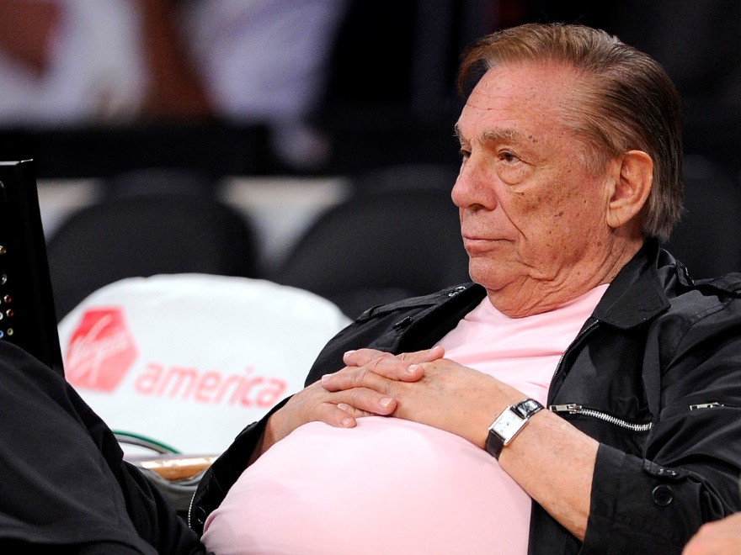

Slide 2
One Body in Christ
Living Sacrifices (Romans 12) – Part 2

Slide 3
Humility
Dual Challenge of Humility
Faith in God’s Grace is the Foundation of Humility
Faith-Based Humility (Galatians 3.24-29)
  Living by Law → Pride. Living by Faith → Humility.
  By faith in Christ all are Sons of God.
  Baptism: Equalizing & Humbling act of Faith
Is my Self-Evaluation based on me or in Christ?

Slide 4
Membership
Inaccurate Views of Membership
Interdependence of Membership (1 Cor. 12.12-26)
  Equal Value of Members of the Body
  God’s Purposeful Composition of the Body
Meaning of Membership
  Personal Investment
  Genuine Openness

Slide 5
Gifting
Different People with Different Gifts
  Office Gifts (Eph. 4.11-13)
  Signifying Gifts (1 Cor. 12.27-31)
Source & Purpose of Gifts (1 Cor. 12.4-11)
God gifts all so that all will give.

Slide 6
Being Useful in the Body
How can I fulfill my role in the Body?
Prophecy: Boldly Speaking out as God’s Mouthpiece
Service: Doing things others cannot or will not do
Teaching: Skillfully explaining God’s will to others
Exhortation: Helping others have courage and resilience
Giving: Possessions, time, energy, wisdom, skill
Leadership: Organizing, visioneering and directing others
Mercy: Caring about and for the ones no one else notices

