Slide 1
Book of Joshua
Lesson 7
Joshua Renews Covenant at Mount Ebal & Mt Gerizim

Slide 2
Class Objectives
Learn about God's fulfillment of the land promise.
Learn about Serving the Lord in the days of Joshua
Learn about the character of Joshua
Study the Geography & Archaeology of the Conquest of Canaan
Be ready to give a defense of the Conquest of Canaan

Slide 3
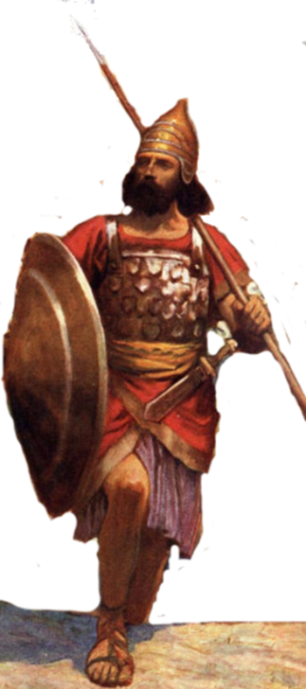
Resting in the land
Living the land
Distributing
the land
Joshua
24:29-33
Conquering the land
Joshua
13-21
Joshua
22-24
Claiming the land
Joshua
6-12
Joshua
1-5
Notes:
I. Claiming the Land (1:1–5:15)
II. Conquering the Land (6:1–12:24)
III. Distributing the Land (13:1–21:45)
IV. Living in the Land (22:1–24:28)
V. Resting in the Land (24:29–33)

Slide 4
Joshua now that
You crossed Jordan River
Circumcised the People
Partaking of the 1st Passover in the Promised Land
Taken Jericho and it’s walls
Had your first defeat in the land
Dealt with sin of Achan
Taken Ai that opens land of Canaan
Where are you going now?
Notes:
I. Claiming the Land (1:1–5:15)
II. Conquering the Land (6:1–12:24)
III. Distributing the Land (13:1–21:45)
IV. Living in the Land (22:1–24:28)
V. Resting in the Land (24:29–33)

Slide 5
Shechem
Abraham – Gen 12:6 “Abram traveled through the land as far as the site of the great tree of Moreh at Shechem.”
Jacob - “camped within sight of the city” after returning from sojourney with Laban & he bought for a hundred pieces of money the piece of land on which he had pitched his tent. (Gn 33:18-19). He moves on to Bethel & Hebron and Dinah incident
Simeon, Levi & Dinah - The sons of Jacob came upon the slain and plundered the city, because they had defiled their sister. Genesis 34:27 After all who went out of the gate of his city listened to Hamor and his son Shechem, and every male was circumcised.
Shechem was destroyed around 1540 BC resulted in debris covering the city up to a depth of 5.25 ft. It is surmised that the Egyptian armies of Ahmose I or Amenhotep I. Rebuilt about 1450 BC (50 yrs before return)

Slide 6
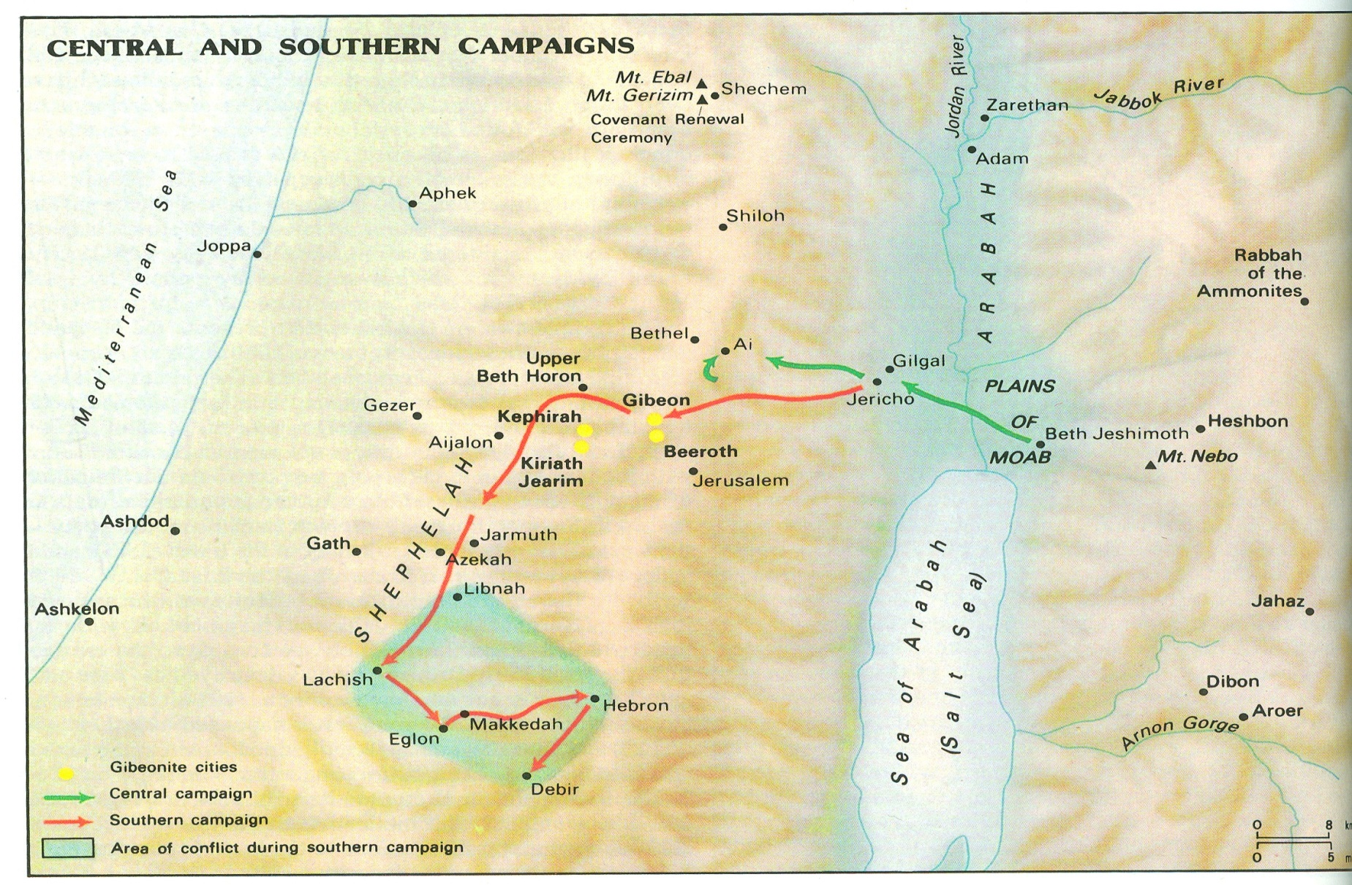
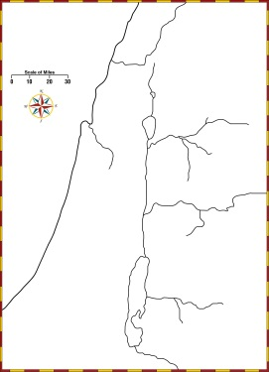

Slide 7
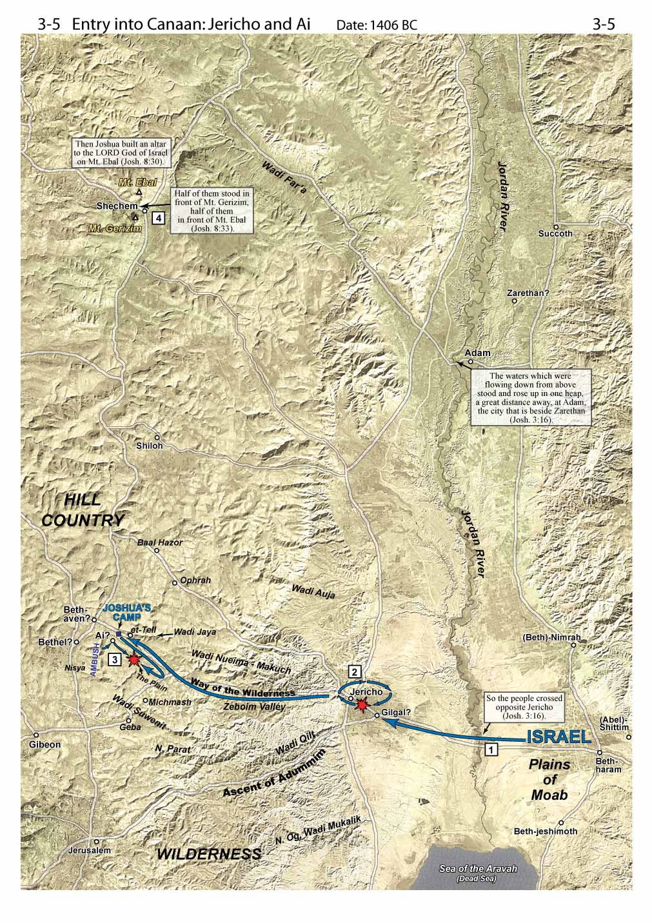
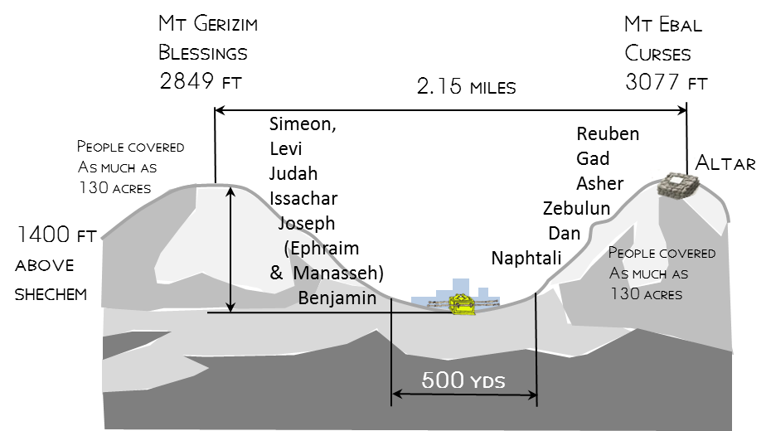

Slide 8
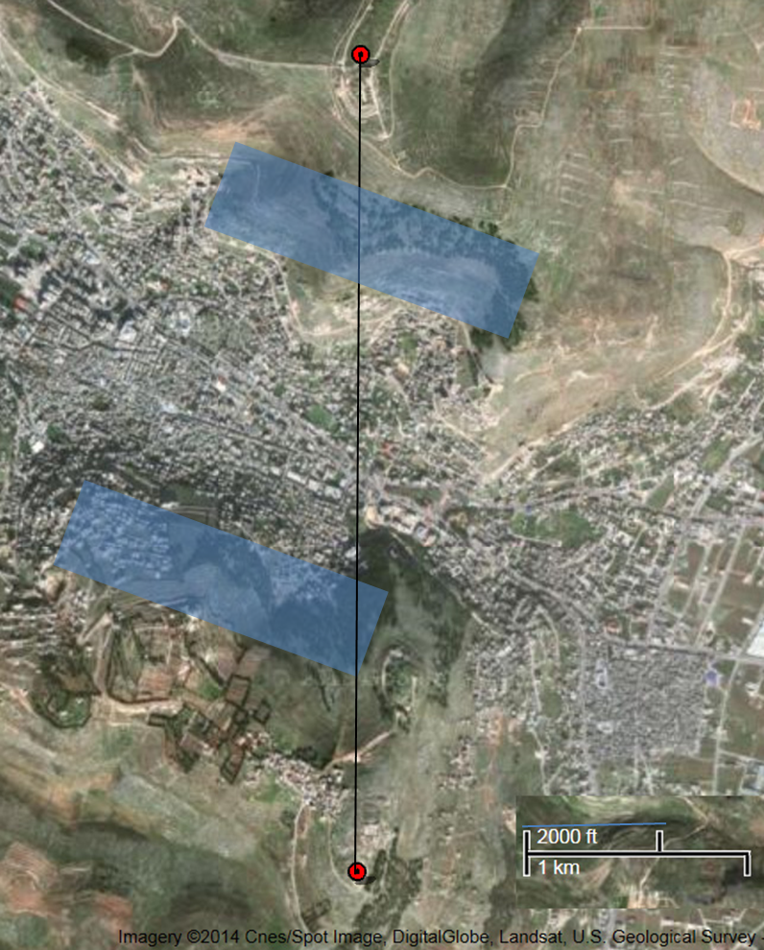
How much Space needed on the sides of Mountain?
Joshua 8:35(ESV) ³⁵There was not a word of all that Moses commanded that Joshua did not read before all the assembly of Israel, and the women, and the little ones, and the sojourners who lived among them.
ft wide | ft deep | space per person
1.5 | 3 | 4.5 | sq ft
 |  | 1250000 | people - bible ca site
 |  | 5625000 | total sq ft
 |  | 43500 | sq ft/acre
 |  | 129 | acres
130 acres

Slide 9
Natural Amphitheater at Shechem

Slide 10
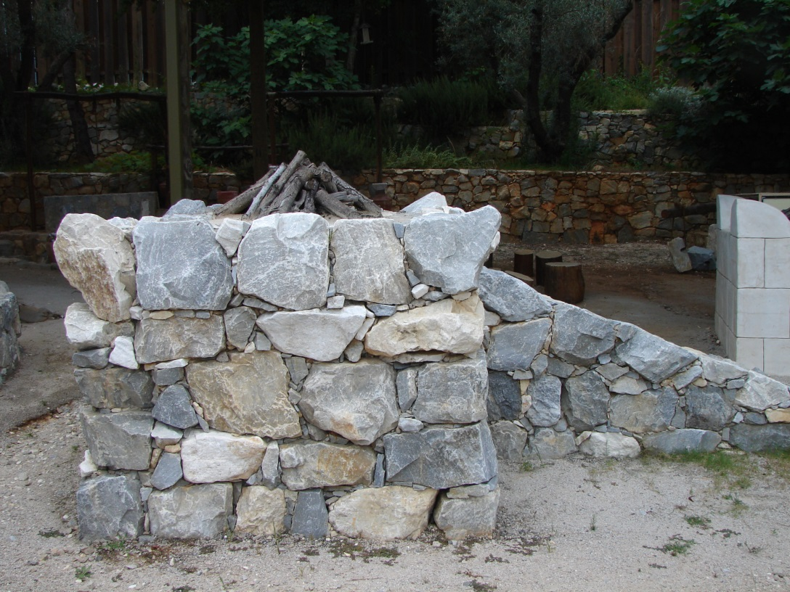
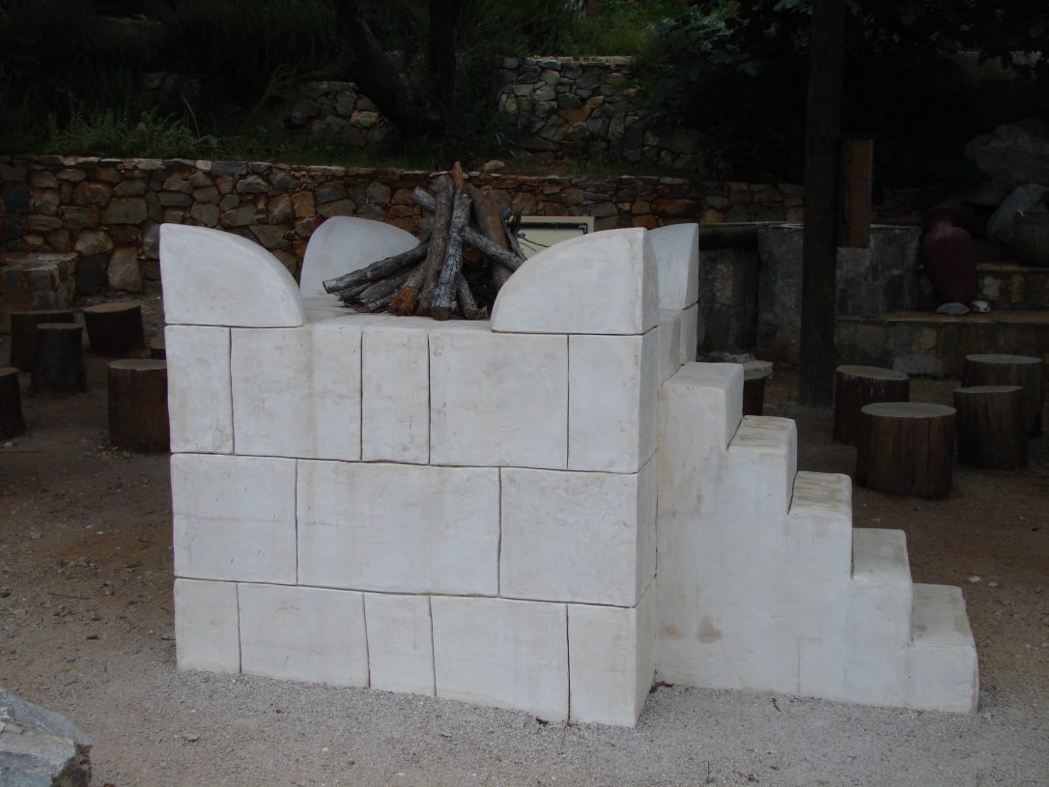
Which Altar Looks Better?
A.
B.

Slide 11
Which Altar Does the Lord Want?
A.
B.

Slide 12
Which Altar Does the Lord Want?
A.
Joshua 8:30-31(ESV) ³⁰At that time Joshua built an altar to the Lord, the God of Israel, on Mount Ebal, ³¹just as Moses the servant of the Lord had commanded the people of Israel, as it is written in the Book of the Law of Moses, “an altar of uncut stones, upon which no man has wielded an iron tool.”
B.

Slide 13
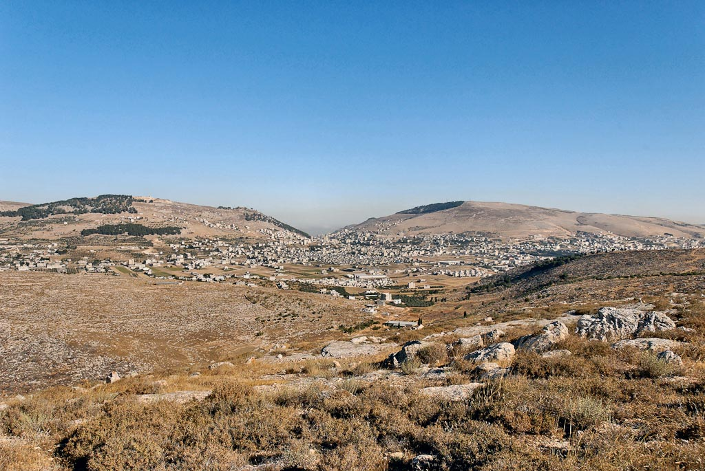
Mount Gerizim, Shechem, Mount Ebal from east
Notes:
tb070507660

Slide 14
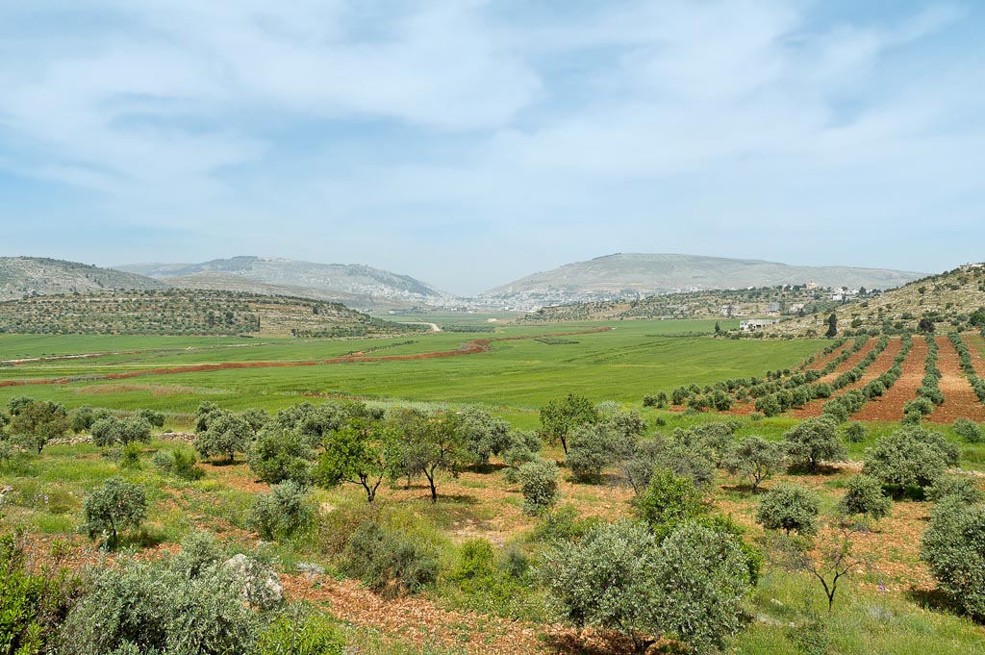
Mount Gerizim, Shechem, and Mount Ebal from east
Notes:
tb050106458

Slide 15
Mt. Gerizim
Mt. Ebal
Shechem
(Tell Balata)
Sychar
Michmethath Valley
Mount Gerizim, Shechem, Mount Ebal from east panorama
Notes:
tb050106401

Slide 16
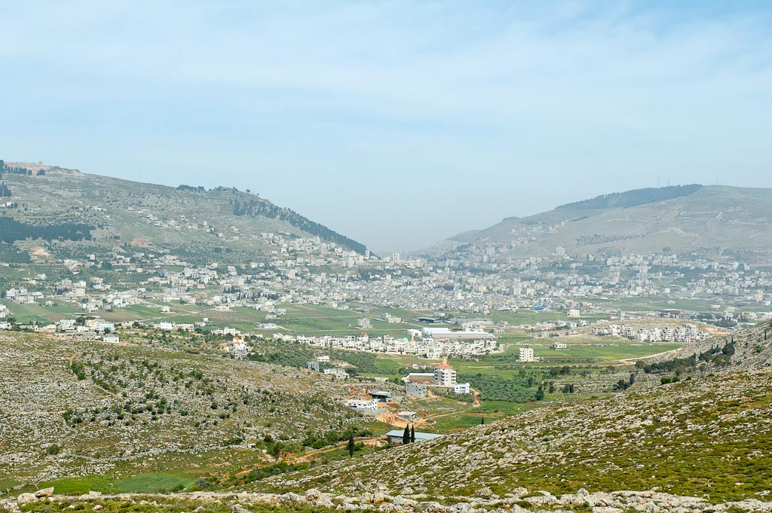
Mount Gerizim, Shechem, Mount Ebal from east
Notes:
Recitation of Blessings and Curses
In accordance with God’s instructions to Moses, Joshua had the Israelites recite the blessings on Mount Gerizim and the curses on Mount Ebal. An altar was built on Ebal and plastered stones inscribed with the law were set up (Deut 11:26-32; 27:1-26; Josh 8:30-35).
It is not easy to determine exactly what happened here, including who stood where and who said what.
Deuteronomy 27 instructed the people to stand on the opposite mountains; Joshua 8 records that the people stood in front of the respective mountains.
Deuteronomy 27 says that the Levites should recite the law and the people respond with a loud “Amen”; Joshua 8 records that Joshua read all the words of the Law (every single one), including the blessings and the curses.
“In unmistakably clear symbolism the reader is told that the right of possessing the promised land is tied to the proclamation of, and subjection to, God’s covenant claims upon his people” (Woudstra 1981: 144).
“Investigations have indicated that the acoustical qualities of that site are excellent for such a ceremony.” (Woudstra references J. de Groot in a German work [Woudstra 1981: 149]).
“The words of blessing and cursing are not to be conceived of as mere words. Within the biblical context they are true vehicles of power, not in a magical sense but because they were uttered on behalf of him whose Word is powerful (Ps. 33:9). To bless is to ‘put’ the ‘name’ of the Lord upon the people (Num. 6:27). To curse is to invoke that name by way of self-malediction or in order to curse others” (Woudstra 1981: 150).
tb050106388

Slide 17
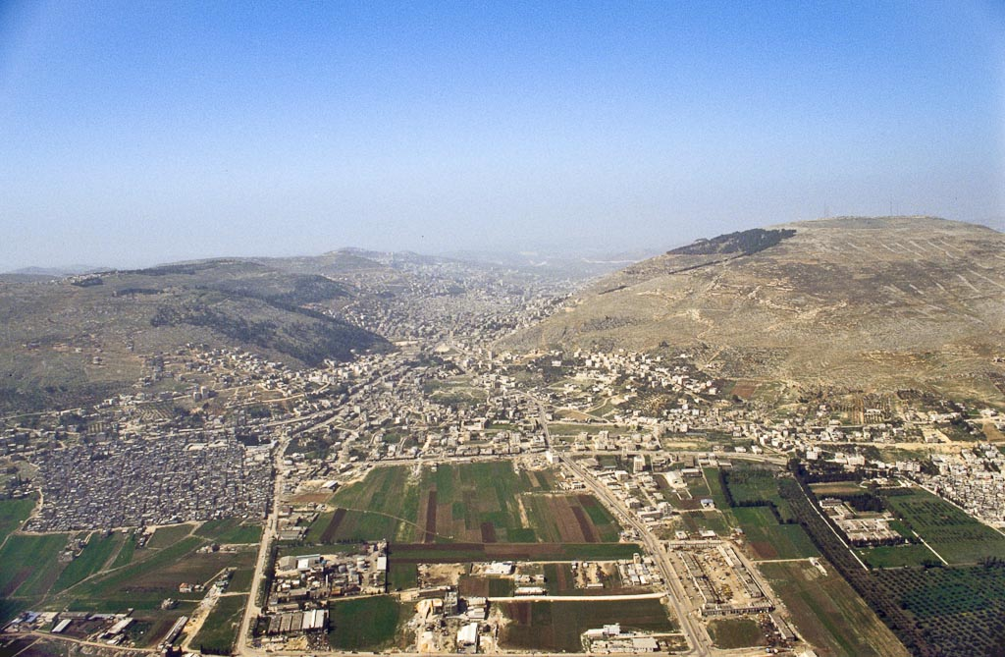
Mt. Ebal
Mt. Gerizim
Nablus
Shechem
(Tell Balata)
Sychar
Michmetah Valley
Shechem and Mounts Gerizim and Ebal aerial from east
Notes:
bb00120041

Slide 18
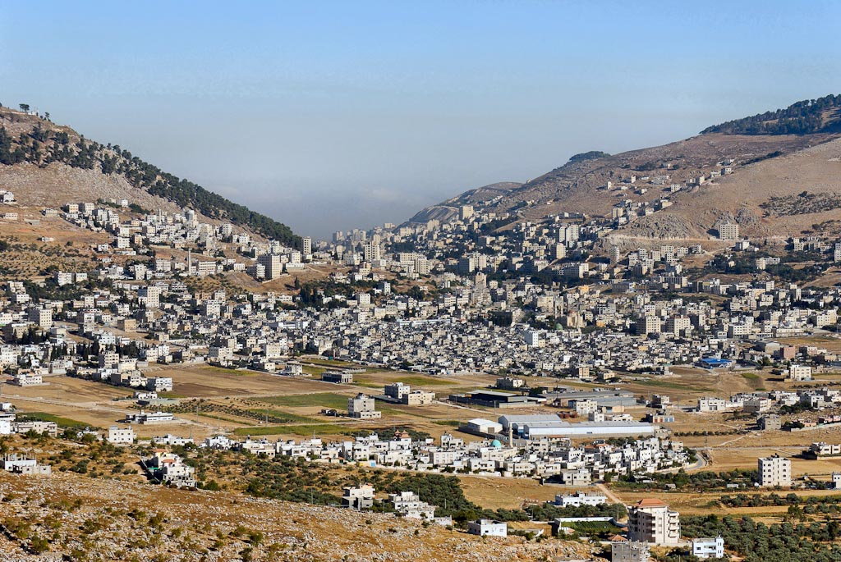
Mt. Gerizim
Mt. Ebal
Shechem
(Tell Balata)
Nablus
Jacob’s Well
Shechem, modern Nablus, from east
Notes:
tb070507663

Slide 19
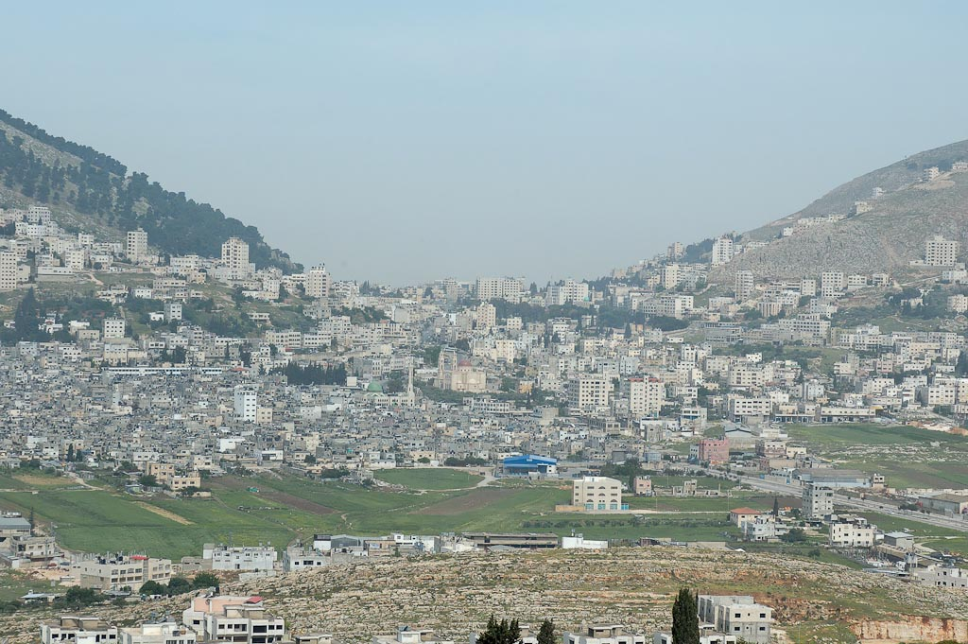
Nablus
Shechem
(Tell Balata)
Jacob’s Well
Nablus, Shechem, from east
Notes:
tb050106416

Slide 20
Mt. Ebal
Sychar
Michmethath Valley
Shechem
(Tell Balata)
Jacob’s
Well
Balata
refugee camp
Mount Ebal, Shechem and Michmethath panorama
Notes:
tb052106504

Slide 21
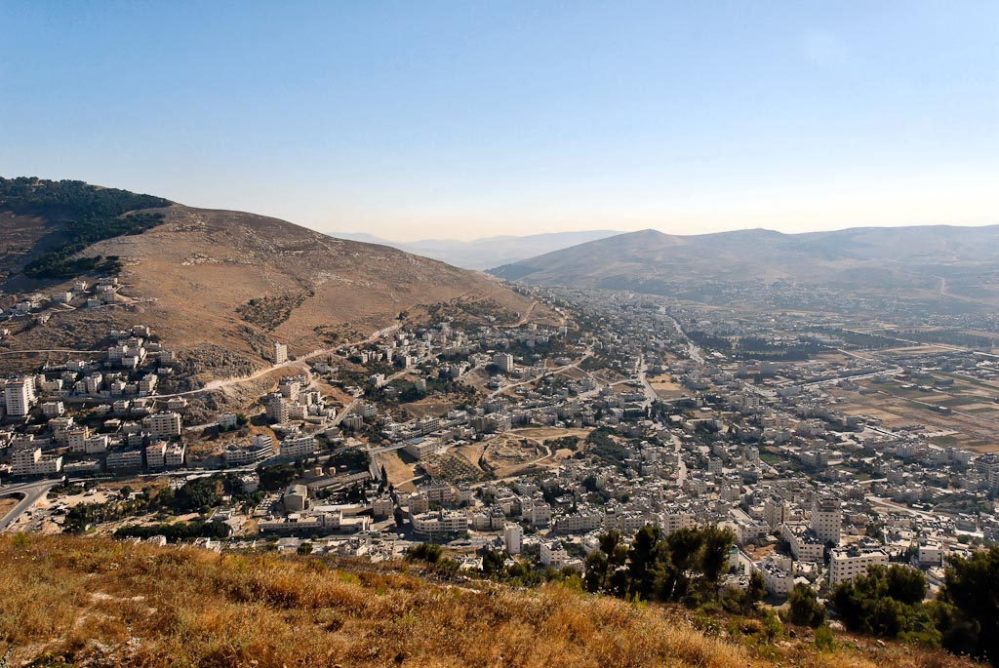
Mt. Ebal
Sychar
Shechem
(Tell Balata)
Mt. Gerizim
Shechem, Mount Ebal, Sychar from Mount Gerizim
Notes:
tb070507675

Slide 22
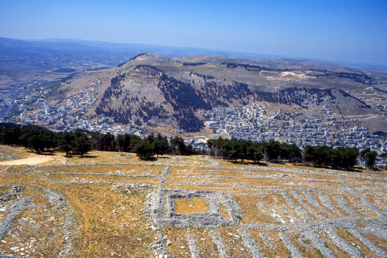
View of Mount Gerizim from above Mount Ebal.
Mt. Ebal
Curses
Mt. Gerizim
Blessings

Slide 23
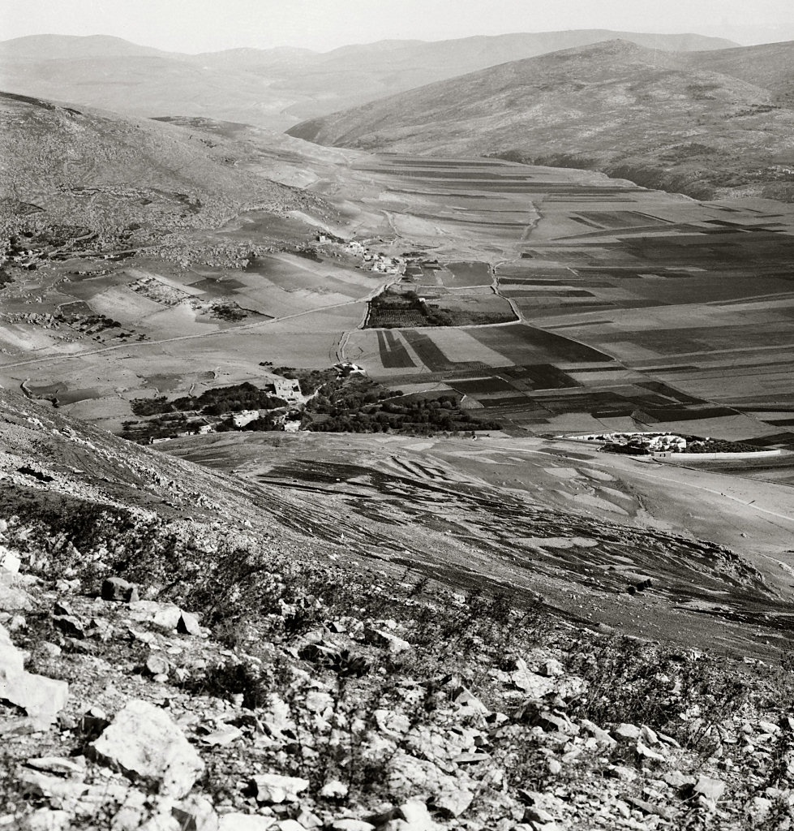
Looking north from Mount Gerizim
Mt. Ebal
Sychar
Tell Balata (Shechem)
Jacob’s Well
Looking north from Mount Gerizim
Notes:
“Nâblûs, the ancient Shechem, has been described by every traveller in Palestine. Situated in the most beautiful position possible, the modern town is also on the site of an overwhelming crowd of scriptural events. Mount Gerizim, ‘the Mountain of Blessing,’ is on its south; Mount Ebal, ‘the Mountain of Cursing,’ on the north. Its history begins 4,000 years ago, when as yet Jerusalem had no existence. To run through it seems like running through the history of the Bible, from Abraham to our Lord. Here is Jacob’s Well, a site accepted nominally; here is the traditional tomb of Joseph; here was the ancient temple of the Samaritans; here where they annually kept the Feast of the Passover; here where the Law was read, Israel standing half over against Mount Gerizim, and half over against Mount Ebal” (Besant 1873: 199-200).
“Those mountains were now before us in all their beauty; Mount Gerizim, crowned by a Wely on its highest point, bearing North; just beyond it the entrance of the valley of Nâbulus bearing nearly N. N. East; further North the rugged heights of Mount Ebal; and then the fine plain extending beyond towards the N. N. E. skirted on its eastern side in its whole length by tracts of picturesque though lower hills” (Robinson and Smith 1841: 3: 92).
Date of photograph: between 1910 and 1920
mat05142

Slide 24
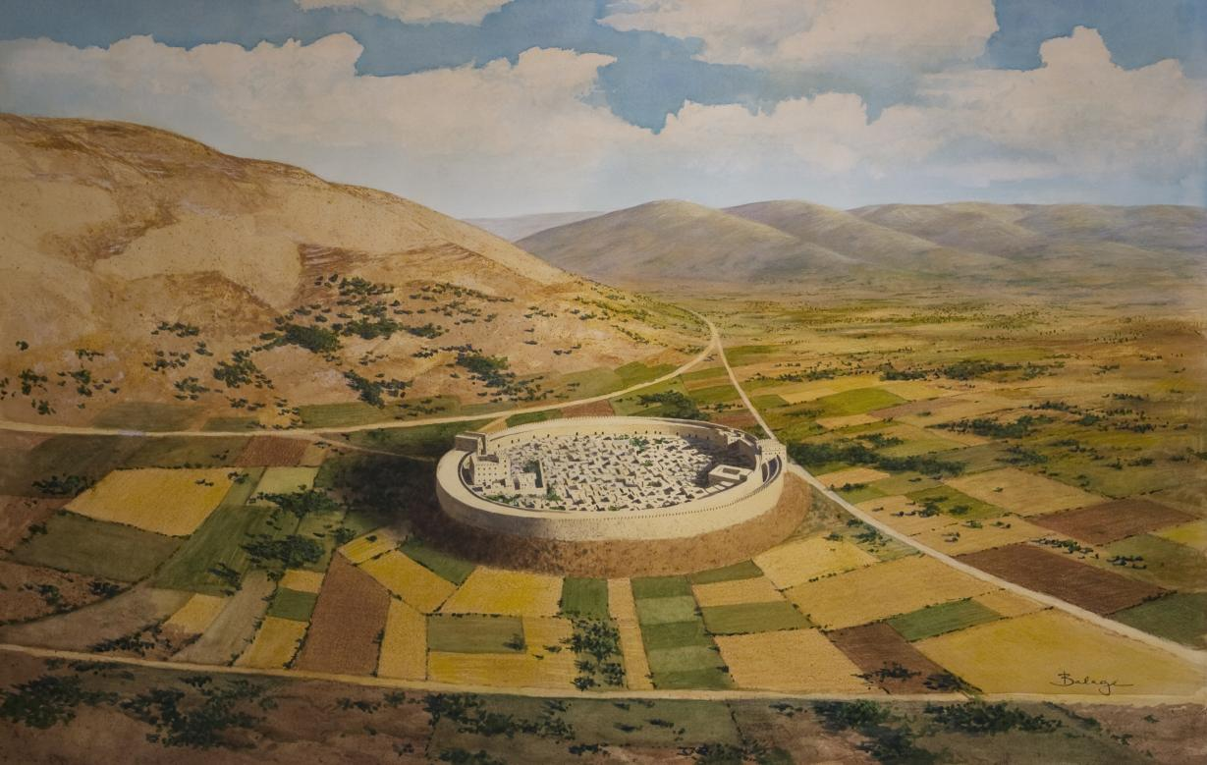

Slide 25
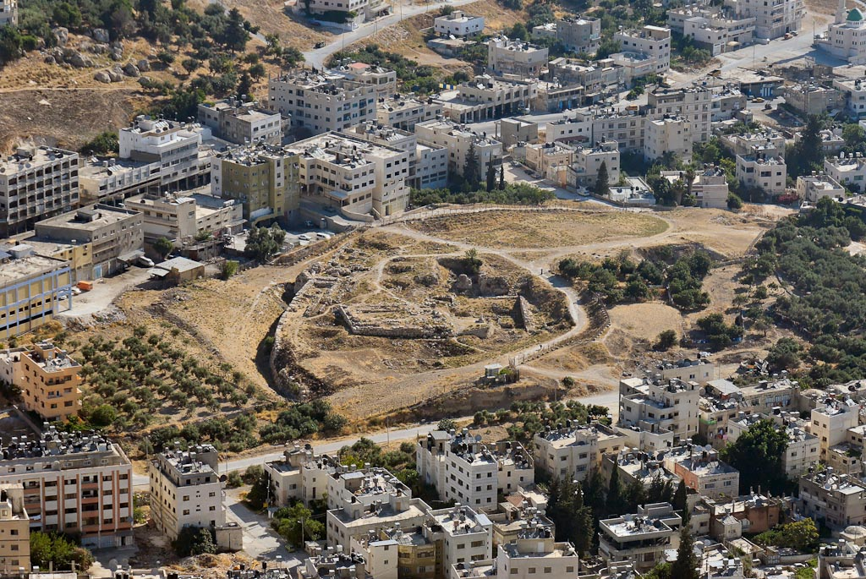
Middle Bronze
gate
Middle Bronze
wall
standing stone
Baal Berith temple
Shechem, Tell Balata, from Mount Gerizim
Notes:
tb070507673

Slide 26
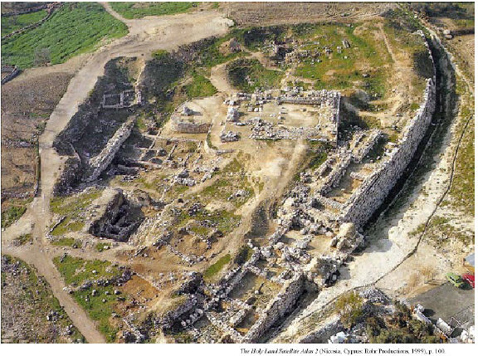

Slide 27
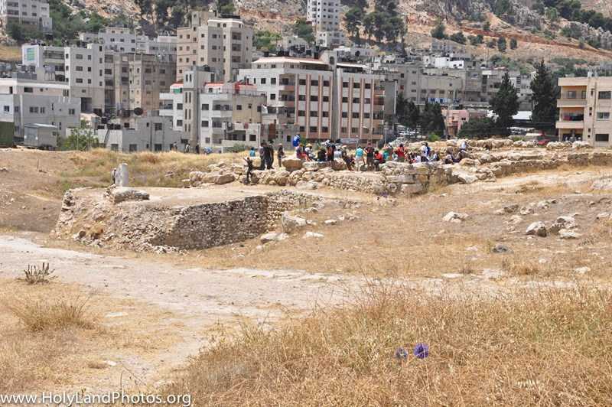
Fortress/Temple
Notes:
View looking west–southwest at the "Fortress Temple." The temple dates to the Middle and Later Bronze Ages (ca. 1650–1200 BC). The group of people is standing in the entrance to the temple. On the left side of the image the rebuilt courtyard of the fortress/temple is visible as is, on the far left, the standing stone.
Note in the background all of the modern buildings of Nablus on the lower slope of Mt. Gerizim.

Slide 28
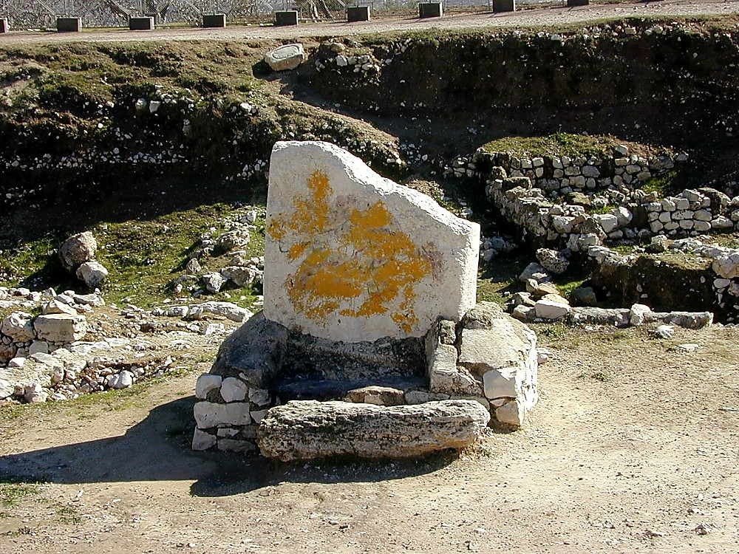
Shechem, Tell Balata, standing stone
Notes:
This stone pillar (massebah) found at Shechem may be similar to the one that Joshua set up as a witness to the renewal of the covenant.
tb011300115

Slide 29
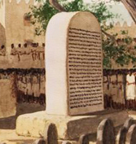
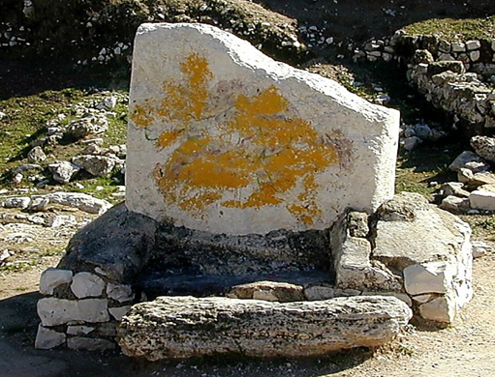
What would be gained from copying the law on stone & from reading the law to the people (Deut 27:2-4)?
stone pillar (massebah) found at Shechem may be similar to the one that Joshua set up as a witness to the renewal of the covenant.
Notes:
Deuteronomy 27:2-3(ESV)
2And on the day you cross over the Jordan to the land that the Lord your God is giving you, you shall set up large stones and plaster them with plaster.
3And you shall write on them all the words of this law, when you cross over to enter the land that the Lord your God is giving you, a land flowing with milk and honey, as the Lord, the God of your fathers, has promised you.

Slide 30
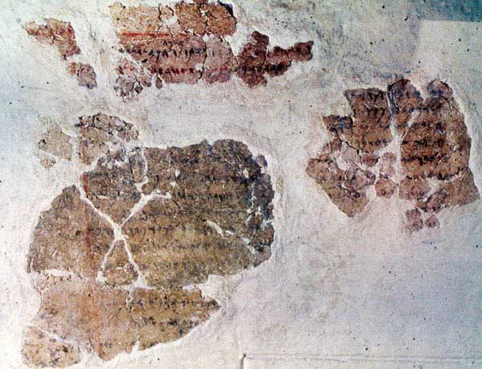
The sayings of Balaam, son of Beor, the man who was a seer of the gods.” It is written with ink on plaster and refers to the non-Israelite prophet known from Numbers 22–24
What would be gained from copying the law on stone & from reading the law to the people (Deut 27:2-4)?
Deuteronomy 27:2-3(ESV)
2And on the day you cross over the Jordan to the land that the Lord your God is giving you, you shall set up large stones and plaster them with plaster.
3And you shall write on them all the words of this law, when you cross over to enter the land that the Lord your God is giving you, a land flowing with milk and honey, as the Lord, the God of your fathers, has promised you.
stone pillar (massebah) found at Shechem may be similar to the one that Joshua set up as a witness to the renewal of the covenant.
Notes:
Deuteronomy 27:2-3(ESV)
2And on the day you cross over the Jordan to the land that the Lord your God is giving you, you shall set up large stones and plaster them with plaster.
3And you shall write on them all the words of this law, when you cross over to enter the land that the Lord your God is giving you, a land flowing with milk and honey, as the Lord, the God of your fathers, has promised you.

Slide 31
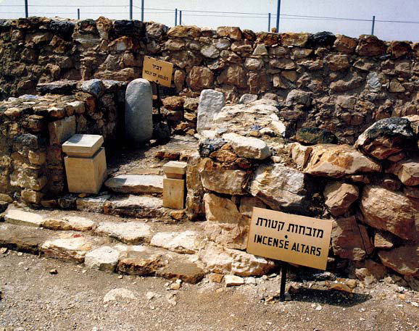
Martin Remembering Masseboth (sacred stones)
Arad Temple

Slide 32
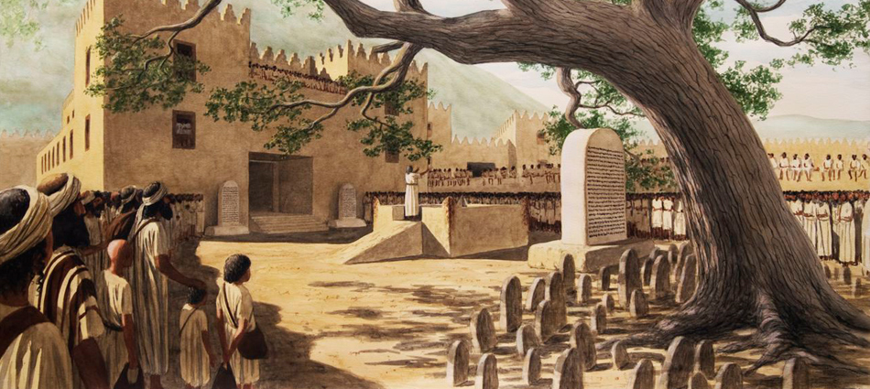
Deuteronomy 27:7-8(ESV) ⁷and you shall sacrifice peace offerings and shall eat there, and you shall rejoice before the Lord your God. ⁸And you shall write on the stones all the words of this law very plainly.”

Slide 33
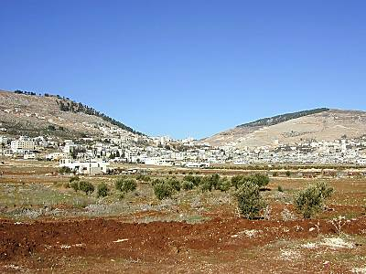
Which Tribes Sat at Mt of Curses & Blessings?
Mt. Gerizim
Blessings
Mt. Ebal
Curses

Slide 34
Which Tribes Sat at Mt of Curses & Blessings?
Evil = Ebal
Mt. Gerizim
Blessings
Mt. Ebal
Curses
Simeon
Levi
Judah
Issachar
Joseph
(Ephraim &
Manasseh)
Benjamin
Reuben
Gad
Asher
Zebulun
Dan
Naphtali

Slide 35
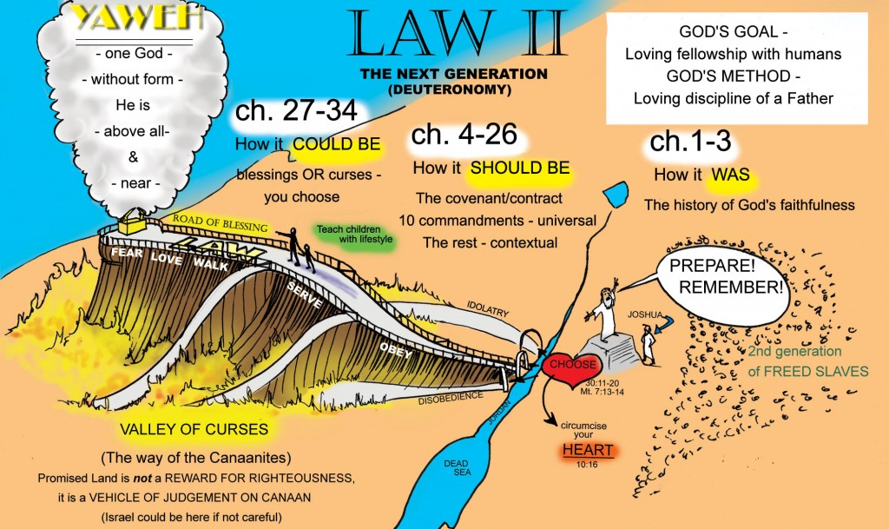
Deuteronomy 28:13-14(ESV) ¹³…if you obey the commandments of the Lord your God, which I command you today, being careful to do them, ¹⁴and if you do not turn aside from any of the words that I command you today, to the right hand or to the left, to go after other gods to serve them.

Slide 36
1, 2
Deut 27:15-26
A ___ Cursed be man who makes a metal image
B___ Cursed be anyone who dishonors his father/mother
C.___ Cursed be anyone who moves his neighbor’s
landmark
D.___ Cursed be anyone who misleads a blind man on the
road
E.___ Cursed be anyone who perverts justice due sojourner,
fatherless & widow
F.___ Cursed be anyone who lies with his father’s wife,
animal, sister, etc
G.___ Cursed be anyone who strikes down his neighbor in
secret
H.___ Cursed be anyone who takes a bribe to shed innocent
blood
5
The 10 Commandments List
Short Form
You shall have no other gods
before Me.
You shall not make idols.
You shall not take the name of the LORD your God in vain.
Remember the Sabbath day, to
keep it holy.
Honor your father & your mother.
You shall not murder.
You shall not commit adultery.
You shall not steal.
You shall not bear false witness
against your neighbor.
10.You shall not covet.
8, 10
Dt 6:4 Lv 19:18 . Love the Lord/love neighbor as yourself
9
7
6
How is the words of the law confirmed (27:26)?
6, 9
Amen

Slide 37
“If”s of Deuteronomy 28
¹“And if you faithfully obey the voice of the Lord your God, being careful to do all his commandments that I command you today, the Lord your God will set you high above all the nations of the earth.

Slide 38
Blessings of Deuteronomy 28:3-6
²And all these blessings shall come upon you and overtake you, if you obey the voice of the Lord your God.
Blessed shall you be in the city, and
Blessed shall you be in the field. Blessed shall be the fruit of your womb and
the fruit of your ground and
the fruit of your cattle,
the increase of your herds and
the young of your flock. Blessed shall be your basket and your kneading bowl. Blessed shall you be when you come in, and
Blessed shall you be when you go out.

Slide 39
“If”s of Deuteronomy 28
¹“And if you faithfully obey the voice of the Lord your God, being careful to do all his commandments that I command you today, the Lord your God will set you high above all the nations of the earth.
²And all these blessings shall come upon you and overtake you, if you obey the voice of the Lord your God.
⁹The Lord will establish you as a people holy to himself, as he has sworn to you, if you keep the commandments of the Lord your God and walk in his ways.

Slide 40
Blessings of Deuteronomy 28:9-11
⁹The Lord will establish you as a people holy to himself, as he has sworn to you, if you keep the commandments of the Lord your God and walk in his ways.
¹⁰And all the peoples of the earth shall see that you are called by the name of the Lord, and they shall be afraid of you.
¹¹And the Lord will make you abound
in prosperity,
in the fruit of your womb and
in the fruit of your livestock and
in the fruit of your ground,
within the land that the Lord swore to your fathers to give you.

Slide 41
“If”s of Deuteronomy 28
¹²The Lord will open to you his good treasury, the heavens, to give the rain to your land in its season and to bless all the work of your hands.
And you shall lend to many nations, but you shall not borrow.
¹³And the Lord will make you the head and not the tail, and you shall only go up and not down,
if you obey the commandments of the Lord your God, which I command you today, being careful to do them,
¹⁴and if you do not turn aside from any of the words that I command you today, to the right hand or to the left, to go after other gods to serve them.

Slide 42
Deuteronomy 28:13-14(ESV) ¹³…if you obey the commandments of the Lord your God, which I command you today, being careful to do them, ¹⁴and if you do not turn aside from any of the words that I command you today, to the right hand or to the left, to go after other gods to serve them.

Slide 43
Curses of Deuteronomy 28
¹⁵“But if you will not obey the voice of the Lord your God or be careful to do all his commandments and his statutes that I command you today,
then all these curses shall come upon you and overtake you.
¹⁶Cursed shall you be in the city, and cursed shall you be in the field. ¹⁷Cursed shall be your basket and your kneading bowl. ¹⁸Cursed shall be the fruit of your womb and the fruit of your ground, the increase of
your herds and the young of your flock. ¹⁹Cursed shall you be when you come in, and cursed shall you be when you go out. ²⁰“The Lord will send on you curses, confusion, and frustration
in all that you undertake to do,
until you are destroyed and perish quickly
on account of the evil of your deeds, because you have forsaken me.

Slide 44
Lord Strikes You of Deuteronomy 28
²¹The Lord will make the pestilence stick to you until he has consumed you off the land that you are entering to take possession of it. ²²The Lord will strike you with wasting disease and with fever, inflammation and fiery heat, and with drought and with blight and with mildew.
They shall pursue you until you perish. ²³And the heavens over your head shall be bronze, and the earth under you shall be iron. ²⁴The Lord will make the rain of your land powder. From heaven dust shall come down on you until you are destroyed. ²⁵“The Lord will cause you to be defeated before your enemies… And you shall be a horror to all the kingdoms of the earth. ²⁷The Lord will strike you with the boils of Egypt, and with tumors and scabs and itch, of which you cannot be healed. ²⁸The Lord will strike you with madness and blindness and confusion of mind, ²⁹and you shall grope at noonday, as the blind grope in darkness, and you shall not prosper in your ways. And you shall be only oppressed and robbed continually, and there shall be no one to help you.
Notes:
21The Lord will make the pestilence stick to you until he has consumed you off the land that you are entering to take possession of it.

Slide 45
³⁰You shall betroth a wife, but another man shall ravish her.
You shall build a house, but you shall not dwell in it.
You shall plant a vineyard, but you shall not enjoy its fruit. ³¹Your ox shall be slaughtered before your eyes, but you shall not eat any of it.
Your donkey shall be seized before your face, but shall not be restored to you.
Your sheep shall be given to your enemies, but there shall be no one to help you. ³²Your sons and your daughters shall be given to another people, while your eyes look
on and fail with longing for them all day long, but you shall be helpless. ³³A nation that you have not known
shall eat up the fruit of your ground
and of all your labors,
and you shall be only oppressed and crushed continually, ³⁴ so that you are driven mad by the sights that your eyes see. ³⁵The Lord will strike you on the knees and on the legs with grievous boils of which
you cannot be healed, from the sole of your foot to the crown of your head. ³⁶“The Lord will bring you and your king whom you set over you to a nation that neither you nor your fathers have known. And there you shall serve other gods of wood and stone.

Slide 46
Lord bring Nations Against You
³⁷And you shall become a horror, a proverb, and a byword among all the peoples where the Lord will lead you away.
⁴⁶They shall be a sign and a wonder against you and your offspring forever.
⁴⁷Because you did not serve the Lord your God with joyfulness and gladness of heart, because of the abundance of all things,
⁴⁸therefore you shall serve your enemies whom the Lord will send against you, in hunger and thirst, in nakedness, and lacking everything.
And he will put a yoke of iron on your neck until he has destroyed you.

Slide 47
Lord bring Nations Against You
⁴⁹The Lord will bring a nation against you from far away, from the end of the earth, swooping down like the eagle, a nation whose language you do not understand, ⁵⁰a hard-faced nation who shall not respect the old or show mercy to the young.
⁵¹It shall eat the offspring of your cattle and the fruit of your ground, until you are destroyed; it also shall not leave you grain, wine, or oil, the increase of your herds or the young of your flock, until they have caused you to perish.
⁵²“They shall besiege you in all your towns, until your high and fortified walls, in which you trusted, come down throughout all your land. And they shall besiege you in all your towns throughout all your land, which the Lord your God has given you.
⁵³And you shall eat the fruit of your womb, the flesh of your sons and daughters, whom the Lord your God has given you, in the siege and in the distress with which your enemies shall distress you.

Slide 48
Disobedience brings Affliction
⁵⁸“If you are not careful to do all the words of this law that are written in this book, that you may fear this glorious and awesome name, the Lord your God,
⁵⁹then the Lord will bring on you and your offspring extraordinary afflictions, afflictions severe and lasting, and sicknesses grievous and lasting. ⁶⁰And he will bring upon you again all the diseases of Egypt, of which you were afraid, and they shall cling to you. ⁶¹Every sickness also and every affliction that is not recorded in the book of this law, the Lord will bring upon you, until you are destroyed.

Slide 49
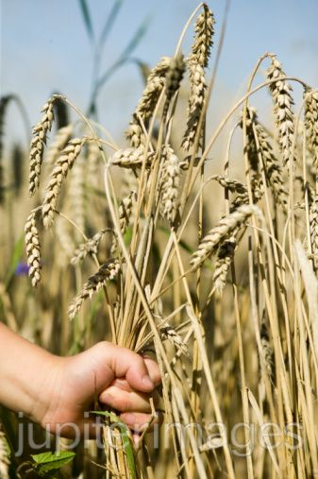
Jeremiah 12 Plucking Them from the Land
¹⁴ Thus says the Lord concerning all my evil neighbors…
“Behold, I will pluck them up from their land, and I will pluck up the house of Judah from among them.
¹⁵ And after I have plucked them up,
a) I will again have compassion on them, and
b) I will bring them again each to his heritage and each to his land.
¹⁶ And it shall come to pass, if they will diligently learn the ways of my people, to swear by my name, ‘As the Lord lives,’ even as they taught my people to swear by Baal,
c) then they shall be built up in the midst of my people.
¹⁷ But if any nation will not listen, then I will utterly pluck it up and destroy it, declares the Lord.”
Deut 28
⁶³And as the Lord took delight in doing you good and multiplying you, so the Lord will take delight in bringing ruin upon you and destroying you. And you shall be plucked off the land that you are entering to take possession of it.

Slide 50
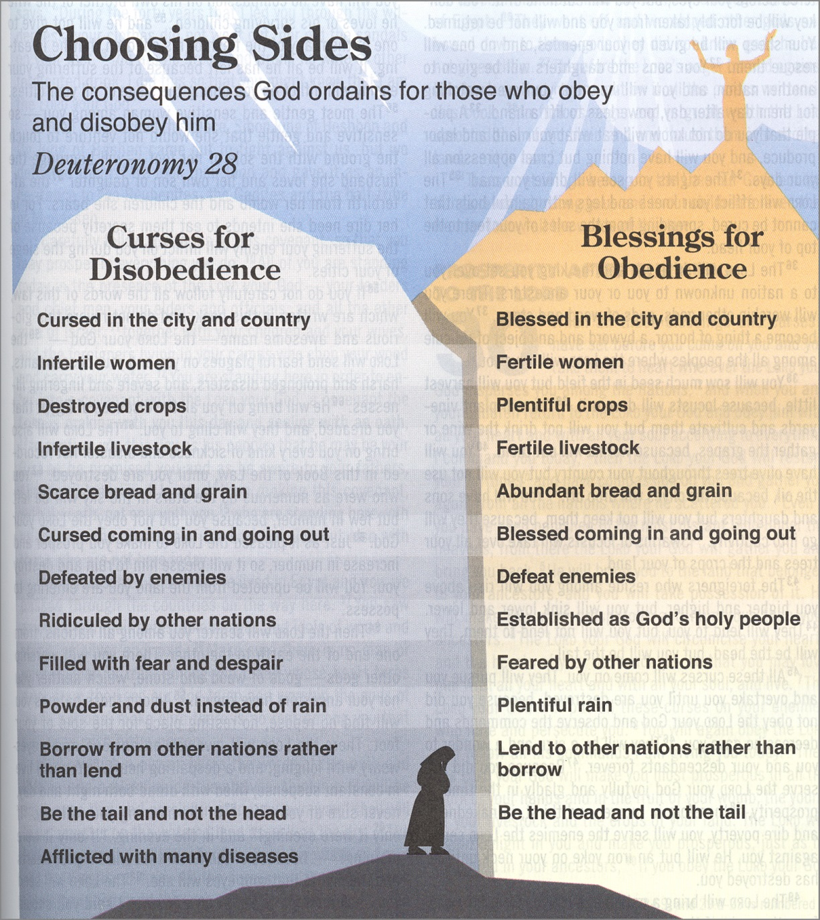

Slide 52
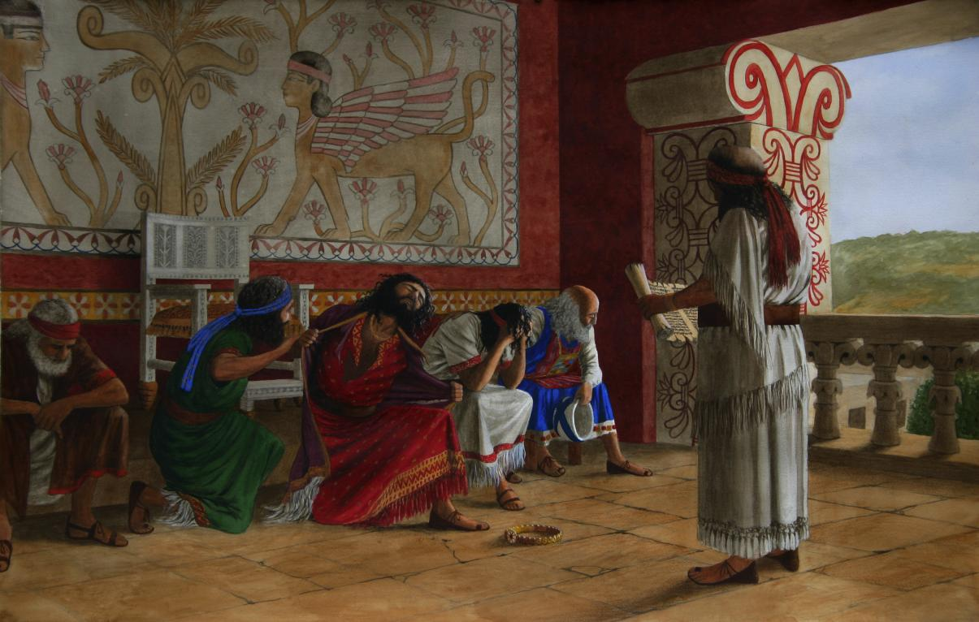
Josiah Hears the Law
2 Kings 22:10-11 (NKJV) ¹⁰Then Shaphan the scribe showed the king, saying, “Hilkiah the priest has given me a book.” And Shaphan read it before the king. ¹¹Now it happened, when the king heard the words of the Book of the Law, that he tore his clothes.

Slide 53
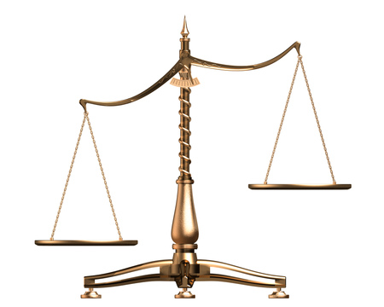
JEREMIAH
Obedience
Captivity
Return
New Covenant
Disobedience
Sword
Pestilence
Famine

