Slide 2
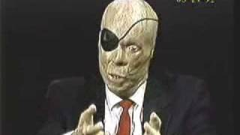
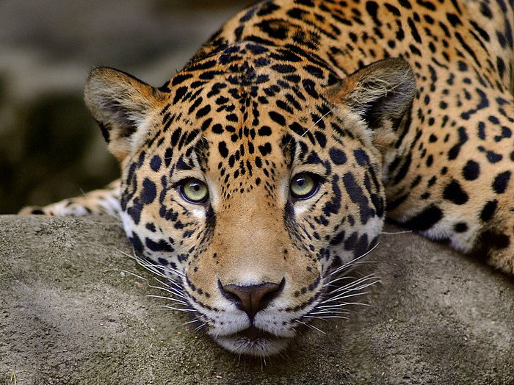
Scars!

Slide 3
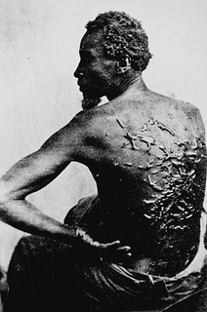
Scars talk! - 2 Cor. 11:24, 25
24 Five times I received at the hands of the Jews the forty lashes less one.
25 Three times I was beaten with rods. Once I was stoned.

Slide 4
Scars talk! - Acts 14:19
But Jews came from Antioch and Iconium, and having persuaded the crowds, they stoned Paul and dragged him out of the city, supposing that he was dead.

Slide 5
Scars talk!
From now on let no one cause me trouble, for I bear on my body the marks of Jesus. (Galatians 6:17)

Slide 6
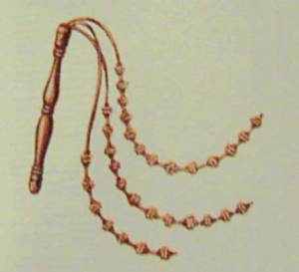
Scars talk!
Acts 5:40 “…and when they had called in the apostles, they beat them and charged them not to speak in the name of Jesus, and let them go.”
Jesus (John 19:1; Matt. 27:26; Jn. 20:27)

Slide 7
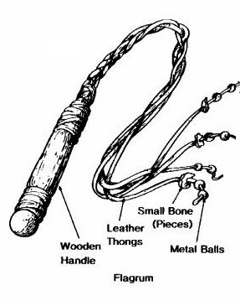
What do scars say?
“I’m telling you the truth!”
“I love you!”

Slide 8
What do scars tell us? 2 Corinthians 4:8,9
8 We are afflicted in every way, but not crushed; perplexed, but not driven to despair;
9 persecuted, but not forsaken; struck down, but not destroyed;

Slide 9
What do scars tell us? 2 Corinthians 4:10, 11
10 …always carrying in the body the death of Jesus, so that the life of Jesus may also be manifested in our bodies.
11 For we who live are always being given over to death for Jesus' sake, so that the life of Jesus also may be manifested in our mortal flesh.

Slide 10
What do scars tell us? 2 Corinthians 4:12
12 So death is at work in us, but life in you.

Slide 11
What do scars tell us? 2 Corinthians 4:15
15 For it is all for your sake, so that as grace extends to more and more people it may increase thanksgiving, to the glory of God.

Slide 12
What do scars tell us? Isaiah 53:5
But he was pierced for our transgressions; he was crushed for our iniquities; upon him was the chastisement that brought us peace, and with his wounds we are healed.

Slide 13
What about our own scars?
“Good” scars - those that come from service to God
“Bad” scars” - those that come from our sins and weaknesses

Slide 14
2 Corinthians 11:28, 29
28 And, apart from other things, there is the daily pressure on me of my anxiety for all the churches.
29 Who is weak, and I am not weak? Who is made to fall, and I am not indignant?

Slide 15
How to deal with “good” scars?
A part of discipleship (2 Tim. 3:12)
Prayer
Consider examples of those whose “scars” far surpass ours - Jesus, the apostles
Focus on the eternal (2 Cor. 4:16-18)

Slide 16
Scars give hope and purpose - 2 Cor. 4:16-18
16 So we do not lose heart. Though our outer self is wasting away, our inner self is being renewed day by day.

Slide 17
Scars give hope and purpose - 2 Cor. 4:17
17 For this light momentary affliction is preparing for us an eternal weight of glory beyond all comparison,

Slide 18
Scars give hope and purpose - 2 Cor. 4:18
18 as we look not to the things that are seen but to the things that are unseen. For the things that are seen are transient, but the things that are unseen are eternal.

Slide 19
Scars because of seeing others who have surpassed us.
I am glad I get to be around people who make me feel morally inferior. People with greater knowledge, courage, and spiritual strength challenge me just by their example in my relationship with them. It is easy to become offended by their "goodness" . . . even to the point of avoiding them because I don't want to feel guilty!

Slide 20
Scars because of seeing others who have surpassed us.
But being around these kind of people will - in the long run - make me a better person. I should seek those people out and associate with them.
(Noah Diestelkamp)

Slide 21
What to do about wounds that come from sin?
Repent!
Trust in His scars! (Isaiah 53:5)
Be thankful for the “scarring” process
An open wound says - “I am still in sin”
A scar says - “I have left the sin and learned from it.”

Slide 22
What does all of this mean to you?
The witnesses told the truth about Jesus Christ!
Jesus loves you!
How will you respond?

