Slide 1
Jesus is Our Light – Our Sunrise
Orientation
Route Decision
Route Monitoring
Destination Recognition
Revelation 2:28 And I will give him the morning star.
Luke 1:76-79 - And you, child, will be called the prophet of the Most High; for you will go before the Lord to prepare his ways, ⁷⁷to give knowledge of salvation to his people in the forgiveness of their sins, ⁷⁸because of the tender mercy of our God, whereby the sunrise shall visit us£ from on high ⁷⁹to give light to those who sit in darkness and in the shadow of death, to guide our feet into the way of peace.”
Revelation 22:16 - “I, Jesus, have sent my angel to testify to you about these things for the churches. I am the root and the descendant of David, the bright morning star.”
Numbers 24:17 - I see him, but not now; I behold him, but not near: a star shall come out of Jacob, and a scepter shall rise out of Israel ...
The Sun of Righteousness
The Light of the World
The Sunrise from On High
The Bright Morning Star

Slide 2
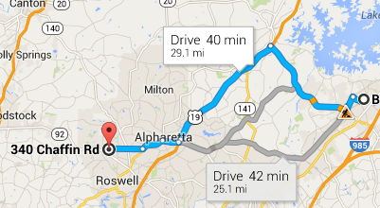
Jesus is Our Light – Our Sunrise
Orientation
Route Decision
Route Monitoring
Destination Recognition
Revelation of our Sin
Reveals our Path
Luke 1:79 - to give light to those who sit in darkness
Malachi 4:1-3 - “For behold, the day is coming, burning like an oven, when all the arrogant and all evildoers will be stubble. The day that is coming shall set them ablaze, says the Lord of hosts, so that it will leave them neither root nor branch. ²But for you who fear my name, the sun of righteousness shall rise with healing in its wings. You shall go out leaping like calves from the stall. ³And you shall tread down the wicked, for they will be ashes under the soles of your feet, on the day when I act, says the Lord of hosts.
Malachi 1:10 - Oh that there were one among you who would shut the doors, that you might not kindle fire on my altar in vain! I have no pleasure in you, says the Lord of hosts, and I will not accept an offering from your hand.
Luke 1:77 - to give knowledge of salvation to his people
The Sun of Righteousness
The Light of the World
The Sunrise from On High
The Bright and Morning Star

Slide 3
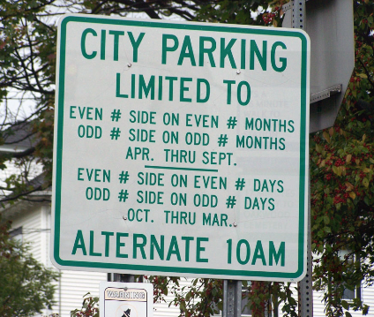
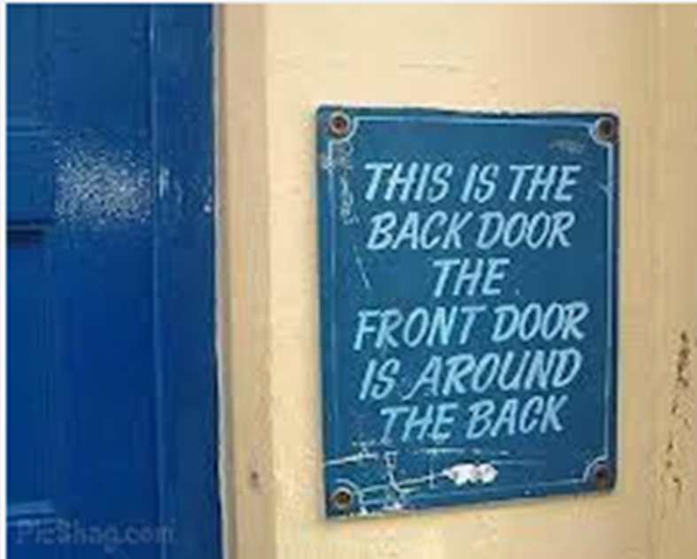
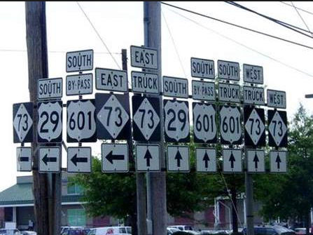
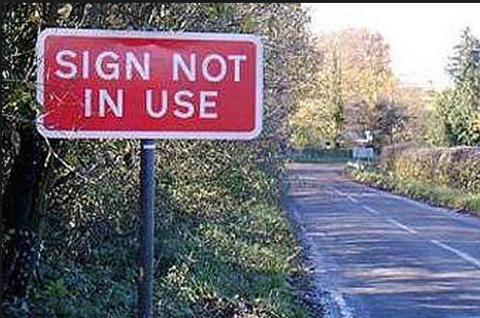

Slide 4
Jesus is Our Light – Our Sunrise
Orientation
Route Decision
Route Monitoring
Destination Recognition
^{Malachi 4:2-6 -} But for you who fear my name, the sun of righteousness shall rise with healing in its wings. You shall go out leaping like calves from the stall. ³And you shall tread down the wicked, for they will be ashes under the soles of your feet, on the day when I act, says the Lord of hosts. ⁴“Remember the law of my servant Moses, the statutes and rules that I commanded him at Horeb for all Israel. ⁵“Behold, I will send you Elijah the prophet before the great and awesome day of the Lord comes. ⁶And he will turn the hearts of fathers to their children and the hearts of children to their fathers,
Revelation of our Sin
Reveals our Path
Redirection of our Steps
Redemption of our Souls
Luke 1:79b - to guide our feet into the way of peace.”
Prov 16:9 - The heart of man plans his way, but the Lord establishes his steps.
Psalms 119:105 - Your word is a lamp to my feet and a light to my path.
Luke 1:77 - to give knowledge of salvation to his people in the forgiveness of their sins, because of the tender mercy of God
The Sun of Righteousness
The Light of the World
The Sunrise from On High
The Bright and Morning Star

Slide 5
Jesus is Our Light
Orientation
Route Decision
Route Monitoring
Destination Recognition
Revelation of our Sin
Reveals our Path
Revitalizes us in our Sorrow
Redirection of our Steps
Redemption of our Souls
Revelation 22:16-17 - “I, Jesus, have sent my angel to testify to you about these things for the churches. I am the root and the descendant of David, the bright morning star.” ¹⁷The Spirit and the Bride say, “Come.” And let the one who hears say, “Come.” And let the one who is thirsty come; let the one who desires take the water of life without price.
The Sun of Righteousness
The Light of the World
The Sunrise from On High
The Bright and Morning Star

