Slide 2
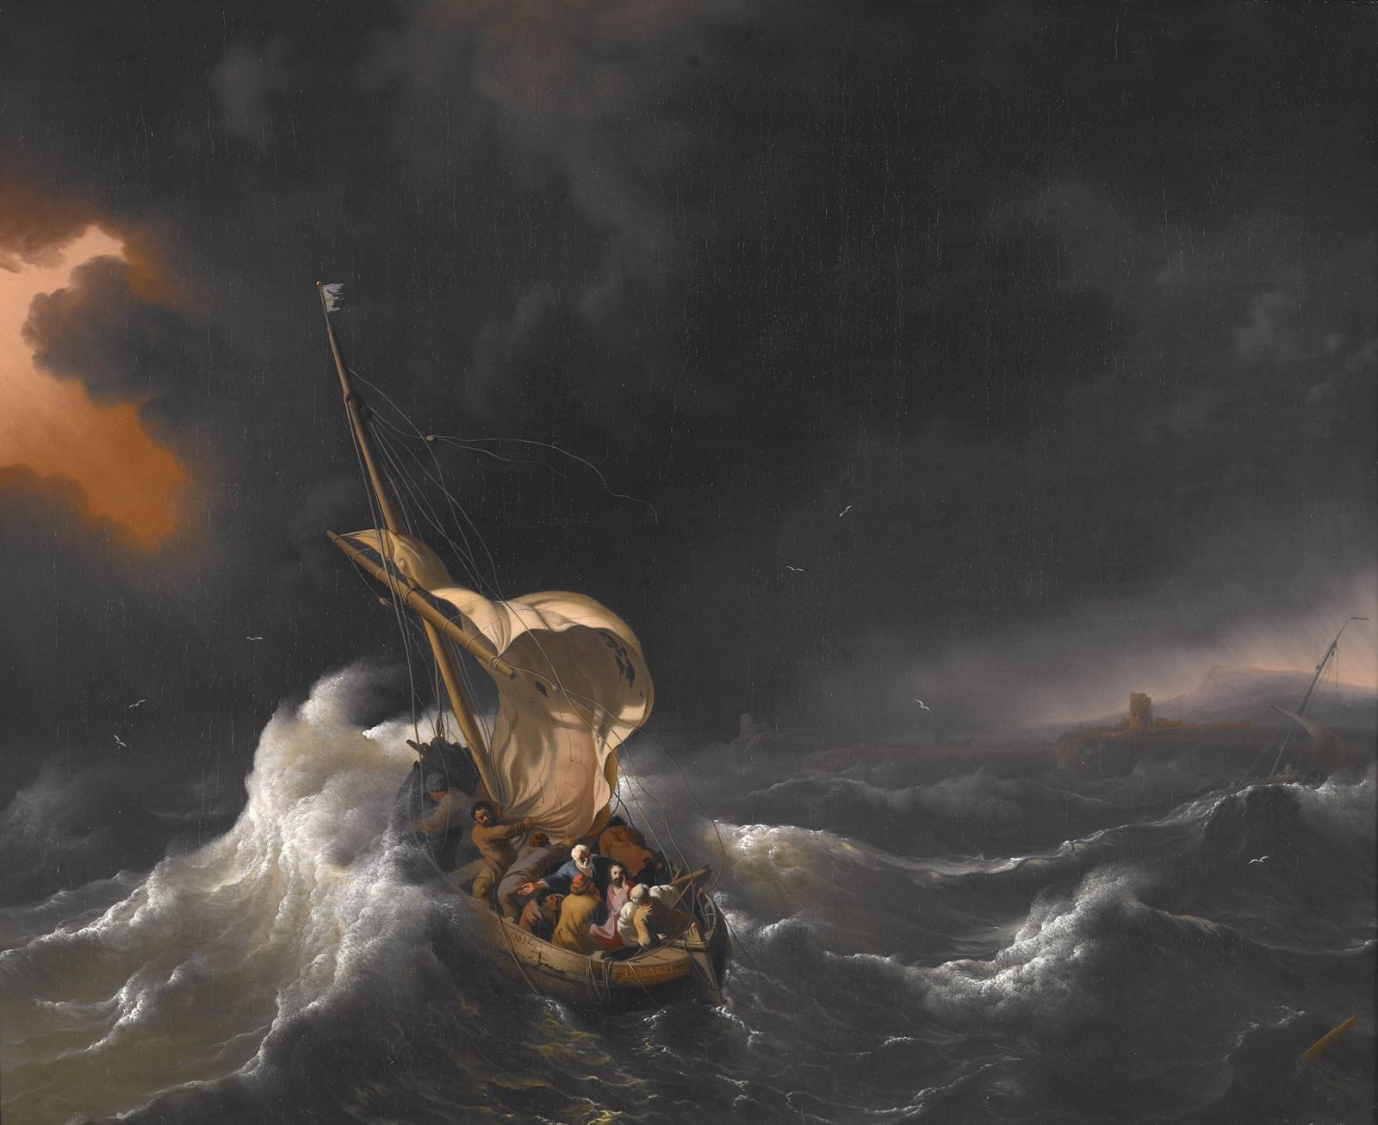
The Storm At Sea.
Matt. 8:23-27; Mk. 4:36-41; Lk. 8: 22-25

Slide 3
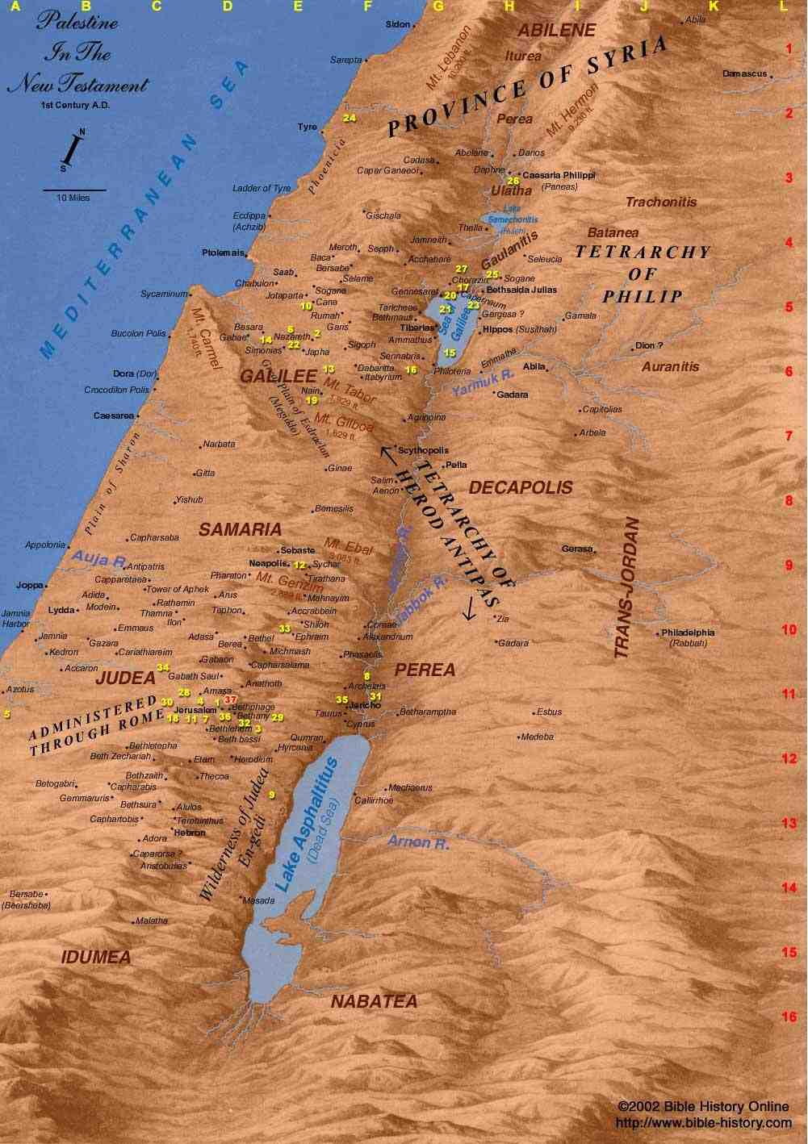

Slide 4
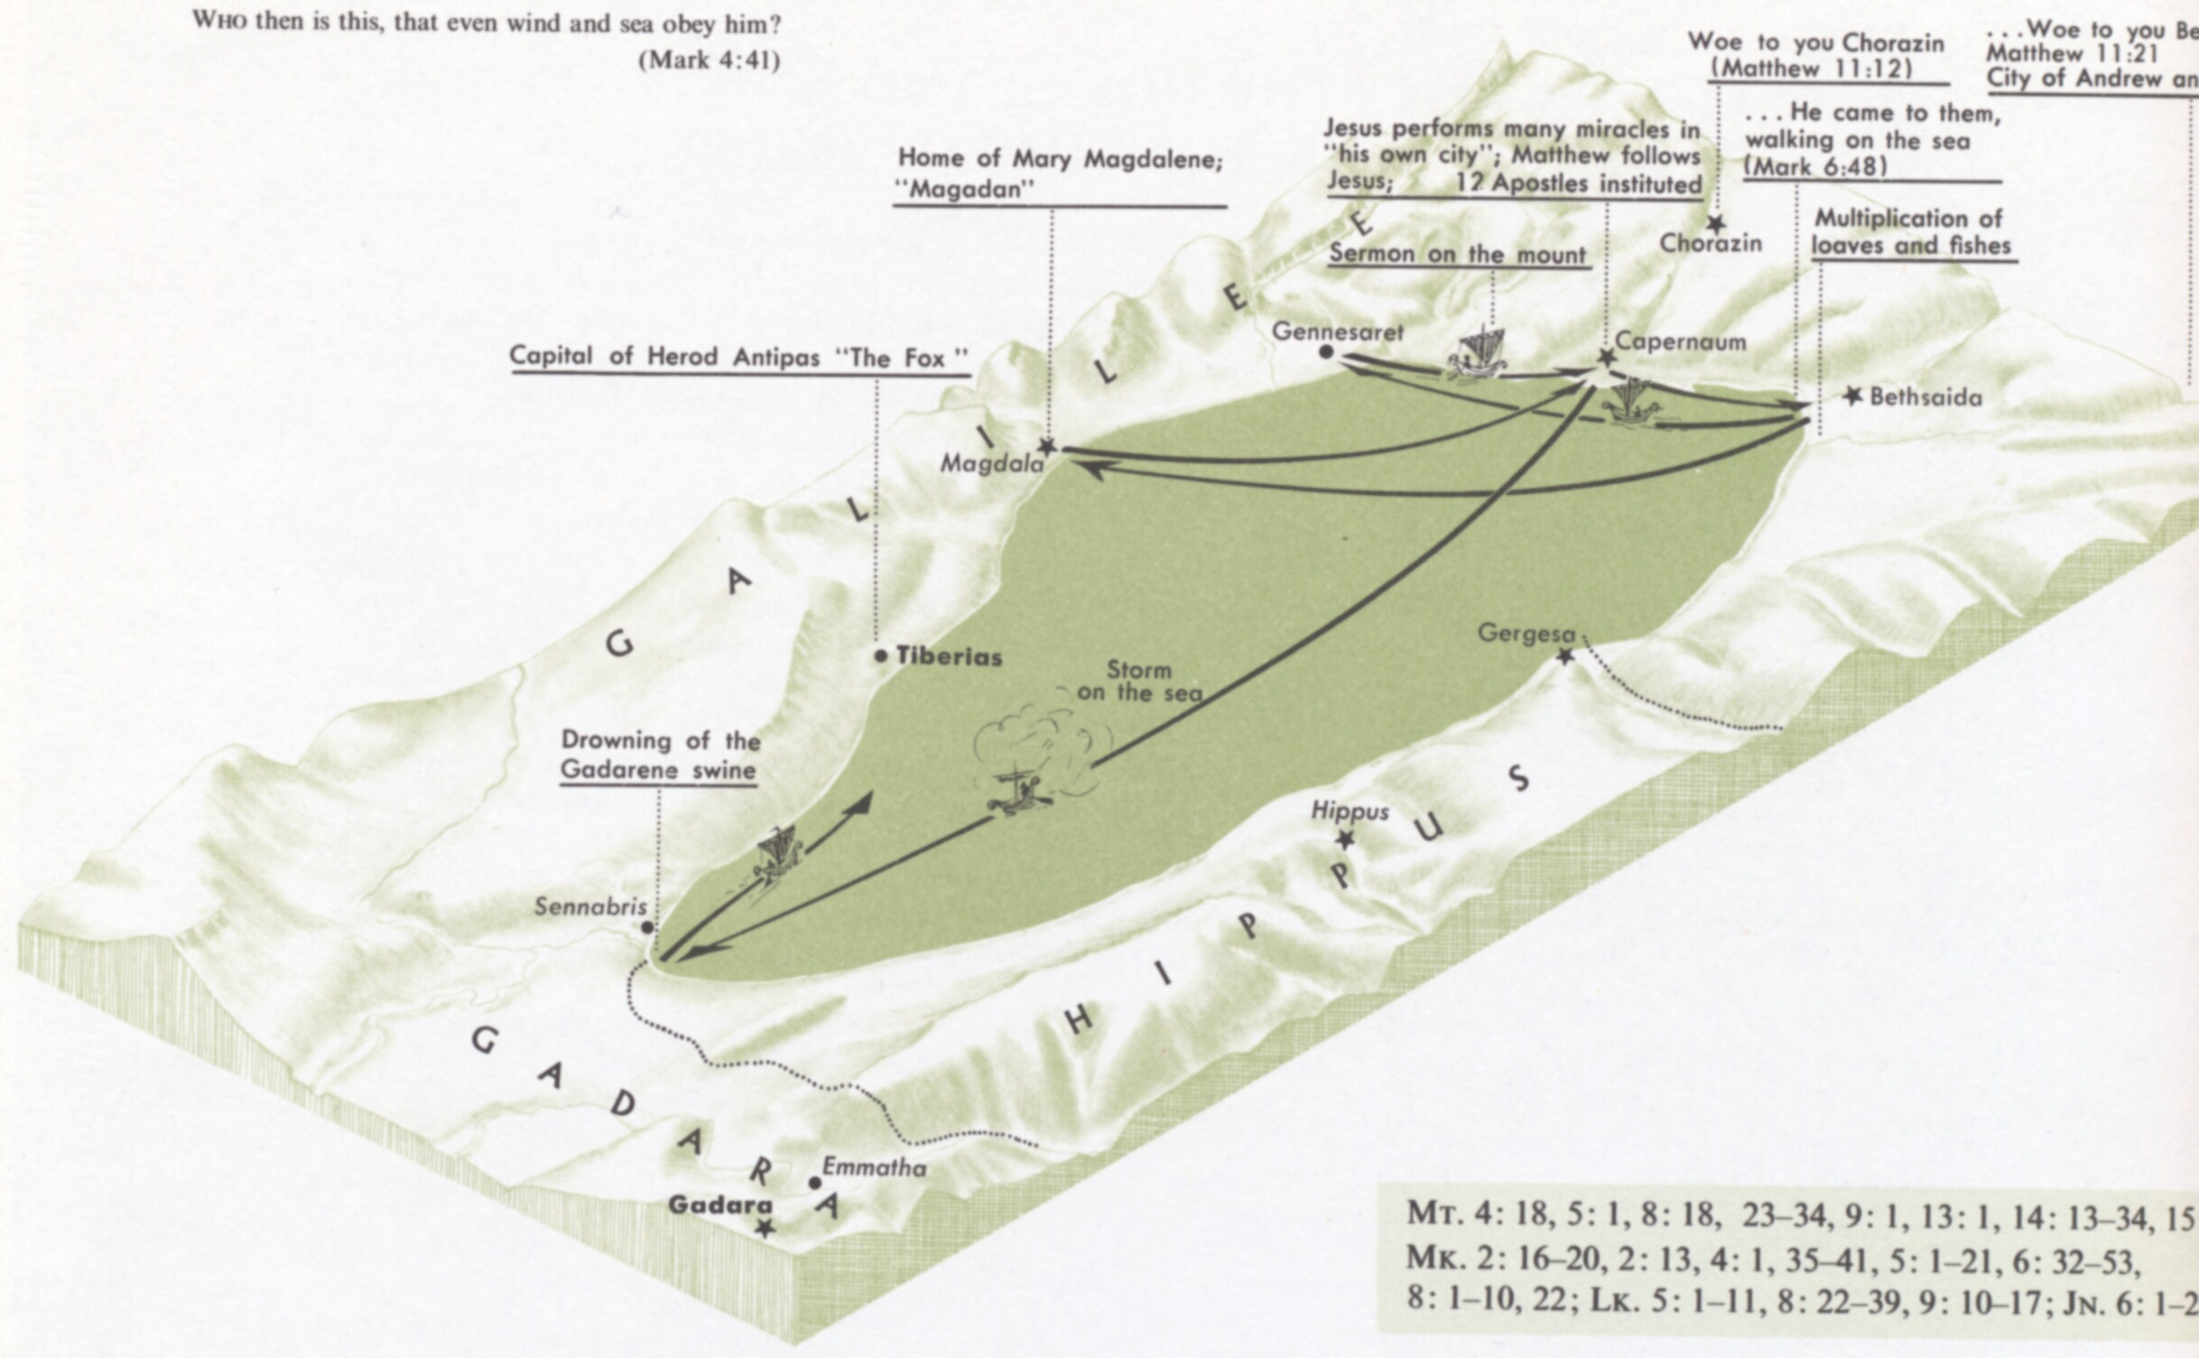

Slide 5
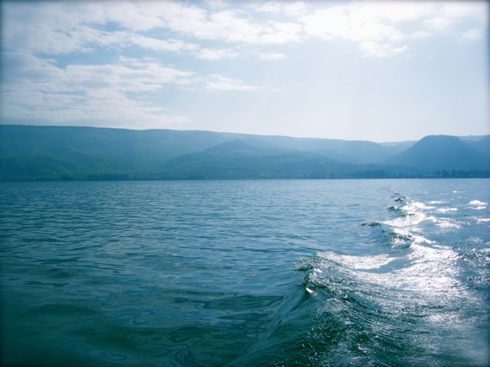
The Storm At Sea (Matt. 8)
We Are In The Sea Of Life- Headed Somewhere.
Disciples Followed Jesus. (23)
Great Storms Of The Sea (24)

Slide 6
“The Lord knew that people do not learn faith from a lecture; faith is learned in the laboratory of life. The storms of life provide the pressure that enables diamonds to form in our character. The apostle’s reaction showed how far he had to go; instead of faith conquering fear, they allowed the circumstances to overshadow Christ’s word. But Jesus would continue to cultivate their faith, instilling in them the ability to completely trust Him no matter how great the odds seemed to be stacked against the fulfillment of His word. He knew the tempests that lay ahead. The hard lessons His men learned in this storm prepared them for the far tougher times they would face down the road.” Chumbley, p. 162

Slide 7
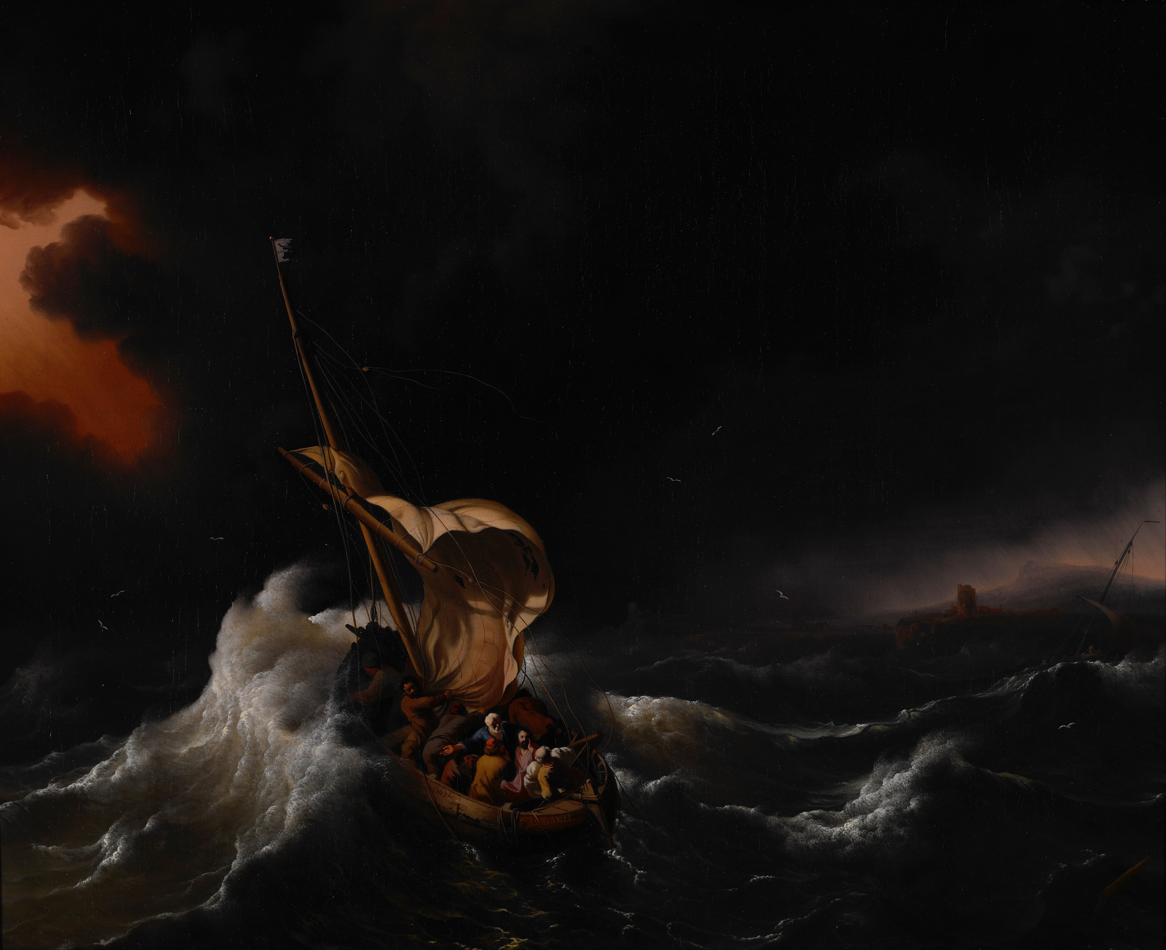
“This Tossing Ship Has Been Accepted In All Ages As A Type Of The Church In Season Of Peril.
J.W. McGarvey, Fourfold
“Lord – Do Not Take This Trial From Me Until I Have Learned The Lesson That You Have For Me.”

Slide 8
The Storm At Sea (Matt. 8)
In The Sea Of Life And Headed Somewhere.
Disciples Followed Jesus. (23)
Great Storms Of The Sea (24)
Slept In The Storm (24)
We Are Perishing (25)
Why Are You So Timid – Men Of Little Faith. (26)
He Rebuked The Winds – Became Perfectly Calm. (26)
How Can Jesus Provide Peace For Us?
What Kind Of A Man Is This, That Even The Wind And The Sea Obey Him? (27)

Slide 9
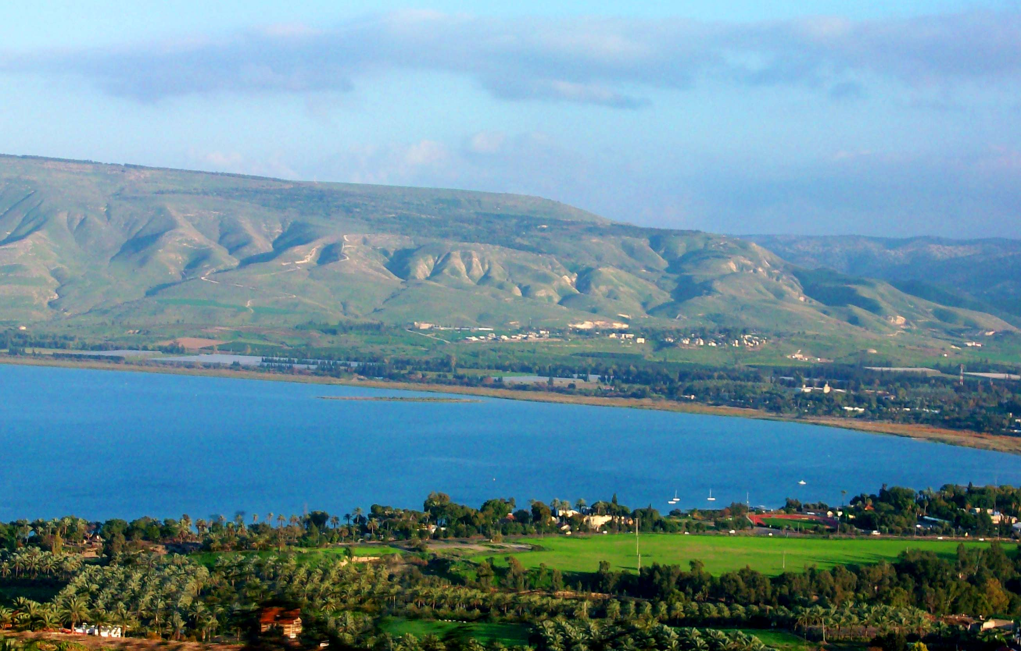
Will “I” Obey Jesus?

Slide 10
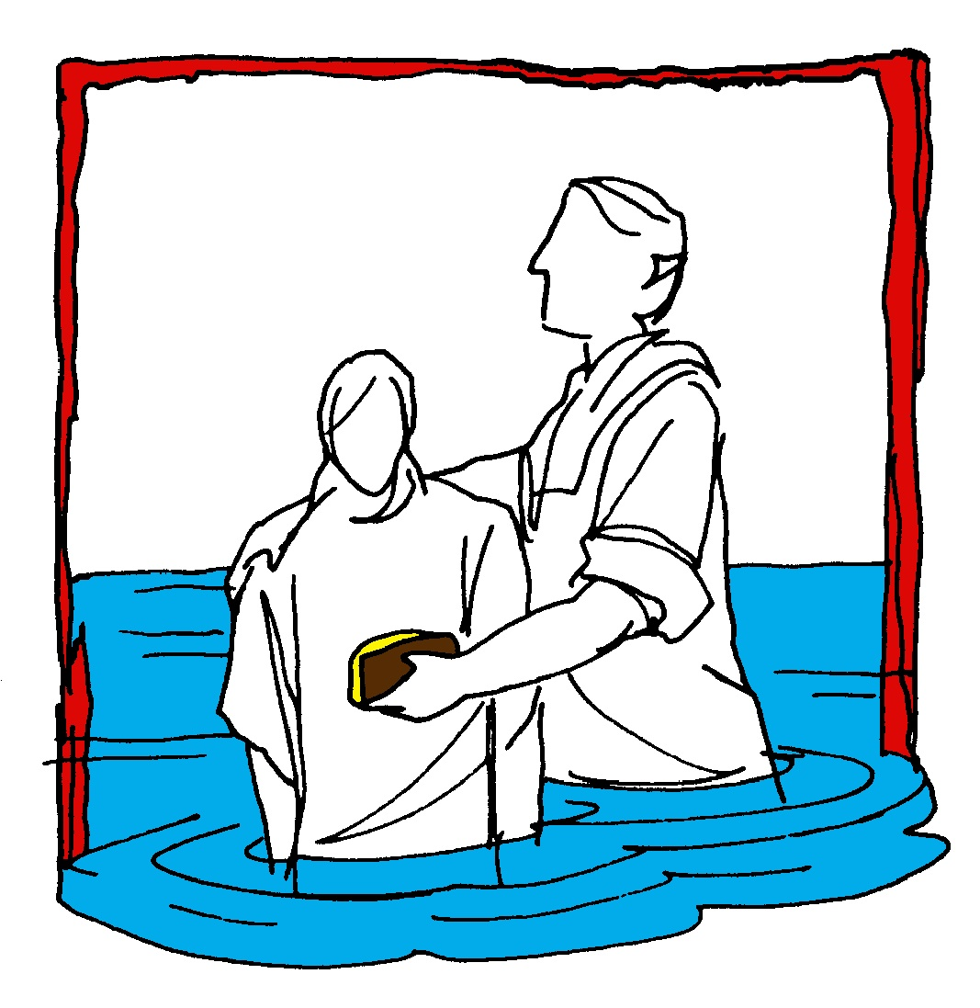
Hear (Rom. 10:17)
Believe (Jn. 8:24)
Repent (Acts 2:38)
Confess (Mt. 10:32-33)
Baptism (Acts 22:16)
Mk. 16:
15-16
Continue… (Mt. 28:20)

