Slide 1
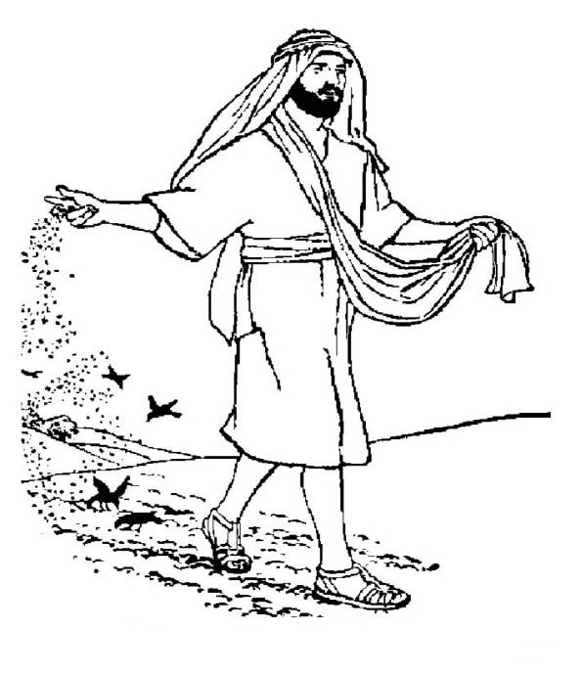
The Parable
of the Sower
In Reverse
Luke 8:8-5, 15-11

Slide 2
The Lessons from the Parable of the Sower
Realistic outlook for those spreading the gospel
A test of the heart, challenging each person to place himself into one of the categories mentioned by Jesus: Luke 8:10,16-18
A challenge to the noble and good heart

Slide 3
When do the different reactions to God's Word emerge?
The sowing is pictured as a single effort, taking place at the same time.
The people reacting to God's Word are therefore contemporaries.
What kind of developments do the "noble and honest" experience?

Slide 4
What is a noble, good or honest heart? – Luke 8:15
They hear with an open mind and seek to understand the word.
They hold to the word, recognizing it as the source of life and truth.
With patience and perseverance they bear fruit in themselves and others and do not shrink back from problems.

Slide 5
The noble and good heart is not determined by…
Wealth or high financial earnings
Education and scholarship
Eloquence and rhetorical abilities
Craftsmanship and professional achievements
Impressive wardrobe or outward appearance

Slide 6
What do the noble- and good-hearted experience in their contemporaries?
Those whose spiritual life is choked out by the thorns of life (sorrows and desire for wealth and pleasure)
Those who give up quickly in view of despair and difficulties because there is no root or solid basis of faith
Those who show virtually no interest in the gospel of Jesus Christ

Slide 7
Spiritual Suffocation
Sorrows: plans or romances fail; illness or loss of loved ones discourages; God did not operate my way
Riches: advancement of career, personal wealth or prestige projects
Pleasures and desires: sex without marriage, works of the flesh, premium on leisure time, worldly concept of the church and compromising the gospel, emotionalism

Slide 8
Momentary emotionalism without roots
God will lift me to a high and solve all my problems
Outward acceptance of Christ based on new social relationships or possible romance
People seeking new experiences but with little understanding of the goals and expectations of Jesus Christ
Relief from undue pressure and enjoyment of the ensuing rejoicing, but no conviction

Slide 9
The world of cold disbelief – picking away the seed
Denial of anything superseding human concepts or scientific verification
Rejection of anything demanding time and commitment and interfering with worldly desires or present goals
Prejudice induced by false concepts of God or bad experiences with religion based on misunderstandings and false doctrine
No absolute truth: All views equally valid!

Slide 10
What are the those with noble and good hearts going to do?
Keep on keeping on!!
The noble-hearted must reach the final goal of eternal salvation.
They must promote faith in fellow-brethren so all will reach the goal of salvation.
They must uphold the gospel of Jesus Christ and His church, where the lost of this world can come and the fallen can return.

