Slide 1
Chapter 18
Summer 2015

Slide 2
Outline of John 18:
Arrest in the Garden (18:1-11)
Peter’s 1st Denial – “Maid” (18:15-18)
Trial Before Annas - “Witnesses?” (18:19-24)
Peter’s 2nd/3rd Denials – “men; servant” (18:25-27)
Pilate & Jews – “Accusation?” (18:28-40)

Slide 3
John 18:1-11 – Betrayal & Arrest
¹ When Jesus had spoken these words, He went out with His disciples over the Brook Kidron, where there was a garden, which He and His disciples entered. ² And Judas, who betrayed Him, also knew the place; for Jesus often met there with His disciples. ³ Then Judas, having received a detachment of troops, and officers from the chief priests and Pharisees, came there with lanterns, torches, and weapons.

Slide 4
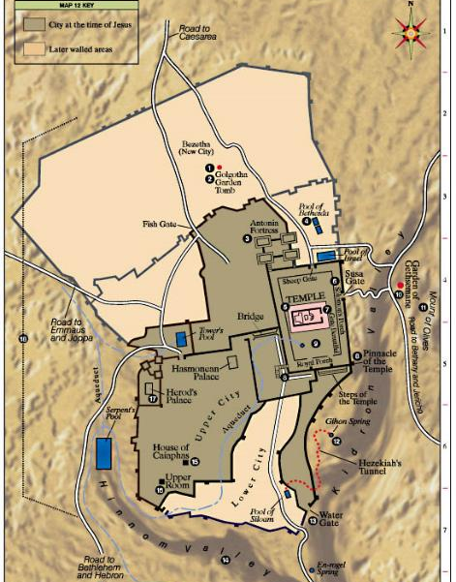

Slide 5
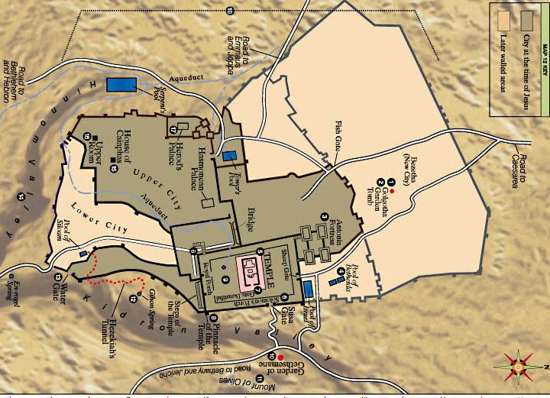

Slide 6
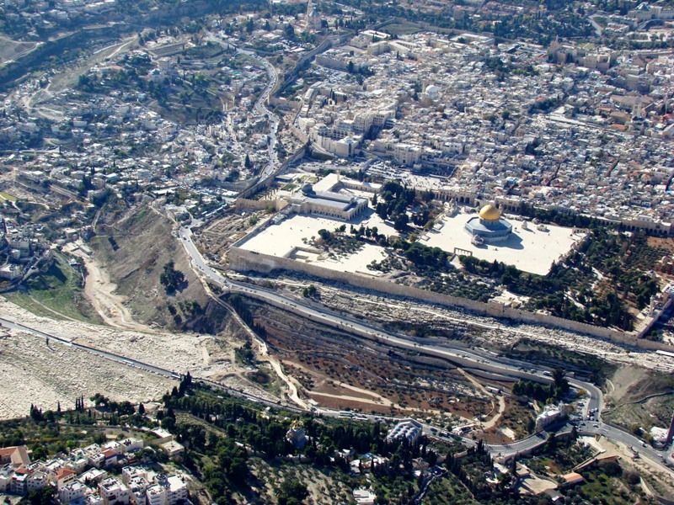

Slide 7
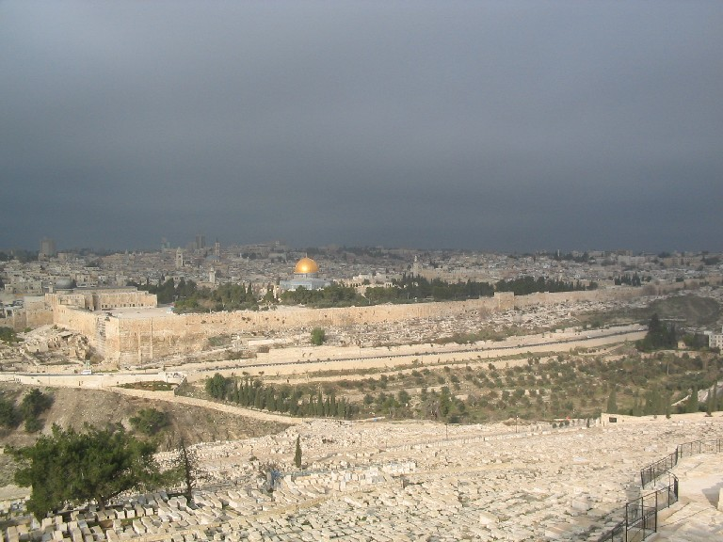

Slide 8
John 18:1-11 – Betrayal & Arrest
See 6:64, 6:71, 13:2,11
¹ When Jesus had spoken these words, He went out with His disciples over the Brook Kidron, where there was a garden, which He and His disciples entered. ² And Judas, who betrayed Him, also knew the place; for Jesus often met there with His disciples. ³ Then Judas, having received a detachment of troops, and officers from the chief priests and Pharisees, came there with lanterns, torches, and weapons. ⁴ Jesus therefore, knowing all things that would come upon Him, went forward and said to them, “Whom are you seeking?”
⁵ They answered Him, “Jesus of Nazareth.”
Jesus said to them, “I am He.” And Judas, who betrayed Him, also stood with them.
⁶ Now when He said to them, “I am He,” they drew back and fell to the ground.
⁷Then He asked them again, “Whom are you seeking?”
And they said, “Jesus of Nazareth.”
⁸ Jesus answered, “I have told you that I am He. Therefore, if you seek Me, let these go their way,” ⁹ that the saying might be fulfilled which He spoke, “Of those whom You gave Me I have lost none.”
¹⁰ Then Simon Peter, having a sword, drew it and struck the high priest’s servant, and cut off his right ear. The servant’s name was Malchus.
¹¹ So Jesus said to Peter, “Put your sword into the sheath. Shall I not drink the cup which My Father has given Me?”
As in 7:32
In control
“delivered Him up”
Remember
17:12
As in Mt 26:39
See 18:16 & 26

Slide 9
Outline of John 18:
Arrest in the Garden (18:1-11)
Peter’s 1st Denial – “Maid” (18:15-18)
Trial Before Annas - “Witnesses?” (18:19-24)
Peter’s 2nd/3rd Denials – “men; servant” (18:25-27)

Slide 10
John 18 – Peter’s Denials
¹⁵And Simon Peter followed Jesus, and so did another disciple. Now that disciple was known to the high priest, and went with Jesus into the courtyard of the high priest. ¹⁶But Peter stood at the door outside. Then the other disciple, who was known to the high priest, went out and spoke to her who kept the door, and brought Peter in. ¹⁷Then the servant girl who kept the door said to Peter, “You are not also one of this Man’s disciples, are you?”
He said, “I am not.”
¹⁸Now the servants and officers who had made a fire of coals stood there, for it was cold, and they warmed themselves. And Peter stood with them and warmed himself.

Slide 11
John 18 – Peter’s Denials
¹⁵And Simon Peter followed Jesus, and so did another disciple. Now that disciple was known to the high priest, and went with Jesus into the courtyard of the high priest. ¹⁶But Peter stood at the door outside. Then the other disciple, who was known to the high priest, went out and spoke to her who kept the door, and brought Peter in. ¹⁷Then the servant girl who kept the door said to Peter, “You are not also one of this Man’s disciples, are you?”
He said, “I am not.”
¹⁸Now the servants and officers who had made a fire of coals stood there, for it was cold, and they warmed themselves. And Peter stood with them and warmed himself. …
²⁵Now Simon Peter stood and warmed himself. Therefore they said to him, “You are not also one of His disciples, are you?”
He denied it and said, “I am not!”
²⁶One of the servants of the high priest, a relative of him whose ear Peter cut off, said, “Did I not see you in the garden with Him?”
²⁷Peter then denied again; and immediately a rooster crowed.
Connection

Slide 12
Outline of John 18:
Arrest in the Garden (18:1-11)
Peter’s 1st Denial – “Maid” (18:12-18)
Trial Before Annas - “Witnesses?” (18:19-24)
Peter’s 2nd/3rd Denials – “men; servant” (18:25-27)

Slide 13
John 18:12-14; 19-24 – Trial before Annas
¹² Then the detachment of troops and the captain and the officers of the Jews arrested Jesus and bound Him. ¹³ And they led Him away to Annas first, for he was the father-in-law of Caiaphas who was high priest that year. ¹⁴ Now it was Caiaphas who advised the Jews that it was expedient that one man should die for the people…
¹⁹ The high priest then asked Jesus about His disciples and His doctrine.
²⁰ Jesus answered him, “I spoke openly to the world. I always taught in synagogues and in the temple, where the Jews always meet, and in secret I have said nothing. ²¹ Why do you ask Me? Ask those who have heard Me what I said to them. Indeed they know what I said.”
²² And when He had said these things, one of the officers who stood by struck Jesus with the palm of his hand, saying, “Do You answer the high priest like that?”
²³ Jesus answered him, “If I have spoken evil, bear witness of the evil; but if well, why do you strike Me?”
²⁴ Then Annas sent Him bound to Caiaphas the high priest.
See 11:49
Mentioned, but not recorded (see Mt 26:59- 68)
More to come…see Acts 4:6…

Slide 14
All the Trials
Annas – Jn 18:12-14, 19-23
“Witnesses?”
Caiaphas – Mt 26:57, 59-68 (Jn 18:24)
False witnesses, “Temple,” “the Christ?”
Sanhedrin – Lk 22:66-71 (Mt 27:1)
“The Christ,” “No need of witnesses.”
Jewish
Roman

Slide 15
John 18:28-32 – Trial Before Pilate (1)
²⁸Then they led Jesus from Caiaphas to the Praetorium, and it was early morning. But they themselves did not go into the Praetorium, lest they should be defiled, but that they might eat the Passover. ²⁹Pilate then went out to them and said, “What accusation do you bring against this man?”
³⁰They answered and said to him, “If He were not an evildoer, we would not have delivered Him up to you.”
³¹Then Pilate said to them, “You take Him and judge Him according to your law.”
Therefore the Jews said to him, “It is not lawful for us to put anyone to death,” ³²that the saying of Jesus might be fulfilled which He spoke, signifying by what death He would die.
³³Then Pilate entered the Praetorium again, called Jesus, and said to Him, “Are you the King of the Jews?”
³⁴Jesus answered him, “Are you speaking for yourself about this, or did others tell you this concerning Me?”
³⁵Pilate answered, “Am I a Jew? Your own nation and the chief priests have delivered You to me. What have You done?”
³⁶Jesus answered, “My kingdom is not of this world. If My kingdom were of this world, My servants would fight, so that I should not be delivered to the Jews; but now My kingdom is not from here.”
³⁷Pilate therefore said to Him, “Are you a king then?”
Jesus answered, “You say rightly that I am a king. For this cause I was born, and for this cause I have come into the world, that I should bear witness to the truth. Everyone who is of the truth hears My voice.”
“Outside”
1
3:14; 12:32-34; & Dt 21:23
“Inside”
Remember 1:49
3:3-5
10:27

Slide 16
John 18:39-19:5 – Trial Before Pilate (2)
³⁸Pilate said to Him, “What is truth?” And when he had said this, he went out again to the Jews, and said to them, “I find no fault in Him at all.
³⁹“But you have a custom that I should release someone to you at the Passover. Do you therefore want me to release to you the King of the Jews?”
⁴⁰Then they all cried again, saying, “Not this Man, but Barabbas!” Now Barabbas was a robber.
¹So then Pilate took Jesus and scourged Him. 2 And the soldiers twisted a crown of thorns and put it on His head, and they put on Him a purple robe. 3 Then they said, “Hail, King of the Jews!” And they struck Him with their hands.
⁴Pilate then went out again, and said to them, “Behold, I am bringing Him out to you, that you may know that I find no fault in Him.”
⁵Then Jesus came out, wearing the crown of thorns and the purple robe. And Pilate said to them, “Behold the Man!”
2
“Outside”
“Inside”
3
“Outside”

Slide 17
Pilate’s movement
Outside (18:28-32) Jews demand Jesus' death
Inside (18:33-38a) “A King?”
Outside (18:38b-40) “Not guilty,” Barabbas choice
Inside (19:1-3) Soldiers scourge Jesus
Outside (19:4-8) “Not guilty,” “Behold the man”
Inside (19:9-11) “Power”
Outside (19:12-16a) “Caesar’s Friend,” Final Sentence

Slide 18
All the Trials
Annas – Jn 18:12-14, 19-23
“Witnesses?”
Caiaphas – Mt 26:57, 59-68 (Jn 18:24)
False witnesses, “Temple,” “the Christ?”
Sanhedrin – Lk 22:66-71 (Mt 27:1)
“The Christ,” “No need of witnesses.”
Pilate – Jn 18:28-33 (Mt 27:2, 11-14)
“Accusation?”
Herod – Lk 23:6-12
No miracle, no answer, many accusations
Pilate – Jn 18:34-19:16 (Lk 23:13-25)
Barabbas, “Behold,” “Power,” “Caesar’s friend”
Jewish
Roman

Slide 19
Jesus in Control
18:4 – Jesus, knowing all things…
18:4-7 – “Whom do you seek?” … “I am He”
18:8 – “Let these go” … “Lost none.”
18:11 – “Put up the sword”
18:21 – Rebuked the high priest (witnesses?)
18:32 – Jesus’ words fulfilled
18:36 – “My servants did not fight”
18:37 – “You say rightly I am a King”
19:11 – “You would have no power, except given to you from above”

Slide 20
John 19:6-11 – Trial Before Pilate (4)
⁶Therefore, when the chief priests and officers saw Him, they cried out, saying, “Crucify Him, crucify Him!”
Pilate said to them, “You take Him and crucify Him, for I find no fault in Him.”
⁷The Jews answered him, “We have a law, and according to our law He ought to die, because He made Himself the Son of God.”
⁸Therefore, when Pilate heard that saying, he was the more afraid, ⁹and went again into the Praetorium, and said to Jesus, “Where are You from?” But Jesus gave him no answer.
¹⁰Then Pilate said to Him, “Are You not speaking to me? Do You not know that I have power to crucify You, and power to release You?”
¹¹Jesus answered, “You could have no power at all against Me unless it had been given you from above. Therefore the one who delivered Me to you has the greater sin.”
4
“Inside”
“Outside”

