Slide 1
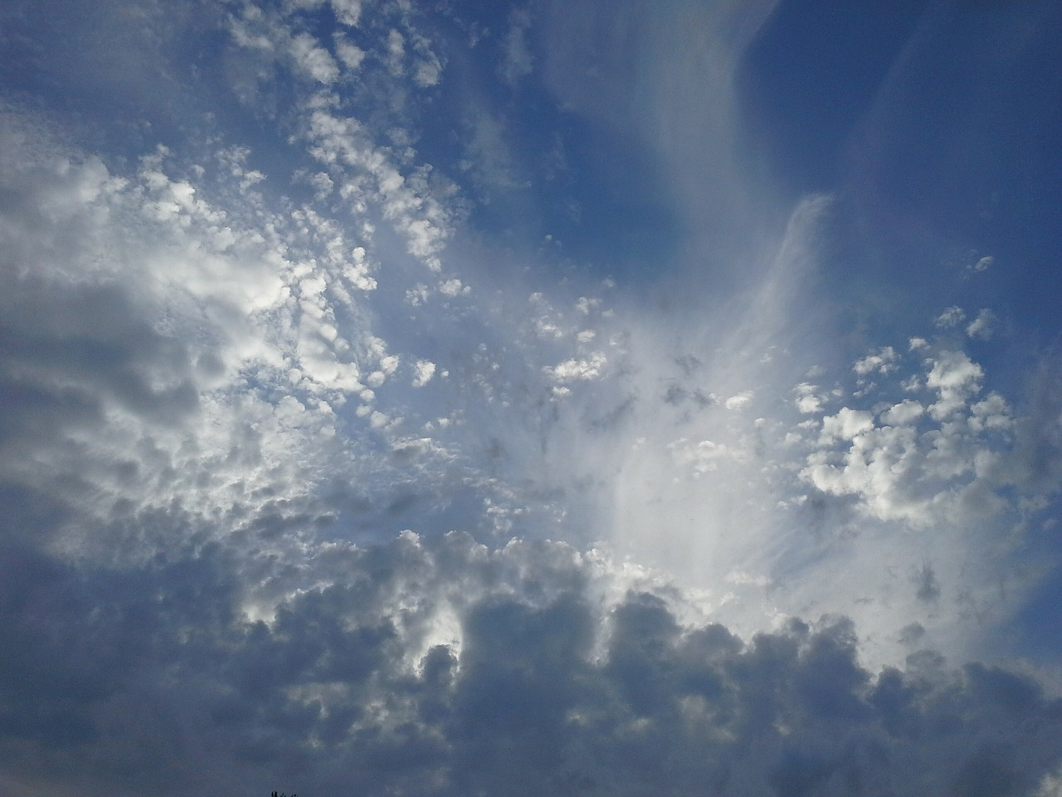
Faith and Evidence
Hebrews 11:6
John 20:29-31
1 Peter 3:13-16
Definition
Reasonable
Understanding
Readiness
Reason

Slide 2
Faith and Evidence
Luke 1:1-4
1 Cor. 15
John 5
As in a court of law:
Documents
Eyewitnesses
Explain all together

