Slide 1
Feasting on the Faithfulness of God

Slide 2
Psalm 89: Faithfulness to the People through the King
God's faithfulness is one of his most questioned qualities in the world and most strongly asserted qualities in Scripture.
God's faithfulness legitimizes his strength for salvation.
God chose David as the example and vehicle of his saving faithfulness for the people.
God's faithfulness is difficult for his people to believe in when things go badly.

Slide 3
Psalm 89: Faithful to All in the King
God's faithfulness needs to be made known to all people.
God's faithfulness legitimizes his strength for salvation.
God’s faithfulness was demonstrated and accessed through his covenant with King David.
God's faithfulness is not always apparent in the world.

Slide 4
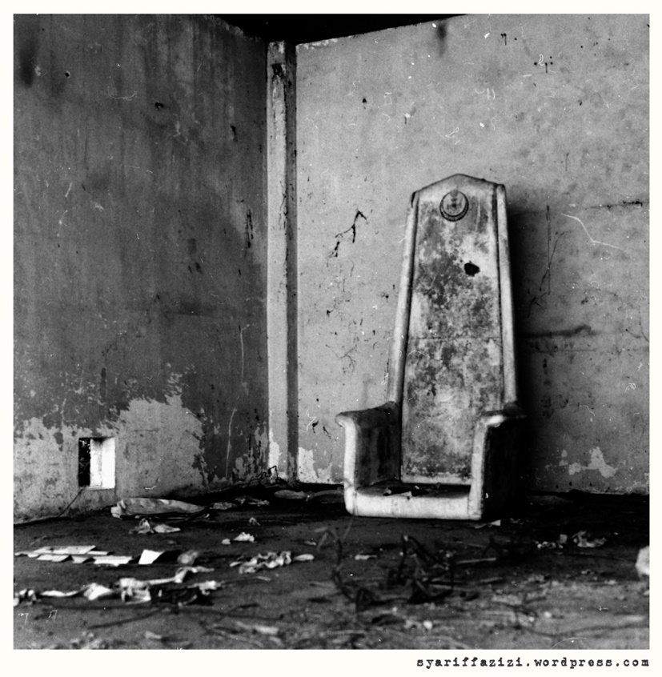
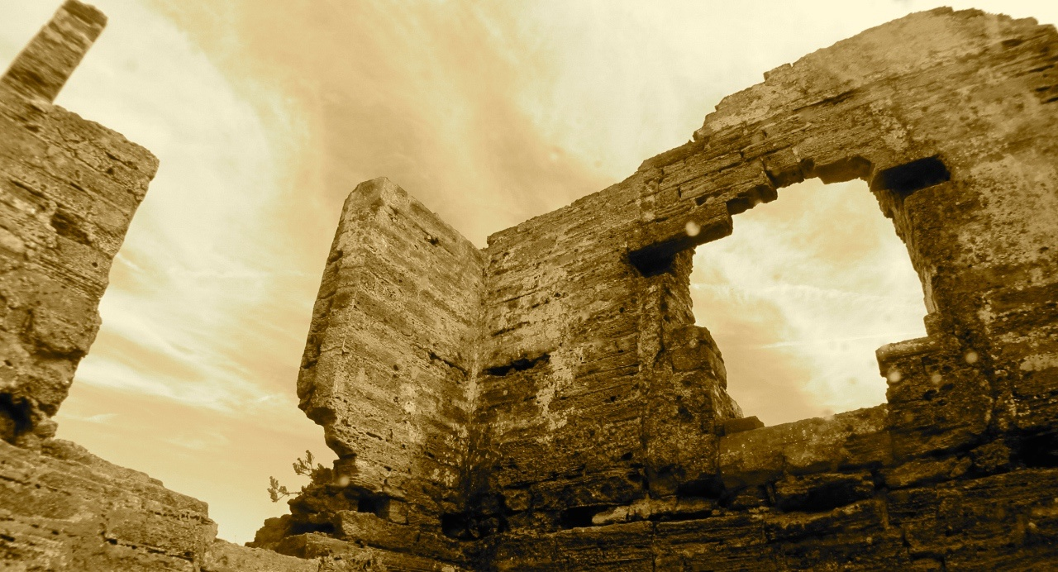
How long, O Lord? Will you hide yourself forever? … Lord, where is your steadfast love of old, which by your faithfulness you swore to David?

Slide 5
Christ, the Son of David in the flesh and the Son of God through the Resurrection from death, proved the faithfulness of God to all the world. (Hebrews 3, 1 Peter 2)
Because of his faithfulness we have hope of the righteousness of God.
When we eat the supper we are remembering for ourselves and proclaiming to the world of the faithfulness of God.

Slide 6
Christ’s Faithfulness
Therefore, holy brothers, you who share in a heavenly calling, consider Jesus, the apostle and high priest of our confession, who was faithful to him who appointed him, just as Moses also was faithful in all God's house. … but Christ is faithful over God's house as a son. And we are his house if indeed we hold fast our confidence and our boasting in our hope.
Hebrews 3.1-6

Slide 7
Christ’s Faithfulness
For to this you have been called, because Christ also suffered for you, leaving you an example, so that you might follow in his steps. … when he suffered, he did not threaten, but continued entrusting himself to him who judges justly. ²⁴ He himself bore our sins in his body on the tree, that we might die to sin and live to righteousness. By his wounds you have been healed.
1 Peter 2.21, 23-24

Slide 8
Christ’s Faithfulness
Now before the Feast of the Passover, when Jesus knew that his hour had come to depart out of this world to the Father, having loved his own who were in the world, he loved them to the end.
John 13.1

Slide 9
The Faithfulness of God in Christ
Christ proves that God is faithful because He was faithful in His life on Earth as God in the Flesh.
Christ proves that God is faithful because God kept his promise(s) in raising Christ from the dead and giving Him the Eternal Throne.

Slide 10
For I am not ashamed of the gospel, for it is the power of God for salvation to everyone who believes, to the Jew first and also to the Greek. ¹⁷ For in it the righteousness of God is revealed from faith for faith, as it is written, “The righteous shall live by faith.”
Romans 1.16-17
But now the righteousness of God has been manifested apart from the law, although the Law and the Prophets bear witness to it— ²² the righteousness of God through faith in Jesus Christ for all who believe. For there is no distinction:²³ for all have sinned and fall short of the glory of God, ²⁴ and are justified by his grace as a gift, through the redemption that is in Christ Jesus, ²⁵ whom God put forward as a propitiation by his blood, to be received by faith. This was to show God's righteousness, because in his divine forbearance he had passed over former sins. ²⁶ It was to show his righteousness at the present time, so that he might be just and the justifier of the one who has faith in Jesus.
Romans 3.21-26

Slide 11
For I am not ashamed of the gospel, for it is the power of God for salvation to everyone who believes, to the Jew first and also to the Greek. ¹⁷ For in it the righteousness of God is revealed from faith for faith, as it is written, “The righteous shall live by faith.”
Romans 1.16-17
But now the righteousness of God has been manifested … the righteousness of God through faith in Jesus Christ for all who believe. For there is no distinction: for all have sinned and fall short of the glory of God, and are justified by his grace as a gift, through the redemption that is in Christ Jesus … It was to show his righteousness at the present time, so that he might be just and the justifier of the one who has faith in Jesus.
Romans 3.21-26

Slide 13
His Faithfulness and Ours
Obedience (Romans 5.19, 13.14)
Community (Romans 15.7-9)
Mission (Romans 15.20-21)

