Slide 1
Obadiah
The Message of

Slide 2
Read 1:1a
Introduction

Slide 3
Edom
Esau was the father of the Edomites. (Genesis 36:8-9)
The name “Edom” means “red”. (Genesis 25:30)
From the “red stew” that Esau took from Jacob in exchange for his birthright.
The Edomites had been given a possession of land by God in Mount Seir. (Deuteronomy 2:5,12)
Abraham
Isaac
Jacob (“Israel”)
Esau (“Edom”)
Israelites
Edomites

Slide 6
God is perfect in holiness, wisdom, power, and love
God does things His own way and in His own time
“Godliness with contentment is great gain” (1 Tim. 6:6)

Slide 7
Edom
Esau was the father of the Edomites. (Genesis 36:8-9)
The name “Edom” means “red”. (Genesis 25:30)
From the “red stew” that Esau took from Jacob in exchange for his birthright.
The Edomites had been given a possession of land by God in Mount Seir. (Deuteronomy 2:5,12)
They became proud and turned from the LORD that blessed them.
E.g., Numbers 20:14-21
Abraham
Isaac
Jacob (“Israel”)
Esau (“Edom”)
Israelites
Edomites

Slide 8
Read 1:1-4

Slide 9
“…For You alone, O LORD, make me dwell in safety.” (Psalm 4:8)
“God is our refuge and strength, a very present help in trouble. Therefore we will not fear, even though the earth be removed, and though the mountains be carried into the midst of the sea; though its waters roar and be troubled, though the mountains shake with its swelling.” (Psalm 46:1-3)

Slide 10
Read 1:5-9

Slide 11
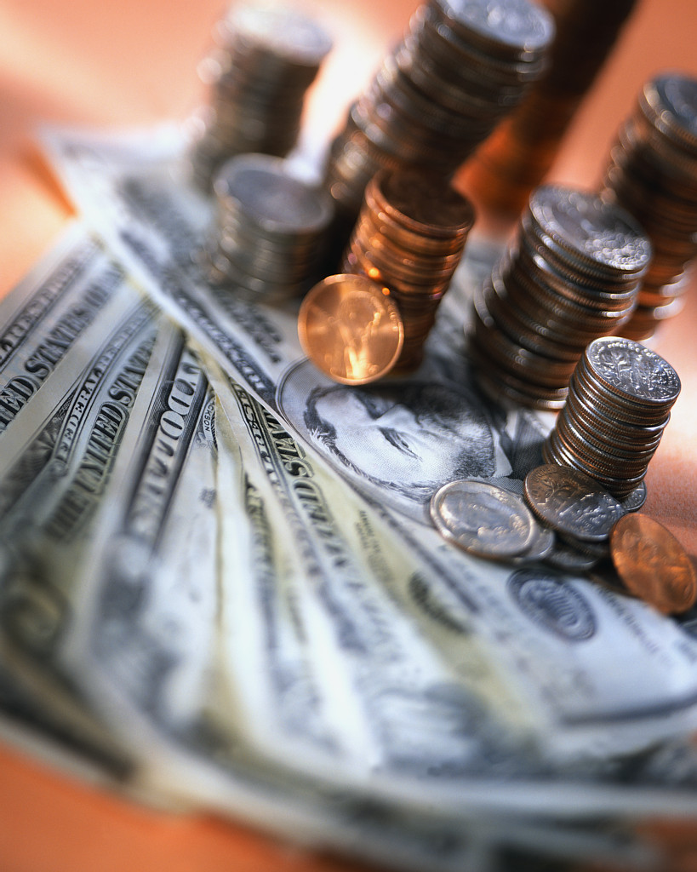
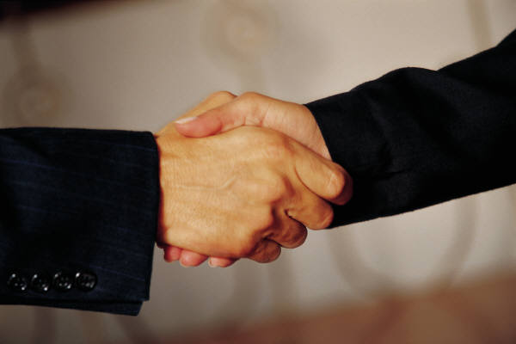
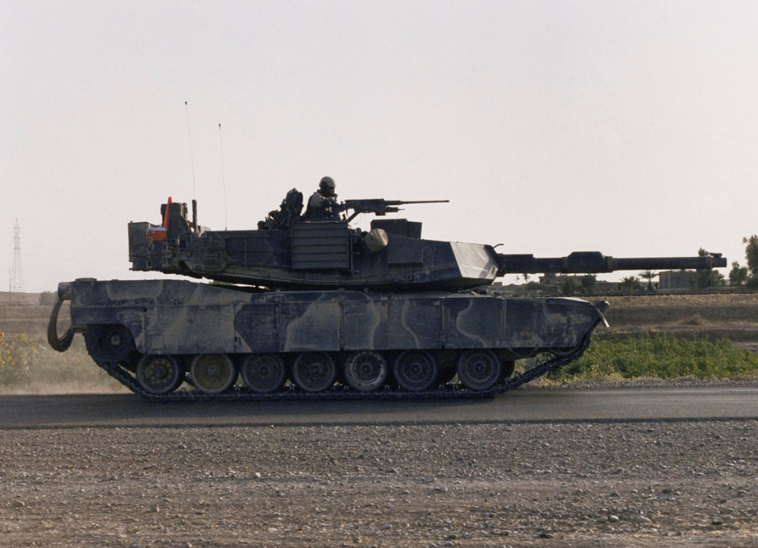
X
X
X
X

Slide 12
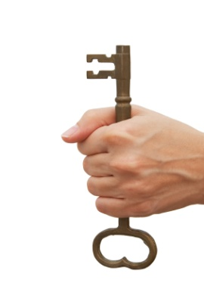
Read 1:10-16
Key Phrase “In the day”

Slide 13
Judah’s “DAY” Of Misfortune
1. “strangers carried captive his forces” (11)
2. “foreigners entered his gates and cast lots for Jerusalem” (11)
3. “in the day of his captivity” (12)
4. “in the day of their destruction” (12)
5. “in the day of distress” (12)
6. “in the day of their calamity” (13)
7. “in the day of their calamity” (13)
8. “in the day of their calamity” (13)
9. “in the day of distress” (14)

Slide 14
“For violence against your brother Jacob…” (1:10)
Judah’s “DAY” Of Misfortune | Edom’s Response on that “DAY”
1. “strangers carried captive his forces” (11) | 1. “you stood on the other side” (11)
2. “foreigners entered his gates and cast lots for Jerusalem” (11) | 2. “even you were as one of them” (11)
3. “in the day of his captivity” (12) | 3. you gazed on the day of your brother (12)
4. “in the day of their destruction” (12) | 4. you rejoiced over the children of Judah (12)
5. “in the day of distress” (12) | 5. you spoke proudly (12)
6. “in the day of their calamity” (13) | 6. you entered the gate of My people (13)
7. “in the day of their calamity” (13) | 7. you gazed on their affliction (13)
8. “in the day of their calamity” (13) | 8. you laid hands on their substance (13)
9. “in the day of distress” (14) | 9. You stood at the crossroads, cut off the escapees, handed over those who remained (14)
Is it right to stand on the side when others are in trouble? (Luke 10:29-37)
Is it right to rejoice in the destruction of others? (Proverbs 24:17-18)
Is it right to take advantage of others, to loot others, in the day of their weakness?

Slide 15
Obadiah 1:15 “As you have done, it shall be done to you.”

Slide 16
Read 1:17-21

Slide 17
(1:21, NIV)
“Deliverers will go up on Mount Zion to govern the mountains of Esau. And the kingdom will be the LORD’s.”

Slide 18
Lessons
Whatever plan God gives you, trust and obey HIM with godliness and contentment.
God alone makes us dwell in safety.
When others are weak or in trouble
Don’t stand on the other side
Don’t gloat or rejoice
Don’t take advantage of them
It can be easy to see concerns in others, but not see the same concerns in ourselves (Luke 6:41-42)
Jonah!

