Slide 1
Study of Daniel
Fall 2015
Online
Materials

Slide 2
Review Quiz on Lesson 1
Key Dates
_______ 1st Captives (incl. Daniel) taken to Babylon
_______ 2nd Set of Captives taken to Babylon
_______ Fall of Jerusalem
_______ Fall of Babylon
2. Three Prophets during Exile
____________ in Jerusalem
____________ in Babylon, among the people
____________ in Babylon, among the rulers
Four Rulers whom Daniel Served (in the Book)
_________________ Babylonian (greatest)
_________________ Babylonian (last)
_________________ Mede
_________________ Persian
Theme of the Book: ______________________________________________________
Daniel’s name means: ____________________________________________________
Three miracles in Daniel
_____________________ (chapter ______)
_____________________ (chapter ______)
_____________________ (chapter ______)
Previous Prophets, who prophesied…
______________ 70 years exile
______________ Named Cyrus as the King who would allow a return
______________ Vessels of the temple & sons to be taken to Babylon
______________ Far-away nation, different language, desolation, siege, scattering (if Israel was disobedient)

Slide 3
Review Quiz on Lesson 1
Key Dates
_______ 1st Captives (incl. Daniel) taken to Babylon
_______ 2nd Set of Captives taken to Babylon
_______ Fall of Jerusalem
_______ Fall of Babylon
2. Three Prophets during Exile
____________ in Jerusalem
____________ in Babylon, among the people
____________ in Babylon, among the rulers
Four Rulers whom Daniel Served (in the Book)
_________________ Babylonian (greatest)
_________________ Babylonian (last)
_________________ Mede
_________________ Persian
Theme of the Book: ______________________________________________________
Daniel’s name means: ____________________________________________________
Three miracles in Daniel
_____________________ (chapter ______)
_____________________ (chapter ______)
_____________________ (chapter ______)
Previous Prophets, who prophesied…
______________ 70 years exile
______________ Named Cyrus as the King who would allow a return
______________ Vessels of the temple & sons to be taken to Babylon
______________ Far-away nation, different language, desolation, siege, scattering (if Israel was disobedient)
605
597
586
539
Jeremiah
Ezekiel
Daniel
Nebuchadnezzar
Belchazzar
Darius
Cyrus
God rules in the kingdoms of men. (Dan 4:17)
God is my Judge.
Fiery furnace
3
Writing on Wall
5
Lion’s Den
6
Jeremiah
Isaiah
Isaiah
Moses

Slide 4
1445-1405 BC
Wilderness
Wanderings
931-722 BC
Divided
Kingdom
605-538 BC
Babylonian
Captivity
444 BC - ~4 BC
The Silent Years
(Intertestamental)
30-90 AD
The Church
NT Era
2166-1859 BC
Patriarchs
1300-1050 BC
Judges
Slavery in Egypt
1859-1445 BC
Conquest
of Canaan
1405-1300 BC
United
Kingdom
1050-931 BC
Life of
Christ
4 BC – 30 AD
United
Kingdom
1050-931 BC
Judah
Alone
722-605 BC
Return
From Exile
538-444 BC
597 BC
2nd Captives
Ezekiel
605 BC
1st Captives
Daniel
586 BC
Fall of
Jerusalem
539BC
Fall of
Babylon
538 BC
1st Return from Exile
562-560 BC
556-539 BC
Evil-Merodach
Nabonidus
Nebuchadnezzar
Neriglassar
Belshazzar
Cyrus the Great
Darius the Mede
605-562 BC
560-556 BC
553-539 BC
539-530 BC
Daniel 1
605-603 BC
Daniel 2
603 BC
Daniel 3
603-587? BC
Daniel 4
? BC
Daniel 5-6
539 BC
Daniel 7
553 BC
Daniel 8
551 BC
Daniel 9
539 BC
Daniel 10-12
536 BC
Based on Graphics from Marc Hinds & David Maxson
Notes:
With animation

Slide 5
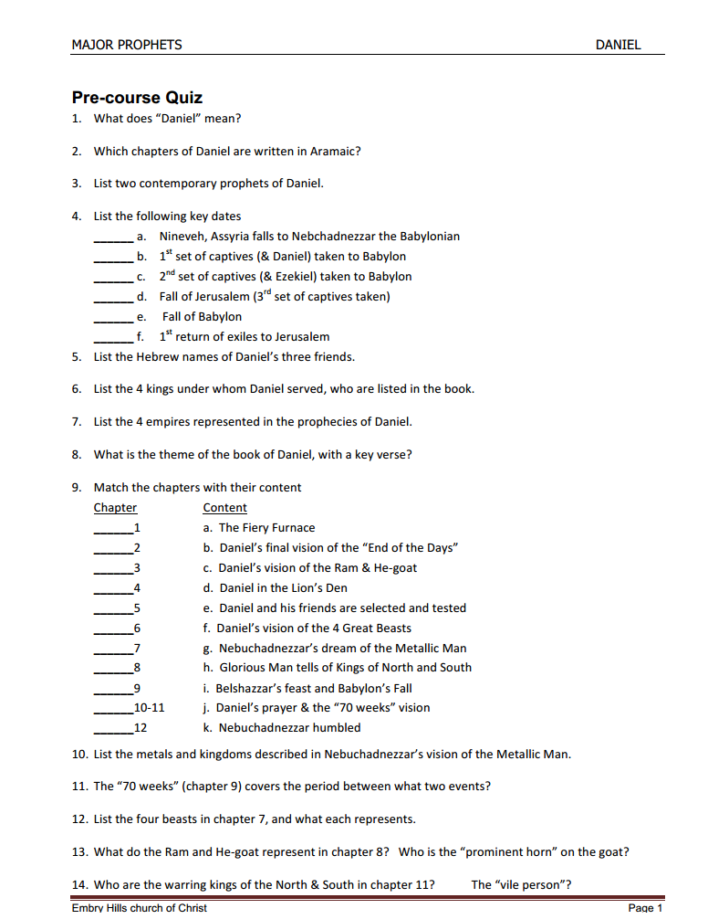
Chapter Matching

Slide 6
Chapter Content
Chapter Content
____ 1 a. Daniel’s friends in the Fiery Furnace
____ 2 b. Daniel’s final vision of the “End of the Days”
____ 3 c. Daniel’s vision of the Ram & He-goat
____ 4 d. Daniel in the Lion’s Den
____ 5 e. Daniel and his friends are selected and tested
____ 6 f. Daniel’s vision of the 4 Great Beasts
____ 7 g. Nebuchadnezzar’s dream of the Metallic Man
____ 8 h. Glorious Man tells of Kings of North and South
____ 9 i. Belshazzar’s feast and Babylon’s Fall
____ 10-11 j. Daniel’s prayer & the “70 weeks” vision
____ 12 k. Nebuchadnezzar humbled
e
g
a
k
i
d
f
c
j
h
b

Slide 7
Chapter Content of Daniel
1 Daniel and his friends are selected and tested
2 Nebuchadnezzar’s dream of the Metallic Man
Daniel’s friends in the Fiery Furnace
Nebuchadnezzar humbled
5 Belshazzar’s feast and Babylon’s Fall
6 Daniel in the Lion’s Den
7 Daniel’s vision of the 4 Great Beasts
8 Daniel’s vision of the Ram & He-goat
9 Daniel’s prayer & the “70 weeks” vision
10-11 Glorious Man tells of Kings of North and South
12 Daniel’s final vision of the “End of the Days”

Slide 8
Outline of Daniel
Chapter | Description | Language
1
2
3
4
5
6
7
8
9
10
11
12
Daniel & Friends tested in captivity
Hebrew
Daniel & Nebuchadnezzar’s
dream of 4 kingdoms
Aramaic
Faith tested in fire
Aramaic
4 Empires Rise & Fall
God Humbles Proud
Nebuchadnezzar is shown
God rules in the nations
Aramaic
Belshazzar’s feast & Babylon’s fall
Aramaic
God Rescues Faithful
Daniel’s faith in a Lion’s Den
Aramaic
Daniel’s vision of 4 beasts
Aramaic
Daniel’s vision of the ram & he-goat
Hebrew
Daniel’s prayer for return
Hebrew
Intro to Daniel’s last visions
Hebrew
Daniel’s vision Between Testaments
Hebrew
Daniel’s vision of the End Days
Hebrew
Notes:
Animated

Slide 9
Cycle of Visions
1
2
3
4
5
6
7
8
9
10
11
12
Mighty
Metallic
Man
Four
Beasts
Seventy
Weeks
1
Gold⁴
1
Lion⁴
2
Silver
2
Bear⁵
Ram³
(Intro)
3 more Kings²
3
Bronze
3
Leopard⁶
He-Goat⁸
Kings of N&S⁶
Fierce King²³
Vile Person²¹
4
Iron/clay
4
(ugly)⁷
[evil] King³⁶
Stone³⁴
Son of Man¹³
Messiah²⁵
time of
trouble¹, time of the end⁴

Slide 10
D. Characters from Daniel
Four Hebrew Men in Babylon
Ch 1-2,4-12
Daniel^{H}
“God is my Judge”
Belteshazzar^{B}
“May Balak protect”
Ch 1,3
Shadrach^{B}
“Command of Aku”
Hananiah^{H}
“The Lord is gracious”
Ch 1,3
Meshach^{B}
“Who is what Aku is”
Mishael^{H}
“Who is what God is”
Ch 1,3
Abenego^{B}
“Servant of Nebo”
Azariah^{H}
“The Lord has helped”
Two Kings of Babylon
Ch 1-4
Nebuchadnezzar
“Nebo, protect the crown”
Ch 5,7,8
Belshazzar
“Bel protect the king”
Two Kings of Medo-Persian
Ch 1,6,10
Cyrus the Persian
“Throne”
Ch 5-6,9,11
Darius the Mede – governor of Babylon
“Preserver”

Slide 11
Daniel 1
Theme: God in control (2, 9)
Nebuchadnezzar’s religious conviction (2, 20; see 3:15)
Nebuchadnezzar’s methods as a ruler (3, 10, 19; see 2:5)
Purpose of the education (5, 19, 20; 2:13, 48)
Daniel’s special gift (17)
Daniel’s tenure (21)

Slide 12
Daniel: Holding to Convictions
Pre-determined his position (1:8)
Explained his conviction from the start (1:8)
Sympathetic to ‘unbelievers’ (1:10,12)
Persistent in appeal & practice (1:8,11,16)
Respectful to authority (1:13)
Trusted in God for the outcome (1:9,17)

