Slide 1
Questions to Consider
Why did you come here this morning?
Are you excited to be here? Why or why not?
What’s been on your mind before you got here this morning?
What do you hope to gain from this morning’s worship? (question focuses on us)
What do you hope to accomplish this morning? (focus turned to God and/or others)
Do you feel privileged to be here?

Slide 2
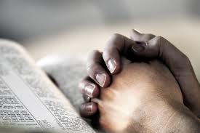
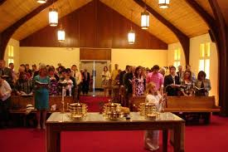
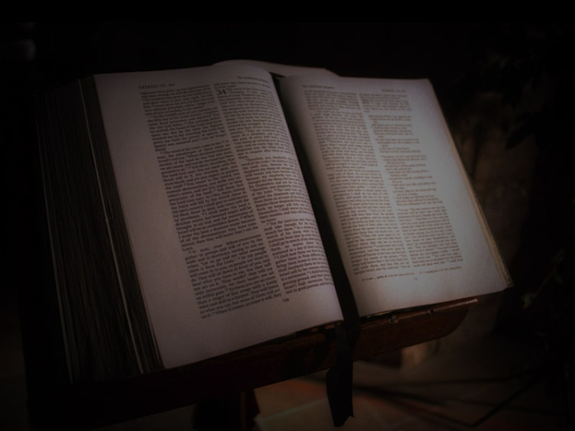
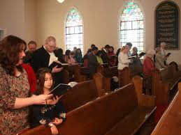
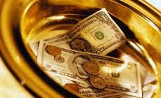
Putting More into and Getting More out of Worship

Slide 3
Putting More into and Getting More out of Worship
Sunday Evening – August 18
Sunday Evening – August 25

Slide 4
Goals of these sermons (that we will each . . .)
Worship God with a more sincere heart
Gain more from worship
Be true worshippers
And that above all else
God will be honored more in our worship

Slide 5
Three Facts About Worship in Song
Our worship in song must be focused on God
“Woman, believe me, the hour is coming when neither on this mountain nor in Jerusalem will you worship the Father . . . ²³ But the hour is coming, and is now here, when the true worshipers will worship the Father in spirit and truth, for the Father is seeking such people to worship him. ²⁴ God is spirit, and those who worship him must worship in spirit and truth.” – John 4:21-24

Slide 6
Three Facts About Worship in Song
Our worship in song must be focused on God
Ephesians 5:18b-21 but be filled with the Spirit, ¹⁹ addressing one another in psalms and hymns and spiritual songs, singing and making melody to the Lord with your heart, ²⁰ giving thanks always and for everything to God the Father in the name of our Lord Jesus Christ, ²¹ submitting to one another out of reverence for Christ
Colossians 3:16-17 ¹⁶ Let the word of Christ dwell in you richly, teaching and admonishing one another in all wisdom, singing psalms and hymns and spiritual songs, with thankfulness in your hearts to God. ¹⁷ And whatever you do, in word or deed, do everything in the name of the Lord Jesus, giving thanks to God the Father through him.

Slide 7
Three Facts About Worship in Song
Our worship in song must be focused on God
Worship in song involves the whole church (all members)
Ephesians 5
¹⁹ addressing one another in psalms and hymns and spiritual songs
²¹ submitting to one another out of reverence for Christ
Colossians 3
¹⁶ . . . teaching and admonishing one another

Slide 8
Three Facts About Worship in Song
Our worship in song must be focused on God
Worship in song involves the whole church (all members)
Worship in song must be done in spirit and in truth
²³ But the hour is coming, and is now here, when the true worshipers will worship the Father in spirit and truth, for the Father is seeking such people to worship him. ²⁴ God is spirit, and those who worship him must worship in spirit and truth.” – John 4:23-24

Slide 9
Three Facts About Worship in Song
Our worship in song must be focused on God
Worship in song involves the whole church (all members)
Worship in song must be done in spirit and in truth
In truth – guided by God
In spirit – with emotions

Slide 10
Worship in Spirit
Ephesians 5:18b-21 but be filled with the Spirit, ¹⁹ addressing one another in psalms and hymns and spiritual songs, singing and making melody to the Lord with your heart, ²⁰ giving thanks always and for everything to God the Father in the name of our Lord Jesus Christ, ²¹ submitting to one another out of reverence for Christ
Colossians 3:16-17 ¹⁶ Let the word of Christ dwell in you richly, teaching and admonishing one another in all wisdom, singing psalms and hymns and spiritual songs, with thankfulness in your hearts to God. ¹⁷ And whatever you do, in word or deed, do everything in the name of the Lord Jesus, giving thanks to God the Father through him.

Slide 11
Worship in Song – Practical Considerations

Slide 12
Two Questions to Consider
Why do we use the scriptures (the New Testament) as our guide?
¹³ And we also thank God constantly for this, that when you received the word of God, which you heard from us, you accepted it not as the word of men but as what it really is, the word of God, which is at work in you believers. ¹⁴ For you, brothers, became imitators of the churches of God in Christ Jesus that are in Judea. For you suffered the same things from your own countrymen as they did from the Jews, – I Thessalonians 2:13-14

Slide 13
Two Questions to Consider
Why do we use the scriptures (the New Testament) as our guide?
How do these scriptures guide us?

Slide 14
Putting More in and Getting More out of Worship

Slide 15
Four Points from the Teaching of Jesus
We need to understand the urgency of our situation
‘Master, I knew you to be a hard man, reaping where you did not sow, and gathering where you scattered no seed, ²⁵ so I was afraid, and I went and hid your talent in the ground. Here you have what is yours.’ - Matt. 25:24-25

Slide 16
Four Points from the Teaching of Jesus
We need to understand the urgency of our situation
We need to have an honest view of what we are able to do
Everyone to whom much was given, of him much will be required, and from him to whom they entrusted much, they will demand the more. - Luke 12:48

Slide 17
Four Points from the Teaching of Jesus
We need to understand the urgency of our situation
We need to have an honest view of what we are able to do
We need to overcome the distractions of this world
²² As for what was sown among thorns, this is the one who hears the word, but the cares of the world and the deceitfulness of riches choke the word, and it proves unfruitful. – Matthew 13:22

Slide 18
Four Points from the Teaching of Jesus
We need to understand the urgency of our situation
We need to have an honest view of what we are able to do
We need to overcome the distractions of this world
We need to have the right priorities

Slide 19
Two Examples from the Life of Jesus
The Healed Demoniac – Mark 5:1-20
² And when Jesus had stepped out of the boat, immediately there met him out of the tombs a man with an unclean spirit. ³ He lived among the tombs. And no one could bind him anymore, not even with a chain, ⁴ for he had often been bound with shackles and chains, but he wrenched the chains apart, and he broke the shackles in pieces. No one had the strength to subdue him. ⁵ Night and day among the tombs and on the mountains he was always crying out and cutting himself with stones. – Mark 5:2-5

Slide 20
Two Examples from the Life of Jesus
The Healed Demoniac – Mark 5:1-20
“Go home to your friends and tell them how much the Lord has done for you, and how he has had mercy on you.” ²⁰ And he went away and began to proclaim in the Decapolis how much Jesus had done for him, and everyone marveled. – Mark 5:19-20

Slide 21
Two Examples from the Life of Jesus
The Healed Demoniac – Mark 5:1-20
Mary – John 12:2-8, Mark 14:3-9
“Leave her alone. Why do you trouble her? She has done a beautiful thing to me. ⁷ For you always have the poor with you, and whenever you want, you can do good for them. But you will not always have me. ⁸ She has done what she could; she has anointed my body beforehand for burial. ⁹ And truly, I say to you, wherever the gospel is proclaimed in the whole world, what she has done will be told in memory of her.” – Mark 14:6-9

Slide 22
Practical Applications
Work on your personal relationship with God
Take advantage of teaching opportunities
Serve through hospitality
Address the needs of others
Give more

Slide 23
Universal Nature of Guilt
Romans 3:19, 23
¹⁹ Now we know that whatever the law says, it says to those who are under the law, that every mouth may be stopped, and all the world may become guilty before God. ²³ for all have sinned and fall short of the glory of God
I John 1:8-10
⁸ If we say that we have no sin, we deceive ourselves, and the truth is not in us. ⁹ If we confess our sins, He is faithful and just to forgive us our sins and to cleanse us from all unrighteousness. ¹⁰ If we say that we have not sinned, we make Him a liar, and His word is not in us
James 2:10
¹⁰ For whoever shall keep the whole law, and yet stumble in one point, he is guilty of all.

Slide 24
God’s Solution for Guilt: Romans 3:22-26
²² the righteousness of God through faith in Jesus Christ for all who believe. For there is no distinction: ²³ for all have sinned and fall short of the glory of God, ²⁴ and are justified by his grace as a gift, through the redemption that is in Christ Jesus, ²⁵ whom God put forward as a propitiation by his blood, to be received by faith. This was to show God's righteousness, because in his divine forbearance he had passed over former sins. ²⁶ It was to show his righteousness at the present time, so that he might be just and the justifier of the one who has faith in Jesus.

Slide 25
Story of Ten Brothers
Genesis 37

Slide 26
Jacob’s Family
Leah Reuben Zilpah Gad
Simeon (Leah’s servant) Asher Levi
Judah
Issachar
Zebulon
Rachel Joseph Bilhah Dan
Benjamin (Rachel’s servant) Naptali

Slide 27
Story of Ten Brothers
Genesis 37
Joseph is sold by his brothers
Jacob convinced of his death
Genesis 42

Slide 28
Story of Ten Brothers
Genesis 37
Joseph is sold by his brothers
Jacob convinced of his death
Genesis 42
Ten travel to Egypt for grain
Simeon left
Jacob refuses to send Benjamin
Genesis 43
Brothers return with Benjamin
Simeon released
Genesis 44
Benjamin appears to be guilty
Judah’s plea

Slide 29
Genesis 44:16
“What shall we say to my lord? What shall we speak? Or how can we clear ourselves? God has found out the guilt of your servants; behold, we are my lord's servants, both we and he also in whose hand the cup has been found.”

Slide 30
Guilt and the Ten Brothers
Did not deny their guilt
Did they allow guilt to define them?
Not by giving up and remaining jealous, self-seeking, cruel men – why not?

Slide 31
Jacob’s Family
Leah Reuben (4) Zilpah Gad (7)
Simeon (5+1) (Leah’s servant) Asher (4) Levi (3)
Judah (3+2)
Issachar (4)
Zebulon (3)
Rachel Joseph Bilhah Dan (1)
Benjamin (Rachel’s servant) Naptali (4)

Slide 32
Guilt and the Ten Brothers
Did not deny their guilt
Did they allow guilt to define them?
Not by giving up and remaining jealous, self-seeking, cruel men – why not?
Yet perhaps in a sense while still trying to serve God
Who then is to be our example of using guilt as motivation to be remade (but with peace)?

Slide 33
Example of Paul
I Timothy 1:15
“Christ Jesus came into the world to save sinners, of whom I am the foremost” Yet
¹² I thank him who has given me strength, Christ Jesus our Lord, because he judged me faithful, appointing me to his service, ¹³ though formerly I was a blasphemer, persecutor, and insolent opponent. But I received mercy because I had acted ignorantly in unbelief, ¹⁴ and the grace of our Lord overflowed for me with the faith and love that are in Christ Jesus.

Slide 34
Example of Paul
I Timothy 1:15
Romans 7:24 – 8:1
Philippians 3:13-14
But one thing I do: forgetting what lies behind and straining forward to what lies ahead, ¹⁴ I press on toward the goal for the prize of the upward call of God in Christ Jesus.

Slide 35
#345 – 3rd verse
“My sin – O, the bliss of this glorious thought, my sin – not in part but the whole, is nailed to His cross and I bear it no more, Praise the Lord, praise the Lord, O, my soul.”

Slide 36
Ephesians 4 - 5
Putting Off Putting On
Lying Truth
Anger
Stealing Labor – honest work Corrupt talk Speech that builds up
Bitterness, wrath, malice Kindness, forgiveness
Sexual immorality
Filthiness, crude jokes Thanksgiving
Foolishness Understand the Lord’s will
Drunkenness Spirit, singing to the Lord

Slide 37
Lying – Ephesians 4:25
²⁵Therefore, having put away falsehood, let each one of you speak the truth with his neighbor, for we are members one of another.

Slide 38
Stealing – Ephesians 4:28
²⁸Let the thief no longer steal, but rather let him labor, doing honest work with his own hands, so that he may have something to share with anyone in need.

Slide 39
Corrupt Speech – Ephesians 4:29, 5:4
²⁹ Let no corrupting talk come out of your mouths, but only such as is good for building up, as fits the occasion, that it may give grace to those who hear.
⁴Let there be no filthiness nor foolish talk nor crude joking, which are out of place, but instead let there be thanksgiving

Slide 40
Ephesians 4:20-21
²⁰But that is not the way you learned Christ!— ²¹assuming that you have heard about him and were taught in him, as the truth is in Jesus,

Slide 41
Ephesians 4:31-32
³¹ Let all bitterness and wrath and anger and clamor and slander be put away from you, along with all malice. ³² Be kind to one another, tenderhearted, forgiving one another, as God in Christ forgave you.

Slide 42
Ephesians 5:3
³But sexual immorality and all impurity or covetousness must not even be named among you, as is proper among saints.

Slide 43
Putting on a New Self

Slide 44
I John 5:18-19
¹⁸ We know that whoever is born of God does not sin; but he who has been born of God keeps himself, and the wicked one does not touch him. ¹⁹ We know that we are of God, and the whole world lies under the sway of the wicked one.
Christians

