Slide 1
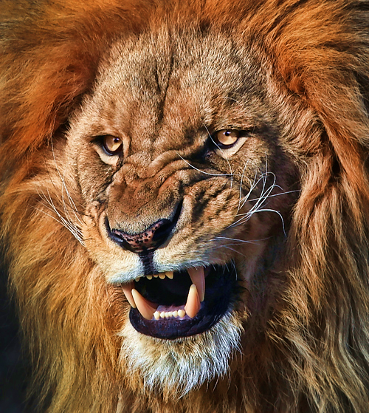
Courage
in a World of Fear
Be sober-minded; be watchful. Your adversary the devil prowls around like a roaring lion, seeking someone to devour. 1 Pet. 5:18
2015 Year End Segment
Lesson 4

Slide 2
Psalm 55:1-8
Give ear to my prayer, O God, and hide not yourself from my supplication! Attend to me, and hear me; I am restless in my complaint and I moan noisily, because of the voice of the enemy, because of the oppression of the wicked. For they bring down trouble upon me, and in wrath they hate me. My heart is severely pained within me; and the terrors of death have fallen upon me. Fearfulness and trembling have come upon me, and horror has overwhelmed me. So I say, "Oh, that I had wings like a dove! I would fly away and be at rest; Indeed, I would wander far off, and remain in the wilderness. I would hasten my escape from the windy storm and tempest.

Slide 3
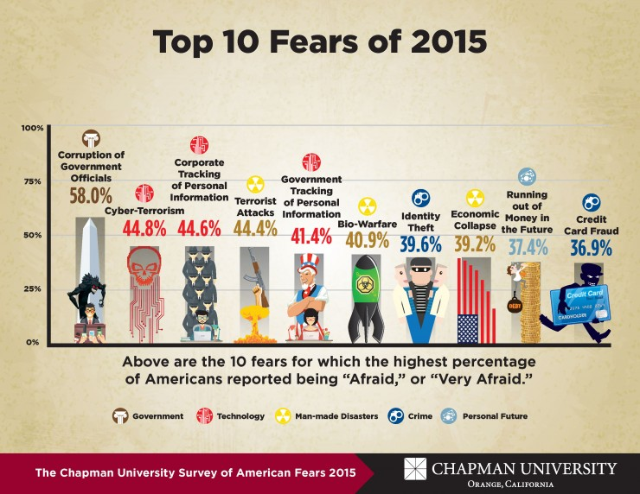
Like David, What can produce such fear and terrors to come upon you?

Slide 4
Like David, What can produce such fear and terrors to come upon you?
Voice of the enemy
Oppression of the wicked
For David it was the betrayal of a loyal friend
Psalm 55:12-14
For it is not an enemy who reproaches me; then I could bear it. Nor is it one who hates me who has exalted himself against me; then I could hide from him. But it was you, a man my equal, my companion and my acquaintance. We took sweet counsel together, and walked in the house of God in the throng.

Slide 5
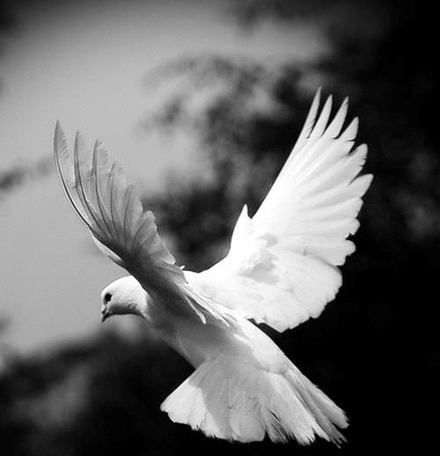
Is it the purpose for Christians to escape a world of fear?
As David so strongly desired?
Fly away and be at rest
Wander far off
Remain in the wilderness
Hasten my escape

Slide 6
Is it the purpose for Christians to escape a world of fear?
I have given them your word, and the world has hated them because they are not of the world, just as I am not of the world. I do not ask that you take them out of the world, but that you keep them from the evil one. They are not of the world, just as I am not of the world. Sanctify them in the truth; your word is truth. As you sent me into the world, so I have sent them into the world. John 17:14-18
Why “keep” us “from the evil one”?

Slide 7
1Pe 5:8 Be sober-minded; be watchful. Your adversary the devil prowls around like a roaring lion, seeking someone to devour.
How will the Father “keep” us “from the evil one”?

Slide 8
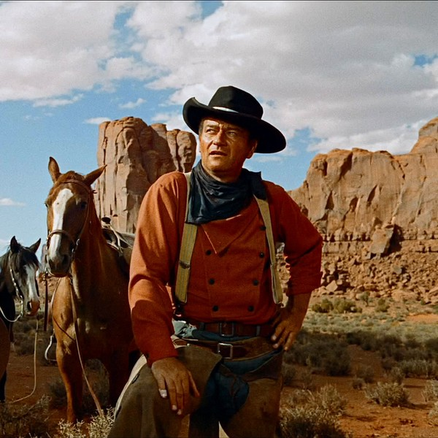
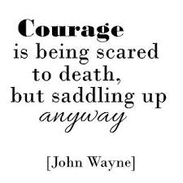
1Co 16:13 Be watchful, stand firm in the faith, act like men, be strong.

Slide 9
Courage in a World of Fear
Where do we look for courage?
In the midst of a world of sin, darkness and selfishness. The perfect breeding ground for a world of fear.
In a second letter written by the Apostle Paul to Timothy
Timothy’s Fears: (Paul is mindful of his tears 1:4)(“my son” 2:1 – Paul’s son in the faith)
Paul’s imprisonment 1:8; 16, 2:9(suffering as an evildoer)
Paul’s imminent execution 4:8
Threats from without: Alexander the copper smith 4:14,15
Threats from within: Ungodly brethren 2:16; imposters 3:13
Timothy’s commission: Train teachers 2:2; Correct those that oppose the truth 2:25; Preach the Word 4:2; work of an evangelist 4:5a; fulfill your ministry 4:5b
Endure hardship, affliction, 1:8; 2:3; 3:12; 4:5
Perilous Times 3:1; Evil men grow worse and worse 3:13
Abandonment?, loneliness “those in Asia” 1:15; Demas 4:10; no one, but the Lord 4:16,17
Failure? Stir up gift of God 1:6; cowardice 1:7; Youthful lust 2:22; disputes 2:16; 23

Slide 10
Courage in a World of Fear
2Tim 1:7 For God has not given us a spirit of fear, but of power and of love and of a sound mind.

Slide 11
Courage in a World of Fear
2Tim 1:7 For God has not given us a spirit of fear, but of power and of love and of a sound mind.
Act 2:38 And Peter said to them, “Repent and be baptized every one of you in the name of Jesus Christ for the forgiveness of your sins”

Slide 12
Courage in a World of Fear
2Tim 1:7 For God has not given us a spirit of fear, but of power and of love and of a sound mind.
Act 2:38 And Peter said to them, “Repent and be baptized every one of you in the name of Jesus Christ for the forgiveness of your sins, and you will receive the gift of the Holy Spirit.”
Rom 1:16 For I am not ashamed of the gospel, for it is the power of God for salvation to everyone who believes, to the Jew first and also to the Greek.
2Tim 1:6 For this reason I remind you to fan into flame the gift of God, which is in you through the laying on of my hands,
2Tim 1:14 By the Holy Spirit who dwells within us, guard the good deposit entrusted to you.
2Tim 1:8-10 Therefore do not be ashamed of the testimony about our Lord, nor of me his prisoner, but share in suffering for the gospel by the power of God, who saved us and called us to a holy calling…
…who abolished death and brought life and immortality to light through the gospel,
2Ti 3:16 All Scripture is breathed out by God and profitable for teaching, for reproof, for correction, and for training in righteousness,

Slide 13
Courage in a World of Fear
2Tim 1:7 For God has not given us a spirit of fear, but of power and of love and of a sound mind.
2Ti 1:1 Paul, an apostle of Christ Jesus by the will of God according to the promise of the life that is in Christ Jesus,
The gospel, the power of God, gives us promises that empower us to find our courage. Do any come to mind?

Slide 14
Courage in a World of Fear
2Tim 1:7 For God has not given us a spirit of fear, but of power and of love and of a sound mind.
Eternal Life: 1 John 2:25 And this is the promise that he made to us—eternal life.
Forgiveness: 1 John 1:9 If we confess our sins, he is faithful and just to forgive us our sins and to cleanse us from all unrighteousness.
Temptation: 1 Cor. 10:13 “No temptation has overtaken you except such as is common to man; but God is faithful, who will not allow you to be tempted beyond what you are able, but with the temptation make a way of escape, that you may be able to bear it.
Holy Spirit: Rom 8:26 Likewise the Spirit helps us in our weakness. For we do not know what to pray for as we ought, but the Spirit himself intercedes for us with groanings too deep for words.
Persecution: Rom 8:31-39 …31 What then shall we say to these things? If God is for us, who can be against us? …33 Who shall bring any charge against God's elect? …35 Who shall separate us from the love of Christ?
Needs: Phil 4:19 And my God will supply every need of yours according to his riches in glory in Christ Jesus.
Wisdom: James 1:5 If any of you lacks wisdom, let him ask God, who gives generously to all without reproach, and it will be given him.

Slide 15
Courage in a World of Fear
2Tim 1:7 For God has not given us a spirit of fear, but of power and of love and of a sound mind.
Paul Reminds Timothy where to get his Courage
2Ti 3:14-17 But as for you, continue in what you have learned and have firmly believed, knowing from whom you learned it and how from childhood you have been acquainted with the sacred writings, which are able to make you wise for salvation through faith in Christ Jesus. All Scripture is breathed out by God and profitable for teaching, for reproof, for correction, and for training in righteousness, that the man of God may be complete, equipped for every good work.
If you will be deliberate and intentional to listen to God’s word, then you will be able to find your Courage.

Slide 16
Courage in a World of Fear
2Tim 1:7 For God has not given us a spirit of fear, but of power and of love and of a sound mind.
2Ti 2:8-10 Remember Jesus Christ, risen from the dead, the offspring of David, as preached in my gospel, for which I am suffering, bound with chains as a criminal. But the word of God is not bound! Therefore I endure everything for the sake of the elect, that they also may obtain the salvation that is in Christ Jesus with eternal glory.
1Jn 3:16 By this we know love, that he laid down his life for us, and we ought to lay down our lives for the brothers.
Luke 9:23 And he said to all, "If anyone would come after me, let him deny himself and take up his cross daily and follow me.

Slide 17
Courage in a World of Fear
2Tim 1:7 For God has not given us a spirit of fear, but of power and of love and of a sound mind.
Where there is room for self; there will always be place for fear.
1Jn 4:18 There is no fear in love, but perfect love casts out fear. For fear has to do with punishment, and whoever fears has not been perfected in love.
When self-preservation becomes self-sacrifice then you will be able to find your Courage.

Slide 18
Courage in a World of Fear
2Tim 1:7 For God has not given us a spirit of fear, but of power and of love and of a sound mind.
Taking a “hands down” approach.
Pro 3:21-26 My son, do not lose sight of these— keep sound wisdom and discretion, and they will be life for your soul and adornment for your neck. Then you will walk on your way securely, and your foot will not stumble. If you lie down, you will not be afraid; when you lie down, your sleep will be sweet.
Do not be afraid of sudden terror or of the ruin of the wicked, when it comes, for the LORD will be your confidence and will keep your foot from being caught.

Slide 19
Courage in a World of Fear
2Tim 1:7 For God has not given us a spirit of fear, but of power and of love and of a sound mind.
Preparation.
Eph 6:15 and, as shoes for your feet, having put on the readiness given by the gospel of peace.
Heb 5:14 But solid food is for the mature, for those who have their powers of discernment trained by constant practice to distinguish good from evil.
2Ti 3:1 But understand this, that in the last days there will come times of difficulty.

Slide 20
Courage in a World of Fear
2Tim 1:7 For God has not given us a spirit of fear, but of power and of love and of a sound mind.
Preparation.
2Ti 4:2-5 preach the word; be ready in season and out of season; reprove, rebuke, and exhort, with complete patience and teaching. For the time is coming when people will not endure sound teaching, but having itching ears they will accumulate for themselves teachers to suit their own passions, and will turn away from listening to the truth and wander off into myths. As for you, always be sober-minded, endure suffering, do the work of an evangelist, fulfill your ministry.

Slide 21
Courage in a World of Fear
2Tim 1:7 For God has not given us a spirit of fear, but of power and of love and of a sound mind.
Devotion to Prayer.
2Ti 1:3 I thank God whom I serve, as did my ancestors, with a clear conscience, as I remember you constantly in my prayers night and day.
When exercising self control then you will be able to find your Courage.

Slide 22
Courage in a World of Fear
2Tim 1:7 For God has not given us a spirit of fear, but of power and of love and of a sound mind.

