Slide 1
Study of Daniel
Lesson 12 – Chapter 11 & 12
Fall 2015

Slide 2
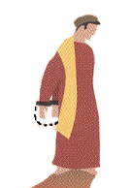


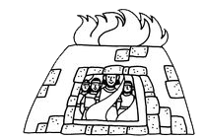
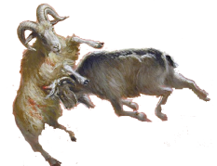

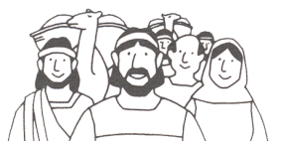

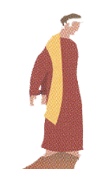
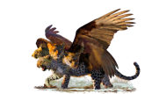
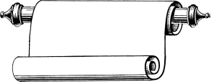
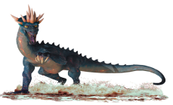


Overview
Taken
Into
Captivity
Captive
But obey
Food God’s Laws
Daniel 10:14(NKJV)
¹⁴Now I have come to make you understand what will happen to your people in the latter days, for the vision refers to many days yet to come.”
Chapter 1
Interprets
Nebuchadnezzar’s
Dream
God Controls Rise & Fall of Kingdoms
Chapter 2
Chapter 3
Fiery
Furnace
Pray to God not Objects
Interprets
Nebuchadnezzar’s
Dream
God Humbles Powerful Dynasty building Kings
Chapter 8
Chapter 4
Ram &
Goat
Chapter 5
Interprets
Writing on
The Wall
God Humbles Vain Spoiled Bad Kings
MENE, MENE,
TEKEL, UPHASSIN
Chapter 9
Prays for Return
& 70 Weeks
Return from Exile
538 BC
Chapter 6
Lion’s
Den
Pray to God not Kings
Chapter
10-12
Chapter 7
God Controls Rise & Fall of Kingdoms
Israel’s
Future
Beast from Sea

Slide 3
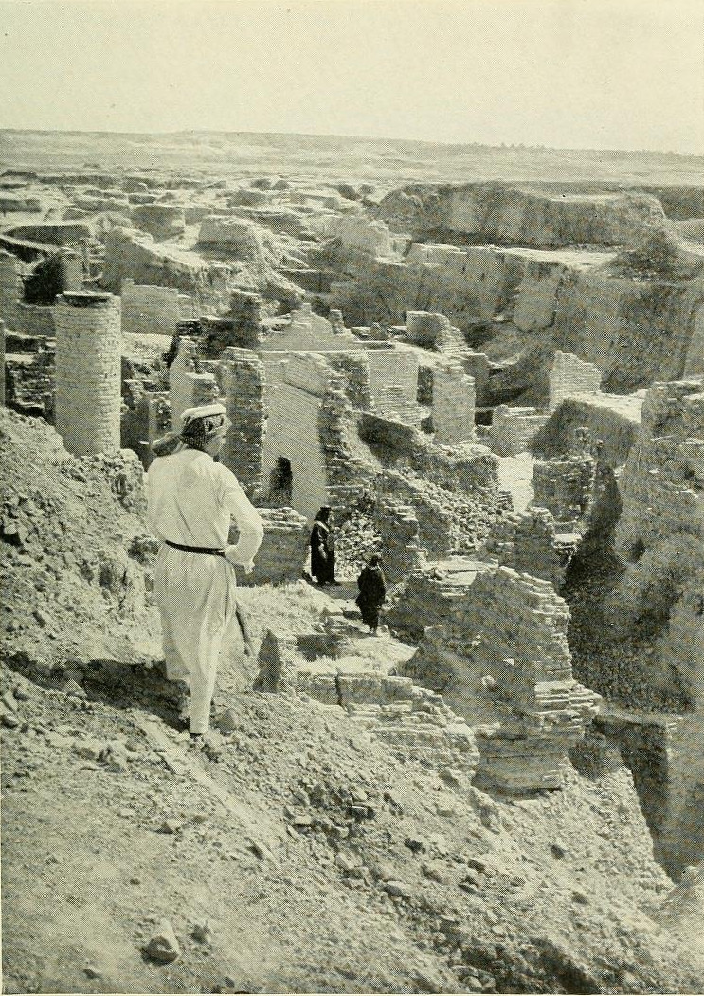
RETURN OF THE
PEOPLE
Proclamation of Cyrus – Ezra 1
Return to Land Ezra - 2:1
TEMPLE ALTAR
Jeshua the priest and Zerubbabel - Ezra 3:2
TEMPLE
Haggai , Zechariah Zerubbabel & Darius the Persian- Ezra 5-6
LAW
Ezra Sent - Ezra 7
WALLS
Nehemiah Sent - Nehemiah
KING
Daniel 2, 7, 9-12

Slide 4
Outline of Chapter 11 & 12
Chapter 11
1–4 Four Persian Kings & Alexander the Great to Come
5–20 Conflict of Greek Kings of North & South
21-35 Antiochus Epiphanes
36-45 Willful King/Roman Empire
Chapter 12
1–4 The Final Tribulation
5–13 Angel’s Final Message

Slide 5
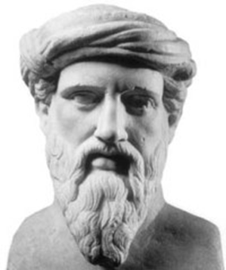
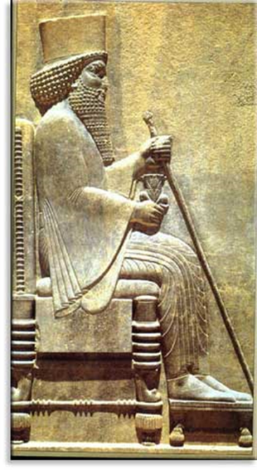
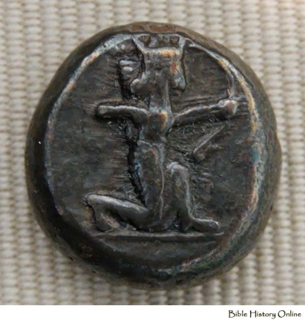
Four Persian Kings
& Alexander the Great to Come
Cambyses II
Vs 2
three more kings shall arise in Persia, and a fourth… shall stir up all against the kingdom of Greece
530-522 BC Cambyses II (conquers Egypt)
522 Bardiya (Smerdis) Imposter/Ursurper
522-486 Darius I
(490 invasion of Greece)
486-465 Xerxes I (Ahasuerus)
– 480 invasion of Greece/Esther
480/479 BC Persians defeated at Thermopylae & Salamis
Silver shekel by King Darius I,
showing King of Persia firing his bow
Xerxes I

Slide 6
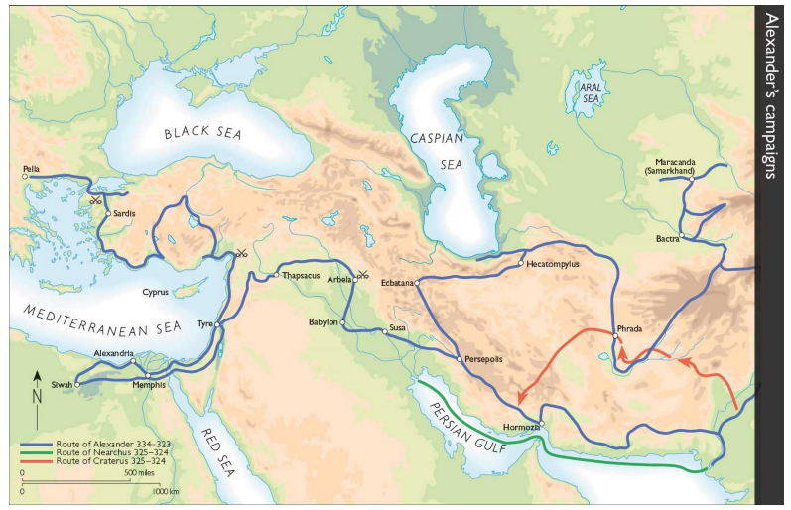
11:3
Then a mighty king shall arise, who shall rule with great dominion and do as he wills. – Alexander the Great 336-323 BC

Slide 7
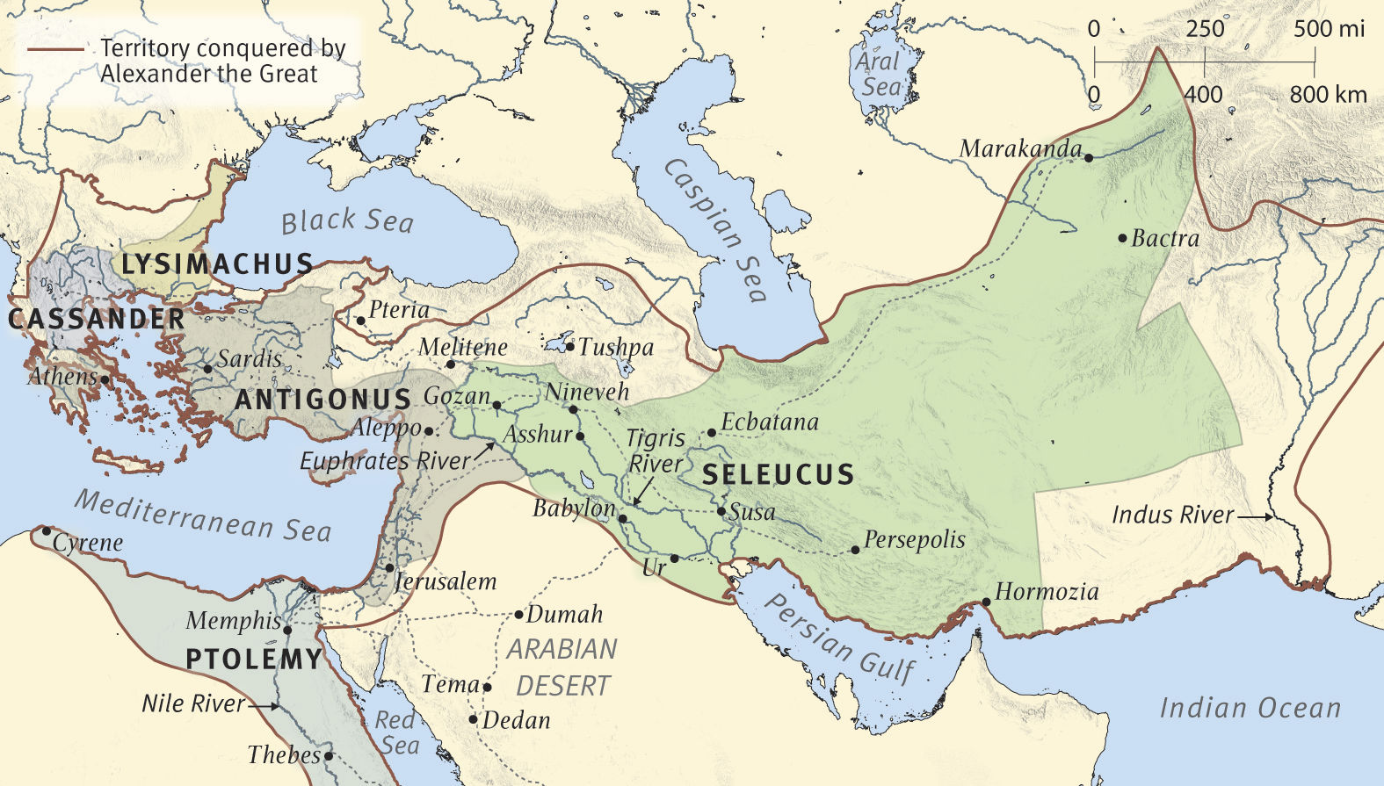
Vs 4 as soon as he has arisen, his kingdom shall be broken and divided toward the four winds of heaven
– kingdom divided 4 ways
1) Lysimachus 3) Seleucus I
2) Cassander son of Antipater 4) Ptolemy I

Slide 8
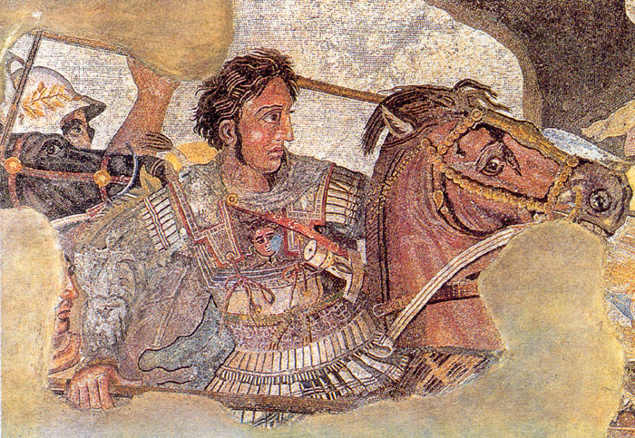
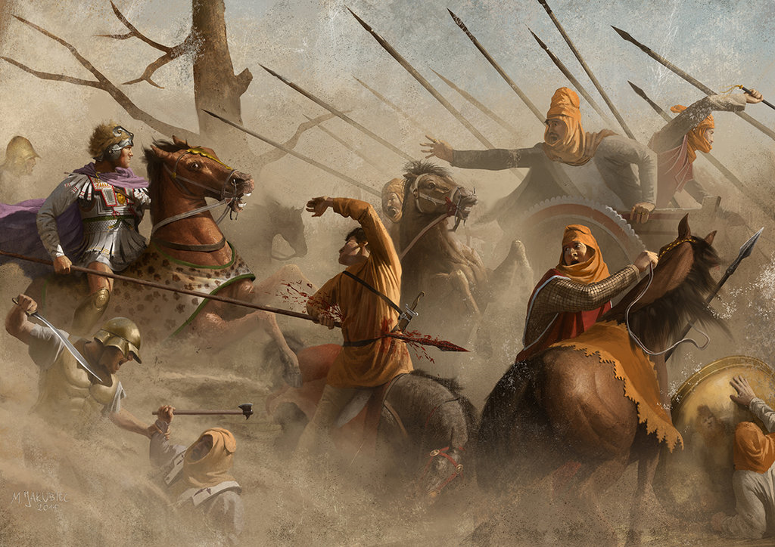
Vs 4 but not to his posterity
– Alexander’s wife & son born posthumously
son & wife murdered – 323 BC
Mary
Joseph
315 BC Maath
315 BC Zadok
290BC Naggai

Slide 9
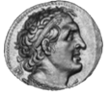
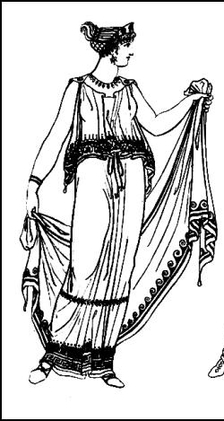
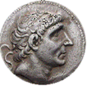
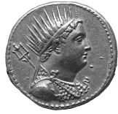
X
X
Ptolemy II
(285-246 BC)
Marries Berenice
Daughter of Ptolemy II
Ptolemy III
(246-221 BC)
Antiochus II Theos
(261-246 BC)
(246 BC)
Vs 6
After some years they shall make an alliance, and the daughter of the king of the south shall come to the king of the north to make an agreement. But she shall not retain the strength of her arm, and he and his arm shall not endure
Berenice Daughter of Ptolemy II marries
Antiochus II
but his former wife (Laodice)poisons both–
Starts 3rd Syrian War (246-241 BC)

Slide 10
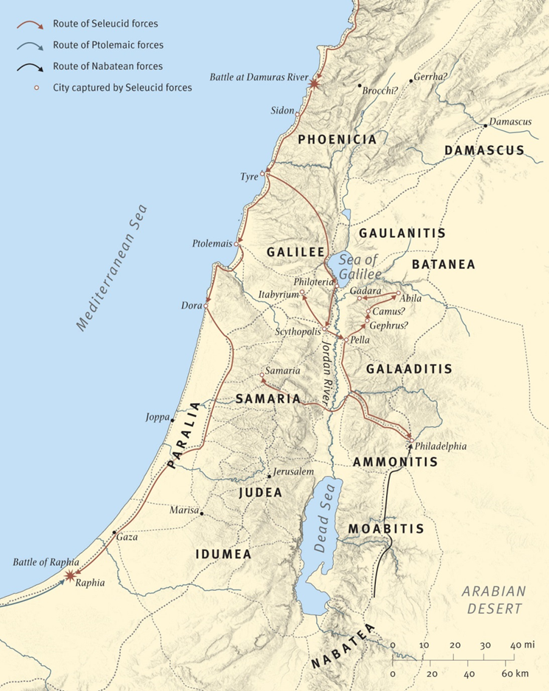
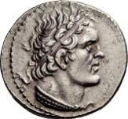
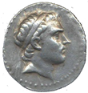
Dan 11 | Year | Event
11 | 217 | Then the king of the south, moved with rage, shall come out and fight with the king of the north. (Battle of Raphia)– Ptolemy IV defeats Antiochus III – 4th Syrian War
Mary
Joseph
215 BC Amos
225 BC Eluid
According to Polybius,
Battle of Raphia – 217 BC
Ptolemy IV had 70,000 infantry, 5,000 cavalry, and 73 war elephants
Antiochus III had 62,000 infantry, 6,000 cavalry, and 102 elephants

Slide 11
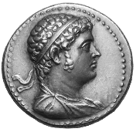
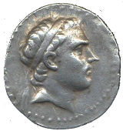
Ptolemy V
(203-181 BC)
Antiochus III
(223-187 BC)
198BC
Cleopatra I
Vs 15 Then the king of the north shall come and throw up siege works and take a well-fortified city. – Antiochus III takes Sidon
Vs 16 He shall stand in the Glorious Land with destruction in his power. & Palestine
Vs 17 He shall give him the daughter of women to destroy the kingdom, but it shall not stand or be to his advantage – Antiochus III gives daughter to Ptolemy V but she sides with husband -
Notes:
Ptolemy III Euergetes organized a campaign to avenge the murder of his sister. He captured Antioch and marched all the way to Bactria and also defeated the Seleucid navy in the Aegean, recapturing the former conquests of his father in Asia Minor.

Slide 12
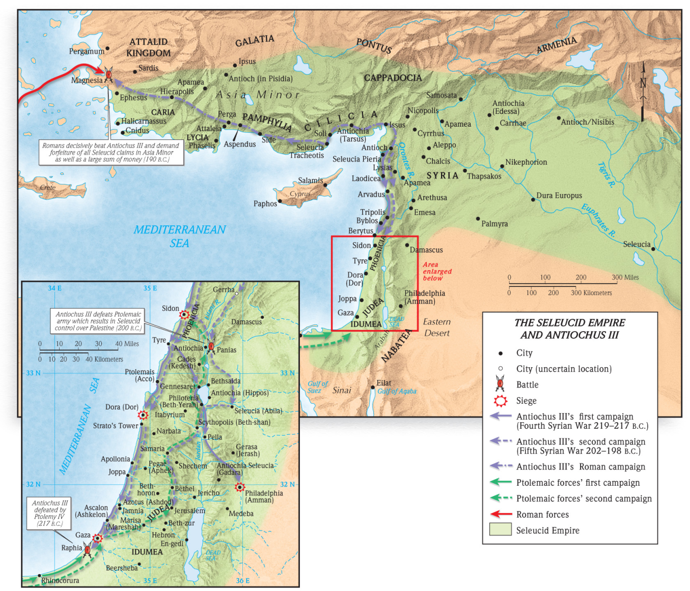
197-190 BC
Vs 18
he shall turn his face to the coastlands and shall capture many of them, but a commander shall put an end to his insolence –
Antiochus III takes Asia Minor, Thrace, Greece-defeated by Romans at Thermopylae in 191 & Lucius Scipio defeats him at Magnesium in 190
Antiochus IV
Epiphanes sent
To Rome as Ransom
Antiochus III
(223-187 BC)

Slide 13
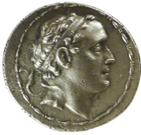
Antiochus III
(223-187 BC)
Mary
Joseph
190 BC Mattathiah
180 BC Eleazar
Vs 19
but he shall stumble and fall, and shall not be found
– Antiochus III assassinated by his own people
187 BC
Seleucus IV
(187-175 BC)
Vs 20
Then shall arise in his place one who shall send an exactor of tribute for the glory of the kingdom. But within a few days he shall be broken, neither in anger nor in battle – Seleucus IV sends Heliodorus to tax Jews & seize temple treasure to pay the Romans instead he is poisoned
Notes:
Ptolemy III Euergetes organized a campaign to avenge the murder of his sister. He captured Antioch and marched all the way to Bactria and also defeated the Seleucid navy in the Aegean, recapturing the former conquests of his father in Asia Minor.

Slide 14
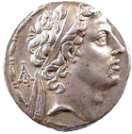
Antiochus IV Epiphanes
(175-164 BC)
Vs 21 175-164 BC
In his place shall arise a contemptible person to whom royal majesty has not been given.
Antiochus IV Epiphanes a notorious monster begins to reign.
Gave himself the surname "Epiphanes" which means "the visible god"
(that he and Jupiter were identical).
He acted as though he really were Jupiter
People called him "Epimanes" meaning "the madman".

Slide 15
Antiochus IV Epiphanes
(175-164 BC)
Vs 22 175 BC
and broken, even the prince of the covenant. – High Priest Onias II removed
Vs 23 175 BC
scattering among them plunder, spoil, and goods – Antiochus IV Epiphanes deceived Jews with many gifts

Slide 16
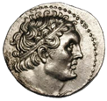
Antiochus IV Epiphanes
(175-164 BC)
Vs 25-27 175 BC
And the king of the south shall wage war with an exceedingly great and mighty army, but he shall not stand, for plots shall be devised against him. – Ptolemy VI is defeated partly by deserters
Ptolemy VI
(181-146 BC)
Vs 28 175 BC
And he shall return to his land with great wealth, but his heart shall be set against the holy covenant. And he shall work his will and return to his own land. – persecution of Jews by Antiochus IV Epiphanes

Slide 17
Antiochus IV Epiphanes
(175-164 BC)
Vs 29 168 BC
At the time appointed he shall return and come into the south, but it shall not be this time as it was before. Antiochus IV Epiphanes attacks Egypt
Ptolemy VI
(181-146 BC)
Vs 30 168 BC
For ships of Kittim shall come against him, and he shall be afraid and withdraw, and shall turn back and be enraged and take action against the holy covenant. Roman envoy orders Antiochus to turn back
Gaius Popillius Laenas, a representative of Rome, met with Antiochus IV and ordered him out of Egypt on the authority of Rome.

Slide 18
Antiochus IV Epiphanes
(175-164 BC)
Vs 31 167 BC
Forces from him shall appear and profane the temple and fortress, and shall take away the regular burnt offering. And they shall set up the abomination that makes desolate. Temple desecrated
Stopped the regular temple sacrifices
Set up a statue of Zeus in the temple whose features were made to resemble him
Offered a pig on its altar
Prohibited Temple worship
Forbade circumcision on pain of death
Sold thousands of Jewish families into slavery
Destroyed all copies of Scripture found &slaughtered everyone in possession of copies Resorted to every conceivable torture to force Jews to renounce their religion.
Vs 32-35 166 -37 BC
but the people who know their God shall stand firm and take action. – Maccabees

Slide 19
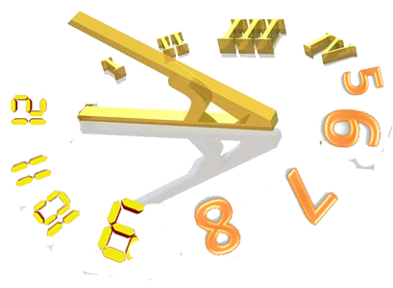
A Radical Different World in A Fullness of Time
Radical Changes | Old Testament | New Testament
Worship
Teachers
Jerusalem
Factions
Political
Language
Land of Israel
Worldview
Temple
Synagogue
Priest
Scribes
Cities in Ruins
Densely populated
Sadducees
Pharisees
Zealots
Self-rule
Roman Rulers
Hebrew/
Aramaic
Aramaic/ Greek
Southern Kingdom
Judea/Samaria & Galilee
Eastern
Western

Slide 20
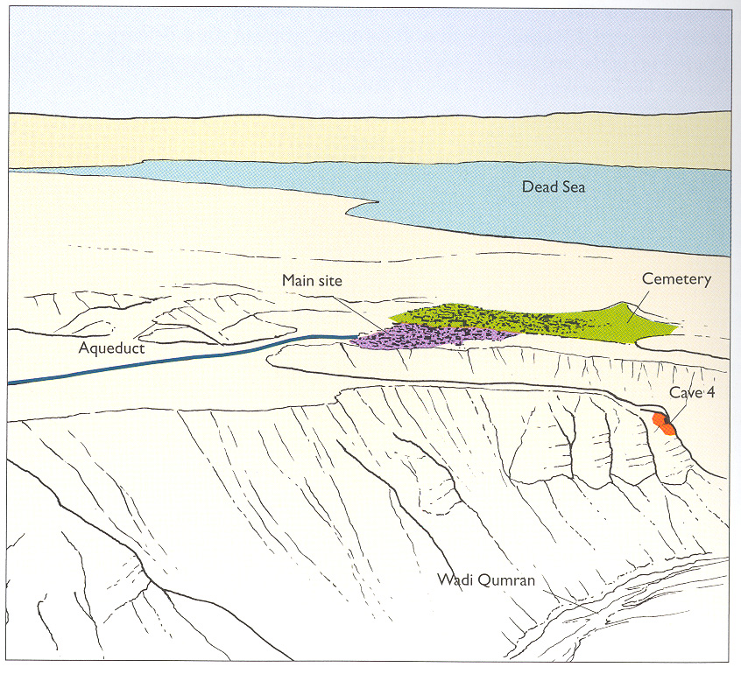
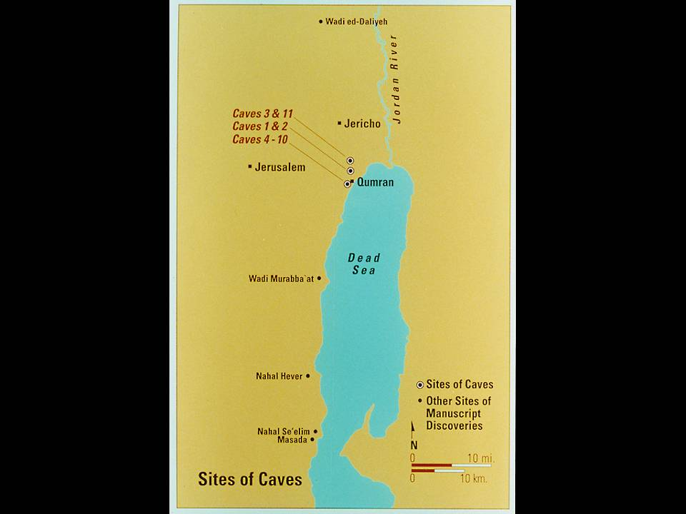
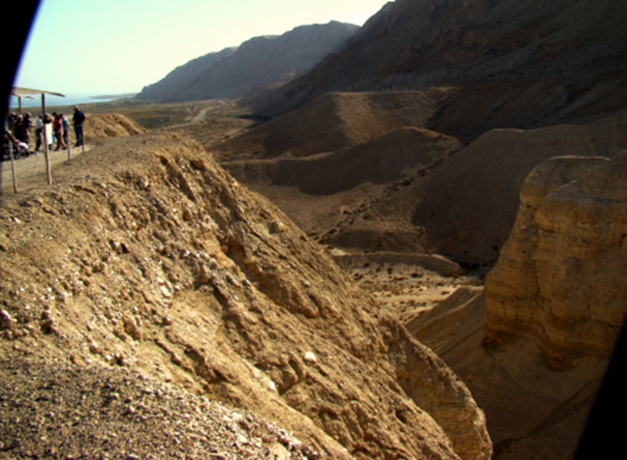
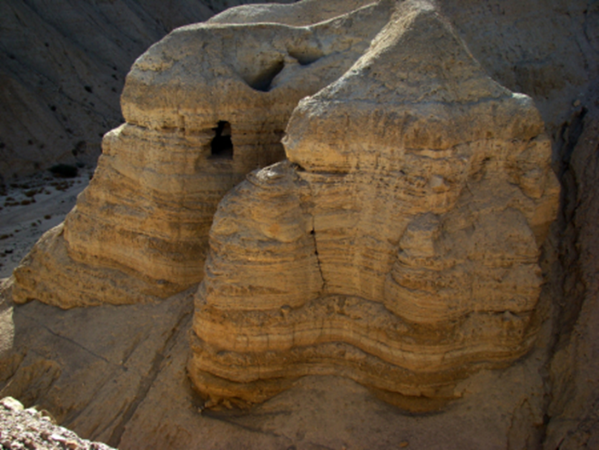
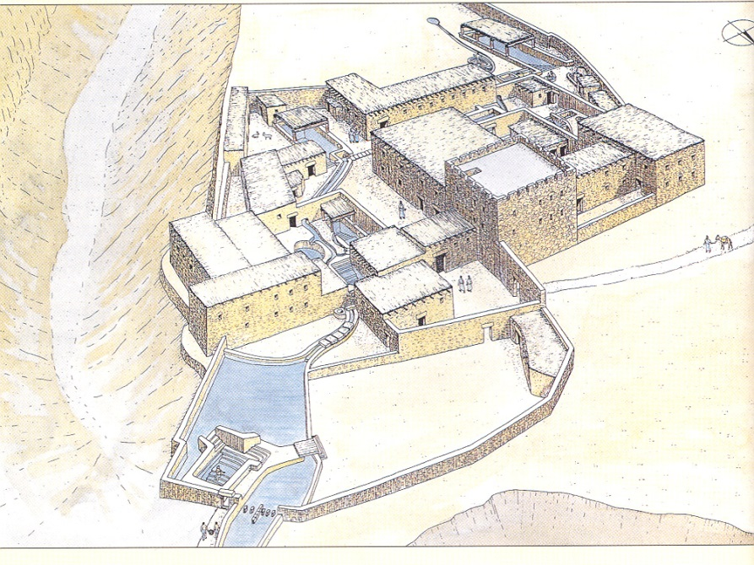
Qumran – Essences/Caves/
Dead Sea Scrolls
Notes:
This map of the northwest Dead Sea shore shows the location of the 11 caves in which written materials were found between 1947 and 1956.
The sequence of the finds was as follows: Cave 1, about one-half mile north of Khirbet Qumran, was discovered early in 1947 by Bedouin shepherds and initially yielded seven Dead Sea Scrolls (see Slides 23-29). Scholars in the joint expedition mounted by the Jordanian Department of Antiquities investigated Cave 1 in 1949 and found 72 additional scroll fragments, some belonging to the initial seven scrolls.
Cave 2, also in the northern cliffs, was discovered by Bedouin in 1952; 18 fragments of Hebrew biblical texts were found in this cave, along with 15 portions of nonbiblical writings.
Later that year, Cave 3 was found by joint expedition members with assistance from the American School of Oriental Research in Jerusalem. The team was conducting a systematic survey of caves in the region, prompted by discovery of Cave 2. The famous Copper Scroll was found in Cave 3 (see Slides 93-96), as well as 14 fragments of leather scrolls (three biblical and 11 nonbiblical).
Caves 4 and 5 were closest to the community buildings of Khirbet Qumran and were discovered after excavations had begun at the settlement. Cave 4 was discovered in 1952 by Bedouin. Why it wasn’t found by the archaeologists excavating a few hundred yards away remains a mystery. But they had confined their search to the limestone cliffs above the settlement, ignoring the caves in the marl terrace below. Why didn’t they explore the lower caves? Frank Cross, a noted Dead Sea Scrolls scholar (see Slide 78), suggests they may have suffered from heat, malaria or simple fatigue. In any event, after 80 percent of the more than 500 fragmentary scrolls found in this cave had been recovered by Bedouin, the professional archaeologists came across the clandestine excavation and systematically completed the work. At the same time, the expedition members found Cave 5, directly west of Cave 4. These caves will be described in more detail in connection with Slides 65-69.
Cave 6 was discovered by the Bedouin before they found Cave 4. Cave 6 is located on the south wall of the entrance to Wadi Qumran, between the limestone cliffs and the marl terrace. The discovery of Cave 6 in this area led the Bedouin to the terrace and Cave 4. Fragments of seven biblical and twenty-four nonbiblical texts were found in Cave 6. But these fragments did not add anything of significance to the other finds, although parts of the important text known as the Damascus Document were among them.
Caves 7-10 were located during the 1955 season by joint expedition members making a systematic survey of caves along the edge of the cliffs stretching north from Qumran. Cave 7 yielded only 19 small fragments, but, surprisingly, they were all written in Greek. Two of the fragments were identified as Greek translations of Hebrew biblical texts. The remaining pieces are so small that scholars have not been able to agree on their identification, although claims have been made that some are fragments of New Testament documents (see Slide 112). Cave 7 also yielded the text known as the Letter of Jeremiah. Caves 8-10 provided only modest remains (although their discovery would have created a sensation before the discovery of other Dead Sea Scrolls). Cave 8 was probably a scroll workshop. Hundreds of tabs were found in this cave, which, according to one theory, were intended to secure the leather thongs that were wrapped around the scrolls. Cave 8 also contained fragments of four biblical texts (one the size of a phylactery text and one the size of a mezuzah text) and one nonbiblical text. Cave 9 yielded only one small scroll fragment. Cave 10 held only one ostracon, a potsherd with two Hebrew characters written on it.
Cave 11 was found in 1956 by Bedouin, near the northern limits of the scroll caves, and was investigated the same year by members of the expedition team. This cave contained the most important scroll discoveries after Caves 1 and 4. Besides a number of small fragments, the famous Temple Scroll, which is the longest scroll and the only complete copy of this previously unknown document in the Qumran library (see Slides 98-101), was found in Cave 11. There were also three other scrolls there, each interesting in its own right—a Targum (a translation into Aramaic) of Job, a psalms scroll and a copy of Leviticus in paleo-Hebrew (the Hebrew script used before the Babylonian conquest).
Meanwhile, some 26 other caves were found in this same area that showed signs of habitation during the period of the Qumran community. Some of them yielded Qumran-type pottery (see Slide 14).

Slide 21
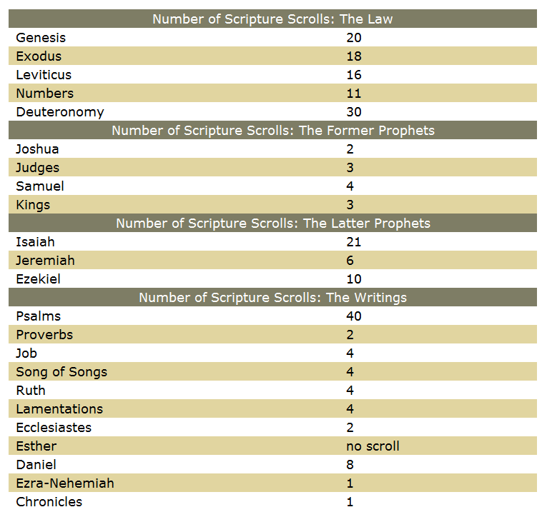

Slide 22
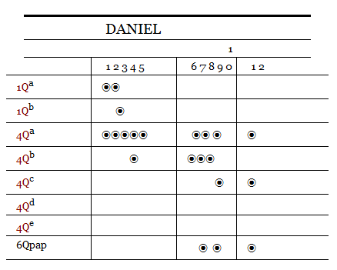
Daniel & Dead Sea Scrolls
125 BC-50 AD
125 BC-50 AD
75-25 BC
30 BC-50 AD
Observe: no Aprocrypha later than Antiochus IV Epiphanes (~168 BC) in Dead Sea Scrolls
150-75 BC
30-68 AD
150 BC-75 AD
50 AD
A manuscript of Daniel dating about 120 B.C. brings into question the alleged Maccabean date of its composition. - Leon Mauldin

Slide 23
Willful King/Roman Empire
Vs 36-39 37 BC to 4 AD
He shall honor the god of fortresses instead of these. A god whom his fathers did not know he shall honor with gold and silver, with precious stones and costly gifts. – Herod the Great
Or Romans
Vs 40-43 31 BC
He shall stretch out his hand against the countries, and the land of Egypt shall not escape. – Cleopatra & Marc Anthony defeated by Augustus

Slide 24
Willful King/Roman Empire
Vs 44 31 BC
But news from the east and the north shall alarm him, and he shall go out with great fury to destroy and devote many to destruction.
– Parthians=East & Gauls = North
Vs 45 14 AD
he shall pitch his palatial tents between the sea and the glorious holy mountain. Yet he shall come to his end, with none to help him
– death of Augustus

Slide 25
The Final Tribulation
Daniel 12:1 (ESV)
1 “At that time shall arise Michael, the great prince who has charge of your people. And there shall be a time of trouble, such as never has been since there was a nation till that time. But at that time your people shall be delivered, everyone whose name shall be found written in the book.
Daniel 12:1 (NIV)
1 "At that time Michael, the great prince who protects your people, will arise. There will be a time of distress such as has not happened from the beginning of nations until then. But at that time your people--everyone whose name is found written in the book--will be delivered.
Daniel 12:1 (NKJV)
1 "At that time Michael shall stand up, The great prince who stands watch over the sons of your people; And there shall be a time of trouble, Such as never was since there was a nation, Even to that time. And at that time your people shall be delivered, Every one who is found written in the book.
Daniel 12:1(NKJV)
¹ “At that time Michael shall stand up,
The great prince who stands watch over the sons of your people;
And there shall be a time of trouble,
Such as never was since there was a nation,
Even to that time.
And at that time your people shall be delivered,
Every one who is found written in the book.
70 AD
ESV-who has charge
NIV- who protects your people
Malachi 3:16(NKJV)
¹⁶ Then those who feared the Lord spoke to one another,
And the Lord listened and heard them;
So a book of remembrance was written before Him
For those who fear the Lord
And who meditate on His name.

Slide 26
The Final Tribulation
Daniel 12:1 (ESV)
1 “At that time shall arise Michael, the great prince who has charge of your people. And there shall be a time of trouble, such as never has been since there was a nation till that time. But at that time your people shall be delivered, everyone whose name shall be found written in the book.
Daniel 12:1 (NIV)
1 "At that time Michael, the great prince who protects your people, will arise. There will be a time of distress such as has not happened from the beginning of nations until then. But at that time your people--everyone whose name is found written in the book--will be delivered.
Daniel 12:1 (NKJV)
1 "At that time Michael shall stand up, The great prince who stands watch over the sons of your people; And there shall be a time of trouble, Such as never was since there was a nation, Even to that time. And at that time your people shall be delivered, Every one who is found written in the book.
Daniel 12:1(NKJV)
¹ “At that time Michael shall stand up,
The great prince who stands watch over the sons of your people;
And there shall be a time of trouble,
Such as never was since there was a nation,
Even to that time.
And at that time your people shall be delivered,
Every one who is found written in the book.
70 AD
Matthew 24:15 (NKJV)
¹⁵“Therefore when you see the ‘abomination of desolation,’ spoken of by Daniel the prophet [Dan 11:,13 12:1], standing in the holy place” (whoever reads, let him understand),

Slide 27
The Final Tribulation
Daniel 12:1(NKJV)
¹ “At that time Michael shall stand up,
The great prince who stands watch over the sons of your people;
And there shall be a time of trouble,
Such as never was since there was a nation,
Even to that time.
And at that time your people shall be delivered,
Every one who is found written in the book.
Matthew 24:21-22(NKJV)
²¹For then there will be great tribulation, such as has not been since the beginning of the world until this time, no, nor ever shall be.
²²And unless those days were shortened, no flesh would be saved; but for the elect’s sake those days will be shortened.

Slide 28
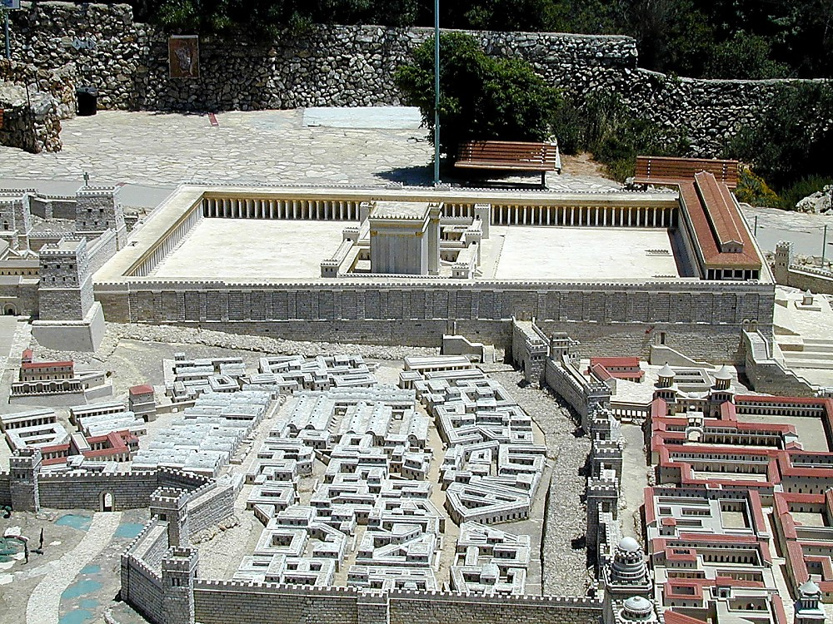
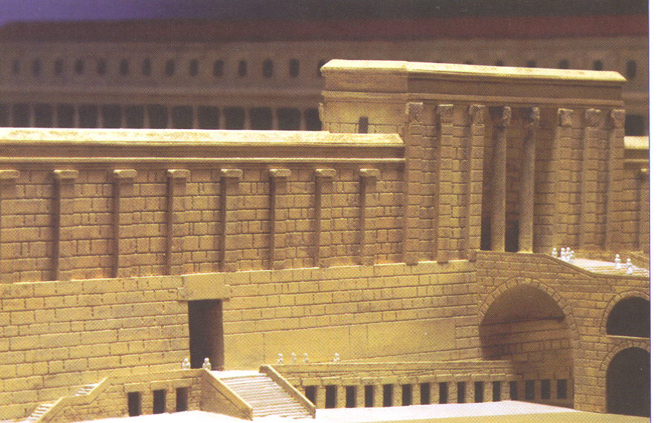

Temple Mount from west
Matthew 24:1-2(NKJV)
¹Then Jesus went out and departed from the temple, and His disciples came up to show Him the buildings of the temple.
²And Jesus said to them, “Do you not see all these things? Assuredly, I say to you, not one stone shall be left here upon another, that shall not be thrown down.”
Temple Mount from west
Notes:
The red arrow and smooth stones show the Western Wall prayer area of today.

Slide 29
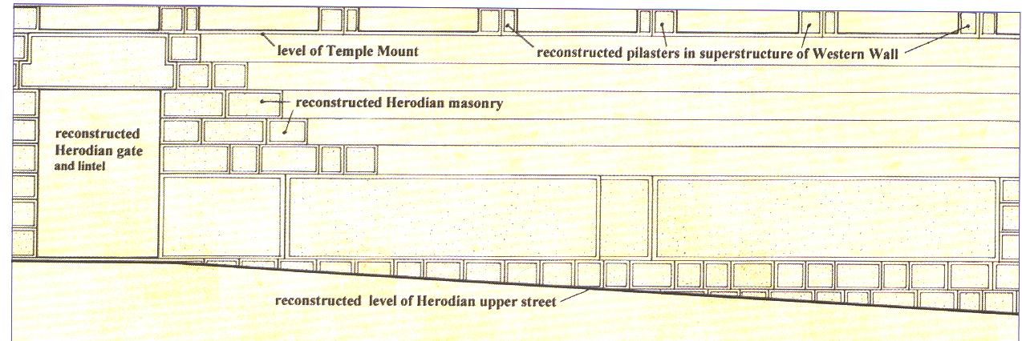
Master Course Stones
10’6”
39’8”
44’2”
570 tons

Slide 30
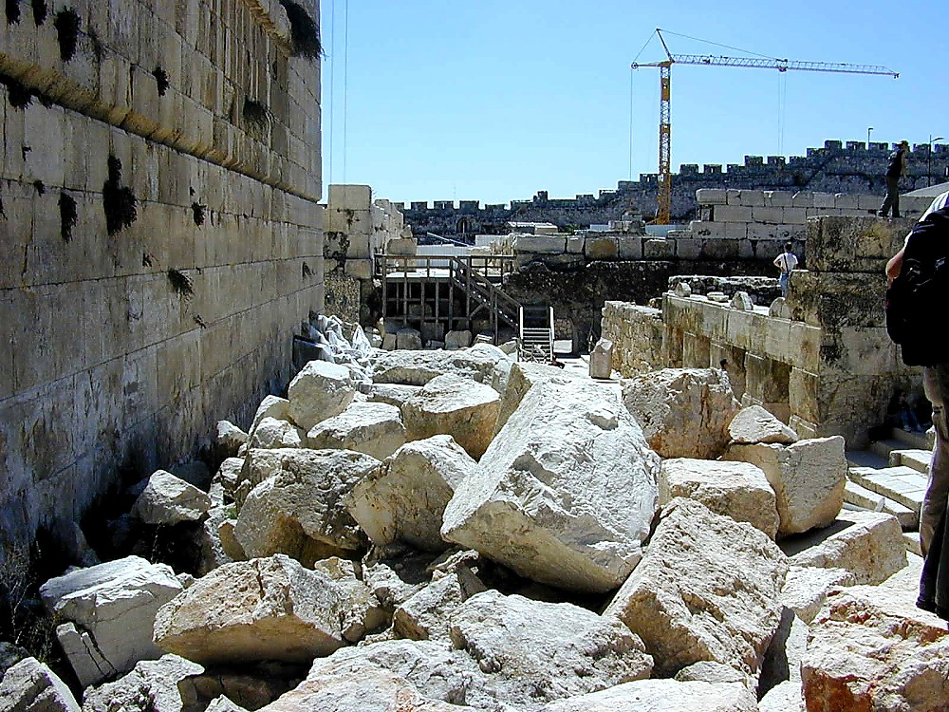
Stones fallen from Western Wall
Stones fallen from Western Wall
Matthew 24:2(NKJV)
²And Jesus said to them, “Do you not see all these things? Assuredly, I say to you, not one stone shall be left here upon another, that shall not be thrown down.”
Matthew 24:3(NKJV)
³Now as He sat on the Mount of Olives, the disciples came to Him privately, saying, “Tell us, when will these things be? And what will be the sign of Your coming, and of the end of the age?”

Slide 31
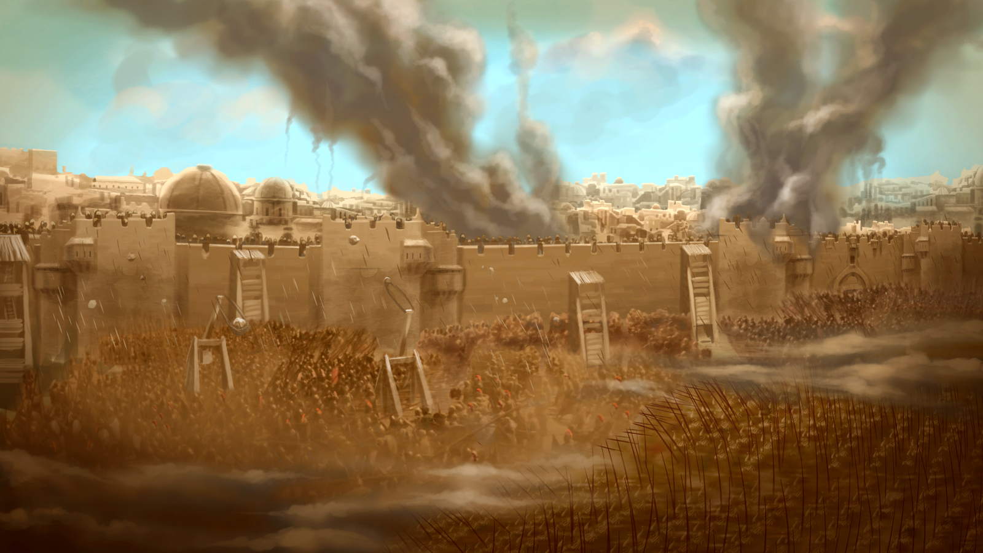
Destruction of Jerusalem
Daniel 12 The Final Tribulation = Destruction of Jerusalem by Romans in 70 AD

Slide 32
The Final Tribulation
Daniel 12:2-3(NKJV)
² And many of those who sleep in the dust of the earth shall awake,
Some to everlasting life,
Some to shame and everlasting contempt.
³ Those who are wise shall shine
Like the brightness of the firmament,
And those who turn many to righteousness
Like the stars forever and ever.
Many does not equal all
Thus a different resurrection
John 5:28-29(NKJV)
²⁸Do not marvel at this; for the hour is coming in which all who are in the graves will hear His voice ²⁹and come forth—those who have done good, to the resurrection of life, and those who have done evil, to the resurrection of condemnation.

Slide 33

Ezekiel 37:11-14(ESV) ¹¹Then he said to me, “Son of man, these bones are the whole house of Israel. Behold, they say, ‘Our bones are dried up, and our hope is lost; we are clean cut off.’ ¹²Therefore prophesy, and say to them, Thus says the Lord God: Behold, I will open your graves and raise you from your graves, O my people. And I will bring you into the land of Israel. ¹³And you shall know that I am the Lord, when I open your graves, and raise you from your graves, O my people. ¹⁴And I will put my Spirit within you, and you shall live, and I will place you in your own land. Then you shall know that I am the Lord; I have spoken, and I will do it, declares the Lord.”

Slide 34
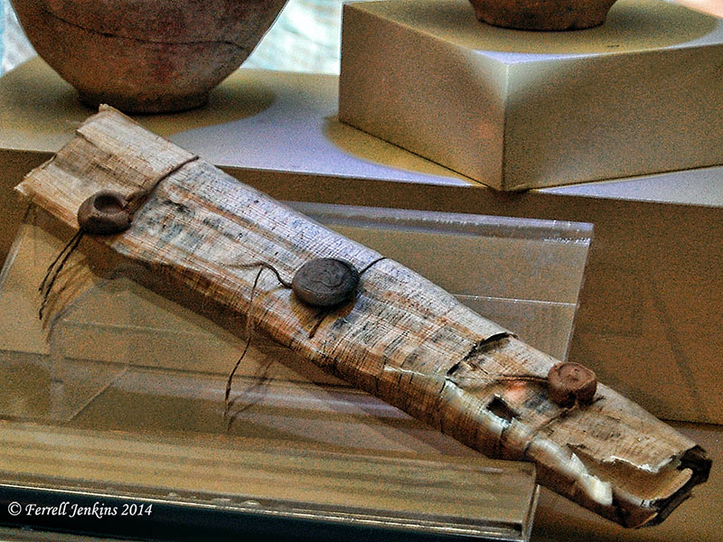
Angel’s Final Message
Daniel 12:4(NKJV)
⁴“But you, Daniel, shut up the words, and seal the book until the time of the end; many shall run to and fro, and knowledge shall increase.”

Slide 35
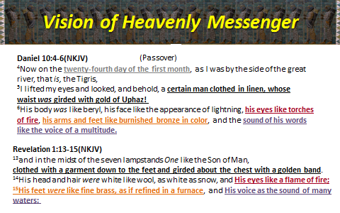
Angel’s Final Message
Daniel 12:5-7(NKJV)
⁵Then I, Daniel, looked; and there stood two others, one on this riverbank and the other
on that riverbank.
⁶And one said to the man clothed in linen, who was above the waters of the river,
“How long shall the fulfillment of these wonders be?”
⁷Then I heard the man clothed in linen,
who was above the waters of the river, when he held up his right hand and his left hand to heaven, and swore by Him who lives forever, that it shall be for a time, times, and half a time; and when the power of the holy people has been completely shattered, all these things shall be finished.
70 AD Destruction of Jerusalem
End of time
End of Jewish system
End of Rome
Other

Slide 36
Angel’s Final Message
Daniel 12:8-12(NKJV)
⁸Although I heard, I did not understand. Then I said,
“My lord, what shall be the end of these things?”
⁹And he said, “Go your way, Daniel, for the words are closed up and sealed till the time of the end.
¹⁰Many shall be purified, made white, and refined,
but the wicked shall do wickedly;
and none of the wicked shall understand,
but the wise shall understand.
¹¹“And from the time that the daily sacrifice is taken away, and the abomination of desolation is set up, there shall be one thousand two hundred and ninety days.
¹²Blessed is he who waits, and comes to the one thousand three hundred and thirty-five days.
Matthew 24:15 (NKJV)
¹⁵“Therefore when you see the ‘abomination of desolation,’ spoken of by Daniel the prophet [Dan 11:,13 12:1], standing in the holy place” (whoever reads, let him understand),
About 3.5 yrs
45 more days

Slide 37
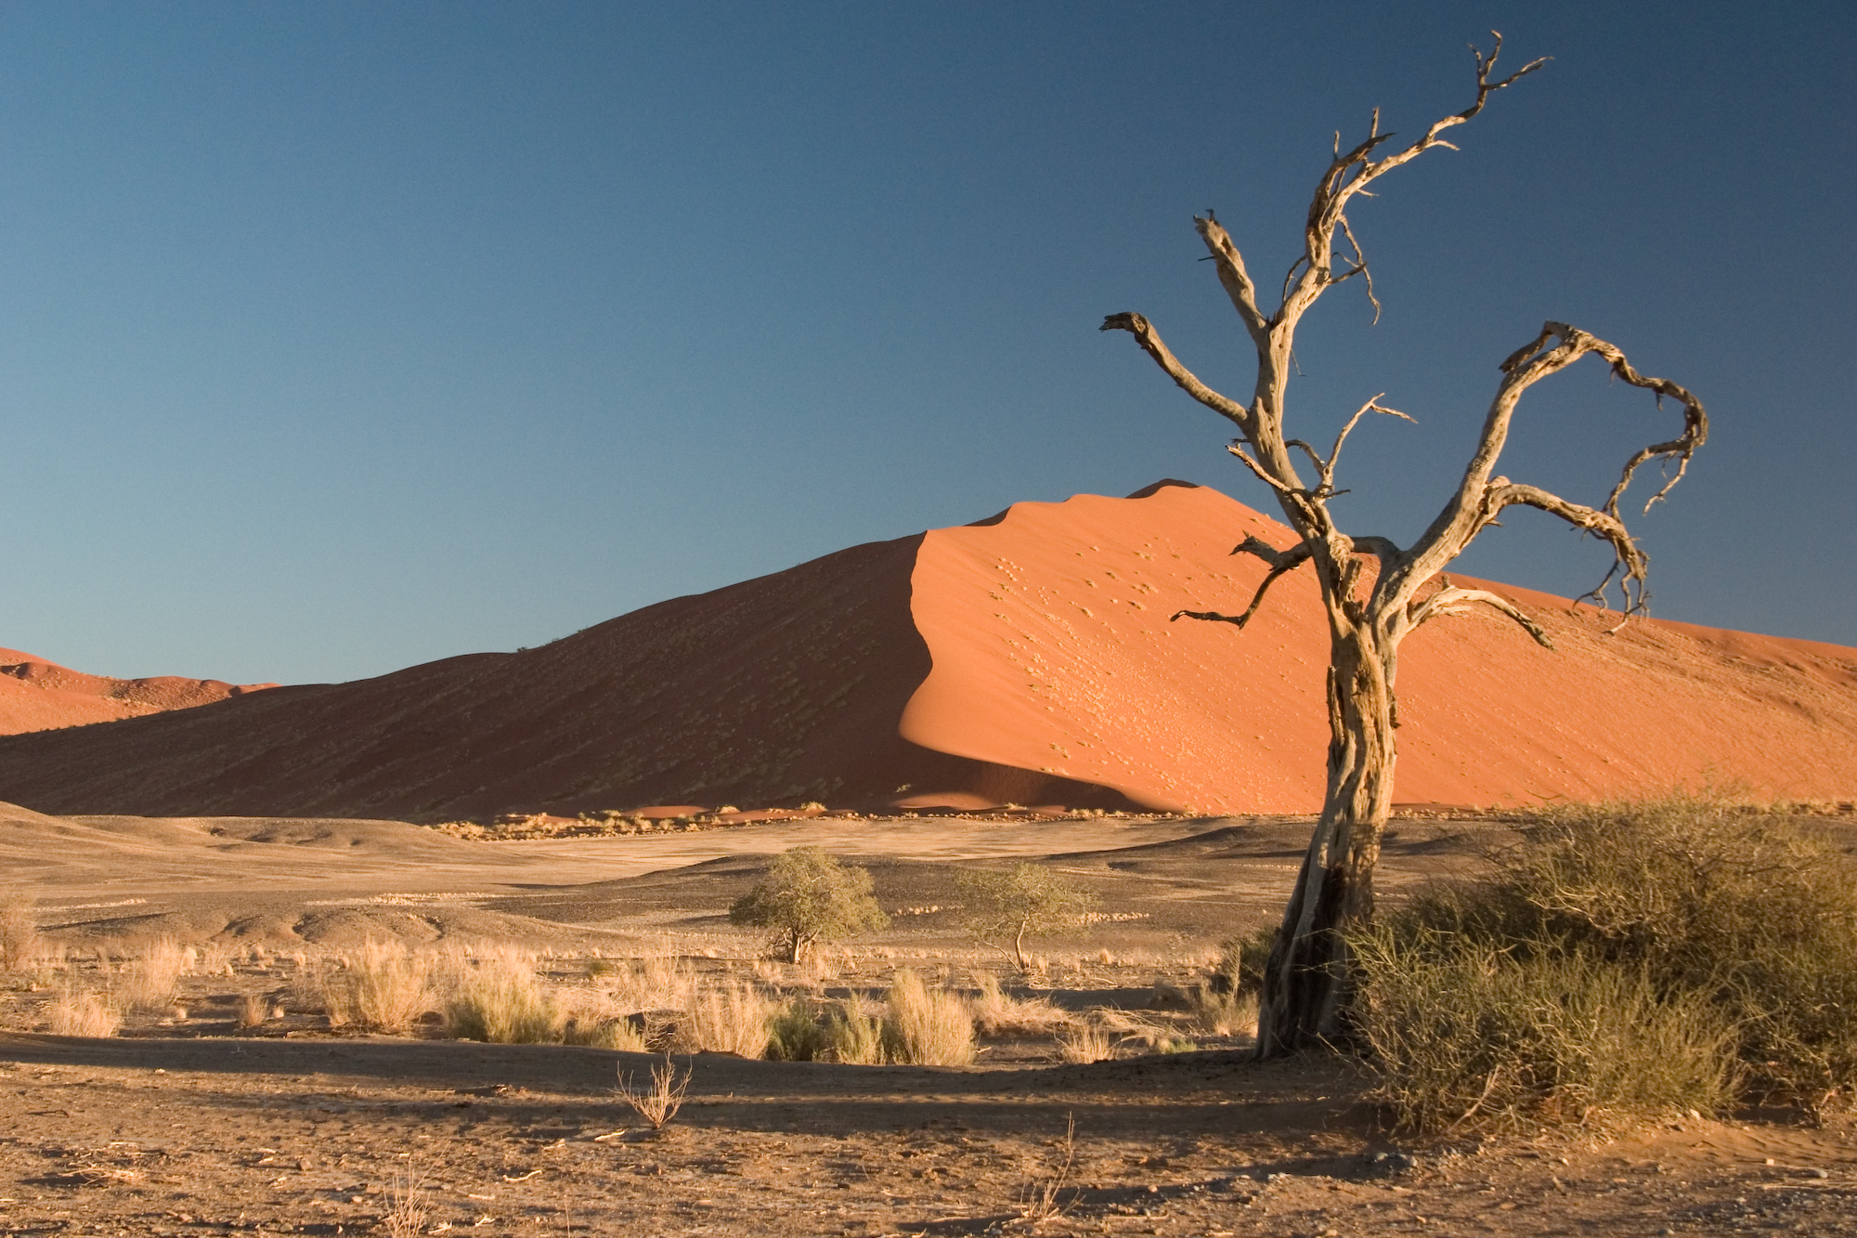
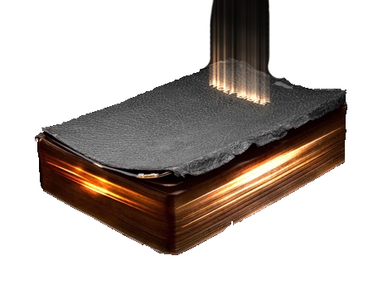
“The Silent Years”
The Intertestamental Period
Book of Daniel a Survival Guide
Daniel 12:13(NKJV)
¹³“But you, go your way till the end; for you shall rest, and will arise to your inheritance at the end of the days.”

Slide 38
Angel’s Final Message
Daniel 12:13(NKJV)
¹³“But you, go your way till the end; for you shall rest, and will arise to your inheritance at the end of the days.”
Stories of Faith
God’ Rules in Kingdom of Men
Power of Prayer
A True Prophet
Evidence of God & Validity of Bible

