Slide 1
Study of Daniel (Lesson 9 – Chapter 8)
Fall 2015
Online
Materials

Slide 2
Class Exercise for Lesson 9
4. List similarities in the two chapters
___________________________________________
___________________________________________
___________________________________________
___________________________________________
___________________________________________
___________________________________________
___________________________________________
___________________________________________
5. List differences in the two chapters
___________________________________________
___________________________________________
___________________________________________
___________________________________________
___________________________________________
___________________________________________
___________________________________________
___________________________________________
___________________________________________
___________________________________________
List the events in the vision of chapter 7
______________________________ (2-4,17)
______________________________ (5)
______________________________ (6)
______________________________ (7,19,23-24a)
______________________________ (8,20-21,24b-25)
______________________________ (9-10)
______________________________ (11-12,26)
______________________________ (13-14,18,22,27)
List the events in the vision of chapter 8
______________________________ (3,4,20)
______________________________ (5-7,21)
______________________________ (8,22)
______________________________ (9)
______________________________ (10-14,23-25)
______________________________ (25d)

Slide 3
Class Exercise for Lesson 9
4. List similarities in the two chapters
___________________________________________
___________________________________________
___________________________________________
___________________________________________
___________________________________________
___________________________________________
___________________________________________
___________________________________________
5. List differences in the two chapters
___________________________________________
___________________________________________
___________________________________________
___________________________________________
___________________________________________
___________________________________________
___________________________________________
___________________________________________
___________________________________________
___________________________________________
List the events in the vision of chapter 7
________________________________ (2-4,17)
________________________________ (5)
________________________________ (6)
________________________________ (7,19,23-24a)
________________________________ (8,20-21,24b-25)
________________________________ (9-10)
________________________________ (11-12,26)
________________________________ (13-14,18,22,27)
List the events in the vision of chapter 8
________________________________ (3,4,20)
________________________________ (5-7,21)
________________________________ (8,22)
________________________________ (9)
________________________________ (10-14,23-25)
________________________________ (25d)
1st Beast (lion)
2nd Beast (bear)
3rd Beast (leopard)
4th Beast (ugly)
OPEN BOOK!
Little, loud horn
Ancient of Days judges
Beasts/horns destroyed
Eternal Kingdom Estab.
Ram pushing from East
Goat from W. destroys Ram
1 horn broken, 4 replace it
Little horn from 1 of 4 horns
Little horn persecutes saints
Little horn destroyed

Slide 4
Cycle of Visions
1
2
3
4
5
6
7
8
9
10
11
12
Mighty
Metallic
Man
Four
Beasts
Seventy
Weeks
1
Gold⁴
1
Lion⁴
2
Silver
2
Bear⁵
Ram³
(Intro)
3 more Kings²
3
Bronze
3
Leopard⁶
He-Goat⁸
Kings of N&S⁶
Fierce King²³
Vile Person²¹
4
Iron/clay
4
(ugly)⁷
[evil] King³⁶
Stone³⁴
Son of Man¹³
Messiah²⁵
time of
trouble¹, time of the end⁴

Slide 5
1445-1405 BC
Wilderness
Wanderings
931-722 BC
Divided
Kingdom
605-538 BC
Babylonian
Captivity
444 BC - ~4 BC
The Silent Years
(Intertestamental)
30-90 AD
The Church
NT Era
2166-1859 BC
Patriarchs
1300-1050 BC
Judges
Slavery in Egypt
1859-1445 BC
Conquest
of Canaan
1405-1300 BC
United
Kingdom
1050-931 BC
Life of
Christ
4 BC – 30 AD
United
Kingdom
1050-931 BC
Judah
Alone
722-605 BC
Return
From Exile
538-444 BC
597 BC
2nd Captives
Ezekiel
605 BC
1st Captives
Daniel
586 BC
Fall of
Jerusalem
539BC
Fall of
Babylon
538 BC
1st Return from Exile
562-560 BC
556-539 BC
Evil-Merodach
Nabonidus
Nebuchadnezzar
Neriglassar
Belshazzar
Cyrus the Great
Darius the Mede
605-562 BC
560-556 BC
553-539 BC
539-530 BC
Daniel 1
605-603 BC
Daniel 2
603 BC
Daniel 3
603-587? BC
Daniel 4
? BC
Daniel 5-6
539 BC
Daniel 7
553 BC
Daniel 8
551 BC
Daniel 9
539 BC
Daniel 10-12
536 BC
Based on Graphics from Marc Hinds & David Maxson
Notes:
With animation

Slide 6
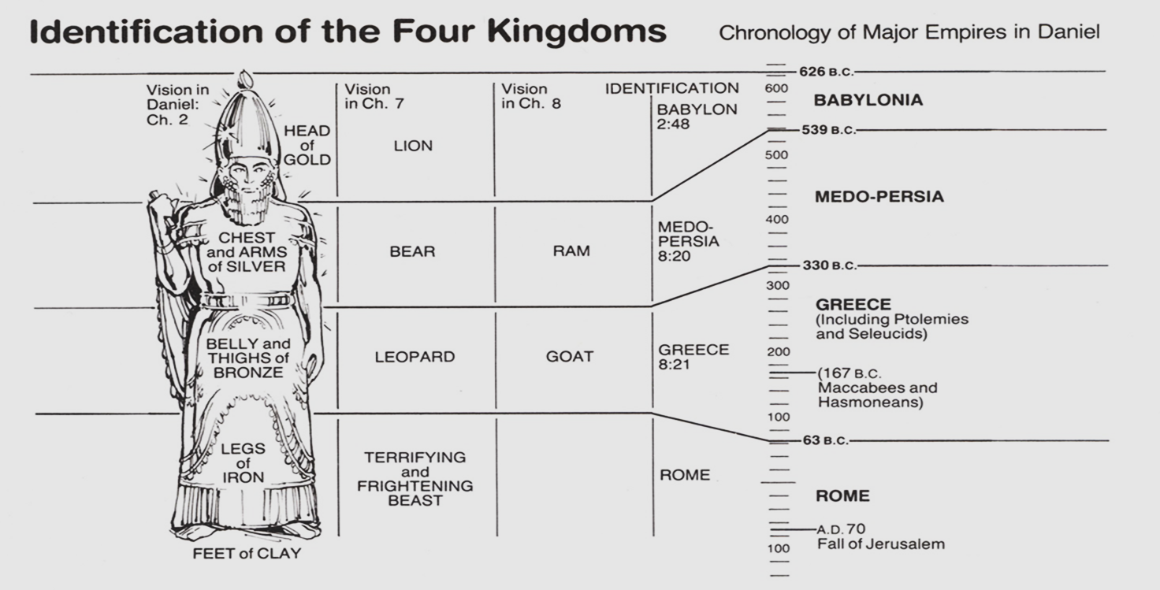
Visions of Kingdoms - Daniel
7
8
400 yrs
600 yrs

Slide 7
Outline of Chapter 8
Time & place of the vision(1-2)
The [2nd] Vision (3-14)
The Ram (3-4)
The Goat (5-8)
He Little Horn (9-12)
The time of the loss of sacrifice (13-14)
The Interpretation (15-26)
The interpreters (15-18)
The identities (19-25)
The Times (26)
Daniel’s reaction to the vision (27)

Slide 8
“Characters” in Chapter 8
Vision
Ram (2 horns)
He-Goat, with a…
Prominent Horn
4 Lesser Horns (toward 4 winds)
Little Horn (out of 1 of the 4 horns)
Interpretation
Medo-Persia (20)
Greece (21)
1st King of Greece (21)
4 lesser kingdoms in place of 1st King of Greece (22)
Persecutor of the holy land & people, against God & Truth

Slide 9
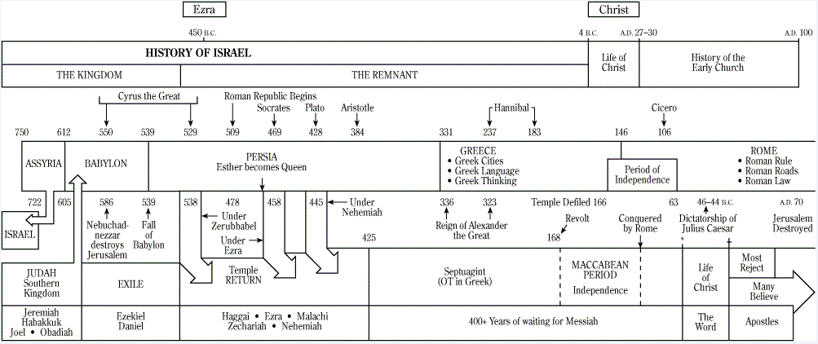
Timeline (not to scale)
RAM
Goat great horn
little horn
4 horns

Slide 10
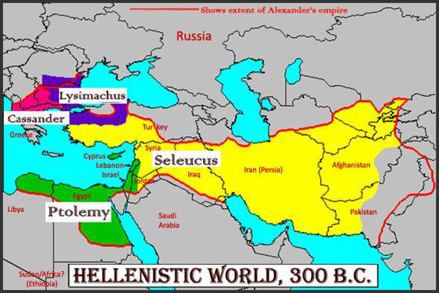
The Four Horns – Daniel 8

Slide 11
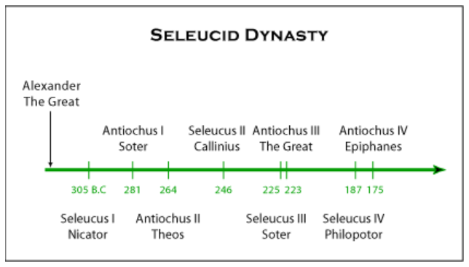
Seleucid Dynasty

Slide 12
Chapter 7 & 8 Comparisons
Similarities
Differences
Visions in Belshazzar’s reign
Animals & (lots of) Horns
Animals are (become) Kings
A parallel heavenly story
God provides interpretation
A little horn persecutes ‘saints’
Questions about one detail
All kingdoms end (except…)
Daniel troubled by the visions
7 – Four Beasts (parallel to chap 2) 8 – Two Beasts (M-P & Greece)
7 – No reference to geography 8 – Geographical (incl. ‘glorious land’)
7 – Concludes with Eternal Kingdom 8 – No Eternal Kingdom
7 – Little horn from 4th kingdom 8 – Little horn from 2nd Kingdom
7 – No guilt in persecuted saints 8 – Persecution due to transgression

Slide 13
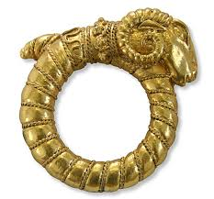
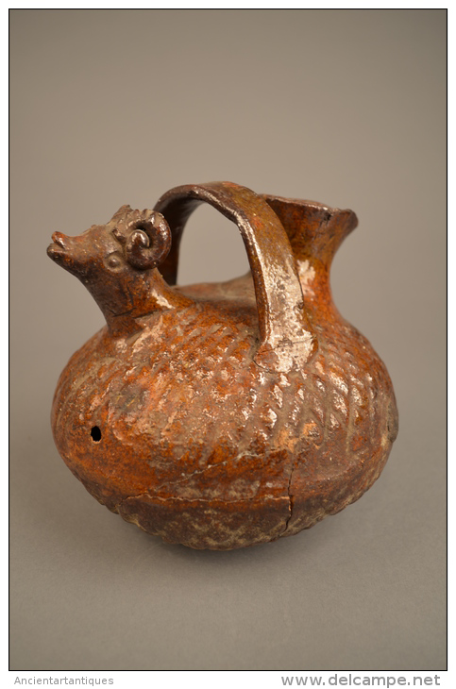
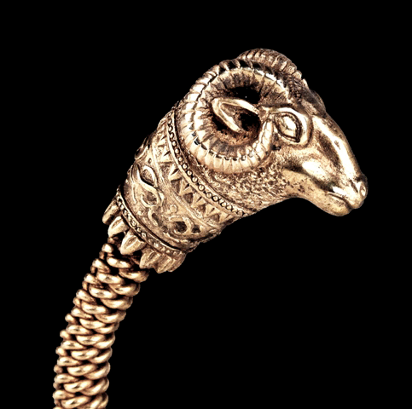
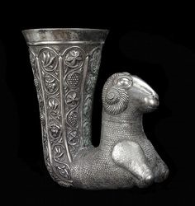
Persian Ram

Slide 14
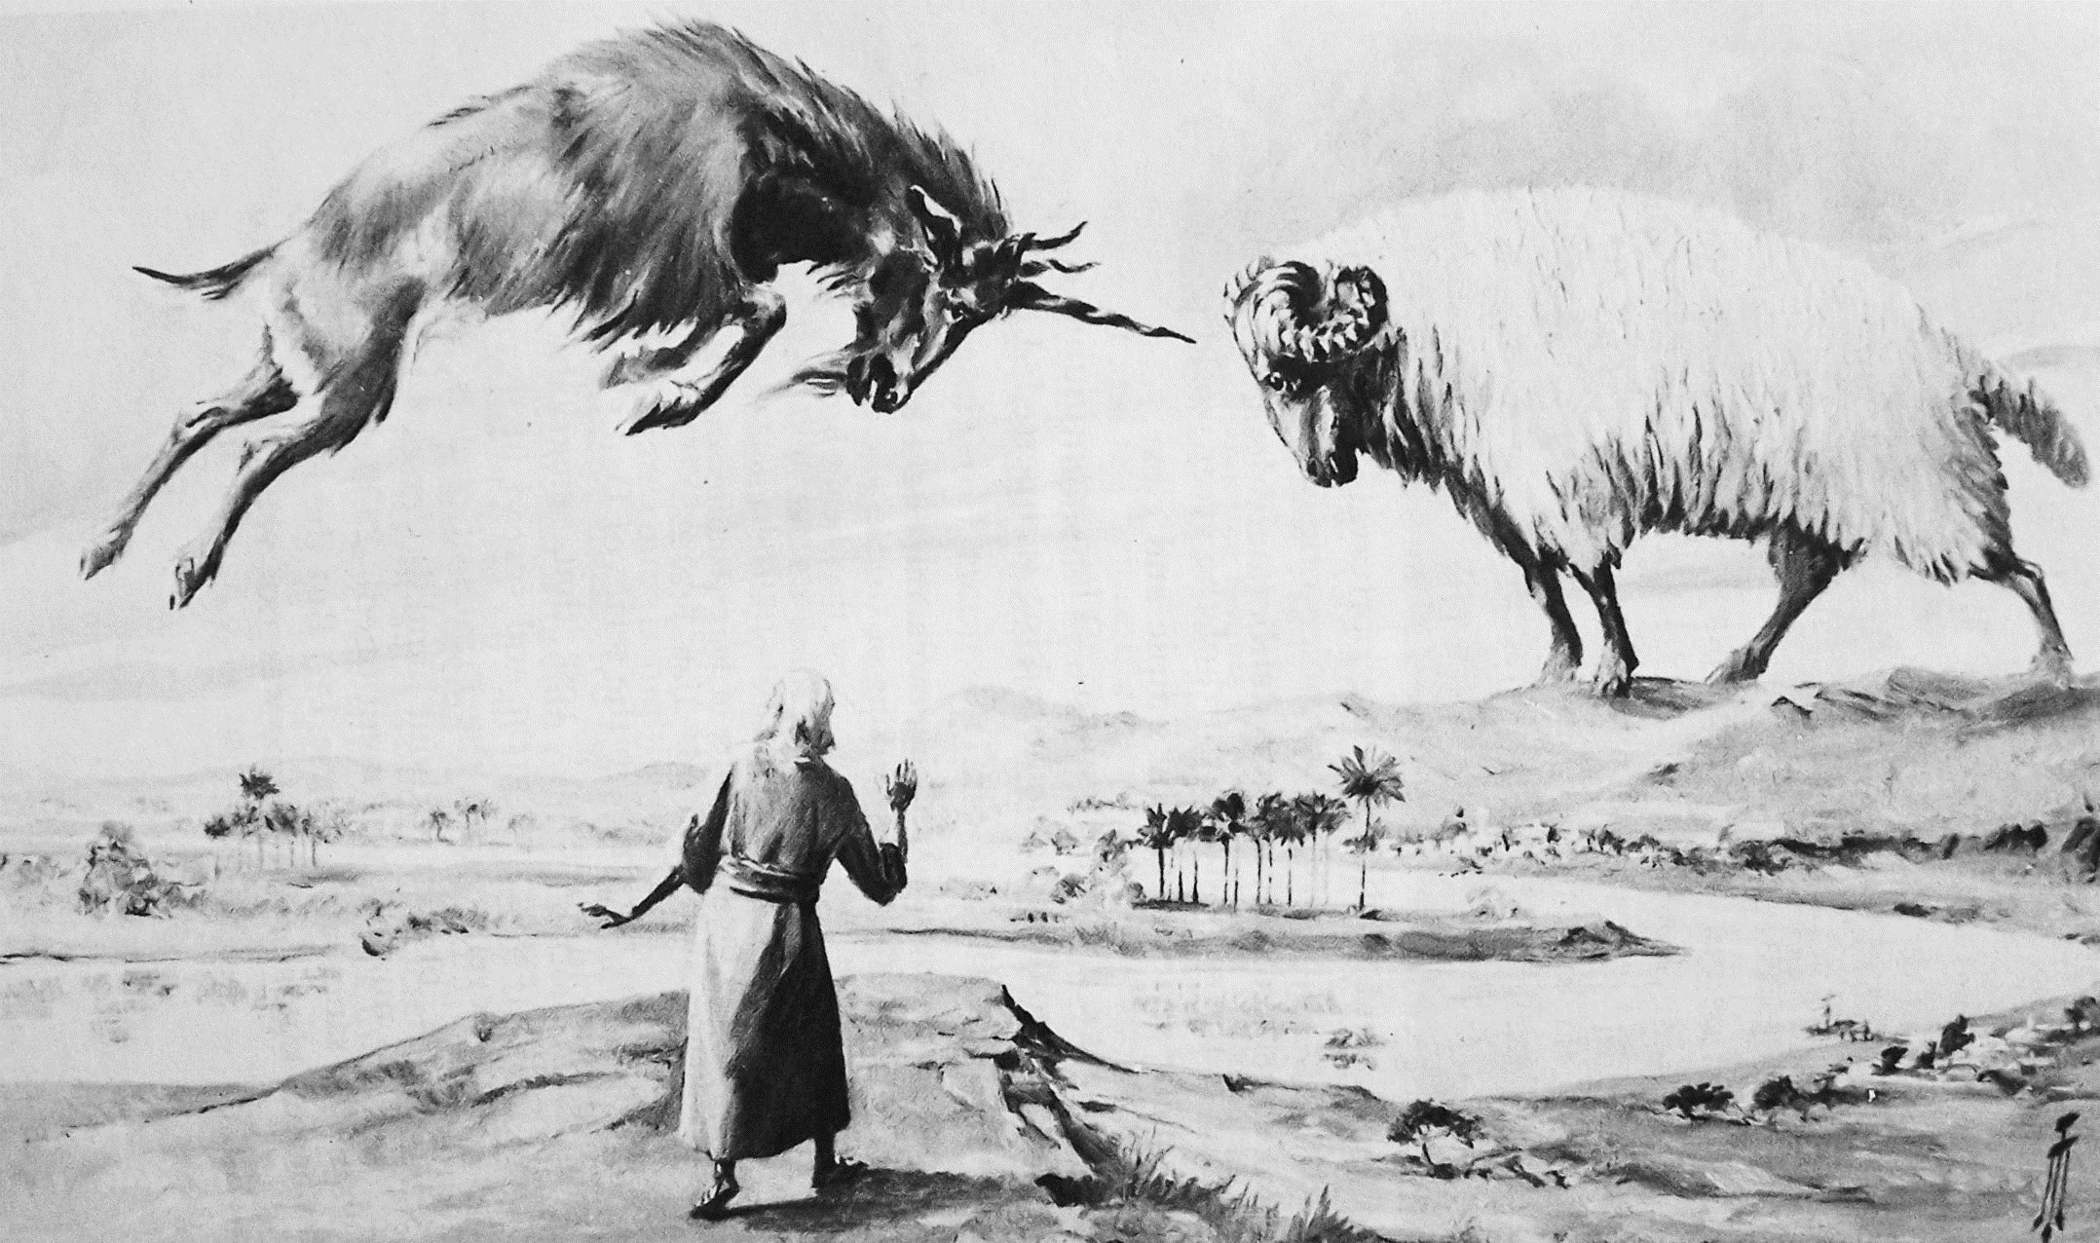

Slide 15
