Slide 1
Why?

Slide 2
1 Corinthians 11:23-24
²³ For I received from the Lord that which I also delivered to you: that the Lord Jesus on the same night in which He was betrayed took bread; ²⁴ and when He had given thanks, He broke it and said, “Take, eat; this is My body which is broken for you; do this in remembrance of Me.”

Slide 3
What We Needed Most:
“God is Spirit” – John 4:24
What Was Required:
An Accurate Concept of God
Fulfillment of Old Covenant
A Model of Holiness
An Acceptable Sacrifice for Sin
A Mediator
Hope of Resurrection
A Human Body
A Human Body
A Human Body
A Human Body
A Human Body
A Human Body

Slide 4
Hebrews 10:5
⁵ Therefore, when He came into the world, He said:
“Sacrifice and offering You did not desire, But a body You have prepared for Me.
John 1:1-14,
¹⁴ And the Word became flesh and dwelt among us, and we beheld His glory, the glory as of the only begotten of the Father, full of grace and truth. (vs, 14)
“Pitched His tent among us”

Slide 5
In His Human Body He:
Showed us God (John 1:18; 14:6; Col. 2:9)
Fulfilled the Covenant (Mt. 5:17; Col. 2:14)
Provided a model of holiness (1Pet.2:21-22)
Died as a sacrifice (Heb. 2:14-15; 9:27-28)
Serves as our Mediator (1 Tim. 2:5)
His Resurrection assures ours (1 Cor. 15:20-22)

Slide 6
This is why Christians remember His body!

Slide 7
What about that little cup of juice that you drink?

Slide 8
1 Corinthians 11:25
²⁵ In the same manner He also took the cup after supper, saying, “This cup is the new covenant in My blood.”
Blood can be precious!

Slide 9
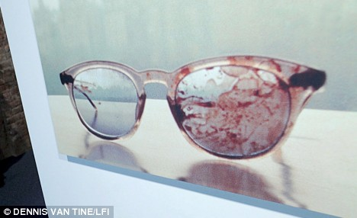
John Lennon’s Blood-stained Glasses
Sold by Yoko Ono for approx. $20,000

Slide 10
Blood represents life and Shed blood represents death.
(Lev. 17:11)
³³ But when they came to Jesus and saw that He was already dead, they did not break His legs. ³⁴ But one of the soldiers pierced His side with a spear, and immediately blood and water came out. (John 19:33-34)

Slide 11
Anne Marie Murphy gave her life to shield some of her students at Sandy Hook.
“A service was held in Katonah, N.Y., for teacher Anne Marie Murphy, 52, who authorities believe helped shield some of her students from the rain of bullets. Roman Catholic Cardinal Timothy Dolan compared her to Jesus.
"Like Jesus, Annie laid down her life for her friends," Dolan said.

Slide 12
The Blood (death) of Jesus--
Matthew 26:28 – Provides remission of sins
Ephesians 2:13 – Brings us near to God
Hebrews 10:19-22 – Gives us boldness to enter
Hebrews 13:12 - Sanctifies us
Revelation 1:5b-6 – Washes us from our sins
Revelation 5:9 – Redeems us
Revelation 12:11 – Gives us Victory over Satan

Slide 13
No wonder Peter calls it “precious”!
“You were not redeemed with corruptible things, like silver or gold, from our aimless conduct received by tradition from your fathers, but with the precious blood of Christ, as of a lamb without blemish and without spot.” (1 Peter 1:18-19)

Slide 14
No wonder Christians want to “drink the cup” often!
1 Corinthians 11:25 “In the same manner He also took the cup after supper, saying, “This cup is the new covenant in My blood.”
This do, as often as you drink it, in remembrance of Me.”

Slide 15
This feast is not Physical but Spiritual.
^{1 Corinthians 10:16} The cup of blessing which we bless, is it not the communion of the blood of Christ? The bread which we break, is it not the communion of the body of Christ?

Slide 16
This feast is more Heavenly than Earthly
^{1 Corinthians 11:26} “For as often as you eat this bread and drink this cup, you proclaim the Lord’s death till He comes.

Slide 17
86 - By Christ Redeemed, in Christ Restored vs 1
1.
By Christ redeemed, in Christ restored,
We keep the Supper of the Word,
And show the death of our dear Lord,
Until He come.
memo –ry a – dored,
Words by: George Rawson
Music by: from Arthur H. Troyte’s Chant
© 2001 The Paperless Hymnal™

Slide 18
86 - By Christ Redeemed, in Christ Restored vs1
© 2001 The Paperless Hymnal™

Slide 19
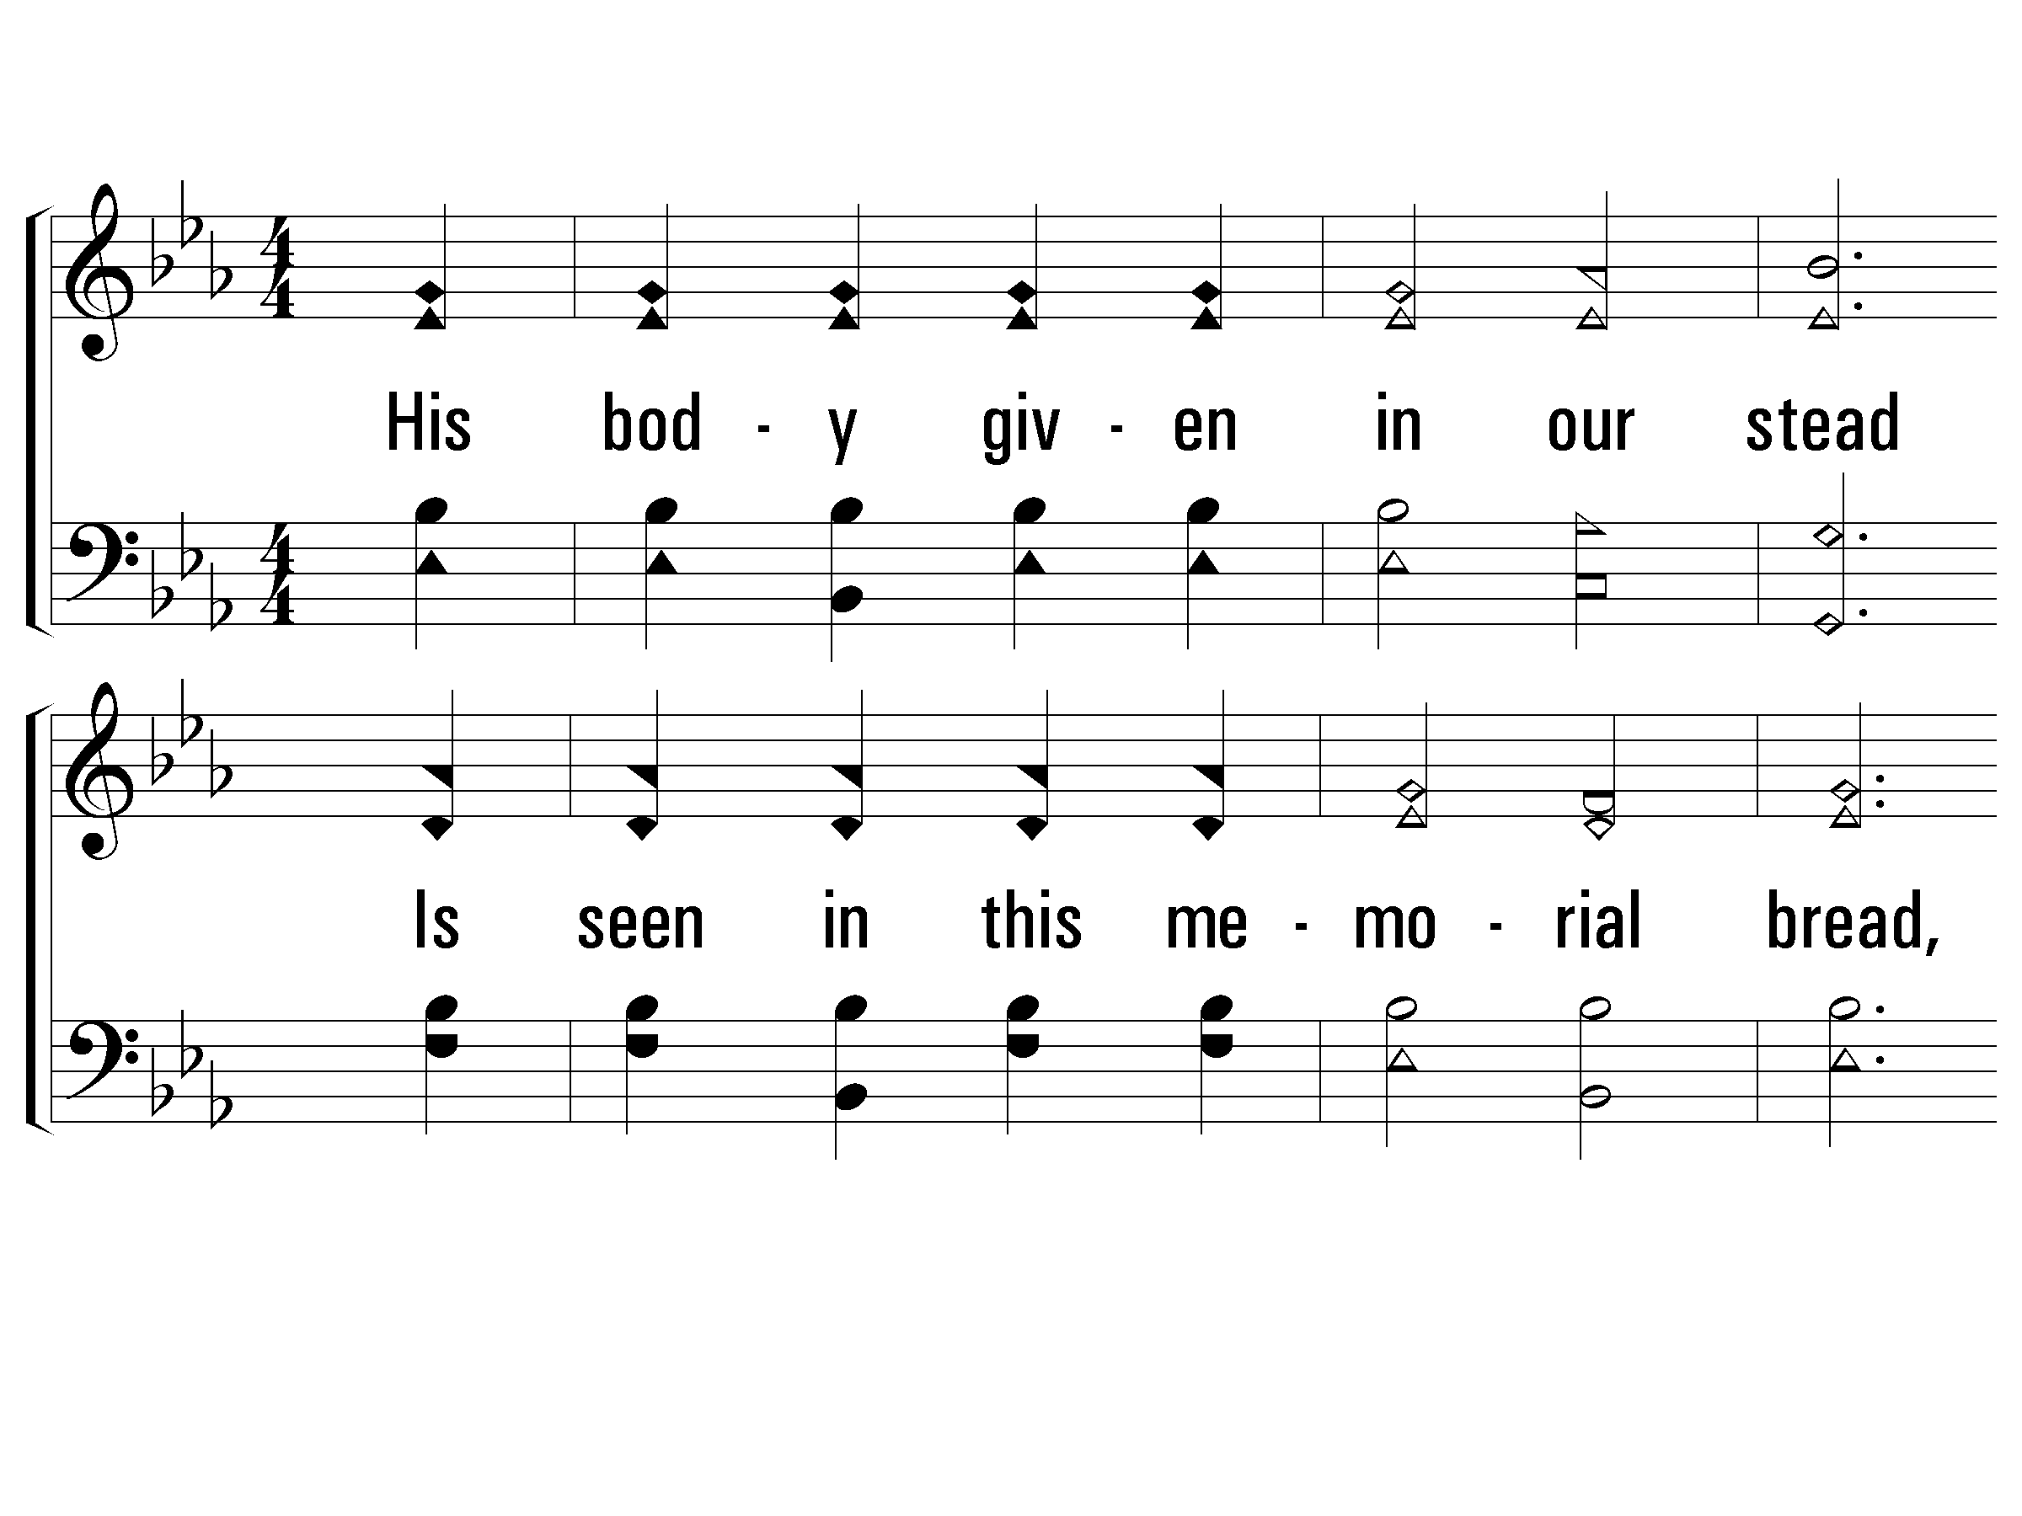
86 - By Christ Redeemed, in Christ Restored vs2
2.
His body given in our stead
Is seen in this memorial bread,
And as we drink we see the blood,
Until He come.
Words by: George Rawson
Music by: from Arthur H. Troyte’s Chant
© 2001 The Paperless Hymnal™

Slide 23
86 - By Christ Redeemed, in Christ Restored vs 4
3.
And thus that dark betrayal night
With the last ad-vent we unite,
By one bright chain of loving rite,
Until He come.
Words by: George Rawson
Music by: from Arthur H. Troyte’s Chant
© 2001 The Paperless Hymnal™

Slide 24
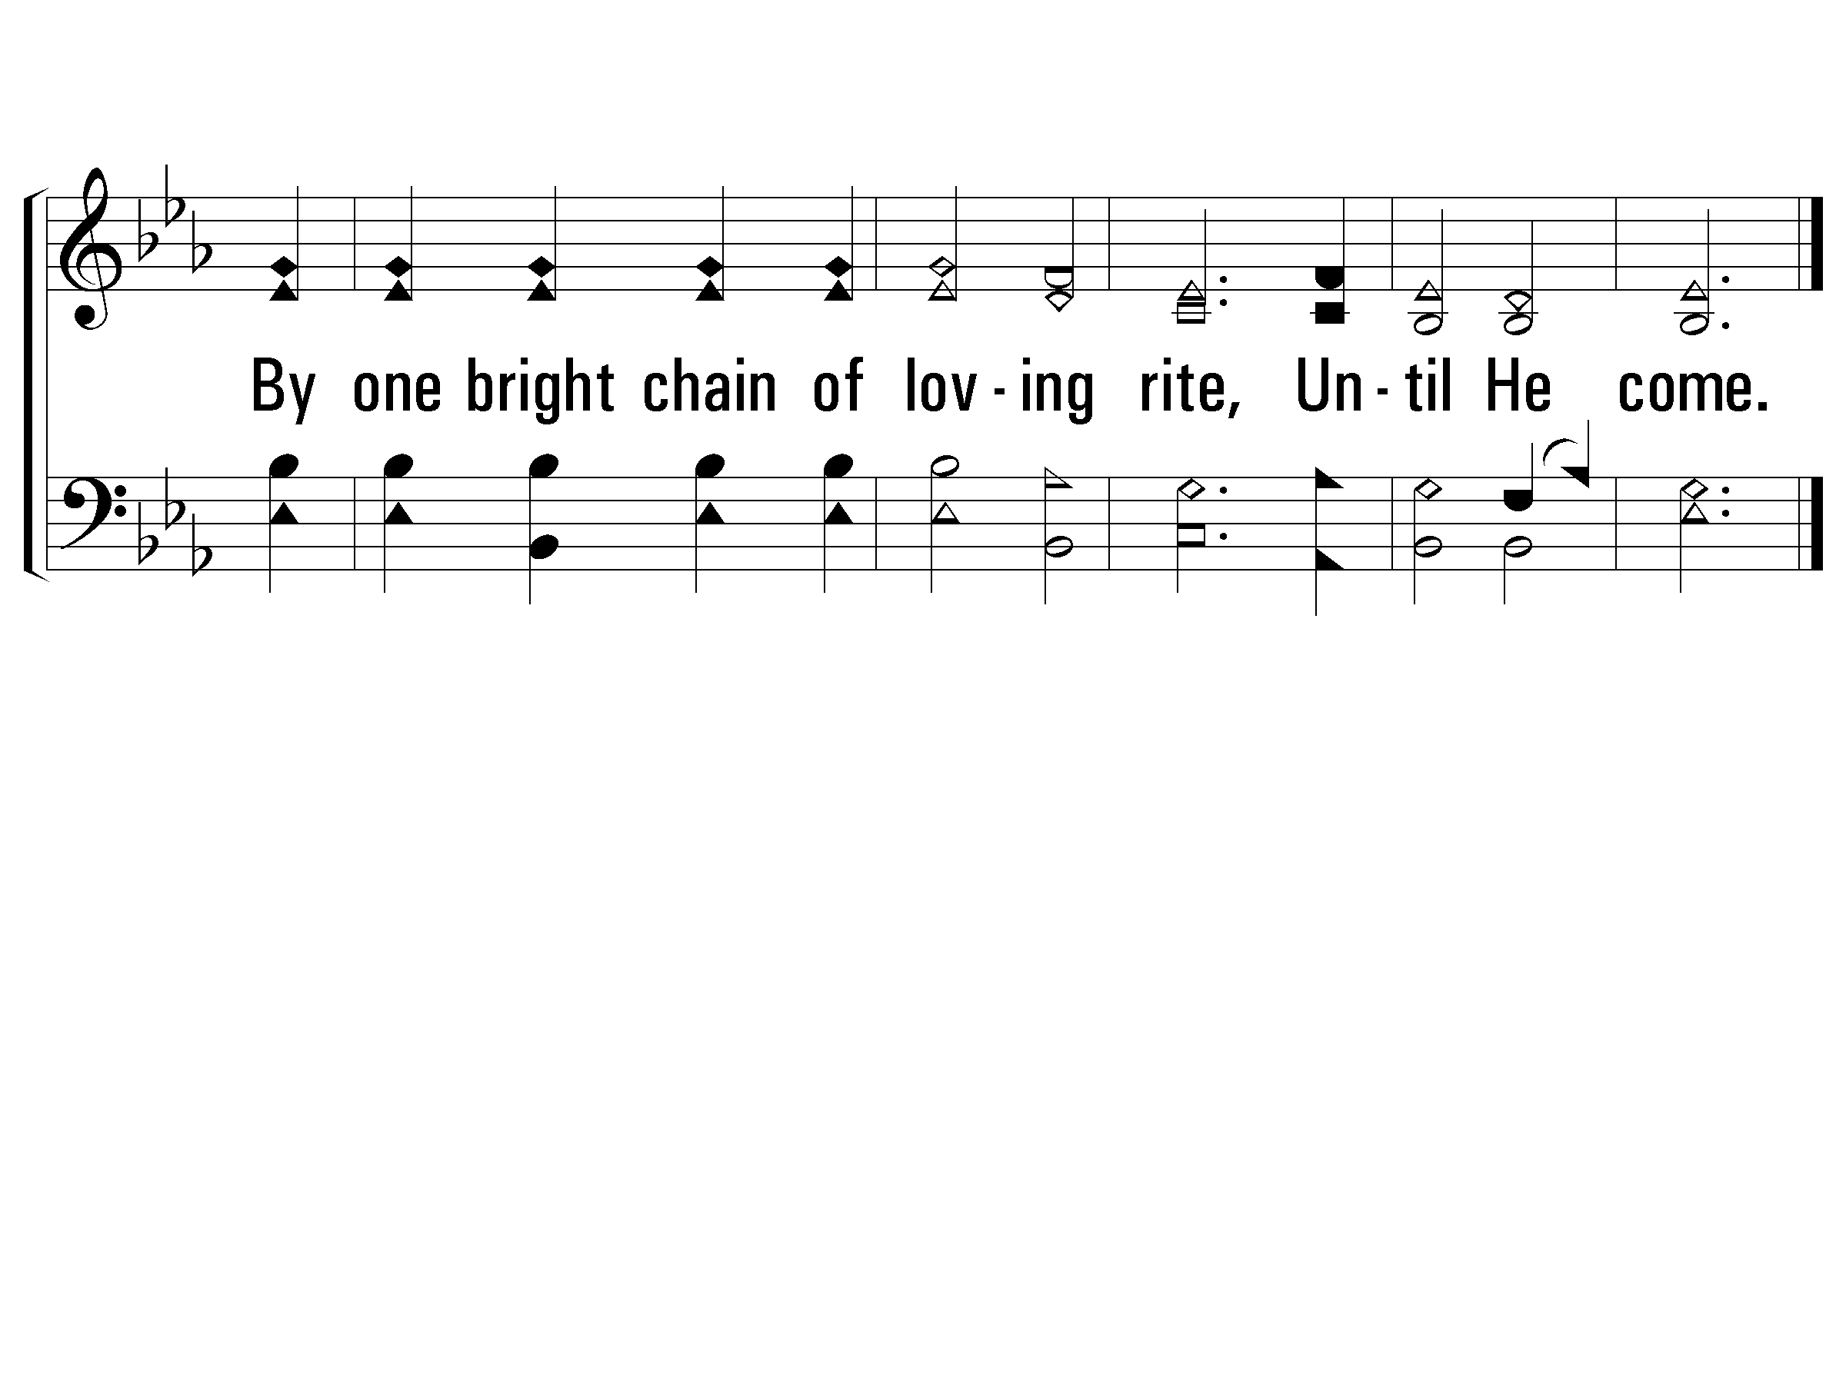
86 - By Christ Redeemed, in Christ Restored vs 4
© 2001 The Paperless Hymnal™

Slide 25
Who is qualified to partake of this feast?
Those washed in the blood of the Lamb (Rev. 1:5)
Those who are in Christ (Ephesians 1:7)
Those baptized into Christ (Galatians 3:27)

Slide 26
“And now, why are you waiting? Arise and be baptized, and wash away your sins, calling on the name of the Lord.” (Acts 22:16)

