Slide 1
The Jerusalem Church
A Model for All Time

Slide 2
Why Was it a Model?
Jesus Christ was its builder (Matt. 16:18)
The Holy Spirit communicated His will to the Apostles (John 16:12-15)
They spoke “as the Spirit gave them utterance” (Acts 2:4)
The church “continued steadfastly in the apostles’ teaching” (Acts 2:42)
This was a tribute to its original members.

Slide 3
A Local Church is:
A body (1 Corinthians 12:27) and a body is only as healthy as its members.
A building (1 Corinthians 3:9) and a building is only as strong as its stones.
A field (1 Corinthians 3:9) and a field is only as fruitful as its soil.
This church was made up of good soil!

Slide 4
Why were they in the church?
Not Because:
-- They liked the preachers
-- They liked the church
-- The church was popular
-- They thought It might help them socially, politically or economically
THEY WERE IN IT BECAUSE THEY LOVED GOD’S TRUTH!

Slide 5
Peter had preached the Truth
Jesus had been crucified (Acts 2:22-23)
God had raised Him up (Vss. 24-32)
He was exalted at God’s right hand (vs. 33)
He had been made both Lord and Christ (36)
All of this was proved by
-- Prophecy (verses 25-31)
-- Eye Witnesses (verse 32)
-- Miraculous signs (verse 33)

Slide 6
They could have rejected it:
It was different from present beliefs.
It meant their leaders were mistaken.
It came from unknown men.
It was spoken in an uncultured accent.
It might divide their families & friends.
It might prove dangerous.
Could have said, “That’ interesting.”

Slide 7
But they were “good soil.”
“Then those who gladly received his word were baptized; and that day about three thousand souls were added to them.”
Acts 2:41
These formed the church in Jerusalem on its first day!
Four Things about their Reaction to Truth

Slide 8
1. They were willing to believe what was proved to be true.
“Then those who gladly received his word were baptized; and that day about three thousand souls were added to them.” (Acts 2:41)
Belief of truth is essential to salvation. Mark 16:16, 2 Thess. 2:11-13

Slide 9
2. They were immediately obedient to the truth.
“Then those who gladly received his word were baptized; and that day about three thousand souls were added to them.” (Acts 2:41)
Obedience to truth is essential to salvation. James 2:26, John 3:36, Mark 16:16, Romans 2:8
All approved examples obeyed promptly!

Slide 10
3. They remained faithful to truth even in persecution.
³² But recall the former days in which, after you were illuminated, you endured a great struggle with sufferings: ³³ partly while you were made a spectacle both by reproaches and tribulations, and partly while you became companions of those who were so treated; ³⁴ for you had compassion on me in my chains, and joyfully accepted the plundering of your goods, knowing that you have a better and an enduring possession for yourselves in heaven. (Heb. 10:32-34)
Faithfulness to truth is essential Heb.10:39; Matt.10:22; Rev. 2:10

Slide 11
4. They Shared the Truth with others

Slide 12
4. They PREACHED the Truth to others
“Therefore those who were scattered went everywhere preaching the word.” (Acts 8:4)
The Result: “fruit in all the world” (Col 1:6)
All of this proved that they were good soil!
Parable of Jesus in Luke 8:4-15

Slide 13
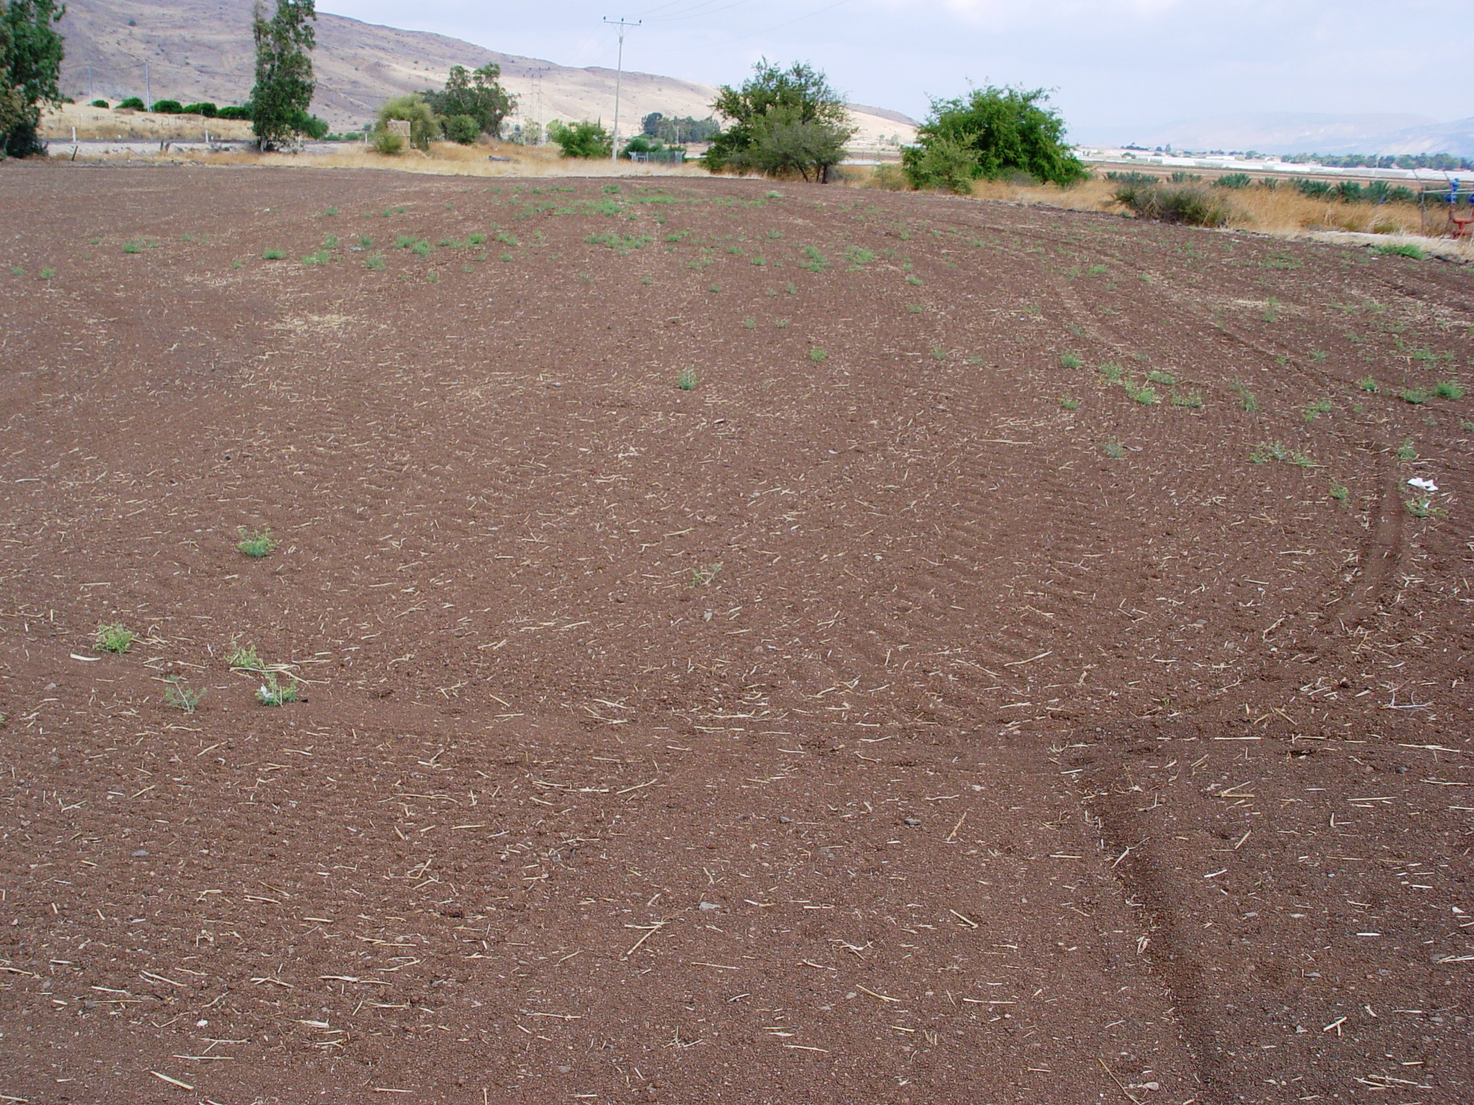
⁵ “A sower went out to sow his seed. And as he sowed, some fell…on good ground, sprang up, and yielded a crop a hundredfold.”
⁹ Then His disciples asked Him, saying, “What does this parable mean?”
¹⁵ The ones that fell on the good ground are those who, having heard the word with a noble and good heart, keep it and bear fruit with patience.

Slide 14
Let Us Ask about the Embry Hills Church:
Is this church made up of people drawn together by our love of truth?
This is the only legitimate basis for unity!

Slide 15
Let Each of Us ask: “What kind of soil am I?”
Am I ready to accept anything that is proved to be true regardless of the consequences?

Slide 16
Let Each of Us ask: “What kind of soil am I?”
Am I ready to obey whatever is proved to be true regardless of the hardships that may be required?
Immediately?

Slide 17
Let Each of Us ask: “What kind of soil am I?”
Am I willing to preach the gospel to others so that I may bear the fruit the Lord desires?

