Slide 5
What does Christ look like?

Slide 6
Compassion

Slide 7
“Whoever gives one of these little ones only a cup of cold water in the name of a disciple, assuredly, I say to you, he shall by no means lose his reward.”
-- Matthew 10:42

Slide 8
"There will always be poor people in the land. Therefore I command you to be openhanded toward your brothers and toward the poor and needy in your land.“
-- Deuteronomy 15:11

Slide 9
“Pure and undefiled religion before God and the Father is this: to visit orphans and widows in their trouble, and to keep oneself unspotted from the world.”
-- James 1:27

Slide 10
"'When you reap the harvest of your land, do not reap to the very edges of your field or gather the gleanings of your harvest. Do not go over your vineyard a second time or pick up the grapes that have fallen. Leave them for the poor and the alien. I am the LORD your God.”
-- Leviticus 19:9-11

Slide 11
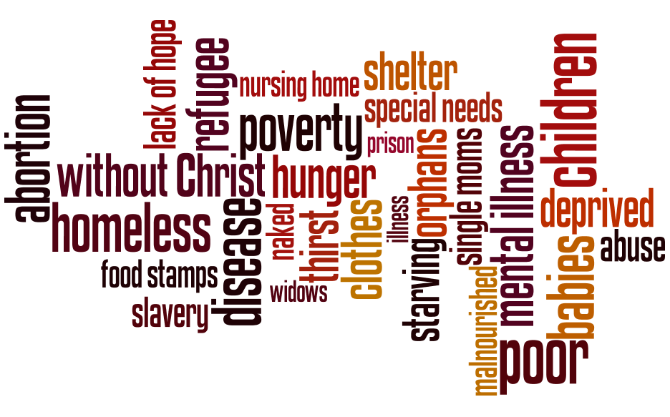

Slide 12
