Slide 1
What Is Worship?
Definition & motive of worship

Slide 2
Old Testament
shahah (171x)
“to bow down,” “to depress,” “prostrate oneself” (Brown-Driver-Brigg’s)
“to depress, that is, prostrate…: bow (self) down, crouch, fall down (flat), humbly beseech, do (make) obeisance, do reverence, make to stoop, worship.” (Strong’s)
Ex 4:31 “they bowed their heads and worshiped.”
Gen 24:52 “he bowed himself to the earth before the LORD.”

Slide 3
New Testament
proskooneho (60x)
“to kiss the hand to (towards) one, in token of reverence; among the Orientals, eps. The Persians, to fall upon the knees and touch the ground with the forehead as an expression of profound reverence; in the N.T. by kneeling or prostration to do homage (to one) or make obeisance, whether in order to express respect or to make supplication.” (Thayer’s)
“to kiss, like a dog licking his master’s hand; to fawn or crouch to, that is, (literally or figuratively) prostrate oneself in homage (do reverence to, adore): worship.” (Strong’s)

Slide 4
New Testament
proskooneho (60x)
Mt 28:9 they came up and took hold of his feet and worshiped him.
Mk 15:19 And they were striking his head with a reed and spitting on him and falling down in homage to him.
Acts 10:25 Cornelius met him and bowed at his feet and worshiped him.

Slide 5
Old English
wyrthscype
Wyrth or weorth – “worthy, honorable” – one worthy of reverence and honor
Rev 4:11 “Worthy are you, our Lord and God, to receive glory and honor and power, for you created all things, and by your will they existed and were created.”
Rev 5:12 “Worthy is the Lamb who was slain, to receive power and wealth and wisdom and might and honor and glory and blessing!”

Slide 6
Fear, awe, and wonder!
Isa 6:5 “Woe is me! For I am lost; for I am a man of unclean lips”
Lk 5:8 …he fell down at Jesus’ knees, saying, “Depart from me, for I am a sinful man, O Lord.”
Mk 1:24 “What have you to do with us, Jesus of Nazareth? Have you come to destroy us? I know who you are—the Holy One of God.”
Isa 6:3 “Holy, holy, holy is the LORD of hosts; the whole earth is full of his glory!”

Slide 7
There is no 2nd place!
Ex 3:5 “Do not come near; take your sandals off your feet, for the place on which you are standing is holy ground.”
Ex 5:2 But Pharaoh said, “Who is the LORD, that I should obey his voice and let Israel go? I do not know the LORD…”
Ex 12:12 For I will pass through the land of Egypt that night, and I will strike all the firstborn… and on all the gods of Egypt I will execute judgments: I am the LORD.”

Slide 8
There is no 2nd place!
Ex 15:11 “Who is like you, O LORD, among the gods? Who is like you, majestic in holiness, awesome in glorious deeds, doing wonders?”
Ex 15:13 “You have led in your steadfast love the people whom you have redeemed; you have guided them by your strength to your holy abode.”
Ex 18:11 “Blessed be the LORD… Now I know that the LORD is greater than all the gods…”

Slide 9
There is no 2nd place!
Ex 19:4-6 “You yourselves have seen what I did to the Egyptians, and how I bore you on eagles’ wings and brought you to myself. Now therefore, if you will indeed obey my voice and keep my covenant, you shall be my treasured possession among all peoples, for all the earth is mine, and you shall be to be a kingdom of priests and a holy nation.”
Ex 20:3 “I am the LORD your God, who brought you out of the land of Egypt, out of the house of slavery. You shall have no other gods before me.”

Slide 10
Implications
Worship is an emotional response
Worship is rooted in revelation

Slide 11
Case studies
Leviticus 8-10
2 Samuel 6

Slide 12
To those who RESIST change:
Some change IS biblical
Don’t judge, Rom 14:4
It’s not about you

Slide 13
To those who DESIRE change:
Some change IS NOT biblical
Don’t judge, Rom 14:4
It’s not about you

Slide 14
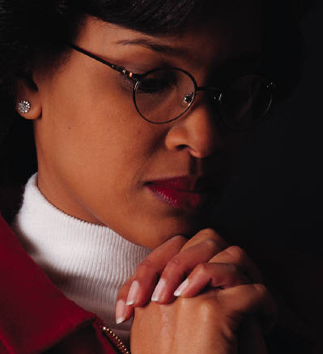
Tips for Worship
Prepare Saturday for Sunday, Mal 1:14
Focus on a Person, Jn 4:24
Hear God’s voice in Scripture, 2 Tim 3:16
Use “Amen” to personalize, 1 Cor 14:16
Drown out distraction with thanks, Jas 2:3
Let your heart sing, Eph 5:19
Allow Word to cut you open, Heb 4:12

