Slide 1
The Work Of The Church
Lesson Four
Mission, Organization, and Autonomy of the Church
Notes:
You begin with purpose. It's why your organization has decided to make a difference.
Your mission follows the path your organization sets to arrive at its destination: it's what you do, the path you choose to follow, the decisions you make to get to your destination. Will you follow a focused and direct path; or one that wanders? The mission-driven path will be direct, and you'll be doing what really matters. That's how you get from one point to another.
Vision is your destination, at a point in the near or distant future. It's your goal, and what you expect to find when you arrive at the destination. Your vision is your mission in action.

Slide 2
Class Agenda
Lesson One - What Is The Church?
Lesson Two - Supreme Authority of Church
Lesson Three - Individual & The Church
Lesson Four - Mission (Purpsose) , Autonomy / Oversight of Church
Lesson Five - Local Church Action: Worship
Lesson Six - Local Church Action: Evangelism
Lesson Seven - Local Church Action: Edification
Lesson Eight - Local Church Action: Benevolence
Lesson Nine - Church Supported Institions
Lesson Ten - Sponsoring Churches
Lesson Eleven - My Role: Self Examination
Lesson Twelve - My Role: Members of One Another
Lesson Thirteen - Conclusion and Review
Notes:
JESUS’ MISSION:
John 1.29 – Behold the Lamb of God who tales away the sins of the world.
Luke 19.10 – Son of Man came to seek and save the lost
INSTRUCTION TO HIS APOSTELS:
Luke 24.45-49 – Forgiveness of sins proclaimed in His name
Mark 16.15-16 – Believs and is Baptized shall be saved.
WHAT THE APOSTLES TAUGHT:
1 Timothy 1.15-16 – Christ came to save sinners
MISSION OF THE APOSTELS
2 Corinthians 5.18-21 – We implore you > be reconciled to God
Philippians 3.8-11 – That I may know Him

Slide 3
Is The Church To Do “Good”?
When It Respects The Authority Of Jesus
God Has Given Us A Pattern To Follow
Matthew 7:21-23 – “Not everyone who says to Me…”
Human Wisdom Vs. God’s Wisdom
David Wants To Build A Temple (2 Sam 7:2ff)
Jer 10:23 – Not Within man to direct his steps
When It Adheres To The Mission Given To It By Jesus.
Worship, Evangelism, Edification, Benevolence (saints)
The Church Can Not Do Everything
The Church Has A SPIRITUAL Mission
Notes:
(a) God gave Noah a pattern for the ark (Gen 6:13-22). Noah followed the pattern and was saved (Gen 7:1-5; 1 Peter 3:20; Heb 11:7).
Moses was instructed to build the tabernacle according to the pattern God gave him (Ex 25:9-40; Ex 26:30; Num 8:4).
(c) David did not follow God’s pattern on how the ark was to be transported and Uzzah died because of it (Ex 25:14; 37:5; 2 Sam 6:3; 1 Chron 15:11-15).
(d) Israel departed from the pattern God gave and was condemned as a result (Acts 7:34-44).
(e) This principle of following the pattern is applied to the church as well (Heb 8:1-5; 1 Cor 3:9-17). The idea that God tells us only what to do and not how to do it is in direct conflict with Bible teaching.
Much of what man decides is good and right in God's sight simply is not. David's desire to build a temple for Jehovah? 2 Samuel 7:2 tells us that David wanted to build a house for the Lord, and correctly consulted the prophet Nathan to see if such would be "good" in God's eyes. Nathan assumed that such an idea must be good, and immediately blessed the project (v. 3) without consulting God. Yet contrary to what everyone else thought about David's idea, God did not want David to build a temple, and expressly forbid it (v. 5ff). Think carefully about this situation. Wouldn't we all have said "Great thinking, David, let's get right to it!"? Yet 2 Samuel 7 illustrates powerfully to us that what men think is good and right is not necessarily good and right. God's revealed word is our standard, not our thoughts and opinions. "O Lord, I know the way of man is not in himself; It is not in man who walks to direct his own steps" (Jeremiah 10:23).
The church cannot do everything. Such is impossible -- resources, man-hours, money and energy are all limited commodities. Since we cannot do everything we dare not divert away any of our limited resources to activities which our Head has not ordered. Everything we do must be under His control, and fulfill the work He requires of us (Col. 3:17).

Slide 4
The Church Is Sufficient Eph 4:11-12
Apostles
Prophets
Evangelists - Preaching
Pastors –Oversee Local Church
Teachers – For Instruction
Christ
Gave
Gifts
Foundation Work Eph 2:20
Apostles
Prophets
Evangelists
Pastors
Teachers
“For”
Perfecting
The Saints
Unto
Work
Of
Service
Build
Up
Body
Unto
Pros –
Purpose
Or aim
In
Order
To
Acts 6:1
Acts 11:29; 12:25
Rom 15:31
2 Cor 9:12-13
Notes:
No mention of Social, Politcal, Secular, or Economic Needs.
God gave these gifts to us so that we might serve Him better and to help us accomplish our Mission.
“Work of Serve”

Slide 5
The Church Is Sufficient Eph 4:11-12
Worship
Evangelism
“Sounding Forth” 1 Thess 1:8
Gospel Came to “all the world” Col 1:6
Edification
Apostles, Prophets, Teachers, Evangelists, and Pastors –
TO PERFECT THE SAINTS!
Benevolence
Take Care of “Needy” Saints

Slide 6
Elders Oversee The Local Congregation
Every Congregation Should Have Elders
Acts 14:23 – appointed elders in every church
Titus 1:5 – appoint elders in every city
Called Elders, Bishops, Pastors
Acts 20:17, 28; 1 Peter 5:1-2 - All the same office
Acts 20:17 - Elders (presbutor) Older men
Acts 20:28 – Bishop (episkopos) Their task was to “Oversee” the Local Church
Acts 20:28 -Pastors (poimen) – Shepherd and Feed the Flock
Notes:
CHURCH ORGANIZATION IN THE NEW TESTAMENT
ELDERS TO OVERSEE THE LOCAL CONGREGATION...
A congregation, once fully developed, would have elders - cf.
Ac 14:23 – so when they had appointed elders in every church
Ti 1:5 – appoint elders in every city as I have commanded you
2. These elders were also called bishops and pastors
Elders (Grk., “presbuteros”, presbyter) for they were older men
b. Bishops (Grk. “episkopos”, overseer) for their task was to oversee the congregation - cf.
Ac 20:17,28; - Elders, Overseer, Shepherd
1 Pe 5:1-2 – The elders among you, Shepherd the flock among you.
c. Pastors (Grk. “poimen”, shepherd) for their task was to shepherd and feed the flock of God - cf. Ac 20:17,28; 1 Pe 5:1-2
-- Not three distinct offices, but different ways to describe the men and their work (cf. Easton’s Bible Dictionary, Moody Handbook of Theology)

Slide 7
Local Church Organization
Autonomy Of The Local Church
Elders Are To Oversee ONLY the Local Church Over Which They Are Overseers.
No Authority To Assume The Work Of Another
No Authority To Delegate Responsibilities
The Local Church Is Sufficient To Accomplish The Work God Set Out For It.
God Authorized No Other Organization To Accomplish This Work.
Either We Believe This Or We Do Not
Notes:
If the Lord planned the church so that it is competent and adequate to accomplish its work, then no other arrangement or institution is necessary.
In fact, any change in God’s arrangement of the church or any human institution built to supplement or subsidize God’s arrangement is not permitted.
Changes and substitutions to God’s design for the church would be as sinful as changes and substitutions to God’s plan of salvation, worship, or any other part of His revelation (Gal 1:6-8)
A failure to understand this has led to division among brethren. If unity is to every be restored, then every Christian must learn;
WHAT is the work of the church?
HOW is that work to be accomplished by the local church?
WHO is responsible to fulfill the mission of the church?

Slide 8
Cooperation
Cooperation – To act or operate jointly or to work together with another or others; to concur in action or effect
Collective / Joint Cooperation – The pooling of resources and / or abilities in order for the many (churches) to act as one.
Concurrent Cooperation – To work independently and concurrently with each other in their efforts toward the same goal.
How Did The NT Church Cooperate?
Notes:
It is not a matter of “IF” the New Testament church cooperated, it is a matter of “HOW” the New Testament church cooperated.
WWII is a great example of Concurrent Cooperation – The Russian and US armies were marching toward Berlin. They did not pool resources, they did not get each other approval for anything, but they were still cooperating toward the same goal.
Powers Ferry Church of Christ, Fayetteville, Westside, Northwest congregations are cooperating. We don’t even know there names – yet we are cooperating toward the same goals – Teaching and Saving the lost.

Slide 9
Acts 11:27-30
One Church Helped Other Churches
Antioch to the “Brethren In Judea”
Delivered by Paul and Barnabas
Delivered Into The Hands Of The Elders In Judea
Several Congregations (1 Thess 2:14; Gal 1:22)
FACTS
Elders Only Have Authority Over Their Congregation
Elders Appointed In Every Church (Acts 14:23)
Paul & Barnabas Delivered Funds to “The Elders”
Then The Funds Were Delivered To EACH Church
Notes:
ONE CHURCH HELPED OTHER CHURCHES IN A TIME OF EMERGENCY BY CONTRIBUTING TO THEIR NEEDS. In Acts 11:27-30 we see how the church in Antioch contributed to the needs of the “brethren in Judea” in a time of famine that occurred under the reign of Claudius Caesar in around 45 AD.
The church in Antioch raised funds “every man according to his ability” (1 Cor 16:1-2).
The church in Antioch chose Paul and Barnabas as messengers to take this money to the “brethren which dwelt in Judea”.
These funds were delivered into the hands of the “elders” among the “brethren in Judea”.
It is important to know that the “brethren in Judea” constituted several congregations (1 Thess 2:14; Gal 1:22). (ALSO Acts 9:31; 14:23)
Did Paul and Barnabas deliver the money to the elders in Jerusalem and let them distribute it to other churches? Such a conclusion is to argue from the Silence of the Scriptures and to make assumptions and conclusions without evidence. We know from our previous study that elders only had oversight in the church in which they were elders (Acts 14:23; 1 Peter 1:1; 5:1-2). COMPARE TO 1 SAM 30:26-31
We noted in that study that they elders of one church are never given authority in the New Testament to oversee the affairs of another church, neither in part nor in whole.
So, we know these facts
(1) Elders only have authority over the congregation where they are overseers.
(2) Elders had been appointed in every church as stated in Acts 14:23,
(3) Paul and Barnabas delivered the money to the “elders”. Based on these facts, the only conclusion that can be made with certainty is that Paul and Barnabas delivered the funds into the hands of the elders of every congregation where there was a need and the elders of each of these churches distributed them.

Slide 10
Local Church Organization (NT)
Deacons Appointed To Serve
Assist Elders in Work of The Church
Members of The Congregation
Saints
Evangelists
Teachers
Notes:
B. DEACONS TO SERVE THE ELDERS AND THE CONGREGATION...
These were servants (Grk., “diakonos”, servant, minister) who assisted the elders in the work of the church. Their qualifications are found in 1 Ti 3:8-13. The work they do is a very noble one - 1 Ti 3:13
C. THE MEMBERS OF THE CONGREGATION ITSELF...
Commonly called saints (Grk., “hagios”, holy one) in the New Testament -- cf. 1 Co 1:2; Ph 1:1. Also called disciples, Christians, believers, etc. Among such members there may have been evangelists and teachers - Ep 4:11
The evangelists would take the gospel to the lost
b. Teachers instructed and edified the members
c. Note: Those commonly referred to as preachers or ministers May do the work of both evangelist and teacher - e.g., 2 Ti 4:5; 2:2. But whether they serve as evangelist, teacher, preacher, or minister, within the local church they likewise submit to the oversight of the elders
[In Ph 1:1, we find the organization of the local church alluded to in Paul’s address: “To all the saints in Christ Jesus who are in Philippi, with the bishops and deacons”. Other than the members (“saints”), what organization existed was a two-tier system (bishops and deacons). But it wasn’t long before changes in organization it occurred.

Slide 11
What Local Saints Did:
Furnished Wages For Evangelist
Provided For The Needs of the Impoverished Saints
Received Benevolent Assistance
Heard “Compliant” When One Sinned Against Another.
Disciplined Unruly Members
Chose Servants, and Messengers
Appointed Overseers (Plural)
Had Physical Means To Implement Their Work
Had Their Own Name
Had A “Membership”
Could Be Gathered Together
Existed As A Unit When Not Assembled
Notes:
Furnished wages for, and the physical needs of, evangelists, 1 Cor. 9:1-14; 2 Cor. 11:8; Phil. 4:15
Provided for the physical needs of those who were impoverished, Acts 11:27-30
Received benevolent assistance, Acts 11:30
Heard the "complaint" one sinned against and spoke to the sinner, Matt. 18:17
Disciplined unruly members, 1 Cor. 5; 2 Thess. 3:6-15
Chose servants, Rom. 16:1; 1 Tim. 3:8-ff; and messengers, Phil. 2:25; 2 Cor. 8:19,23, to implement their work.
Appointed overseers to provide for spiritual direction, Phil. 1:1; 1 Pet. 5:2; Acts 14:23
Had the physical means to implement their work, 1 Cor. 16:1-3; Phil. 4:15
Had their own name (reputation) Rev. 2:2
Had a "membership" Acts 13:1
Could be gathered together Acts 11:26; 14:27
Existed as a unit when not assembled Acts 14:27

Slide 12
Local Church
Local Church Worshipped
Acts 20:7; 1 Cor 1:17-22; Heb 10:25
Local Church Supported Preaching
2 Cor 11:8; Phil 4:15-18
Or Several Churches Sending Support Directly To The Evangelist (Not Thru A Missionary Society). 2 Cor 11:8
Local Church Took Care Of Its Needy Saints
Acts 2:44-45; 4:32-37
When Need Was Too Great Other Churches Sent Relief To The Elders Where The Need Was.
Rom 15:25-31; 1 cor 16:1-4; 2 Cor 8:16-24
Local Church Edified its Members
1 Cor 5:1-13; 2 Thess 3:6-7, 14-15
Notes:
Local Church Worshipped
Acts 20:7; 1 Cor 1:17-22; Heb 10:25
Local Church Supported Preaching
2 Cor 11:8; Phil 4:15-18
Or Several Churches Sending Support Directly To The Evangelist (Not Thru A Missionary Society). 2 Cor 11:8
Local Church Too Care Of Its Needy
Acts 2:44-45; 4:32-37
When Need Was Too Great Other Churches Sent Relief To The Elders Where The Need Was.
Rom 15:25-31; 1 cor 16:1-4; 2 Cor 8:16-24
Local Church Disciplined
1 Cor 5:1-13; 2 Thess 3:6-7, 14-15

Slide 13
The NT Local Church
Had Organization
Were Organized on the Local Level Only
They Were Independent
They Were The Only Authorized Collectives
They Were Sufficient
Notes:
They had "organization“
The Philippian letter makes it clear that this group of saints, as a unit, (a) planned work, 4:10, (b) implemented work through ministers and servants, 4:15-16, (Epaphroditus being one of them, 2:25; 4:18), and (c) had bishops to provide spiritual leadership, 1:1. (Notice that "your fellowship", 1:5, "your thought", 4:10, "your messenger", 2:25, "your service", 2:30, and "the things that came from you", 4:18, denote many acting as one, i.e., collective planning and implementation.)
They were organized on the local level only
The "local level" is the only "level" upon which God's people were structured. The scriptures know nothing of attempts to organize the "church universal" by getting Christians to act collectively in some arrangement other than a local church. No work has been assigned to such a group, no oversight has been provided and no method of raising the funds to implement the work has been set up. The only church organization known to the New Testament is that of a local church, not the church universal.
They were independent
They planned and implemented their own work, selected their own overseers and sent their own servants and messengers to do their collective work. Phil. 1:5; 4:15-16 make it clear that Philippi acted independently in all of their planning an working
They were the only authorized collectives of this nature
Local churches are the only organizational arrangements we read about in the New Testament that provide for spiritual works. Robert Turner said it well: "There is no divinely recognized collective unit larger, or smaller, than the local church for the performance of the work of the church; and no loyal Christian will support or condone that which is contrary to divine sanction. The organizational structure of the church begins and ends with the independent congregation, and it is here that the Christian fulfils his collective obligations,--or miserable fails." "The Christian's Relation To The Local Church", Digest Of Truth (date unknown).
They were all sufficient
None of the congregations were charged with doing a work it was unable to provide for and thus needing a "sufficiency" supplied from another source.

Slide 14
Organization Apostasy
Single Bishop Over One Congregation
2nd Century AD
Bishops In Rome Oversee Other Bishops.
International Church of Christ
Hierarchy of Control Over Several Congregations
Sponsoring Church Concept
Elders Oversee Work Of Other Churches
Churches Give Funds to Sponsoring Church Which Carries Out The Work
Notes:
II. CHANGES IN THE ORGANIZATION OF THE CHURCH
A. ANCIENT CHANGES...
1. In the New Testament, churches that had elders (bishops) never had just one...
a. There was always a plurality - cf. Ph 1:1; Ac 20:17
b. This certainly prevented a one-man rule over a church
2. But things soon changed; as noted by the Holman Bible Dictionary...
a. During the second century A.D. churches came to have a single bishop, and then that bishop came to exercise oversight over nearby rural churches as well as the city church so that his ecclesiastical territory became known as a “diocese” or (“eparchy” in the East).
b. Bishops of churches that had been founded by apostles were said to be in succession to the apostles, and hence their teaching was held to be authentic and their authority collegial.
c. By 400 A.D. in the West, the bishop of Rome began to assume extraordinary authority above other bishops
3. According to A. T. Robinson’s Word Pictures: “Ignatius shows that in the early second century the office of bishop over the elders had developed, but Lightfoot has shown that it was not so in the first century.”
B. MODERN CHANGES: Many denominations have simply adopted the later changes in church organization Some go back to 400 A.D., and emulate an organization similar to Roman Catholicism. Others go back to the second century A.D and have a three tier system of bishop, elders, deacons within a congregation, or where a bishop or group of bishops (presbyters) oversee a number of churches
Some who have sought to restore New Testament Christianity have adopted changes that are not much different than what occurred in the past
a. The International Church of Christ has developed a hierarchy of control over
churches that emulates the structure found in Catholicism and other churches
b. The sponsoring-church concept adopted by many churches of Christ has the same effect as changes which occurred in the second century (elders in one area overseeing other churches or areas)

Slide 15
Why Is This Important?
Reflects Improper Attitude Toward Scripture
Is “all Scripture” From God? Are They Authoritative? Or just Suggestions?
Reflects a Lack of Trust in God
We Have Come Up with New, Better Ways to Fulfill our Purpose than God
Change In Organization = Change in Purpose
The organization of a thing reveals its purpose.
Upsets the “Balance of Power”
One Man/Men Can Have Too Much Control Over Other Churches
Error Can Spread Quickly
No “Checks and Balances”
Notes:
C. THE IMPORT OF SUCH CHANGES: One might wonder whether such changes have any importance. My response is yes, for several reasons
First, it reflects an improper attitude toward the Scriptures and the Lord. That we are free to change whatever we desire and that we can come up with a more efficient plan than the Lord.
b. Second, organization (design) reflects purpose; change the organization and you change the purpose - E.g., in the New Testament organization of the local church, the purpose of the elders is to watch and feed the flock over which the Spirit has appointed them. When elders become overseers of other churches or works in other areas. They are no longer shepherds, but administrators. They presume authority in areas they have not been given. They take on works they really can’t oversee (at least, effectively) -- Their purpose as God’s shepherds has changed
c. Third, changes in organization upset the “balance of power”. Other than the authority given the inspired apostles, no man or group of men were given more authority than the elders of a particular church. Even their authority was limited to the church were they were. A plurality of elders in one congregation also kept them in check. When changes in church organization occurred.it became possible for one man to control one or more churches. It became possible for a group of men to control a group of churches -- Thus authority over churches which ought to rest in Christ and His apostles now becomes vested in uninspired men!
d. Finally, the Divine wisdom to slow the development of error is hindered. Some changes in church organization were an attempt to restrain error, but whenever you have an organizational structure above the local church, the potential for error’s spread multiplies. If error creeps in a local church, it is less likely to spread if each congregation is independent and autonomous. But if error creeps into a hierarchy like those developed in the second century and later, it can quickly spread to churches expected to submit to such hierarchy

Slide 16
The Church Is Sufficient Eph 4:11-12
Worship
Evangelism
“Sounding Forth” 1 Thess 1:8
Gospel Came to “all the world” Col 1:6
Edification
Apostles, Prophets, Teachers, Evangelists, and Pastors –
TO PERFECT THE SAINTS!
Benevolence
Take Care of “Needy” Saints

Slide 17
The Work Of The Church
Lesson Five
Local Church Action:
WORSHIP
Notes:
There is a sign in front of a church building that says “Worship at the church of your choice”
A little girl asked her daddy what “worship” was.
He told her it is when you go to church and listen to a preacher preach.
Could you imagine a worse definition of worship?

Slide 18
Establishing Authority
Direct Command
“Take out the trash this morning”
“Mow the Lawn on Saturday”
Approved Examples
Looking both ways before you cross the street
Pray before I eat
Whittle by pushing the knife away from your hand
Necessary Inference
Wash your hands before you eat (how often?)
You see someone pack a suitcase – infer a trip
You see someone with a sun burn – infer he was outside

Slide 19
Establishing Authority Church and Evangelism
Direct Command
1 Tim 3:15 – Church is Pillar and Ground of Truth
Approved Example
Acts 11:22 – Jerusalem sent Barnabas to Antioch
Phil 1:3-5 – Church at Philippi and Paul
1 Thess 1:8 – Sounded out the word of the Lord
How Did The Local Church Evangelize?
Local Church Support a Gospel Preacher (1 Cor 9:14)
Local Church Directly Support a Man In Another Area (Phil 1:3-5)
Several Local Churches Support One Man Directly (2 Cor 11:8-9)

Slide 20
WHAT IS “WORSHIP”?
WORTH (Worthy) and SHIP (Condition or Quality)
Worship has an Object – Ascribe Worth to God
Verb: Reverence, to Honor, to Show Obeisance
Noun: Worthiness, Respect, Reverence Paid, Extravagant Respect or Admiration for, or Devotion to …
“proskyneo” – to prostrate oneself (Matt 28:9, 17; Rev 7:11)
“leitourgeo” – to perform religious service, Ministry
“latreuo” – to perform religious duties (Mt 4:10, Lk 2:37, Ro 12:1)
“Threskeia” – Religious Service (James 1:26-27)
“Sebomai” – To show reverence or respect for one
“Eusebeia” – Religion, Piety, Devotion, Godliness
When do we Worship?
Notes:
Is there anything more important that the Christian does than worship God?
When we come together to worship God Almighty, we loudly proclaim;
Who we believe to be in charge of the universe.
Who we believe to be God
Who we believe to be worthy of Worship and Praise, and Glory and Honor.
We say look at the simplicity of New Testament worship.
Look at what can be done when hearts are brought before God
We re-center our hearts on the things that are most important in this life.
We refresh our spirit as if we found an Oasis.
So that we might serve God

Slide 21
Acts of Our Collective Worship
Communion (Acts 20.7; 1 Cor 11.23-26)
Prayer (1 Cor 14.15-16, Phil 1.4-6)
Singing (Eph 5.19)
Collection (1 Cor 16.2)
Scripture Read (Col 4.16; 1 Tim 4.13)
God’s Word Proclaimed (Acts 20.7)
Notes:
I am afraid to say that for too many people, worship is nothing but monotony! (chart of St. Andrews)
Church services are looked at as nothing but a dreadful bore. (slide of child being dragged to church).
The same songs, same prayer, same preacher, the same old message.
Every week it is just the same old thing.
Instead of being looked at as a life changing experience as something that we look forward to.
For too many I’m afraid it is looked at as something to be endured.
Not something to be built up with.

Slide 22
Acceptable Worship
1 Corinthians 14:40 - But all things should be done decently and in order
Hebrews 12:28: Therefore let us be grateful for receiving a kingdom that cannot be shaken, and thus let us offer to God acceptable worship, with reverence and awe, (29) for our God is a consuming fire.
If there is “Acceptable” Worship, is there “Unacceptable” Worship as well?
John 4:23-24 – Must Worship Him in Spirit and in Truth
What about a Sincere, Heartfelt Worship?
Mark 12.29-30 – And you shall love the Lord your God with all your heart and with all your soul and with all your mind and with all your strength.

Slide 23
Acceptable Worship
Worship Must Be To God and God Alone
Ex 20.1ff ; Matt 4.10
Not to be entertained
Worship is Making an Offering – A Giving of Ourselves
Our Presence, Our Voices, Our Contribution, and Commitment
Not Being Pleased with the Service, but Pleasing to God
Worship is Giving to God Something That Pleases Him
Worship Propels Us To Service in Our Lives
Worship Must be in Spirit and in Truth
John 4.23-24

Slide 24
Acts of Worship
Communion (Acts 20.7; 1 Cor 11.23-26)
On the First Day of the Week – Every First Day of the Week
Prayer (1 Cor 14.15-16, Phil 1.4-6)
Everything is Done Decently and in Order
Singing (Eph 5.19)
Singing and Making Melody in Your Heat to the Lord
Collection (1 Cor 16.2)
On the First Day of the Week – Cheerfully Giving Back to the Lord
Scripture Read (Col 4.16; 1 Tim 4.13)
Let all things be done for the building up (1 Cor 14.26
God’s Word Proclaimed (Acts 20.7)
Preach the Word!

Slide 25
Worship in Truth 1 Kings 12.25-33
It Started with Doubting God (1 Kings 11:38)
Human Wisdom (1 Kings 12.31-33) Devised in His Heart
Prov 3.5 – Trust in the Lord with all your heart and lean not on your own understanding
Appealed: Convenience (12.28) – Jerusalem is too far
Let’s make worship easy.
Apperance: Similar to the Truth (12.32) – Like the feast is Juda
Change the Pattern, Add a Little, Subtract a Little, Expedient
Effect: Provoked the Anger of the Lord (2 Kings 17.9-12, 16-17)
Result: God Removed them from His Sight (2 Kings 17.18)

Slide 26
What Hinders Our Worship?
We Fail to Follow the Pattern
Performance Syndrome - (Leaders and Participants)
I wonder if they are going to do anything special today?
Are you in Attendance or are you an Worshiper
Worship is not a Performance – It is a Participation Together
Notes:
The NT Church Sang, Prayed, Took the Lord’s Supper, they Gave, they had Teaching and Preaching
They did it simply and according to God’s pattern and the Church Grew.
Eph 5:19 – They sang without instruments
Not Hard to Understand – they sang in their hearts.
They came to Worship God, not to be Entertained.
Is Worship Stale and Boring? That is when we tamper with the Pattern
PERFORMACE:
Is the song leader and preacher going to be any good today?
CASUAL
I am not talking about a Dress Code, buy our Hearts
What I do impacts others
How do you prepare to Worship? Are you tired? Done your Lesson? On Time?
Ready to Sing, Pray, Read, Preach
Amos 6:1 – Israel took worship for granted

Slide 27
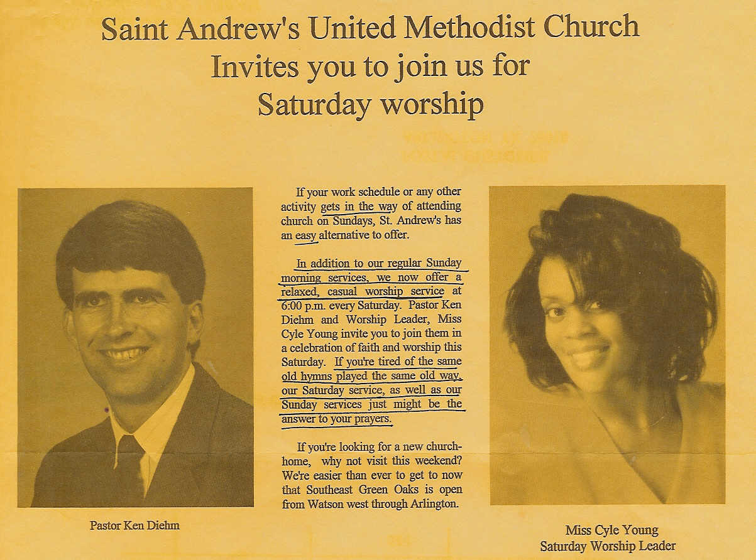

Slide 28
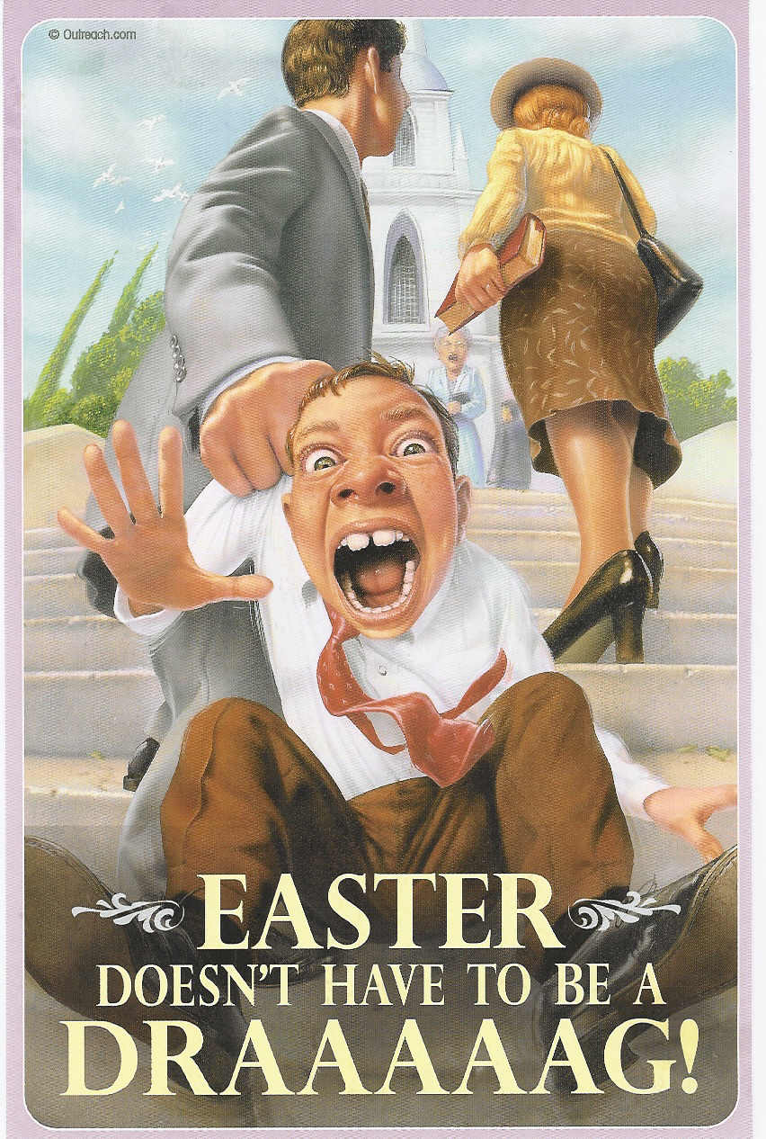
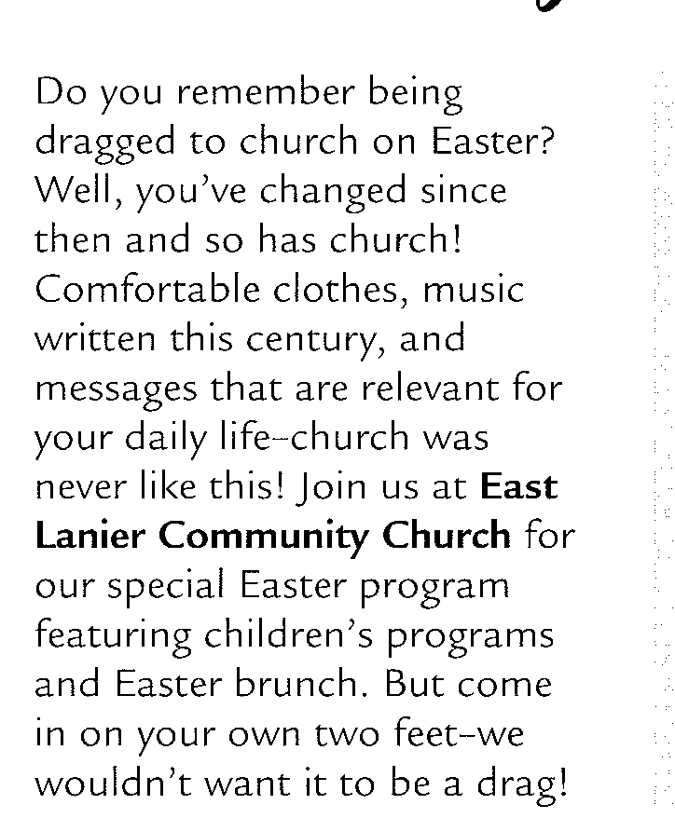

Slide 29
What Hinders Our Worship?
Fail to Follow the Pattern
Performance Syndrome
I wonder if they are going to do anything special today?
“It’s only a singing tonight …”
Casual Approach to Worship (Attitude)
Amos 6.1 – woe to you who are at ease in Zion
Our Attitude
How we Prepare (Leaders and Participants)
What we Offer (Malachi 1.8)
Notes:
The NT Church Sang, Prayed, Took the Lord’s Supper, they Gave, they had Teaching and Preaching
They did it simply and according to God’s pattern and the Church Grew.
Eph 5:19 – They sang without instruments
Not Hard to Understand – they sang in their hearts.
They came to Worship God, not to be Entertained.
Is Worship Stale and Boring? That is when we tamper with the Pattern

Slide 30
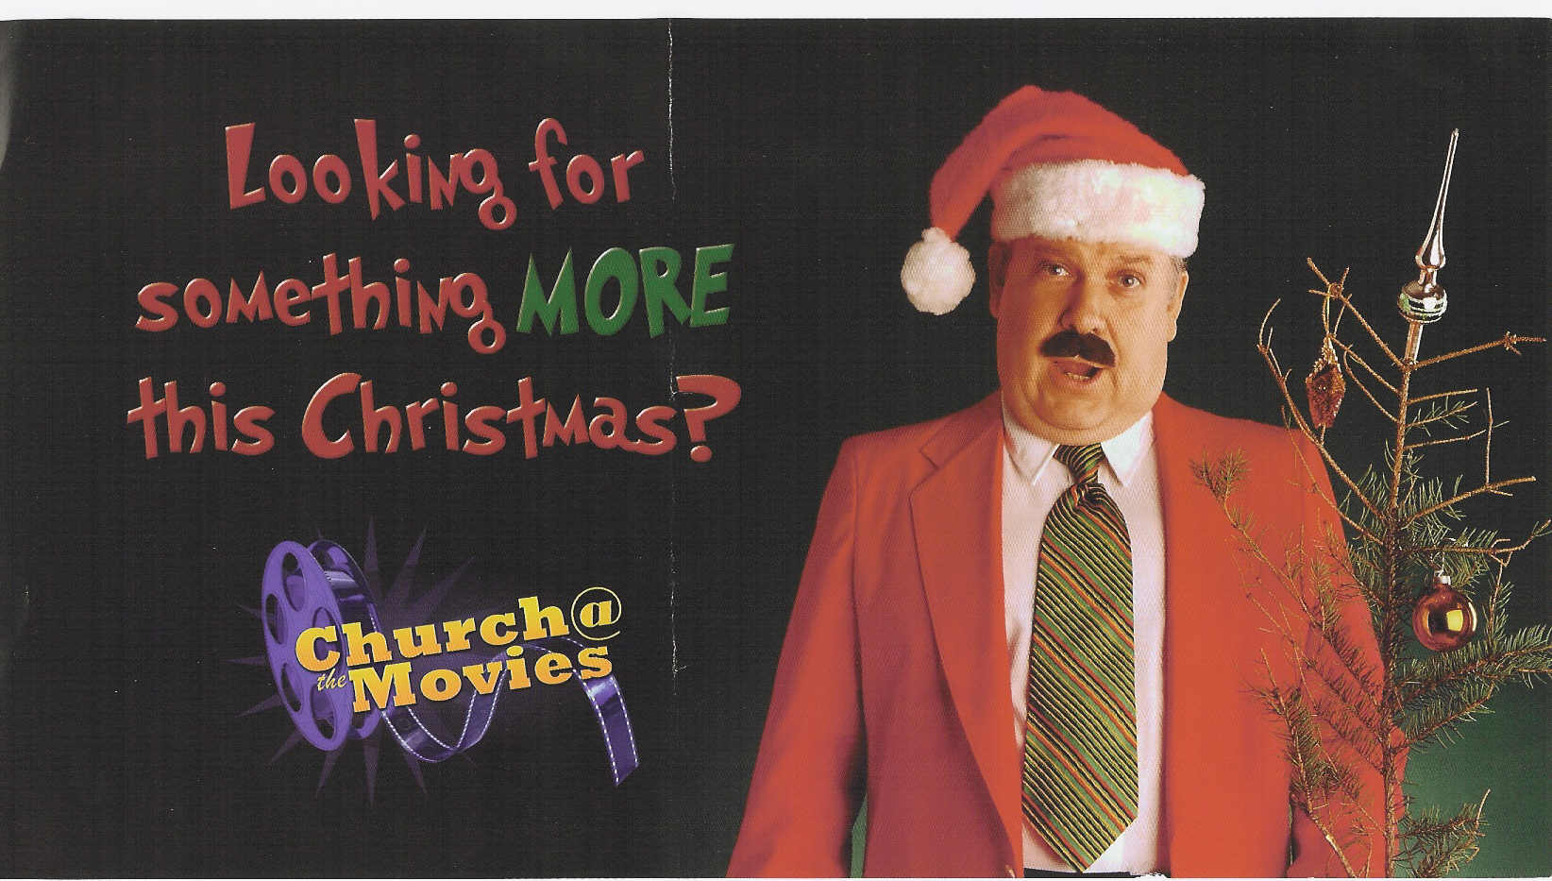
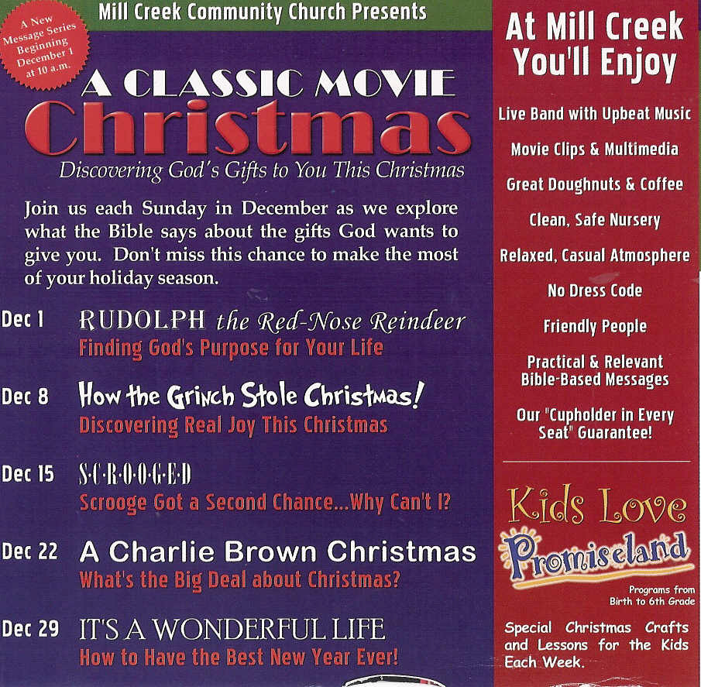

Slide 31
Becoming “TRUE” Worshipers
John 4:23-24 - But the hour is coming, and is now here, when the true worshipers will worship the Father in spirit and truth, for the Father is seeking such people to worship him. God is spirit, and those who worship him must worship in spirit and truth
We Must Have the Right Object: the FATHER/ God
We Must Have the Right Method: TRUTH
We Must Have the Right Heart: SPIRIT
We Need a Capacity for Grandeur (Rev 7.11)
Am I Focused on What is Going On Here?
Am I Disciplining Myself to Worship God?

