Slide 1
Simply church

Slide 2
goal
Remove the varnish of human tradition to uncover the original New Testament church.

Slide 3
Descriptions of the church
New Testament assemblies
Local church organization
Role of women
Mission/work of the church
My role in the church

Slide 4
Simply church
Ministry: My Role in the Church

Slide 5
Who Is In the Ministry?
And he gave the apostles, the prophets, the evangelists, the shepherds and teachers to equip the saints for the work of ministry…
Ephesians 4:11-12

Slide 6
What Is Ministry?
NASV: “for the equipping of the saints for the work of service…”
Doulos – a slave, ownership (Rom 1:1; 1 Pet 2:16)
Leitourgos – priestly service, service in the church (Acts 13:2; Rom 15:27)
Diakonos – a servant, a service of love (Acts 1:17, 25; 6:1, 4)

Slide 7
The Need for Ministry
…from whom the whole body, joined and held together by every joint with which it is equipped, when each part is working properly, makes the body grow so that it builds itself up in love.
Ephesians 4:16

Slide 8
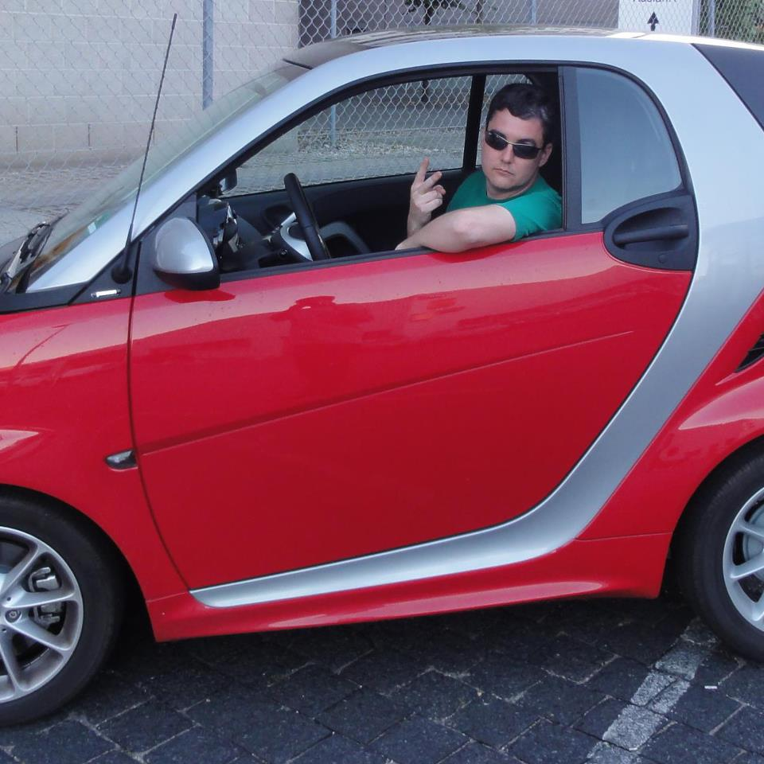
Barnabas – A True Servant
Unsupported minister (1 Cor 9:6)
Bachelor (1 Cor 9:5)
Giver (Acts 4:36-37)
Teacher (Acts 13:1)
Enlister (Acts 11:25-26)
Traveler (Acts 13-14; 15:39)
Encourager (Acts 11:23)
Risk taker (Acts 9:26-30)
Debater (Acts 15:2, 39)
Step asider (Acts 13:4-12)
Never give upper (Acts 15:36-41)
True Disciple Maker (Acts 11:23-24)

Slide 9
Conclusion:
Ministry is not a position, but an attitude of service.
Ministry is the use of one’s unique gifts to serve the saints and lead the lost to Christ

Slide 10
Exhortation:
Discover your gifts and talents
Use them to serve others

Slide 11
In-town work:
How can I help?
Social media helpers
Street work
Attend and invite to studies
Correspondence course work
Prayers warriors

