Slide 1
The Work of the Church
Class THIRTEEN – CONCLUSION AND REVIEW

Slide 2
Schedule
Date | Teacher | Title
1/3 | Dave | What is the Church?
1/6 | Dave | The Supreme Authority of Christ
1/10 | Dave | Collective Action: The Individual and the Local Church
1/13 | Larry | The Mission, Organization and Autonomy of the Church
1/17 | Larry | Local Church Action: Worship
1/20 | Larry | Local Church Action: Evangelism
1/24 | Dave | Local Church Action: Edification
Date | Teacher | Title
1/27 | Dave | Local Church Action: Benevolence
1/31 | Larry | Challenges to God’s Design: Church-Supported Human Institutions
2/3 | Larry | Challenges to God’s Design: Sponsoring Churches
2/7 | Dave | My Role in the Local Church: Personal Self-Evaluation
2/10 | Dave | My Role in the Local Church: Members of One Another
2/14 | Dave | Conclusion and Review

Slide 3
ekklesia
Church, congregation, Assembly;
A group of people gathered together
(From “EK”, out/FROM, and “Kaleo”, to CALL)

Slide 4
“Ekklesia” in the New Testament
The “Universal” Church | The “Local” Church
Composed of all the saved | Composed of those in one location
There is just one | There are many
Began on Pentecost | Begins when people join together
Added by the Lord | Enter by joining ourselves
Lord keeps record of membership | Enrolled by human judgment

Slide 5
Origin of the English word “church”
“And He put all things under His feet, and gave Him to be head over all things to the church, which is His body, the fullness of Him who fills all in all.” (Eph. 1:22-23)
kyriakon
(Late Greek)
chirche
(Middle English)
church
(today)
cirice
(Old English)
kyriakos
(Greek)
Meaning: “of the lord”
From the Greek kyrios meaning “lord, master”
(cf. Revelation 1:10, 1 Corinthians 11:20)

Slide 6
How do we determine the Lord’s will? Using the New Testament
Direct Statements
Some direct statements come directly from the Lord’s mouth and are universal in application (Jn. 3:16, Mk. 16:16)
Approved Examples
We’re called to follow examples (Jesus: 1 Pet. 2:21; Paul: Phil. 4:9)
Necessary Conclusions
This simply means that we put facts together to draw a forced logical conclusion.
Other direct statements are spoken by people to other people, and we have to determine if they apply to us (cf. 1 Cor. 4:17)
If we see an example in Scripture that is approved and that can be applied to us, it teaches us about the Lord’s will and provides a model.
The first two categories depend on this!
Examples:
Jesus (Matt. 19, 22)
Hebrews 7:11-15

Slide 7
Wrong Sources of Authority
Not from men | Parents, preachers, elders, teachers, human wisdom 1 Corinthians 1:13
Not from the Old Testament | Jesus’ authority expressed by the Spirit through the apostles and prophets of the New Testament; Old Testament law applied only to Israel (Romans 2:14)
Not from tradition or creeds of men | Jesus condemned traditions that were substituted for God’s commandments (Matthew 15:3-9); any claimed written authority that is more or less than the New Testament is not the New Testament!
Not from the congregation / majority | Is the majority always right? (Matthew 7:13-14) The Lord does not give the congregation this authority.
Not from results (good works) | Do the ends justify the means? Even if you mean well? (1 Chronicles 15:1-14, Leviticus 10:1-3)
Not from conscience / feelings | Paul had a good conscience while he was harming Christians! (Acts 23:1, 26:9-11) See Proverbs 14:12, Jeremiah 10:23

Slide 8
What work has the Lord given the church?
What does He want me to do?
What does he want the church to do collectively?
Is there a difference?

Slide 9
Local Church Action
Worship
Jn. 4:24, “worship Him in spirit and in truth”
Communion, Praying, Singing, Collection, Reading, God’s Word Proclaimed
Evangelism
1 Tim. 3:15, “… which is the church of the living God, the pillar and ground of the truth.”
Churches sent wages directly to evangelists to support their financial needs.
Edification
Eph. 4:12, “… for the equipping of the saints … for the edifying of the body of Christ.”
Worship, Teaching, Church Discipline, Congregational Meetings, Work, etc.
Benevolence
2 Cor. 9:11-14, “…while, through the proof of this ministry, they glorify God…”
Collectively, churches provided support specifically for the needs of Christians only.

Slide 10
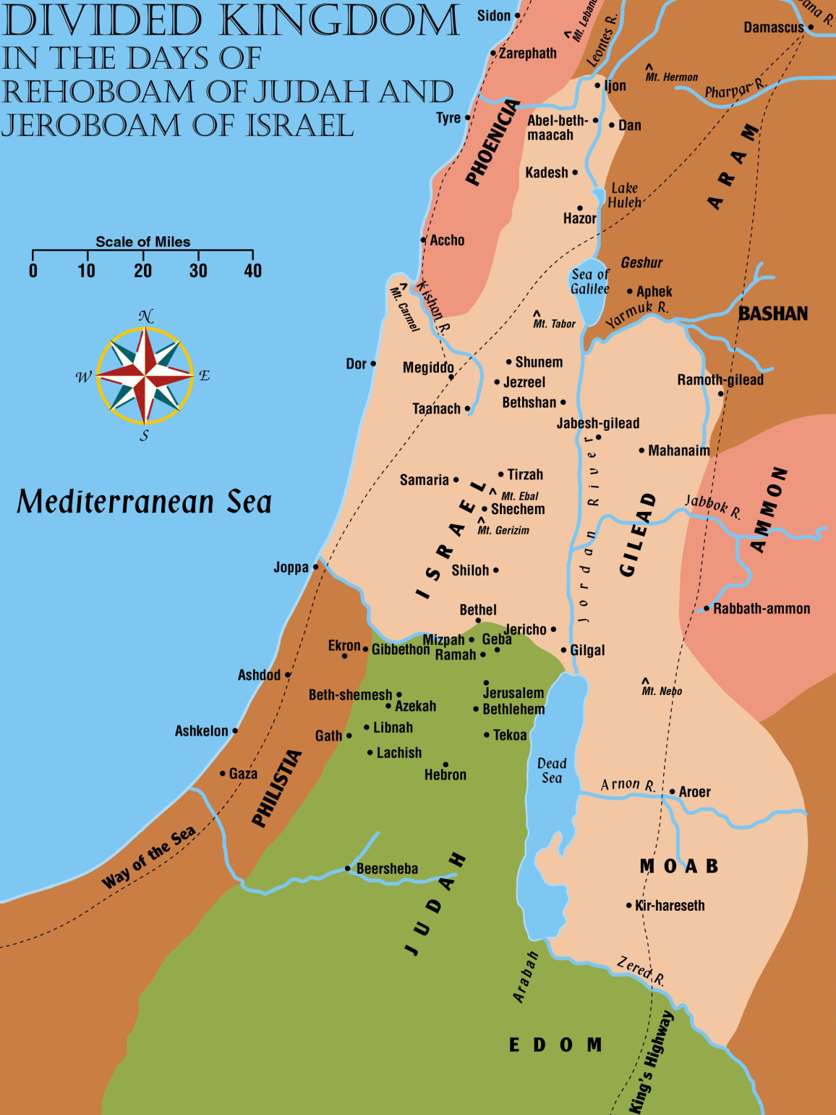
1 Kings 12

Slide 11
Personalities
“so we, being many, are one body in Christ, and individually members of one another.” (Romans 12:5)
Barnabas
Acts 4:36-37
Acts 11:22-26
Peter
Matthew 14:22-23
Matthew 16:21-23
Nicodemus
John 3:1-10
John 19:38-42
James
Luke 9:33
John 7:45-53
Mark 10:35-43
Luke 9:51-56
Acts 12:1-3
Acts 9:26-27

Slide 12
1. Make a list of your strengths in the church’s work. 2. What can you do to build on these strengths? 3. What are some areas you don’t think of as your strengths but would like to build? 4. What are some works you can get involved in (or people you can get involved with) that can help?
Action plan

