Slide 1
Lesson 1 Please Read…. Galatians 1:1-10
1:1 Paul, an apostle (not from men nor through man, but through Jesus Christ and God the Father who raised Him from the dead), 2 and all the brethren who are with me, To the churches of Galatia: 3 Grace to you and peace from God the Father and our Lord Jesus Christ, 4 who gave Himself for our sins, that He might deliver us from this present evil age, according to the will of our God and Father, 5 to whom [be] glory forever and ever. Amen. 6 I marvel that you are turning away so soon from Him who called you in the grace of Christ, to a different gospel, 7 which is not another; but there are some who trouble you and want to pervert the gospel of Christ. 8 But even if we, or an angel from heaven, preach any other gospel to you than what we have preached to you, let him be accursed. 9 As we have said before, so now I say again, if anyone preaches any other gospel to you than what you have received, let him be accursed. 10 For do I now persuade men, or God? Or do I seek to please men? For if I still pleased men, I would not be a bondservant of Christ.

Slide 2
Galatians
-Lesson 1

Slide 3
 | Title | Day | Date
1 | Gal 1:1-10 – Turning to Another Gospel | Sunday | Feb 21, 2016
2 | Gal 1:11-24 – The Legitimacy of Paul’s Apostleship | Wednesday | Feb 24, 2016
3 | Gal 2:1-10 – The Jerusalem Conference | Sunday | Feb 28, 2016
4 | Gal 2:11-21 – Standing Up to Peter | Wednesday | March 2, 2016
5 | Gal 3:1-18 – The Just Shall Live by Faith | Sunday | March 6, 2016
6 | Gal 3:19-4:7 – The Purpose of the Law of Moses | Wednesday | March 9, 2016
7 | Gal 4:8-31 – The Jerusalem Above | Sunday | March 13, 2016
8 | Gal 5:1-15 – Faith Working Through Love | Wednesday | March 16, 2016
9 | Gal 5:16-21 – Works of the Flesh | Sunday | March 20, 2016
 | Gospel Meeting | Wednesday | March 23, 2016
10 | Gal 5:22-26 – Fruit of the Spirit | Sunday | March 27, 2016
11 | Gal 6:1-5 – Bear One Another’s Burdens | Wednesday | March 30, 2016
12 | Gal 6:6-18 – Sowing to the Spirit | Sunday | April 3, 2016
13 | Words and Terms of Interest in Galatians | Wednesday | April 6, 2016
Galatians
Schedule
of Lessons

Slide 4
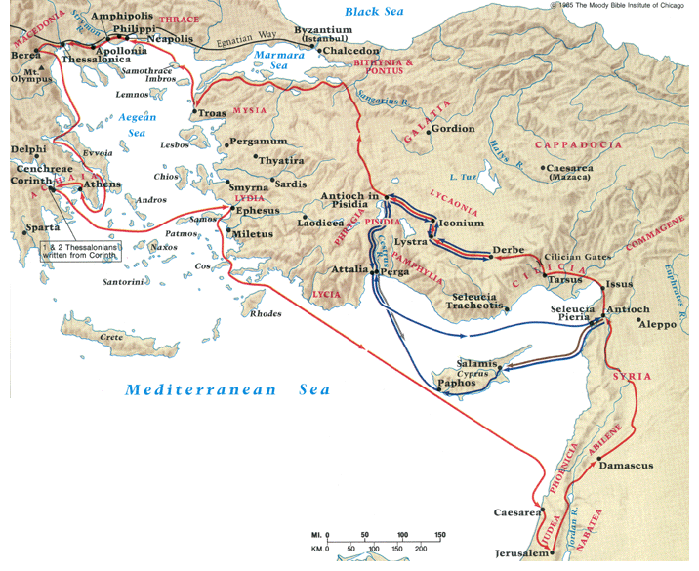
Galatia: “Country of the Gauls”
Gauls
The northern Galatian view (churches established during second journey)
The southern Galatian view (churches established during first journey)

Slide 5
Theme and Purpose of Galatians
1) Judaizers have persuaded relatively new Gentile converts to adopt circumcision and the law of Moses.

Slide 6
Theme and Purpose of Galatians
1) Judaizers have persuaded relatively new Gentile converts to adopt circumcision and the law of Moses.
2) Paul correctly sees this as abandonment of justification by faith and reverting to a law/ works system of salvation. This he seeks to correct.

Slide 7
Theme and Purpose of Galatians
1) Judaizers have persuaded relatively new Gentile converts to adopt circumcision and the law of Moses.
2) Paul correctly sees this as abandonment of justification by faith and reverting to a law/ works system of salvation. This he seeks to correct.
3) Paul expresses his anger at the Judaizers for undermining the faith of the Galatians and his disappointment toward the Galatians for their instability.

Slide 9
Structure of Galatians
Chapters
Authenticity of Paul’s apostleship and his gospel defended.
1 2
Principle of justification by faith (apart from law) defended
3 4
5 6
Practical applications of a faithful life

Slide 10
Galatians 1:1-10
1:1 Paul, an apostle (not from men nor through man, but through Jesus Christ and God the Father who raised Him from the dead), 2 and all the brethren who are with me, To the churches of Galatia: 3 Grace to you and peace from God the Father and our Lord Jesus Christ, 4 who gave Himself for our sins, that He might deliver us from this present evil age, according to the will of our God and Father, 5 to whom [be] glory forever and ever. Amen. 6 I marvel that you are turning away so soon from Him who called you in the grace of Christ, to a different gospel, 7 which is not another; but there are some who trouble you and want to pervert the gospel of Christ. 8 But even if we, or an angel from heaven, preach any other gospel to you than what we have preached to you, let him be accursed. 9 As we have said before, so now I say again, if anyone preaches any other gospel to you than what you have received, let him be accursed. 10 For do I now persuade men, or God? Or do I seek to please men? For if I still pleased men, I would not be a bondservant of Christ.

Slide 11
Salutation – 1:1-5
Paul is a true and legitimate apostle having been made so by Jesus and the Father
Men (particularly the original apostles) were not the agents of Paul’s appointment

Slide 12
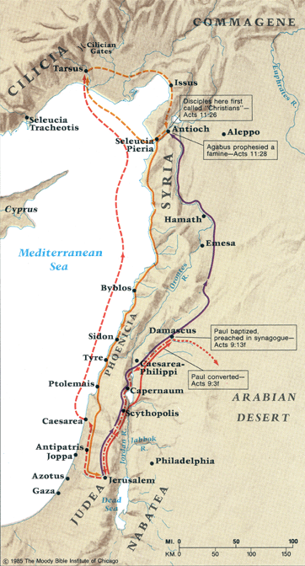
“Not According to Man”
Paul: zealous, successful Jew
Separated from womb to special purpose
Apostle before going to Jerusalem
Preached in Damascus before meeting apostles
Limited contact with apostles

Slide 13
Salutation – 1:1-5
Paul is a true and legitimate apostle having been made so by Jesus and the Father
Men (particularly the original apostles) were not the agents of Paul’s appointment
The “churches of Galatia” seem to be affected , False doctrines might be an influence regionally as well as congregationally.
Jesus is the source of deliverance from “this present evil age.”

Slide 14
Warning – 1:6-10
“I marvel …”. Paul states his surprise that the Galatians have compromised their beliefs so quickly
“turning away … from Him who called you.” Suggest a deeper issue of leaving the Lord, of abandoning Him.
“to a different gospel” Suggest something serious.

Slide 15
Jesus’ View of Scripture
Matthew 5: 17 “Do not think that I came to destroy the Law or the Prophets. I did not come to destroy but to fulfill. 18 For assuredly, I say to you, till heaven and earth pass away, one jot or one tittle will by no means pass from the law till all is fulfilled. 19 Whoever therefore breaks one of the least of these commandments, and teaches men so, shall be called least in the kingdom of heaven; but whoever does and teaches them, he shall be called great in the kingdom of heaven. 20 For I say to you, that unless your righteousness exceeds the righteousness of the scribes and Pharisees, you will by no means enter the kingdom of heaven.

Slide 16

Old Testament Teachings
Teaching of Christ
Teachings of Apostles
I Thes 4:1,2 – Finally then, brethren, we urge and exhort in the Lord Jesus that you should abound more and more, just as you received from us how you ought to walk and to please God; ²for you know what commandments we gave you through the Lord Jesus.

Slide 17
I Thes 4:1,2 …you received from us how you ought to walk…what commandments we gave you through the Lord Jesus
Phil 4:9 The things you learned, received, heard, saw in me: these do
I Thes 2:13,14 …word of God you heard from us…not the word of men… but as it is in truth, the word of God.
II Thes 2:15 …hold the traditions …taught…by word or epistle
I Tim 3:14,15 …continue in the things learned …knowing from whom learned (also vs 10 – you have followed my doctrine…)
I Tim 6:3 …if anyone teaches otherwise…he … knows nothing
I Cor 14:36,37 If anyone thinks himself to be a prophet or spiritual, let him acknowledge that the things I write unto you are the commandments of the Lord.

Slide 18
Universal Consistency:
I Cor 4:16,17a Imitate me… Timothy will remind you of my ways in Christ, as I teach everywhere, in every church.
I Cor 16:1 As I have given orders to the churches of Galatia, so you must do also
I Cor 14:33b,34 as in all the churches of the saints, let the women keep silence…
Col 4:16 See that [this epistle] is read also in the church of the Laodiceans…

Slide 19
Non-acceptance of variation:
II Thes 3:6 Withdraw from every brother who walks…not according to the tradition which he received from us
II Thes 3:14 If anyone does not obey our word in this epistle, note… and do not keep company with him
I Tim 4:1,2 Some will depart from the faith (not eating meats, forbidding to marry

Slide 20
Warning – 1:6-10
“I marvel …”. Paul states his surprise that the Galatians have compromised their beliefs so quickly
“turning away … from Him who called you.” Suggest a deeper issue of leaving the Lord, of abandoning Him.
“to a different gospel” Suggest something serious.
The gospel of Jesus Christ was the “good news” any other ‘news’ was not news nor was it good news.
Definition of news
  a : a report of recent events
  b : previously unknown information
  c : something having a specified influence or effect

Slide 21
Warning – 1:8-9
Unequivocal, absolute declaration:
“anyone (angel or apostle or man) who preaches anything that contradicts what we have previously taught you is accursed.”
1) We are the legitimate conveyors of the gospel message
2) We have done our job completely and properly
3) You have received the full measure of the gospel
4) There is no room for additions or substitutions
5) Any substantive changes is easy evidence of falsehood and consequent condemnation.

Slide 22
Warning – 1:10
10 For do I now persuade men, or God? Or do I seek to please men? For if I still pleased men, I would not be a bondservant of Christ.
1) Is Paul not teaching the Gentiles to be circumcised because he wants to please them?
2) Has Paul been inconsistent in his teachings?

