Slide 1
Jacob’s Journey
A story of God’s transformation

Slide 2
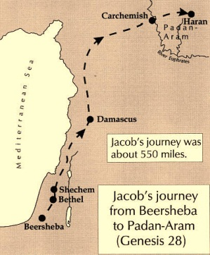

Slide 3
Jacob’s Journey
Phase 1 (Genesis 25-28)
**1st Vision (28:10-22)
Phase 2 (Genesis 29-31)
**2nd Vision (31:2-3, 11-13)
Phase 3 (Genesis 31-32)
**3rd Vision (32:22-32)

Slide 4
Phase 1 (Genesis 25-28)
Jacob is from a messed up family.
25:22,23,28
Jacob has no real belief in God.
25:29-34
27:5-29
27:20,24
Jacob’s sin and selfishness ruins his life.
27:34, 41
28:2

Slide 6
1st Vision: Bethel (28:10-22)
Enters wandering, darkness, and hardship.
Sees stairway reaching down from heaven.
Relationship
See angels going up and down.
Aid & Provision
Receives promises for first time.
LESSON: GOD WANTS A RELATIONSHIP WITH ME.

Slide 7
Phase 2 (Genesis 29-31)

Slide 9
Phase 2 (Genesis 29-31)
Jacob still living mainly for himself.
29:17-18, 30
Jacob’s life full of conflict.
29:20, 21-26, 27-30,
29:31- 30:20
Jacob works hard and is blessed by God.
30:27, 29-30
31:6,9
Jacob unable to break free from Laban.
30:25-43
31:1-2

Slide 11
2nd Vision: Haran (31:2-3, 11-13)
Return to the Promised Land.
God has been with him.
Laban has mistreated him.
Remember Bethel.
LESSON: GOD CALLS ME BACK TO HIS HOUSE.

Slide 12
Phase 3 (Genesis 31-32)
Jacob leaves for Canaan.
31:17-18
Influence of sin still hangs on him.
31:19-21, 25-55
Jacob still mindful of God’s help.
31:42
Jacob has to face the problems he ran from.
32:1-21

Slide 14
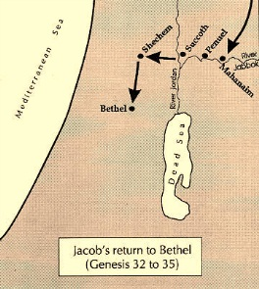

Slide 15
3rd Vision: Mahanaim (32:22-32)
Jacob wrestles with God in the night.
Vows to not let go until God blesses him.
Name changed to Israel.
He struggled with God and man, and prevailed.
LESSON: MY ONLY HOPE IS TO CLING TO GOD.

Slide 16
Conclusion
God transformed Jacob into Israel.
God brought Jacob back to the land.
The sun that set on Jacob eventually rose.
Jacob declared Jehovah his God.
One last vision for Jacob

Slide 18
Conclusion
God transformed Jacob into Israel.
God brought Jacob back to the land.
The sun that set on Jacob eventually rose.
Jacob declared Jehovah his God.
One last vision for Jacob:
35:1- Return to Bethel

Slide 19
FINISH THE JOURNEY

