Slide 1
o

Slide 2
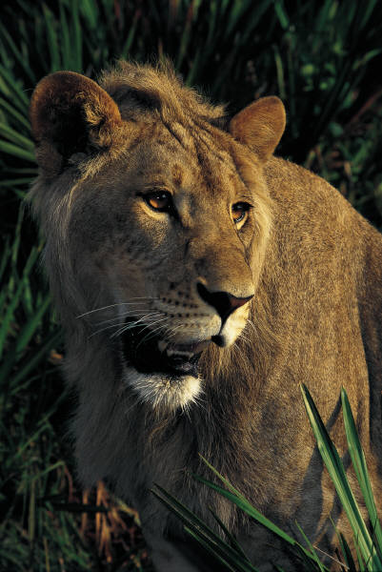
When The World Throws Us To The Lions
We must be what we’ve always been.
We must do what we’ve always done.
We must trust whom we’ve always trusted.

