Slide 1
Four Facts About Spiritual Enemies
Ephesians 6:12

Slide 2
1. You need to recognize them!
Psalm 97:10 - “You that love the Lord hate evil!”
Psalm 119:104 - “Through your precepts I get understanding. Therefore I hate every false way.”
Luke 6:26 - “Woe to you when all men speak well of you…”

Slide 3
2. Different enemies threaten more at different stages...
Stages of life (2 Tim. 2:22; Titus 2)
Stages of Bible history
Egyptian “gods” - Josh. 24:14
Canaanite “gods” - Judges 2:12
Apathy, Discouragement - Haggai
Spiritual Pride - Matthew 23
Judaizing teachers - Galatians
Gnosticism - 1 John, 1,2 Corinthians
Persecution - Revelation

Slide 4
2. Different enemies threaten more at different stages...
In “recent” history of known disciples:
1800 - 1860 - Denominations
1860 - 1900 - Prosperity, Desire to copy denominations
1900 - 1950 - Infighting
1950 - 1970 - Prosperity, Desire to copy denominations
1970 - 2000 - Infighting
2000 - - Postmodernism, worldliness

Slide 5
3. Different generations often fear different enemies

Slide 6
4. The enemy that “gets us” is usually the one we don’t fear
Numbers 13:32, 33 - And they gave the children of Israel a bad report of the land which they had spied out, saying, “The land through which we have gone as spies is a land that devours its inhabitants, and all the people whom we saw in it are men of great stature.
33 There we saw the giants (the descendants of Anak came from the giants); and we were like grasshoppers in our own sight, and so we were in their sight.

Slide 7
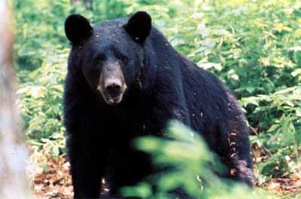
4. The enemy that “gets us” is usually the one we don’t fear

Slide 8
Satan’s 10 most effective weapons
10. Antireligious scientific theories
9. False religions
8. Party spirit among Christians
7. Spirit of presumption regarding God’s authority
6. Postmodernism
5. Materialism
4. Comfortable Christianity
3. Worldliness (TV, movies, entertainment culture),
2. Lust of flesh, pornography
1. Pride/selfishness lack of love

Slide 9
Enemies Beyond Our Comprehension
Eph. 6:12 “For we do not wrestle against flesh and blood, but against principalities, against powers, against the rulers of the darkness of this age, against spiritual hosts of wickedness in the heavenly places.”
But God has not left us defenseless - Ephesians 6:14 - 18
Our greatest defense - A fervent love for God

