Slide 1
Be prepared to share a couple key learnings you have from chapters 1 & 2
Read Galatians 3:1-14
Review Lesson 5 questions

Slide 2
A Study of Galatians
Lesson 5
Galatians 3:1-14
The Just shall live by Faith

Slide 3
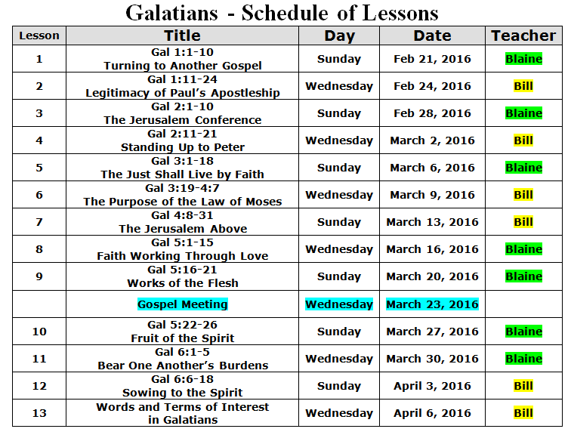

Slide 4

Structure of Galatians
Chapters
Authenticity of Paul’s apostleship and his gospel defended.
1 2
Principle of justification by faith (apart from law) defended
3 4
5 6
Practical applications of a faithful life

Slide 5
Galatians Lessons Learned:
1. Paul challenges the fault teaching
2. “turning away … from Him who called you.” “to a different gospel” Suggest a serious and deep issue of leaving the Lord, of abandoning Him.
3. “anyone (angel or apostle or man) who preaches anything that contradicts what we have previously taught you is accursed.” Unequivocal, absolute declaration, of having what they(we) needed
4. There was benefit in the study of God’s word with others in Jerusalem; there was/is one Truth and one source.
5. Paul’s teaching were/ are authoritative
6. Even the ‘strong’ can be effected by peer pressure and need for social acceptance

Slide 6
What contributes to a person’s vulnerability in being led astray into false doctrine?
Personal & cultural baggage / desires
Family History / Influence
Lack of Study
Lack of thought / consideration

Slide 7
Origin of the Galatians’ Faith - 3:1-5
3:1 O foolish Galatians! Who has be-witched you that you should not obey the truth, before whose eyes Jesus Christ was clearly portrayed among you as crucified? 2 This only I want to learn from you: Did you receive the Spirit by the works of the law, or by the hearing of faith? 3 Are you so foolish? Having begun in the Spirit, are you now being made perfect by the flesh? 4 Have you suffered so many things in vain -- if in-deed [it was] in vain? 5 Therefore He who supplies the Spirit to you and works miracles among you, [does He do it] by the works of the law, or by the hearing of faith? --

Slide 8
Origin of the Galatians’ Faith - 3:1-5
?
3:1 O foolish Galatians! Who has be-witched you that you should not obey the truth, before whose eyes Jesus Christ was clearly portrayed among you as crucified? 2 This only I want to learn from you: Did you receive the Spirit by the works of the law, or by the hearing of faith? 3 Are you so foolish? Having begun in the Spirit, are you now being made perfect by the flesh? 4 Have you suffered so many things in vain -- if in-deed [it was] in vain? 5 Therefore He who supplies the Spirit to you and works miracles among you, [does He do it] by the works of the law, or by the hearing of faith? --
Law
Faith
Sprit

Slide 9
Origin of the Galatians’ Faith - 3:1-5
3:1 O foolish Galatians! Who has be-witched you that you should not obey the truth, before whose eyes Jesus Christ was clearly portrayed among you as crucified? 2 This only I want to learn from you: Did you receive the Spirit by the works of the law, or by the hearing of faith? 3 Are you so foolish? Having begun in the Spirit, are you now being made perfect by the flesh? 4 Have you suffered so many things in vain -- if in-deed [it was] in vain? 5 Therefore He who supplies the Spirit to you and works miracles among you, [does He do it] by the works of the law, or by the hearing of faith? --
Law
Faith
Sprit
John 3:5 Jesus answered, “Most assuredly, I say to you, unless one is born of water and the Spirit, he cannot enter the kingdom of God. 6 That which is born of the flesh is flesh, and that which is born of the Spirit is spirit.

Slide 10
Origin of the Galatians’ Faith - 3:1-5
3:1 O foolish Galatians! Who has be-witched you that you should not obey the truth, before whose eyes Jesus Christ was clearly portrayed among you as crucified? 2 This only I want to learn from you: Did you receive the Spirit by the works of the law, or by the hearing of faith? 3 Are you so foolish? Having begun in the Spirit, are you now being made perfect by the flesh? 4 Have you suffered so many things in vain -- if in-deed [it was] in vain? 5 Therefore He who supplies the Spirit to you and works miracles among you, [does He do it] by the works of the law, or by the hearing of faith? --
Law
Faith
Sprit
1 Corinthians 12:13 For by one Spirit we were all baptized into one body—whether Jews or Greeks, whether slaves or free…

Slide 11
Origin of the Galatians’ Faith - 3:1-5
3:1 O foolish Galatians! Who has be-witched you that you should not obey the truth, before whose eyes Jesus Christ was clearly portrayed among you as crucified? 2 This only I want to learn from you: Did you receive the Spirit by the works of the law, or by the hearing of faith? 3 Are you so foolish? Having begun in the Spirit, are you now being made perfect by the flesh? 4 Have you suffered so many things in vain -- if in-deed [it was] in vain? 5 Therefore He who supplies the Spirit to you and works miracles among you, [does He do it] by the works of the law, or by the hearing of faith? --

Slide 12
Origin of the Galatians’ Faith - 3:1-5
God
3:1 O foolish Galatians! Who has be-witched you that you should not obey the truth, before whose eyes Jesus Christ was clearly portrayed among you as crucified? 2 This only I want to learn from you: Did you receive the Spirit by the works of the law, or by the hearing of faith? 3 Are you so foolish? Having begun in the Spirit, are you now being made perfect by the flesh? 4 Have you suffered so many things in vain -- if in-deed [it was] in vain? 5 Therefore He who supplies the Spirit to you and works miracles among you, [does He do it] by the works of the law, or by the hearing of faith? --
Sprit
?
Law
Faith
Miracles
Miracles

Slide 13
The True Sons of Abraham – 3:6-9
God
Faith ?
6 just as Abraham "believed God, and it was accounted to him for righteousness." 7 Therefore know that [only] those who are of faith are sons of Abraham. 8 And the Scripture, fore-seeing that God would justify the Gentiles by faith, preached the gospel to Abraham beforehand, [saying,] "In you all the nations shall be blessed." 9 So then those who [are] of faith are blessed with believing Abraham.
Law Keeping ?

Slide 14
Escaping the Curse of the Law – 3:10-14
Deuteronomy 27:26 ‘Cursed is the one who does not confirm all the words of this law by observing them…’
Habakkuk 2:4 “Behold the proud,
His soul is not upright in him;
But the just shall live by his faith.”
Leviticus 18:5 You shall therefore keep My statutes and My judgments, which if a man does, he shall live by them: I am the Lord.
10 For as many as are of the works of the law are under the curse; for it is written, "Cursed [is] everyone who does not continue in all things which are written in the book of the law, to do them." 11 But that no one is justified by the law in the sight of God [is] evident, for "the just shall live by faith." 12 Yet the law is not of faith, but "the man who does them shall live by them." 13 Christ has redeemed us from the curse of the law, having become a curse for us (for it is written, "Cursed [is] everyone who hangs on a tree"), 14 that the blessing of Abraham might come upon the Gentiles in Christ Jesus, that we might receive the promise of the Spirit through faith.

Slide 15
4. Where else in the NT is Gen 15:6 quoted? For what purpose(s)?

