Slide 2
When Will Jesus Return?
Steve Wolfgang
15 May 2011
Embry Hills, Atlanta

Slide 3
What Were You Doing?
September 9, 1988?
October 28, 1992?
September 6, 1994?

Slide 4
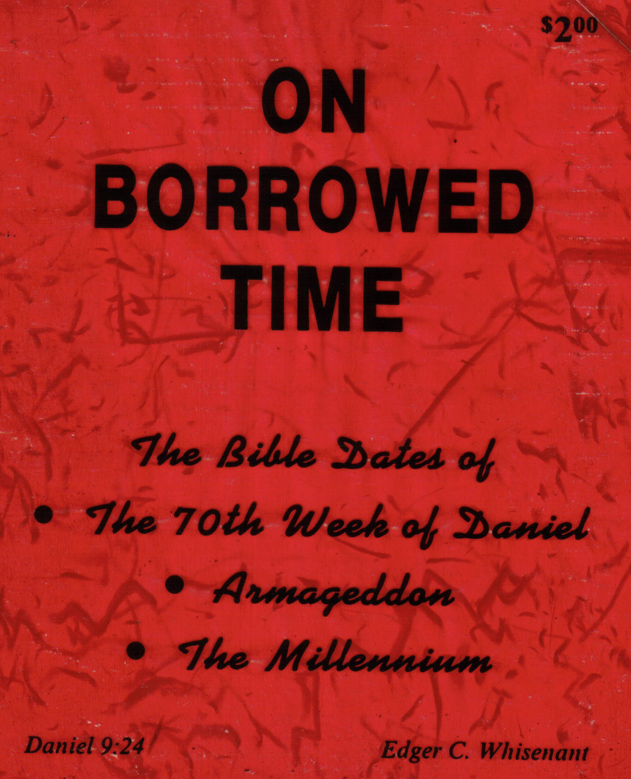
1988 1989

Slide 5
Rapture Ruptured

Slide 6
Tim LaHaye Jerry Jenkins Left Behind

Slide 8
Left Behind 70+ Million Copies

Slide 10
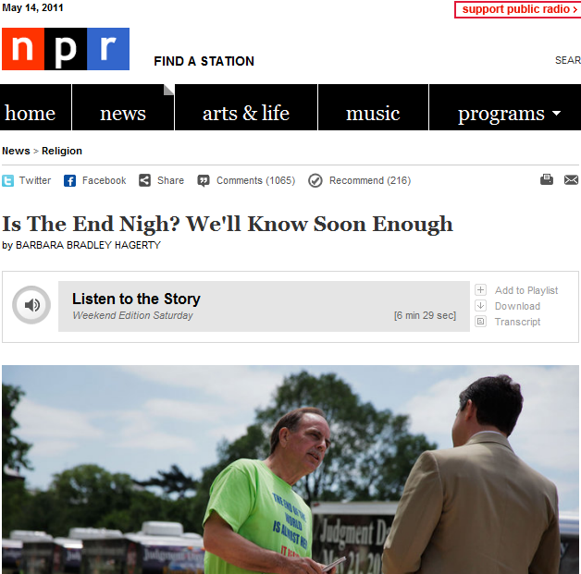

Slide 11
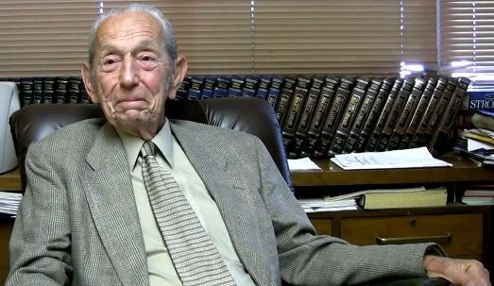
Harold Camping
Born 19 July 1921
BS, Civil Engineering,
U Cal, Berkeley
Founded Family Radio,
San Francisco Bay area,
--1958
Heard on AM/FM radio,
short wave, satellite, internet
Christian Reformed Church until 1988

Slide 12
Harold Camping Family Radio
Predicted the “rapture” to occur on 6 September, 1994
Now predicts “rapture” on 21 May 2011
God will then totally destroy the earth on 11 October 2011

Slide 13
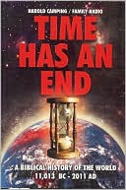
Harold Camping
Based on his 1970 book,
The Biblical Calendar
of History
Revised as Adam When?
Time Has An End: A
Biblical History of the
World: 11,013 BC
To 2011 AD
Latest: We Are
Almost There!

Slide 14
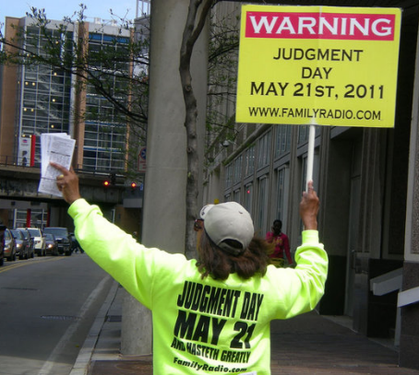
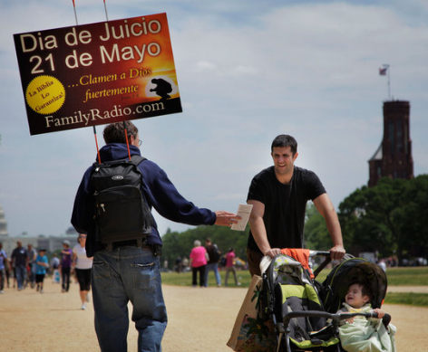
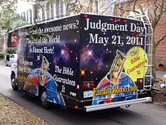

Slide 15
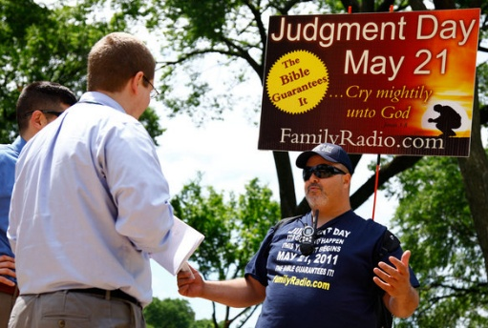

Slide 16
Deuteronomy 18:20-22
“But the prophet who presumes to speak a word in My name, which I have not commanded him to speak, or who speaks in the name of other gods, that prophet shall die. And if you say in your heart, ‘How shall we know the word which the LORD has not spoken?’ – when a prophet speaks in the name of the LORD, if the thing does not happen or come to pass, that is the thing which the LORD has not spoken; the prophet has spoken it presumptuously; you shall not be afraid of him.”

Slide 17
Millennialism
From Greek, mille, for 1000 years
With reference to Christ’s return
POST: return after millenium
- popular in 19th century
- tends to optimism
PRE: return before millennium
- Prophecy conferences from 1878
A-millennialism: figurative, present

Slide 18
Millennial Groups
Seventh-Day Adventism
Jehovah’s Witnesses
Assemblies of God
Church of God in Christ
Many Pentecostal, charismatic, Evangelical/Fundamentalist groups

Slide 19
Pre-millennial-ism

Slide 22
Pre-millennial-ism

Slide 23
Last Issue Before Christ Returns! 16 October 1844

Slide 24
Isaac Errett Christian Standard, 1866
“in our country there is a widespread and growing interest in the study of prophecy, as is evident from the number of books and pamphlets constantly issuing from the press” – books in which “the prevalent tendency at present is to what is called Chiliasm -- the premillennial advent of the Messiah and his personal reign of a thousand years on the earth.”

Slide 25
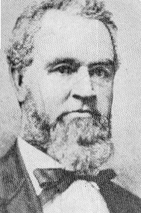
Isaac Errett Christian Standard, 1866
“perplexing and unprofitable”
“proneness to extremes”
“ingenious attempts to force
peculiar interpretations”
“pernicious results of much
of the literalistic and
dogmatical interpretation
now so fashionable.”

Slide 26
Isaac Errett Christian Standard, 1866
Every variety of extravagant conception is gravely put forth as the certain teaching of the Scripture. . . The second chapter of Daniel refers to the United States! Louis Napoleon is the Man of Sin! The Battle of Armageddon is to be fought in the Mississippi Valley!

Slide 27
Isaac Errett Christian Standard, 1866
Preachers go into the pulpits with their pockets filled with Tribunes and Heralds …and demonstrate that the “little horn” that symbolizes Louis Napoleon is at least one eighth of an inch longer than it was at the last lecture.

Slide 28
Isaac Errett Christian Standard, 1866
“An earthquake, the rising
of an island out of the sea,
a rumor of war, a
commercial panic, or a
bit of gossip about what
Napoleon said is a god-send
to these interpreters.”

Slide 29
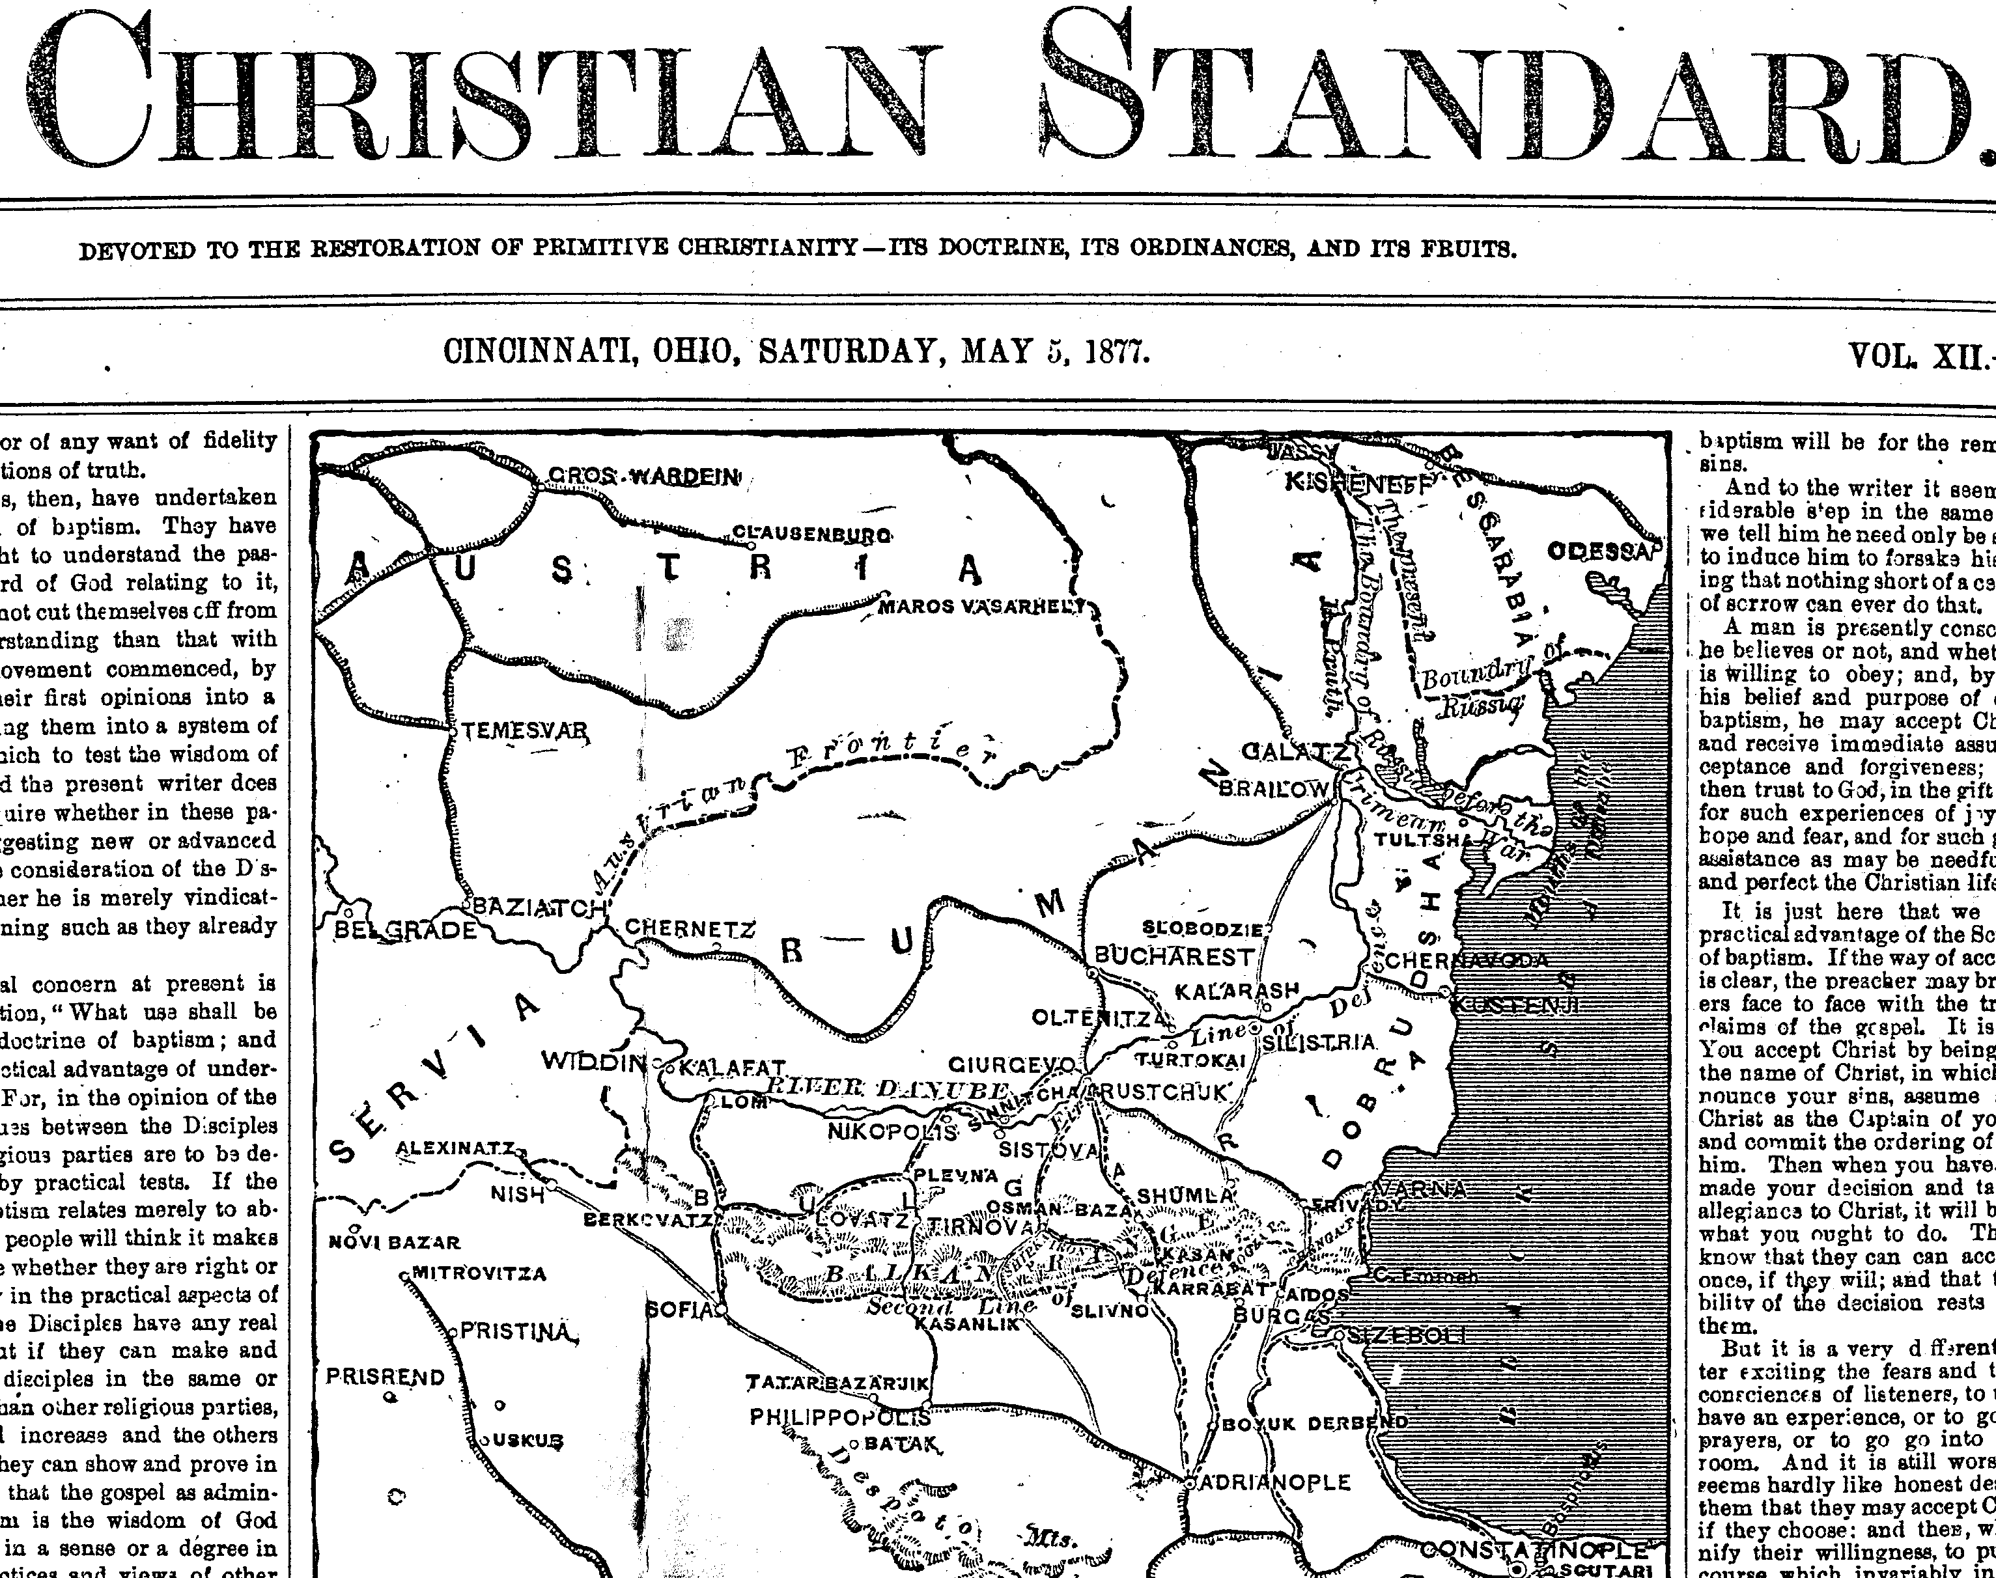

Slide 32
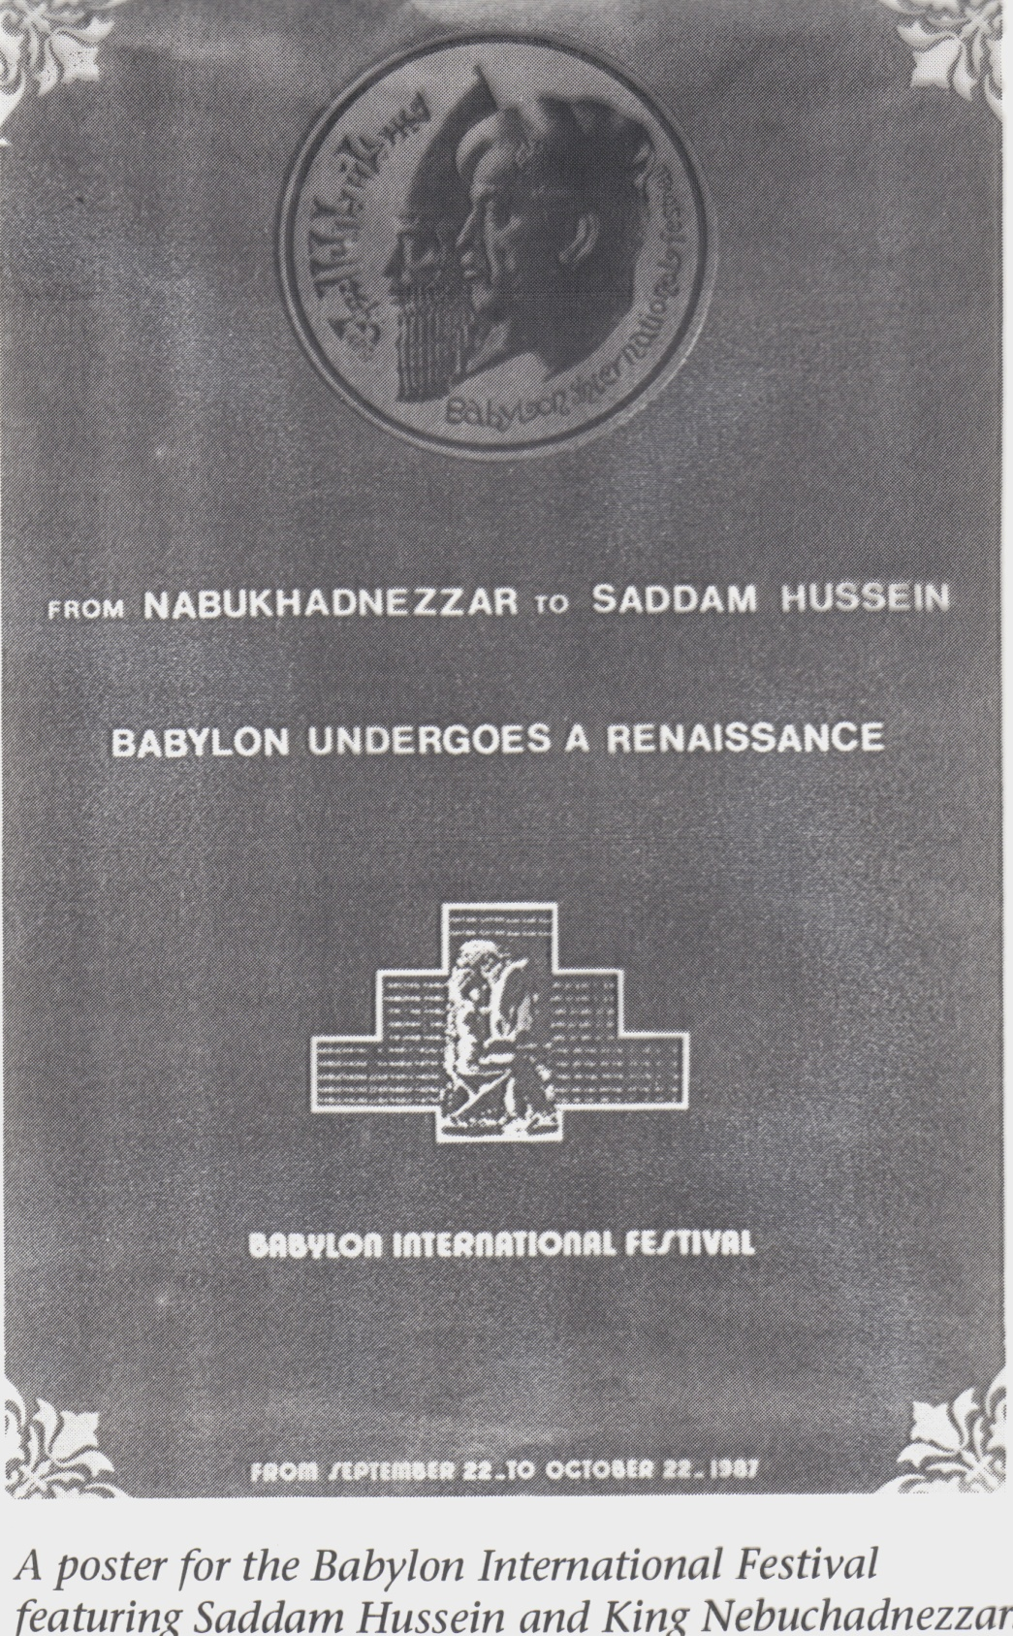

Slide 33
Matthew 24
Background:
Matthew 22-23
Questions: v3
Answers: vv32, 36

Slide 34
Did Jesus Return Already? Who Knew?
Realized Eschatology
Preterism
Partial Preterism
Full Preterism
AD 70 Doctrine
Max King teachings

Slide 35
What Happened in 70 AD?
Destruction of Jerusalem
Second Coming of Christ
End of the World
Resurrection of the Dead
Day of Judgment
Eternal Kingdom Established

Slide 36
“A.D. 70 Doctrine”

Slide 37
“Realized Eschatology”
Eschatology – from Greek, eschatos, superlative for “final” or “last”
Belief that the “last things” had to occur for Christ to fully establish his reign or kingdom
“Realized” = this has already fully occurred, or been “realized”

Slide 38
“Preterism”
Doctrine teaching that most or all of the Biblical prophecies concerning the “last days” or “end times” refer to events which occurred in the 1st century after Christ’s birth
“Full Preterism” or “Hyper-Preterism” holds that all such prophecies were fulfilled in the AD 70 destruction of Jerusalem

Slide 39
“Words Mean What I Want Then To Mean”
“Heaven & earth” = Jewish economy
“Judgment Day” = Destruction of Judaism
“End of the world” = end of Jewish system
“Resurrection” = revival of church from the dead form of Judaism

Slide 40
“Words Mean What I Want Then To Mean”
“Resurrection” = revival of church from the dead form of Judaism
“out of the decay of Judaism rose the spiritual body of Christianity…this is the primary meaning of Paul’s statement [in 1 Cor 15:42-44]”
Max King, Spirit of Prophecy, pp. 199-200

Slide 41
If Jesus Already Came…
1 Corinthians 4:1-5 –Why can’t we judge hidden things?
1 Corinthians 11:23-26 – Why still observe the Lord’s Supper?
Matthew 22:29 – Why are we still married?
Luke 20:34-36 – Why is there still death?

Slide 42
What Saith the Scripture?
Acts 1:9 – “in like manner”
Acts 17:31 – day of judgment – Athenians
Philippians 3:20-21 – transformation concurrent with return from heaven
Revelation 21:4 – pain and death are still realities
Matthew 24–25

Slide 43
Why “Popularity?”
Not that popular
Seems outlandish
Passages strained; words re-invented
Answers premillennialism?
Promotes arcane, “secret” knowledge
“Fresh look” – pride?
Often held by those with other “issues”

Slide 44
How Is This Different From 2 Timothy 2:14-19?
“their talk will spread like gangrene…men who have gone astray from the truth, saying tha the resurrection has already taken place, and they upset the faith of some” (vv. 17-19)

Slide 45
The End

Slide 50
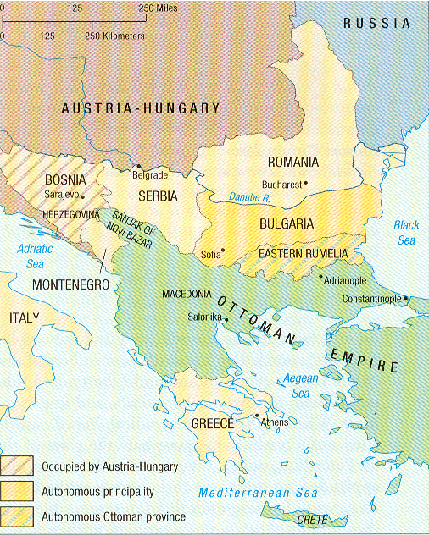

Slide 51
Isaac Errett Christian Standard, 1866
New Testament Christians “did not belong to this world. They ‘confessed that they were strangers and pilgrims.’ They cut loose from its ambitions, and pleasures, as fearing to be lured into forgetfulness of the superior joys of the coming Kingdom of God.”

Slide 52
Isaac Errett Christian Standard, 1866
We see but little now of this heavenly-mindedness -- the eager looking for the day of God, which held the primitive disciples aloof from the pomps, and the strifes, and the follies of the world. . . Heaven is not a reality to us. . . and tired of shadowy theories, we have learned to ‘love this present world.’ The Church greatly needs to be led back to the primitive hope.”

Slide 53
Isaac Errett Christian Standard, 1866
“one extreme…
quenches the
inspiration of
the ‘one hope’
so dear to the
apostolic church”

Slide 54
Isaac Errett Christian Standard, 1866
“another extreme -- that of exalting this theme into the place of the Gospel . . . burdening the divine promise of the Savior’s return with such a medley of sensuous, dogmatic, and absurd literalisms, as to bring the theme itself into contempt.”

Slide 55
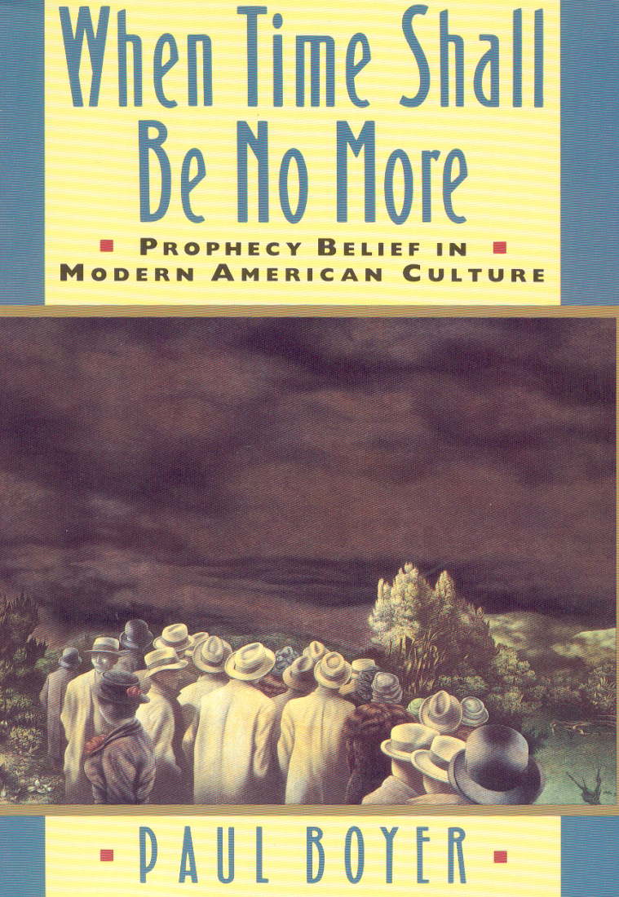
Ezekiel 38 “Rosh” = Russia
Gesenius, a
German Hebraicist
at the University
of Halle, identified
the “Rosh” of
Ezekiel 38 as
“Russia.”

Slide 56
Wilhelm Gesenius (1786-1842)
Gesenius, whose 1828 Hebrew-Chaldee lexicon became a standard reference work, went so far as to identify “Meschech” in the same chapter with Moscow – and “Tubal” with the Siberian city, “Tobolsk.”
Paul Boyer, When Time Shall Be No More: Prophecy Belief in Modern American Culture (Cambridge, MA: Harvard University Press, 1992), pp. 84-86, 154-156.

Slide 57
Turkish Anti-Christ
The Ottoman Turks, on the other hand, had an even longer career as the anti-Christ, dating from at least the 16th century, when Luther identified them as Gog of Ezekiel 38 in the 1530 edition of his German Bible – as did a variety of Roman Catholic commentators.

Slide 58
Anti-Christ = Ottoman Turks
“The Islamic Turks had long been regarded as an antichristian power throughout the European world, and had been viewed as such in earlier English and American works of prophetic interpretation,” becoming by the late eighteenth century “a major theme in American millennial literature.”[i] [i] Ruth H. Bloch, Visionary Republic: Millennial Themes in American Thought, 1786-1800 (Cambridge: Cambridge University Press, 1985, p. 145.

Slide 59
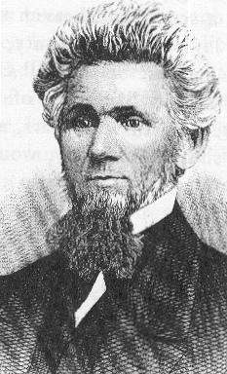
Amos Sutton Hayden
b. Mahoning County, 1813
Baptized at age 15
by Walter Scott
Principal, Western Reserve
Eclectic Institute, 1850-57
(Hiram College)
The Sacred Melodeon &
History of Disciples on the Western Reserve

Slide 61
S. Hayden Christian Standard, 1877
“The sanctuary being the church, . . . the Prince of the host is none other than Jesus Christ . . . the ‘horn,’ Islamism, the religion of Mohammed, has a host of warriors given him against the saints, the followers of Jesus.”

Slide 62
Amos Sutton Hayden
By the Mohammedan power, the place of the sanctuary, the whole territory of the primitive church of Christ, was invaded, overrun with fire and sword in the hands of the ‘locusts,’ the armies of war . . . They have literally ‘trodden down’ the place of the sanctuary, the lands of the Christian Church. And they have held all these lands in vassalage to the Moslem rule from the time the Apocalyptic locusts began their ravages to the present hour.

Slide 63
S. Hayden Christian Standard, 1877
“And who does not see,” he inquired, “in the complete and overwhelming overthrow of the Christian religion, effected by the Califs of that new and vigorous imposture, the exact fulfillment of the prophecy before us in the eighth chapter of Daniel, and the ninth chapter of the Revelation?”

Slide 64
Amos Sutton Hayden
“What a wonderful and
convincing demonstration
the prophecy affords
of the truth of the Bible.”
“Turkey in the Light of Prophecy, VIII” Christian Standard 12 (June 30, 1877):204-205.

Slide 65
A.S. Hayden Christian Standard, 1877
“corruption grew up in the church. She lost her first love. Dogmatics took the place of the truth . . . ambition and pride and avarice filled the high places of the church . . . Heresy, fanaticism, and division prevailed. Monasticism was introduced, and spread rapidly. The worship of images, prayers for the dead ... and innumerable other departures from the faith were accepted. . . “

Slide 66
Amos Sutton Hayden
“The culmination of this state of defection was the fully developed ‘man of sin,’ with Rome as the seat and center of it, and the overthrow of the churches of the East by the victorious arms of the Arabian prophet.”
“Turkey in the Light of Prophecy, VIII”
Christian Standard 12 (June 30, 1877): 204-205.

Slide 67
Washington’s Birthday Congressional Address, 1857
Popularizing the work of another Tennessee Methodist, Samuel Davies Baldwin, President of Soule College at Murfreesboro, Fountain Pitts used his Congressional address to calculate the exact time of the destruction of the temple. Beginning with the offering of the daily sacrifice which occurred “according to astronomy, at sunrise, three minutes past five o’clock A.M.” on “the 189th day of the year 68 A.D.”

Slide 68
Solar Time – 1290 Days
As recounted by a newspaper reporter, Pitts then calculated from that point by “solar time, according to the eclipses of the sun,” reaching the remarkably exact conclusion that “the 1290 days run out at a quarter to three o’clock P.M. on the 4th day of July, 1776” – which, according to “the best sources of information,” was the exact time at which the Declaration of Independence was proclaimed “on the glorious fourth.”

Slide 69
American Millennium
Armed with such precise timetables, Pitts then predicted that Armageddon would be fought in the Mississippi River valley, when Rosh (Russia) would invade the United States. Prevailing with Divine help, however, the United States would lead the world into a millennial age where “commerce and trade, agriculture and manufactures, science and art” would flourish, and the entire world would know “but one kind of civil government. . ., Republicanism, and but one religion. . ., Christianity.”

Slide 70
A.S. Hayden Christian Standard, 1877
Wary of all such time-specific schemes, Hayden attempted to distance himself from any attempt to calculate an exact day or hour. Still, when he came to Revelation 9:15, he could scarcely refrain from his own exercise in numerology. Explaining the text, “And the four angels were loosed which were prepared for an hour and a day, and a month and a year, for to slay the third part of men,” Hayden explained, “That is, [in] prophetic time 391 years and 15 days.”

Slide 71
Millennial Arithmetic
By starting in the year 1281, [when] the Turks, under Ortogrul, gained their first victory over the Greek empire by the conquest of Cutahi; and in the year 1672, they wrested Kamienietz, their last conquest, from the Poles. If we now compute 391 years from the year 1281, they will exactly bring us down to the year 1672.

