Slide 1
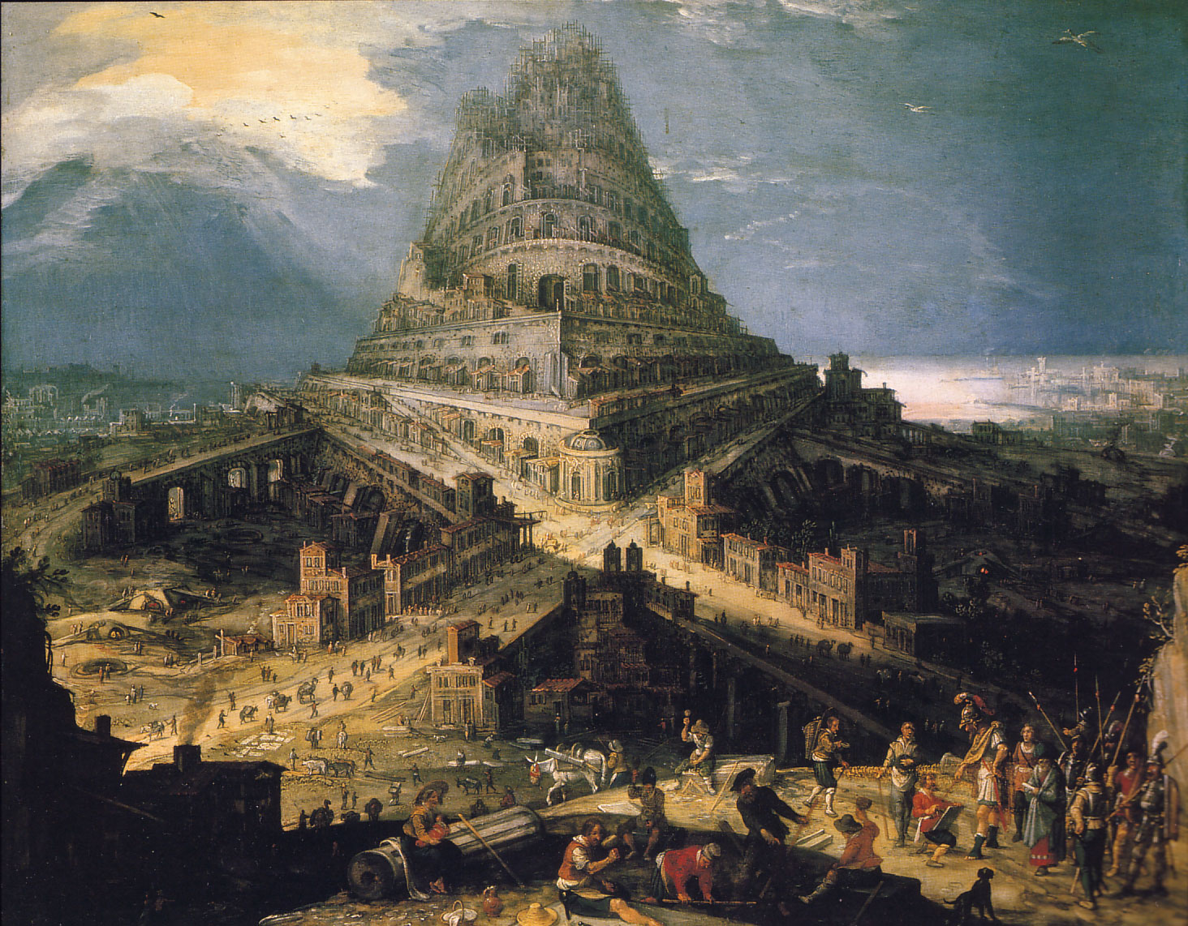
A Tale of Two Cities

Slide 2
The Great City: The City of Man
0
Then Cain went out from the presence of the LORD and dwelt in the land of Nod on the east of Eden. And Cain knew his wife, and she conceived and bore Enoch. And he built a city, and called the name of the city after the name of his son—Enoch. Genesis 4:16-17

Slide 3
The Great City: The City of Man
“we shall rebel”
Cush fathered Nimrod; he was the first on earth to be a mighty man… The beginning of his kingdom was Babel, Erech, Acca, and Calneh, in the land of Shinar. From that land he went into Assyria and built Nineveh, Rehoboth-Ir, Calah, and Resen between Nineveh and Calah; that is the great city. Genesis 10:8, 10-12 (ESV)

Slide 4
The Great City: The City of Man
And they said, “Come, let us build ourselves a city, and a tower whose top is in the heavens; let us make a name for ourselves…” Genesis 11:4
Bab-ili
“the gate of god”
Babel
the city of confusion

Slide 5
The Great City: The City of Man
Tyre
Nineveh
Babylon
Dedicated to glory of self
Autonomy from God
Opposed to God and his people

Slide 6
The Great City: The City of Man
Purple and scarlet (v 4)
Dedicated to glory of self
Autonomy from God
Opposed to God and his people

Slide 7
The Great City: The City of Man
Abominations and fornication (v 4)
Dedicated to glory of self
Autonomy from God
Opposed to God and his people

Slide 8
The Great City: The City of Man
Dedicated to glory of self
Autonomy from God
Opposed to God and his people
Blood of the saints (v 6)

Slide 9
The Holy City: The City of God
By faith Abraham obeyed when he was called to go out to the place which he would receive as an inheritance. And he went out, not knowing where he was going. By faith he dwelt in the land of promise as in a foreign country, dwelling in tents with Isaac and Jacob, the heirs with him of the same promise; for he waited for the city which has foundations, whose builder and maker is God. Hebrews 11:8-10

Slide 10
The Holy City: The City of God
“Now make us a king to judge us like all the nations.” 1 Samuel 8:5

Slide 11
The Holy City: The City of God
But King Solomon loved many foreign women, as well as the daughter of Pharaoh: women of the Moabites, Ammonites, Edomites, Sidonians, and Hittites—from the nations of whom the LORD had said to the children of Israel, “You shall not intermarry with them, nor they with you. Surely they will turn away your hearts after their gods.” Solomon clung to these in love. 1 Kings 11:1-2

Slide 12
The Holy City: The City of God
Dedicated to glory of self
Autonomy from God
Opposed to God and his people

Slide 13
The Holy City Today
…you have come to Mount Zion and to the city of the living God, the heavenly Jerusalem, to an innumerable company of angels, to the general assembly and church of the firstborn who are registered in heaven, to God the Judge of all, to the spirits of just men made perfect, to Jesus the Mediator of the new covenant, and to the blood of sprinkling that speaks better things than that of Abel. Hebrews 12:22-24

Slide 14
The Holy City Today
And to the angel of the church in Pergamos write… “I know your works, and where you dwell, where Satan’s throne is. And you hold fast to My name and did not deny My faith even in the days in which Antipas was My faithful martyr, who was killed among you, where Satan dwells. Revelation 2:12-13

Slide 15
The Holy City Today
“Because you say, ‘I am rich, have become wealthy, and have need of nothing’… I counsel you to buy from me gold refined in the fire” Revelation 3:17-18

Slide 16
The Holy City Today
“Behold, I stand at the door and knock. If anyone hears My voice and opens the door, I will come in to him and dine with him, and he with Me.” Revelation 3:20

Slide 17
…the name of the city from that day shall be: THE LORD IS THERE.”
Ezekiel 48:35

Slide 18
Our Lord finds our desires not too strong, but too weak. We are half-hearted creatures, fooling about with drink and sex and ambition when infinite joy is offered us, like an ignorant child who wants to go on making mud pies in a slum because he cannot imagine what is meant by the offer of a holiday at the sea. We are far too easily pleased.
(C.S. Lewis “The Weight of Glory”)

