Slide 1
Study of Daniel
Spring 2016

Slide 2
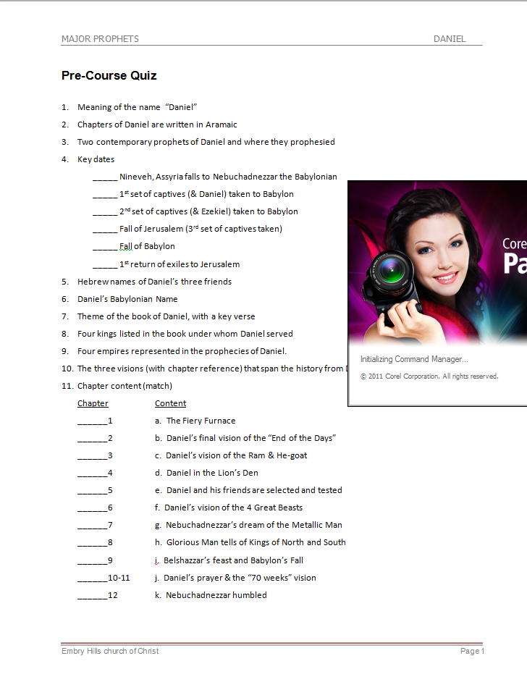
Take Pre-course Quiz on Daniel

Slide 3
A. Daniel’s Personal Information
Daniel: “God is my Judge”
Life spanned Babylonian & Medo-Persian Empires
Book spans 70 years of Daniel’s life (606-536 BC)
Daniel’s work was primarily in Babylon
Contemporary Prophets: Jeremiah and Ezekiel
Jeremiah remained in Jerusalem
Ezekiel prophesied in Babylon
Daniel’s Class: “King’s descendant” and “Noble”

Slide 4
1445-1405 BC
Wilderness
Wanderings
931-722 BC
Divided
Kingdom
605-538 BC
Babylonian
Captivity
444 BC - ~4 BC
The Silent Years
(Intertestamental)
30-90 AD
The Church
NT Era
2166-1859 BC
Patriarchs
1300-1050 BC
Judges
Slavery in Egypt
1859-1445 BC
Conquest
of Canaan
1405-1300 BC
United
Kingdom
1050-931 BC
Life of
Christ
4 BC – 30 AD
United
Kingdom
1050-931 BC
Judah
Alone
722-605 BC
Return
From Exile
538-444 BC
722 BC
586 BC
Temple/City Destroyed
Northern Kingdom:
ISRAEL
597 BC
Ezekiel
605 BC
Daniel
Saul
David
Solomon
Southern Kingdom:
JUDAH
931 BC
Based on Graphics from Marc Hinds & David Maxson
Notes:
With animation

Slide 5
C. Theme of Daniel
And He changes the times and the seasons; He removes kings and raises up kings; He gives wisdom to the wise And knowledge to those who have understanding. (Dan 2:21)
In order that the living may know That the Most High rules in the kingdom of men, Gives it to whomever He will, And sets over it the lowest of men.’ (Dan 4:17)
And you have lifted yourself up against the Lord of heaven. They have brought the vessels of His house before you, and you and your lords, your wives and your concubines, have drunk wine from them. And you have praised the gods of silver and gold, bronze and iron, wood and stone, which do not see or hear or know; and the God who holds your breath in His hand and owns all your ways, you have not glorified. (Dan 5:23)

Slide 6
D. Characters from Daniel
Four Hebrew Men in Babylon
Ch 1-2,4-12
Daniel^{H}
“God is my Judge”
Belteshazzar^{B}
“May Balak protect”
Ch 1,3
Shadrach^{B}
“Command of Aku”
Hananiah^{H}
“The Lord is gracious”
Ch 1,3
Meshach^{B}
“Who is what Aku is”
Mishael^{H}
“Who is what God is”
Ch 1,3
Abenego^{B}
“Servant of Nebo”
Azariah^{H}
“The Lord has helped”
Two Kings of Babylon
Ch 1-4
Nebuchadnezzar
“Nebo, protect the crown”
Ch 5,7,8
Belshazzar
“Bel protect the king”
Two Kings of Medo-Persian
Ch 1,6,10
Cyrus the Persian
“Throne”
Ch 5-6,9,11
Darius the Mede – governor of Babylon
“Preserver”

Slide 7
Chapter Content
Chapter Content
____ 1 a. Daniel’s friends in the Fiery Furnace
____ 2 b. Daniel’s final vision of the “End of the Days”
____ 3 c. Daniel’s vision of the Ram & He-goat
____ 4 d. Daniel in the Lion’s Den
____ 5 e. Daniel and his friends are selected and tested
____ 6 f. Daniel’s vision of the 4 Great Beasts
____ 7 g. Nebuchadnezzar’s dream of the Metallic Man
____ 8 h. Glorious Man tells of Kings of North and South
____ 9 i. Belshazzar’s feast and Babylon’s Fall
____ 10-11 j. Daniel’s prayer & the “70 weeks” vision
____ 12 k. Nebuchadnezzar humbled
e
g
a
k
i
d
f
c
j
h
b

Slide 8
Chapter Content
Chapter Content of Daniel
1 Daniel and his friends are selected and tested
2 Nebuchadnezzar’s dream of the Metallic Man
Daniel’s friends in the Fiery Furnace
Nebuchadnezzar humbled
5 Belshazzar’s feast and Babylon’s Fall
6 Daniel in the Lion’s Den
7 Daniel’s vision of the 4 Great Beasts
8 Daniel’s vision of the Ram & He-goat
9 Daniel’s prayer & the “70 weeks” vision
10-11 Glorious Man tells of Kings of North and South
12 Daniel’s final vision of the “End of the Days”

Slide 9
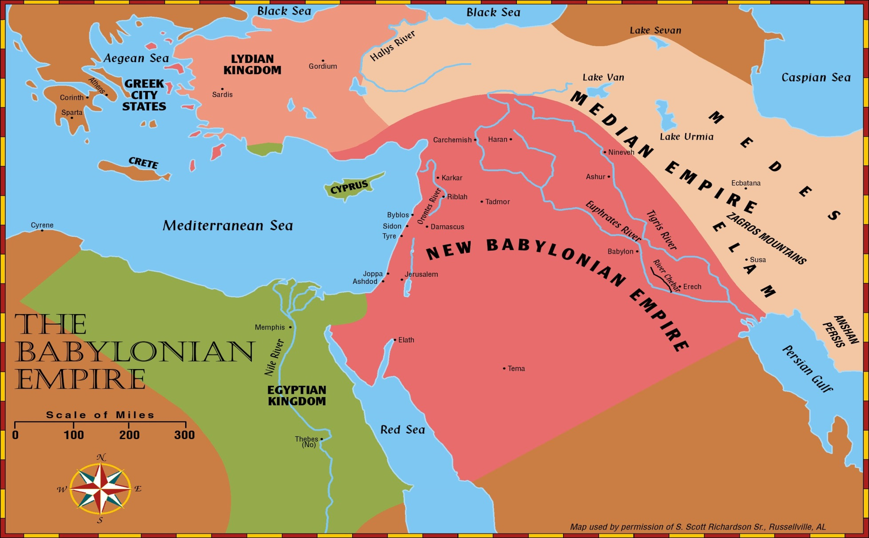
Prophets of the Babylonian Period
Zephaniah (630-625 BC)
Nahum (630-612 BC)
Jeremiah (627-586 BC)
Habakkuk (612-602 BC)
Daniel (606-536 BC)
Ezekiel (592-570 BC)

Slide 10
Josiah’s Family
Killed at Megiddo
By Pharaoh Necho
640-609
Age 8
Zebudah
Hamutal
Hamutal
609-597
Age 25
609 (3 mon)
Age 23
597-586
Age 21
Nehushta
597
Age 8/18
Zerubbabel
Governor on Return
Shealtiel

Slide 11
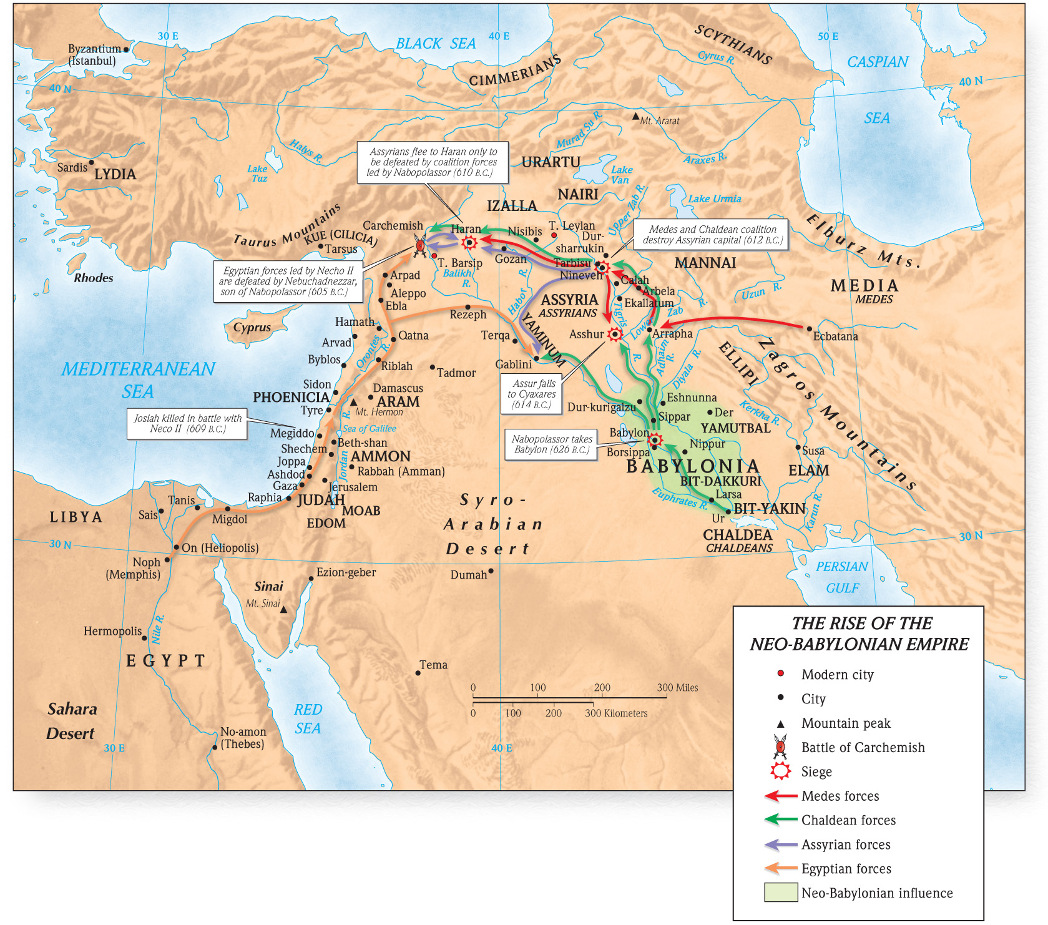
Assyria, Babylon, Egypt

Slide 12
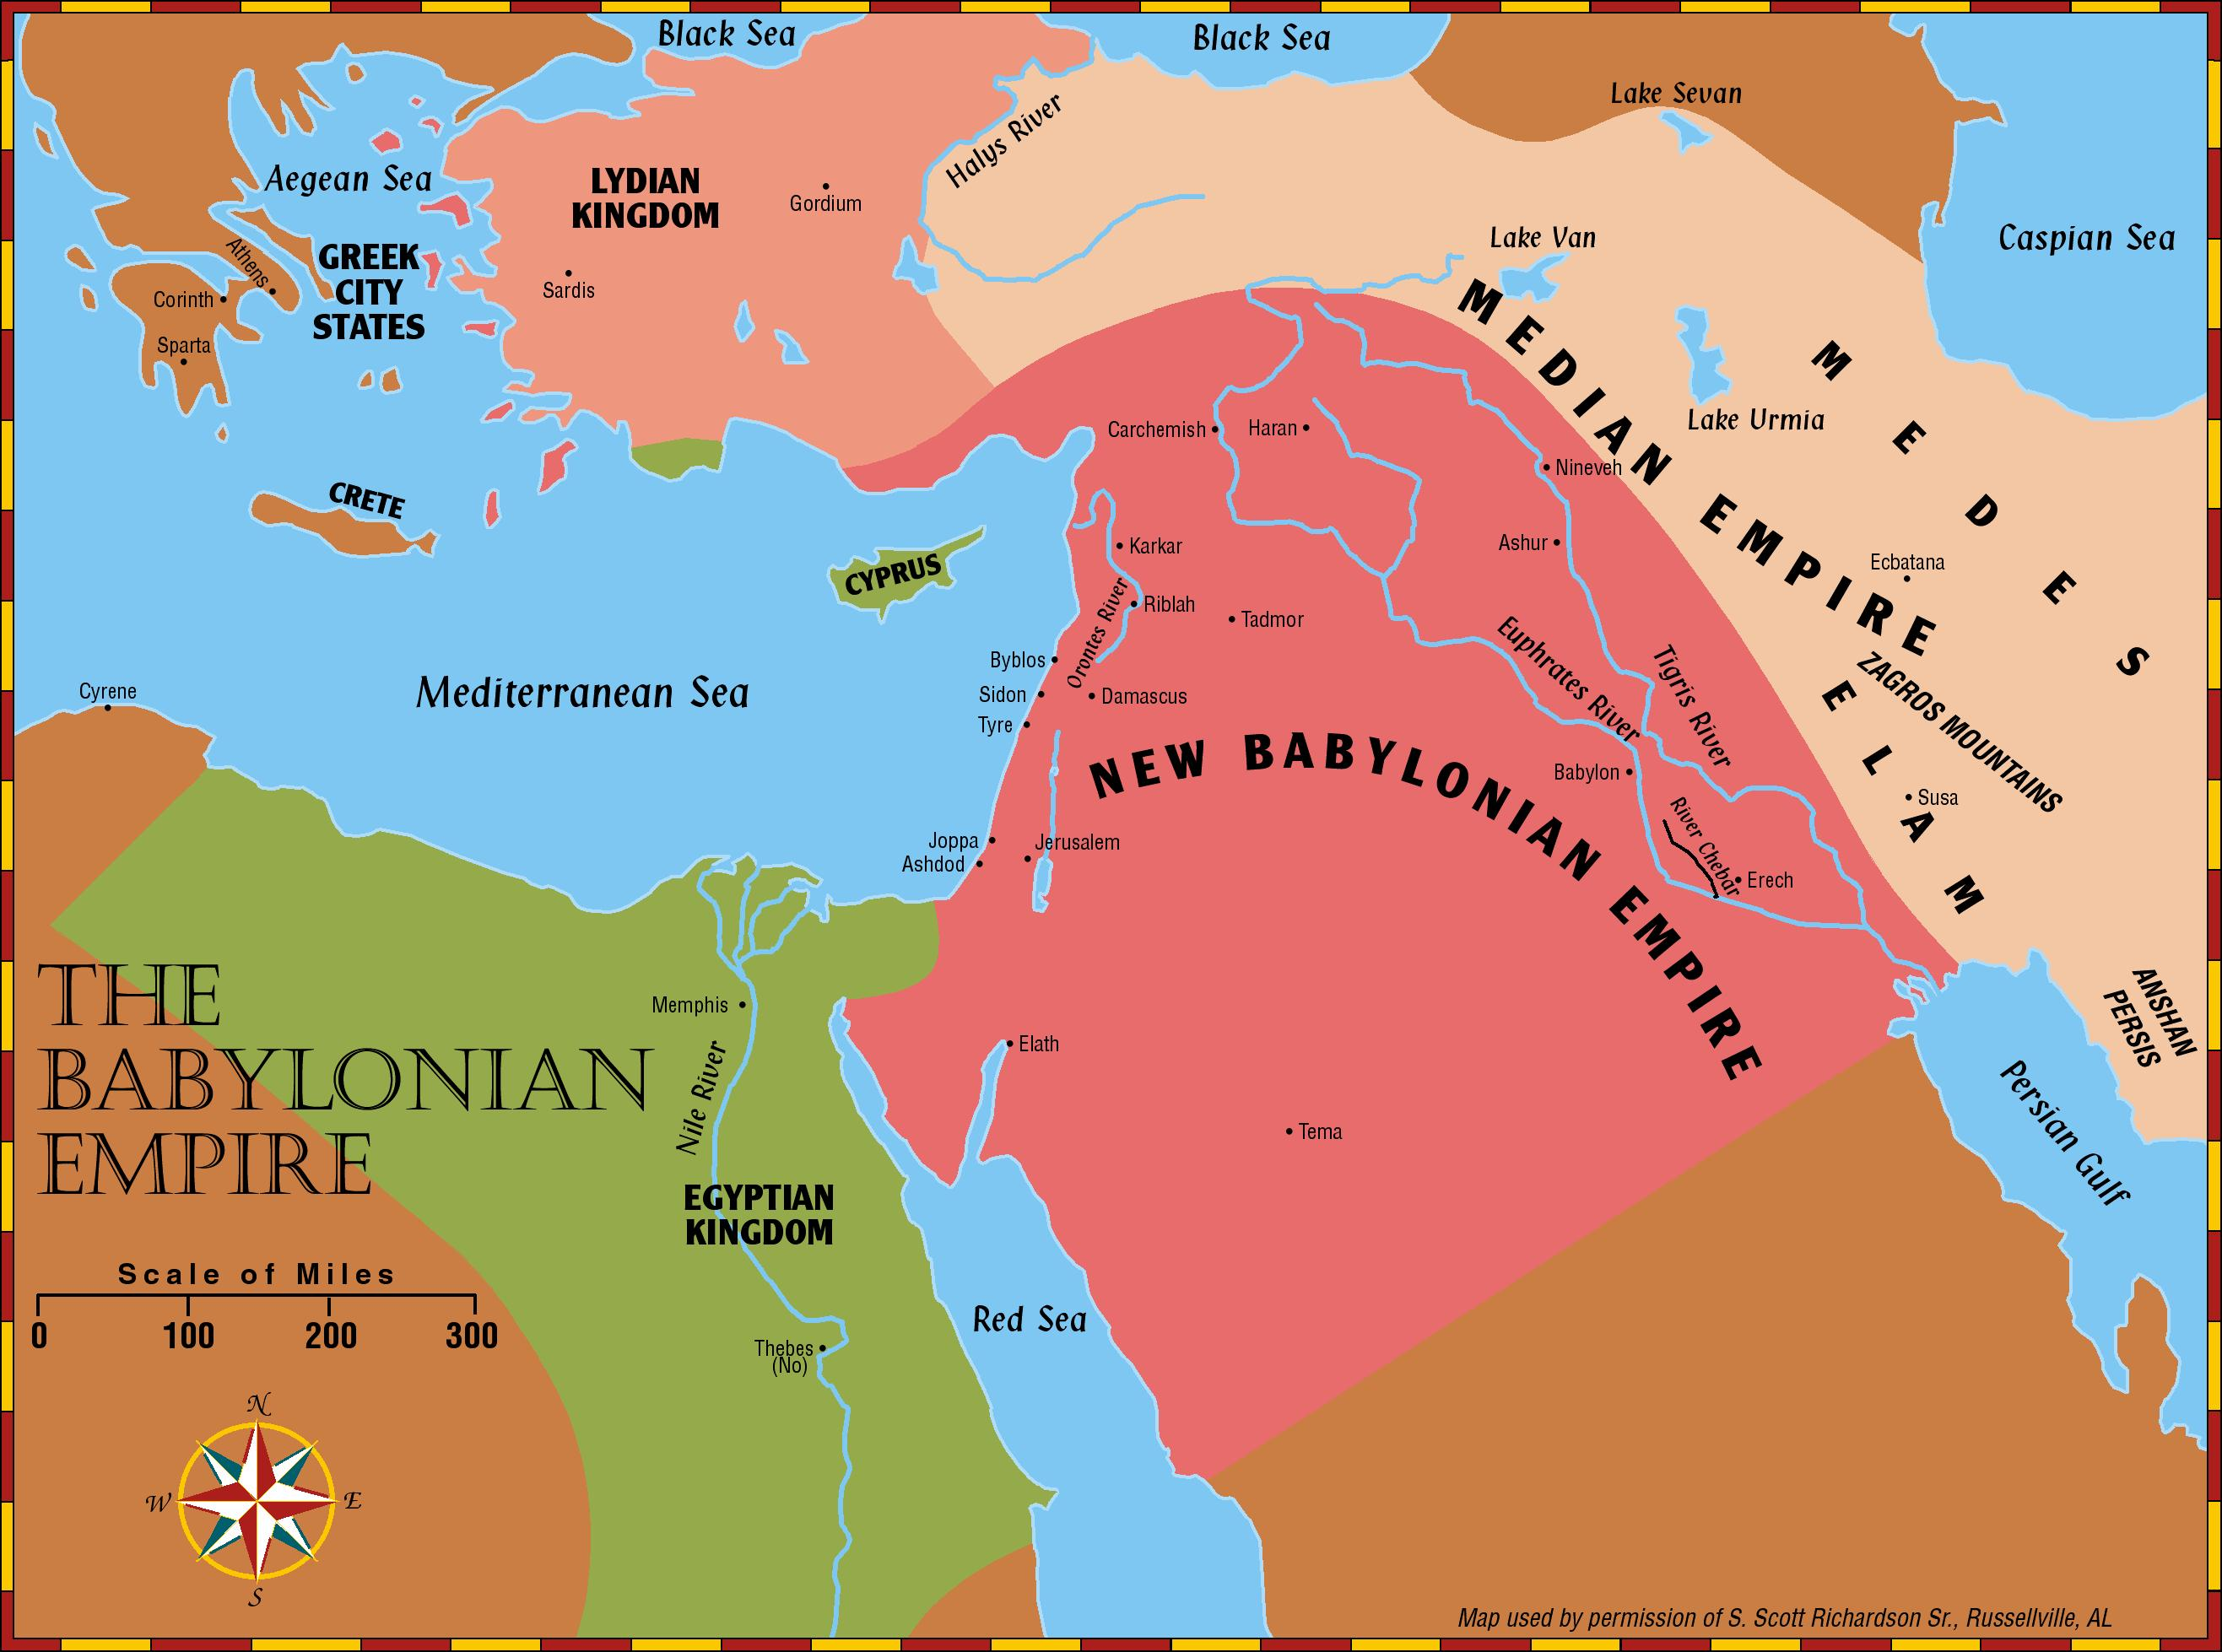
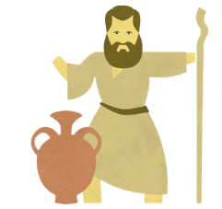
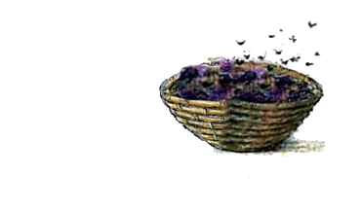
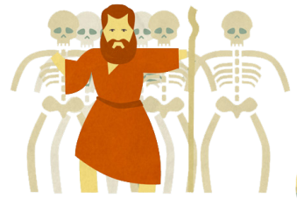
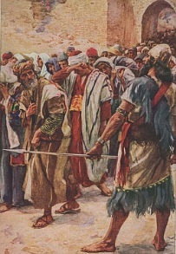
Daniel
Rulers
Jeremiah
Bad Figs
Ezekiel
Good Figs

Slide 14
C. Precursor Prophecies
Leviticus 26
Deuteronomy 28
Isaiah 44:23 – 45:1
II Kings 20:16 Isaiah 39:7
Jeremiah 25
Jeremiah 29
(see Matt 24:15)
Desolation, scattering
Foreign King (far away)
‘Cyrus’ to allow a return
Babylon to take sons away
Babylon punished in 70 yrs
People to return in 70 yrs
“… spoken of by Daniel…”

Slide 15
God’s Prophets
Leviticus 26
Deuteronomy 28
800 yrs
Matthew 24
600 yrs
Isaiah 39, 44
100+ yrs
Jeremiah 25, 29
70+ yrs

Slide 16
Jeremiah 19:10-12(ESV) ¹⁰“Then you shall break the flask in the sight of the men who go with you, ¹¹and shall say to them, ‘Thus says the Lord of hosts: So will I break this people and this city, as one breaks a potter’s vessel, so that it can never be mended. Men shall bury in Topheth because there will be no place else to bury. ¹²Thus will I do to this place, declares the Lord, and to its inhabitants, making this city like Topheth.

Slide 17
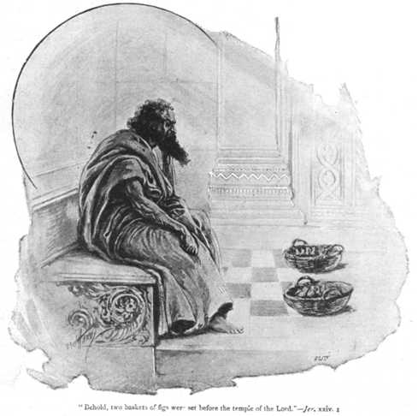
Jeremiah’s Good & Bad Figs - Jer 24
…Like the bad figs that are so bad they cannot be eaten, so will I treat Zedekiah the king of Judah, his officials, the remnant of Jerusalem who remain in this land, and those who dwell in the land of Egypt. ⁹I will make them a horror to all the kingdoms of the earth, to be a reproach, a byword, a taunt, and a curse in all the places where I shall drive them. ¹⁰And I will send sword, famine, and pestilence upon them, until they shall be utterly destroyed from the land that I gave to them and their fathers.”
³And the Lord said to me, “What do you see, Jeremiah?” I said, “Figs, the good figs very good, and the bad figs very bad, so bad that they cannot be eaten.”

Slide 18
Promise of Return after Seventy Years Captivity
Jeremiah 25:11-12(ESV) ¹¹This whole land shall become a ruin and a waste, and these nations shall serve the king of Babylon seventy years. ¹²Then after seventy years are completed, I will punish the king of Babylon and that nation, the land of the Chaldeans, for their iniquity, declares the Lord, making the land an everlasting waste.
Jeremiah 29:10-14(ESV) – Letter to Exiles in Babylon ¹⁰“For thus says the Lord: When seventy years are completed for Babylon, I will visit you, and I will fulfill to you my promise and bring you back to this place. ¹¹For I know the plans I have for you, declares the Lord, plans for wholeness and not for evil, to give you a future and a hope. ¹²Then you will call upon me and come and pray to me, and I will hear you. ¹³You will seek me and find me. When you seek me with all your heart, ¹⁴I will be found by you, declares the Lord, and I will restore your fortunes and gather you from all the nations and all the places where I have driven you, declares the Lord, and I will bring you back to the place from which I sent you into exile.
Daniel 9:1-2(ESV) ¹In the first year of Darius the son of Ahasuerus, by descent a Mede, who was made king over the realm of the Chaldeans— ²in the first year of his reign, I, Daniel, perceived in the books the number of years that, according to the word of the Lord to Jeremiah the prophet, must pass before the end of the desolations of Jerusalem, namely, seventy years.
Governor of Chaldeans
70 years
70 years
520 BC
Haggai-rebuild Temple
586 BC
Jerusalem
Temple
Destroyed
539 BC
Cyrus Conquers Babylon
597 BC
2nd Captives
522 BC
Darius becomes emperor
609 BC Josiah dies
605 BC
1st Captives
538 BC Edict Go Home
537 BC Rebuild altar & foundation
516 BC
Temple finish

Slide 19
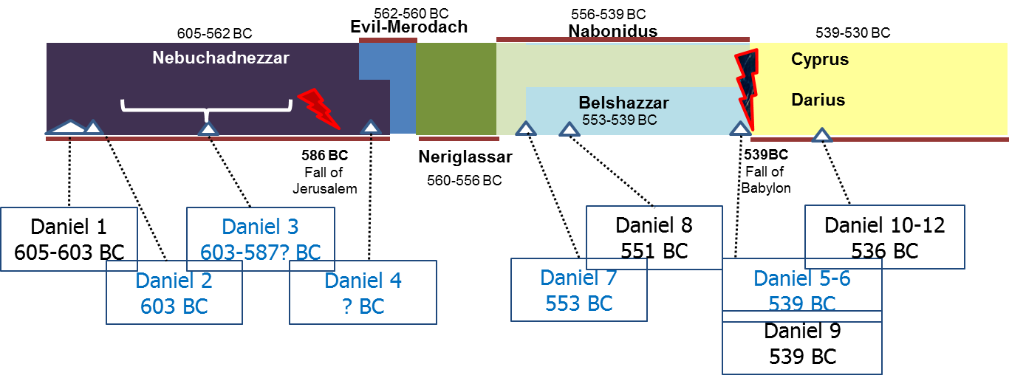
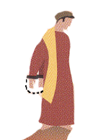
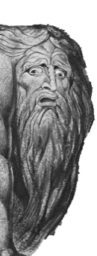
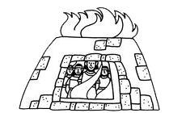
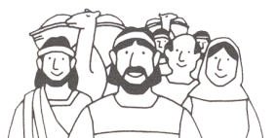
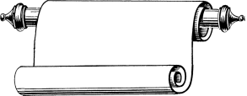
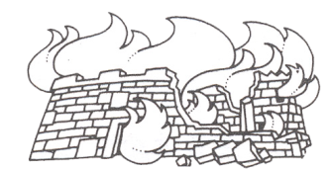
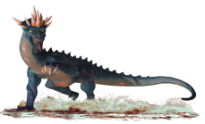
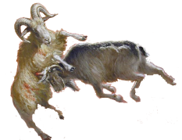
620 BC
605
600
590
580
570
560
550
540
530
520
627-605 BC
605-562 BC
(co 555?)562-560 BC
556-539 BC
Cyrus
Nabopolassar
Nebuchadnezzar
Evil-Merodach
Nabonidus
539-
530 BC
Cambyses
Born
About
620 BC
Darius
The
Mede
530-
522 BC
Taken
Into
Captivity
Chapter 1
Chapter 2
Interprets
Nebuchadnezzar’s
Dream
Chapter 9
Return from Exile
538 BC
Prays for Return
Interprets
Nebuchadnezzar’s
Dream
Chapter 3
Chapter
10-12
Fiery
Furnace
Chapter 4
Chapter 5
Interprets
Writing on
The Wall
Israel’s
Future
MENE, MENE,
TEKEL, UPHASSIN
Chapter 6
Lion’s
Den
4 Creatures
Chapter 7
586 BC
Jerusalem
Temple
Destroyed
Chapter 8
2nd Captives
Including Ezekiel
597 BC
Neriglassar
Belshazzar
Ram &
Goat
560-556 BC
553-539 BC

Slide 20
Outline of Daniel
Chapter | Description | Language
1
2
3
4
5
6
7
8
9
10
11
12
Daniel & Friends tested in captivity
Hebrew
Daniel & Nebuchadnezzar’s
dream of 4 kingdoms
Aramaic
Faith tested in fire
Aramaic
4 Empires Rise & Fall
God Humbles Proud
Nebuchadnezzar is shown
God rules in the nations
Aramaic
Belshazzar’s feast & Babylon’s fall
Aramaic
God Rescues Faithful
Daniel’s faith in a Lion’s Den
Aramaic
Daniel’s vision of 4 beasts
Aramaic
Daniel’s vision of the ram & he-goat
Hebrew
Daniel’s prayer for return
Hebrew
Intro to Daniel’s last visions
Hebrew
Daniel’s vision Between Testaments
Hebrew
Daniel’s vision of the End Days
Hebrew
Notes:
Animated

