Slide 2
Aquila and Priscilla
Acts 18:2,3

Slide 4
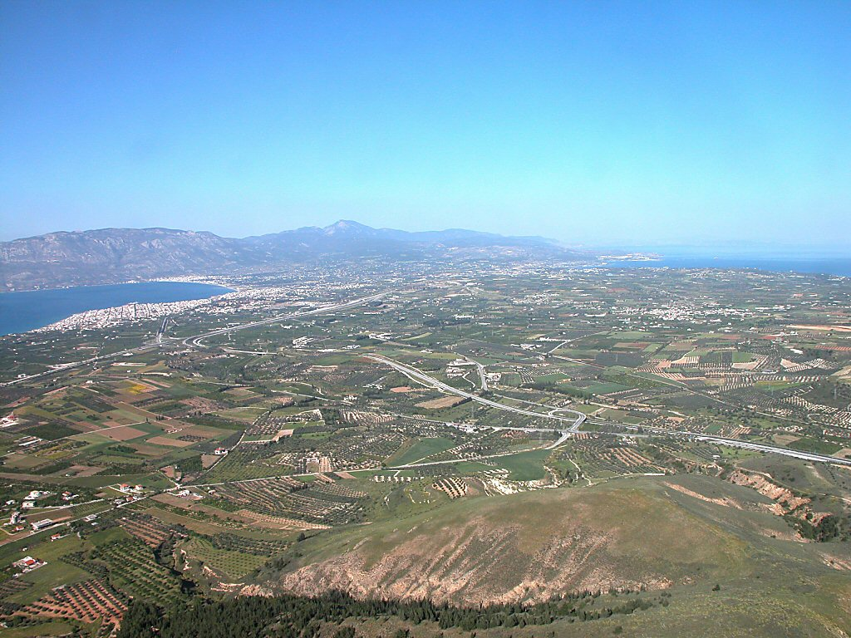
The Isthmus of Corinth
T. Bolen
Notes:
Bolen: Corinth
The ancient city of Corinth was one of the major commercial centers of the ancient world. Its glory spanned both the Greek and Roman empires, first as a member of the Achaean League, and later the capital city of the Roman province of Achaia. It was perfectly situated at the narrowest part of the isthmus, a level piece of limestone four miles wide connecting mainland Greece with the southern peninsula (Peloponnesus). Corinth had a port on either side of the Isthmus—Lechaion on the Corinth gulf and Cenchrea on the Saronic gulf—and thus held control of the seas on both sides of Greece.

Slide 5
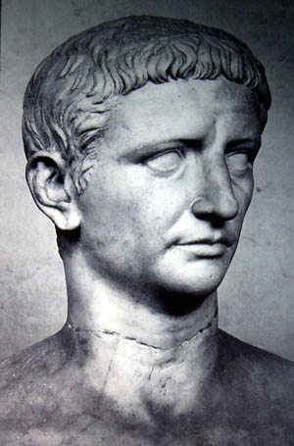
The Edict of Claudius - 49 AD
“Since the Jews constantly made disturbances at the instigation of Chrestus, he expelled them from Rome.”
Suetonius

Slide 6
Lessons from Aquila and Priscilla
They attached themselves to someone who could help them go to heaven! (Acts 18:2,3; 18, 19)

Slide 7
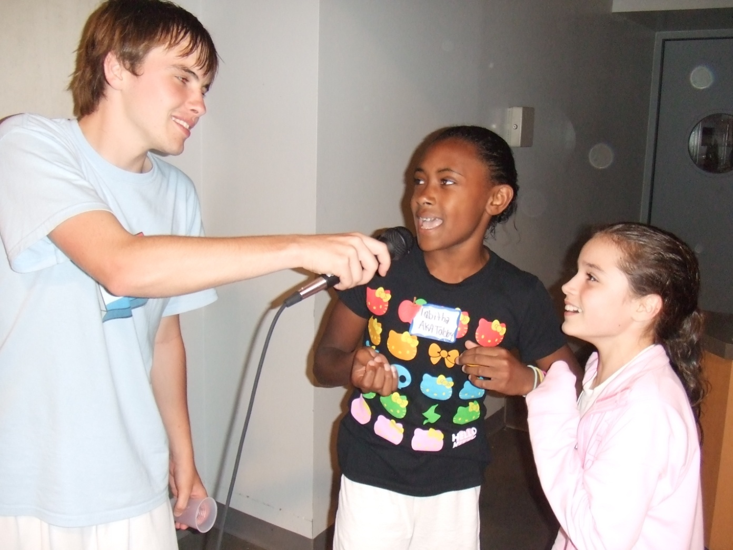
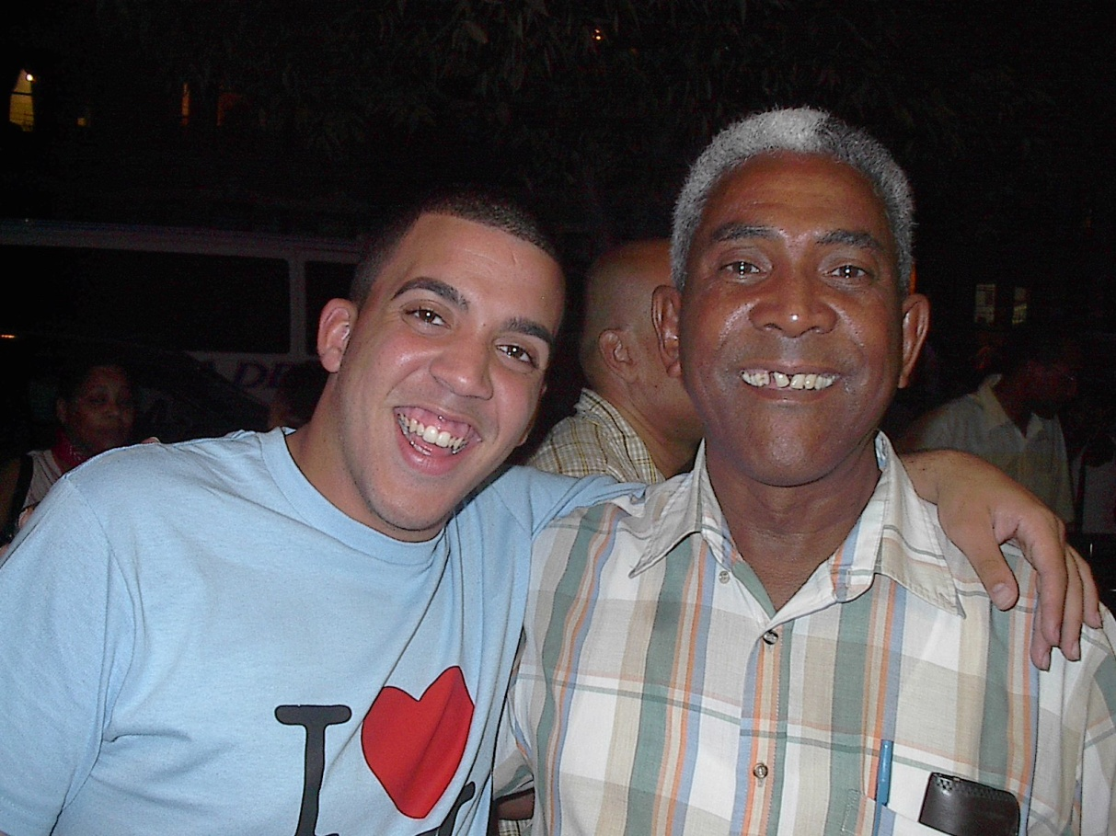
Help to go to heaven

Slide 8
Lessons from Aquila and Priscilla
They attached themselves to someone who could help them go to heaven! (Acts 18:2,3; 18, 19)
Wise in correction of others (18:24-28)

Slide 9
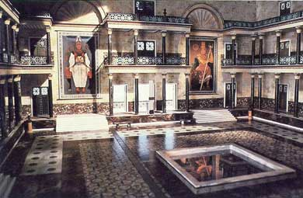
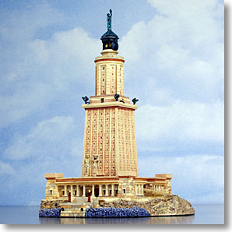
Alexandria, home of Apollos

Slide 10
Lessons from Aquila and Priscilla
They attached themselves to someone who could help them go to heaven! (Acts 18:2,3; 18, 19)
Wise in correction of others (18:24-28)
Risked their lives for Paul (Rom.16:3,4)
Gave their house to the church (Rom.16:5)
A pair, “a team” without jealousy (1 Cor. 16:19)

