Slide 1
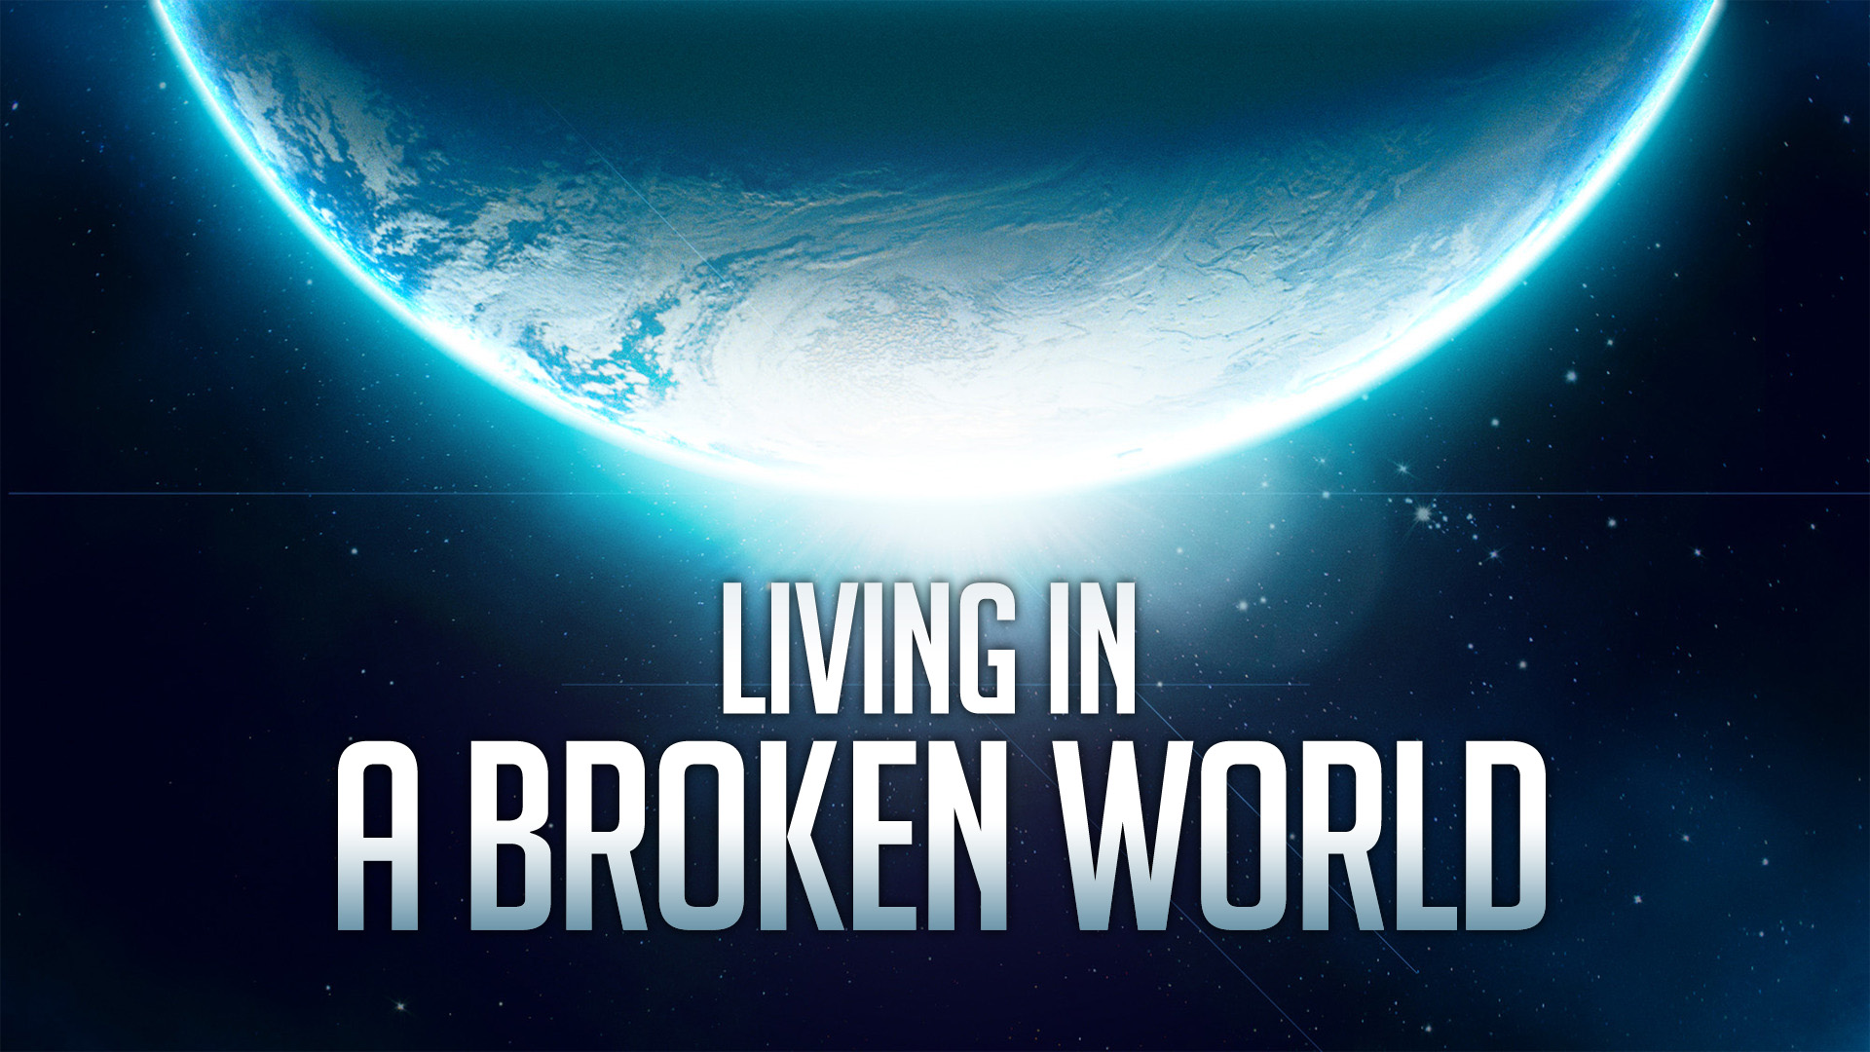
Living In A Broken World

Slide 2
Our Broken World
A World Where Evil Abounds.
Isaiah 5:20, Galatians 5:19-25
Don’t Panic: It’s Been Broken A Long Time.
Genesis 3:17-24
Renew Our Minds Often.
Romans 12:2, Hebrews 10:24-25
Learn To Navigate Our Troubling Surroundings.
Notes:
WHERE EVIL ABOUNDS: The Greed, The PRIDE, The Fornication, The Cursing, The Idolatry, The Destruction of Babies, Etc…
It’s Been Broken A Long Time:
- God didn’t take man out of the world. God actually sent us INTO this broken world.
- Don’t Panic: It’s Actually Been Far Worse.
Genesis 6:5
RENEW OUR MINDS OFTEN: Hopefully – the more broken the world is, the more we will LOVE GOD instead of LOVING this world. So we can face the darkness in our world with an internal LIGHT of God’s love. So – in some sense – the entire BIBLE is our guide for how to live in a broken world!
You say: Ok, but Phillip, even when my mind is looking above – how do I navigate these tough situations? I can help with that… Tonight we are going to look specifically at Gen. 18 and 19 and learn how Abraham and Lot navigated the sinful world they were confronted with living near Sodom and Gomorrah. While sexual sin is a big part of this chapter – the lessons are useful for any of the sins we find in our BROKEN WORLD. From
The beginning of the chapter is a lot of good news… God has promised the birth of Isaac. Gen. 18:16-20 God takes it very seriously when sin spreads in the world.
Admire God’s great patience…Just 10 righteous people would be all it would take to be the light and the salt to give this city hope.
Gen 19:4 – need to understand that this section is answering the question are there EVEN 10 people who would say “don’t do this”

Slide 3
Learning From Lot
Lot Engages The Men In Conversation
Lot Speaks With Kindness & Respect
Lot Addresses The Men With Equality & As Interconnected.
Lot Focuses On The Action, Not The Temptation.
Lot Expresses His Moral Judgment.
Lot Offers A Horrible Compromise.
Lot Emphasizes His Moral Responsibility.
Notes:
Gen. 19:1-11
LOT ENGAGES - - You have to be worried if an angry mob is at your door – yet He tries to have a reasonable discussion. 1 Cor 6:9-11 gives us clear reason for hope. There are good hearted people in the world who get wrapped up in all kinds of sin, who WILL RESPOND to the gospel and will be SAVED! So Lot has a straightforward and respectful conversation. We need to have those conversations too. Don’t assume anyone is beyond the saving power of God.
Kindness & Respect: “Please”
“Brothers” – if he had addressed them as children, this would show that he was viewing himself in a superior position. Not only does the term brothers indicate equal maturity – but it also indicated common connection.
In our nation today – we might appeal to someone and say – this is our country too...
In our nation today – we’ve already seen business owners speak up about their personal convictions…
Vs. 7 “do not act” Lust can build in the heart – and be sinful – but LOT is wise to focus his attention on the option that they have: to turn their hearts.
Vs. 7 “wickedly” – He expresses his moral judgment.
*Doesn’t matter if it is FRAUD, DISHONESTY, IDOLATRY, SELFISHNESS, PORNOGRAPHY, IMMODESTY – whatever the sin or issue – we can’t deny when something is evil.
Vs. 8 – He has a responsibility to protect his guest. He has responsibility to stand for righteousness. To oppose evil. He can’t stand by and remain silent or fail to protect these men.
** I just want you to see that Lot did all the right things (except the compromise obviously) – everything I would advise you to do in a conversation with someone about this issue. Be kind, Be respectful, Focus on the Action itself – and express the moral nature of the issue – emphasize that you have a moral responsibility to fulfill. But I equally want you to know that with some people (not all, but some) doing all the right things will still be completely – even rudely or violently rejected and opposed. (vs 9)
In fact, if we want to look at the truth of verse 9 even more closely – I would like to point out – that while there are only 2 men inside – there is a large crowd ADVOCATING and supporting the desires of the those who would be involved in this sin.
NO AMOUNT of kindness or compromise will satisfy those who reject the MORAL component of the issue.
** BY ALL MEANS – we must continue to show kindness. But no matter how kind we are – as long as Christians today take a FIRM moral stand against homosexuality there will be those who REJECT our kindness, and will not change – nor will they allow us to peacefully live alongside them fulfilling our individual moral responsibilities. SECONDLY – Notice that compromises aren’t likely to win – no matter how much is given up. We simply aren’t dealing with an issue where compromises solve the problem. This is a question of deeming an action sinful. That action is either sinful or not. Period. There are only 2 choices here. Sin or Not Sin.

Slide 4
What’s A Christian To Do?
Like Abraham, Petition God For Mercy For The Sake of the Righteous.
Genesis 18:23
Like Abraham, Keep Some Distance, So You Can Fulfill Your Calling.
Genesis 18:19, Ezekiel 16:49
Keep Your Distance Despite The Worldly Advantages Others Offer.
Genesis 13:8-13, Genesis 14:9-16
Notes:
So – once this boils down to a MORAL ISSUE – for which there IS NO COMPROMISE – what do we do? If being kind and respectful isn’t enough – then what do we do…we come back to Abraham.
PETITION GOD FOR MERCY. Pray for our world. Pray for God’s long-suffering that more may come to salvation. Pray for open doors and help to boldly speak the gospel. Pray for our national leaders… Pray for God to raise up people like Daniel who will be in positions of influence to tell the rulers in this world the will of God.
Vs 23-32 shows us not only Abraham’s desire for mercy, but also Abraham’s unfamiliarity with the city. He knows Lot is there – so he knows there is still some good there. Like Abraham, we need to remember the good in the world and pray for protection of the righteous in the world.
FULFILL YOUR CALLING When it becomes obvious we can no longer have an immediate positive influence – then the best thing to do is limit the negative influence the choices of others will have on our family. – We have a responsibility to guide our families in God’s path – the narrow way – and that includes much more than just the sin of Gen 19. There pride and greed are also mentioned. **Some have tried to use this Ezekiel passage to suggest the actions of Ch 19 were not the real reason for the destruction of the city. *Absolutely wrong. ALL the sins of these cities contribute to God’s punishment. In fact, the 2 angels in ch 19 are there to see if things are really as bad as is reported – and the sins of Ch 19 – CONFIRM that the city is full of wickedness – so they are DEFINITELY a big part of the reason the cities are destroyed.
WORLDLY ADVANTAGES: Are there advantages to living in NYC, San Fransico, LA and other large cities – absolutely. But there are dangers in those places too. The same can be said for Sodom. Lot didn’t HAVE to move all the way into Sodom – but he decided to bc it seems to have been good for his business. In the end he lost everything.
Today, there are professions and industries where being well connected in the gay community could be very useful in one’s career. I think I am accurate in saying that branches of the arts, entertainment, interior decorating and design, acting, all have a sizeable enough openly gay colleagues that a person’s networking potential could easily be affected. Christians can go into those fields of study and work – but Christians must know – the day will come when a choice must be made – so MAKE THE SMART CHOICE NOW. KNOW that you will be kind, and respectful, but that you CANNOT compromise the moral issue at hand.
WORLDLY ADVANTAGE – Lot goes for the good soil and the big city – but also recognize that even when you CONTRIBUTE to their success – that won’t guarantee your safety among the people. WE ARE NOT OF THIS WORLD!
(Seek to have a long-term positive influence. Plant seeds where you can. Shine where you can. Be available.)

Slide 5
What’s A Christian To Do?
Keep Enough Distance To Protect The Most Vulnerable In The Family.
Genesis 19:14-16
Keep Enough Distance That When You Must Walk Away Completely – Everyone’s Hearts Can Let Go.
Genesis 19:26, Luke 17:28-33
Know That Judgment Will Eventually Come.
Genesis 19:27-29
Notes:
MOST VULNERABLE – When the NT says the soul of LOT was tormented – it doesn’t say that about his whole family. (2 Peter 2:7-8) His daughters and His wife. You might think you can handle it – but that doesn’t mean everyone can. Saying “I’m strong enough to not compromise” doesn’t assure that everyone is not impacted… BEWARE.
EVERYONE’S HEARTS Can LET GO: Jesus wants us to remember this woman! Jesus wants us to remember the high price of getting wrapped up in sin. Sometimes it is harder to let go than we anticipate. *** If we know in our heart – that we could walk away from it all – that’s not enough. Can your spouse? Can your children? You can’t assume they are ready to give it all up.
KNOW THE JUDGMENT WILL COME – We TAKE NO joy in the death of these people. Here’s an idea – take a cue from the most righteous people you know. When the most Godly people you know are avoiding a place – it’s a pretty good idea for us to avoid that place as well!

Slide 6
Living In A Broken World
Notes:
Tonight – we must rise up to our responsibility to be Salt & Light in our dark world, we must lead our families in righteousness (keeping our distance from evil influences) and we must prepare ourselves to stand before God in Judgement one day.
All SIN is an affront to God.

