Slide 1
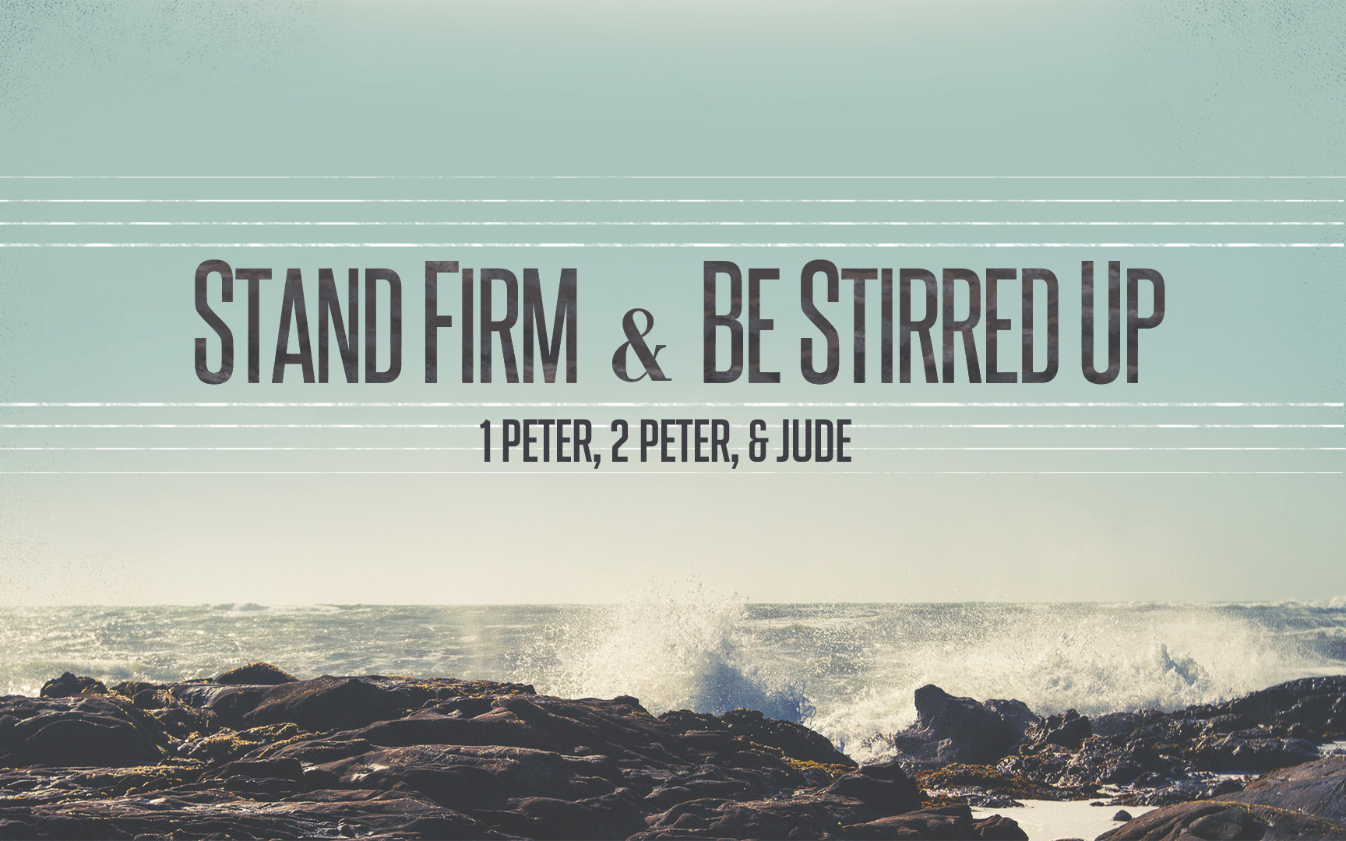
Stand Firm & Be Stirred Up
Notes:
Happy to be in class with you today… Warm up…
Phillip: Be patient and get great comments out of the class. It is better NOT to finish than to rush through…

Slide 2
Stand Firm In Our Families
Wives Whose Behavior Speaks Volumes.
1 Peter 3:1-2 (Continuation of 2:12)
Wives Whose Beauty Is Inside Out.
1 Peter 3:3-4
Wives Who Think About Sarah.
1 Peter 3:5-6
Wives Whose Security Is In GOD.
Notes:
Those people believe some strange things…but wow, they have great families.
SARAH’s SECURITY WAS IN GOD. (Psalm 18:2)

Slide 3
Warm Up Question
What do we know about the kind of husband Peter was?
(Matthew 8:14, 1 Corinthians 9:5)
Notes:
Not a lot. He traveled. He was hospitable.
We know the standard he Held Himself to…

Slide 4
Stand Firm In Our Families
Husbands Committed To What Is RIGHT.
Husbands “Live With” aka Show In Your Actions.
An Understanding Approach To Her Insights.
An Appreciation For Her As A Fine Vessel.
Husbands Honoring Their Wives.
An Everyday Treasure.
Notes:
**Understanding Approach: If you haven’t seen the viral video – it’s not about the nail – you really need to see it!
HONOR: To assign Value, Worth, or WEIGHT. Rather than treat as common or ordinary. Back to vs. 17. Honor in the Community. Honor at Home.
“Everywhere God wants me to show Honor – I will show it – because even when others are not worthy – GOD IS.”
An everyday Treasure….This summer people will go all over the world to see and to take pictures of things – that other people see every day.
>>You go to Paris to see the Effile tower – but other people see it everyday…so often they forget about it and ignore it.
>>You go to FL to see the beach or to see Mickey Mouse…but other people see it everyday – sometimes they even wish they could get away from the sand in their toes.
The more familiar something is, the more we tend to take it for granted, and even begin to let the negative qualities dominate our thinking. Husbands are reminded to SLOW DOWN and stop and realize how WILDLY LUCKY they are to have a Godly wife in their life. YOU HAVE A TREASURE. Having her everyday should make you more thankful – not less!

Slide 5
Building Family Harmony
Giving A Blessing To Others
1 Peter 2:8-12
Bringing Harmony To Our Relationships
Learn My Role Really Well.
Let Our Roles Compliment Instead of Compete.
Sympathy, Kindness, Humility, Peacemakers…

Slide 6
Moving Closer To Our Goals
Develop a reputation for good works among those who are most critical of our faith. (CITIZENS, WORKERS, FAMILY)
Promote greater “Harmony” in our home and congregation by learning our part well. (ACTIONS IN OUR ROLES)
Build a deeper relationship with the shepherds. (JESUS 1st)
Deepen our appreciation for the suffering of Christ and what it means to share in that suffering. (IMITATING HIM)
Invest in the things that last the longest. (HEART OF SUBM.)
Notes:
Jesus First – We will never love them more than we love him. We need to FIRST appreciate HE IS OUR SHEPHERD!
More Like You…… Any way that we become more like Jesus is a cause for rejoicing. If people see HIS LOVE and HIS ACTIONS IN US, we can rejoice in that.
Suffering…..Don’t get upset and worked up over injustice in the political system or on the job. Get upset that there are people who are going to Hell and we need to help them!
Invest….. God is giving us plenty of ways to practice submission face to face – and that helps us develop the heart we ultimately need to be in submission to HIM who we can’t see. God is giving us practice to show HONOR to others – so that we are well exercised to show HONOR TO HIM.)

Slide 7
Stand Firm & Be Stirred Up

Slide 8
When Suffering We Become More Like…
Christ, The Just. (vs. 18)
Noah, The Faithful. (20)
1st Century Disciples Turned Away From Sin. (4:1)
Peter & Disciples Shared In Suffering. (4:12-13)
The Righteous Have Always Suffered. (4:18)
Notes:
Observation Question 1
Observation Question 2

Slide 9
Accepting The Reality
“Indeed, all who desire to live a godly life in Christ Jesus will be persecuted.”
- 2 Timothy 3:12

Slide 10
Accepting The Reality
“If the world hates you, you know that it has hated Me before it hated you.”
- John 15:18-20
Notes:
TRANSITION: So how do we RESPOND TO SUFFERING?
With Zeal for Good Deeds.
With Courage.

Slide 11
Zeal When Suffering
“…You Prove Zealous For What Is Good.”
1 Peter 3:13
Discussion Question #1.
Christian zeal is the courage to exercise great wisdom, great energy, and great diligence in loving service to God.
Discussion Question #2.

Slide 12
Looking To Jesus When Suffering
Jesus Is Lord of Our Hearts & Our Hope.(3:15)
Jesus Saved Us From Far Worse, Bringing Us To God. (18)
Jesus Never Stopped Preaching. (19)
Jesus Is Reigning As King. (22)

Slide 13
Looking To Jesus When Suffering
Jesus Shows Us Unwavering Determination. 4:1
Jesus Deserves All Glory & Dominion. 4:11
Jesus Is Coming Back To Bring Great Joy. 4:13
Jesus Did What Was Right, Trusting The Will of God To Be Accomplished. 4:19

Slide 14
Suffering As A Christian…
Helps Me Remember His Love.
Helps Me Remember What He Endured.
Helps Me Set An Example Before Others That God Is Worthy of Everything I Have To Give.
Helps Me Remember His Power Over Death.

Slide 15
Zealous Christians Will…
Leave Lust In The Past. (vs 1)
Leave Drinking In The Past. (vs 2)
“The end of all things is near; therefore, be of sound judgment and sober spirit for the purpose of prayer.” (1 Peter 4:7)
Discussion Question #3. (4:7-11)
Application Question #2. (4:19)

Slide 16
Class Lesson Schedule
Lesson | Title/Material | Teacher | Day | Date
1 | Introduction to I Peter | Russ | Sunday | May 29, 2016
2 | Stand Firm in Salvation (I Peter 1:1-12) | Russ | Wednesday | June 1, 2016
3 | Stand Firm in Hope & Holiness (I Peter 1:13-2:10) | Phillip | Sunday | June 5, 2016
 | VBS – Special Class |  | Wednesday | June 8, 2016
4 | Stand Firm in Community and Family (I Peter 2:11-3:12) | Phillip | Sunday | June 12, 2016
5 | Stand Firm in Zeal during Suffering (I Peter 3:13-4:19) | Phillip | Wednesday | June 15, 2016
6 | Stand Firm with the Chief Shepherd (I Peter 5:1-13) | Phillip | Sunday | June 19, 2016
7 | Introduction to II Peter | Russ | Wednesday | June 22, 2016
8 | Stirring Up our Spiritual Growth (II Peter 1:1-21) | Phillip | Sunday | June 26, 2016
9 | Stirring Up Pure Doctrine and Pure Living (II Peter 2:1-22) | Phillip | Wednesday | June 29, 2016
10 | Contending for the Faith (Jude) | Phillip | Sunday | July 3, 2016
11 | Stirring Up our Insight (II Peter 3:1-18) | Phillip | Wednesday | July 6, 2016
12 | Grounded & Growing in Difficult Times | Phillip | Sunday | July 10, 2016
13 | Review | Phillip | Wednesday | July 13, 2016

Slide 17
Stand Firm & Be Stirred Up

