Slide 1
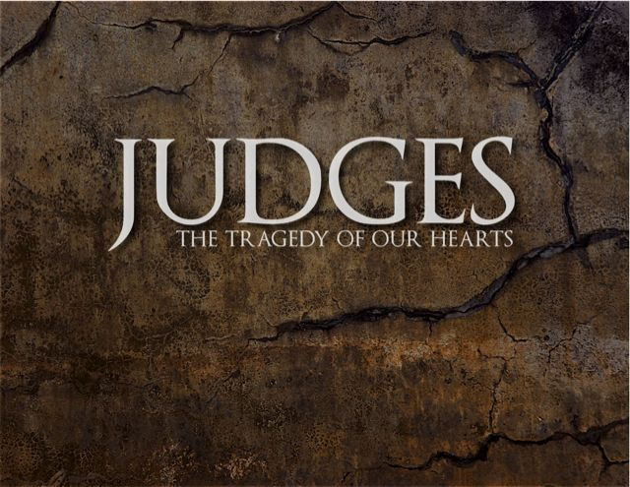
Lesson 2
Conditions in Israel

Slide 2
Objectives – Lesson 1 Introduction and Overview
Place the 12 major Old Testament periods in order.
Define both concepts behind the term: “Judge” .
Explain why the sum of intervals of the “Oppressions” and “Judging” is more than the total time elapsed in the period of the Judges.
List the three major sections of the book.
Label a map of Palestine with the locations of the major tribes and enemies.
List the four elements of the “Disobedience Cycle” in the period of the Judges.

Slide 3
Objectives – Lesson 2 Conditions in Israel (1:1-3:6)
Define “Gilgal” and “Bochim,” and explain the significance of these terms/places.
List the tribe that did best at conquest.
List the tribe that did worst at conquest.
Describe the geographical order of ch. 1
List 3 areas of Israelites’ disobedience

Slide 4
1-Beginnings Gen 1-5
2-Flood Gen 6-11
1445-1405 BC
5-Wilderness
Wanderings
931-722 BC
9-Divided
Kingdom
605-538 BC
11-Babylonian
Captivity
444 BC - ~4 BC
The Silent Years
(Intertestamental)
30-90 AD
The Church
NT Era
2166-1859 BC
3-Patriarchs
1380-1050 BC
7-Judges
4-Slavery in Egypt
1859-1445 BC
6-Conquest
of Canaan
1405-1380 BC
8-United
Kingdom
1050-931 BC
10-Judah
Alone
722-605 BC
12-Return
From Exile
538-444 BC
Life of
Christ
4 BC – 30 AD
1400 BC
1300 BC
1200 BC
1100 BC
East of Jordan:
Ammonites
& Philistines
Jephthah
Jair
Eli
Samuel
West of Jordan:
Elon
Midianites
Tola
Abdon
Saul
David
Solomon
Gideon
Canaanites
Moab
Deborah
Ehud
Philistines
Shamgar?
Samson
Judah : South
Othniel
Philistines
Mesopotamian
Ibzan
Egypt:
Battle of Kadesh
Egypt-Hittites
Merneptah
Sea People
Vs Ramses III
Based on Graphics from Marc Hinds & Zondervan Pictorial Encyclopedia of the Bible
Notes:
Judges describes cycles of apostasy, oppression, and deliverance in the southern region (3:7–31), the central region (6:1–10:5), the eastern region (10:6–12:15), and the western region (13:1–16:31).

Slide 5
I. Conditions in Israel (1:1-3:6)
- Unoccupied Areas (1:1-2:5)
- Religious/Political Cycles (2:6-3:6)
II. The Judges (3:7-16:31)
- Othniel* (3:7-11)
- Ehud* (3:12-30)
- Shamgar* (3:31)
- Deborah* and Barak (4:1-5:31)
- Gideon* (6:1-8:35)
- Abimelech, Tola, Jair (9:1-10:5)
- Jephthah* (10:6-12:7)
- Ibzan, Elon, Abdon (12:8-15)
- Samson* (13:1-16:31)
III. Cultural Decline (17:1-21:25)
- Micah and the Danites (17:1-18:31)
- Crime and Civil War (19:1-21:25)
Outline of judges

Slide 6
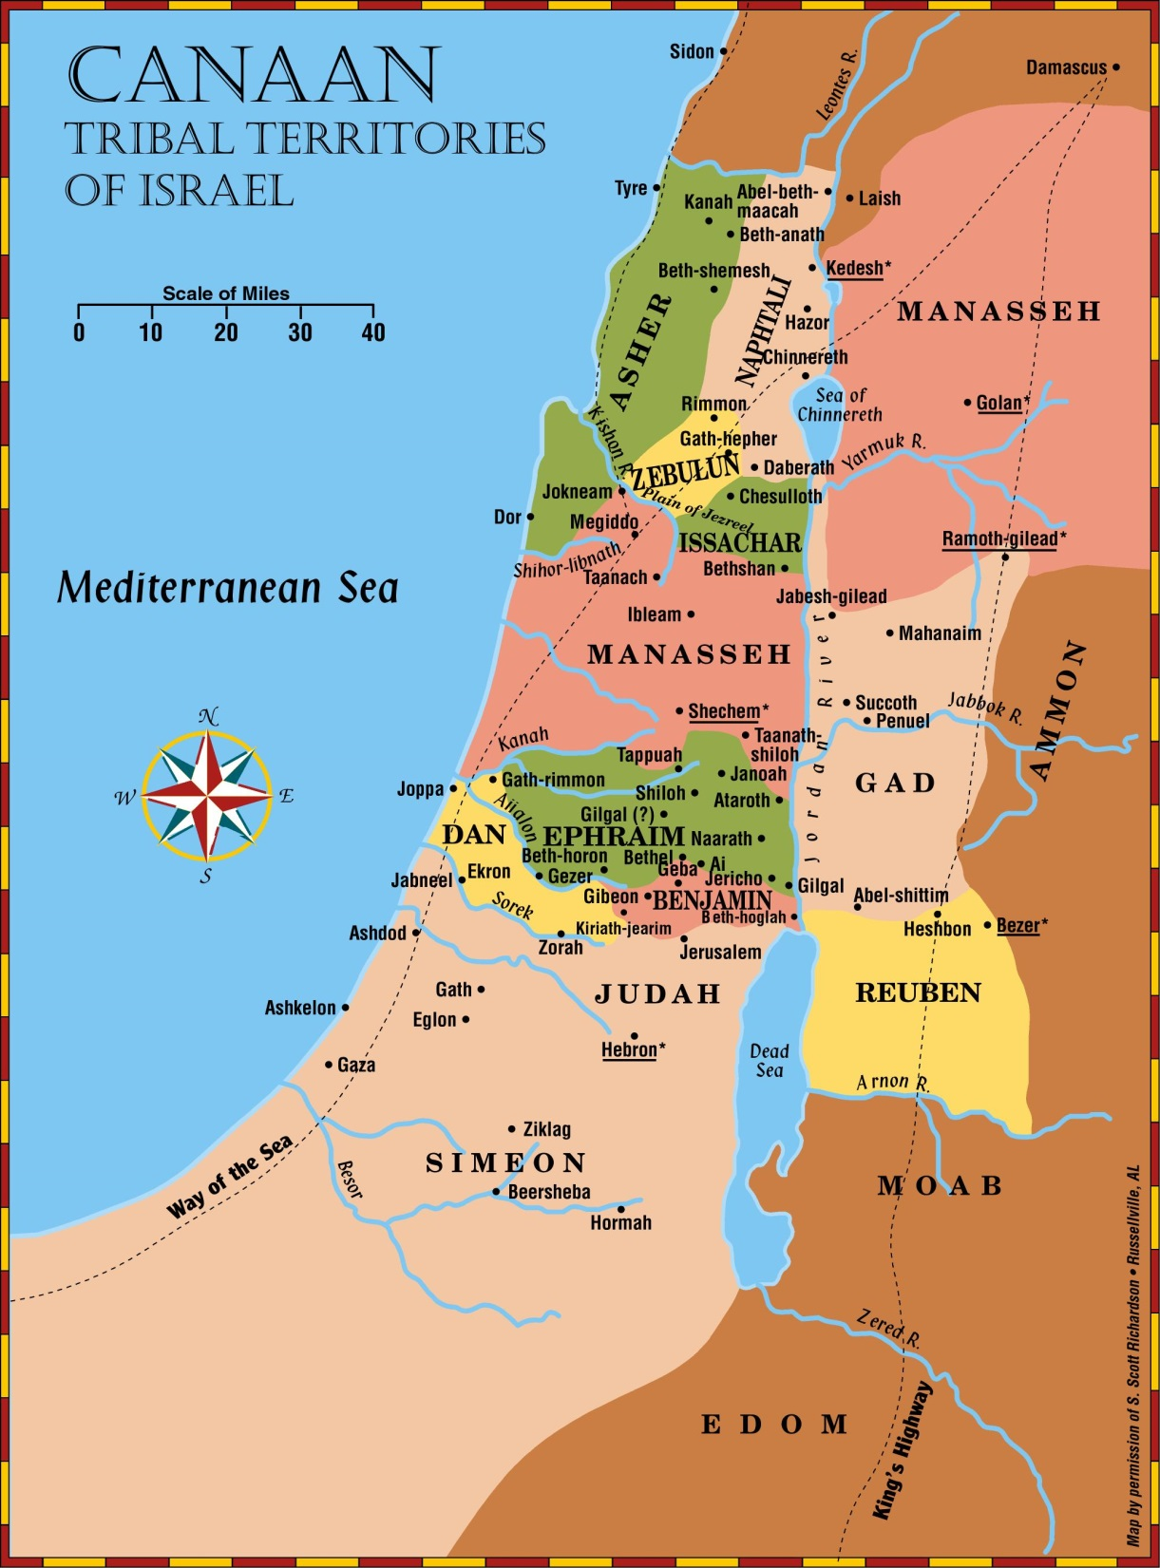
Tribes of israel

Slide 7
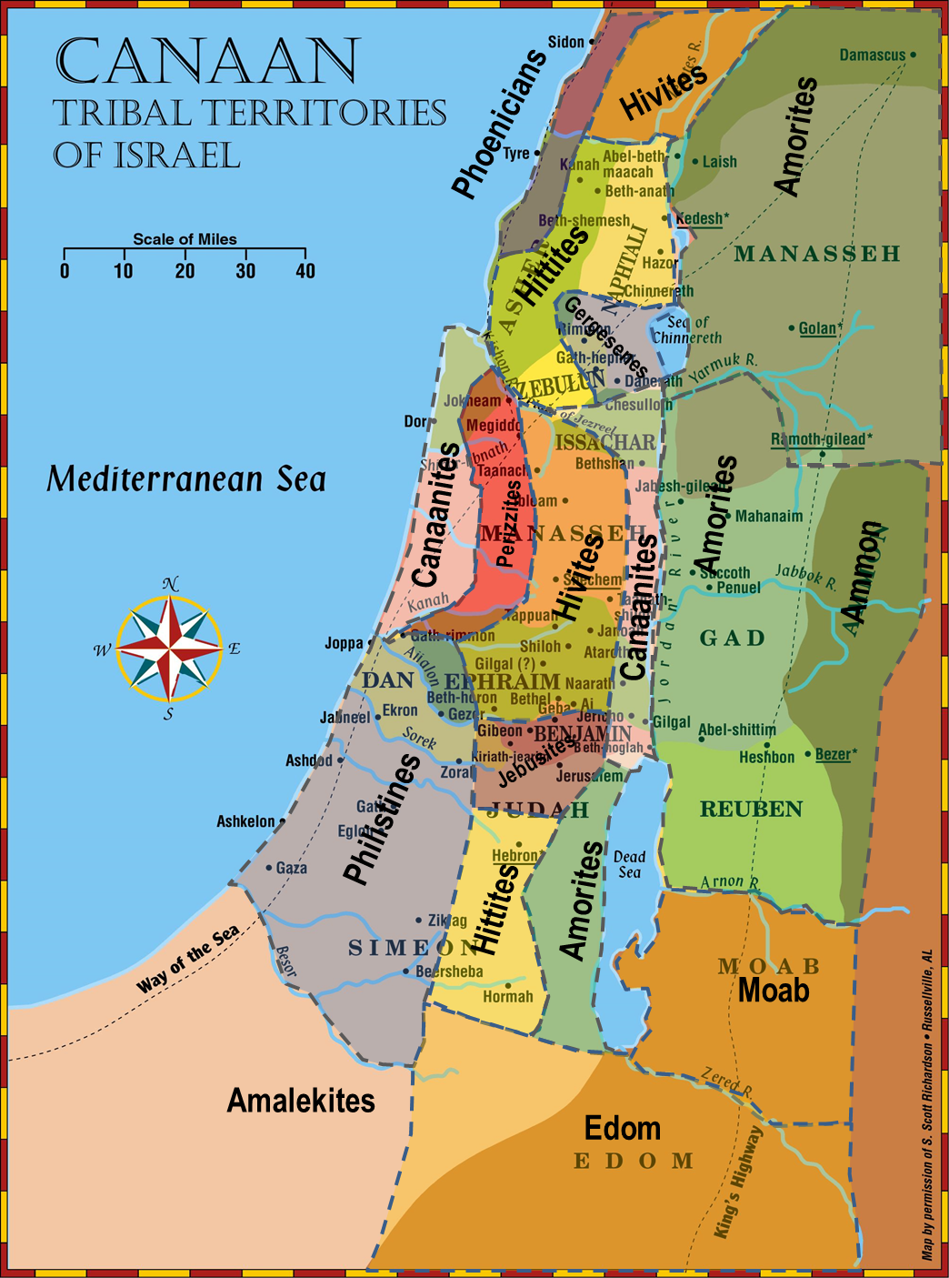
Nations not conquered

Slide 8
Israel in the Promised Land – The Ideal
Unified & guided by God, not men.
No central governmental organization
Led, locally, by faith-filled people, as needed
No competition for power/leadership (see Num 11:25-29)
“No King…everyone did that which was right in God’s eyes.”
Intensely separated from the non-believing world
Purged idolatry and immorality (even from own families)
Formed no alliances, covenants, intermarriages, except with faithful people
Their purity & obedience were examples to the nations around
Carefully obedient to the written Word
Every generation knew the Lord (Jg 2:10)
Remembered (carried out) the consequences of obedience & disobedience
The Word filled their lives (Levites, family study – Dt 6)
They worshiped as God instructed
Trusted in God’s care (Jg 2:7)
Content with the blessing in the land.
Not afraid to face enemies of God.
Did not depend on worldly measures of strength
Were strengthened by their repeated victories

Slide 9
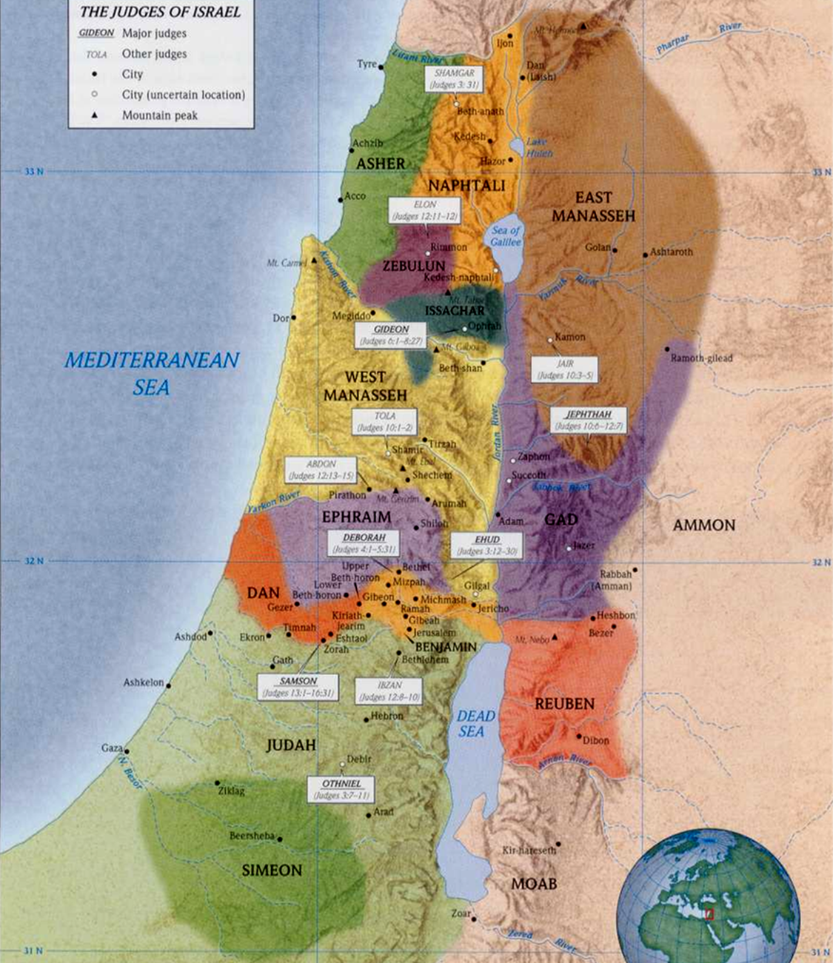
Placing the judges & tribes

Slide 10
Outline of Judges 1:1-3:6
Incomplete Conquest of Canaan (1:1-36)
Judah & Simeon conquer Bezek (1:1-3)
Judah defeats Jerusalem, lowland, Hebron, Debir (1:4-11)
Othniel conquers Kirjath Sepher and is rewarded (1:12-15)
Judah & Simeon conquer Philistine territories (1:16-20)
Benjamin fails to defeat the Jebusites (1:21)
Ephraimites conquer Bethel (1:22-26)
Manasseh fails to drive out Canaanites, but puts them under tribute (1:27-28)
Ephraim fails at Gezer (1:29)
Zebulun fails at Kitron & Nahalol, themselves put under tribute (1:30)
Asher fails at Acco, Sidon, etc… (1:31-32)
Naphtali fails at Beth Shemesh & Beth Anath, but puts them under tribute (1:33)
Amorites forced Dan into the mountains (1:34-36)
Bochim: The Broken Covenant (2:1-6)
Announcement of the Angel (1:1-3)
Reaction: “Weeping” (2:4-6)
Introduction to the Period of the Judges (2:6-3:6)
Death of Joshua (1:6-10)
Cycle of Disobedience, Defeat, and Deliverance (2:11-22)
Israel did evil (1:11-13)
God Punished with Enemies (1:14-15)
God raised up judges (1:16-18)
Israel returned to evil after the judge died( 2:19-20)
God finally left the nations to test them (1:20-22)
Nations Left to Prove Israel (3:1-6)
Taught to know war (3:1-3)
Obedience to commandments tested (3:4-6)

Slide 11
Joshua - Judges Duplication
Incident Joshua Judges
Caleb given Hebron by Moses 14:1-15 1:20
Caleb takes Kirjath Arba/Hebron (& kills giants) 15:13-14 1:9-10
Othniel takes Kirjath Sepher, gets a wife & springs 15:15-19 1:12-16
Benjamin did not drive out Jebusites 15:63 1:21
Ephraim did not drive out Canaanites 16:10 1:29
Manasseh put Canaanites to forced labor 17:12-13 1:27-28
Zebulun put Canaanites to forced labor 1:30
Iron chariots forced Ephraim/Manasseh & Judah to mtns. 17:17-18 1:19

Slide 12
Judges 1:16-21
¹⁶ Now the children of the Kenite, Moses’ father-in-law, went up from the City of Palms with the children of Judah into the Wilderness of Judah, which lies in the South near Arad; and they went and dwelt among the people. ¹⁷ And Judah went with his brother Simeon, and they attacked the Canaanites who inhabited Zephath, and utterly destroyed it. So the name of the city was called Hormah. ¹⁸ Also Judah took Gaza with its territory, Ashkelon with its territory, and Ekron with its territory. ¹⁹ So the Lord was with Judah. And they drove out the mountaineers, but they could not drive out the inhabitants of the lowland, because they had chariots of iron. ²⁰ And they gave Hebron to Caleb, as Moses had said. Then he expelled from there the three sons of Anak. ²¹ But the children of Benjamin did not drive out the Jebusites who inhabited Jerusalem; so the Jebusites dwell with the children of Benjamin in Jerusalem to this day.

Slide 13
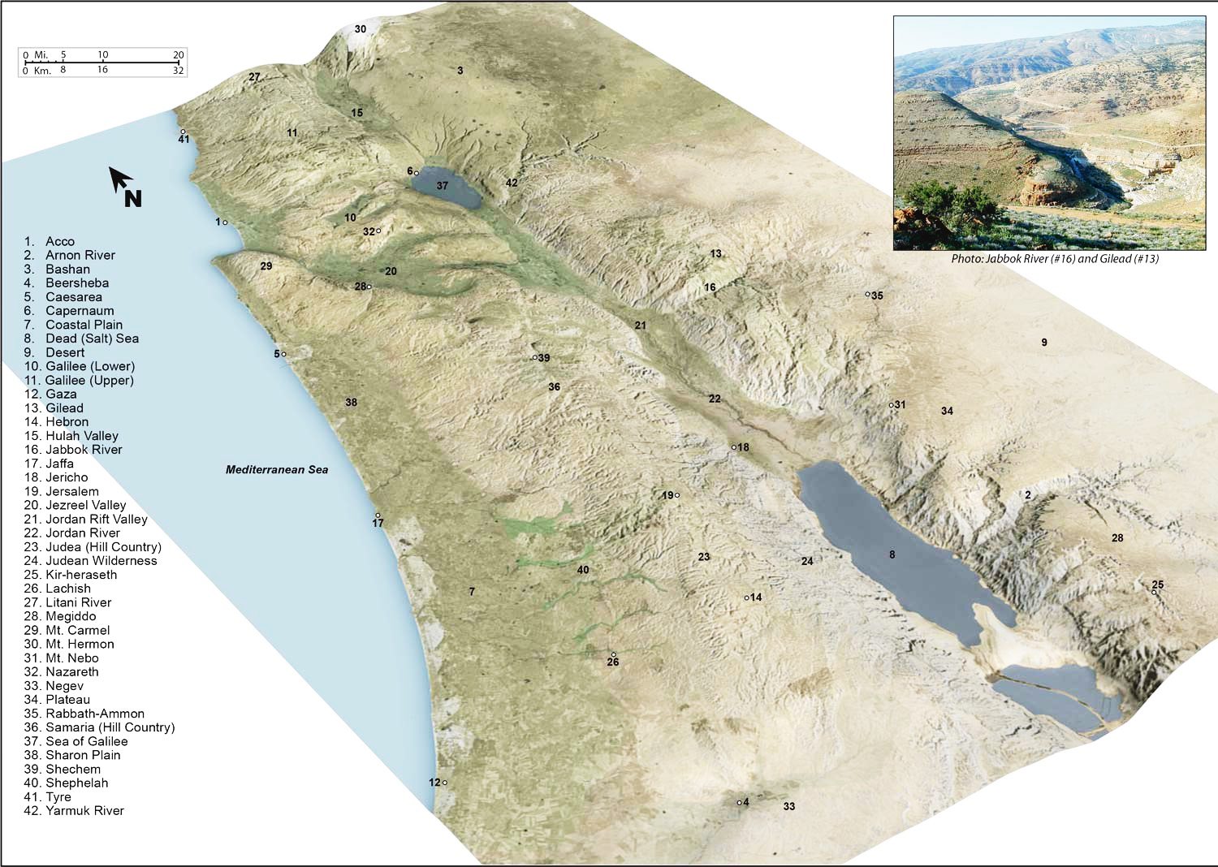

Slide 14
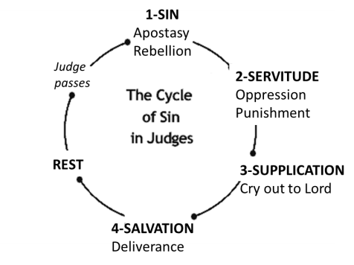
The Cycle
⁷ So the people served the Lord all the days of Joshua, and all the days of the elders who outlived Joshua, who had seen all the great works of the Lord which He had done for Israel. ⁸ Now Joshua the son of Nun, the servant of the Lord, died when he was one hundred and ten years old.⁹ And they buried him within the border of his inheritance at Timnath Heres, in the mountains of Ephraim, on the north side of Mount Gaash.¹⁰ When all that generation had been gathered to their fathers, another generation arose after them who did not know the Lord nor the work which He had done for Israel.
¹¹ Then the children of Israel did evil in the sight of the Lord, and served the Baals; ¹² and they forsook the Lord God of their fathers, who had brought them out of the land of Egypt; and they followed other gods from among the gods of the people who were all around them, and they bowed down to them; and they provoked the Lord to anger. ¹³ They forsook the Lord and served Baal and the Ashtoreths. ¹⁴ And the anger of the Lord was hot against Israel. So He delivered them into the hands of plunderers who despoiled them; and He sold them into the hands of their enemies all around, so that they could no longer stand before their enemies. ¹⁵ Wherever they went out, the hand of the Lord was against them for calamity, as the Lord had said, and as the Lord had sworn to them. And they were greatly distressed.
¹⁶ Nevertheless, the Lord raised up judges who delivered them out of the hand of those who plundered them. ¹⁷ Yet they would not listen to their judges, but they played the harlot with other gods, and bowed down to them. They turned quickly from the way in which their fathers walked, in obeying the commandments of the Lord; they did not do so. ¹⁸ And when the Lord raised up judges for them, the Lord was with the judge and delivered them out of the hand of their enemies all the days of the judge; for the Lord was moved to pity by their groaning because of those who oppressed them and harassed them. ¹⁹ And it came to pass, when the judge was dead, that they reverted and behaved more corruptly than their fathers, by following other gods, to serve them and bow down to them. They did not cease from their own doings nor from their stubborn way.
Judges 2:7-19

Slide 15
Long-term Consequences
Then the anger of the Lord was hot against Israel; and He said, “Because this nation has transgressed My covenant which I commanded their fathers, and has not heeded My voice, ²¹ I also will no longer drive out before them any of the nations which Joshua left when he died, ²² so that through them I may test Israel, whether they will keep the ways of the Lord, to walk in them as their fathers kept them, or not.” ²³ Therefore the Lord left those nations, without driving them out immediately; nor did He deliver them into the hand of Joshua.
Judges 2:10-23

Slide 16
Sins of Israelites
Did not know Jehovah or His works (2:10)
Served Baals and Ashtoreths (2:11-13)
Did not drive out the Canaanites (1:28)
Did not obey Jehovah, as their fathers (2:17b)
Gave & took daughters & sons in marriage (3:5) (made covenants, 2:2)

Slide 17
Objectives – Lesson 2 Conditions in Israel (1:1-3:6)
Define “Gilgal” and “Bochim,” and explain the significance of these terms/places.
List the tribe that did best at conquest.
List the tribe that did worst at conquest.
Describe the geographical order of ch. 1
List 3 areas of Israelites’ disobedience

Slide 19
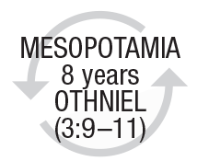
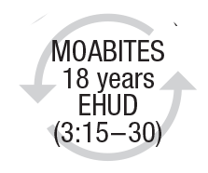
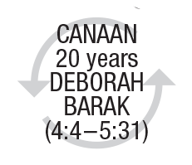
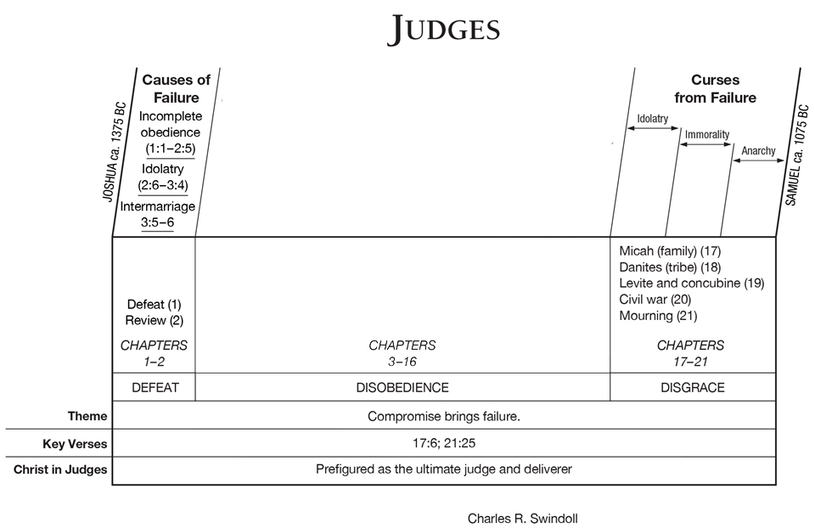
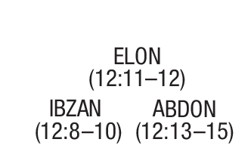
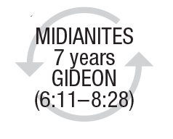
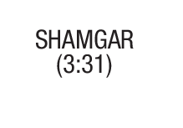
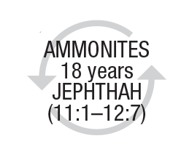
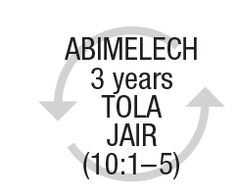
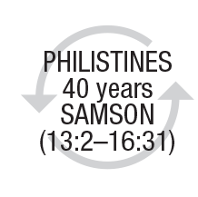
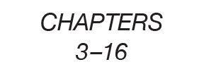
DISOBEDIENCE & DELIVERANCE
modified

Slide 20
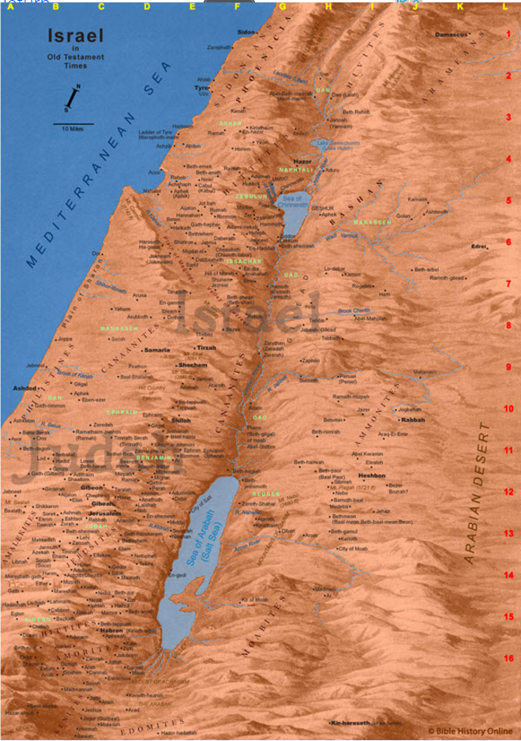

Slide 21
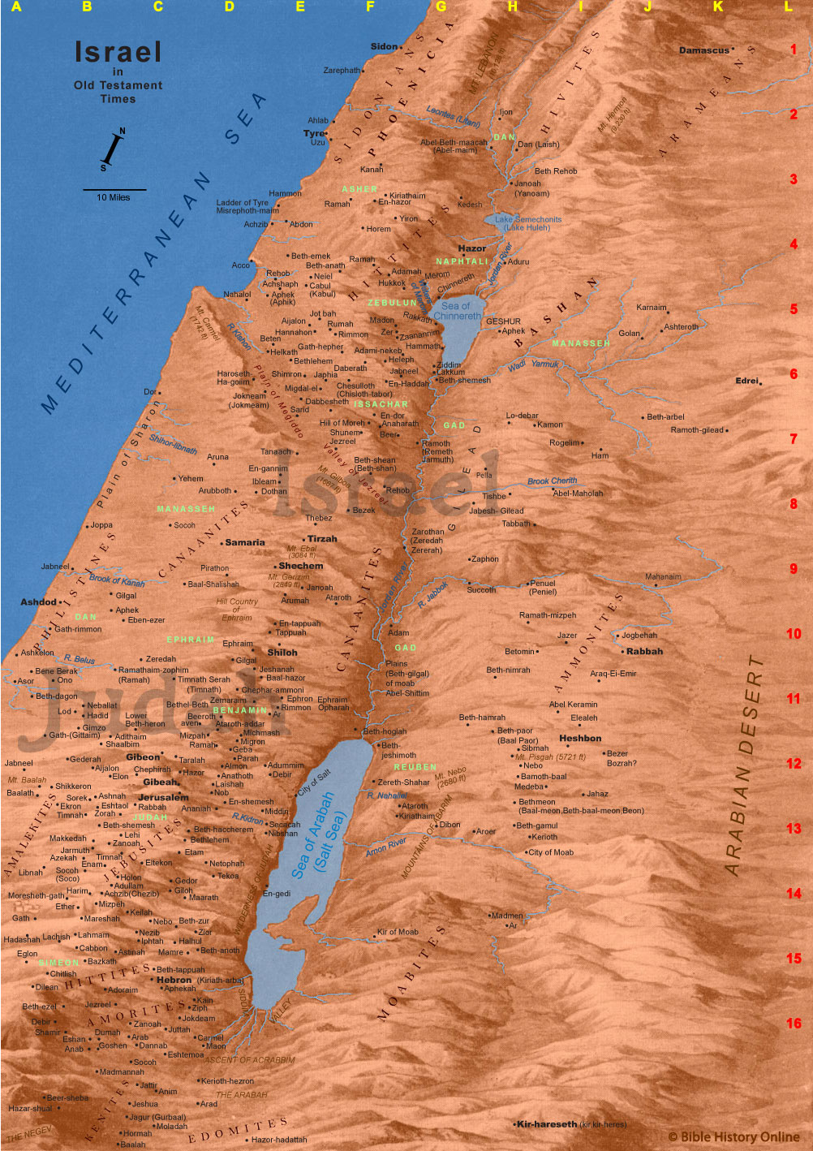

Slide 22
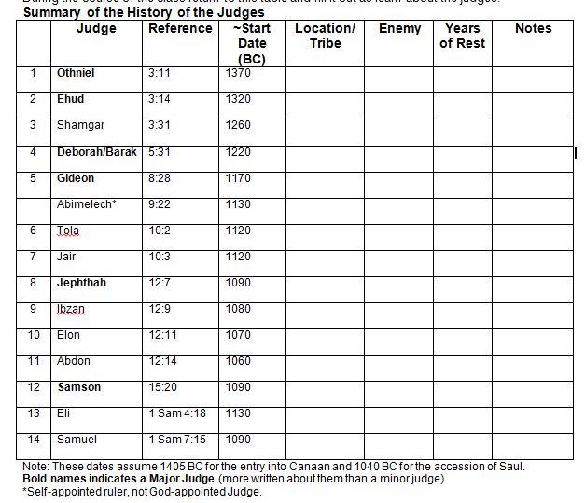

Slide 23
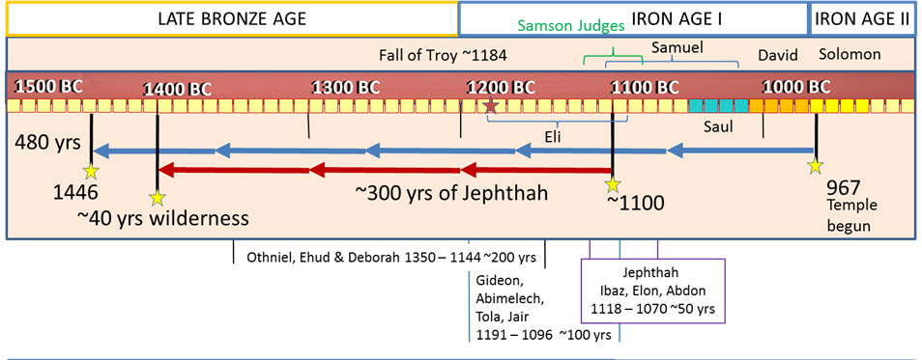
Changing Times

Slide 24
Major/Minor Difference is length

Slide 25
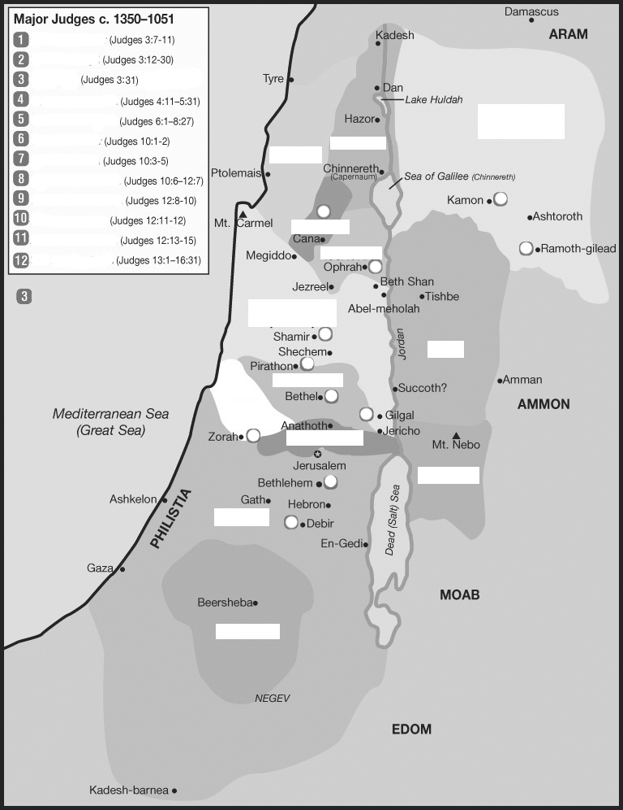
Placing the judges & tribes

