Slide 1
Lesson 7
Jephthah, Ibzan, Elon & Abdon
Notes:
Check on names for Othniel
Jephthah/Gideon education
Gilgal – place of Pent/Joshua etc in Judges
Comparison of Moses and Gideon’s angel interaction

Slide 2
Objectives – Lesson 8 Jephthah, Ibzan, Elon & Abdon (Judges 10:6-12:15)
Explain the geographical relationship of Jephthah and Samson (and their enemies).
Name the tribe and describe the family background of Jephthah.
Describe the history of the territory in dispute between Ammon and Israel.
Give two examples of the conciliatory character of Jephthah.
Describe the dispute with Ephraim and how it was resolved.
Tell the story of Jephthah’s vow and it’s result.

Slide 3
I. Conditions in Israel (1:1-3:6)
II. The Judges (3:7-16:31)
III. Cultural Decline (17:1-21:25)
Outline of judges

Slide 4
I. Conditions in Israel (1:1-3:6)
- Unoccupied Areas (1:1-2:5)
- Religious/Political Cycles (2:6-3:6)
II. The Judges (3:7-16:31)
- Othniel* (3:7-11)
- Ehud* (3:12-30)
- Shamgar* (3:31)
- Deborah* and Barak (4:1-5:31)
- Gideon* (6:1-8:35)
- Abimelech, Tola, Jair (9:1-10:5)
- Jephthah* (10:6-12:7)
- Ibzan, Elon, Abdon (12:8-15)
- Samson* (13:1-16:31)
III. Cultural Decline (17:1-21:25)
- Micah and the Danites (17:1-18:31)
- Crime and Civil War (19:1-21:25)
Outline of judges

Slide 5
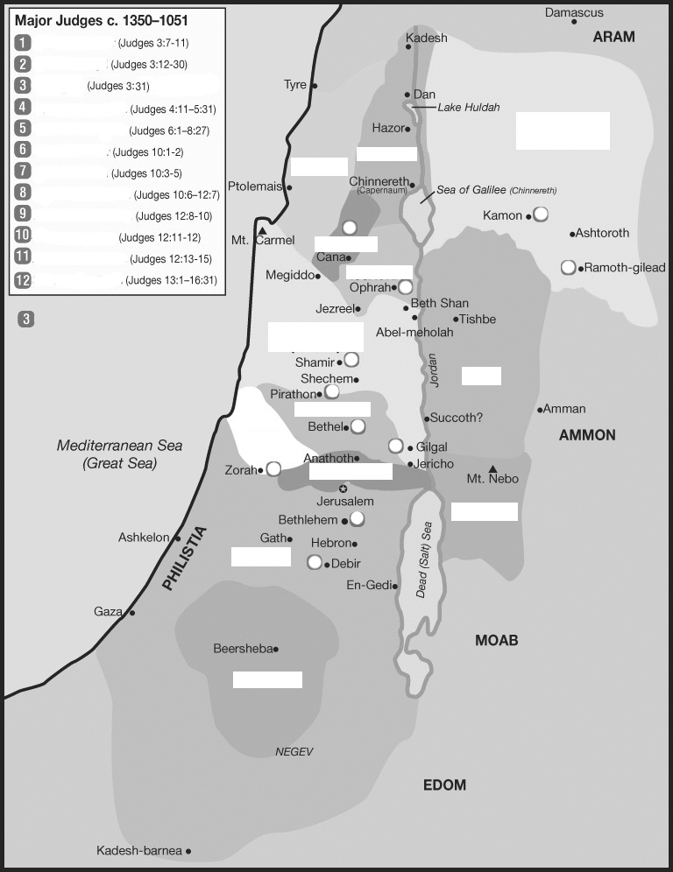
Placing the judges & tribes
Othniel
Ehud
Shamgar
Deborah/Barack
3
Manasseh
East
Gideon
Tola
Asher
Naphtali
Jair
Jephthah
4
Ibzan
10
7
Elon
Zebulun
Abdon
Issachar
8
5
West of
Jordan
Manasseh
West
East of
Jordan
6
11
Gad
Ephraim
Dan
4
2
Benjamin
9
Reuben
Judah
1
Judah
South
Simeon

Slide 6
Israel in the Promised Land – The Ideal
Unified & guided by God, not men.
No central governmental organization
Led, locally, by faith-filled people, as needed
No competition for power/leadership (see Num 11:25-29)
“No King…everyone did that which was right in God’s eyes.”
Intensely separated from the non-believing world
Purged idolatry and immorality (even from own families)
Formed no alliances, covenants, intermarriages, except with faithful people
Their purity & obedience were examples to the nations around
Carefully obedient to the written Word
Every generation knew the Lord (Jg 2:10)
Remembered (carried out) the consequences of obedience & disobedience
The Word filled their lives (Levites, family study – Dt 6)
They worshiped as God instructed
Trusted in God’s care (Jg 2:7)
Content with the blessing in the land.
Not afraid to face enemies of God.
Did not depend on worldly measures of strength
Were strengthened by their repeated victories

Slide 7
Sins of Israelites
Did not know Jehovah or His works (2:10)
Served Baals and Ashtoreths (2:11-13)
Did not drive out the Canaanites (1:28)
Did not obey Jehovah, as their fathers (2:17b)
Gave & took daughters & sons in marriage (3:5) (made covenants, 2:2)
Judges 3:7 (ESV) ⁷ And the people of Israel did what was evil in the sight of the LORD. (4?)
They forgot the LORD their God (1)
and served the Baals and the Asheroth. (2)

Slide 8
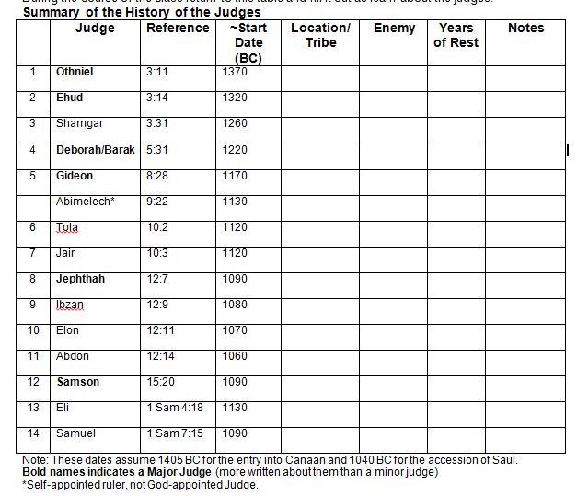
Judah/
Debir
Cushan-rishathaim
40
Related
to Caleb
Benjamin
Eglon/Moab++
80
Left handed
Philistines
Kills 600 Philistines with Ox Prod
Bethel-Ephraim /Kedesh-Naphtali
Jabin of Hazor
& Sisera
40
900 iron chariots
Death by woman
Oprah/Manasseh
Midainites, Amalekites, East
40
From 32000 to 300 men, signs
Shechem
/Manasseh
Civil war
Parable of the trees
Ephraim
Issachar
23
Gilead/Manasseh
22
30 sons, donkeys, cities
Gilead/Manasseh
Philistines &
Ammonites
Judged
6 yrs
Rash/Tragic vow
Bethlehem/Judah
Judged 7yrs
30 sons +
30 daughters
Aijalon/Zebulun
Judged 10yrs
Pirathon/Ephraim
Judged 8yrs
40 sons + 30 grandsons w/donkeys
Notes:
Judges 3:26 (ESV) ²⁶ Ehud escaped while they delayed, and he passed beyond the idols and escaped to Seirah.

Slide 9
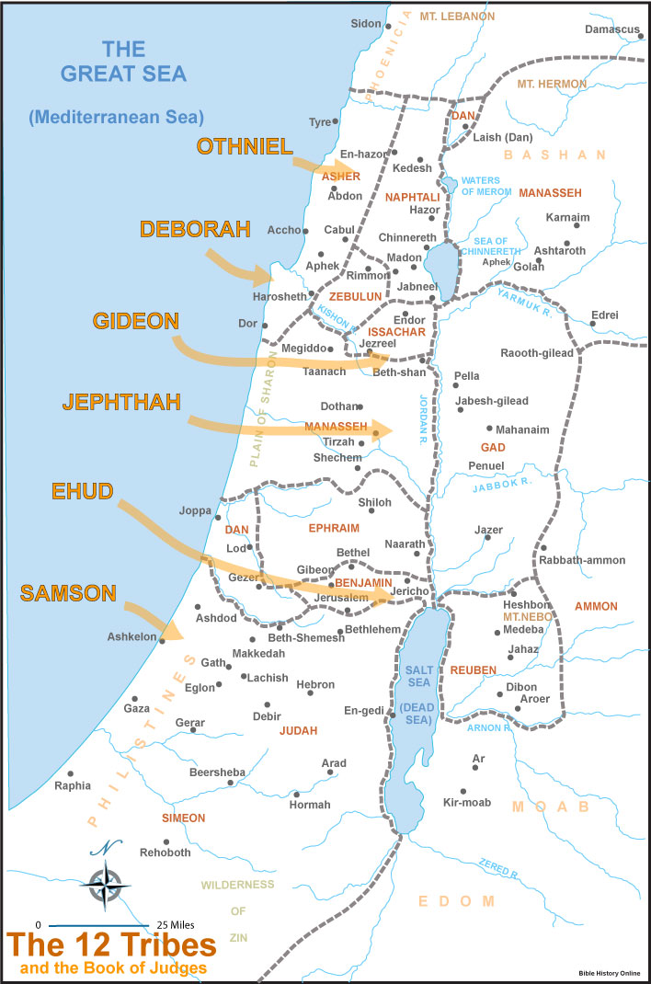
Jair
Ibzan

Slide 10
1-Beginnings Gen 1-5
2-Flood Gen 6-11
1445-1405 BC
5-Wilderness
Wanderings
931-722 BC
9-Divided
Kingdom
605-538 BC
11-Babylonian
Captivity
444 BC - ~4 BC
The Silent Years
(Intertestamental)
30-90 AD
The Church
NT Era
2166-1859 BC
3-Patriarchs
1380-1050 BC
7-Judges
4-Slavery in Egypt
1859-1445 BC
6-Conquest
of Canaan
1405-1380 BC
8-United
Kingdom
1050-931 BC
10-Judah
Alone
722-605 BC
12-Return
From Exile
538-444 BC
Life of
Christ
4 BC – 30 AD
1400 BC
1300 BC
1200 BC
1100 BC
East of Jordan:
Ammonites
& Philistines
Jephthah
Jair
Eli
Samuel
West of Jordan:
Elon
Midianites
Tola
Abdon
Saul
David
Solomon
Gideon
Canaanites
Moab
Deborah
Ehud
Philistines
Samson
Judah : South
Othniel
Philistines
Shamgar?
Mesopotamian
Ruth?
Ibzan
Egypt:
Battle of Kadesh
Egypt-Hittites
Merneptah
Sea People
Vs Ramses III
Travels of
Wen-Amon
Based on Graphics from Marc Hinds & Zondervan Pictorial Encyclopedia of the Bible
Notes:
Judges describes cycles of apostasy, oppression, and deliverance in the southern region (3:7–31), the central region (6:1–10:5), the eastern region (10:6–12:15), and the western region (13:1–16:31).

Slide 11
Major/Minor Difference is length

Slide 12
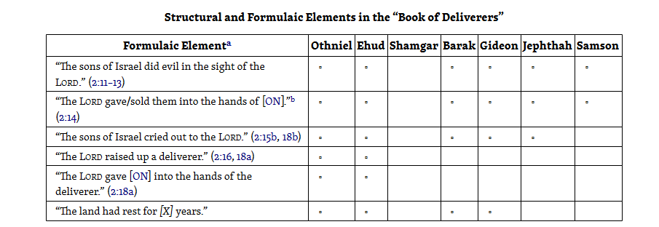
Major Judges

Slide 13
People again did evil
Judges 10:6-7(ESV) ⁶The people of Israel again did what was evil in the sight of the Lord and
served the Baals and
the Ashtaroth,
the gods of Syria,
the gods of Sidon,
the gods of Moab,
the gods of the Ammonites, and
the gods of the Philistines.
And they forsook the Lord and did not serve him. ⁷So the anger of the Lord was kindled against Israel, and he sold them into the hand of the Philistines and into the hand of the Ammonites,
(1)
(2)
(3)
(4)
(5)
(6)
(7)

Slide 14
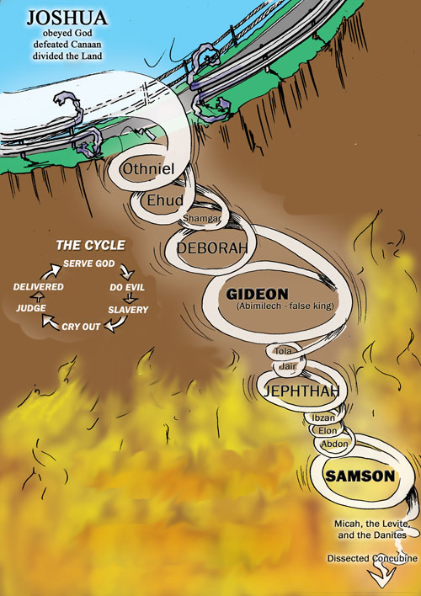
Cycle of Decline
Judges 3:7(ESV) …They forgot the Lord their God and served the Baals and the Asheroth.
Joshua 24:19-22(ESV)
19 But Joshua said to the people, “You are not able to serve the Lord, for he is a holy God. He is a jealous God; he will not forgive your transgressions or your sins.
20 If you forsake the Lord and serve foreign gods, then he will turn and do you harm and consume you, after having done you good.”
21And the people said to Joshua, “No, but we will serve the Lord.” 22Then Joshua said to the people, “You are witnesses against yourselves that you have chosen the Lord, to serve him.” And they said, “We are witnesses.”
Judges 3:12(ESV) And the people of Israel again did what was evil in the sight of the Lord…
Judges 4:1(ESV) And the people of Israel again did what was evil in the sight of the Lord…
Judges 6:1(ESV) The people of Israel did what was evil in the sight of the Lord…
Judges 6:30(ESV) Then the men of the town said to Joash, “Bring out your son, that he may die, for he has broken down the altar of Baal and cut down the Asherah beside it.”
Judges 10:6(ESV) The people of Israel again did what was evil in the sight of the Lord and served the Baals and the Ashtaroth, the gods of Syria, the gods of Sidon, the gods of Moab, the gods of the Ammonites, and the gods of the Philistines.
And they forsook the Lord and did not serve him.

Slide 15
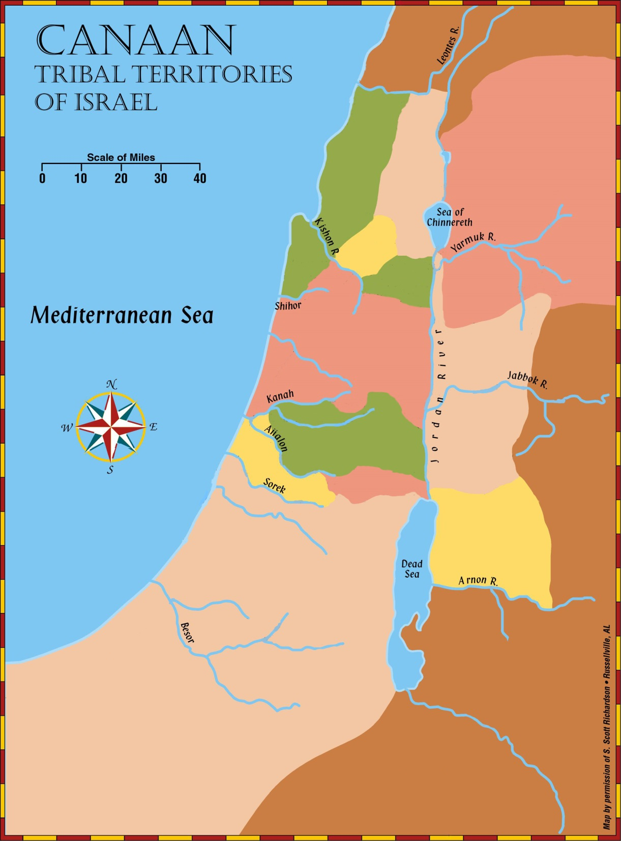
OPPRESSED TRIBES
Sidon
Syria
Judges 10:7-9(ESV) ⁷So the anger of the Lord was kindled against Israel, and he sold them into the hand of the Philistines and into the hand of the Ammonites, ⁸and they crushed and oppressed the people of Israel that year. For eighteen years they oppressed all the people of Israel who were beyond the Jordan in the land of the Amorites, which is in Gilead. ⁹And the Ammonites crossed the Jordan to fight also against Judah and against Benjamin and against the house of Ephraim, so that Israel was severely distressed.
Manasseh-East
Gilead
Manasseh-West
Shiloh/Samuel
Philistines
Ephraim
Gad
Benjamin
Ammon
Samson
Reuben
Judah
Moab
Edom

Slide 16
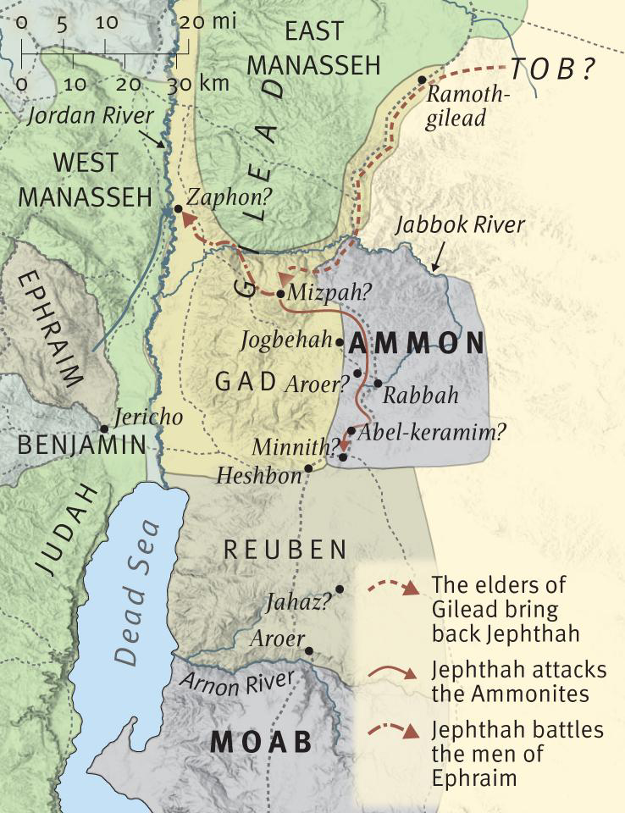
locate
Judges 11:32-33(ESV) ³²So Jephthah crossed over to the Ammonites to fight against them, and the Lord gave them into his hand. ³³And he struck them from Aroer to the neighborhood of Minnith, twenty cities,
and as far as
Abel-keramim,
with a great blow. So the Ammonites were subdued before the people of Israel.

Slide 17
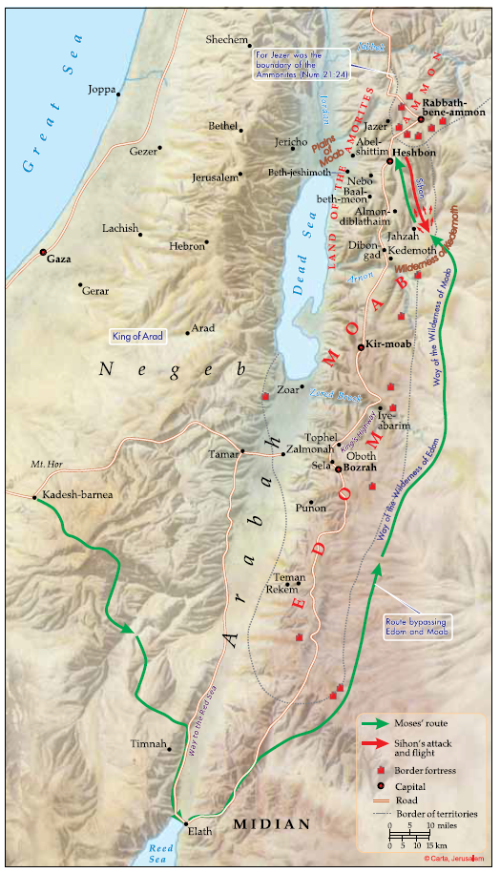
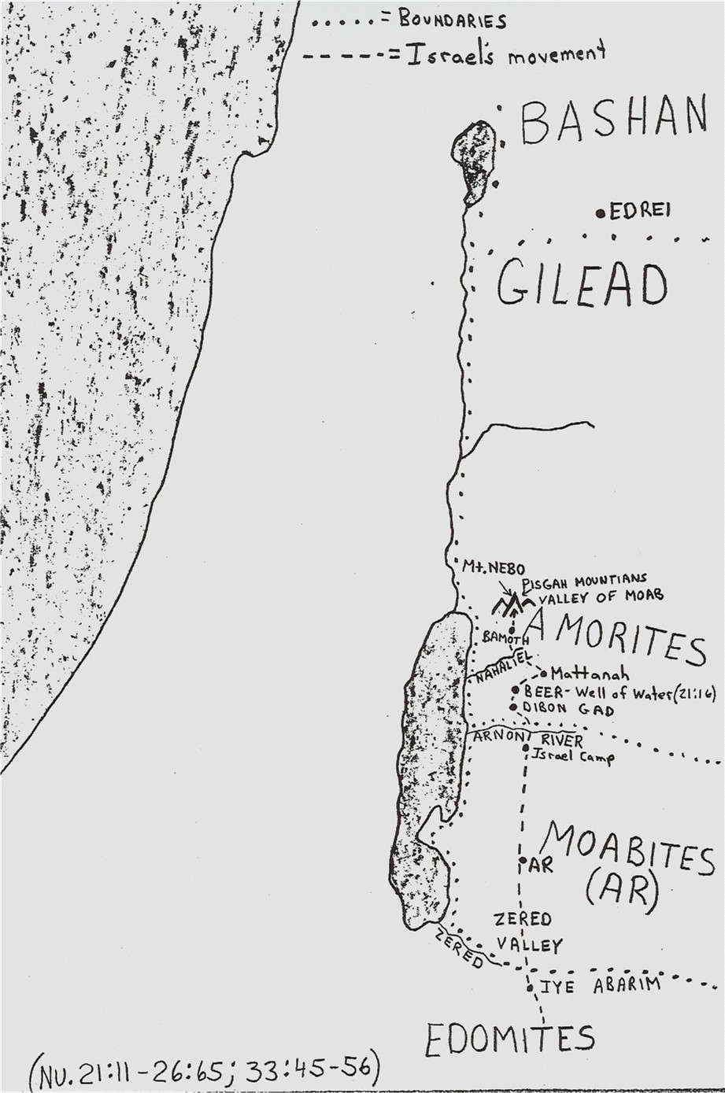
Locate
Numbers 21:33 (ESV) ³³Then they turned and went up by the way to Bashan. And Og the king of Bashan came out against them, he and all his people, to battle at Edrei.
Judges 11:13 (ESV) ¹³And the king of the Ammonites answered the messengers of Jephthah, “Because Israel on coming up from Egypt took away my land, from the Arnon to the Jabbok and to the Jordan; now therefore restore it peaceably.”
Numbers 21:24(ESV) ²⁴And Israel defeated him (Sihon king of the Amorites) with the edge of the sword and took possession of his land from the Arnon to the Jabbok, as far as to the Ammonites, for the border of the Ammonites was strong.
Numbers 21:11(ESV) ¹¹And they set out from Oboth and camped at Iye-abarim, in the wilderness that is opposite Moab, toward the sunrise.
Numbers 20:21(ESV) ²¹Thus Edom refused to give Israel passage through his territory, so Israel turned away from him.

Slide 18
Judges 11:16-23(ESV) ¹⁹Israel then sent messengers to Sihon king of the Amorites, king of Heshbon, and Israel said to him, ‘Please let us pass through your land to our country,’ ²⁰but Sihon did not trust Israel to pass through his territory, so Sihon gathered all his people together and encamped at Jahaz and fought with Israel. ²¹And the Lord, the God of Israel, gave Sihon and all his people into the hand of Israel, and they defeated them. So Israel took possession of all the land of the Amorites, who inhabited that country. ²²And they took possession of all the territory of the Amorites from the Arnon to the Jabbok and from the wilderness to the Jordan.
Numbers 21:33 (ESV) ³³Then they turned and went up by the way to Bashan. And Og the king of Bashan came out against them, he and all his people, to battle at Edrei.
Numbers 21:24(ESV) ²⁴And Israel defeated him (Sihon king of the Amorites) with the edge of the sword and took possession of his land from the Arnon to the Jabbok, as far as to the Ammonites, for the border of the Ammonites was strong.
Judges 11:16-23(ESV) ¹⁷Israel then sent messengers to the king of Edom, saying, ‘Please let us pass through your land,’ but the king of Edom would not listen. And they sent also to the king of Moab, but he would not consent. So Israel remained at Kadesh. ¹⁸“Then they journeyed through the wilderness and went around the land of Edom and the land of Moab and arrived on the east side of the land of Moab and camped on the other side of the Arnon. But they did not enter the territory of Moab, for the Arnon was the boundary of Moab.
Numbers 21:11(ESV) ¹¹And they set out from Oboth and camped at Iye-abarim, in the wilderness that is opposite Moab, toward the sunrise.
Numbers 20:21(ESV) ²¹Thus Edom refused to give Israel passage through his territory, so Israel turned away from him.

Slide 19
Judges 11:26-28(ESV) ²⁶While Israel lived in Heshbon and its villages, and in Aroer and its villages, and in all the cities that are on the banks of the Arnon, 300 years, why did you not deliver them within that time?
²⁷I therefore have not sinned against you, and you do me wrong by making war on me.
The Lord, the Judge, decide this day between the people of Israel and the people of Ammon.”
²⁸But the king of the Ammonites did not listen to the words of Jephthah that he sent to him.
Numbers 21:33 (ESV) ³³Then they turned and went up by the way to Bashan. And Og the king of Bashan came out against them, he and all his people, to battle at Edrei.
Numbers 21:24(ESV) ²⁴And Israel defeated him (Sihon king of the Amorites) with the edge of the sword and took possession of his land from the Arnon to the Jabbok, as far as to the Ammonites, for the border of the Ammonites was strong.
Numbers 21:11(ESV) ¹¹And they set out from Oboth and camped at Iye-abarim, in the wilderness that is opposite Moab, toward the sunrise.
Numbers 20:21(ESV) ²¹Thus Edom refused to give Israel passage through his territory, so Israel turned away from him.

Slide 20
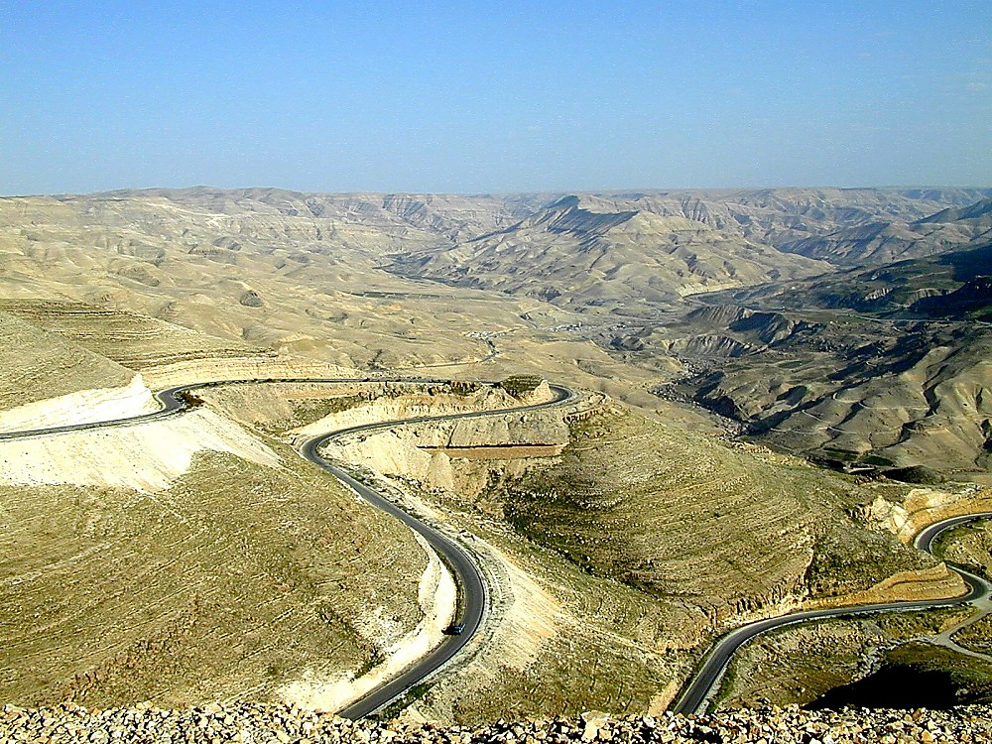
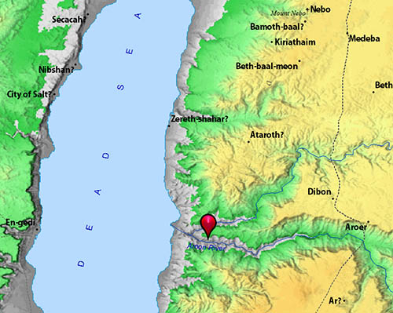
Arnon Valley view to southeast
Notes:
The Arnon River
The Arnon River was the northern border of Moab during much of its history (Num 21:13; Deut 3:16). In the time of Mesha, Moab conquered Israelite lands to the north and repaired the highway that crossed the Arnon, thus unifying the areas to the north and south.
Nahal Arnon (Wadi Mujib) is an impressive canyon that is nearly 3 miles (5 km) wide at the point opposite Aroer where the King’s Highway ran. Its depth is between 1,300 and 2,300 feet (406 m and 718 m) (Mattingly 1992a: 398). As such, the Arnon was a barrier to travel in ancient times. Alternately, travelers could use the Wilderness Highway to the east which avoided the east-west gorges like the Arnon.
Fifteen miles to the east of the Dead Sea, the Arnon River splits into two branches and then into four. This is important, as Numbers 21:14-15 refers to the “valleys” of the Arnon. This is a reference to the upper reaches.
Isaiah speaks of the crossing point at the Arnon: “Then, like fleeing birds or scattered nestlings, the daughters of Moab will be at the fords of the Arnon ” (16:2 NASB).
tb031801041

Slide 21
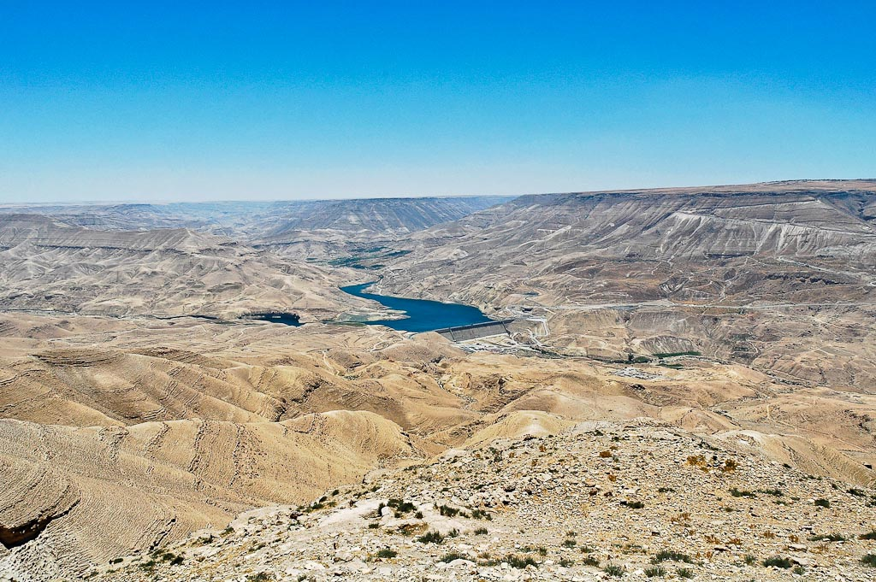
Arnon Valley view southeast from Aroer
Notes:
Numbers 21:26 (NIV) “Heshbon was the city of Sihon king of the Amorites, who had fought against the former king of Moab and had taken from him all his land as far as the Arnon.”
tb061204190

Slide 22
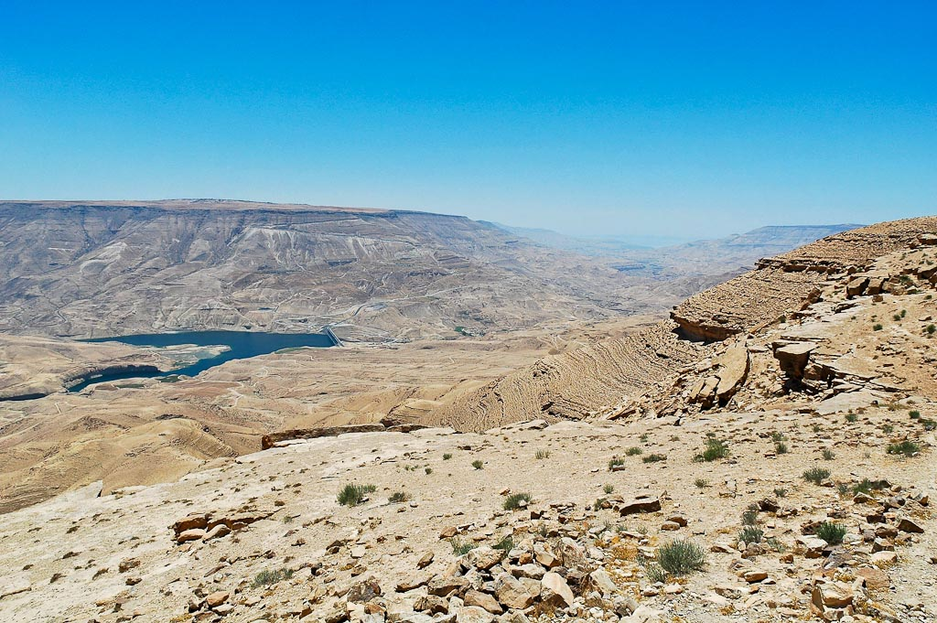
Arnon Valley view southwest from Lehun
Notes:
Moab: Geography and History
Borders
The border of Moab was only about 25 miles (40 km) east to west, including “steep and frightening ascents” from the Dead Sea (Cleave 1994: 207).
The distance from Nahal Arnon (Wadi Mujib) to Nahal Zered (Wadi Hesa) is about 35 miles (56 km). These are both huge canyons, and are major features of Transjordan. They have always served as geopolitical borders. Traversing them is not easy.
The Arnon is 1,700 feet (530 m) deep and 2 miles (3.2 km) across from top edge to top edge. The floor of the valley is only 130 feet (40 m) wide.
The Zered is less dramatic than the Arnon, but because the character of the land on either side was so different, the peoples were less inclined to expand over this river.
Geology
The land of Moab consists mainly of Cenomanian limestone on the rim above the Rift Valley, some basalt on the plateau, and also Senonian chalk further east.
Sufficiently good agriculture is apparent in the story of Ruth, in which the family of Elimelech left the hill country of Judah because of a famine in the land of Judah.
tb061204212

Slide 23
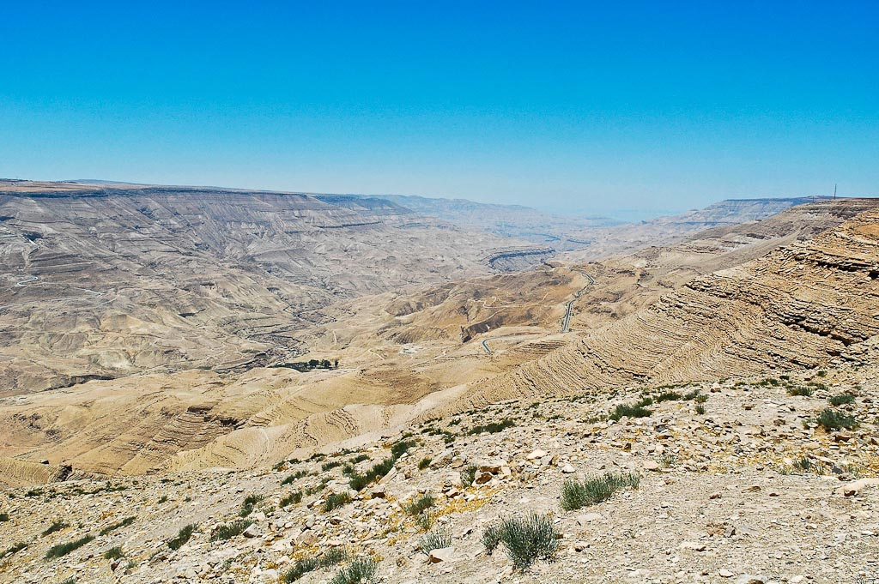
Arnon Valley view southwest from Aroer
Notes:
Moab’s Early History
Prior to Moabite settlement, the territory, as well as Ammon, Gilead and Bashan, had been lived in by the Rephaim, whom the Moabites called the Emim. In Abraham’s time, before Lot’s descendants (Ammon and Moab) were born, Chedarlaomer of Babylon completed a successful military expedition against the Rephaim, seriously weakening their hold on Transjordan. Chedarlaomer’s expedition must have created a settlement vacuum which was eventually filled by the Ammonites, Moabites and Edomites (Gen 14:1-16).
The Moabites were descendants of Lot and his oldest daughter (Gen 19:37). How long it took Moab and Ammon to become clans/tribes is uncertain. Considering Biblical chronology, Moab and Ammon (as well as Edom) must have formed as kingdoms or strong tribal groups when the Israelites were in Egypt (between c. 1850-1450 BC).
Israelite Conquest
The “former king” of Moab is clearly in Hebrew the “first king” (Num 21:26; Dt 2:10-11). The Moabites must have been only in their initial stages of a monarchy when Israel came through, having just taken it from the giant Rephaim. This first king of Moab had lost the territory of the Mishor to Sihon the Amorite.
Israel was not to harass Moab on the journey to Canaan (Dt 2:8-18; Num 21:10-15, 25-30). Like Ammon, and by God’s granting, Moab had dispossessed the giant people of the Rephaim, in this case called Emim. While Moab’s technical northern border was the Arnon, he often attempted to extend sovereignty onto the Medeba Plateau. Sihon the Amorite took the cities north of the Arnon away from Moab prior to the Israelite conquest (Num 21:26).
Israel conquered the Mishor when Sihon refused passage (Num 21, Dt 2:24-37).
Deuteronomy 3:10 gives the three-part geographical breakdown of Transjordan (north of the Arnon river): “tableland, Gilead, and Bashan.”
Before Gad and Reuben settled, the king of Moab, Balak, appears to have had access to the Mishor, since Sihon was gone. It is here that he brought Balaam son of Beor, to the heights of Nebo to curse Israel.
Settlement and Judges
This area was settled by Gad and Reuben (Num 32:1-2), two tribes who desired to remain as shepherds in Transjordan, staying more or less semi-nomadic. They failed to move, unlike the other tribes, from a pastoral to an agricultural lifestyle. The areas which they settled are difficult to define precisely, as they apparently intertwine, change and flip-flop. There are two different accounts of Gad and Reuben’s territorial settlement (Smith 1931: 383).
Reuben clusters around Heshbon, while Gad envelops him north and south (all the way to Arnon; Num 32:34-38).
Reuben settled south of Heshbon, and Gad is to the north of Heshbon as far as Mahanaim and the Sea of Chinereth (Josh 13:15-28).
Parts of Moab were actually the inheritance of Reuben, but were very rarely controlled by Israel.
Explanations for differences in the accounts:
Because of the transitory-pastoral life of the two tribes, the borders were never clearly defined. Shepherds from one tribe crossed the boundaries into another. They were related and there could have been cooperation, assimilation, and a combining of the two tribes.
The borders changed over time. Gad eventually expanded more north as far as the Sea of Chinereth, vacating (though not entirely, since Mesha mentions Gadites being in Ataroth for a long time) some of sites south of Heshbon. During the monarchy, Gad seems to have taken precedence (1 Sam 13:7, 2 Sam 24:5), suggesting its expansion.
Eglon of Moab oppressed Israel and took over Jericho. This is somewhat comparable to the 1948-1967 Jordanian rule of the West Bank, where a Transjordanian power pushed over and controlled Cisjordan (Jud 3:12-13).
Ruth the Moabitess came to Bethlehem with Naomi and became part of the Messianic line.
David and Solomon
By the time the Israelite monarchy was forming, the Mishor was in the hands of Ammon/Moab. David (with Joab) was successful in returning the territory to Israel (1 Chr 19:14-15).
While David sought refuge for his parents (possibly with relatives?) in Moab, he later, as king, fought and subdued Moab (1 Sam 22:3; 2 Sam 8:2).
Solomon took Moabite wives and built a temple on the Mt. of Olives to Chemosh, the god of Moab (1 Ki 11:7).
Moab’s End
Not long after Mesha’s revolt, in Jehu’s time (841-814 BC), Aram penetrated into Transjordan as far as the Arnon River (2 Ki 10:32-33).
There is a record of Moabite raiders apparently in Transjordan during Jehoash’s reign (2 Ki 13:20).
Following Mesha’s casting off of the yoke of Ahab ca. 852 BC, little is heard from Moab for nearly a century. If the southern border of Jeroboam’s kingdom went no farther than the north end of the Dead Sea, then the Moabites on the tableland retained their independence (Bartlett 1973: 238; MBA 138; contra Bright 1981: 257-58 and Aharoni 1979: 344). It, however, is not clear that Moab maintained her freedom.
At some point prior to Assyria’s coming (733 BC), Moab had once again taken control of the Mishor. This is seen as Isaiah mourned Moab’s impending loss, including the Mishor locales of Heshbon and Jazer. “Within three years Moab’s splendor will be despised” (Isa 16:8, 9, 14).
Most of Moab (and Edom) were subdued and became vassals to Assyria. With the downfall of Assyria there was a resurgence of Moabite and Edomite autonomy/identity (cf. Judah under Josiah). When the Babylonians came into the region, the cities of the Mishor were considered by the prophet Jeremiah to be mostly under Moabite control (Jer 48:1, 8, 18-21). But at the same time, Moab was losing its grip on the Mishor.
tb061204191

Slide 24
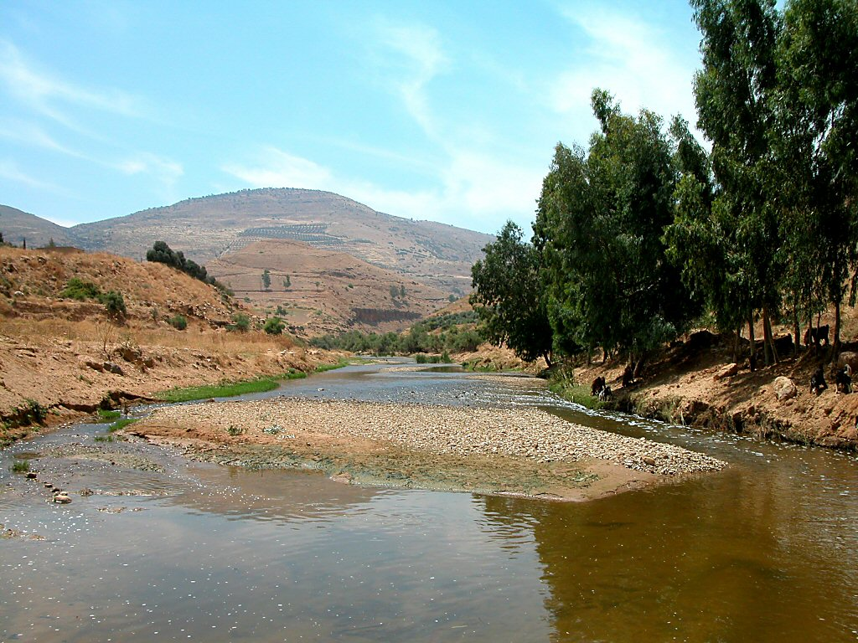
Jabbok River with Penuel
Notes:
tb060403030

Slide 25
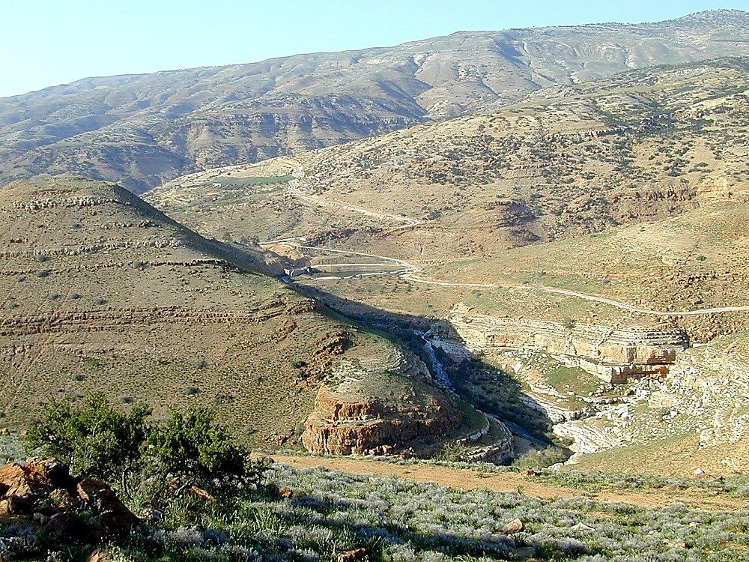
Penuel and fords of Jabbok from south
Notes:
Jacob Names Peniel
Genesis 32:30-31 (NKJV) “So Jacob called the name of the place Peniel: ‘For I have seen God face to face, and my life is preserved.’ Just as he crossed over Penuel the sun rose on him, and he limped on his hip.”
tb031701148

Slide 26
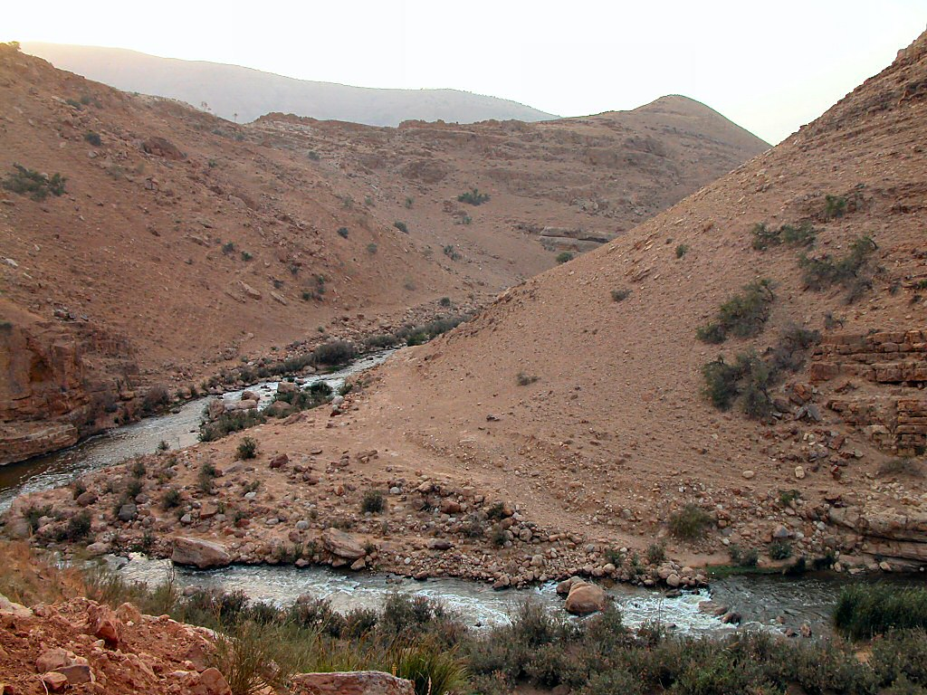
Jabbok River east of Mahanaim
Notes:
tb110603135

Slide 27
Israel
god
Judges 10:9-16(ESV) ⁹…so that Israel was severely distressed.
¹⁰And the people of Israel cried out to the Lord, saying, “We have sinned against you, because we have forsaken our God and have served the Baals.”
¹⁵And the people of Israel said to the Lord, “We have sinned; do to us whatever seems good to you. Only please deliver us this day.” ¹⁶So they put away the foreign gods from among them and served the Lord…
Judges 10:9-16(ESV) ¹¹And the Lord said to the people of Israel, “Did I not save you from the Egyptians and from the Amorites, from the Ammonites and from the Philistines? ¹²The Sidonians also, and the Amalekites and the Maonites (dwelt in Mt. Seir, south of the Dead Sea) oppressed you, and you cried out to me, and I saved you out of their hand. ¹³Yet you have forsaken me and served other gods; therefore I will save you no more. ¹⁴Go and cry out to the gods whom you have chosen; let them save you in the time of your distress.” ¹⁶…and he became impatient over the misery of Israel.

Slide 28
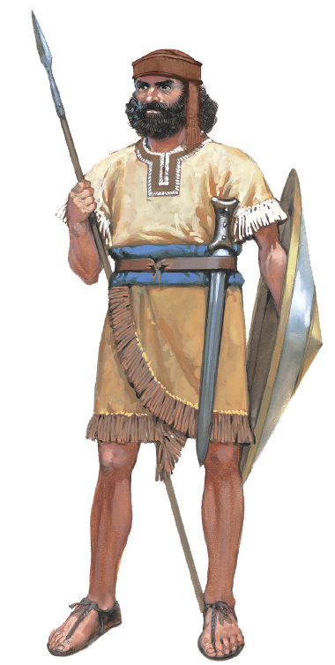
Jephthah
Judges 10:18(ESV) ¹⁸And the people, the leaders of Gilead, said one to another, “Who is the man who will begin to fight against the Ammonites? He shall be head over all the inhabitants of Gilead.”
Judges 11:1(ESV) ¹Now Jephthah the Gileadite was a mighty warrior, but he was the son of a prostitute. Gilead was the father of Jephthah.
Judges 11:2(ESV) ²And Gilead’s wife also bore him sons. And when his wife’s sons grew up, they drove Jephthah out and said to him, “You shall not have an inheritance in our father’s house, for you are the son of another woman.”
Judges 11:3(ESV) ³Then Jephthah fled from his brothers and lived in the land of Tob, and worthless fellows collected around Jephthah and went out with him.

Slide 29
Jephthah, the judge
Judges 11:5-11(ESV) ⁵And when the Ammonites made war against Israel, the elders of Gilead went to bring Jephthah from the land of Tob. ⁶And they said to Jephthah, “Come and be our leader, that we may fight with the Ammonites.” ⁷But Jephthah said to the elders of Gilead,
“Did you not hate me and drive me out of my father’s house?
Why have you come to me now when you are in distress?” ⁸And the elders of Gilead said to Jephthah, “That is why we have turned to you now, that you may go with us and fight with the Ammonites and be our head over all the inhabitants of Gilead.” ⁹Jephthah said to the elders of Gilead, “If you bring me home again to fight with the Ammonites, and the Lord gives them over to me, I will be your head.” ¹⁰And the elders of Gilead said to Jephthah, “The Lord will be witness between us, if we do not do as you say.” ¹¹So Jephthah went with the elders of Gilead, and the people made him head and leader over them. And Jephthah spoke all his words before the Lord at Mizpah.

Slide 30
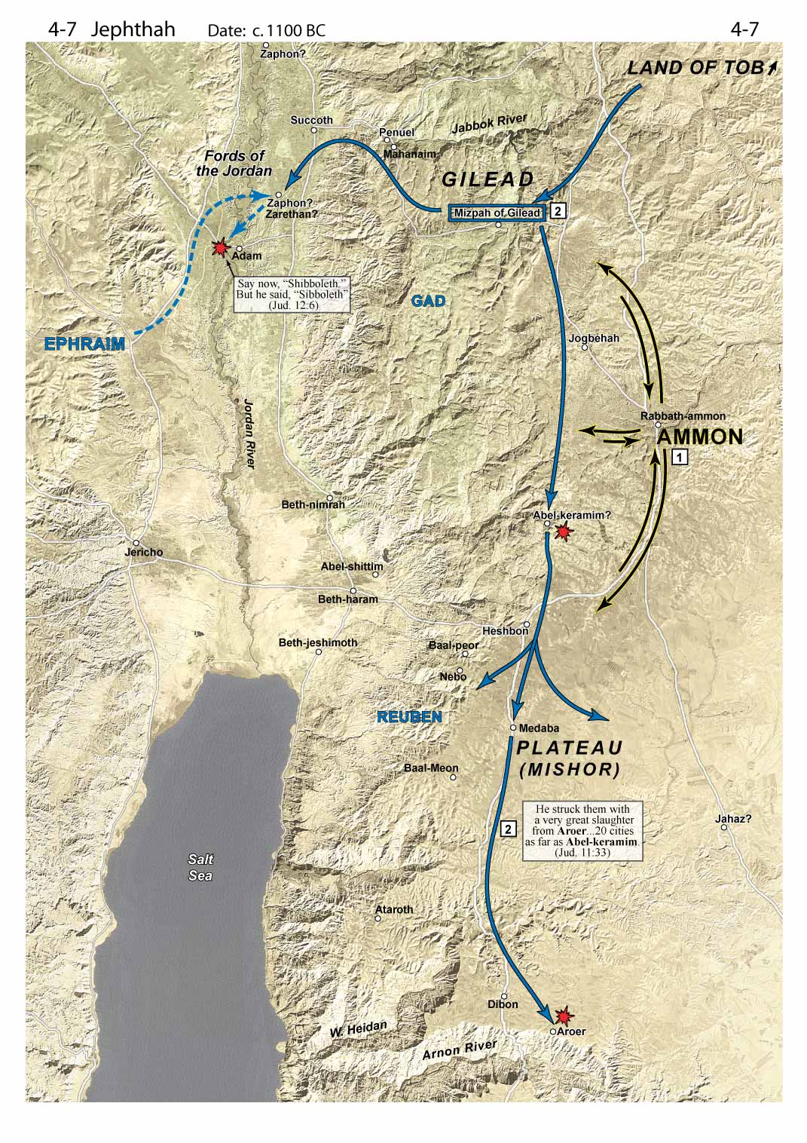
Locate
Judges 11:32-33(ESV) ³²So Jephthah crossed over to the Ammonites to fight against them, and the Lord gave them into his hand. ³³And he struck them
from Aroer
to the neighborhood of Minnith, twenty cities, and as far as Abel-keramim, with a great blow.
So the Ammonites were subdued before the people of Israel.

Slide 31
Jephthah’s vow
Judges 11:29-32(ESV) ²⁹Then the Spirit of the Lord was upon Jephthah, and he passed through Gilead and Manasseh and passed on to Mizpah of Gilead, and from Mizpah of Gilead he passed on to the Ammonites. ³⁰And Jephthah made a vow to the Lord and said, “If you will give the Ammonites into my hand, ³¹then whatever comes out from the doors of my house to meet me when I return in peace from the Ammonites shall be the Lord’s, and I will offer it up for a burnt offering.” ³²So Jephthah crossed over to the Ammonites to fight against them, and the Lord gave them into his hand.
Judges 11:35(ESV) ³⁵And as soon as he saw her, he tore his clothes and said, “Alas, my daughter! You have brought me very low, and you have become the cause of great trouble to me.
For I have opened my mouth to the Lord, and I cannot take back my vow.”

Slide 32
Jephthah’s vow
Judges 11:36-37(ESV) ³⁶And she said to him, “My father, you have opened your mouth to the Lord; do to me according to what has gone out of your mouth, now that the Lord has avenged you on your enemies, on the Ammonites.” ³⁷So she said to her father, “Let this thing be done for me: leave me alone two months, that I may go up and down on the mountains and weep for my virginity, I and my companions.”
Judges 11:39-40(ESV) ³⁹And at the end of two months, she returned to her father, who did with her according to his vow that he had made. She had never known a man, and it became a custom in Israel ⁴⁰that the daughters of Israel went year by year to lament the daughter of Jephthah the Gileadite four days in the year.

Slide 33
Jephthah the judge
Jephthah, more than any other character in Judges, lived and spoke always “before Jehovah” (e.g. 11:11). What is there in his life that might have produced this godliness?
What examples of temperance, patience and forgiveness do you see in Jephthah’s life?
How do you reconcile Jephthah’s sacrifice of his daughter with an otherwise faithful life?
Judges 11:11(ESV) ¹¹So Jephthah went with the elders of Gilead, and the people made him head and leader over them. And Jephthah spoke all his words before the Lord at Mizpah.
Judges 12:7(ESV) ⁷Jephthah judged Israel six years. Then Jephthah the Gileadite died and was buried in his city in Gilead.

Slide 34
Ephraim
Judges 1 ²⁹And Ephraim did not drive out the Canaanites who lived in Gezer, so the Canaanites lived in Gezer among them.
Judges 2 ⁸And Joshua the son of Nun, the servant of the Lord, died at the age of 110 years. ⁹And they buried him within the boundaries of his inheritance in Timnath-heres, in the hill country of Ephraim, north of the mountain of Gaash.
Judges 3 ²⁶Ehud escaped while they delayed, and he passed beyond the idols and escaped to Seirah. ²⁷When he arrived, he sounded the trumpet in the hill country of Ephraim. Then the people of Israel went down with him from the hill country, and he was their leader.
Judges 5 (Deborah) ¹⁴ From Ephraim their root they marched down into the valley,
Judges 8 (Gideon) ¹Then the men of Ephraim said to him, “What is this that you have done to us, not to call us when you went to fight with Midian?” And they accused him fiercely. ²And he said to them, “What have I done now in comparison with you? Is not the gleaning of the grapes of Ephraim better than the grape harvest of Abiezer? ³God has given into your hands the princes of Midian, Oreb and Zeeb. What have I been able to do in comparison with you?” Then their anger £ against him subsided when he said this.

Slide 35
Ephraim
Judges 12:1-6(ESV) ¹The men of Ephraim were called to arms, and they crossed to Zaphon and said to Jephthah, “Why did you cross over to fight against the Ammonites and did not call us to go with you? We will burn your house over you with fire.” ²And Jephthah said to them, “I and my people had a great dispute with the Ammonites, and when I called you, you did not save me from their hand. ³And when I saw that you would not save me, I took my life in my hand and crossed over against the Ammonites, and the Lord gave them into my hand. Why then have you come up to me this day to fight against me?” ⁴Then Jephthah gathered all the men of Gilead and fought with Ephraim. And the men of Gilead struck Ephraim,
because they said,
“You are fugitives of Ephraim, you Gileadites, in the midst of Ephraim and Manasseh.”

Slide 36
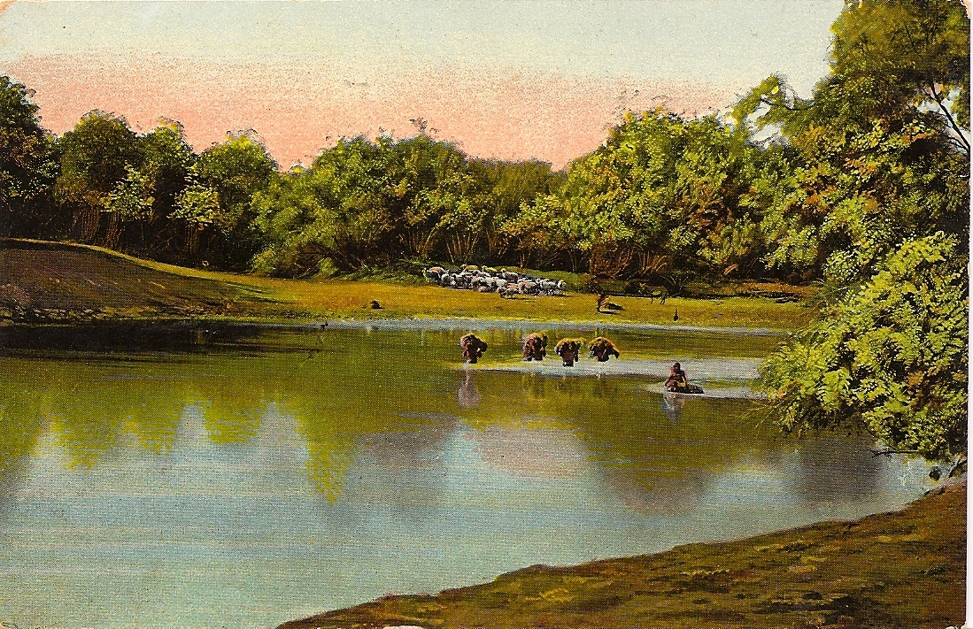
ephraim
Judges 12:5-6(ESV) ⁵And the Gileadites captured the fords of the Jordan against the Ephraimites. And when any of the fugitives of Ephraim said, “Let me go over,” the men of Gilead said to him, “Are you an Ephraimite?” When he said, “No,” ⁶they said to him, “Then say Shibboleth,” and he said, “Sibboleth,” for he could not pronounce it right. Then they seized him and slaughtered him at the fords of the Jordan. At that time 42,000 of the Ephraimites fell.

Slide 37
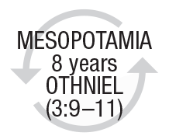
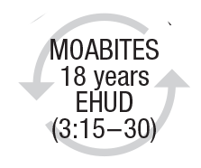
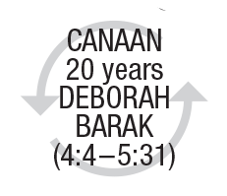
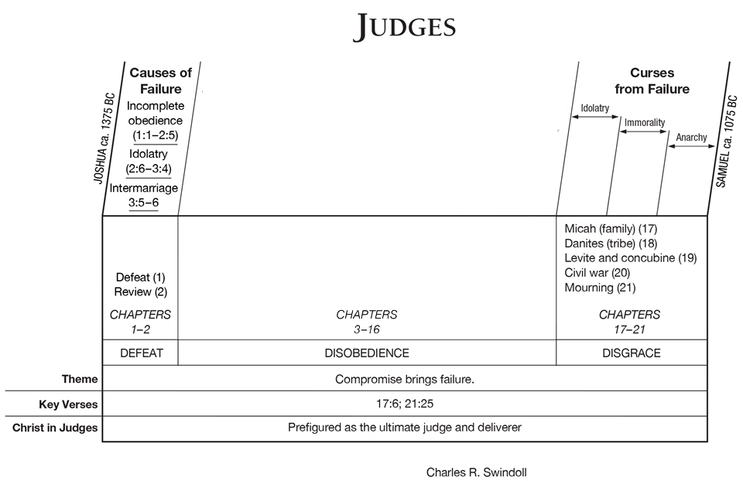
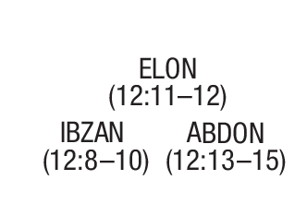
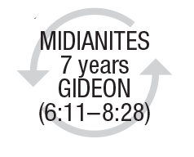
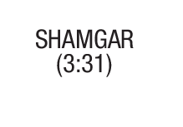
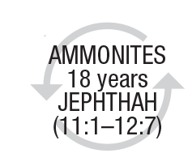
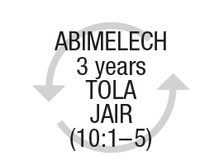
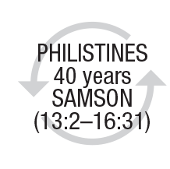
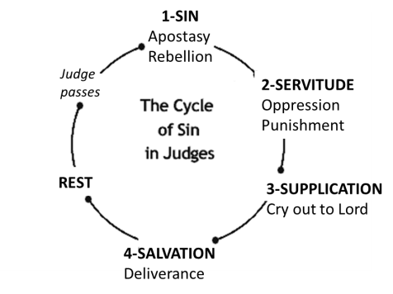
DISOBEDIENCE & DELIVERANCE
modified

