Slide 1
Haggai, Zechariah, Malachi
Lesson 2: introduction to haggai

Slide 2
Haggai, Zechariah, Malachi
Class Goals (by the end of our study each of us will . . .)
Have an increased appreciation for the sovereignty and power of God
Have an increased faith in Jesus as the prophesied Messiah
Worship in a more sincere and sacrificial manner
Resolve to remain faithful in a nation plagued by sins

Slide 3
Timeline #1
70 yrs
70 yrs
609 B.C. 597 586 | 539 538 537 522 520 516 B.C.
g
e
f
c
b
a
d
Book of Haggai, start rebuilding temple again
Darius the great restores order and becomes emperor
First year in Judah; altar rebuilt, ceremonies restored, temple foundation laid
Temple finished
Cyrus the Persian conquers Babylon
Cyrus’ edict for Jews to return
Three sieges of Judah by Babylonians; Captivity

Slide 4
Timeline #2
Cambyses | Darius I | Xerxes I | Artaxerxes I
530 B.C.
522
486
465
445
424 B.C.
479
c
458
f
a
516
b
d
460
432
e
Esther becomes queen
Ezra returns
Haggai and Zechariah preach and prophecy
Temple completed
Malachi preaches and prophecies
Nehemiah returns

Slide 5
Haggai
Zechariah
malachi
Match the following with the associated book
m
_____ “Will man rob God?”
_____ Zerubbabel chosen as a signet
_____ Eight messianic prophecies
_____ “Is it a time for you yourselves to dwell in your paneled
houses, while this house lies in ruins?”
_____ Priests specifically condemned
_____ First to command the temple be rebuilt
_____ Eight night visions
_____ Encourages the people to rebuild the temple
_____ John the Baptist foretold
h
z
h
m
h
z
z
m

Slide 6
FILL IN THE STRUCTURE OF THE EIGHT NIGHT VISIONS
Structure of Eight Night Visions
First
Second
Third
Fourth
Fifth
Sixth
Seventh
Eighth
a/c
e
God patrolling the earth
The cleaning of the land
God patrolling the earth
The two anointed leaders of post-exilic Judah
The threat of the nations against Judah
d
b
a/c

Slide 7
ANSWER THE FOLLOWING QUESTIONS
Which OT book gives a good historical background to the writings of Haggai, Zechariah, and Malachi?
Which OT book gives an account of the rebuilding of Jerusalem’s walls less than a hundred years after the completion of the temple?
Besides Haggai, Zechariah, Malachi, and the answer to #1 and #2, what is the only other OT book to detail events in the post-exilic period (post Babylonian captivity)?
Ezra
Nehemiah
Esther

Slide 8
Introduction to haggai
Lesson 2

Slide 9
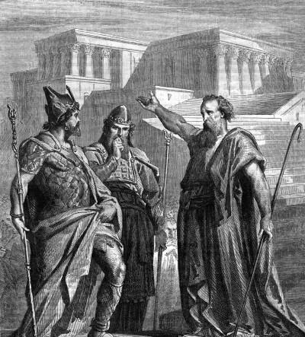
author
Haggai literally means “festival” or “joyous one”
Only mentioned two times in Bible (Ezra 5:1; 6:14)
Refers to himself as “the prophet” (1:1) and “the messenger of the LORD” (1:13)
He was inspired by God
Notes:
Point 1: I don’t know if the meaning of his name means that this is how Haggai was, but it would make sense wouldn’t it? With a goal of encouraging the people to continue rebuilding the temple, wouldn’t a joyous, festive personality lend to people’s encouragement? (Recall someone in class who has a similar personality)
Make point about different personalities and their effectiveness in the kingdom.
Point 2: I mentioned this point only because sometimes it helps me to be able to box off the information we have on certain people, or events, or thoughts in the Bible.
Information can sometimes be overwhelming when certain points or characters are spread across 10 books
Point 3: Why do you think he refers to himself in these ways?
Gives credit where credit is due
Gives authority to his statements
Reminds himself whose ideas these were
Tells us today….[point 4]

Slide 10
“thus says the lord”
Variant of phrase occurs twenty-six times in a book of only thirty-eight verses
The word of the LORD came…
Thus says the LORD of hosts…
…says the LORD
Declares the LORD of hosts…
As the LORD their God had sent…
Spoke…with the LORD’s message
Notes:
Who is the central character of Haggai?
Who is the central character of the Bible?
Haggai makes sure everyone knows:
Where the word came from…
What He is saying…
How He’s saying it…
There is no doubt who Haggai’s focus is on, and who governs His life. Isn’t that a good example for us?
Do the people we interact with know this?
What is our ratio of mentions of God to the entirety of our speech?
We don’t have to append these statements to what we say in order to project God, but it is worth thinking about what we are doing to show Him, and talk about Him, to other people.
Haggai gives us a good example.

Slide 11
date
70 yrs
70 yrs
609 B.C. 597 586 | 539 538 537 522 520 516 B.C.
Three sieges of Judah by Babylonians: Captivity
Cyrus the Persian conquers Babylon
Cyrus’ edict willing for Jews to return
First year in Judah:
Rebuilt altar of burnt offerings
Restored some ancient ceremonies
Laid foundation of new temple
Darius the great restores order and becomes emperor
Book of Haggai: Start rebuilding temple again
Finish building the temple 3 ½ years later
“¹ In the second year of Darius the king, in the sixth month, on the first day of the month, the word of the LORD came by the hand of Haggai the prophet…”

Slide 12
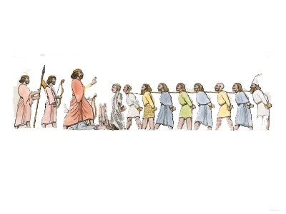
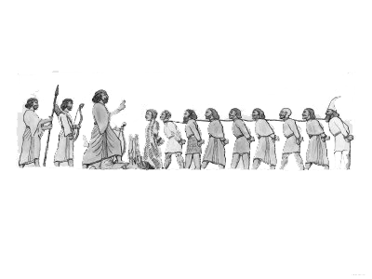
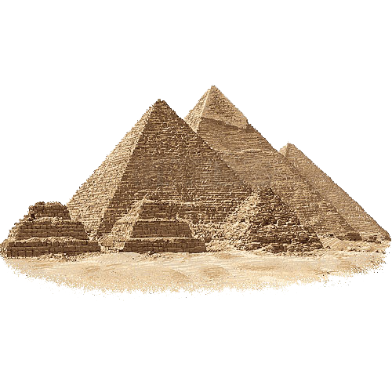
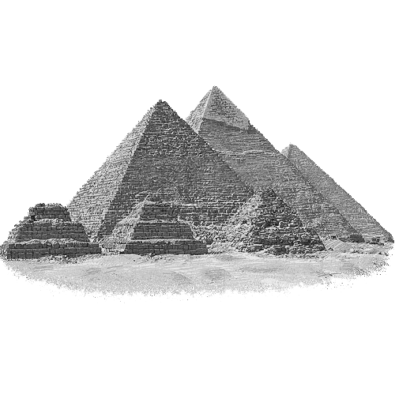
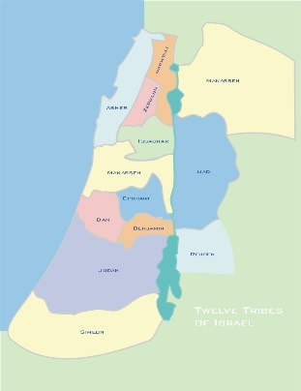
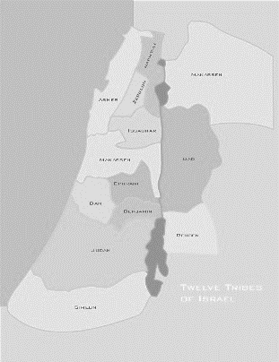
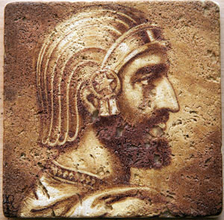
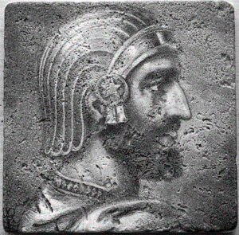
background
70 years
Abram
70 years
Land
Nation
Blessing to all nations
²² Now in the first year of Cyrus king of Persia, that the word of the LORD by the mouth of Jeremiah might be fulfilled, the LORD stirred up the spirit of Cyrus king of Persia, so that he made a proclamation throughout all his kingdom and also put it in writing: ²³ “Thus says Cyrus king of Persia, ‘The LORD, the God of heaven, has given me all the kingdoms of the earth, and he has charged me to build him a house at Jerusalem, which is in Judah. Whoever is among you of all his people, may the LORD his God be with him. Let him go up.’”
2 Chronicles 36:22-23 (ESV)
“⁴³ Thus the LORD gave to Israel all the land that he swore to give to their fathers. And they took possession of it, and they settled there. ⁴⁴ And the LORD gave them rest on every side just as he had sworn to their fathers. Not one of all their enemies had withstood them, for the LORD had given all their enemies into their hands. ⁴⁵ Not one word of all the good promises that the LORD had made to the house of Israel had failed; all came to pass.
Joshua 21:43-45 (ESV)
“¹ Now the LORD said to Abram, “Go from your country and your kindred and your father’s house to the land that I will show you. ² And I will make of you a great nation, and I will bless you and make your name great, so that you will be a blessing. ³ I will bless those who bless you, and him who dishonors you I will curse, and in you all the families of the earth shall be blessed.”
Gen 12:1-3 (ESV)
“²³ During those many days the king of Egypt died, and the people of Israel groaned because of their slavery and cried out for help. Their cry for rescue from slavery came up to God. ²⁴ And God heard their groaning, and God remembered his covenant with Abraham, with Isaac, and with Jacob. ²⁵ God saw the people of Israel – and God knew.
Exo 2:23-25 (ESV)
¹¹ This whole land shall become a ruin and a waste, and these nations shall serve the king of Babylon seventy years.
Jeremiah 25:11 (ESV)
Deuteronomy 28:15 → Joshua 23:14-16 → Jeremiah 2:11-13 → Daniel 1:1-2 →
2 Kings 24:10-16 → 2 Kings 25:1-21

Slide 13
Persian kings who reigned during this period
cyrus
Cambyses
Darius i
559 B.C.
529
522
486 B.C.

Slide 14
Persian kings who reigned during this period
cyrus
Cambyses
Darius i
559 B.C.
529
522
486 B.C.
By 549, defeated the Median king and united the Medes and Persians under his own rule.
Eventually conquered nearly every major empire in the known world, making his statement in Ezra 1:2 powerfully true.
“The LORD, the God of heaven, has given me all the kingdoms of the earth…”
Did not lead captives away from their homeland, opting instead to help captives return to their homelands and rebuild temples to their deities.

Slide 15
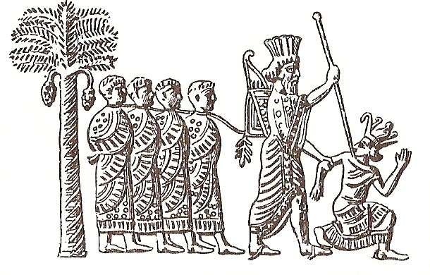
Persian kings who reigned during this period
cyrus
Cambyses
Darius i
559 B.C.
529
522
486 B.C.
Son of Cyrus the Great
Expanded the empire into Egypt by defeating pharaoh Psamtik III during the battle of Pelusium in 525 B.C.
Notes:
Image seen on Persian Seal from this time period.

Slide 16
Persian kings who reigned during this period
cyrus
Cambyses
Darius i
559 B.C.
529
522
486 B.C.
Ruled the empire at it’s peak which included:
Much of West Asia
The Caucasus
Central Asia
Parts of the Balkans
Portions of North and Northeast Africa, including Egypt
Eastern Libya
Coastal Sudan
Eritrea
Most of Pakistan
The Aegean Islands
Northern Greece
Notes:
Image seen on Persian Seal from this time period.

Slide 17
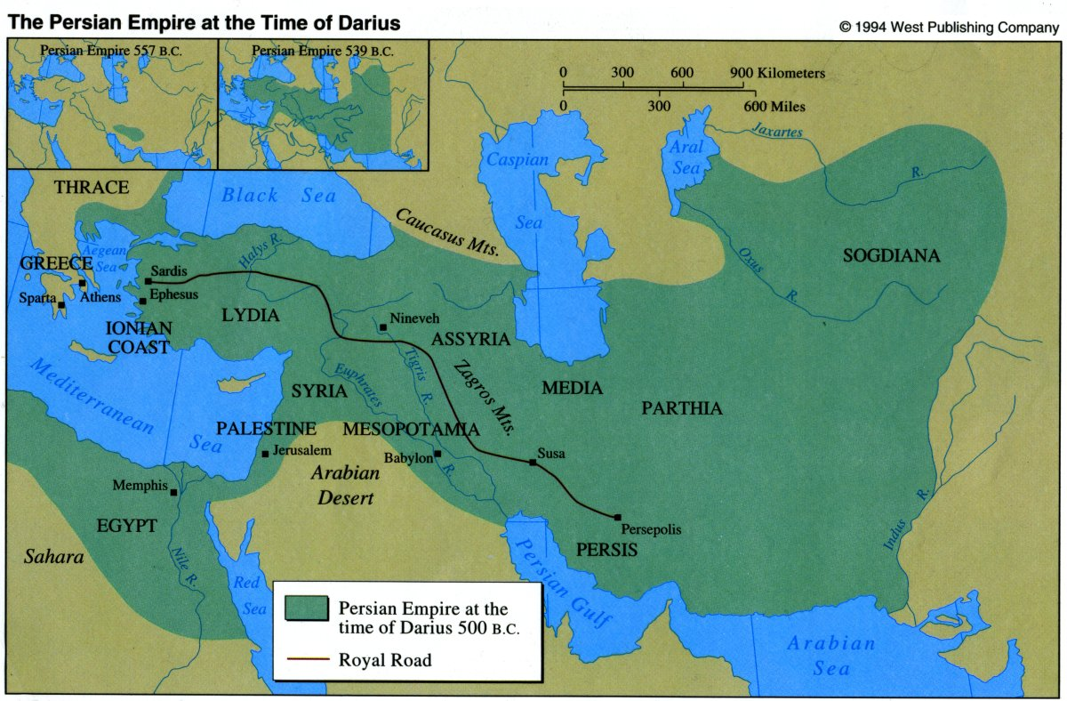

Slide 18
Theme: build the temple
Haggai was sent to stir up the people’s spiritual indifference and encourage them to complete the work on the temple that had started nearly 16 years earlier.
“¹ Now the prophets, Haggai and Zechariah the son of Iddo, prophesied to the Jews who were in Judah and Jerusalem, in the name of the God of Israel who was over them. ² Then Zerubbabel the son of Shealtiel and Jeshua the son of Jozadak arose and began to rebuild the house of God that is in Jerusalem, and the prophets of God were with them, supporting them.”
Ezra 5:1-2
“¹⁵ and this house was finished on the third day of the month of Adar, in the sixth year of the reign of Darius the king.
Ezra 6:15
→

Slide 19
Outline of haggai
Message 1
Build the Lord’s house (Chapter 1)
Message 2
The latter house will be more glorious (Chapter 2:1-9)
Message 3
From this day on, God will bless you (Chapter 2:10-19)
Message 4
Zerubbabel is chosen as God’s signet (Chapter 2:20-23)

Slide 20
Haggai, Zechariah, Malachi
Class Goals (by the end of our study each of us will . . .)
Have an increased appreciation for the sovereignty and power of God
Have an increased faith in Jesus as the prophesied Messiah
Worship in a more sincere and sacrificial manner
Resolve to remain faithful in a nation plagued by sins

