Slide 1
Shining as Lights in the World
Notes:
Read Matthew 5:13-16 to intro class → display slide
(refer to Philippians 2:12-18)

Slide 2
Shining as Lights in the World
2016 Year End Series
Key Texts – Ephesians 5:11-14; Matthew 5:13-16
  Do not participate in the unfruitful deeds of darkness, but instead even expose them; for it is disgraceful even to speak of the things which are done by them in secret. But all things become visible when they are exposed by the light, for everything that becomes visible is light. For this reason it says, “Awake, sleeper, And arise from the dead, And Christ will shine on you.” (Ephesians 5:11-14)
  What do Jesus’ Salt, City, and Lamp metaphors teach us about our place in the world?
Notes:
9:02

Slide 3
Shining as Lights in the World
2016 Year End Series
Key Texts – Ephesians 5:11-14; Matthew 5:13-16
Goals of Studies
  Highlight key character traits of children of Light
  Understand specific, practical steps required to adopt the character of CoL
  Consider evangelistic effects of CoL
Notes:
9:10

Slide 4
Shining as Lights in the World
2016 Year End Series
Key Texts – Ephesians 5:11-14; Matthew 5:13-16
Goals – Character → Confession
Schedule of Studies
Date | Topic | Teacher
S – 12/18 | Introduction to Series | Ben
W – 12/21 | Daniel: Holiness | James
S – 12/25 | David: Mercy & Peacemaking | Sam
W – 12/28 | Elijah: True Worship | Roger Polanco
S – 1/1 | Caleb: Courageous Faith | Larry
W – 1/4 | Jeremiah: Taking God & Word Seriously | Barry
Notes:
9:12

Slide 5
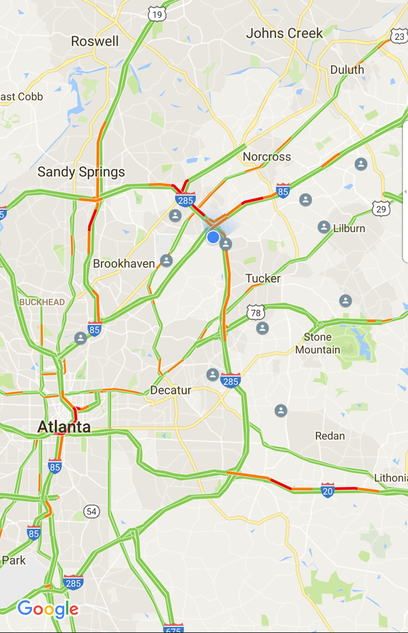
Neighborhood Gospel Groups
Phase 1: (Re)Discovering Jesus
Focus on fundamentals of Gospel
8-Week schedule (mid-Jan. – Feb.)
P’tree Corners, Roswell, Duluth
*Expanding in late Spring and Fall
Notes:
9:13

Slide 6
Small Groups Bible Studies
W
O
R
L
D
L
I
N
E
S
S
U
N
G
O
D
L
I
N
E
S
S
S
E
L
F
I
S
H
N
E
S
S
F
A
I
T
H
L
E
S
S
N
E
S
S
“Therefore go and make disciples of all nations, baptizing them in the name of the Father and of the Son and of the Holy Spirit, ²⁰ and teaching them to obey everything I have commanded you. …”
(Matt. 28:18-20)
“take up the Cross and follow Me” (Mark 8:34)
Bible Teaching
Special Events
Assemblies & Work Groups
Social Media
Personal Relationship
Developmental Training
Opportunity Creation
Individual Disciple Making
Response
(God’s Work)
Notes:
9:16
What is missing from this chart?

Slide 7
Personal Holiness
“Therefore go and make disciples of all nations, baptizing them in the name of the Father and of the Son and of the Holy Spirit, ²⁰ and teaching them to obey everything I have commanded you. …”
(Matt. 28:18-20)
“take up the Cross and follow Me” (Mark 8:34)
Bible Teaching
Peace & Joy
Hospitality
Wisdom in Daily Life
Personal Relationship
Faith-based Courage
Opportunity Creation
Individual Disciple Making
Response (God’s Work)
Notes:
9:21
Having godly character is required to be fruitful in our ministry
How have you seen godly character be effective evangelistically?

Slide 8
Notes:
9:26
The command to Rise and Shine in the dark world - Isaiah 60:1-5
The need to rise up - Isaiah 59:9-15
The darkness we rise up from and the purpose we shine - Isaiah 58:1-14

Slide 9
“Christ Will Shine on You”
Confession and Character are both required in our evangelistic mission.
  Central elements to the nature of Christ
  Essential to win people to repentance
  Mutually beneficial ministry activities
  Confession requires the support of character and character is only meaningful if it results in confession.
Christ shines light through the synchronized Character and Confession of His people to produce Conversion of sinners.
Notes:
9:37

Slide 10
Shining as Lights in the World
Character and Confession
Date | Topic | Teacher
S – 12/18 | Introduction to Series | Ben
W – 12/21 | Daniel: Holiness | James
S – 12/25 | David: Mercy & Peacemaking | Sam
W – 12/28 | Elijah: True Worship | Roger Polanco
S – 1/1 | Caleb: Courageous Faith | Larry
W – 1/4 | Jeremiah: Taking God & Word Seriously | Barry

