Slide 1
Jesus’ Church is the focal point of all that He is and does. (Matthew 16:13-23, esp. v. 18)
‘Church’ (Grk: ekklesia) was not originally a religious word but merely a word that describes a group, gather, assembly of people. (Acts 19:32, 39, 41; 20:28)
The Church Jesus builds is then His special group of people. (1 Peter 2:4-10)

Slide 2
Who are God’s people?
Notes:
How do I become one with God?
How do I become one with others?

Slide 4
Not the Church Jesus Built

Slide 5
Activity
Organization
Purpose
Nature
Every unbiblical view and practice of ‘church’ stems from a lack of understanding of one or more of these elements.

Slide 6
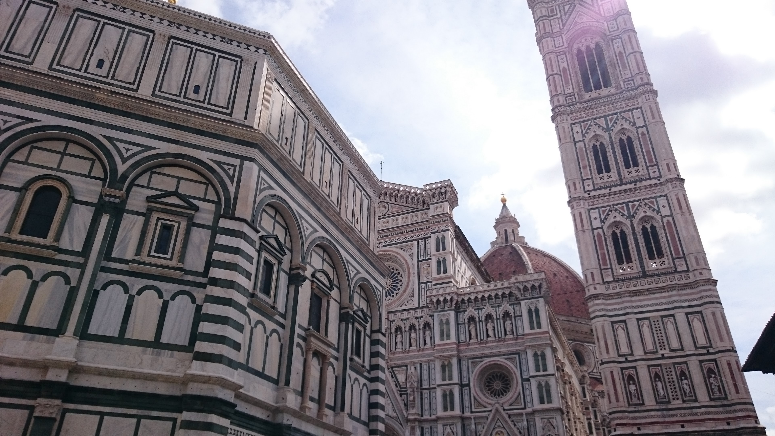
“I’ll meet you over at the church on Sunday.”
Notes:
Insert image of a building
Building view
“I’ll meet you over at the church on Sunday.”

Slide 7
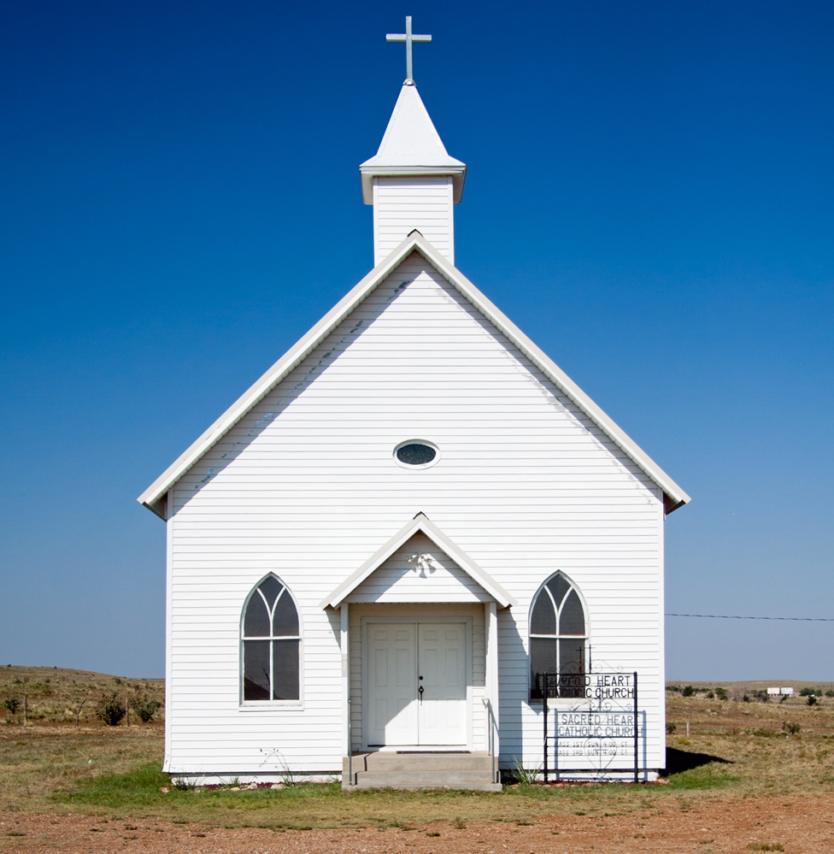
“I’ll meet you over at the church on Sunday.”
Notes:
Insert image of a building
Building view

Slide 8
G O D
“The path to enjoy a saving, blessing relationship with God is through the church.”
Notes:
Make image that illustrates church as the mediator between lost and God
Catholic view #2
Acts 5:11 → 4:32 → 4:4 → 2:41 shows that “church” = simply people who have been saved by and have devoted themselves to Christ. It is not…
“To the one who conquers…” – 2:7, 11, 17, 29 …
Thyatira was composed of some very bad people while others had no responsibility for those actions (2:23-24)
Sardis is said to have some who have a relationship with God, others who did not. (3:4)
This perspective reflects that the church is an entity separate from God’s group of saved and devoted people, not the people themselves. (Opposite of the definition of ‘church’)
It also place the church as the path to salvation rather than the collection of the saved. It makes church the savior but Christ does that!
It implies that a church is safe / saved as a collective yet the reality is that churches are composed of both saved and unsaved people. It isn’t a package.

Slide 9
G O D
“The path to enjoy a saving, blessing relationship with God is through the church.”
Notes:
Make image that illustrates church as the mediator between lost and God
Catholic view #2
Acts 5:11 → 4:32 → 4:4 → 2:41 shows that “church” = simply people who have been saved by and have devoted themselves to Christ. It is not…
“To the one who conquers…” – 2:7, 11, 17, 29 …
Sardis is said to have some who have a relationship with God, others who did not. (3:4)
This perspective reflects that the church is an entity separate from God’s group of saved and devoted people, not the people themselves. (Opposite of the definition of ‘church’)
It also place the church as the path to salvation rather than the collection of the saved. It makes church the savior but Christ does that!
It implies that a church is safe / saved as a collective yet the reality is that churches are composed of both saved and unsaved people. It isn’t a package.

Slide 10
“The Church is the sum of all the different types of churches and denominations.”
PENTECOSTAL
BAPTIST
NON - DENOM
METHODIST
C. Of Christ
PRESBYTERIAN
THE CHURCH
Notes:
Make image that illustrates “denominational tree” or basket of denominations.
Ecumenical view
Problem #1: Individuals, not groups, come to Jesus (1 Peter 2:4ff).
Problem #2: Jesus said there is only one Way (Matthew 7:13-14; John 14:6; Acts 9:2, 19:23, 22:4, 24:14, 24:22). How could there be many, who disagree on substantive matters, that are all the same?
Problem #3: While a group may be judged as right / wrong in God’s eyes, God always judges people individually (Acts 5:1-11; Revelation 3:1-6). How could God’s group be made up of smaller groups which could contain individuals who may or may not be saved by and devoted to Him?

Slide 11
“The church is the sum of all the ‘churches of Christ’.”
NORTH ATLANTA
POWERS FERRY
WEST END
EMBRY HILLS
INTOWN
ROSWELL
THE CHURCH
Notes:
Make image that illustrates “denominational tree” or basket of denominations.
Ecumenical view
Problem #1: Individuals, not groups, come to Jesus (1 Peter 2:4ff).
Problem #2: Jesus said there is only one Way (Matthew 7:13-14; John 14:6; Acts 9:2, 19:23, 22:4, 24:14, 24:22). How could there be many, who disagree on substantive matters, that are all the same?
Problem #3: While a group may be judged as right / wrong in God’s eyes, God always judges people individually (Acts 5:1-11; Revelation 3:1-6). How could God’s group be made up of smaller groups which could contain individuals who may or may not be saved by and devoted to Him?

Slide 12
Chief Leader
Regional Leader
Regional Leader
Regional Leader
Atlanta
Beijing
Chicago
Brussels
Istanbul
Tokyo
Paris
Seoul
Seattle
NYC
London
Vienna
Notes:
Jesus exercises direct authority over churches, for anyone(s) else to do so would be to usurp His position. (2:1+7; 8+11 …)
None of the churches in Revelation 2-3 given permission / instruction to ‘police’ each other.
Colossae told to send the letter, NOT to give instructions themselves. (Colossians 4:16

Slide 13
Central Power
Regional
Co-Op
Regional
Co-Op
Regional
Co-Op
Atlanta
Beijing
Chicago
Brussels
Istanbul
Tokyo
Paris
Seoul
Seattle
NYC
London
Vienna
Notes:
Jesus exercises direct authority over churches, for anyone(s) else to do so would be to usurp His position. (2:1+7; 8+11 …)
None of the churches in Revelation 2-3 given permission / instruction to ‘police’ each other.
Colossae told to send the letter, NOT to give instructions themselves. (Colossians 4:16

Slide 14
‘Beings’
Church
“Church is not to be formal or organized but instead is something each of us are to be.”
Notes:
Make image that illustrates chaotic, unorganized, loose collection
Emergent view
How can we then explain prescriptive doctrines that are to be followed (1 Corinthians 4:17, et al) and leadership structures that were to be maintained (Ephesians 4:11; Philippians 1:1; 1 Timothy 3:1-13; 1 Peter 5:1-4)?

Slide 15
Activity
Organization
Purpose
Nature
Every unbiblical view and practice of ‘church’ stems from a lack of understanding of one or more of these elements.

Slide 16
How do I become one with God?
How do I become one with others?

Slide 17
Who are God’s people?
Notes:
How do I become one with God?
How do I become one with others?

Slide 18
Who Are God’s People? Acts 2:24-41
Those who repent of their self and sin.
Those who come in faith to submit to Jesus the Christ.
Those who are baptized into Christ.

Slide 19
God
All Saved

Slide 20
We were buried therefore with him by baptism into death, in order that, just as Christ was raised from the dead by the glory of the Father, we too might walk in newness of life. For if we have been united with him in a death like his, we shall certainly be united with him in a resurrection like his.
Romans 6:4-5

Slide 21
Having been buried with Him in baptism … And you, who were dead in your trespasses and the uncircumcision of your flesh, God made alive together with him, having forgiven us all our trespasses, by canceling the record of debt that stood against us with its legal demands.
Colossians 2:12-14

Slide 22
For in Christ Jesus you are all sons of God through faith. For all of you who were baptized into Christ have clothed yourselves with Christ.
There is neither Jew nor Greek, there is neither slave nor free, there is neither male nor female—for all of you are one in Christ Jesus.
Galatians 3:26-28

Slide 23
In Baptism we are united with Christ and He adds us to His Body.
Baptism into Christ is then one of the deepest bonds of unity among the Church—God’s people.

Slide 24
The Church In Christ
Baptized believers have confidence in their relationship with God through Christ (not ‘church membership’).
Baptized believers have the unique opportunity and responsibility of a shared life with others who are also in Christ.
Baptized believers submissively orient their personal and communal life to the rule of Christ.

