Slide 1
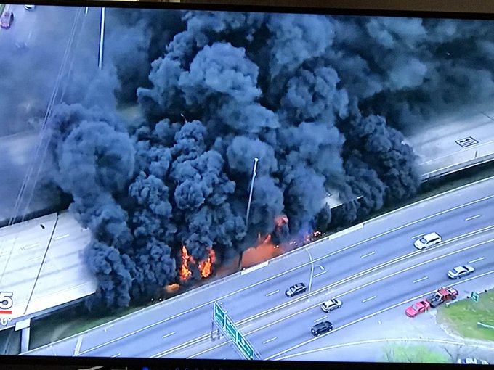
Would you have set this fire?

Slide 2
Genesis 42:18-22

Slide 3
Spake I not unto you, saying, “Do not sin against the child.” (Gen. 42:22 KJV)
“You shall not let any of your descendants pass through the fire to Molech” (Leviticus 18:21).
“Another generation arose after them who did not know the Lord nor the work which He had done for Israel” (Judges 2:10).
“I have told him that I will judge his house forever for the iniquity which he knows, because his sons made themselves vile, and he did not restrain them” (1 Samuel 3:13).
“The rod and rebuke give wisdom, But a child left to himself brings shame to his mother” (Prov. 29:15).
Read Matthew 18:1-5
To sin against a child is to sin against Jesus!
Sin against children can cost them their souls!

Slide 4
This fire did not cause a soul to be lost!

Slide 5
Matthew 18:6

Slide 6
Spake I not unto you, saying, “Do not sin against the Child.”
“Whoever causes one of these little ones who believe in Me to sin, it would be better for him if a millstone were hung around his neck, and he were drowned in the depth of the sea” (Matthew 18:6)
“Yet if your brother is grieved because of your food, you are no longer walking in love. Do not destroy with your food the one for whom Christ died” (Romans 14:15).
”And because of your knowledge shall the weak brother perish, for whom Christ died? ¹² But when you thus sin against the brethren, and wound their weak conscience, you sin against Christ” (1 Cor. 8:11-12).

Slide 7
Christ did not die for this highway!

Slide 8
1 Corinthians 3:10-17

Slide 9
Spake I not unto you, saying, “Do not sin against the child.”
“Whoever causes one of these little ones who believe in Me to sin…” (Matthew 18:6)
“If any man defile the temple of God, him shall God destroy” (1 Corinthians 3:17)
“Know ye not that ye are the temple of God” ( 1 Cor. 3:16 KJV)
“Ye” is plural. The temple here is the local church.
The temple is defiled by attracting those not devoted to Christ.

Slide 10
That highway was not the temple of God!

Slide 11
1 Corinthians 6:15-18

Slide 12
Spake I not unto you, saying, “Do not sin against the child.”
“Whoever causes one of these little ones wo believe in Me to sin…” (Matthew 18:6)
“If any man defile the temple of God, him shall God destroy” (1 Corinthians 3:17)
“Do you not know that your bodies are members of Christ? Shall I then take the members of Christ and make them members of a harlot? Certainly not! (1 Corinthians 6:15)
¹⁸ Flee fornication.

Slide 13
This highway was not a member of Christ!
It was not bought with His blood!

Slide 14
A few million dollars and a few months will repair the highway.
Only the death of God’s Son can remove the consequences of sin.
By the Grace of God We Can be Forgiven!

