Slide 1

Genesis Answers…
The Important questions of life…

Slide 2
It is Possible that there is Supernatural
The Universe had Supernatural Origins
The Universe had a Intelligent, Personal Origin
There is a Purpose for the Creation
It is Likely There is a Moral Law
Miracles & Revelation are Possible
Divine Revelation is Possible
Divine Revelation or Bible would be Accurate
Bible is Inspired
Based on Bible Testimony Jesus is the Son of God
Accurate Account of Jesus’ Life
Teachings of the Bible are Truth
Teachings of Jesus are Truth

Slide 3

Bible would be Accurate
Creation, Flood, Redemption Story, Moses, Moral Laws, Miracles, Nature of Man, Purpose of Man, Nature of God, Christ & Holy Spirit, Requirements for Worship, Personality of Jesus, Coming Judgment, Heaven, Hell, Angels, Demons, & Satan

Slide 4



Creation, Flood, Redemption Story, Moses, Moral Laws, Miracles, Nature of Man, Purpose of Man, Nature of God, Christ & Holy Spirit, Requirements for Worship, Personality of Jesus, Coming Judgment, Heaven, Hell, Angels, Demons, & Satan
Bible Authority Established
Bible would be Accurate
Based on Bible Testimony Jesus is Son of God
Teachings of Jesus are True
Accurate Account of Jesus’ Life
A Step of Faith not
A Leap of Faith
Bible can be Understood
Bible is Inspired
Bible is Accurate
Bible is Reliable
If Bible Revelation of Creator then
Divine Revelation Possible
& Accurate So Purpose is Known
Creation
has a purpose
Likely a Moral Law
Miracles &
Revelations
Universe had an Intelligent, Personal Origin
Possible that Universe had Supernatural Origin
It is Possible that there is Supernatural Force
Based on material from mmb, jr Establishing Bible Authority Class - 10/30/2002

Slide 5
Bible would be Accurate
It is Possible that there is Supernatural
Impossible that there is Supernatural
The Universe had Supernatural Origins
The Universe had natural Origins
The Universe had a Intelligent, Personal Origin
Universe Unintelligent Origin – Life via Chance/Evolution
Bible would be myths, tall tales. inaccurate & lies
Evidence of
Creation and Flood
No evidence of
Creation or Flood

Slide 6
Evidence of
Creation and Flood
Universe Unintelligent Origin
Evidence Life via Chance/Evolution
7. Do fossils provide evidence of a worldwide flood?
5. What about missing links in evolution tree?
6. Do fossils prove evolution?
10. Is there evidence of a worldwide flood or was it local?
Young Earth
Old Earth – Evolution needs time
16. Is the world billions of years old?
13. Did man and dinosaurs exist together?
17. Does the existence of so many galaxies and their movement prove an old universe?
15. Does radiometric dating of rocks and carbon 14 dating prove that Genesis dating is wrong?
Bible truth or lies
16. Is the world young (less than 10,000 yrs)?
12. Could you fit all the animals into the ark?
14. Does the long life spans before the flood show Genesis is based on myths?
Notes:
*13 Did man and dinosaurs exist together?
*15 Does radiometric dating of rocks and carbon dating prove that Genesis dating is wrong?
*16 Is the world young (less than 10,000 yrs) or is it billions of years old?
*5 What about missing links in evolution tree?
*7 Do fossils provide evidence of a worldwide flood?
*10 Is there evidence of a worldwide flood or was it local?
*14 Does the long life spans before the flood show Genesis is based on myths?
*17 Does the existence of so many galaxies and their movement prove an old universe?
*6 Do fossils prove evolution?
*12 Could you fit all the animals into the ark?

Slide 7
Intelligent Origin
Evidence of
Creation and Flood
Unintelligent Origin
Evidence Life via
Chance/Evolution
Young Earth
- 7 days
Genealogy – Long Life Spans
Dinosaurs/man
Old Earth
Billions of years
Distance of Galaxies
Radiometric Dating of Rocks
- Slow formation of fossils
Fossils time frame show evolution
Dinosaurs/man not together
Worldwide Flood
Landscape show evidence
Dino’s in the ark?
Notes:
*13 Did man and dinosaurs exist together?
*15 Does radiometric dating of rocks and carbon dating prove that Genesis dating is wrong?
*16 Is the world young (less than 10,000 yrs) or is it billions of years old?
*5 What about missing links in evolution tree?
*7 Do fossils provide evidence of a worldwide flood?
*10 Is there evidence of a worldwide flood or was it local?
*14 Does the long life spans before the flood show Genesis is based on myths?
*17 Does the existence of so many galaxies and their movement prove an old universe?
*6 Do fossils prove evolution?
*12 Could you fit all the animals into the ark?

Slide 8
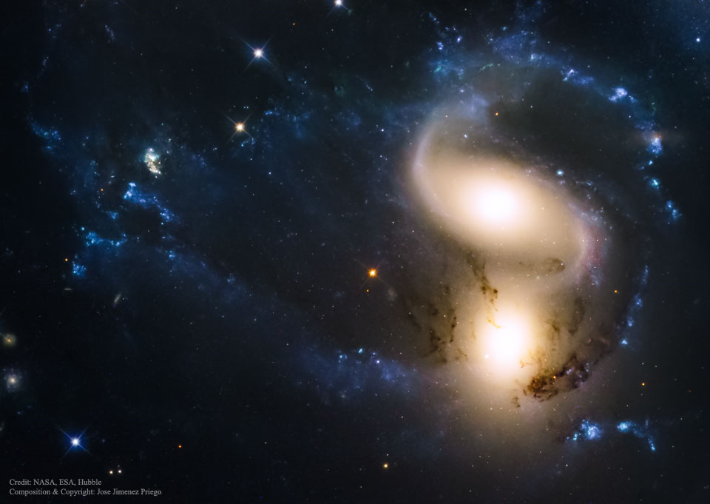
Colliding Galaxies

Slide 9
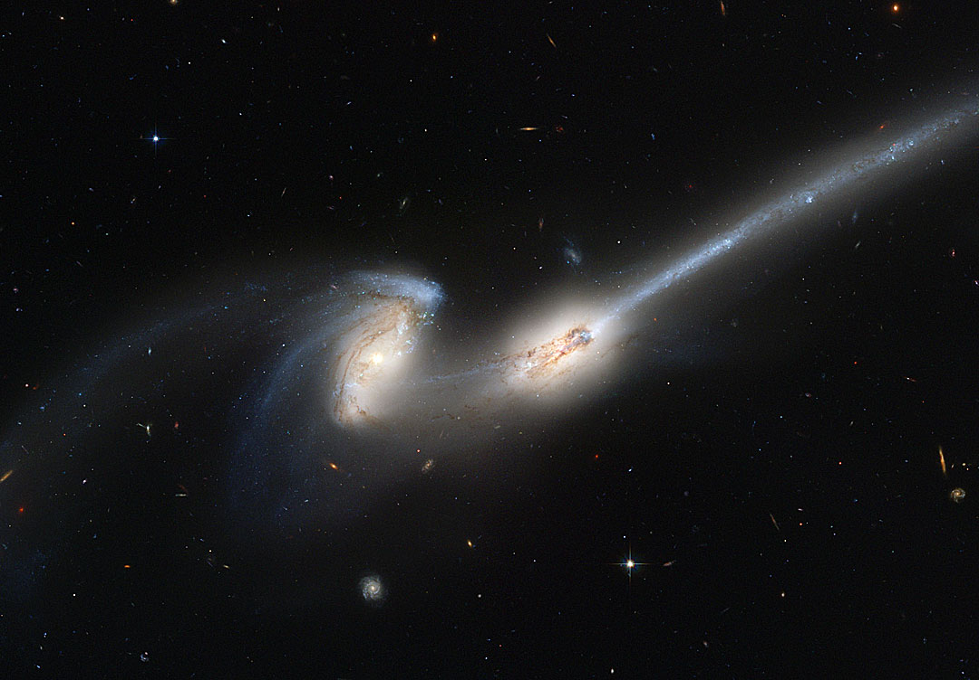
Colliding Galaxies

Slide 10
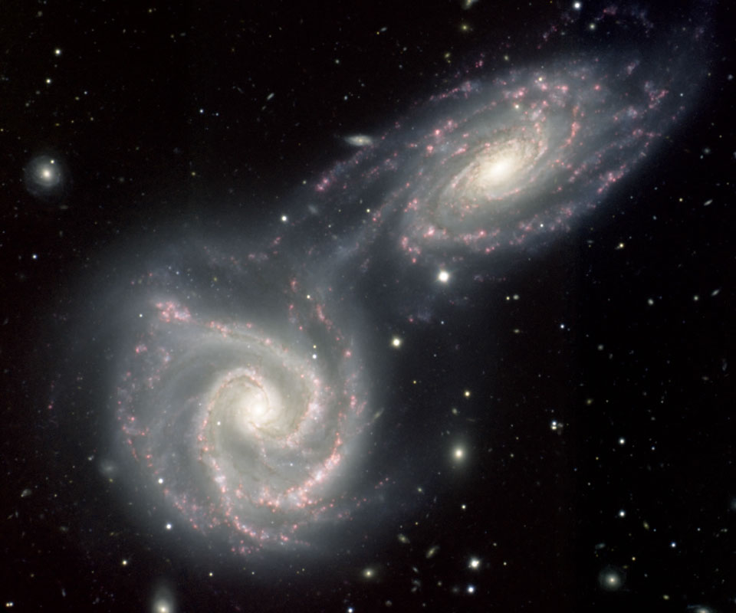
Colliding Galaxies

Slide 11

How old was Adam when he was created?

Slide 12
How old was Adam when he was created?
Appearance of Age

Slide 13
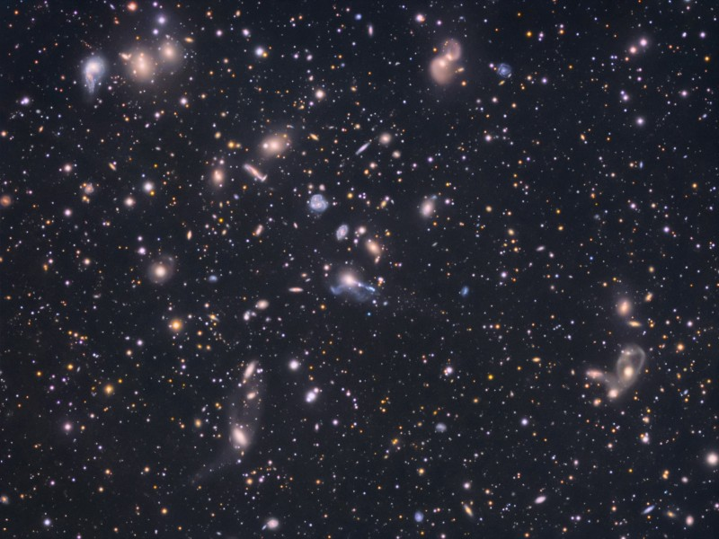
How Many Stars in the Universe?
Light from the objects farthest away from us would take approximately 13.7 billion light-years to travel to Earth
Kornreich used a very rough estimate of 10 trillion galaxies in the universe.
Multiplying that by the Milky Way's estimated 100 billion stars results in a large number indeed:
1,000,000,000,000,000,000,000,000 stars,
or a "1" with 24 zeros after it.
Kornreich emphasized that number is likely a gross underestimation
www.space.com

Slide 14

IS THERE A CHANCE?
To get all proteins needed from the amino acids?
1Chance in 12,680,000,000,000,000,000,000,000,000,000,000,000,000,
000,000,000,000,000,000,000,000,000,000,000,000,000,000,
000,000,000,000,000,000,000,000,000,000,000,000,000,000,
000,000
Dr. John P. Marcus, Ph.D. Biological chemistry University of Michigan
Notes:
12.7 x 10e43

Slide 15

Chance of Building Blocks of Life on 1 Planet
1E+24 |  | number of stars in universe
1.26E+44 |  | To get all proteins needed from the amino acids?
=
7.94E-19 |  | % Chance
Notes:
Specific or (Special) Theory Of Evolution
It has been proven in laboratory experiments that within a species of animals and/or plants changes can be noticed. This theory is also called “Micro-Evolution”
1. Mutations - Sudden small changes in the DNA code of the genes, which are passed on, to an organisms offspring, i.e. Fruit flies, blind fish. Even though this has been proven, mutations are generally bad for that species and not good (evolution teaches that the bad traits are weeded out and only the good and useful traits are passed on). Also these mutations usually do not last longer than a generation or two.
2. Kinds - we can notice several different kinds of dogs, cats, etc…
We can cross breed animals to create a stronger faster horse.
3. We do not argue with this because it has no impact or contradiction with the bible. The problem is that most of the public does not know the difference and are confused about this subject. They hear of “evolution” on the news and think that this applies to all forms of evolution.

Slide 16
Chance of Building Blocks of Life on 1 Planet
1E+24 |  | number of stars in universe
1.26E+44 |  | To get all proteins needed from the amino acids?
=
7.94E-19 |  | % Chance
But there or more stars – do 4 times more
Better odds - reduce odds to 1/4th
Notes:
Specific or (Special) Theory Of Evolution
It has been proven in laboratory experiments that within a species of animals and/or plants changes can be noticed. This theory is also called “Micro-Evolution”
1. Mutations - Sudden small changes in the DNA code of the genes, which are passed on, to an organisms offspring, i.e. Fruit flies, blind fish. Even though this has been proven, mutations are generally bad for that species and not good (evolution teaches that the bad traits are weeded out and only the good and useful traits are passed on). Also these mutations usually do not last longer than a generation or two.
2. Kinds - we can notice several different kinds of dogs, cats, etc…
We can cross breed animals to create a stronger faster horse.
3. We do not argue with this because it has no impact or contradiction with the bible. The problem is that most of the public does not know the difference and are confused about this subject. They hear of “evolution” on the news and think that this applies to all forms of evolution.

Slide 17
Chance of Building Blocks of Life on 1 Planet
4E+24 |  | number of stars in universe
3.15E+43 |  | To get all proteins needed from the amino acids?
=
1.27E-17 |  | % Chance
Although the universe is filled with stars and planets conducive to life, the absence of any evidence for alien life suggests that even if the emergence of life is easy, its persistence may be difficult.
Notes:
Specific or (Special) Theory Of Evolution
It has been proven in laboratory experiments that within a species of animals and/or plants changes can be noticed. This theory is also called “Micro-Evolution”
1. Mutations - Sudden small changes in the DNA code of the genes, which are passed on, to an organisms offspring, i.e. Fruit flies, blind fish. Even though this has been proven, mutations are generally bad for that species and not good (evolution teaches that the bad traits are weeded out and only the good and useful traits are passed on). Also these mutations usually do not last longer than a generation or two.
2. Kinds - we can notice several different kinds of dogs, cats, etc…
We can cross breed animals to create a stronger faster horse.
3. We do not argue with this because it has no impact or contradiction with the bible. The problem is that most of the public does not know the difference and are confused about this subject. They hear of “evolution” on the news and think that this applies to all forms of evolution.

Slide 18
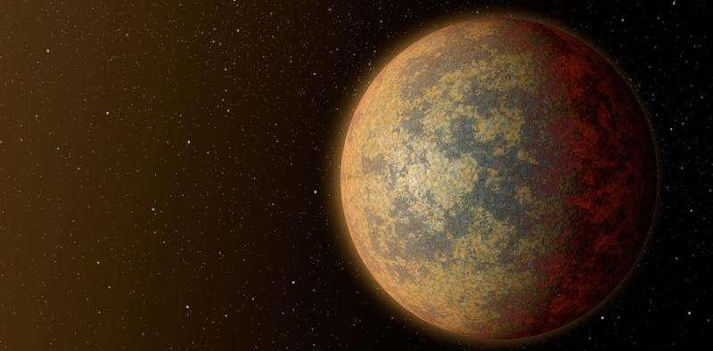
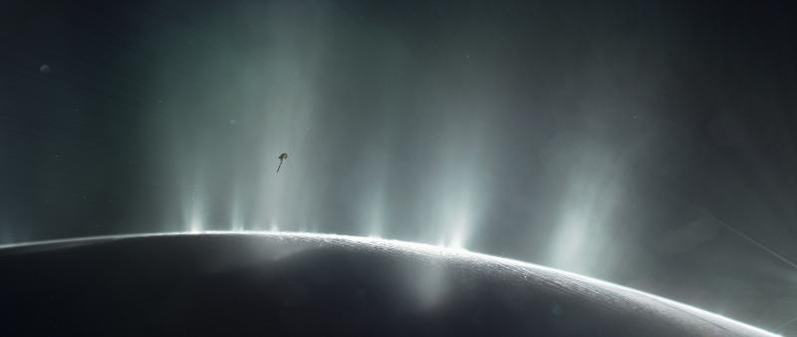
Mars, Venus and Earth were more similar to each other in their first billion years than they are today. Even if only one of the planets saw the emergence of life, this era coincided with heavy bombardment from asteroids, which could have spread life between the planets.
But about 1.5 billion years after formation, Venus started to experience runaway heating and Mars experienced runaway cooling. If Mars and Venus once harbored life, that life quickly went extinct.
Conditions for Life Exist on Saturn Moon Enceladus
Although life cannot be confirmed, the clues from Enceladus all indicate the conditions for life exist on the oceans of Enceladus, the sixth-largest moon of Saturn.

Slide 19

Evolution Math is Not Rocket Science
Evolution happened on earth. So your assumptions of it being impossible are not correct
Evolution/development of life is preferred path/lowest energy path
Extraterrestrial – evolve one planet transported by asteroids to another

Slide 20
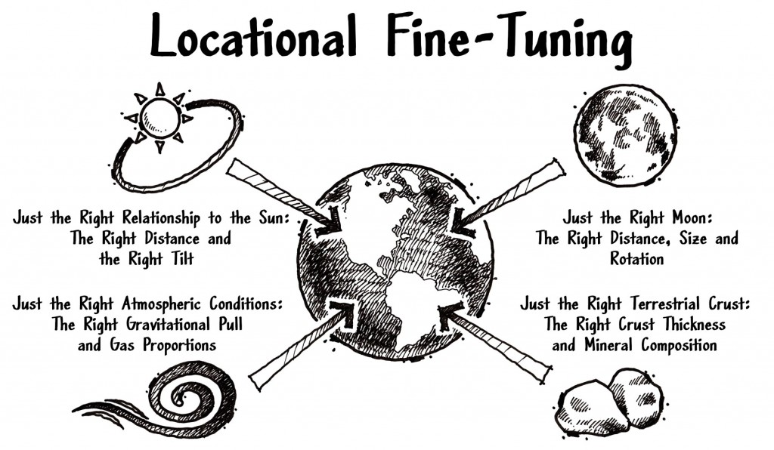
Harvard Astronomer - Howard Smith
The exotic diversity of exoplanets came as a surprise.
The bottom line for extraterrestrial intelligence is that it is probably rarer than previously imagined,
Let us be grateful for the amazing gifts of life and awareness, and acknowledge that humanity and our home planet, Earth, are rare and cosmically precious.
Notes:
Theistic Evolution
This is a compromise theory and not harmonious with the teachings of the bible. This theory state that God created evolution billions of years ago and then He stepped back and let nature take its course. This theory contradicts the teaching that God created the universe in six days.
This enables a person to accept the teachings of evolutions as “fact” and also claim to be a Christian because he believes in God. This way he/she can avoid conflict and discussions about a complicated subject. BUT this also means we must throw out the bible - because this is not what the bible teaches!
We are told that God not only created the universe in six days, but that He is alive and active in our lives. He hears our prayers and He answers them. He is all powerful, all knowing, and all present. One can not hold on to God and Theistic Evolution at the same time.

Slide 21

Are we the only planet where God created life?
Lewis, C.S
.
Out of the Silent Planet.
Perelandra:
That Hideous Strength.

Slide 22
Evolution: Fact or Faith?
“It is absolutely safe to say that, if you meet somebody who claims not to believe in evolution, that person is ignorant, stupid or insane (or wicked...).”
Richard Dawkins –The Blind Watchmaker

Slide 23
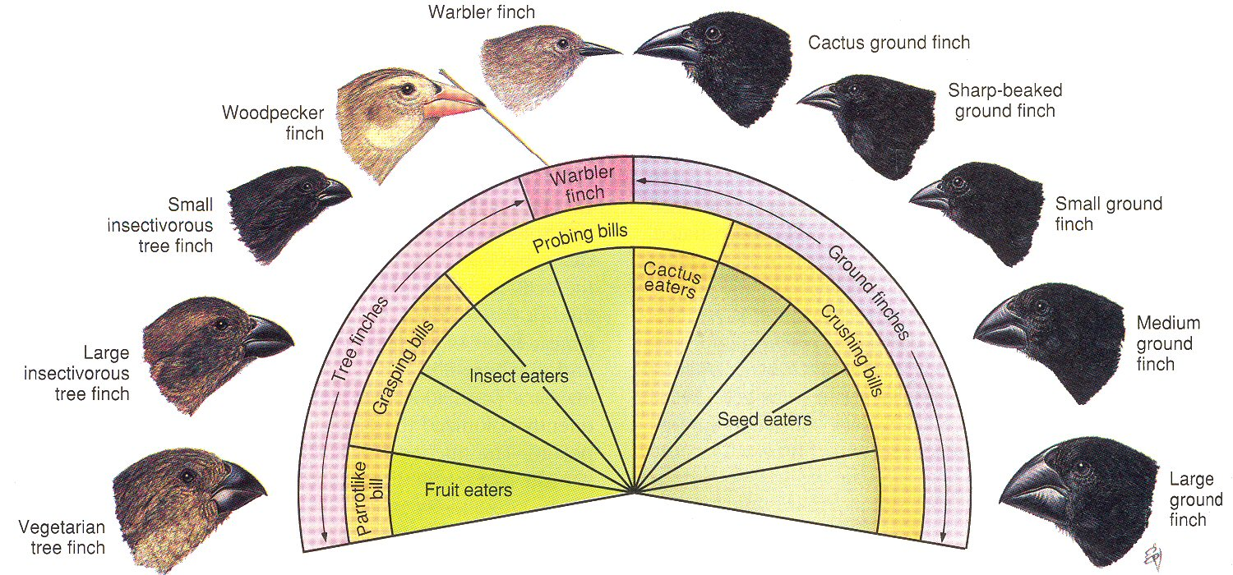
Natural Selection in Action
Darwin's Finches
The Darwin's Finches diagram illustrates the way the
finch has adapted to take advantage of feeding in different
ecological niche's.
Notes:
Why did he begin questioning that God is necessary. Here is one fo the reasons. On the Galapgos Islands he found a bunch of birds and notice the differences in the variations of their beaks. We need to think like an evolutionist and let this in. Darwin said this kind of bird was located on a particular island in the group of islands. When he went to another island the birds were more like this . When he went to another island they were more like this, tiny with smaller beaks. And basically the whole population of birds on each of these island had these characteristics and they didn’t have any of the other ones. But yet they were similar enough that he called them all finches. There is nothing unreasonable about that. I believe that all these finches came from a common ancestry somewhere back in time and they evolved to be where they are, and in the shape their in. There has been other experiments in the Galapagos. If you change the food source this population over a period of genrations evolves back to a smaller beak. You can see evolution in action. Yes and No. You can see this type of evolution in action and if you deny that you are denying something that has massive supportive evidence.

Slide 24


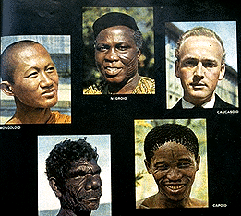
Micro-Evolution
change within a “Kind”
adaptation
speciation
limited range of possible variation
much evidence (labs & in nature)
Observable
Grand illustration of Designer’s Wisdom
Notes:
Speciation is the evolutionary process by which new biological species arise. Speciation is the formation of two or more genetically distinct groups of organisms after a division within a single group or species. They are groups of organisms capable of interbreeding which segregate into two or more populations, which gradually develop barriers to reproduction. These barriers can form separated populations, and may reproduce at different locations or at different times of the year. When the reproductive isolation is maintained long enough, the separated groups may develop into separate, distinct, identifiable species. There are two main types of speciation. Sympatric speciation refers to the evolution of two or more species from an ancestral species in the same place at the same time. Allopatric speciation refers to the evolution of two or more species ...

Slide 25
Macro-Evolution
"Macro-evolution (major structural transition) is nothing more than micro-evolution (flies in a bottles) extended.
If black moths can displace white moths in a century, then reptiles can become birds in a few million years by the smooth and sequential summations of countless changes"
- Stephen Jay Gould

Slide 26
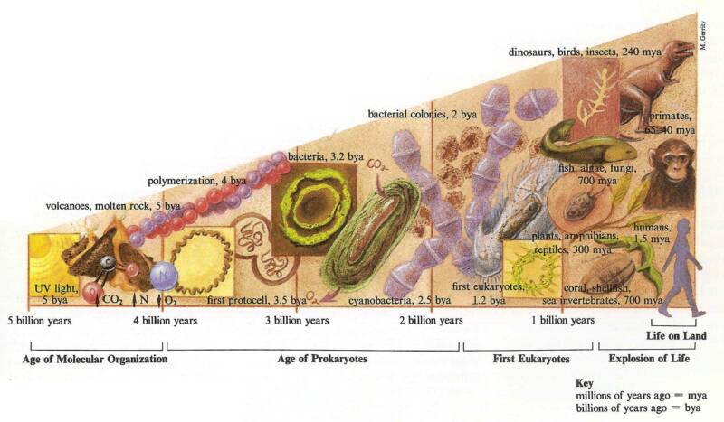
Macro-Evolution
Change from one “kind” to another “kind”
unlimited change potential required
no direct evidence ( a lot of assumptions)
not observed in nature
Proof?

Slide 27
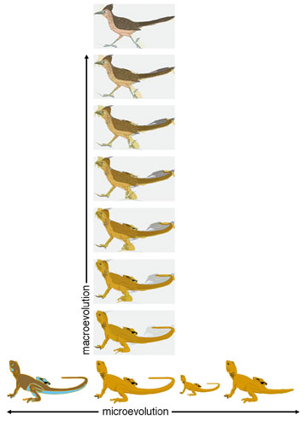
No evidence
Macro-
evolution
Evidence? Yes!
Micro-
evolution

Slide 28
Fossils Provide Direct Evidence
S. M. Stanley, Johns Hopkins, "It is doubtful whether, in the absence of fossils, the idea of evolution would represent anything more than an outrageous hypothesis. ...The fossil record and only the fossil record provides direct evidence of major sequential changes in the Earth's biota."
NEW EVOLUTIONARY TIMETABLE, p.72, 1981

Slide 29
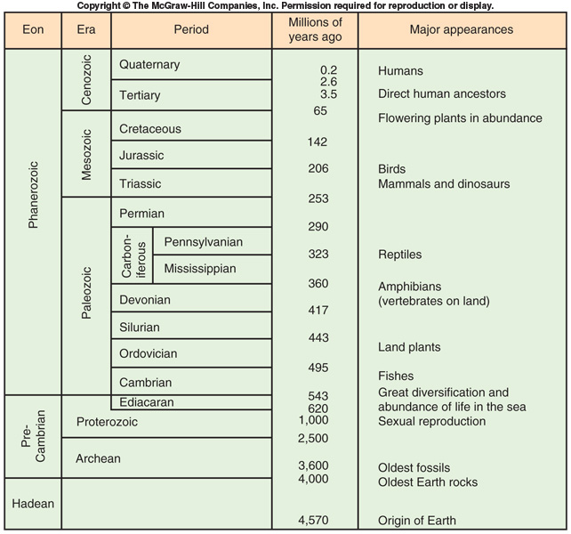
EXTINCTIONS AND GEOLOGICAL TIME
GEOLOGICAL TIME SCALE
Assumes Uniformity of Formation – What Happens Today has always happened
The Geologic Column
Notes:
Main Entry: stra·tig·ra·phy
Pronunciation: \strə-ˈti-grə-fē\
Function: noun
Etymology: International Scientific Vocabulary
Date: 1865
1 : geology that deals with the origin, composition, distribution, and succession of strata
2 : the arrangement of strata
Feature one is that there are lots of fossils. And they are filled with information about the past. This column that you see in every major textbook of geology and biology etc is supposed to be an organization of the fossil record and the layers of the earth. There are 11 major periods of geolgogic history are lined up on this chart. What evolutionist will say is that generally speaking at the bottom of the column you will find less complex fossils and as you go up the column toward the modern times you find more complicated fossils. That is what Mr goudl was talking about, he said you see the evidence for large scale changes based on sequences in the fossil recored. I believe we have to admit that it is generally a fact that the lower you dig in the earth, the deeper you go the less complex the fossils are, generally speaking. The evolutionist says, therefore you see first life evolved from simplest forms and then over time the other forms evolved from those and left fossils.

Slide 30
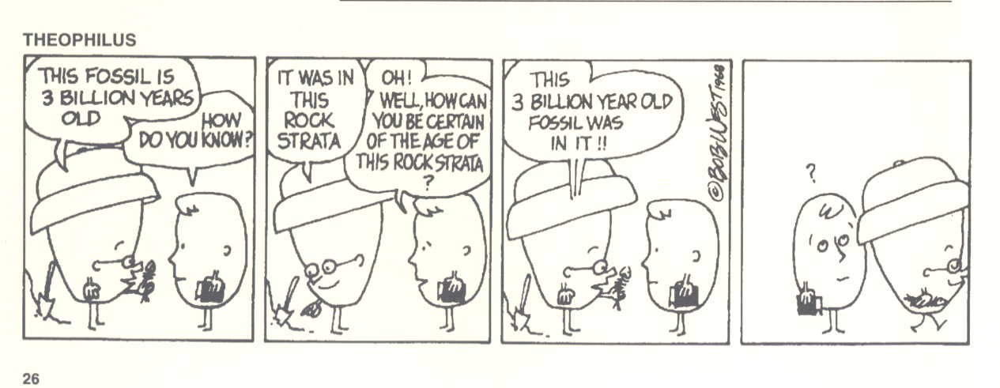
Dating Methods Often Use “Circle Reasoning”

Slide 31
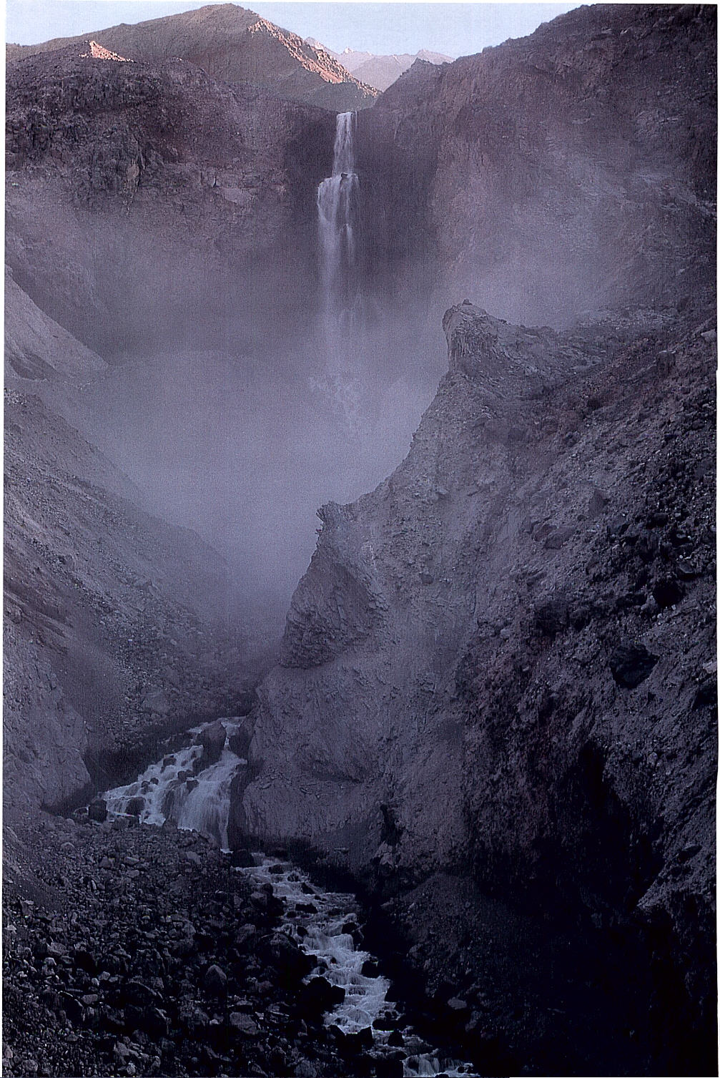
This Canyon
was Formed in
less than
10 Years!
Loowit Falls
outside Mt.
St. Helens.
How Old Is
This Canyon?
50,000 Years?
100,000 Years?
200,000 Years?
300,000 Years?
400,000 Years?
500,000 Years?

Slide 32
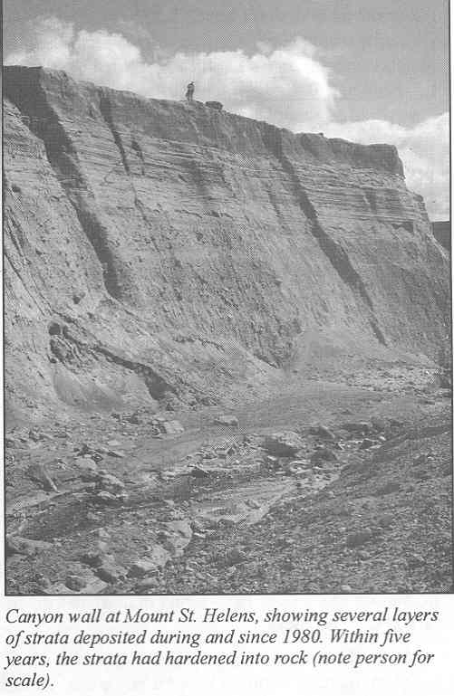
Canyon Wall at
Mt. St. Helen

Slide 33
Rapid Strata Formation at Mt. St. Helens
March 19, 1982
June 12, 1980
May 18, 1980
Toutle River, Mt. St. Helens
Stratified layers up to 400 feet thick formed as a result of landslides, air fall tephra, pyroclastic flow, and mudflows, during the Mt. St. Helens eruptions.

Slide 34
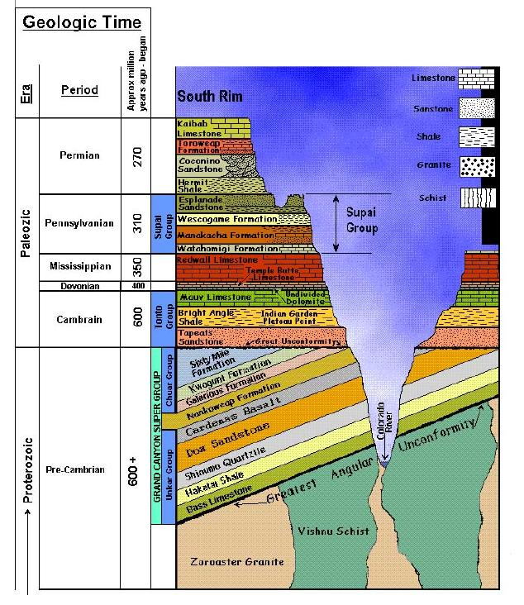
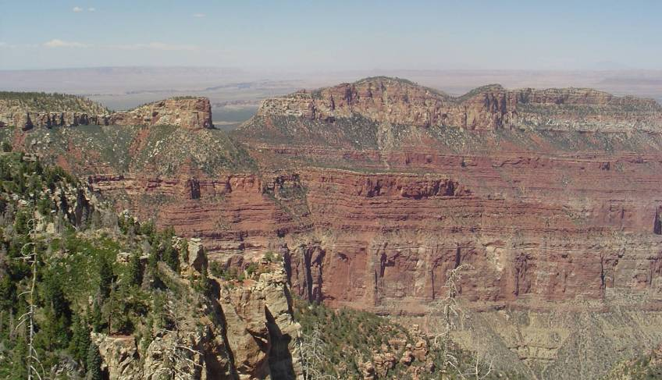
Supai Group
30 million years
Redwall Limestone
150 million years
Muav Limestone
Notes:
Here you can the flat layers of rock that at first glance look like continuous layering of sediment. We would not guess that there is a 20 million year gap between the Redwall and the Supai and a 150 million year gap between the Muav and the Redwall.
It’s not until we look closely at the fossils that allow us to determine the ages of the rocks do we see that there is a big gap in time between the layers.

Slide 35
Assumptions Of Radiometric Dating Methods
Constant Decay Rate
No Loss Or Gain Of Parent Or Daughter Elements
Known Amounts Of Daughter Present At Start
Sealed Top
Parent
(100% at start)
Rate of Decay
Daughter
(0% at start)
Sealed Bottom

Slide 36
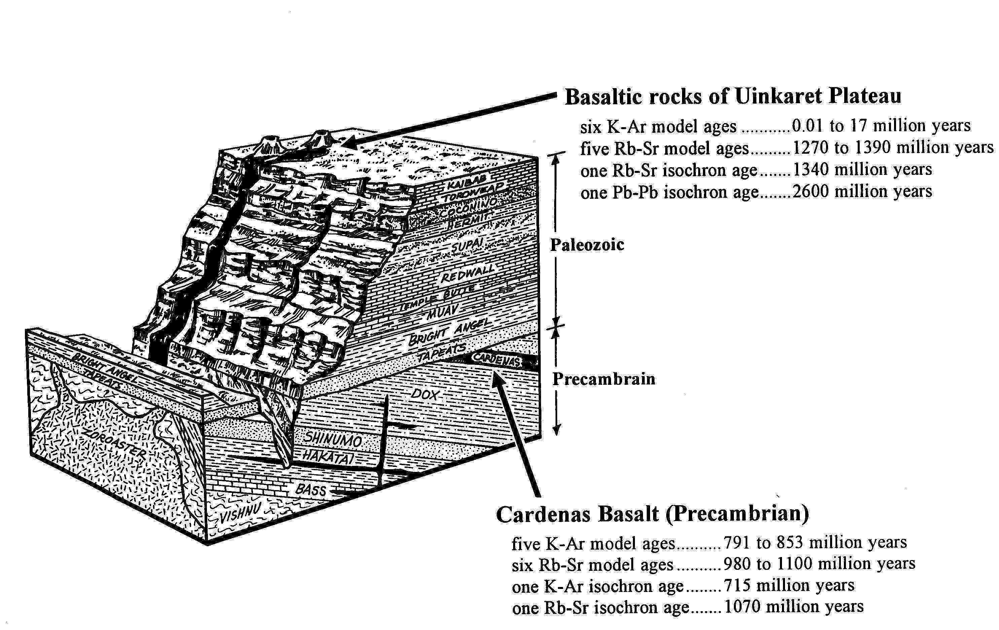
Older Rock on Top??

Slide 37
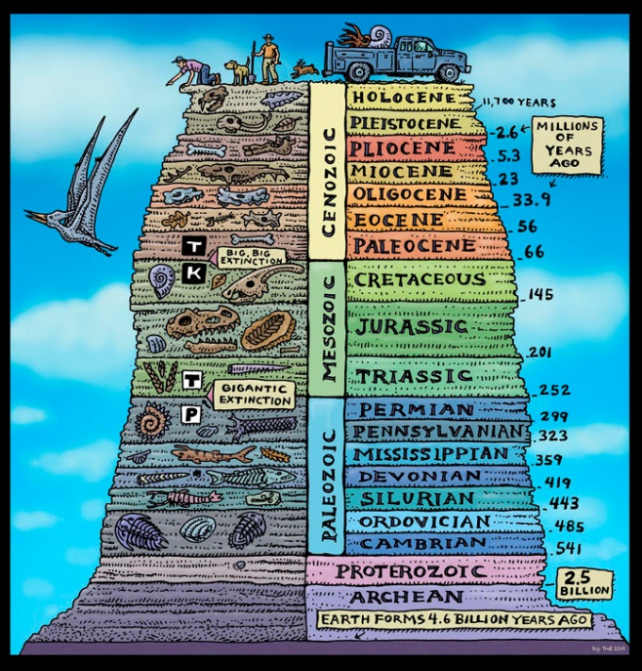
Appearance of Age
Universe
Fossils
Adam

Slide 38
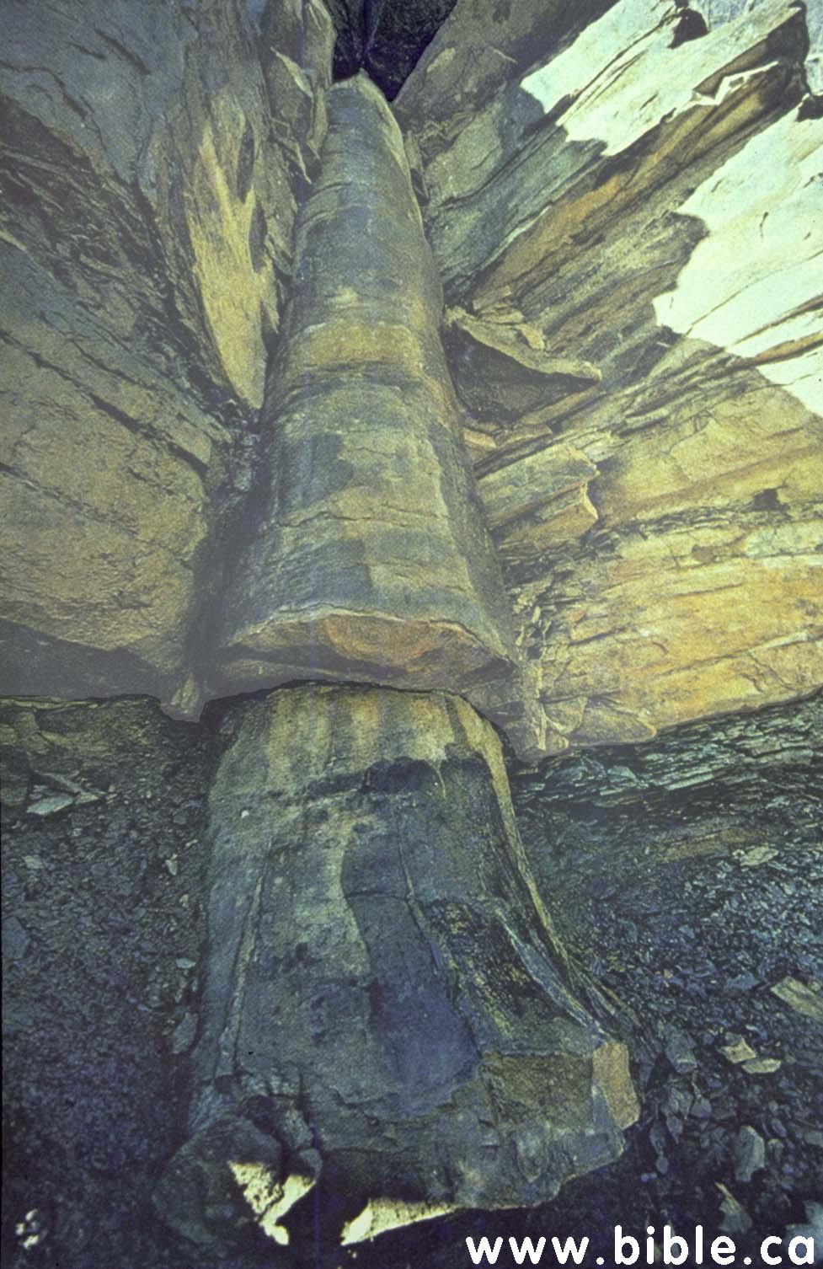
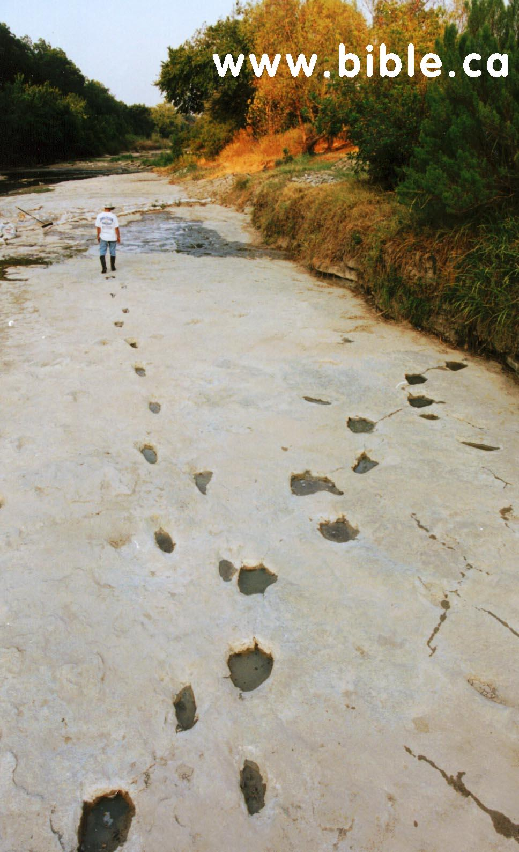
Young Earth/Flood
Man lived with the dinosaurs. On the Paluxy River bed near Glen Rose Texas, fossilized footprints were revealed by erosion of a dinosaur and a human whose paths crossed.
Discovered by Stan Taylor in 1969

Slide 39

Human Artifacts in Coal
Sulfur Springs Arkansas
Nov. 27 - 1948
“While I was working in the Municipal Electric Plant in Thomas, Okla. in 1912, I came upon a solid chuck of coal which was too large to use. I broke it with a sledge hammer. This iron pot fell from the center, leaving the impression, or mould of the pot in a piece of the coal.
Jim Stull (an employee of the company) witnessed the breaking of the coal, and saw the pot fall out.
I traced the source of the coal and found that it came from Wilburton, Oklahoma Mines.”
Frank J. Kennord
Creation Evidences Museum,
Glen Rose, Texas.

Slide 40
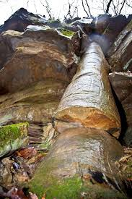
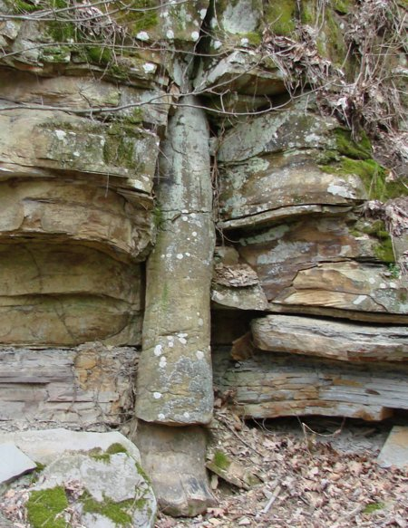
Evidence of Rapid Burial
Polystrate Tree in
Tennessee
Polystrate Fossils
Petrified tree trunks are found that frequently cross several strata proving the layers were deposited at the same time instead of over millions of years.

Slide 41
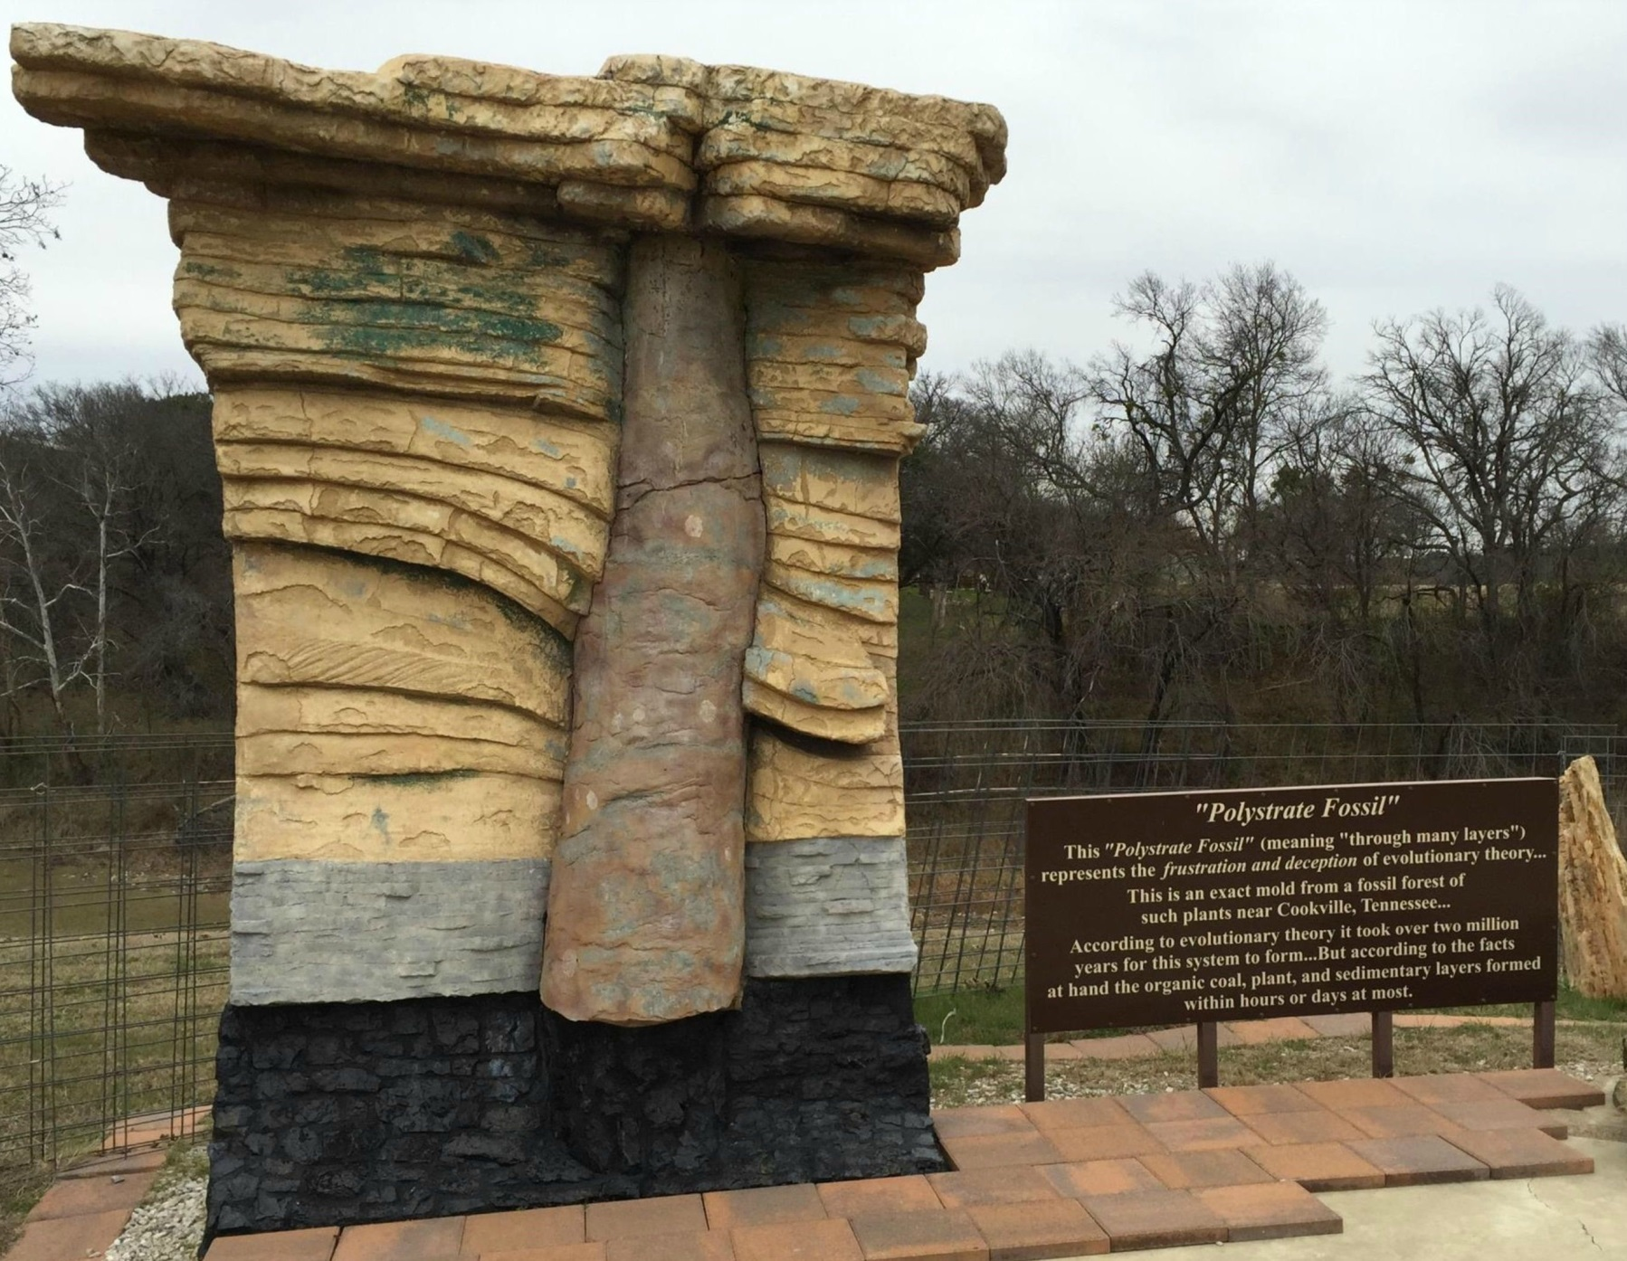

Slide 42
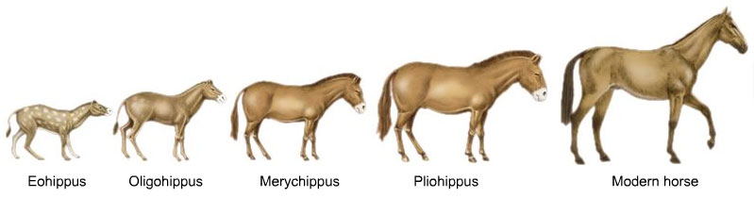
The Horse
“The horse is a well-documented case study in evolution. The fossil record shows clear steps in the progression from a four-toed, small browsing animal - one of a line that gave rise to tapirs, rhinoceroses, and other mammals in addition to horses - to the modern horse,…”
"Evolutionary History of the Modern Horse," Microsoft® Encarta® Encyclopedia 2000. © 1993-1999 Microsoft Corporation.

Slide 43
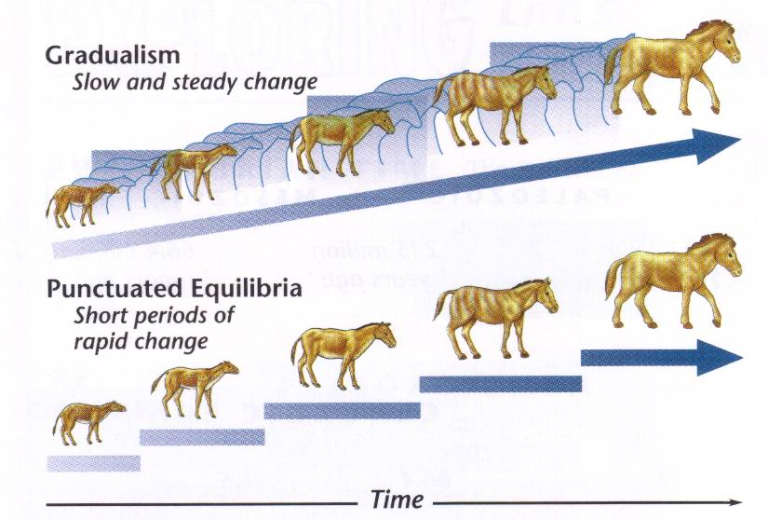
What Textbooks Don’t Contain
The rib count, vertebrae count, tooth count and the size of the animal, varies widely and does not show any direct line of progression (18, 15, 19, 18)
Similarity could be genetic variability

Slide 44
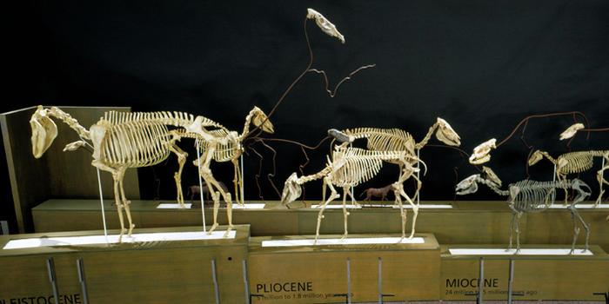
What Textbooks Don’t Contain
Natural History Museum – New York City
Cherry Picked – Large species co-existed with larger

Slide 45
Genesis 1 Theories
Literal – 6 Consecutive 24 Hour Periods
“Day-Age” Theory – “Days” stand for “Ages”
  Psa 90:4 – for a thousand years are but a day.
“Days of Revelation” Theory –
  Creation took a long period of time, but God revealed it to man in six 24 hour periods.
“Gap Theory” (several different kinds of “Gaps”)
  God took Six, 24 Hour Periods to Create, but they were not consecutive days. Eons of time took place between the “days” of creation.
Fairy Tale

Slide 46
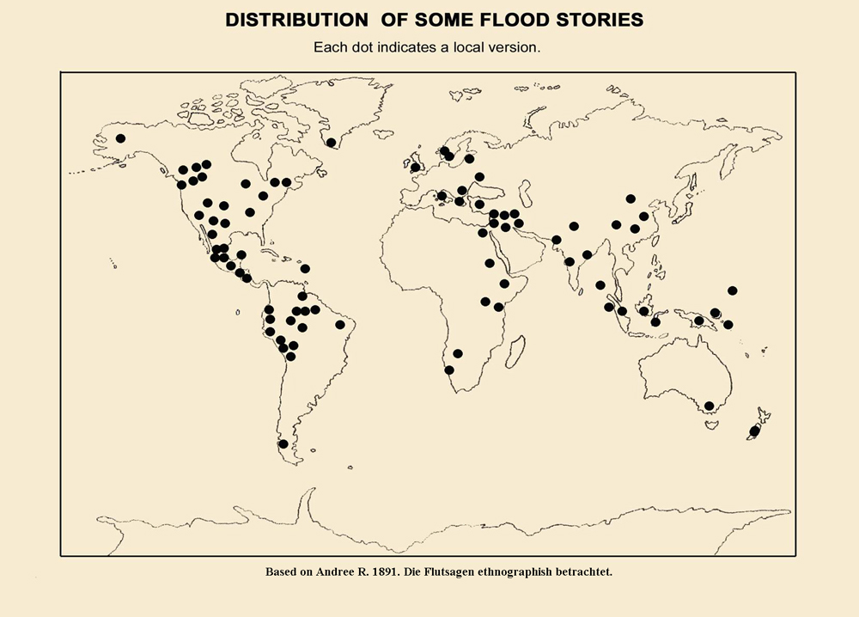

Slide 47
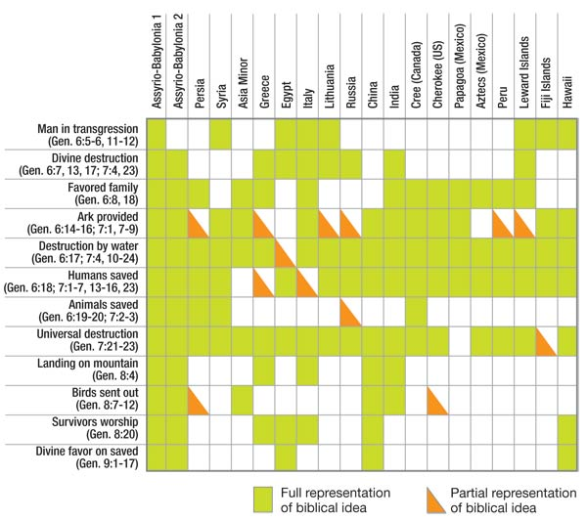
Chart adapted from B.C. Nelson, The Deluge Story in Stone, Appendix 11, Flood Traditions, Figure 38, Augsburg, Minneapolis, 1931

