Slide 1

The book of
Genesis
Lesson 10: Review of Gen 1-11

Slide 2
Class Schedule, (Segment 1)
Session | Topic | Reading | Date
Lesson 1 – Grant | Introduction |  | Sun, April 16
Lesson 2 – Grant | Creation | Gen 1:1-2:3 | Wed, April 19
Lesson 3 - Sam | Adam & Eve | Gen 2:4-4:26 | Sun, April 23
Lesson 4 - Sam | Adam & Eve – Descendants | Gen 2:4-4:26 | Wed, April 26
Lesson 5 - Danny | Science, History & Genesis |  | Sun, April 30
Lesson 6 – Grant | Key Figure: Adam |  | Wed, May 3
Lesson 7 – Grant | Noah | Gen 5:1–9:29 | Sun, May 7
Lesson 8 – Grant | Noah | Gen 5:1–9:29 | Wed, May 10
Lesson 9 - Sam | After the Flood | Gen 10:1-11:26 | Sun, May 14
Lesson 10 - Sam | Review | Gen 1-11 | Wed, May 17
Lesson 11 – Grant, Danny | Aspects of Patriarchal Life |  | Sun, May 21
Lesson 12 – Sam | Abraham | Gen 11:27-25:12 | Wed, May 24
Lesson 13 - Sam | Abraham | Gen 11:27-25:12 | Sun, May28
Notes:
Note that we’re approaching this as a textual study, meaning that our focus will mainly stay on the features of the book which God inspired. For that reason it will be important that you read the book. There is lesson material, but that should only help focus your reading. I think you should have plenty of time for reading. Since we won’t have a lot of time to read the text aloud in class, having the text read means that you’ll be able to follow any discussion we have and be able to easily understand anything we talk about from up here.
Note that we’ve broken this down by section/topic rather than by date. We didn’t’ want to commit to strict sections of the text which are large and deal with the same basic characters. So for instance we’ve allowed 2 classes to cover Noah and the Flood, or 5 classes to cover Abraham. Lesson material should reflect that setup. It won’t be lesson 1,2,3, etc. The material you get will cover the entire section and can be done at your own pace.
We have interjected here a number of ‘topical’ classes. Danny Haynes will be presenting a single class at the beginning covering the issues of how Genesis relates to science and history. The point of the class is more of a textual study of Genesis, but we recognize that those are important issues and worth addressing so Danny has agreed to give us an overview of some of those evidences. We also have a class once we start the section on the patriarchs that I hope will be a historical look at the life of the patriarchs, and explain the world in which they lived. That should be really interesting and help our study through the last ¾ of the book. There are two classes that will focus on the characters of Adam and Abraham, and I think specifically will look at what the New Testament writers have to say about them. That should broaden our understanding of the significance of them for understanding who we are as Christians today. And then we have a couple of review periods in there as well.

Slide 3
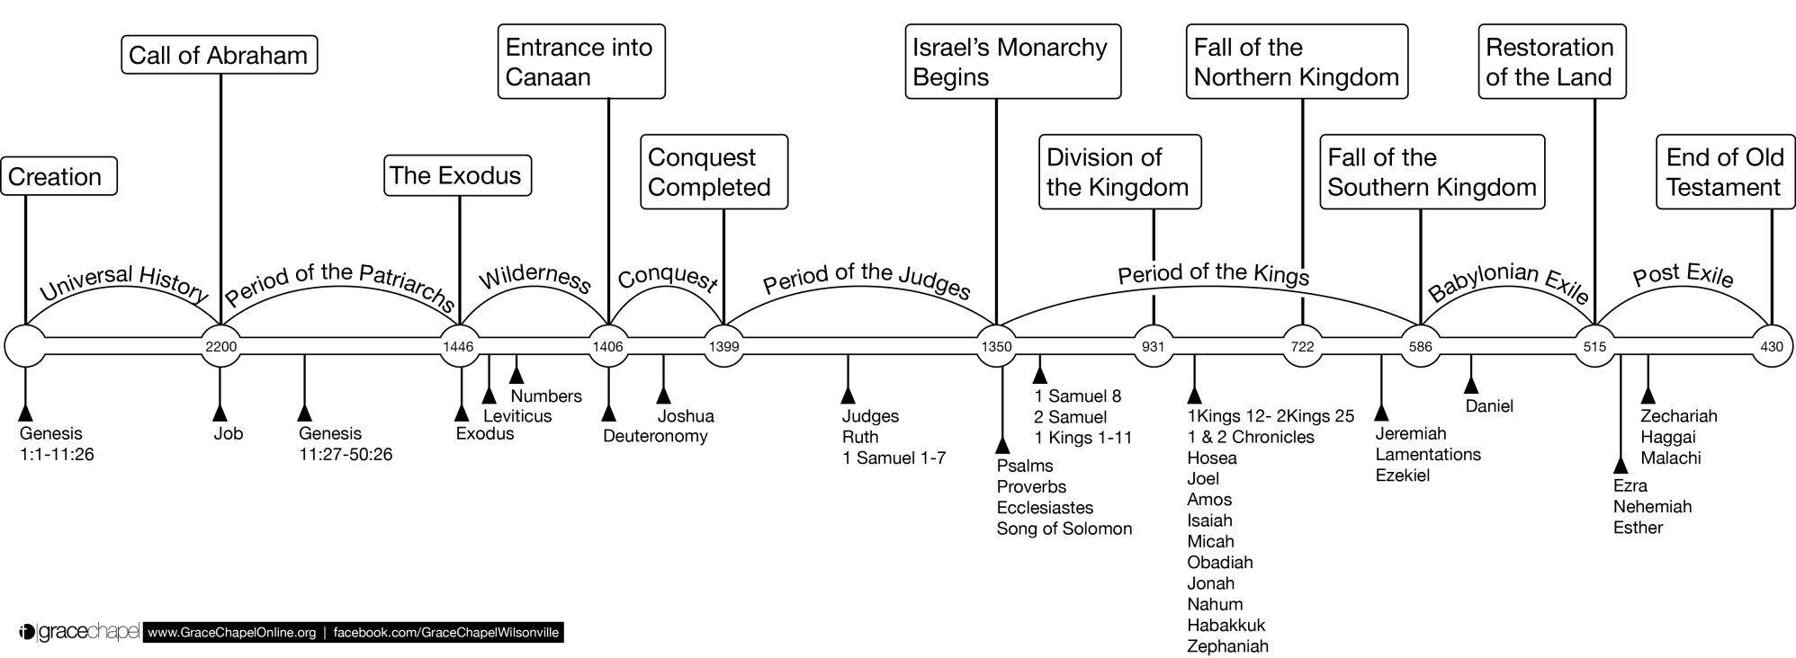

Old Testament Timeline

Slide 4
Content & Structure
Genesis tells the story of God and his people.
  From Creation
  Through ‘the Fall’
  Reclaimed through the Call of Abra(ha)m
  To displacement in Egypt
  Conflict: Will human beings aid or thwart the purpose of God for his creation?
1-11 Early History
‘The Fall’
12-50 Patriarchal History
The Call of Abra(ha)m
The Flood
Dispersion of the Nations
Designation of Jacob as ‘Israel’
Displacement in Egypt / Joseph
Creation
Notes:
Turning back to the content of the book itself, Genesis is a large-scale/epic narrative. It tells a story – one which follows the relationship between the Creator God and his creation, most specifically with human beings, and even more specifically with the ancestors of Israel. And what is at stake in that story is the question of whether humans will aid or thrwart / help or hurt God’s purpose for creation. That is the basic conflict in this book.
The story is essentially told in two parts. The first 11 chapters (roughly) tell us about what might be called Early or Primordial history, meaning events which occur at the very beginning of the universe. The chapters contain the narratives of creation of the world, and then the widespread introduction of sin into the world, weather that be in Eden, or leading up to the flood, or in the dispersion of the nations at Babel. Then with chapter 12 you have the major turning point, not only of the book itself, but as we’ll see, of the history of God’s entire plan of salvation – the call and promises to Abraham. And the rest of the narrative of Genesis all the way through the rest of the book is focused on the history of Abraham and his children as the subject of God’s call and promises to see if/how those will be fulfilled.

Slide 5
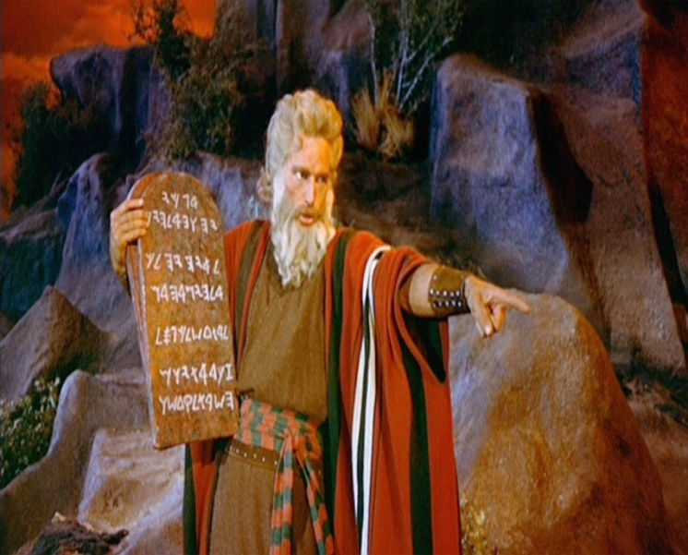
Composition & Authorship
The Pentateuch is anonymous
Numerous references throughout the OT that Moses wrote down the law of the Israelites at Sinai
Long-standing Jewish and biblical tradition held that Moses’ writing of the law extended to all books of the Torah
Upheld by Jesus and the Gospel writers
And beginning with Moses and with all the prophets, [Jesus] explained to them the things concerning Himself in all the Scriptures.“ (Lk 24:27)
Notes:
Who wrote Genesis? Everyone knows that Genesis, along with the rest of the Torah/Pentateuch was written by Moses. These book are after all known as the ‘The Law/Books of Moses.’ But we should point out as a matter of fact that those writing themselves do not have an attributed author.
However, authorship has never been in doubt within Jewish and biblical tradition. Starting with Sinai and running throughout the books of Exodus, Leviticus, Numbers and Deuteronomy, there is frequent witness to the laws and records which God Moses would write down for the Hebrew people and priests to be regulated by. Further, those references extend into the rest of the Old Testament where there are numerous references to Israelite law as the ‘the Law of Moses.’ And that association is even made explicit in non-biblical Jewish sources, like Josephus and the later Jewish Rabbis, who explicitly held that Moses has authored the five books of the Torah. (Josephus CAp 1:37-43; TB Baba Batra 14b-15a)
Jesus and the Gospel writers affirm this traditional view over and over again in the New Testament, referring to the law and the scripture as that which was written by Moses. Indeed by that time, this view was so ingrained that Jesus could say [Luke 24 citation], where for Moses he is referring metonymically to the five books of the Torah.
So again, from a biblical perspective the composer/author of Genesis is not in doubt – it is Moses.

Slide 6
Canon & Title
First Book of the ‘Torah’ – Hebrew for ‘Law, Instruction’
  (with Exodus, Leviticus, Numbers, Deuteronomy)
‘Pentateuch’ – Greek for ‘Five-Part Book’
Genesis – ‘the origin, source, or beginning of a thing’
From the Greek genesis – ‘generations’
  LXX 2:4: Biblos geneseōs – ‘the book of the generations’
Hebrew – bereshit/bə·rê·šîṯ – ‘In the beginning’
  The first word of the Hebrew text of the book
Notes:
The place to start talking about Genesis is at the beginning – of the bible, that is. Genesis is not just the first book of the Bible, it is also the first of the 5-book set of the OT known as the Torah, which is the Hebrew word for ‘Law’ or ‘instruction.’ These were kind of the backbone of Jewish history and divine instruction. This ‘Pentateuch, or ‘Five-Part Book’ in Greek, established the ancestral, national, social, legal and moral identity of Israel. Genesis is the first of that set.
The books title reflects some interesting things about the content of this text. In English, the book is known as Genesis, a word which generally refers to the origin, source or beginning of a thing. We have a general understanding of that meaning, but the word itself comes from Greek.
In the LXX, the Greek translations of the OT, the book uses the root word in a phrase in 2:4 – BIB-los gen-NES-say-os – ‘the book of the generations.’ That’s an important phrase through Genesis as we’ll say, and it actually the basis for the books title. That phrase refers to the fact that what we have in genesis is a record of the people and events of various generations of people. Thus the story is a retrospective of ancient ancestry.
Finally, in the original Hebrew in which the book was written, the title is ‘be-ray-SHEET,’ which it itself the very first word in the text, and means ‘In the beginning…’ Like the English title this suggests that the entire story of Genesis represents the beginning of God’s dealings in the world.

Slide 7
Content & Structure
“These are the generations of…”
2:4
Heavens & Earth
5:1
6:9
Noah
10:1
11:10
Noah’s Sons
Shem
Adam
11:27
Terah
25:12
25:19
Isaac
36:1
37:2
Jacob (Israel)
Ishamel
Esau(Edom)
Notes:
Structure is important as well because it tells something about the intentions of the author, and Genesis has one of the most clearly defined structures of any book of the Bible. The various stories and episodes within Genesis are organized around 10 different ‘accounts’ or ‘generations.’ In each of the verses listed you have the phrase ‘elleh toledot’ in Hebrew, which is usually translated as “These are the generations of…” This phrase introduces a genealogy and or a narrative in the name of person referenced which progresses the story along from one phase to another.
[[Do you see anything here that interests you or surprises you?]] [[What does this tell you about the author’s intentions?]]
These formulaic introductions are frequently followed by genealogies – [[what is the purpose of recording a genealogy in a book like Genesis?]]
Note that the first 5 of these occur in the Primordial History section of 1-11, while the last 5 occur in the larger section of the book which deals with the patriarchs of Israel. (11:27, which is right at the end of chapter 11, is the ACTUAL transition point from Primordial History to Patriarchal History)

Slide 8

1:1-2
‘In the beginning, God created the heavens and the earth…’
‘Formless and void’
‘Darkness over the face of the deep’
‘The Spirit of God hovered over the waters’
SOMETHING FROM NOTHING
ORDER FROM CHAOS
Notes:
Two ways of understanding ‘created the heavens and the earth.’ Either an initial act of creation OR a summary statement for all of ch. 1
Gap Theory – H&E are created, then a gap where the creation becomes F&V, and then god (re)creates out of that
Day/Age Theory – non-literal 24-hour days allow for time for creation
Understanding of tohu wabohu – formless wasteland, without substance >> chaos (Is 45:18-19), unformed, unfilled
Understanding of darkness over the face of the deep – primordial waters/sea from which God created the world (2 Peter 3:5-6)
Understanding of the spirit/wind/breath of God hovering over the waters – an active wind? A restrictive/confrontational act? An act of formation? (Deut. 32)
The purpose of this verse is not for us to speculates about times and processes – what the world was or wasn’t. The point is to set up the idea that from out of this primordial state, God brings about abundant life upon a good Earth. From nothingness he brings something, and from chaos he brings order. I think that as the account carries on, we see other hints that the value of creation lies in this principle of order and symmetry and structure.

Slide 9
1:3-25
Day 1
Light
Day 2
Expanse
Day 3
Earth
Vegetation
Day 4
Luminaries
Day 5
Fish/Birds
Day 6
Animals
Humans
Notes:
One of those hints is in the sequence in which God creates.
Genesis describes 8 separate acts of creation over 6 days with Days 3 & 6 containing two distinct creative actions on each day
Days 1-3 are foundations, creating fundamental aspects of the earthly environment
Days 4-6 are the counterparts to days 1-3 in populating and governing that creation

Slide 10
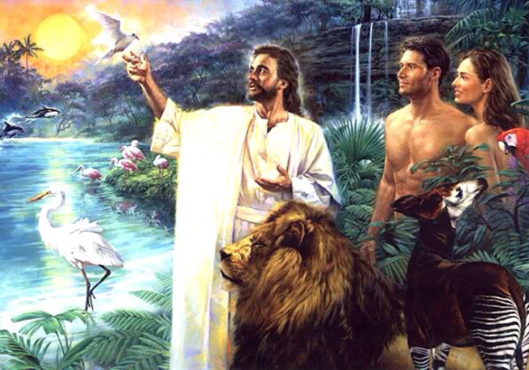
Creating Man
Man was formed…
  From the dust of the earth
  In God’s image, according to His likeness
  With the breath of life in his nostrils
  Male and female
With purpose…
  Be fruitful and multiply
  Fill the earth and subdue it
  Have dominion over fish, birds, and all creatures that move
  Tend the garden and care for it
  Allowed to eat all plants – (applied to both man and animal)

Slide 11
The First Sin
Therefore, to him who knows to do good and does not do it, to him it is sin. (Jas 4:17)
The Actors
  The serpent – more cunning than any beast of the field
  The woman –knew the command and the consequences
  The man – who did not lead
The Terms
  Do not eat, lest you die
  But… you will become like God, knowing good and evil
The Act
  The women saw that it was
    Good for food
    Pleasant to the eyes
    Desirable to make one wise
  She took the fruit and ate
  She gave to her husband with her, and he ate
For all that is in the world—the lust of the flesh, the lust of the eyes, and the pride of life—is not of the Father but is of the world. (1Jn 2:16)

Slide 12
Consequences, The Curse
The Serpent – Because you have done this [deceived the woman]
  Cursed more than all cattle and beasts
  Go on your belly, eat dust
  Enmity between you and the woman
  Enmity between your seed and her Seed
The Man – Because you heeded the voice of your wife and ate
  Cursed is the ground for your sake
    In toil you shall eat all your life
    Thorns and thistles will grow for you
    In the sweat of your face you shall eat bread
The Woman
  Greatly multiply your sorrow and conception
  In pain you shall bring forth children
  Desire shall be for your husband, he shall rule over you

Slide 13
Family Relationships
In the Garden, Before the Fall
“One Flesh”
Children
Woman
Man
Earth
(Garden)
“be fruitful”
Helper
Subdue

Slide 14
Family Relationships
After the Fall
Pain
Rule Over
Toil
“One Flesh”
Children
Woman
Man
Earth
(Multiplied)
“be fruitful”
Helper
Subdue
(Thorns, etc)
People
Affection
Security
Cooperation
Feeling
Intuition
Things
Self/Ego
Achievement
Competition
Facts
Logic
Desire
Differences in Emphasis and Abilities

Slide 15
Family Relationships
In Christ, The Ideal Marriage
Honor
Submit
Hope
Nurture
Admonish
Rule Manage
Chasten
Love
Love
Woman
Man
Spiritual
  Provided Spiritual Leadership (Eph 5:24, 1 Tim 2:12-13)
Emotional
  Loved, Desired, Sense of belonging (Eph 5:25-29, Sol 7:10)
  Respected, Honored (1 Pet 3:7, Sol 7:10)
  Protected from Fear (Sol 4:7-8, 1 Pet 3:6)
  Given an Object of Affection (Sol 8:1-2)
Physical
  Sexual Desires Satisfied (1 Cor 7:3-5)
  Protected, Provided for (1 Tim 5:8)
Spiritual
  Provided Spiritual Companionship (1 Pet 3:7)
Emotional
  Ego, Sense of Worth Bolstered (1 Pet 3:6, Prov 20:29)
  Respect of Others Fostered (Prov 12:4, 31:23)
  Comforted in Insecurity (Gen 24:67)
  Companionship, Contentment (Sol 8:10)
Physical
  Sexual Desires Satisfied (1 Cor 7:3-5, Prov 5:15-19)
  Food, Clothing, Provision (Prov 31:13-15)
Needs Fulfilled

Slide 16
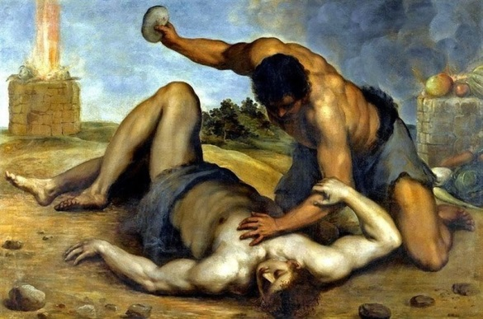
The Sin of Cain
God Speaks a Warning
  Notices his anger, and that his countenance has fallen
  If you do well, will you not be accepted?
  If you do not do well, Sin lies at the door
  It’s desire is for you, but you should rule over it
Cain Kills Abel
  Premeditated - he speaks to him first
  In secret – while in the field
  Lied to God about knowing where Abel was
  Denied responsibility – “Am I my brother’s keeper?”
Consequences
  You are cursed from the earth
  The ground shall not yield its strength
  A fugitive and a vagabond

Slide 17
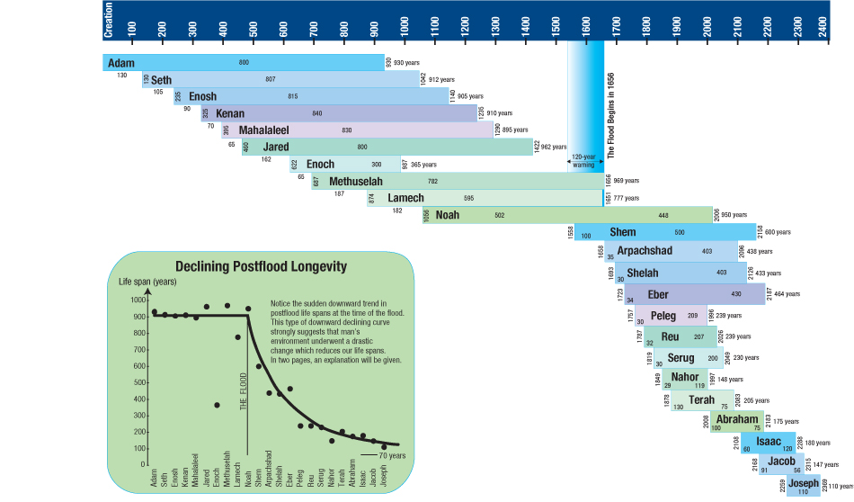
Adam
Gen 5:1
Noah
Gen 6:9
Noah’s Sons
Gen 10:1
Shem
Gen 11:10
Terah
Gen 11:27

Slide 18
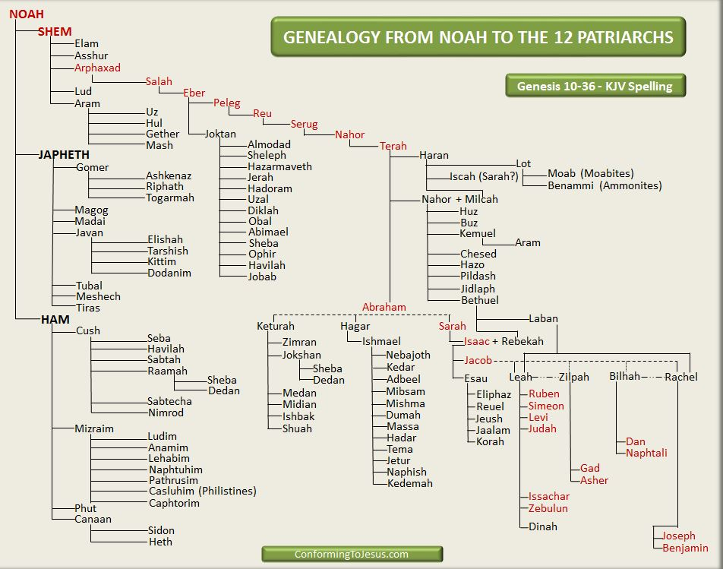
Nations Descended from Noah
Gen 10:1 Genealogy of the Sons of Noah
All Nations of earth
Divided in the time of Eber
Peleg’s descendants are not listed
Gen 11:10 Genealogy of Shem
Godly lineage of Abraham, David, and Jesus

Slide 19
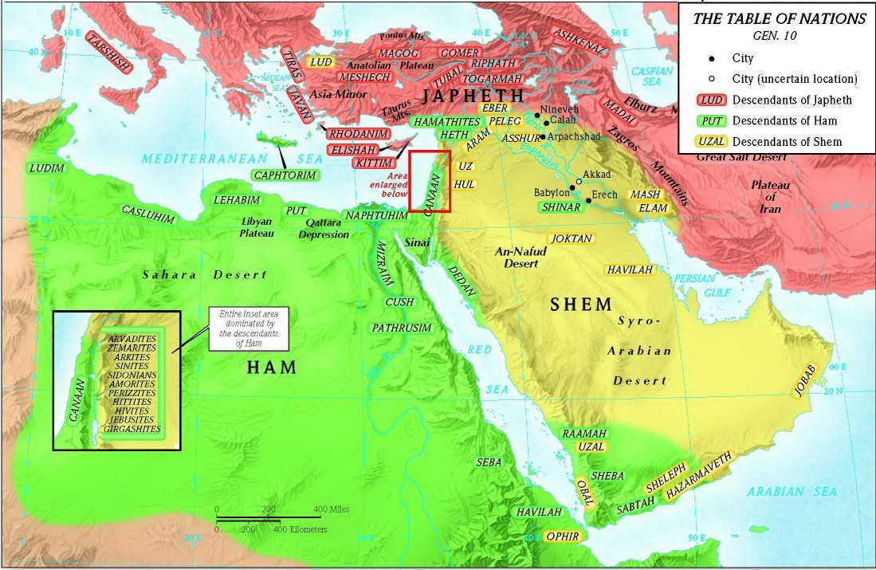
Lands of the Sons of Noah

Slide 20
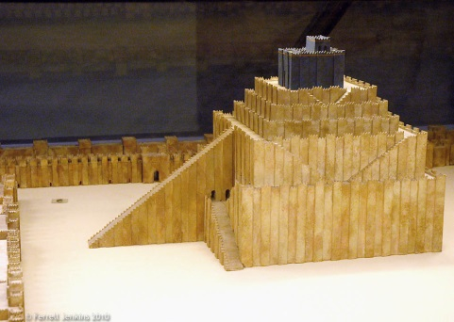
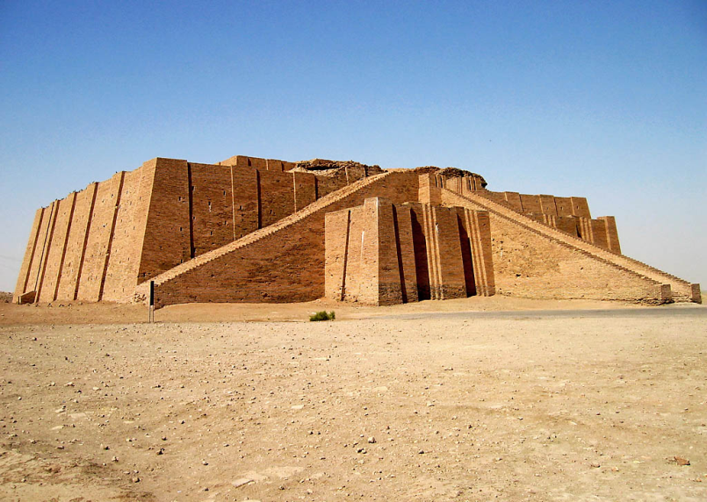
Confusing of Languages
The whole earth had 1 language and speech
Journeyed to Shinar and dwelt there
Started to build a tower
  Baked brick and asphalt
  To reach the heavens
  To make a name
  To avoid being scattered
The Lord came down
  “…this is what they begin to do…”
  Nothing would stop them
  Confused their language
  Scattered them across the whole earth
Called Babel because God confused the language
Reconstructed Ziggurat at Ur in Iraq.
Photo by Josh McFall.

