Slide 1
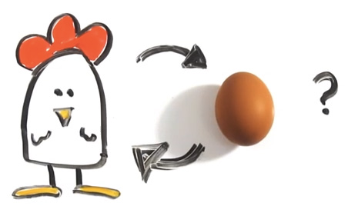
Genesis Life of the Patriarchs…
The Important questions of life…

Slide 2
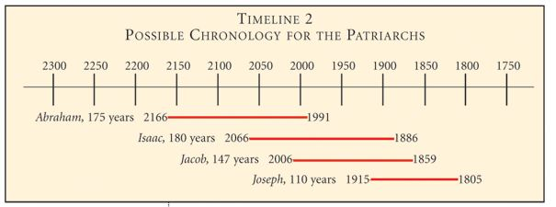
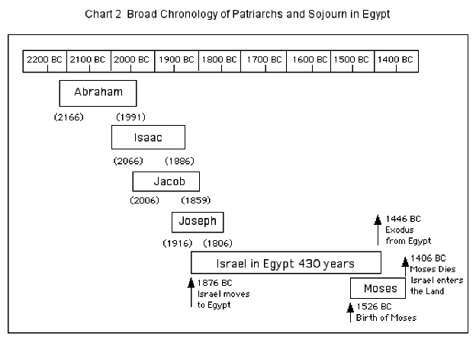
Timeline

Slide 3
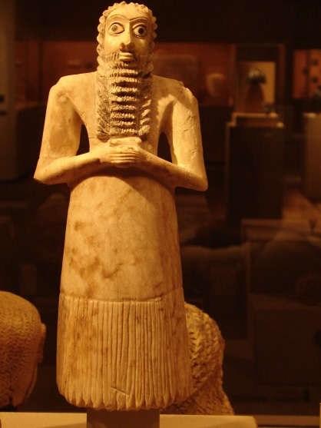
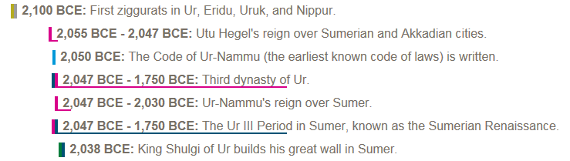
Timeline
^{Hebrews 11}
8 By faith Abraham obeyed when he was called to go out to a place that he was to receive as an inheritance. And he went out, not knowing ^{where he was going.}
Abram Left at the height of Ur Power

Slide 4
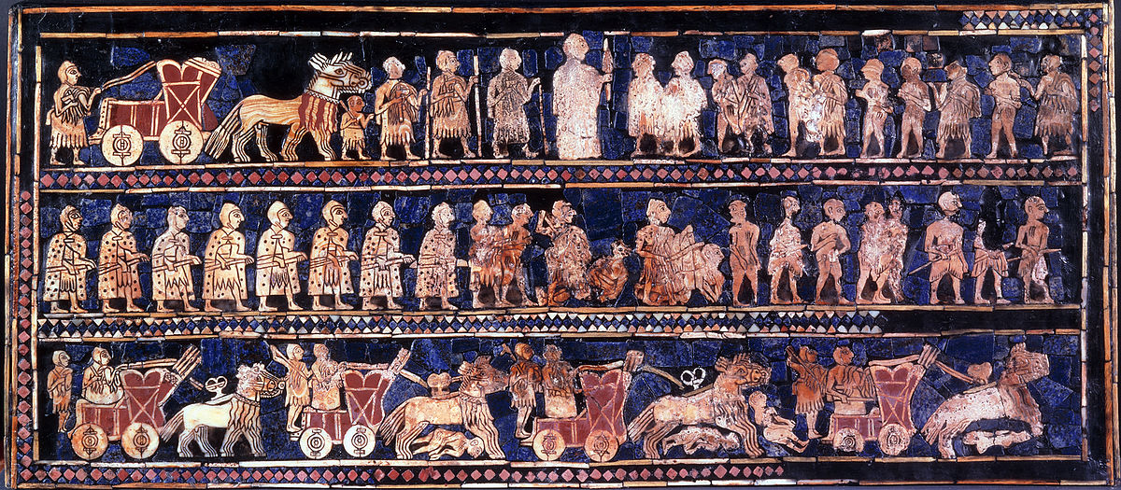
Citizen of Ur
8 By faith Abraham obeyed when he was called to go out to a place that he was to receive as an inheritance. And he went out, not knowing where he was going. 9 By faith he went to live in the land of promise, as in a foreign land, living in tents with Isaac and Jacob, heirs with him of the same promise. 10 For he was looking forward to the city that has foundations, whose designer and builder is God. 11 By faith Sarah herself received power to conceive, even when she was past the age, since she considered him faithful who had promised. 12 Therefore from one man, and him as good as dead, were born descendants as many as the stars of heaven and as many as the innumerable grains of sand by the seashore.
13 These all died in faith, not having received the things promised, but having seen them and greeted them from afar, and having acknowledged that they were strangers and exiles on the earth. 14 For people who speak thus make it clear that they are seeking a homeland. 15 If they had been thinking of that land from which they had gone out, they would have had opportunity to return. 16 But as it is, they desire a better country, that is, a heavenly one. Therefore God is not ashamed to be called their God, for he has prepared for them a city.
17 By faith Abraham, when he was tested, offered up Isaac, and he who had received the promises was in the act of offering up his only son, 18 of whom it was said, “Through Isaac shall your offspring be named.” 19 He considered that God was able even to raise him from the dead, from which, figuratively speaking, he did receive him back. 20 By faith Isaac invoked future blessings on Jacob and Esau. 21 By faith Jacob, when dying, blessed each of the sons of Joseph, bowing in worship over the head of his staff. 22 By faith Joseph, at the end of his life, made mention of the exodus of the Israelites and gave directions concerning his bones.
  . (2016). (Heb 11:822). Wheaton: Standard Bible Society.
The Holy Bible: English Standard Version. (2016). (Heb 11:8–22). Wheaton: Standard Bible Society.
^{Hebrews 11}
8 By faith Abraham obeyed when he was called to go out to a place that he was to receive as an inheritance. And he went out, not knowing ^{where he was going.}
Notes:
8 By faith Abraham obeyed when he was called to go out to a place that he was to receive as an inheritance. And he went out, not knowing where he was going. 9 By faith he went to live in the land of promise, as in a foreign land, living in tents with Isaac and Jacob, heirs with him of the same promise. 10 For he was looking forward to the city that has foundations, whose designer and builder is God. 11 By faith Sarah herself received power to conceive, even when she was past the age, since she considered him faithful who had promised. 12 Therefore from one man, and him as good as dead, were born descendants as many as the stars of heaven and as many as the innumerable grains of sand by the seashore.
13 These all died in faith, not having received the things promised, but having seen them and greeted them from afar, and having acknowledged that they were strangers and exiles on the earth. 14 For people who speak thus make it clear that they are seeking a homeland. 15 If they had been thinking of that land from which they had gone out, they would have had opportunity to return. 16 But as it is, they desire a better country, that is, a heavenly one. Therefore God is not ashamed to be called their God, for he has prepared for them a city.
17 By faith Abraham, when he was tested, offered up Isaac, and he who had received the promises was in the act of offering up his only son, 18 of whom it was said, “Through Isaac shall your offspring be named.” 19 He considered that God was able even to raise him from the dead, from which, figuratively speaking, he did receive him back. 20 By faith Isaac invoked future blessings on Jacob and Esau. 21 By faith Jacob, when dying, blessed each of the sons of Joseph, bowing in worship over the head of his staff. 22 By faith Joseph, at the end of his life, made mention of the exodus of the Israelites and gave directions concerning his bones.
. (2016). (Heb 11:822). Wheaton: Standard Bible Society.
The Holy Bible: English Standard Version. (2016). (Heb 11:8–22). Wheaton: Standard Bible Society.

Slide 5
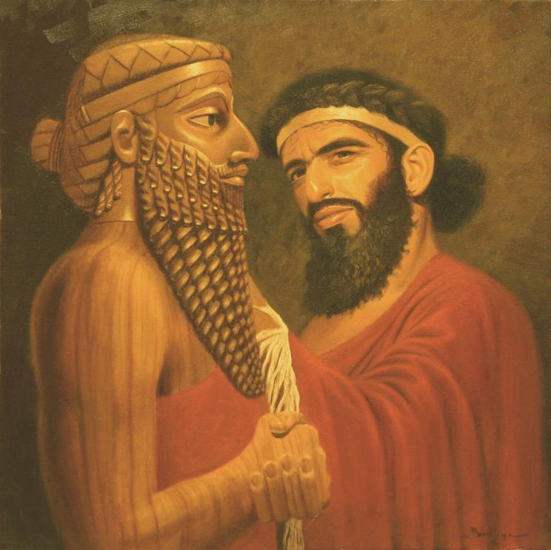
Naram-Sin
2254 to 2218 BC
Abraham
2166 to 1991 BC
Victory Stele of Naram-Sin is a stele that dates to approximately 2254-2218 BC

Slide 6
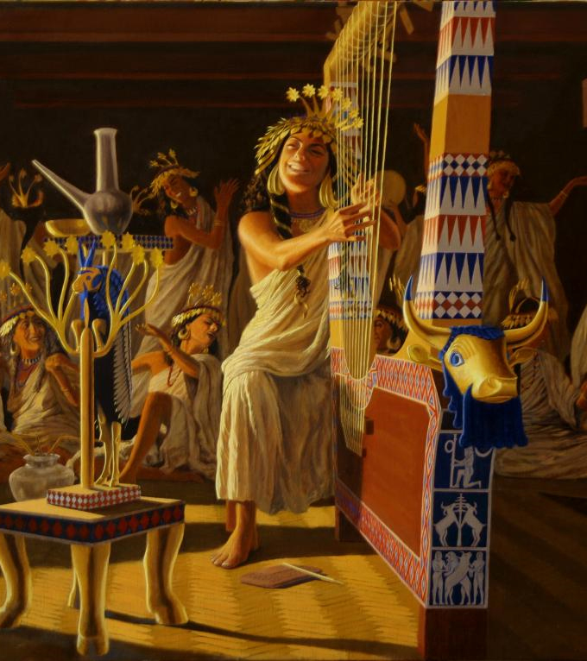
Woman of Ur
^{Hebrews 11}
11 By faith Sarah herself received power to conceive, even when she was past the age, since she considered him faithful who had promised

Slide 7
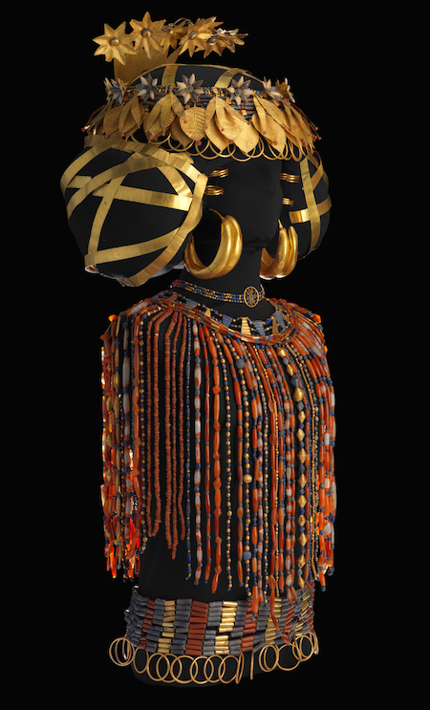
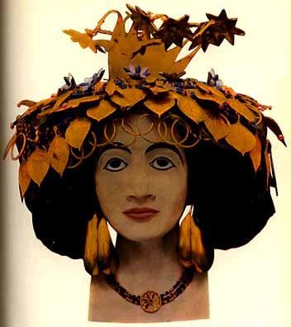
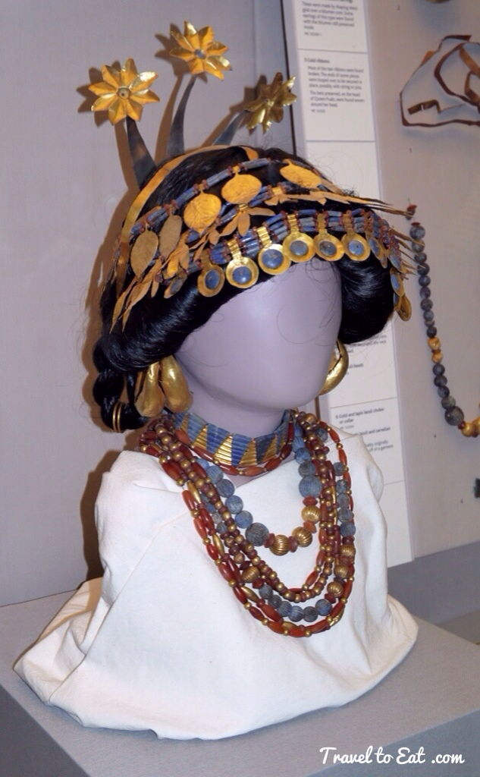
A Woman of Ur

Slide 8
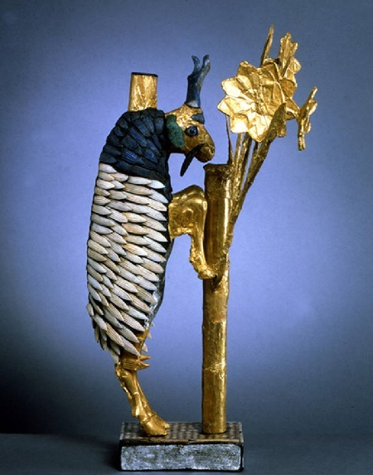
Hebrews 11
17 By faith Abraham, when he was tested, offered up Isaac, and he who had received the promises was in the act of offering up his only son,
18 of whom it was said, “Through Isaac shall your offspring be named.”
19 He considered that God was able even to raise him from the dead, from which, figuratively speaking
Genesis 22
13 And Abraham lifted up his eyes and looked, and behold, behind him was a ram, caught in a thicket by his horns. And Abraham went and took the ram and offered it up as a burnt offering instead of his son.
Object Find at Ur

Slide 9
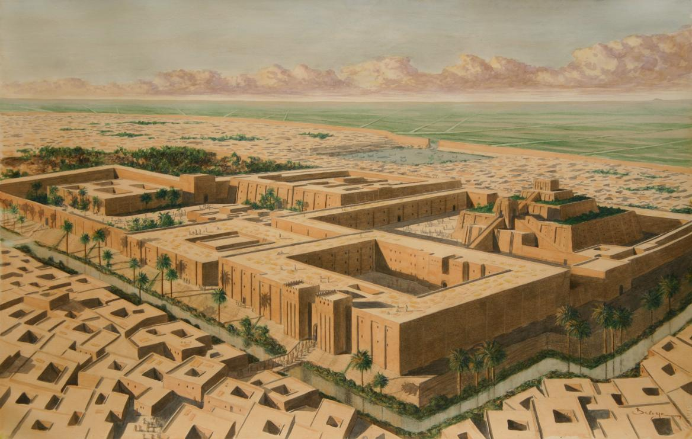
Ur City Center

Slide 10
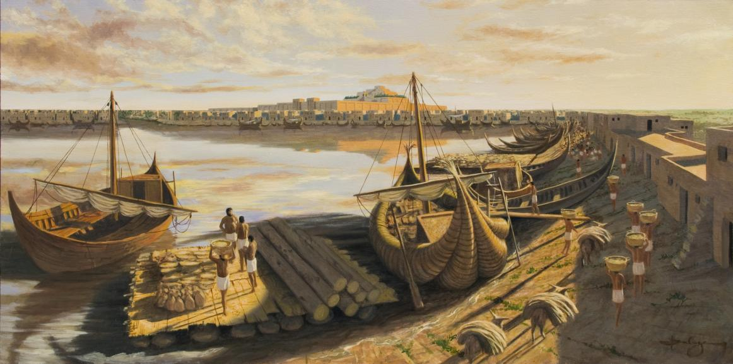
Harbor of Ur

Slide 11
From Ur to Haran to Land that will be Yours
Genesis 11:31-32(ESV)
³¹Terah took Abram his son and Lot the son of Haran, his grandson, and Sarai his daughter-in-law, his son Abram’s wife, and they went forth together from Ur of the Chaldeans to go into the land of Canaan, but when they came to Haran, they settled there.
³²The days of Terah were 205 years, and Terah died in Haran.

Slide 12
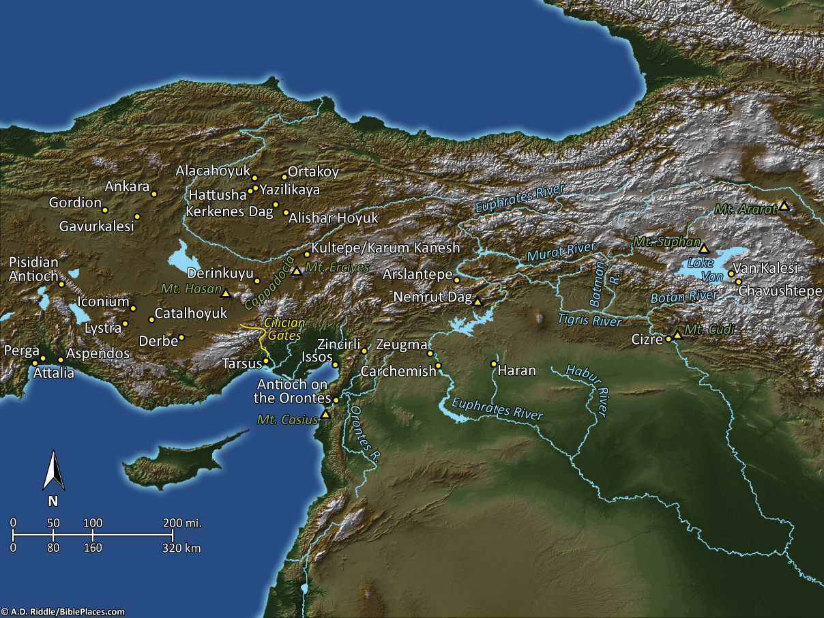
Haran
Pictorial Library Vol. 9: Eastern & Central Turkey
Notes:
This map is intended to help users locate the places which appear in the photographs in this presentation. The map therefore does not represent or label every geographic feature, and the sites are a mixture of modern and ancient place names.

Slide 13
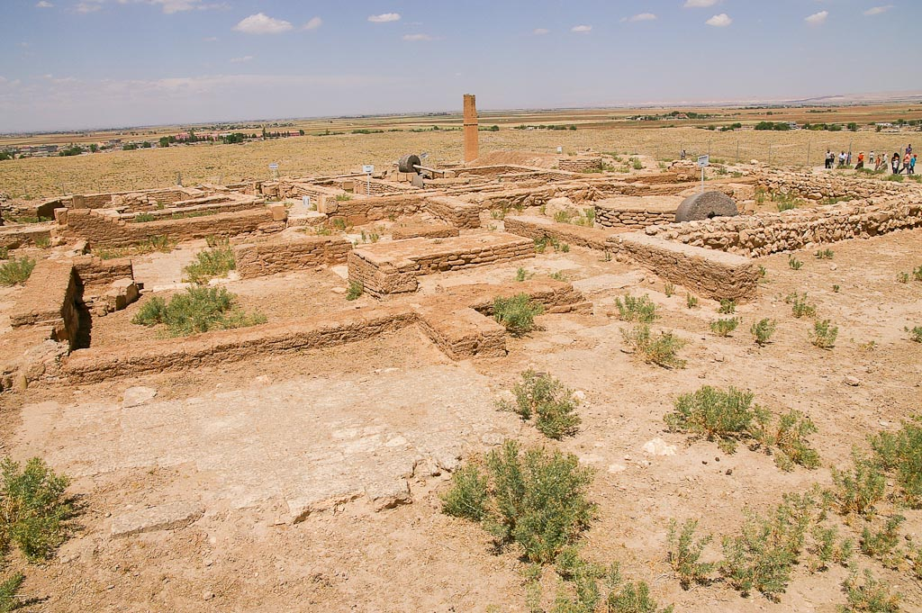
Tell Haran excavations from southwest
Notes:
The excavated remains on the tell belong to the Islamic town from the 12th and 13th centuries AD. The town consisted of rectangular and square mudbrick houses which had rooms arranged around a paved courtyard. In a few places, remains from the Early Bronze Age and Neo-Babylonian period (6th century BC) have been exposed.
adr1005201942

Slide 14
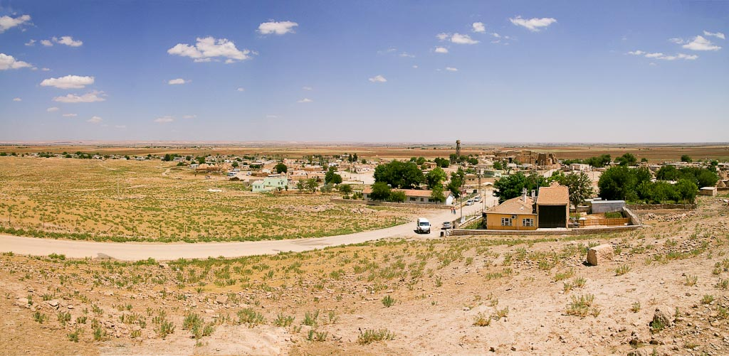
Tell Haran view southeast of modern village and Haran Plain panorama
Notes:
adr1005201959

Slide 15
From Ur to Haran to Land that will be Yours
Genesis 12:1-4(ESV)
¹Now the Lord said to Abram, “Go from your country and your kindred and your father’s house to the land that I will show you.
²And I will make of you a great nation, and I will bless you and make your name great, so that you will be a blessing.
³I will bless those who bless you, and him who dishonors you I will curse, and in you all the families of the earth shall be blessed.”
⁴So Abram went, as the Lord had told him, and Lot went with him. Abram was seventy-five years old when he departed from Haran.
~2091 BC?

Slide 16
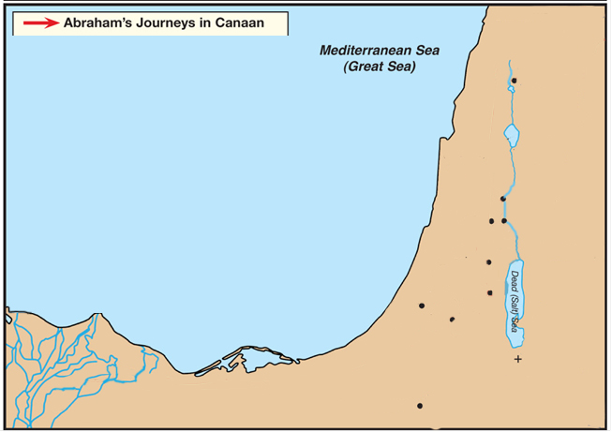


Coastal Road
Dan
King’s Highway
Central Ridge Road
Shechem
Bethel
Ai
Jerusalem
Hebron
Gerar
Beersheba

Slide 17
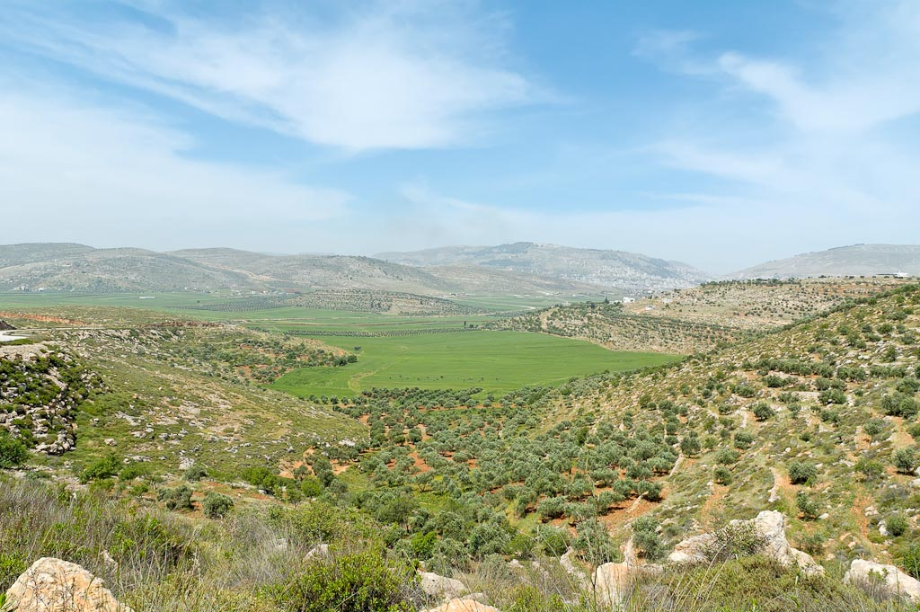
Genesis 12:6(ESV)
⁶Abram passed through the land to the place at Shechem, to the oak of Moreh. At that time the Canaanites were in the land.
Fields near Shechem
Notes:
tb050106475

Slide 18
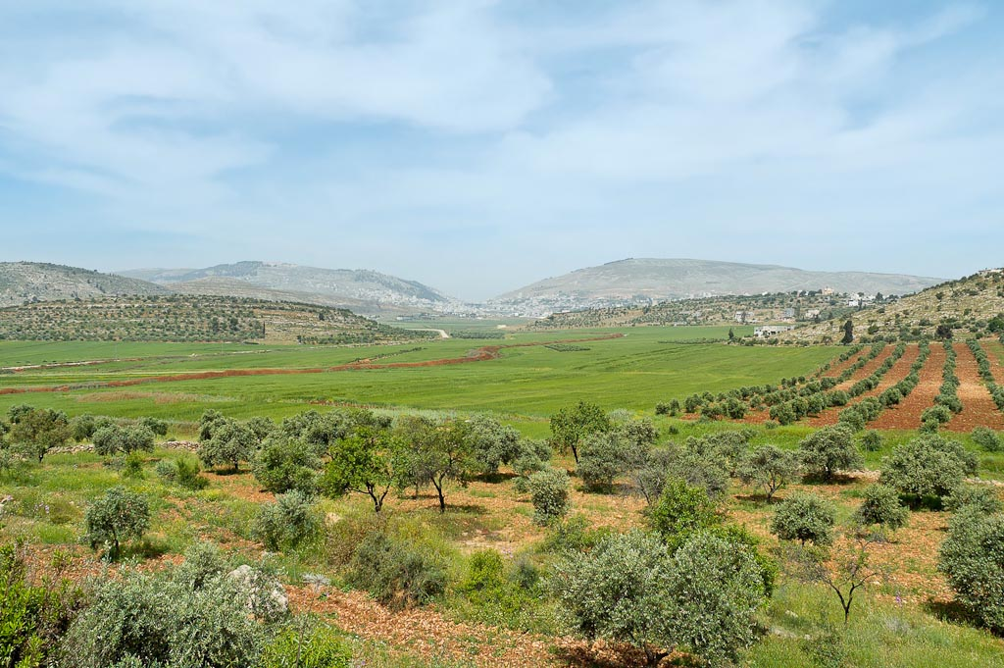
Mt Gerizim
Mt Ebal
Shechem
Mount Gerizim, Shechem, and Mount Ebal from east
Notes:
tb050106458

Slide 19
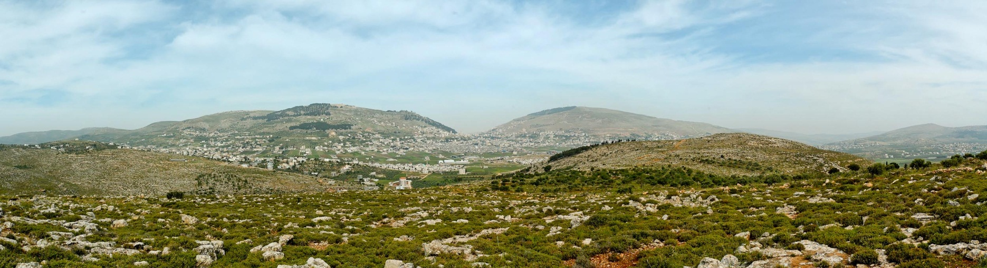
Mt. Gerizim
Mt. Ebal
Shechem
(Tell Balata)
Sychar
Michmethath Valley
Mount Gerizim, Shechem, Mount Ebal from east panorama
Notes:
tb050106401

Slide 20
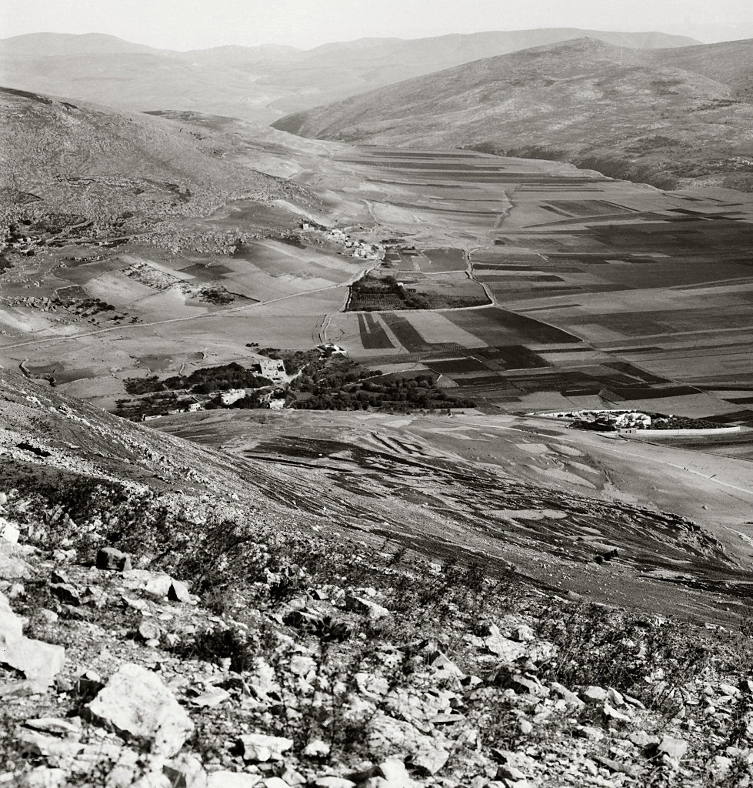
Looking north from Mount Gerizim
Mt. Ebal
Sychar
Tell Balata (Shechem)
Jacob’s Well
Looking north from Mount Gerizim
Notes:
“Nâblûs, the ancient Shechem, has been described by every traveller in Palestine. Situated in the most beautiful position possible, the modern town is also on the site of an overwhelming crowd of scriptural events. Mount Gerizim, ‘the Mountain of Blessing,’ is on its south; Mount Ebal, ‘the Mountain of Cursing,’ on the north. Its history begins 4,000 years ago, when as yet Jerusalem had no existence. To run through it seems like running through the history of the Bible, from Abraham to our Lord. Here is Jacob’s Well, a site accepted nominally; here is the traditional tomb of Joseph; here was the ancient temple of the Samaritans; here where they annually kept the Feast of the Passover; here where the Law was read, Israel standing half over against Mount Gerizim, and half over against Mount Ebal” (Besant 1873: 199-200).
“Those mountains were now before us in all their beauty; Mount Gerizim, crowned by a Wely on its highest point, bearing North; just beyond it the entrance of the valley of Nâbulus bearing nearly N. N. East; further North the rugged heights of Mount Ebal; and then the fine plain extending beyond towards the N. N. E. skirted on its eastern side in its whole length by tracts of picturesque though lower hills” (Robinson and Smith 1841: 3: 92).
Date of photograph: between 1910 and 1920
mat05142

Slide 21
Coastal Road
Dan
King’s Highway
Genesis 12:8(ESV)
⁸From there he moved to the hill country on the east of Bethel and pitched his tent, with Bethel on the west and Ai on the east. And there he built an altar to the Lord and called upon the name of the Lord.
Central Ridge Road
Shechem
Bethel
Ai
Jerusalem
Hebron
Gerar
Beersheba

Slide 22
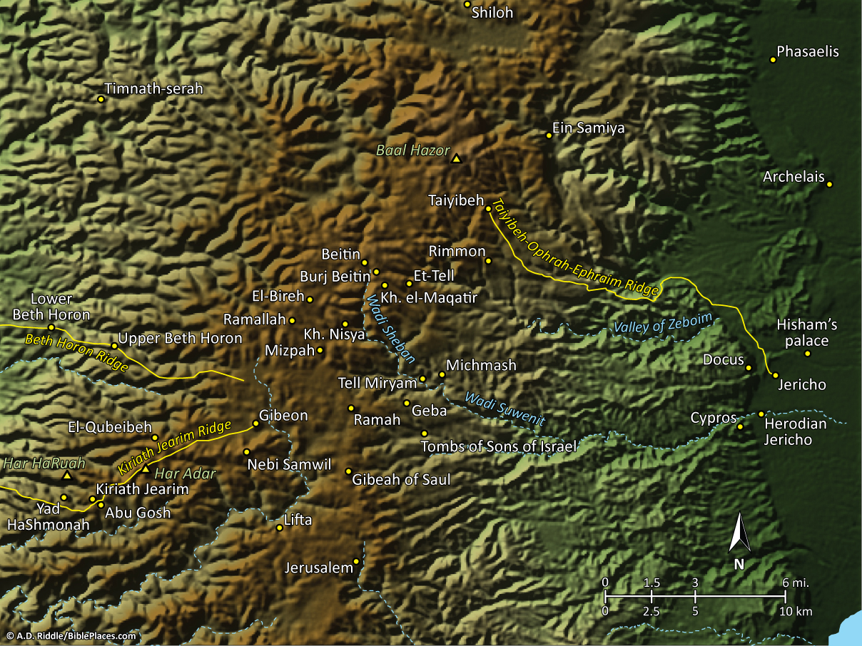
Pictorial Library Vol. 2: Benjamin
Notes:
This map is intended to help users locate the places which appear in the photographs in this presentation. The map therefore does not represent or label every geographic feature, and the sites are a mixture of modern and ancient place names.

Slide 23
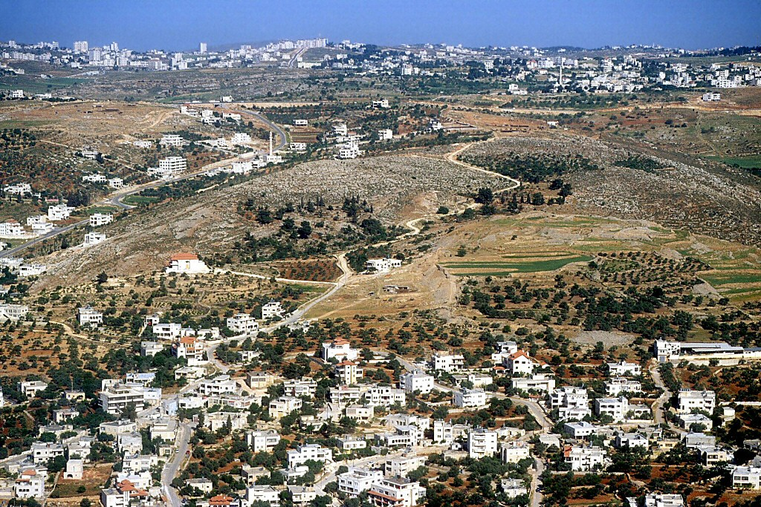
Beitin
Khirbet el-Maqatir
Et-Tell
Et-Tell, Khirbet el-Maqatir, Beitin aerial from east
Notes:
tbs104309905

Slide 24
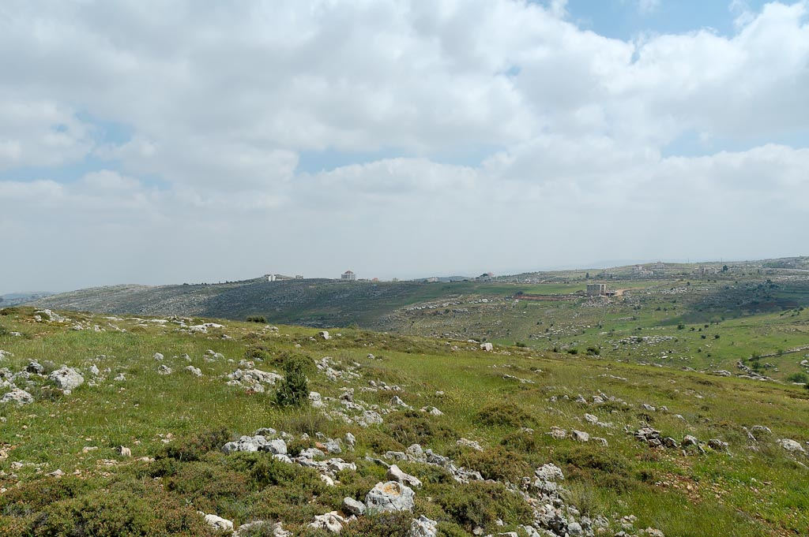
Khirbet el-Maqatir
Et-Tell
Khirbet el-Maqatir and et-Tell from north
Notes:
tb041106366

Slide 25
Coastal Road
Dan
King’s Highway
Genesis 12:9(ESV)
⁹And Abram journeyed on, still going toward the Negeb.
Central Ridge Road
Shechem
Bethel
Ai
Jerusalem
Hebron
Gerar
Beersheba
NEGEB

Slide 26
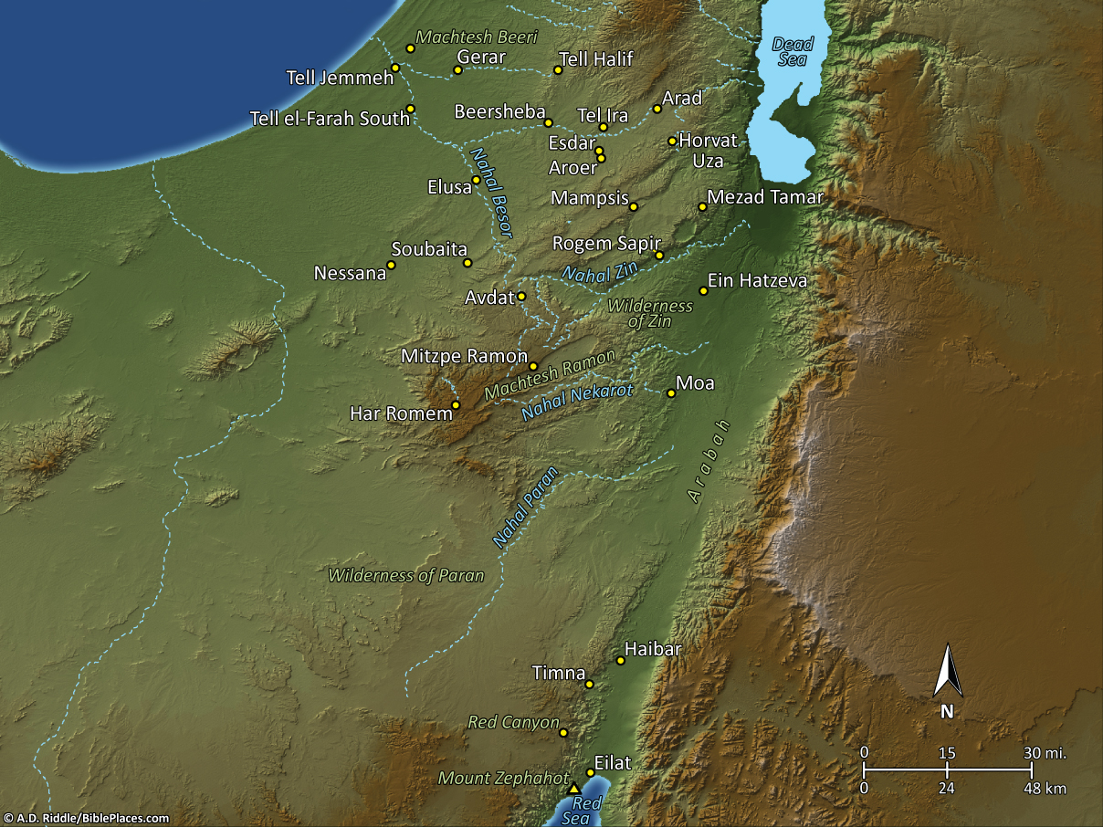
Pictorial Library Vol. 5: Negev
& the South
Notes:
This map is intended to help users locate the places which appear in the photographs in this presentation. The map therefore does not represent or label every geographic feature, and the sites are a mixture of modern and ancient place names.

Slide 27
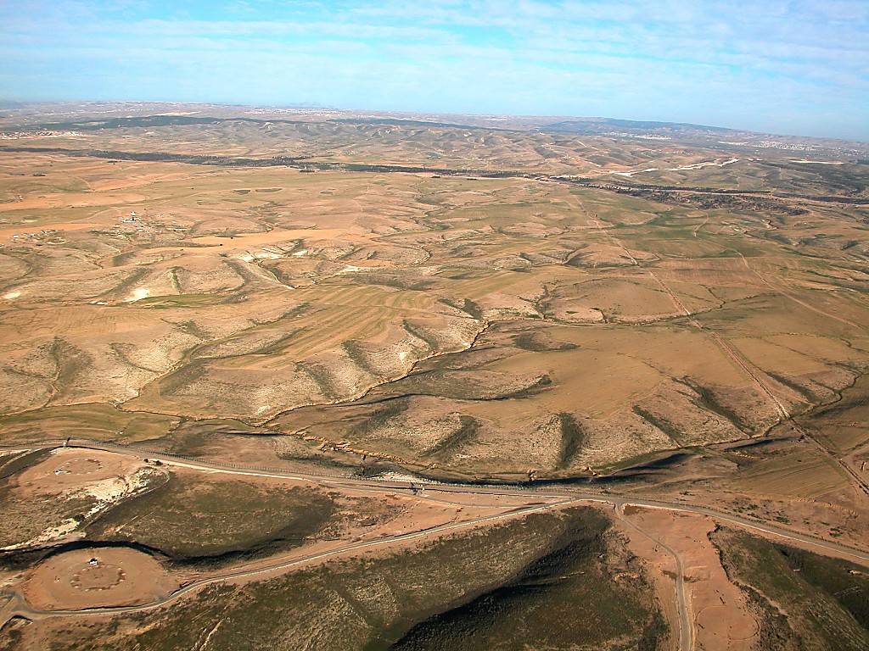
Negev north of Beersheba aerial
Notes:
tb010703599

Slide 28
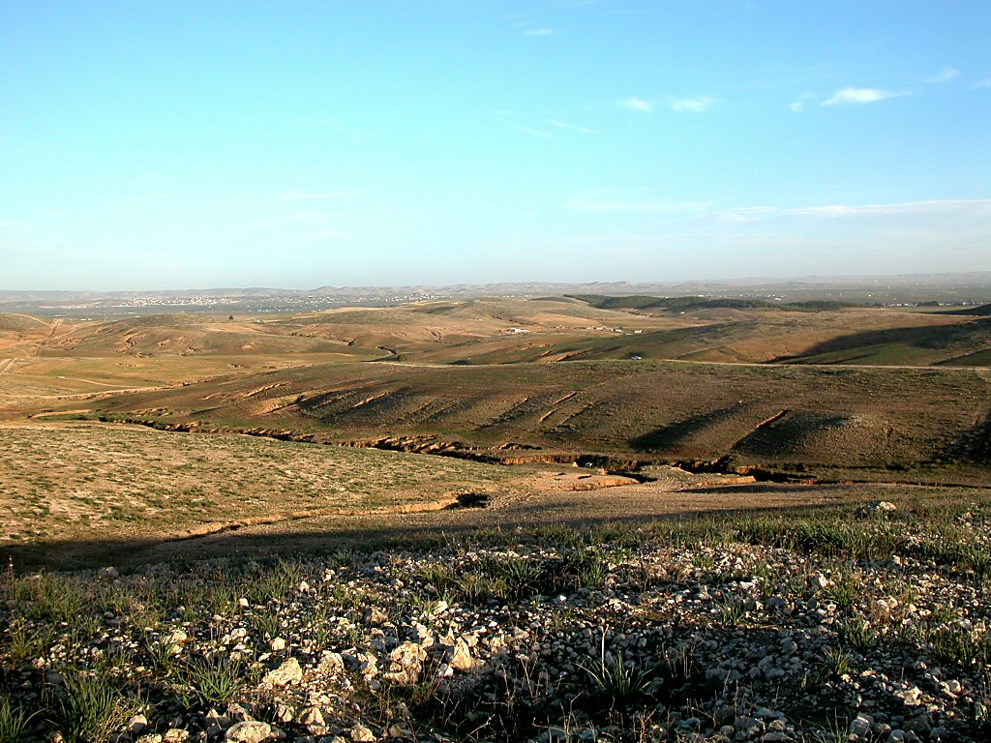
Negev hills north of Beersheba
Notes:
tb010503597

Slide 29
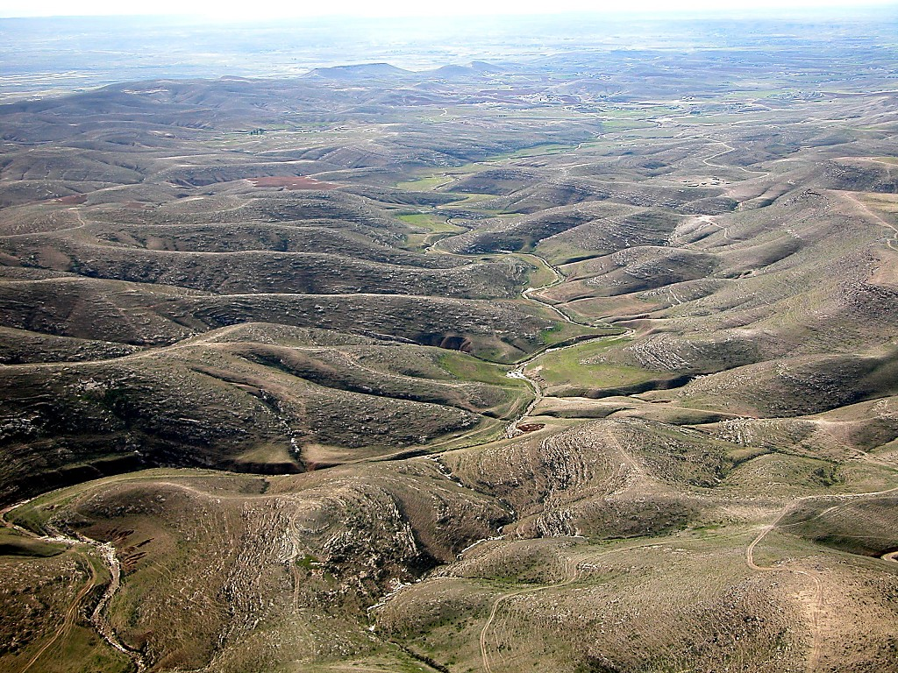
Negev east of Beersheba aerial
Notes:
tb010703593

Slide 30
Camels

Slide 31
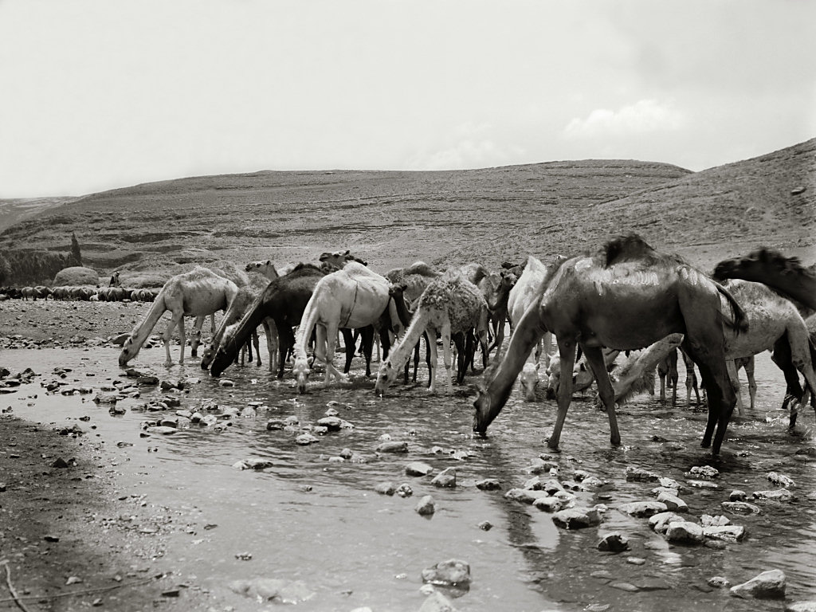
Camels drinking
Camels drinking
Notes:
Date of photograph: between 1910 and 1920
mat01282

Slide 32
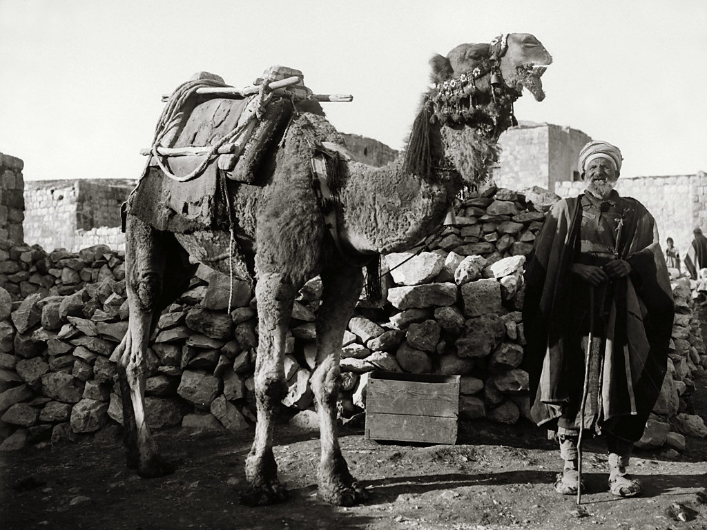
Camel
Camel
Notes:
Date of photograph: between 1910 and 1920
mat01277

Slide 33
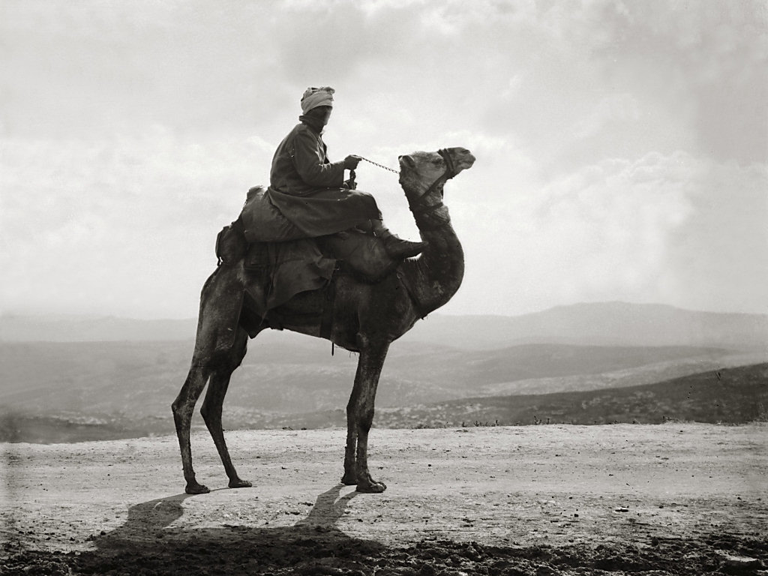
Camel, ship of the desert
Camel, ship of the desert
Notes:
“Of all the burden-bearing beasts, from the Siam elephant to the Himmaleh goat, this ‘ship of the desert,’ as he has been poetically termed,-this clumsy-joined, splay-footed, wry-necked, vicious camel, with its look of injured innocence, and harsh, complaining voice, is incomparably the most disagreeable.
Loud have been the praises of its submissive and self-sacrificing spirit, all gentleness and sagacity; its power of enduring hunger and thirst for an indefinite period, and its unwearied tramp day after day through the smiting sun and over the burning sands of the desert; but this animal is anything but patient or uncomplaining. As to the enormous weight it can carry, we have heard it growl in expostulation at a load which the common ‘kadish’ (Syrian pack-horse) would be mortified to have allotted to him as suited to his thews and sinews” (Lynch 1849: 222).
Date of photograph: between 1910 and 1920
mat05251

Slide 34
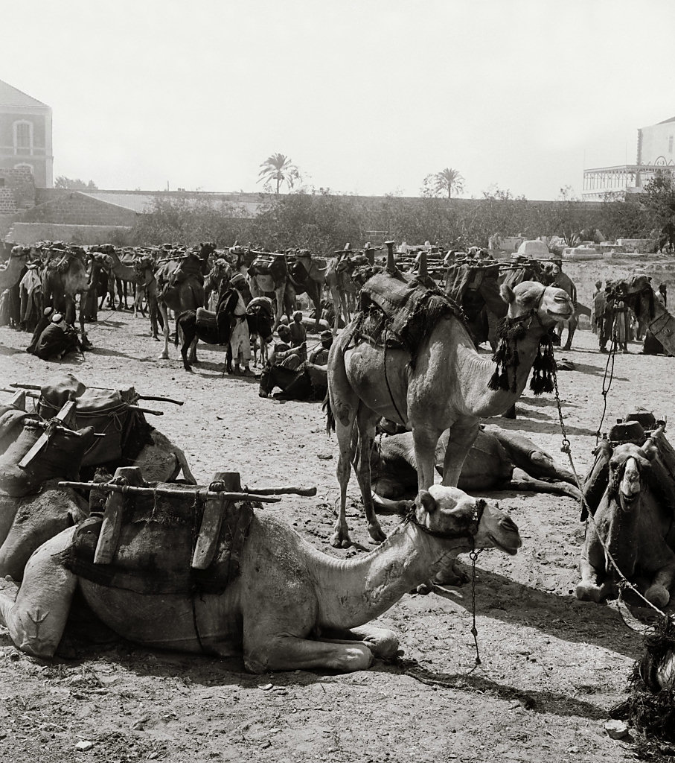
Halt of camels
Genesis 12:16(ESV)
¹⁶And for her sake he dealt well with Abram; and he had sheep, oxen, male donkeys, male servants, female servants, female donkeys, and camels.
Halt of camels
Notes:
“Much of the ill-nature and obduracy of the camel is doubtless attributable to the almost entire neglect of its owner in providing food and cleansing its hide, so subject to cutaneous disease.
In the neighbourhood of towns, where it cannot graze, straw is given to it; but in the desert it must crop the thistle or the parched herbage as it passes, straying from side to side in its march, like the yawing of a stately ship before the wind. At night, if it be necessary to keep the camels within the encampment for security, the mukris gather thistles, herbage, and dwarf bushes for them, but otherwise turn them loose to graze. There is no question that if the camel were well fed and gently treated, it would sustain the character ascribed to it by partial writers” (Lynch 1849: 223).
Date of photograph: between 1910 and 1920
mat01278

Slide 35
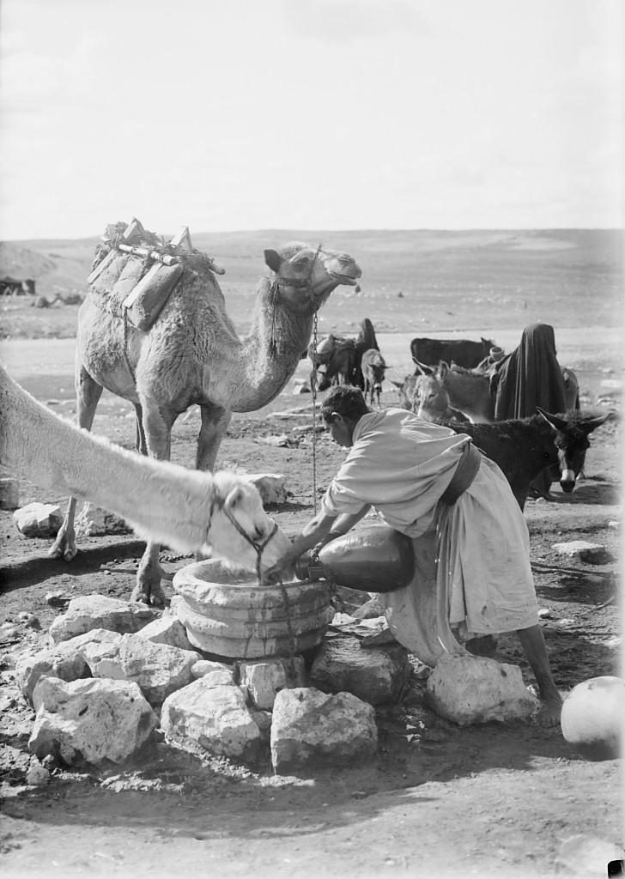
Man giving water to camel
Man giving water to camel
Notes:
Date of photograph: approximately 1900 to 1920
mat10619
35

Slide 36
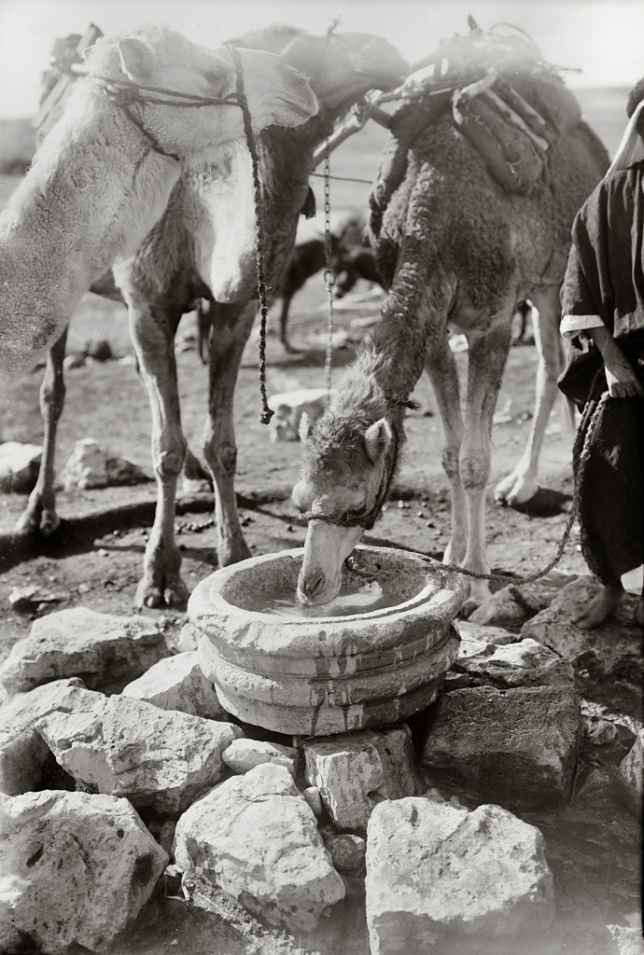
Camel drinking
Genesis 24:10-12(ESV)
¹⁰Then the servant took ten of his master’s camels and departed, taking all sorts of choice gifts from his master; and he arose and went to Mesopotamia to the city of Nahor.
¹¹And he made the camels kneel down outside the city by the well of water at the time of evening, the time when women go out to draw water.
¹²And he said, “O Lord, God of my master Abraham, please grant me success today and show steadfast love to my master Abraham.
Camel drinking
Notes:
Date of photograph: approximately 1900 to 1920
mat10620
36

Slide 37
Genesis Camels Biblical Error?
Archaeologists from Tel Aviv University recently radiocarbon-dated camel bones from digs at an ancient copper smelting camp in the Aravah Valley that runs along the Israeli-Jordanian border. Primarily based upon this radiocarbon analysis, the authors concluded that the first “significant” appearance of domesticated camels in the southern Levant (the region of the Middle East containing Israel, Jordan, and southern Lebanon) occurred around 900 B.C.
1.Sapir-Hen, L. and E. Ben-Yosef. 2013. The Introduction of Domestic Camels to the Southern Levant: Evidence from the Aravah Valley. Friends of the Institute of Archaeology of Tel Aviv University. 40: 277-285.
2.Finding Israel’s First Camels. American Friends of Tel Aviv University. Posted on aftau.org February 3, 2014, accessed February 13, 2014.

Slide 38
Genesis Camels Biblical Error?
But even if camels were rare in the land of Israel during the time of the patriarchs, this does not mean they were non-existent. There is even some evidence of camel domestication in Mesopotamia and Syria from before Abraham’s time.5 Furthermore, Egyptian artifacts depicting domesticated camels—which even secular archaeologists date as being from before the time of Abraham—have been found. These include a camel’s head made of pottery, a terra cotta tablet, camel models, petroglyphs, and rope made of camel hair.5 Genesis first mentions camels when Pharaoh gave some to Abraham as a gift while he was in Egypt (Genesis 12:16)! So, if domesticated camels were present in Egypt from before the time of Abraham and the king of Egypt gave some to Abraham as a gift, how then do Abraham’s camels, or even those belonging to Isaac and Jacob, constitute an anachronism?

Slide 39
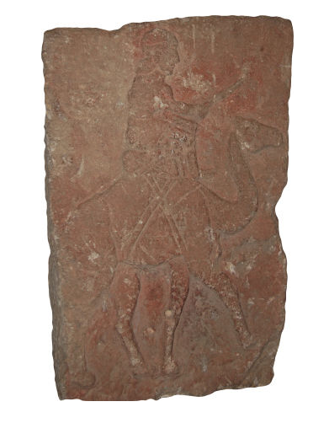
Genesis Camels Biblical Error?
Camels (24: 10). Though the biblical text portrays camels being used for long-distance travel in a number of places in Genesis, the evidence for camel domestication is somewhat sketchy. Kitchen gives a complete listing of the data— zoological, textual, and iconographic— from the period between 2000 and 1200 B.C.

Slide 40
Coastal Road
Dan
King’s Highway
Genesis 13:2-4(ESV)
²Now Abram was very rich in livestock, in silver, and in gold.
³And he journeyed on from the Negeb as far as Bethel to the place where his tent had been at the beginning, between Bethel and Ai,
⁴to the place where he had made an altar at the first. And there Abram called upon the name of the Lord.
Central Ridge Road
Shechem
Bethel
Ai
Jerusalem
Hebron
Gerar
Beersheba
NEGEB
Sodom
& Gomorrah

Slide 41
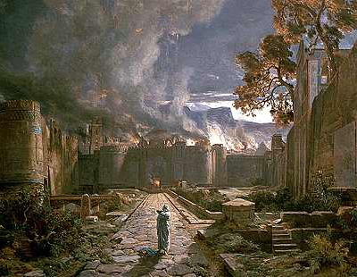
Sodom
Genesis 13:11-13(ESV)
¹¹So Lot chose for himself all the Jordan Valley, and Lot journeyed east. Thus they separated from each other.
¹²Abram settled in the land of Canaan, while Lot settled among the cities of the valley and moved his tent as far as Sodom.
¹³Now the men of Sodom were wicked, great sinners against the Lord.

Slide 42
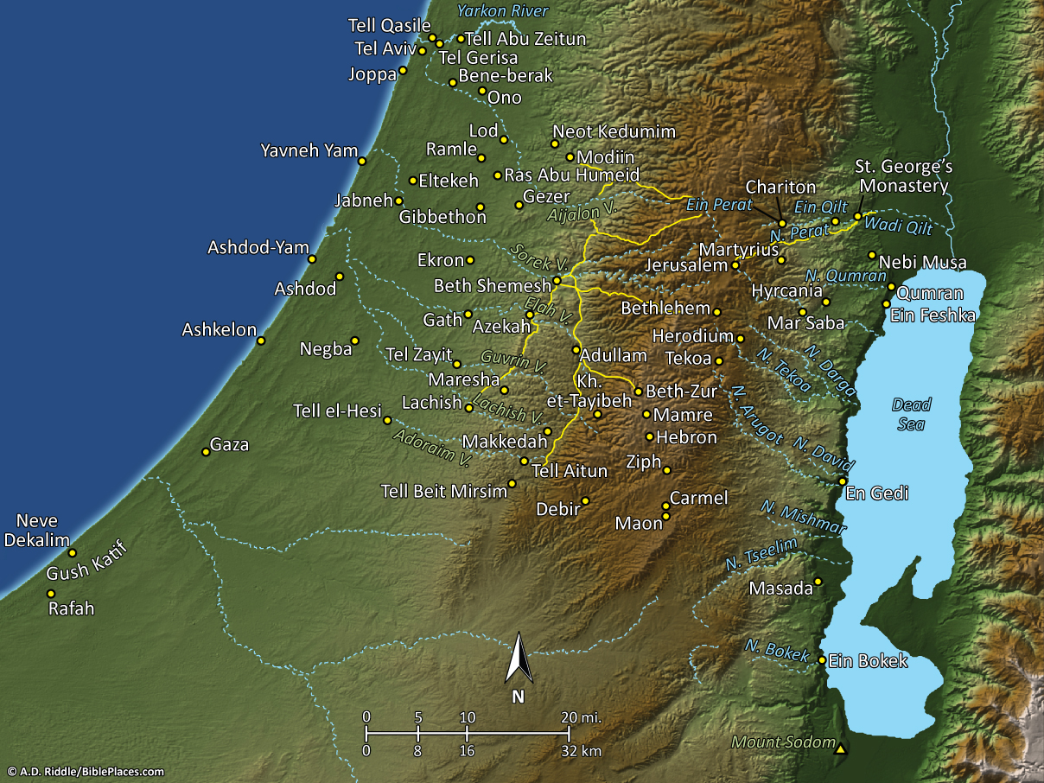
Pictorial Library Vol. 4: Judah
& the Dead Sea
Notes:
This map is intended to help users locate the places which appear in the photographs in this presentation. The map therefore does not represent or label every geographic feature, and the sites are a mixture of modern and ancient place names.

Slide 43
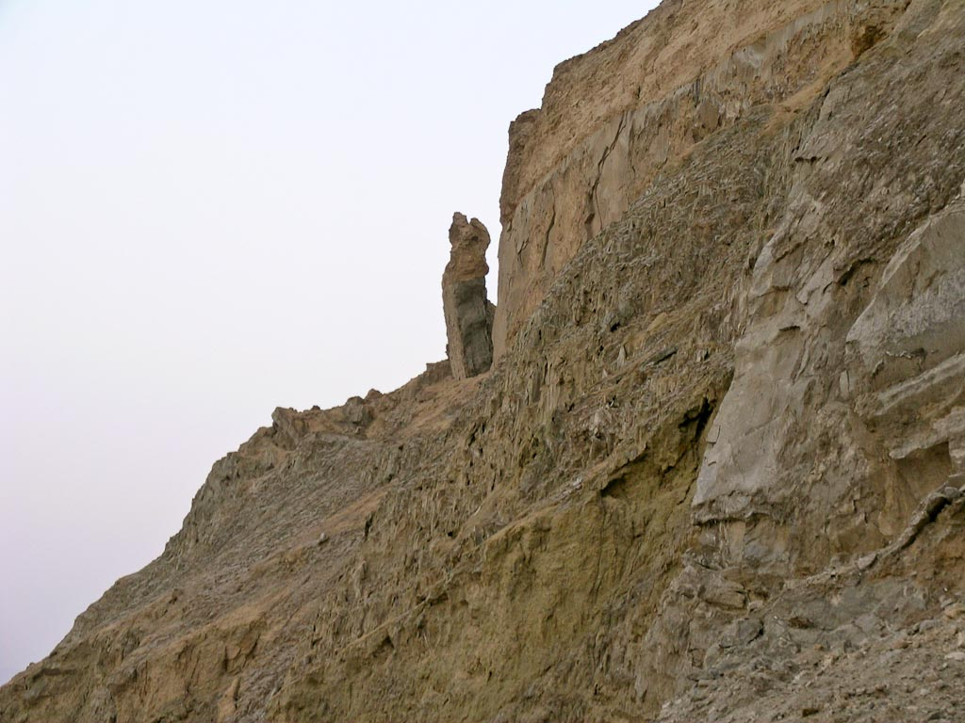
Lot's wife
Notes:
Tradition has identified this rocky outcropping with the wife of Lot who was turned into a pillar of salt (Gen 19:26). This tradition has no foundation in fact.
tb022804741

Slide 44
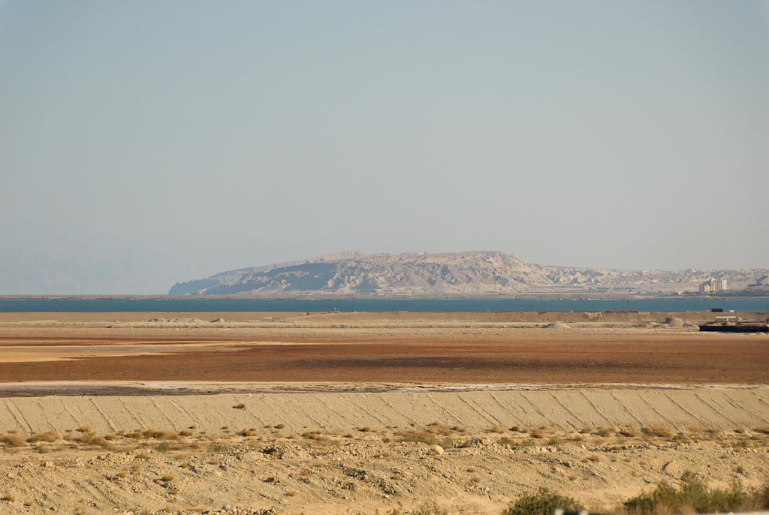
Mount Sodom from north
Notes:
tb052307915

Slide 45
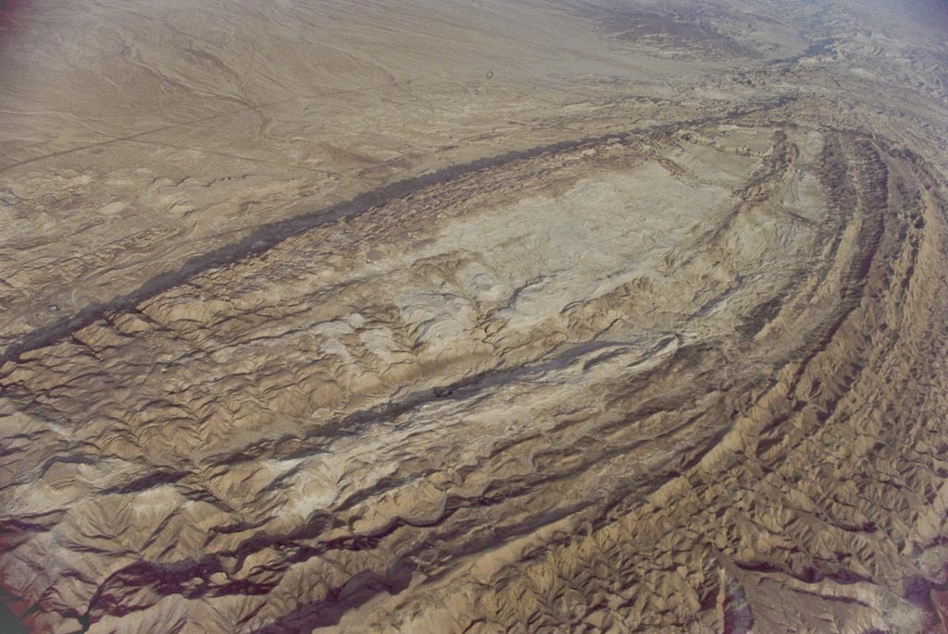
Mount Sodom aerial
Notes:
bb00080046

Slide 46
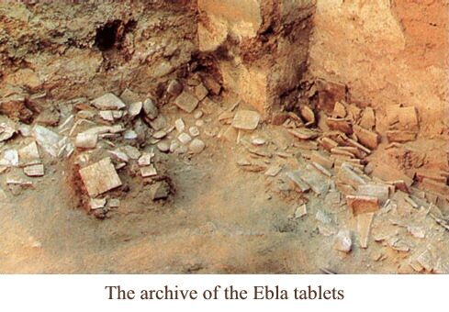
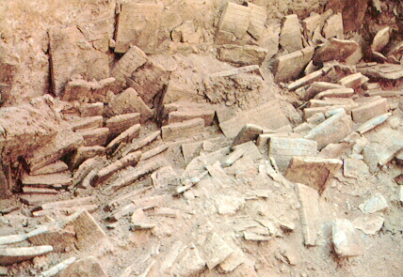

Slide 47
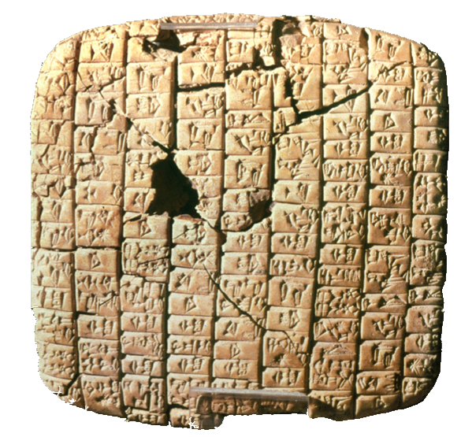
Ebla Tablets
These 16,000+ clay tablets
were discovered in Aleppo,
Syria, at Tel-Mardikh in the
late 1970’s by Italian
archaeologist Paolo Mathiae.
Epigrapher, Giovanni
Pettinato has discovered:
Biblical cities such as Sodom, Zeboim, Admah, Hazor, Megiddo,
Jerusalem, and Gaza
Names such as Nahor, Israel, Eber, Michael and Ishmael
Biblical words thought to have developed much later such asTehom (the deep, Gen 1:2); Canaan
Ebla Tablet 2300 BC

Slide 48
Lot at Gate of Sodom
Genesis 19:1-3(ESV)
¹The two angels came to Sodom in the evening, and Lot was sitting in the gate of Sodom. When Lot saw them, he rose to meet them and bowed himself with his face to the earth
²and said, “My lords, please turn aside to your servant’s house and spend the night and wash your feet. Then you may rise up early and go on your way.” They said, “No; we will spend the night in the town square.”
³But he pressed them strongly; so they turned aside to him and entered his house. And he made them a feast and baked unleavened bread, and they ate.

Slide 49
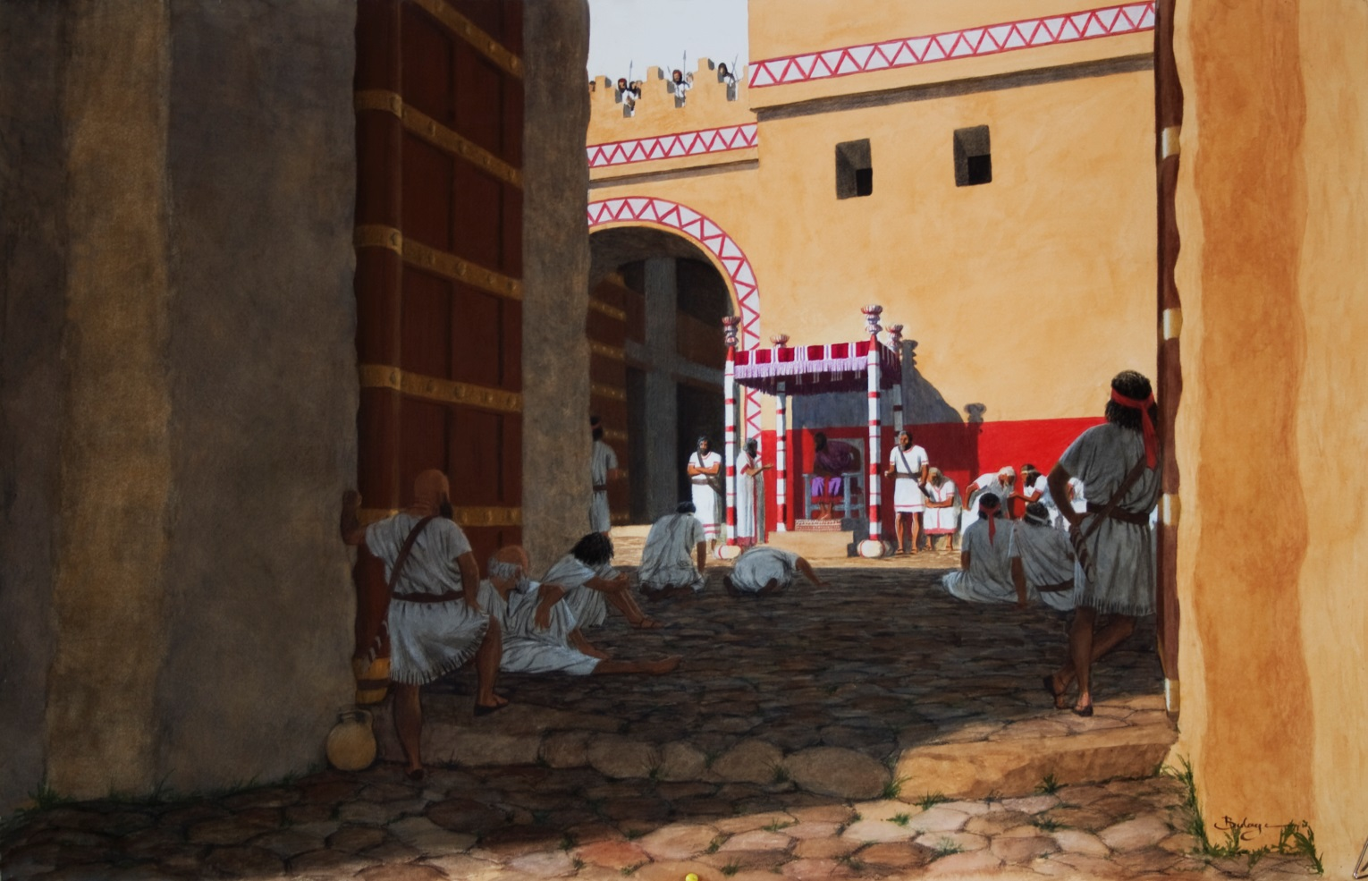
Lot at the Gate
Judgement Seat at Dan

Slide 50
Hebron
Genesis 23:1-5(ESV)
¹Sarah lived 127 years; these were the years of the life of Sarah.
²And Sarah died at Kiriath-arba (that is, Hebron) in the land of Canaan, and Abraham went in to mourn for Sarah and to weep for her.
³And Abraham rose up from before his dead and said to the Hittites,£
⁴“I am a sojourner and foreigner among you; give me property among you for a burying place, that I may bury my dead out of my sight.”
⁵The Hittites answered Abraham,

Slide 51
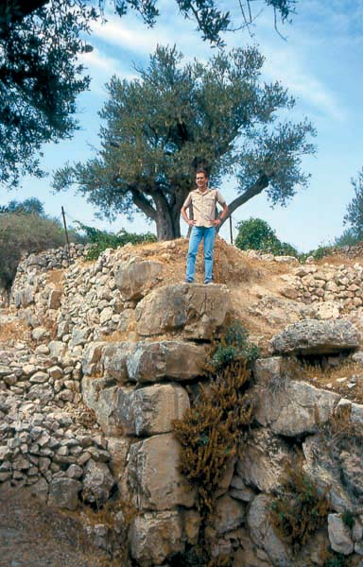
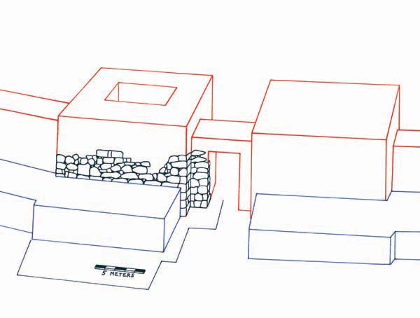
he drawing shows how the later wall and gate were built up against the earlier wall. This Middle Bronze Age gate may have been the one referred to in the Bible; when Abraham buys the burial plot for his family, the transaction is witnessed by “all who entered the gate” (Genesis 23:10).
Kim Chadwick
Author Chadwick stands atop the imposing boulders that formed the Middle Bronze Age II gate tower at Biblical Hebron. The much smaller remains of the Early Bronze Age wall are buried in the rubble at lower left.

Slide 52
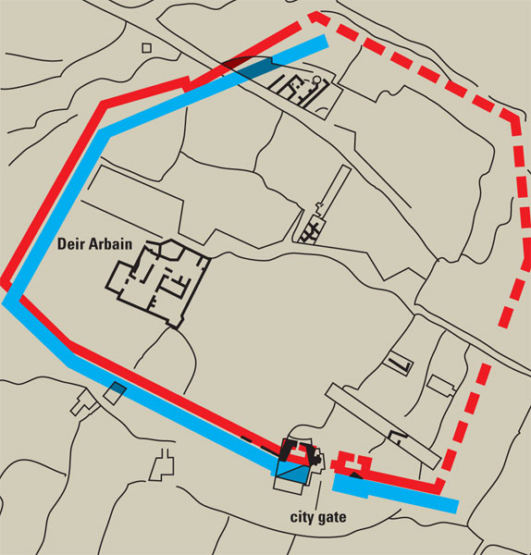
Genesis 23:8-10(ESV)
⁸And he said to them, “If you are willing that I should bury my dead out of my sight, hear me and entreat for me Ephron the son of Zohar,
⁹that he may give me the cave of Machpelah, which he owns; it is at the end of his field. For the full price let him give it to me in your presence as property for a burying place.”
¹⁰Now Ephron was sitting among the Hittites, and Ephron the Hittite answered Abraham in the hearing of the Hittites, of all who went in at the gate of his city,
The plan shows the walls of ancient Hebron during two key periods of occupation: the Early Bronze Age III (2600–2300 B.C.E.), shown in blue, and the Middle Bronze Age II (1750–1550 B.C.E.), in red. The solid lines represent excavated portions of the walls or sections that are fairly certain based on topography; dashed lines indicate the presumed lines of the walls.

Slide 53
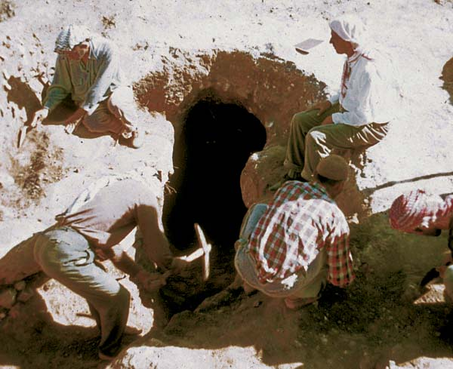
Philip Hammond
Workers excavate a burial cave, designated Tomb 4, during the American expedition to Hebron in 1965. Eight burials and numerous objects were found.

Slide 54
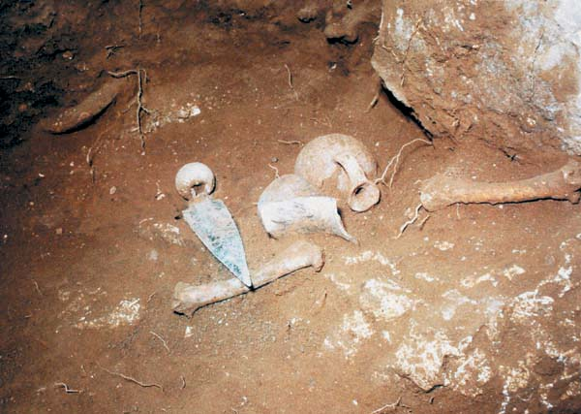
Philip Hammond
Eight burials and numerous objects were found, including the wide-blade dagger with a limestone pommel shown here. The dagger, typical of the period may have been the type envisioned by the Biblical author when describing Abraham’s near sacrifice of Isaac. The dagger and a Middle Bronze Age II juglet were found alongside the skeletal remains of presumably a Canaanite warrior.
Notes:
Hammond also cleared a Middle Bronze II burial cave on the south slope of the tell that also has a Biblical parallel. Designated as Tomb 4, it was a natural cave that contained eight burials (see photo on next page). In addition to over a hundred complete or restorable pottery vessels, more than 60 other objects were recovered, including jewelry, Egyptian scarabs from the Hyksos period (c. 1680–1560 B.C.E.) and toggle pins. The most handsome find, however, was a large dagger with a wide blade and a tennis-ball-sized limestone pommel into which a handle of wood had once been inserted. The dagger lay next to the skeleton of an aged man who had been buried in a loose garment fastened by one of the bronze toggle pins. The 10-inch bronze blade of the dagger had turned green from time. It may well be similar to the knife envisioned by the Biblical writer in the story of the binding of Isaac, when Abraham nearly sacrificed his son until the Lord ordered him to desist (Genesis 22:10).

Slide 55
Pictorial Library Vol. 4: Judah
& the Dead Sea
Notes:
This map is intended to help users locate the places which appear in the photographs in this presentation. The map therefore does not represent or label every geographic feature, and the sites are a mixture of modern and ancient place names.

Slide 56

Vineyards in fall colors near Hebron
Notes:
tb111706174

Slide 57

Hebron Machpelah
Notes:
Herodian Construction
Each course is offset 0.6 inches (1.5 cm) from the course below. For visual effect, the upper margin was made larger than the other margins.
The pilasters and the architectural proportions of this structure are nearly identical to the those of the Temple Mount (the pilasters on the Temple Mount are not visible today).
The single, block bases of the pilasters each have seven faces.
tb092204983

Slide 58

Pictorial Library Vol. 5: Negev Basin
Notes:
This map is intended to help users locate the places which appear in the photographs in this presentation. The map therefore does not represent or label every geographic feature, and the sites are a mixture of modern and ancient place names.

Slide 59

Gerar, Tel Haror, view of Nahal Gerar at eastern base
Notes:
Gerar: Site Identification
Four major candidates have been proposed for the location of Gerar. Among them, Tel Haror is widely accepted as Gerar today. Three locations previously suggested include:
Khirbet Umm Jerrar: Conder and Kitchener identified this as Gerar because of supposed name preservation. However, the name, meaning “Ruin of the Potter’s Mother,” probably has to do with the visible strata of pottery on the tell. It was mostly a Byzantine settlement.
Tell el-Jemmeh
Petrie, Albright, and Galling identified Gerar at this site, but archaeological confirmation has not been found.
Mazar identified this as Yurza of the Amarna tablets, but Thutmose’s reference implies that Yurza was north and not south of Gaza.
Gerar’s lack of mention in Egyptian and Assyrian texts indicates that it was not located on the main highway as Tell el-Jemmeh was.
Tell esh-Sheri’ah
Clermont-Ganneau, Abel, and Alt preferred this site, which is next to Wadi esh-Sheri’ah (Nahal Gerar).
This site was occupied in the Late Bronze, Iron, and later periods, but it is not an impressive site, and was probably not a major city like Gerar was in biblical times.
Wright has tried to identify this with Gath of the Philistines, and Aharoni suggests this is Ziklag.
tb050701254

Slide 60

Gerar, Tel Haror, from southeast
Notes:
Gerar: Tel Haror
Thomsen suggested Tel Haror (Tell Abu Hureireh) was the site of Gerar, although it had been rejected because others saw only a small citadel of a Muslim sheikh.
Aharoni and Amiran have shown that occupation was much more extensive than originally thought. Significant amounts of pottery from the Chalcolithic through the Iron Ages has been found. Much of the material is from the Middle Bronze II and Late Bronze, especially Cypriote milk bowls and Mycenaean juglets.
Tel Haror was one of the largest sites in southern MB Canaan, covering 40 acres.
The tell is surrounded by a rampart of beaten earth.
The town sits on the western bank of the Wadi esh-Sheri’ah, the valley of Gerar.
The site is clearly associated with the Philistine plain but is off the main coastal highway.
The distance of Tel Haror to Eleutheropolis fits Eusebius’ location of Gerar.
Gerar no longer existed in the Iron I period (11th century BC), and the appointment of David as lord of Ziklag in the western Negev basin may have been designed to fill this void.
“The many allusions to one or another of the Sea Peoples (never the Philistines) during the Late Bronze Age do leave open the possibility that Caphtorians might have established a city-state in the western Negeb at some time” (Rainey in Herzog 1984: 98).
tb050701256

Slide 61

Genesis 21:32-34(ESV)
³²So they made a covenant at Beersheba. Then Abimelech and Phicol the commander of his army rose up and returned to the land of the Philistines.
³³Abraham planted a tamarisk tree in Beersheba and called there on the name of the Lord, the Everlasting God.
³⁴And Abraham sojourned many days in the land of the Philistines.
Beersheba well and tamarisk tree
Notes:
The Well of Beersheba (Genesis 21:22-34)
Excavators cleared the well of Beersheba to a depth of 65 feet (20 m). This did not reach the water table, but the excavators stopped digging at this point.
There is no evidence to attribute the well to the patriarchal period; excavators believe that it was dug in the Iron Age (c. 1200 BC).
“Original date of the well is difficult to determine. However, the well did not disturb the Iron Age I pits or structures, and it was still in existence during the construction of the external gate of stratum V” (Herzog 1993: 169). The well continued in use until the Hellenistic period, based on finds from the fill.
Why is this well outside the city? Perhaps it was plugged up at the time the wall was built.
There are other wells in the area, including the traditional “well of Abraham” in the modern city of Beersheba.
“Beer-sheba, though often mentioned, seems not to have been built till the Israelite period. But it is to be noted that the stories nowhere speak of a town at Beer-sheba (except in the notation in Gen., ch. 26:33, explaining that the latter name of the place) or its inhabitants, but only of a well and a holy place. It does not necessarily follow that the great well dug on the mound there is the very one associated with the patriarchs and that the traditions about it must therefore have originated ca. the 12th century, as Y. Aharoni believes” (Bright 1981: 82, n. 33).
tb122304334

Slide 62

Women carrying water jars
Women carrying water jars
Notes:
“When going to fetch water, the women wear only the under-dress, which they tuck and tie up until they present most comical figures. A great part of their lives seems to be spent in going to and fro between the tent and the spring, with their little black donkeys or in sitting squatted on the edge of the stream, beating the clothes which require washing (and generally require it very much) with a stone” (Conder 1878: 2: 284).
Date of photograph: between 1910 and 1920
mat00063

Slide 63

Busy scene at desert well
Busy scene at desert well
Notes:
Date of photograph: between 1898 and 1946
mat05402

Slide 64
Man giving water to camel
Man giving water to camel
Notes:
Date of photograph: approximately 1900 to 1920
mat10619
64

Slide 65

Woman at well near Bethlehem
Woman at well near Bethlehem
Notes:
Date of photograph: Sept. 23, 1938
mat04072

Slide 66

Joseph’s Well at Dothan with cattle
Joseph’s Well at Dothan with cattle
Notes:
66
“In cattle breeding the Fellahin are not successful. The oxen and cows are under-sized, and are kept entirely for agricultural purposes; it is only when they are of no further use for work that they are sold to the butcher. Fattened cattle are unknown (Klein 1883: 47).
“Oxen and cows are fed throughout the winter on tibn, or crushed straw. Living the hard life that he does himself, the Fellah can hardly be expected to take much care of his cattle. If one animal after another dies from want of care, it is the will of Allah, and he must submit. He bears it philosophically, and tries by cheating and deception to recover the loss” (Klein 1883: 48).
Date of photograph: between 1898 and 1946
mat06028

Slide 67

Bedouin woman making bread
Bedouin woman making bread
Notes:
"Hospitality to strangers is another characteristic common to the Arabs, and to the people of Haouran. A traveller may alight at any house he please; a mat will be immediately spread for him, coffee made, and a breakfast or dinner set before him. In entering a village it has often happened to me, that several persons presented themselves, each begging that I would lodge at his house; and this hospitality is not confined to the traveller himself, his horse or his camel is also fed, the first with half or three quarters of a Mound of barley, the second with straw" (Burckhardt 1822: 294).
Date of photograph: between 1910 and 1920
mat01316

Slide 68
Joseph & the Price of a Slave
Genesis 37:28(ESV)
²⁸Then Midianite traders passed by. And they drew Joseph up and lifted him out of the pit, and sold him to the Ishmaelites for twenty shekels£ of silver. They took Joseph to Egypt.

Slide 69

Notes:
The price of slaves in the ancient Near East from the third millennium B.C. through the first millennium B.C. Prices listed in the Bible closely conform to known prices in the Near East at periods to which Biblical events can be dated. This correspondence makes it unlikely that the Biblical numbers were invented centuries later by writers who composed the early history.
Editor, Hershel Shanks: BAR 21:02 (March/April 1995). Biblical Archaeology Society, 2004; 2004

Slide 70

Notes:
Avaris 16th century

Slide 71
Coastal Road
Dan
King’s Highway
Central Ridge Road
Shechem
Bethel
Ai
Jerusalem
Hebron
Gerar
Beersheba

