Slide 2
By the power of the Gospel changed people change people.
Notes:
¹² I am grateful to the one who has strengthened me, Christ Jesus our Lord, because he considered me faithful in putting me into ministry, ¹³ even though I was formerly a blasphemer and a persecutor, and an arrogant man. But I was treated with mercy because I acted ignorantly in unbelief, ¹⁴ and our Lord’s grace was abundant, bringing faith and love in Christ Jesus. ¹⁵ This saying is trustworthy and deserves full acceptance: “Christ Jesus came into the world to save sinners”—and I am the worst of them! ¹⁶ But here is why I was treated with mercy: so that in me as the worst, Christ Jesus could demonstrate his utmost patience, as an example for those who are going to believe in him for eternal life. ¹⁷ Now to the eternal king, immortal, invisible, the only God, be honor and glory forever and ever! Amen.

Slide 3
Quietness
Self-Control
Godliness
By the power of the Gospel changed people change people.
Notes:
First of all, then, I urge that requests, prayers, intercessions, and thanks be offered on behalf of all people, ² even for kings and all who are in authority, that we may lead a peaceful and quiet life in all godliness and dignity. ³ Such prayer for all is good and welcomed before God our Savior, ⁴ since he wants all people to be saved and to come to a knowledge of the truth. ⁵ For there is one God and one intermediary between God and humanity, Christ Jesus, himself human, ⁶ who gave himself as a ransom for all, revealing God’s purpose at his appointed time. ⁷ For this I was appointed a preacher and apostle—I am telling the truth; I am not lying—and a teacher of the Gentiles in faith and truth.
¹¹ A woman must learn quietly with all submissiveness. ¹² But I do not allow a woman to teach or exercise authority over a man. She must remain quiet.

Slide 4

Changed people change people through Gospel-centered…
Quietness
Notes:
First of all, then, I urge that requests, prayers, intercessions, and thanks be offered on behalf of all people, ² even for kings and all who are in authority, that we may lead a peaceful and quiet life in all godliness and dignity. ³ Such prayer for all is good and welcomed before God our Savior, ⁴ since he wants all people to be saved and to come to a knowledge of the truth. ⁵ For there is one God and one intermediary between God and humanity, Christ Jesus, himself human, ⁶ who gave himself as a ransom for all, revealing God’s purpose at his appointed time. ⁷ For this I was appointed a preacher and apostle—I am telling the truth; I am not lying—and a teacher of the Gentiles in faith and truth.
¹¹ A woman must learn quietly with all submissiveness. ¹² But I do not allow a woman to teach or exercise authority over a man. She must remain quiet.

Slide 5

Changed people change people through Gospel-centered…
Quietness
Self-Control
Notes:
⁸ So I want the men in every place to pray, lifting up holy hands without anger or dispute.
¹³ For Adam was formed first and then Eve. ¹⁴ And Adam was not deceived, but the woman, because she was fully deceived, fell into transgression. ¹⁵ But she will be delivered through childbearing, if she continues in faith and love and holiness with self-control.

Slide 6
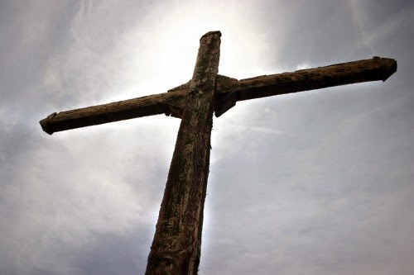
Changed people change people through Gospel-centered…
Quietness
Self-Control
Godliness
Notes:
that we may lead a peaceful and quiet life in all godliness and dignity
⁹ Likewise the women are to dress in suitable apparel, with modesty and self-control. Their adornment must not be with braided hair and gold or pearls or expensive clothing, ¹⁰ but with good deeds, as is proper for women who profess reverence for God.

Slide 7
By the power of the Gospel changed people change people.
Starting with person in the mirror.

Slide 9

Fighting for “The Faith”
Believe the Facts (1 Timothy 4:1, 6; 6:21)
Obey the Commands (1 Tim. 6:10)
Commit to the Worldview (1 Tim. 3:9, 13)
Notes:
¹⁸ I put this charge before you, Timothy my child, in keeping with the prophecies once spoken about you, in order that with such encouragement you may fight the good fight. ¹⁹ To do this you must hold firmly to faith and a good conscience, which some have rejected and so have suffered shipwreck in regard to the faith. ²⁰ Among these are Hymenaeus and Alexander, whom I handed over to Satan to be taught not to blaspheme.

