Slide 1
The book of Genesis
Lesson 16: Abraham

Slide 2
Class Schedule, (Segment 1)
Session | Topic | Reading | Date
Lesson 14 – Grant | Key Figure: Abraham |  | Sun, June 4
Lesson 15 – Grant | Abraham | Gen 11:27-25:11 | Sun, June 11
Lesson 16 – Sam | Abraham | Gen 11:27-25:11 | Wed, June 14
Lesson 17 – Sam | Abraham | Gen 11:27-25:11 | Sun, June 18
Lesson 18 – Grant | Jacob | Gen 25:12-36:43 | Wed, June 21
Lesson 19 – Grant | Jacob | Gen 25:12-36:43 | Sun, June 25
Lesson 20 – Grant | Jacob | Gen 25:12-36:43 | Wed, June 28
Lesson 21 – Grant | Jacob | Gen 25:12-36:43 | Sun, July 2
Lesson 22 – Sam | Joseph | Gen 37:1-50:26 | Wed, July 5
Lesson 23 – Sam | Joseph | Gen 37:1-50:26 | Sun, July 9
Lesson 24 – Sam | Joseph | Gen 37:1-50:26 | Wed, July 12
Lesson 25 – Sam | Joseph | Gen 37:1-50:26 | Sun, July 16
Lesson 26 - Grant | Review |  | Wed, July 19
Notes:
Note that we’re approaching this as a textual study, meaning that our focus will mainly stay on the features of the book which God inspired. For that reason it will be important that you read the book. There is lesson material, but that should only help focus your reading. I think you should have plenty of time for reading. Since we won’t have a lot of time to read the text aloud in class, having the text read means that you’ll be able to follow any discussion we have and be able to easily understand anything we talk about from up here.
Note that we’ve broken this down by section/topic rather than by date. We didn’t’ want to commit to strict sections of the text which are large and deal with the same basic characters. So for instance we’ve allowed 2 classes to cover Noah and the Flood, or 5 classes to cover Abraham. Lesson material should reflect that setup. It won’t be lesson 1,2,3, etc. The material you get will cover the entire section and can be done at your own pace.
We have interjected here a number of ‘topical’ classes. Danny Haynes will be presenting a single class at the beginning covering the issues of how Genesis relates to science and history. The point of the class is more of a textual study of Genesis, but we recognize that those are important issues and worth addressing so Danny has agreed to give us an overview of some of those evidences. We also have a class once we start the section on the patriarchs that I hope will be a historical look at the life of the patriarchs, and explain the world in which they lived. That should be really interesting and help our study through the last ¾ of the book. There are two classes that will focus on the characters of Adam and Abraham, and I think specifically will look at what the New Testament writers have to say about them. That should broaden our understanding of the significance of them for understanding who we are as Christians today. And then we have a couple of review periods in there as well.

Slide 3
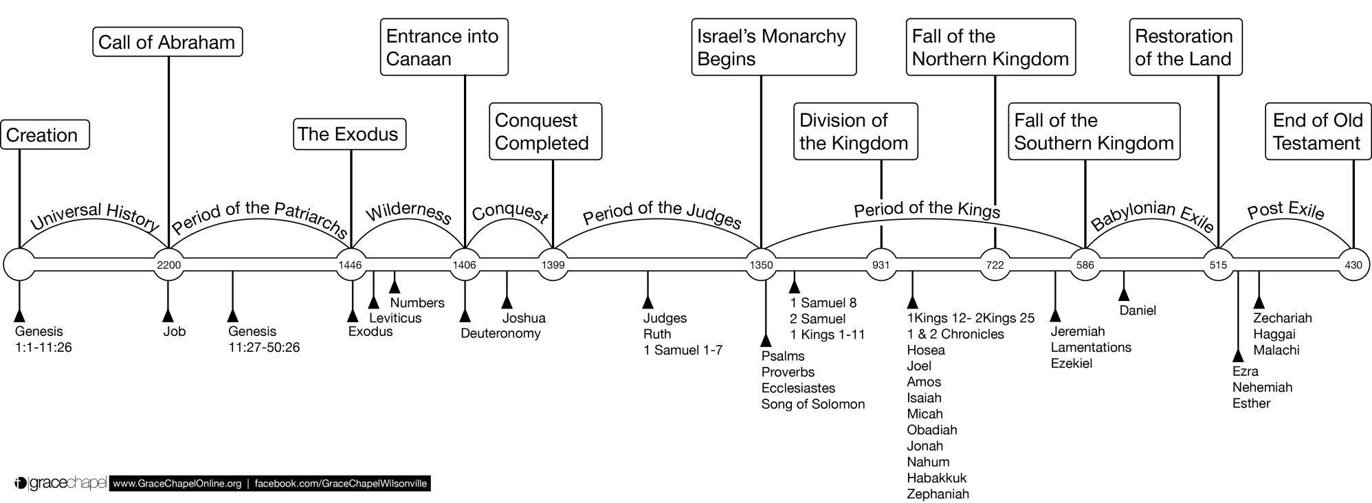
Old Testament Timeline

Slide 4
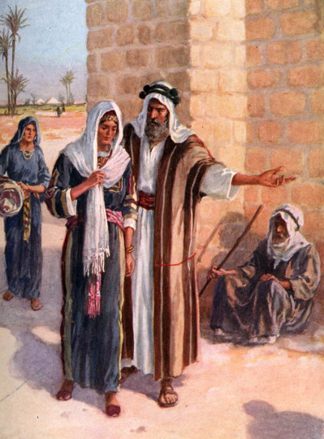
She is My Sister…
Abimilech, King of Gerar
Sent and took Sarah
Threatened by God in a Dream
Protested his righteousness before God
Was prevented from sinning by God
Asked “why”?
Abraham’s Reasons
They might not fear God here. Might kill me.
She really is my (half) sister
This has been our standard practice
Aftermath
Abraham “the prophet” prays for healing
Sarah restored, along with a bountiful gift
God healed the women of Abimelech’s house

Slide 5
Questions
Why did Abraham have this agreement with Sarah to lie?
Was the result different this time than in Egypt? Why do you think this might be?
In what way was Abraham “a prophet”?
Was Abraham escorted out of the country, as in Egypt?
In what way might this story be related to the story in 21:22?

Slide 6
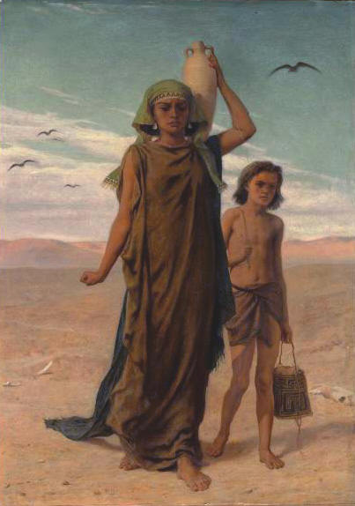
The Importance of Isaac
The Son of the Promise
At the promised time, born to Sarah
Through whom is the fulfillment of promises
”He laughs” Gen 17:17, 18:12
Circumcised on the 8th day
A joy to his parents
The Son of the Bondwoman
Ishmael scoffed (frequently)
“Cast out the bondwoman and her son”
It displeased Abraham, but God redirected him
Hagar had given up hope of life, but God intervened
God promised a great nation and 12 princes from Ishmael

Slide 7
Questions
Why did God command Abraham to heed Sarah in the matter of Hagar?
How does Paul use this story in Gal 4:21-31?
How deep was the love of Abraham and Sarah for Isaac? Why do you think this is so?
Did Isaac and Ishmael ever unite again? (Hint Gen 25:9)

Slide 8
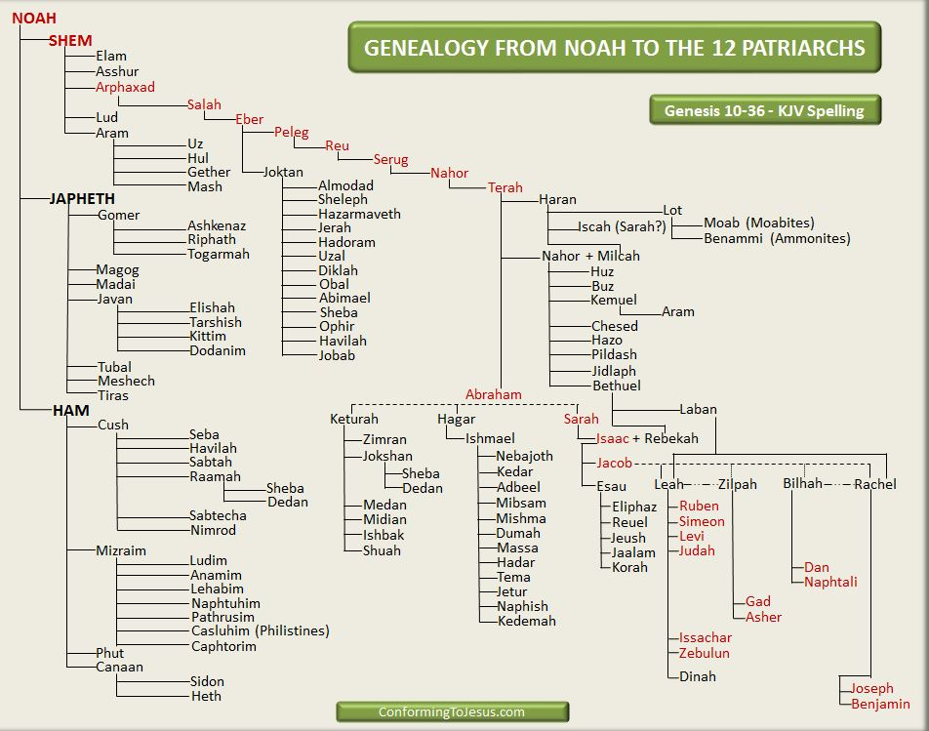

Slide 9
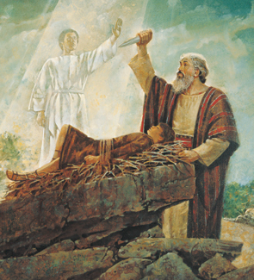
The Proof of Abraham’s Faith
Go to the mountain and sacrifice… a test
“Your son, your only son Isaac, whom you love”
A 3 days journey to the Land of Moriah
Offer him as a burnt offering
Abraham Obeyed
Early the next morning he prepared and went
“My son, God will provide for Himself the lamb”
Built the alter, laid out the wood, Bound his son
And God provided the lamb
The angel stopped him
God provided a ram for this physical sacrifice
“In the Mount of the Lord it shall be provided”
The Blessings reaffirmed bountifully

Slide 10
Questions
Was God tempting Abraham? (hint James 1:13)
How was Abraham’s “test” different from Job’s?
What sacrifice did God really want from him?
Where is the “Land of Moriah” in NT times? (Hint: 2 Chron 3:1)
What effect do you think this event might have had on Isaac?
What is different now when God repeats the blessings?

