Slide 1
The Book of Genesis
Jacob

Slide 2
Overview of Chapters 12-50
Establishes God’s plan to redeem his creation through a single entity: Abraham>Israel
Characterized by God’s gracious covenant with his chosen people and their response of faithfulness.
Consists of Three Parts
Abra(ha)m Cycle: 11:27-25:18
Jacob/Israel Cycle: 25:19-37:1
Joseph Cycle: 37:2-50:26
12-50 Patriarchal History
Promise/Covenant
Preservation of Heir (Issac)
Abraham
Takeover of Blessing
Travails in Laban’s House
Jacob
The Dreamer Estranged & Reconciled to his Brothers
Joseph

Slide 3
Themes & Theology
God as Creator
The unifying theme of the Patriarchal History is divine promise.
Sovereign
Faithfulness
Marked by Covenant

Slide 4
Themes & Theology
God’s people as keepers of creation
Abraham and descendants as ‘tricksters’
Reversals/The Younger over the Older
Name Meanings
Ancestry
Land

Slide 5
Geography

Slide 6
Jacob Cycle
God is faithful to His choice
God’s choice is not a guarantee of a ‘good life’
Abraham
Jacob
Father-Son Relationship
Sojourn within Canaan
Promise
Sacrifice
Brother Relationship
Sojourn away from / back to Canaan
Blessing
Trickery
Notes:
The things we have mentioned thus far are true either because of or in spite of the fact that Jacob is not a good guy in traditional sense in the story of the bible. Jacob is a schemer, a scoundrel, a rascal, a rogue, and a mama’s boy. He provides little, if any, example of exemplary behavior. One commentator puts it this way: “The narrative about Jacob portrays Israel in its earthiest and most scandalous appearance in Genesis. The narrative is not edifying in any conventional religious or moral sense. Indeed, if one comes to the narrative with such an agenda, the narrative is offensive.”
And so this batch of stories presents us with a problem…what do we take from Jacob as a whole? I would suggest two major lessons. 1) God is faithful to his sovereign choice. We’ve already said that the major theme of the Patriarchal history is that of divine promise – within that context God acts in ways which we may not understand, but which serve his eternal purpose. And no matter what, God will continue to act in accordance with those promises. That is precisely the point Paul makes about God’s choice of Jacob in Romans 9, saying that God’s choice is not because of works, but because of him who calls. For that reason, I think it is important to remind ourselves that God’s choice to bless Abraham through the covenant promises was not based on Abraham’s righteousness or faithfulness. Abraham only showed righteousness as a response to God’s choice, not as a prerequisite to it. God’s choice to bless Abraham is just as much about God’s grace as his choice of Jacob. 2) God’s sovereign election is not a guarantee of earthly blessing and what we might call a ‘good life’ (although sometimes it is, we’ll see that in a moment w/ Isaac), but in fact may bring with it conflict. Jacob’s life is marked by conflict – in his stolen blessing from Esau, his treachery both from and towards his uncle Laban, and even in his wrestling with God. Jacob is an example that God’s ‘plan’ often works through a lifetime of pain - and this is exactly why, I think, Jacob turns out to be perfect namesake for Israel. A people who indeed wrestled with God for their entire existence could have no better person to embody their history.
A few points that are interesting to contrast this unit with the Abraham unit we just came through: 1) Whereas the overarching issues in the Abraham narrative have to do with the father-son relationship, Jacob deals with other familial conflicts, not only between he and his uncle, but most notably with his brother Esau. 2) Whereas Abraham dwells and lives mostly with the promised land of Canaan, Jacob’s journey takes him back to Haran, out of the land, and back to it. 3) Inasmuch as promise and blessing can be distinguished, Abraham deals more with the notion of promise, whereas Jacob deals more with blessing. Promise is more vertical/religious, where blessing is more horizontal/earthly, 4) The character of Abraham deals mostly in sacrifice, whereas the character of Jacob deals mostly in trickery and deceitfulness.

Slide 7
Jacob Outline
Conflict w/ Esau 25:19-28:9
Conflict w/ Laban 29:1-30
Escape from Laban 30:25-31:55
Reconciliation w/ Esau 32-33:17
Meeting at Bethel
28:10-22
Birth of Children
29:31-30:24
Meeting at Penu’el
32:22-32
Concluding Material 33:18-36:43
Notes:
In terms of the outline of this section, the bulk of the account we have goes from chapters 25 through 33, and deal with Jacob’s conflicts with Esau and Laban, and you can see here that the story starts and ends with Esau and that the conflict and escape from Laban is in the middle.
Between these sections are very significant occurrences. On his way to Laban Jacob encounters YHWH at Bethel. That’s the story of the angels going up and down the ladder or stairway. Within Laban’s household we’re told about the children that Jacob has by his wives and servants – these of course become more significant near the end of Jacob’s life. Thirdly, just before he reconciles with Esau, Jacob encounters God again at Penu’el and wrestles with him there. These three narratives I think are the redemption of Jacob, because these are the times when we really see God actively working toward the eventual establishment of his people Israel.

Slide 8
The Blessing of Isaac
The only chapter in Genesis which focuses on the character of Isaac independent from Abraham/Jacob
Expansion on the conflict with Abimelech in Ch. 20
God repeats covenant promises to Isaac (v.3-5, 24-25)
God blesses Isaac with material wealth (v.13-16)
God’s blessing results in a treaty with Abimelech regarding the water rights in the area.
Notes:
Why is this story here?
The juxtaposition of Isaac as trickster here, and yet being tricked in the next chapter is emphasized.
The pattern of conflict-resolution fits nicely with the Jacob story
Shows the wealth of Isaac, which emphasizes the birthright Esau has just given up

Slide 9
The Birth of Esau & Jacob
Isaac prays to the LORD/YHWH to overcome Rebekah’s barrenness
The children ‘struggled’ in the womb
3 things revealed
Two children (boys)
These are designated as the ancestors of two future peoples/nations
The older son will serve the younger
Notes:
The story of Esau and Jacob begins with a familiar problem – barrenness, but it is more quickly overcome in this case, and in double measure!
Rebekah is disturbed by the activity proceeding in her womb, and so she goes to ‘consult with’ or ‘inquire of’ the LORD.
[[What are 3 things revealed to Rebekah?]]
She is having twin boys
These are designated as the ancestors of two future nations.
The older son will serve the younger. It should be noted that this ‘prophetic’ word from God here has double meaning. First, that Jacob, not Esau, will receive the rights and blessings of the firstborn son. Second, that Edom would serve Israel. Of course, Paul gives this verse a 3rd meaning in Romans 9, as a precedent for God’s choice to reveal the Gospel to Gentiles.
Thus, these births are within the womb destined by God. God is already disclosing to their mother, the course that these two lives will have. It is not insignificant that God’s choice here overrules the cultural law of ‘primogeniture’ – that is, the privileging of the first-born. That concept wasn’t just a convenient way of doing things, it was a fundamental conviction and procedure at that time. And yet God elects to overturn that concept here by blessing the younger over the older.

Slide 10
The Birth of Esau & Jacob
God’s choice overturns ‘primogeniture’
Esau
Red/ruddy
Hairy
Hunter
Jacob
Grabbing onto his brother’s heel
Mild-mannered
Notes:
Thus, these births are within the womb destined by God. God is already disclosing to their mother, the course that these two lives will have. It is not insignificant that God’s choice here overrules the cultural law of ‘primogeniture’ – that is, the privileging of the first-born. That concept wasn’t just a convenient way of doing things, it was a fundamental conviction and procedure at that time. And yet God elects to overturn that concept here by blessing the younger over the older.
Esau’s name appears to be given in consideration of the fact that he is hairy and red (not necessarily that he has red hair). The Hebrew terms separately for those two attributes are direct etymological referents of Esau’s ancestral nation Edom, and the location where he comes to live Seir. Esau is described as one who is skillful and experienced in hunting. Because Isaac, we are told, has an appetite for game/meat, he prefers/loves Esau.
Jacob comes from the womb second – but fighting all the way. The significant act of holding on to his brother’s heel is presented as an act of conflict, as if Jacob is still wrestling with Esau to be the first one born. The action leads to his name, a verbal form of the Hebrew noun ‘heel’ which means ‘to follow closely’ in the sense of attempting to restrain, hold back, overtake, or supplant.’ Jacob, we are told, is a man who stayed within the tent home, and thus was preferred by his mother. The word in v. 27 sometimes translated ‘quiet’ or ‘mild’ is a word that in other contexts in the Bible refers to moral integrity – e. g of Job as ‘blameless’ in Job 1:8. But that isn’t the sense here since a) that doesn’t contrast well with Esau as a hunter, and b) Jacob is anything but blameless. Here it means something like ‘naïve to ways of the outside world (as exemplified by Esau) – he is therefore settled, not adventurous.

Slide 11
Esau Sells the Birthright
Esau the Hunter is famished
‘The red stuff…the red stuff!’
Edom
Birthright
Reserved for the firstborn male
Double portion of inheritance
Jacob seals the transaction with Esau’s oath
Esau ‘disregarded’ his birthright.
Notes:
Genesis has already had two cases of fraternal rivalry – Cain v. Abel and Ishmael v. Isaac. In both cases, the elder brother emerges unfavorably. This case is no different.
Esau apparently wasn’t that skilled – he comes home one day with nothing. This is really expressed in the Hebrew. For one, the verb for eat connotes the action of gulping down, as if Esau is going to eat the whole bowl in one swallow. Second, the phrase ‘the red stuff’ – it is actually repeated in the Hebrew, indicating that Esau doesn’t care what it is, he just wants it now!
Here we have a second explanation for the origins of Esau’s name – again the connection of the notion of ‘red,’ this time with Edom, the name of the people whom Esau will bear.
Jacob immediately responds by asking him for his birthright. Birthright is exclusively associated with the firstborn male of any family. In Hebrew usage, this person is often expressed in relation to the father with the phrase ‘the first issue of his strength.’ or with the mother with the phrase ‘the first to open the womb.’ So there was a recognized significance to being the first born. And this came with special privileges. Deut. 21:15-17 demonstrates that a father is obligated to acknowledge his firstborn son as the principal heir, which resulted in an inheritance twice as large as that given to any other children.) This is what Jacob is bartering for here – the double-portion of his father’s inheritance (which is large because we know of Isaac’s wealth.
My understanding is that while they are often connected, the birthright is separate from the blessing of the father.
Esau agrees and Jacob confirms the action with Esau’s oath, swearing to give up his birthright. The deal is done. The actions of Esau are highlighted by the concluding statement. Esau quickly eats and goes away, seemingly without regret, and thus we are told he ‘despised/spurned/repudiated’ his birthright.

Slide 12
The Book of Genesis
Jacob

Slide 13
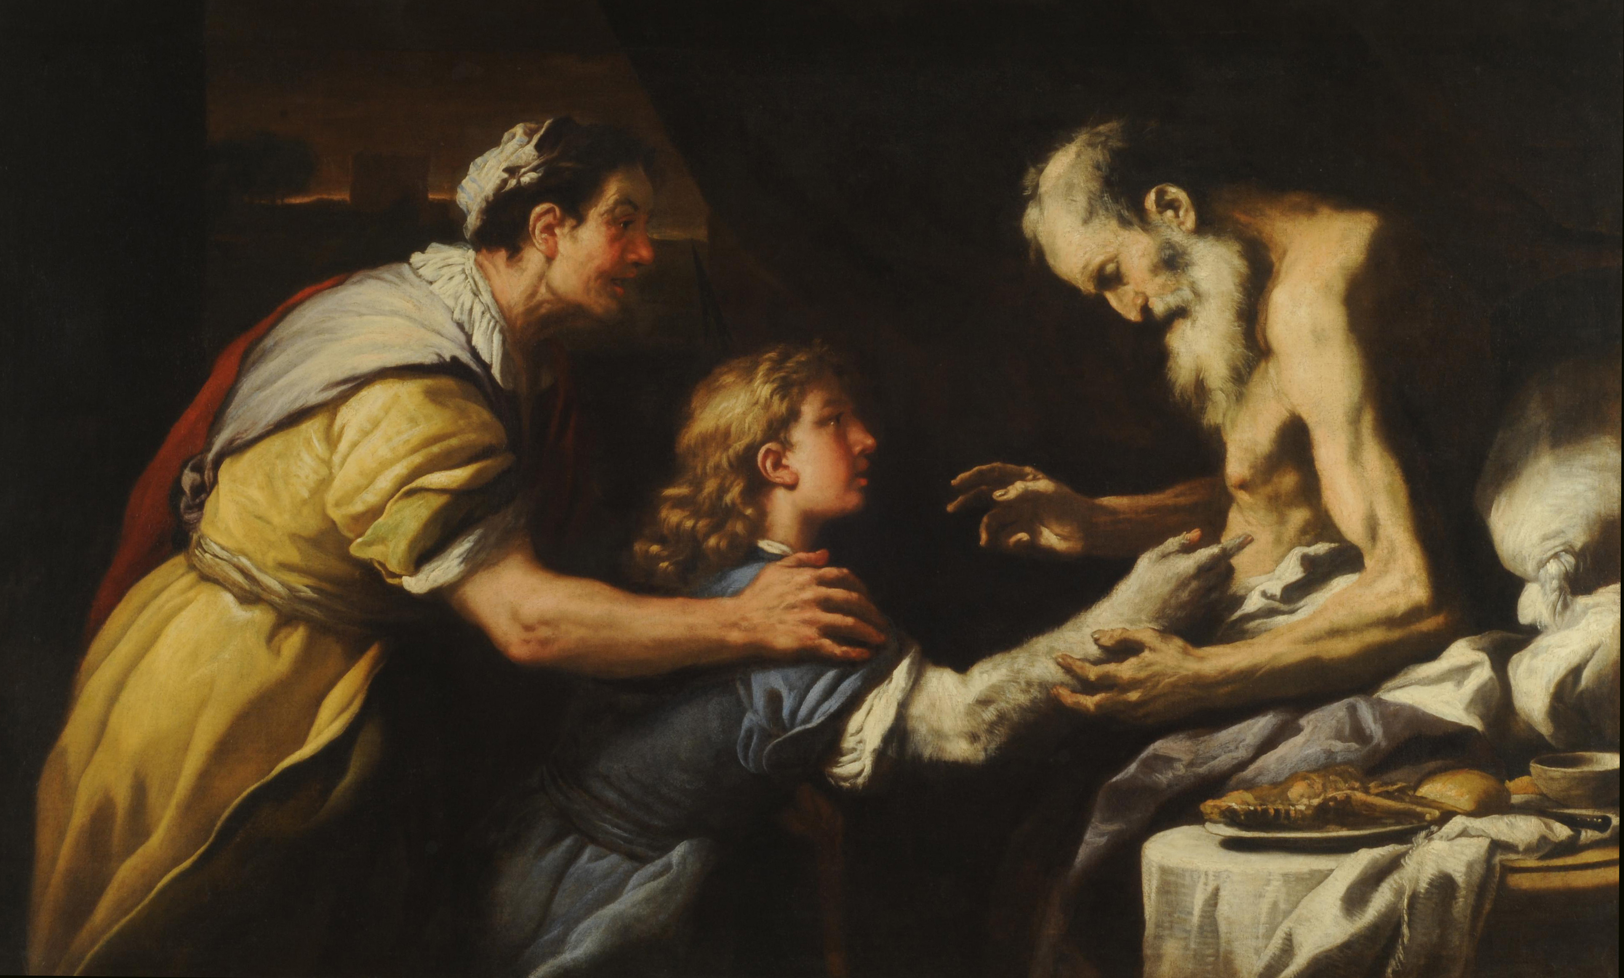
Jacob Steals the Blessing
Aged and blind Isaac prepares to bless Esau
Blessing
Sets identity/destiny of the child
Intergenerational
Holds genuine power
Rebekah initiates the trickery
Food / Skin / Clothing
Jacob is readily complicit
Notes:
…but at this point Jacob has only half of what he needs. He also needs to overcome his father’s love of Esau to receive the family blessing.
Isaac, old and blind, sends out Esau to hunt so that he may prepare what amounts to Isaac’s final meal with the intention that he will bless Esau upon eating it.
The notion of the blessing here is foreign to our rational individualistic culture. Our is one in which initiative to make one’s own way in the world is privileged. A person has a say in the outcome of their own life, and is a direct result of the choices that a person makes. But the blessing from a father to a son functions another way – to establish the identity of the child and set his destiny for him. What Jacob will be is established and set in motion by these words. Thus, parents have a direct say in the destinies of the lives of their children. And of course, the blessing of this family is all the more important, because the blessing carries with it the hope of fulfillment of God’s promises to Abraham.
This is something which we don’t have a good understanding today. I think we identify with Esau once the deed has been done and discovered when he says “Bless me also father!” and “Do you only have one blessing?” Why can’t Isaac renege on what has been done, considering that cheating was definitively involved? The answer is because that’s not how the act of blessing works. The words and actions of Isaac cannot be dismissed or undone because the words themselves have a genuine power and authority. Once they are spoken, the cannot be taken back. Isaac can no more take back his blessing than he can make himself see again.
[[Why does Rebekah initiate the deception?]]
She refers to Isaac/Esau as ‘your father/brother’
The deception is elaborate – she cooks a meal, and makes Jacob up in goat hair and Esau’s clothing.
[[How would you describe Jacob’s willingness to go along with this?]]
His concern is not about whether to go through with it, but rather how they’ll get away with it.
He is worried that the ruse will bring a curse upon him, rather than a blessing

Slide 14
Jacob Steals the Blessing
Jacob tells two lies:
Purposely identifies himself as Esau
Appeals to YHWH’s aid to explain himself
Issac remains suspicious
3 parts to the blessing
Basis for the blessing
What Jacob will receive
Jacob’s future descendants
Notes:
[[What two lies does Jacob tell?]]
Despite the elaborate rues, Isaac remains suspicious – Jacob has to answer for his supposed whereabouts, the speed with which the food was prepared, and his tone of voice…And in v. 23-4 when most bibles say that Isaac blesses Jacob (actually, this should probably be taken as ‘he was about to bless him’ or ‘was on the verge of blessing him’), he asks him a second time, just to make sure he really is Esau. J
The blessing has 3 parts
The basis for the blessing – this is maybe the high point of the irony in this story. Because Jacob smells like a fertile field which has been blessed by God, his blessing is of a type which will follow suit.
A statement of what Jacob will receive – phrases about dew of heaven, fatness of earth, grain and wine are predictions of wealth and fertility. For the most part, Jacob becomes a herdsman, not a farmer, but like his father, he too will be physically blessed
A statement of his position over others, which we be manifested in his future descendants – This is not just a statement about Jacob, but about the nation which will bear his later name of Israel – other nations are to serve them, and they will be lord over their brothers (particularly Esau/Edom). And the final statement strongly alludes to the original promise to Abraham, that those who curse him will be cursed and those who bless him will be blessed.

Slide 15
Isaac and Esau Mourn
Jacob leaves quickly and Esau returns ready to receive the blessing
Esau matches his father’s distress
Isaac maintains and repeats the blessing to Jacob
Esau connects Jacob’s actions with his birthright also
Esau is given a ‘blessing’ of his own
Esau will become a man of the sword (i.e. war/plunder)
His people will not serve Israel forever
Notes:
The action in the story is quite vivid here – picturing Esau returning just as Jacob leaves.
Esau’s reaction tells that he understands the importance of the deception which Isaac has discovered and revealed. In fact, the descriptions of the reactions are grammatically identical, indicating that they mourn not only equally but together over this fraud.
Again, Isaac makes no attempt to rescind the blessing. It is irrevocable. It is important here, to underscore the point earlier, that Isaac does not do this because he has an insight into the divine will. He does not appeal to God’s word to Rebekah (if he even knows it), or that it must be God’s will that this happened. No, the blessing is what the blessing is because that’s the way blessings go…
Jacob open admits that the blessing was taken deceit, though he does not implicate Rebekah (if he even knows to)
Esau ties this event with the taking of his birthright, suggesting that at least Esau sees Jacob acting deviously in both cases.
Esau sees that Jacob has earned his name – he is the ‘heel-grabber,’ the ‘supplanter’
Esau is given a loose kind of blessing in the end
He will be a predator, a man of the sword, living by violence
Like Jacob this concerns not only himself but his future people – there will come a time when they will break loose from their brother.
May refer to Edom’s independence from Israel during the reign of Jehoram King of Judah as told in 2 Kings/2 Chronicles

Slide 16
The Separation of Jacob & Esau
Two stories give independent reasons for Jacob leaving his home and running off to Padan-Aram
Esau plots to kill Jacob
Jacob should find a wife
Esau’s wives
Esau had 2 wives from among the Hittite women
In response to Jacob search for a wife, Esau marries an Ishmaelite woman
Notes:
The two stories at the end of 27 and beginning of 28 give different reasons for Jacob going off to Haran/Padan-Aram.
Ch. 27 states that Esau was plotting to kill Jacob after Isaac died. For a second time, Rebekah is able to learn the truth beforehand, and warns him to run to her brother Laban in Haran
She states that he should go for ‘a while…until she is able to bring him back.’ We should note that Jacob ends up being gone for 20 years – and we not told that he ever sees his mother again after this.
In addition, Isaac apparently doesn’t die during that time, or for some time long afterwards, in fact….when Isaac does finally die, the reconciled brothers will bury him together.
Ch. 28 tells us that Jacob should go to Laban in order to seek a wife
Here Isaac has no qualms over the deception used to procure the blessing, and Isaac again blesses Jacob, wishing upon him the blessing of Abraham, that he would return to take possession of the land.
The other subplot to this story that we have not touched on is that Esau is already married, and married to foreign women from among the Hittites. We are told that upon Jacob leaving to find a wife from among the family, that he makes an attempt at the same, marrying an Ishmaelite woman.
- It is important that though Esau leaves the story for a while, he will return later, and will be painted in a more sympathetic light. Not only does he forgive Jacob, but his full line of descendants and the kingly class among them is given in chapter 36 at the end of the Jacob cycle.

Slide 17
Encounter at Bethel
Jacob comes to Nowhere
‘A Certain Place’
Stone Pillow
The Dream
Ladder/Stairway
Angels ascending/descending
YHWH stands ‘above it’ / ‘beside him’
Promises Repeated
Jacob makes a vow at ‘Bethel’
Notes:
It should be noted that when Jacob leaves for Bethel he is already, pretty old – he is somewhere between 40-70 years old. And he has never encountered YHWH at this point in his life. That might seem strange considering that God has chosen Jacob from birth to the be the one to carry forward the covenant.
Jacob comes to ‘a certain place’ – we are not told the name of the place until the conclusion of the story. This suggests that Jacob is really nowhere – he is in an undefined, uncharted spot. This is reinforced by the detail that there is no place to stay, so that he uses a stone for a pillow. Jacob is on the run and he is alone.
One interesting note from the Hebrew text here that is probably not reflected in your English translations: The verb tenses in v. 10-11 (left/went/came/stayed/put/lay down/dreamed (v.12)) are all (essentially) indicative, past tense verbs – that is they state what happened. But w/ the description of the dream in v. 12, starting with the word ‘Look!’ or ‘Behold!,’ the verbs change to participles, thus describing the action as present, and encouraging us to see what he sees: (“And behold, a stairway setting upon the earth, and the top of it reaching to heaven. And behold, the angels of God ascending and descending on it. And Behold, the LORD standing above it, saying…)
Here we have another instance of God appearing in a dream. [[When did that happen before?]] With Abimelech in ch. 20.
The Dream itself is strange. We have God’s angels or messengers (we’ve already encountered these before as well!) going up and down on a ladder, or stairway. Traditionally, this has been read as a ladder, but as stairways are easier to imagine and to paint, that’s more to some. Some have suggested that ‘ladder’ doesn’t make sense because a ladder doesn’t really allow for two-way traffic, but then I would suggest that more important than that is why winged angels would need either one.
But the dream is important too…[[Does the description ‘there was a ladder set upon the earth, and the top of it reached to heaven’ remind you of anything?]] But here we have angels coming down to earth and go back up to heaven [[What does that mean?]] Whereas at Babel you had men attempting to reach up to heaven, I think this dream gives us a window into the realities of the spiritual realm. Heaven and earth are already connected, they already overlap, and here are God’s messengers coming down to do God’s will and returning back to God. God is not in the world, but he is not separate from the world either. And now, despite Jacob’s isolation, God is reaching down to interject himself into Jacob’s life – He is not alone!
This is suggested by the looseness of the preposition in v. 13 – most translations position God as ‘above it’ that is, at the top of the ladder. But the preposition there could also read ‘over him,’ suggesting that YHWH speaks at Jacob’s side a the bottom of the ladder.
YHWH then repeats the promises given to Jacob’s father and grandfather – the promise of the land for his descendants, the numerous descendants, as the dust of the earth, and again, that all the families of the earth will be blessed in him/them. Jacob is now the bearer of the promises and the covenant. It is interesting that YHWH does not make any mention of stolen blessing from Isaac. These promises are not just the next step in the line of Abraham – these are a fresh start for Jacob personally. Thus, God says in v. 15 “Behold, I am with you and will keep you wherever you go, and will bring you back to this land. For I will not leave you until I have done what I have promised you.’ Notice there that six times God is the subject of what he will do to/for Jacob. The emphasis is upon God as the protector of Jacob’s life.
And Jacob surely gets the significance of all this:
This place is a sacred place: Surely, the LORD is in this place! This place is the ‘house of God,’ the ‘gate of heaven!’ Bethel would become one of the leading Israelite cities under the divided kingdom, and one of its most important holy places (for better or worse!)
Thus the stone pillow is made a monument, a visual symbol of the encounter.
He names the place ‘Bethel’ (lit. ‘house of God’)
Jacob makes his own vow
Focuses on the more immediate aspects of God’s promise to him in v. 15-16.
Calls for God’s protection and provision, and return to his homeland
Promises devotion to God expressed in the tithe.
We shouldn’t read too much into the conditional form of the statement

Slide 18
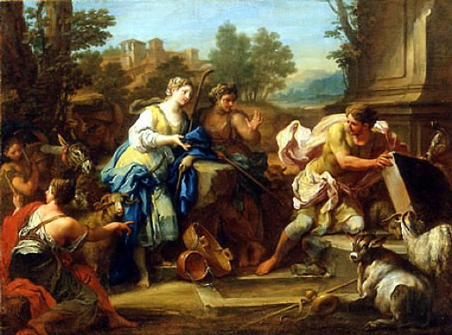
Jacob Meets Rachel & Laban
Jacob reaches ‘the East’
Inquires of Laban (lit. Is peace to him?)…
…but encounters Rachel at the well
Jacob moves the well stone by himself…
Then kisses Rachel, and cries.
Laban comes and invites Jacob into his house.
Notes:
Padan-Aram is ‘the East’ in Genesis geography
This story is intended to be funny…
He is looking for Laban and asks the shepherds about him
But he finds Rachel at the well. This is pretty typical – we’ve already seen Isaac’s wife found at the well, now Jacob will find his there too.
In a feat of herculean strength, he is able to move the stone from the well by himself when he sees Rachel.
This reminds me of John 21 – when the disciples encounter the resurrected Jesus after fishing. Having caught a net-load of fish, it says the disciples brought the boat up to the shoreline. But then when Jesus asked for some of the fish, Peter – the most enthusiastic – goes back onto the boat, grabs the entire net of 153 large fish, and drags them up to where Jesus is on the shore, and the net was not broken.
This is juxtaposed by the next action, in which he kisses Rachel and cries.
This kiss is probably not a romantic kiss, but a kiss of greeting (although it is strange for it to involve a woman), much like the kiss between Jacob and Laban to follow.
The crying is probably due to the successful end of his journey (remember it’s a long way from Beer-Sheeba in south Canaan to Padan-Aram)…either that or because he had thrown out his back rolling the stone away

Slide 19
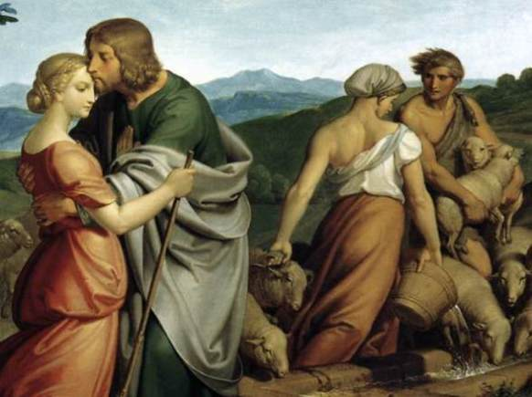
The Deceiver is Deceived
Jacob agrees to work for Laban for his daughter Rachel
He loves Rachel’s physical appearance
When Jacob calls for Rachel’s hand, Laban throws a party
Laban delivers Leah to Jacob
Notes:
Although we could have mentioned this before, the way women are treated in this story offends our modern sensibilities, with women used as wages and as sexual bait for trickery, we aren’t told about the perspectives of these women to these arrangements until later in which we find out about their rivalry over bearing children…these kinds of issues are difficult, unfortunately that can’t be our focus in a class of this scope. I would say, that there are several other places in the biblical story where other women are held up in a positive light. We shouldn’t use a text like this to promote the idea that women are wholly degraded by the Bible, because that just isn’t true.
Jacob agrees to work 7 years in Laban’s house, with his payment to be eventual marriage to Rachel. It is unclear the meaning/intention of Laban’s statement in v. 15, or why 7 years is the contract term for a wife.
It is clear why Jacob agrees to this – he finds Rachel physically attractive. We are told that Leah has ‘weak’ eyes – it’s not clear what this means, but it could mean that she had youthful eyes. Regardless, he loves Rachel because she is beautiful in form and appearance – another translation states she is ‘shapely and attractive.’
Laban’s deception of Jacob is set up in v. 19 when he implies that the terms of the agreement are acceptable to him
V. 20 is a rare example of a statement of romantic love in the OT.
Jacob calls on Laban to give Rachel to him
The language here is fairly demanding, indicating Jacob’s sense of right
He calls Rachel his wife, and makes a strong indication of his intentions.
The procedure here – the party, the giving of the woman – is a bit strange. It is not clear how the ceremony works.
Laban delivers Leah to Jacob and the two are intimate during the night.
Jacob does not realize the deception until the morning. (It was dark, perhaps he was drunk)…”Behold, it was Leah!!”
[[What are the parallels between this story and Jacob’s taking of the blessing?]]
Pretending to be another person
In the presence of the one tricked
Both involve not being able to see
Jacob pretends to be his older brother / Leah pretends to be her older sister

Slide 20
The Deceiver is Deceived
Jacob discovers the ruse and is angry!
Laban appeals to cultural custom as a defense
Jacob takes Rachel as his wife also, but works another 7 years
Jacob loved Rachel more than Leah
Notes:
[[How does Jacob’s offense at this action strike you? Is he justified in his anger?]]
Laban appeals to cultural custom as a defense for his action. Despite his earlier indication that he would give Rachel, he now suggests that he was not able to give Rachel before Leah. In doing so, he ironically calls Leah ‘the firstborn.’
However, the resulting offer in v. 27 to have Jacob work for another 7 years indicates his real motives – he gets to double up on Jacob’s contract!
Jacob is able to take Rachel as his wife prior to that time, and the story tells us in v. 30 that Jacob loved Rachel more than Leah – literally that he ‘hated’ Leah.
Here is one more parallel with the earlier story. Parental favoritism has turned into marital favoritism.

Slide 21
The 12 Sons of Jacob
Reuben
Simeon
Dan
Naphtali
Levi
Judah
Gad
Asher
Issachar
Zebulun
Joseph
Benjamin
Notes:
Despite the fact that Jacob loves Rachel, she is barren – a familiar theme in Genesis as we’ve seen. God looks favorably upon Leah, and grants here the privilege of children.
Sibling rivalry results in 13 children born to Jacob – 12 sons and a daughter (who we’ll meet later). These 12 sons will be important at the end of Genesis when Jacob gives out the blessing before he dies.
6 children born to Leah
2 to Rachel’s maid Bilhah
2 to Leah’s maid Zilpah
Finally…2 to Rachel herself. These two Joseph and Benjamin will be the object of Jacob’s affection, a problem which will result in the downfall of Jacob’s life.
And of course Joseph will be the primary character in the final act in the narrative of Genesis.

