Slide 1
The book of Genesis
Lesson 22: Joseph
The Dreamer

Slide 2
Class Schedule, (Segment 1)
Session | Topic | Reading | Date
Lesson 14 – Grant | Key Figure: Abraham |  | Sun, June 4
Lesson 15 – Grant | Abraham | Gen 11:27-25:11 | Sun, June 11
Lesson 16 – Sam | Abraham | Gen 11:27-25:11 | Wed, June 14
Lesson 17 – Sam | Abraham | Gen 11:27-25:11 | Sun, June 18
Lesson 18 – Grant | Jacob | Gen 25:12-36:43 | Wed, June 21
Lesson 19 – Grant | Jacob | Gen 25:12-36:43 | Sun, June 25
Lesson 20 – Grant | Jacob | Gen 25:12-36:43 | Wed, June 28
Lesson 21 – Grant | Jacob | Gen 25:12-36:43 | Sun, July 2
Lesson 22 – Sam | Joseph – The Dreamer | Gen 37, 39-41 | Wed, July 5
Lesson 23 – Sam | Joseph – The Ruler | Gen 42-45 | Sun, July 9
Lesson 24 – Sam | Joseph and his Brothers | Gen 38, 46-48 | Wed, July 12
Lesson 25 – Sam | The Twelve Sons of Israel | Gen 49-50 | Sun, July 16
Lesson 26 - Grant | Review |  | Wed, July 19
Notes:
Note that we’re approaching this as a textual study, meaning that our focus will mainly stay on the features of the book which God inspired. For that reason it will be important that you read the book. There is lesson material, but that should only help focus your reading. I think you should have plenty of time for reading. Since we won’t have a lot of time to read the text aloud in class, having the text read means that you’ll be able to follow any discussion we have and be able to easily understand anything we talk about from up here.
Note that we’ve broken this down by section/topic rather than by date. We didn’t’ want to commit to strict sections of the text which are large and deal with the same basic characters. So for instance we’ve allowed 2 classes to cover Noah and the Flood, or 5 classes to cover Abraham. Lesson material should reflect that setup. It won’t be lesson 1,2,3, etc. The material you get will cover the entire section and can be done at your own pace.
We have interjected here a number of ‘topical’ classes. Danny Haynes will be presenting a single class at the beginning covering the issues of how Genesis relates to science and history. The point of the class is more of a textual study of Genesis, but we recognize that those are important issues and worth addressing so Danny has agreed to give us an overview of some of those evidences. We also have a class once we start the section on the patriarchs that I hope will be a historical look at the life of the patriarchs, and explain the world in which they lived. That should be really interesting and help our study through the last ¾ of the book. There are two classes that will focus on the characters of Adam and Abraham, and I think specifically will look at what the New Testament writers have to say about them. That should broaden our understanding of the significance of them for understanding who we are as Christians today. And then we have a couple of review periods in there as well.

Slide 3
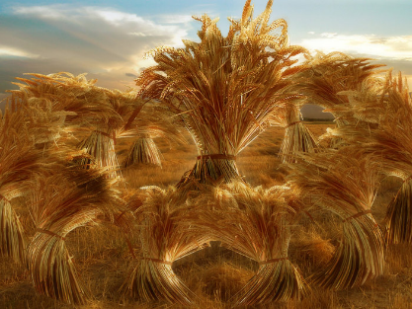
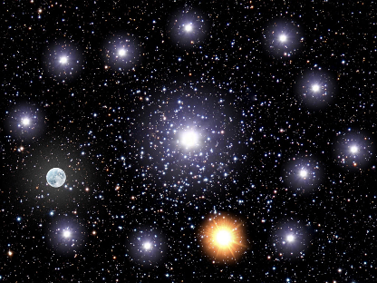
Joseph the Dreamer
Jacob Favored Joseph
He was “the son of his old age”
The first son of Rachel, Jacob’s favorite wife (now deceased)
Born after a long period of barrenness
Born in Paden Aram, before the final period of service to Laban
Gave him a special coat of many colors
Joseph was learning to be a shepherd (age 17)
Working with the sons of Bilhah and Zilpah
Brought Jacob a bad report of them
Joseph had dreams
Eleven sheaves bowed to his sheaf
Eleven stars, the sun, and the moon bowed to his star
Jacob rebuked him, His brothers hated and envied him

Slide 4
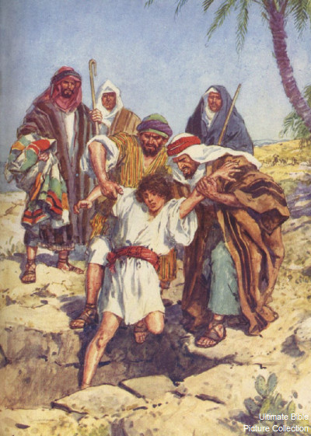
Joseph Betrayed by his Brothers
Jacob sent him to check on his brothers
Tending the flocks in Shechem
Moved to Dothan, and Joseph followed
The Plot
The brothers saw him coming from afar
“Look, this dreamer is coming!”
Plotted to kill him
Rueben tried to stop them from murder by suggesting they throw him in a pit
Judah suggested selling him to traders as a slave
The Cover-up
The coat was dipped in blood and sent to Jacob to identify
Jacob recognized the coat, and knew Joseph was dead
Jacob mourned him excessively, and would not be comforted

Slide 5
Questions
Were Joseph’s dreams from God?
Were all Eleven brothers intent on killing him?
Where did Joseph end up?
What similarities might we find in the life of Joseph vs the life of Jesus?

Slide 6
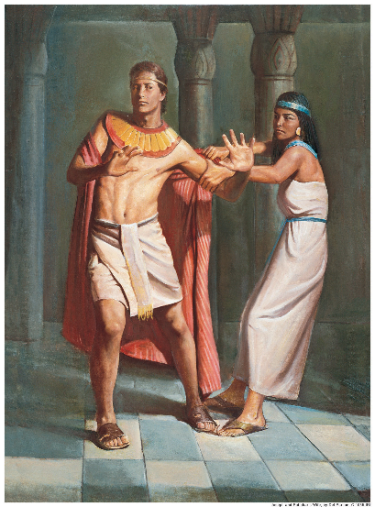
Joseph In Slavery
A servant in Potiphar’s Household
Potiphar, captain of the guard of Pharoah bought him
God’s blessing on all that he did was obvious
Soon rose to overseer of the household
Potiphar’s wife desired him
He was handsome in form and appearance
She tried repeatedly to seduce him, but he refused. He would not sin against his Master and against God
When her trap failed, she accused him of attempting rape
Back to the bottom
Potiphar’s anger was aroused
Joseph was imprisoned

Slide 7
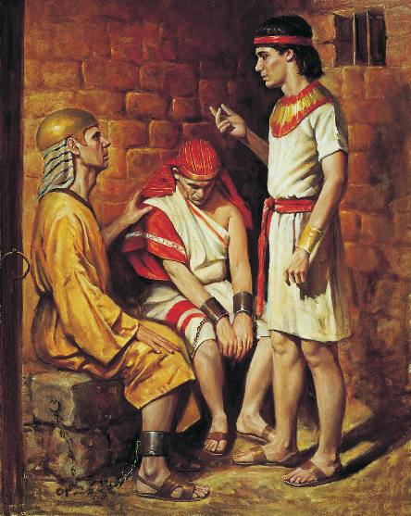
Joseph Interprets Dreams
Joseph rose to service in Prison
Found favor in the sight of the Keeper of the Prison
He committed all the prisoners to Joseph’s care
Chief Butler and Chief Baker were imprisoned with him
They had offended Pharoah
They both had dreams
“Do not interpretations belong to God?”
Joseph interpreted both dreams correctly
Joseph asked the Butler to remember him
It was two more years before he was finally remembered

Slide 8
Questions
What lessons was Joseph learning that would serve him well later as a leader?
Did Joseph seek after righteousness?
Was Joseph a responsible administrator?
How can we see God’s providence in the life of Joseph thus far?

Slide 9
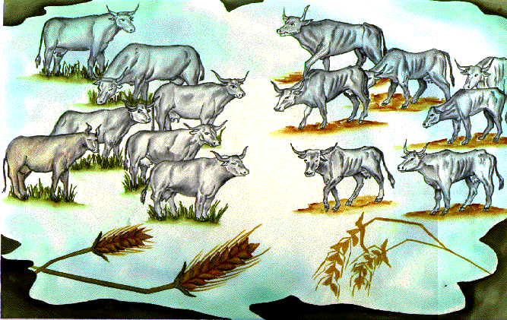
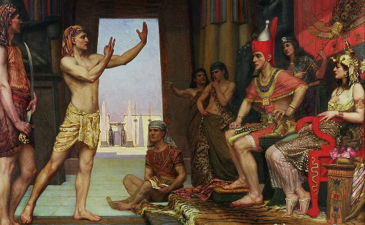
Joseph Interprets Pharoah’s Dream
Pharoah had a dream
Seven fat cows and seven lean cows
Seven fat heads of grain and seven lean heads
The Magicians and Wise Men of Egypt could not interpret the dream
The Chief Butler remembered “the young Hebrew man”
Joseph is summoned
He is cleaned up and presented
Correctly interprets the dreams as one sure message
Years of famine are coming. God has determined it
Provides a plan for preserving the nation
Pharoah recognizes the value of Joseph
“a man in whom is the Spirit of God”
Wise and discerning

Slide 10
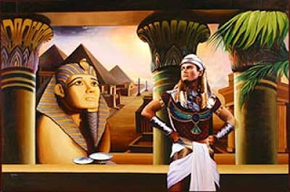
Joseph Begins to Rule
Joseph is Exalted
Pharoah sets him over all of Egypt to execute the plan
Given Authority, Wife, and Egyptian Name
Two sons are born: Manasseh and Ephraim
Joseph goes to work (age 30)
Travels throughout the whole land to evaluate
Gathers 1/5 into barns, beyond measure of counting
Appoints guards to protect it
The famine begins as predicted
As food runs out in all lands, there is bread in Egypt
Joseph begins to sell food to the people
And far away in the promised land…
His brothers prepare to come and buy

Slide 11
Questions
How did God use Dreams in the life of Joseph?
What growth do you see in Joseph’s understanding of this purpose?

