Slide 1
The book of Genesis
Lesson 25:
The Twelve Sons of Israel

Slide 2
Class Schedule, (Segment 1)
Session | Topic | Reading | Date
Lesson 14 – Grant | Key Figure: Abraham |  | Sun, June 4
Lesson 15 – Grant | Abraham | Gen 11:27-25:11 | Sun, June 11
Lesson 16 – Sam | Abraham | Gen 11:27-25:11 | Wed, June 14
Lesson 17 – Sam | Abraham | Gen 11:27-25:11 | Sun, June 18
Lesson 18 – Grant | Jacob | Gen 25:12-36:43 | Wed, June 21
Lesson 19 – Grant | Jacob | Gen 25:12-36:43 | Sun, June 25
Lesson 20 – Grant | Jacob | Gen 25:12-36:43 | Wed, June 28
Lesson 21 – Grant | Jacob | Gen 25:12-36:43 | Sun, July 2
Lesson 22 – Sam | Joseph – The Dreamer | Gen 37, 39-41 | Wed, July 5
Lesson 23 – Sam | Joseph – The Ruler | Gen 42-45 | Sun, July 9
Lesson 24 – Sam | Joseph and his Brothers | Gen 38, 46-48 | Wed, July 12
Lesson 25 – Sam | The Twelve Sons of Israel | Gen 49-50 | Sun, July 16
Lesson 26 - Grant | Review |  | Wed, July 19
Notes:
Note that we’re approaching this as a textual study, meaning that our focus will mainly stay on the features of the book which God inspired. For that reason it will be important that you read the book. There is lesson material, but that should only help focus your reading. I think you should have plenty of time for reading. Since we won’t have a lot of time to read the text aloud in class, having the text read means that you’ll be able to follow any discussion we have and be able to easily understand anything we talk about from up here.
Note that we’ve broken this down by section/topic rather than by date. We didn’t’ want to commit to strict sections of the text which are large and deal with the same basic characters. So for instance we’ve allowed 2 classes to cover Noah and the Flood, or 5 classes to cover Abraham. Lesson material should reflect that setup. It won’t be lesson 1,2,3, etc. The material you get will cover the entire section and can be done at your own pace.
We have interjected here a number of ‘topical’ classes. Danny Haynes will be presenting a single class at the beginning covering the issues of how Genesis relates to science and history. The point of the class is more of a textual study of Genesis, but we recognize that those are important issues and worth addressing so Danny has agreed to give us an overview of some of those evidences. We also have a class once we start the section on the patriarchs that I hope will be a historical look at the life of the patriarchs, and explain the world in which they lived. That should be really interesting and help our study through the last ¾ of the book. There are two classes that will focus on the characters of Adam and Abraham, and I think specifically will look at what the New Testament writers have to say about them. That should broaden our understanding of the significance of them for understanding who we are as Christians today. And then we have a couple of review periods in there as well.

Slide 3
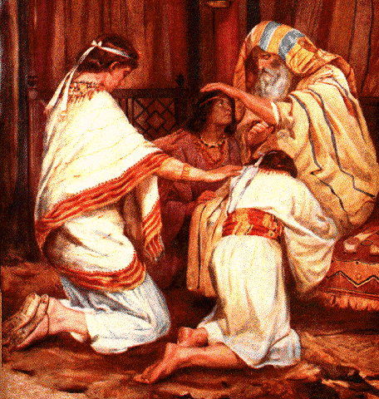
Jacob Blesses Joseph’s Sons
Joseph visits his father
Joseph was told his father was sick
Joseph came to visit with his two sons (18-20 years?)
Jacob reminded him of God’s promises in a visitation
Jacob adopted Ephraim and Manasseh
“…mine, as Reuben and Simeon they shall be mine”
Remembered Rachel’s untimely death
Jacob blessed Joseph, through his sons
Jacob reversed the order of preeminence
Crossed his hands, reversing their order of age
Joseph attempted to intervene, but was refused
Both would be great and a blessing in Israel
Joseph would thus receive a double portion in the land

Slide 4
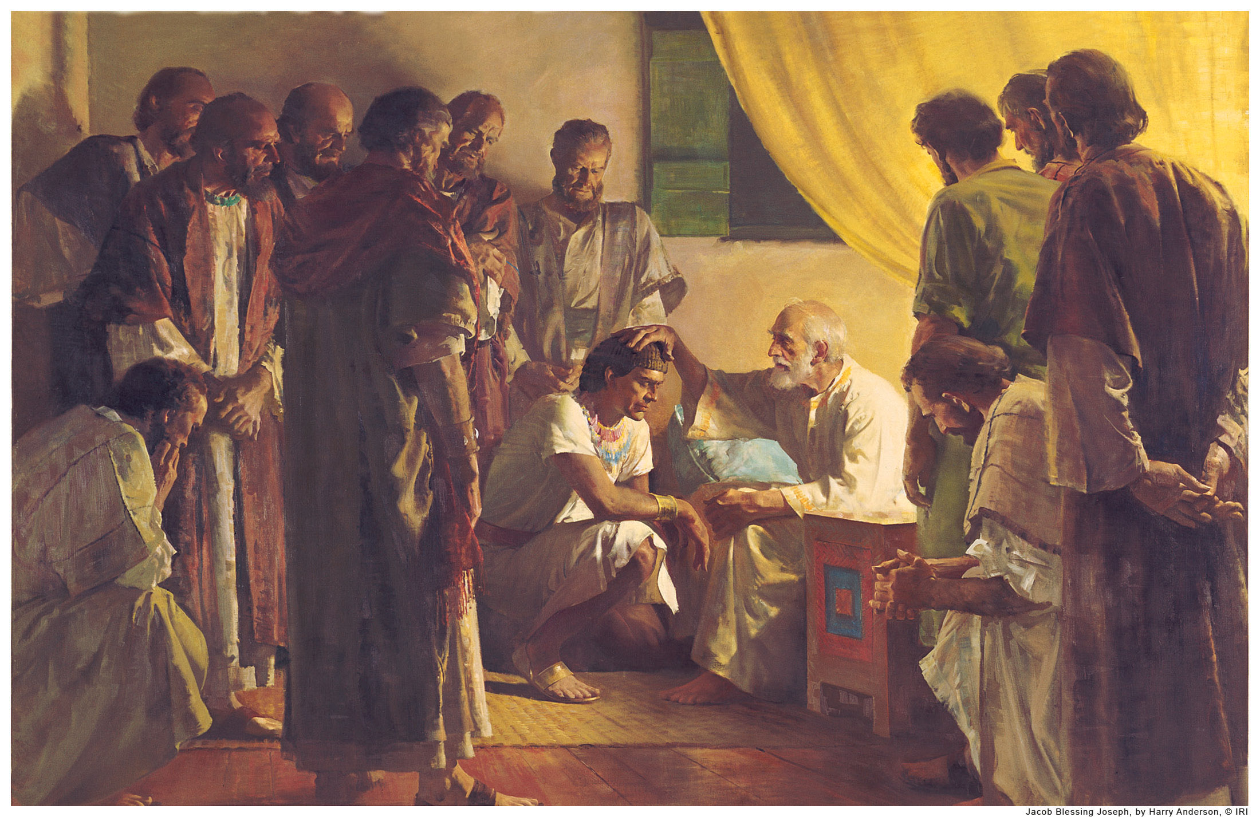
Jacob’s Blessings
Jacob called his sons to gather for a Blessing
Given as prophecy (“…what shall befall you…”)
Expressed in Hebrew poetic form
Each one blessed according to his own blessing
In order: Sons of Leah, of handmaidens, of Rachel
Not just good things
Reuben, Simeon, and Levi censured for their actions
The anger of Simeon and Levi was cursed
Issachar censured for indolence
Some given advice or warnings
Varying time frames in the message
Some would pertain to thee time of entering the land
Some was Messianic

Slide 5
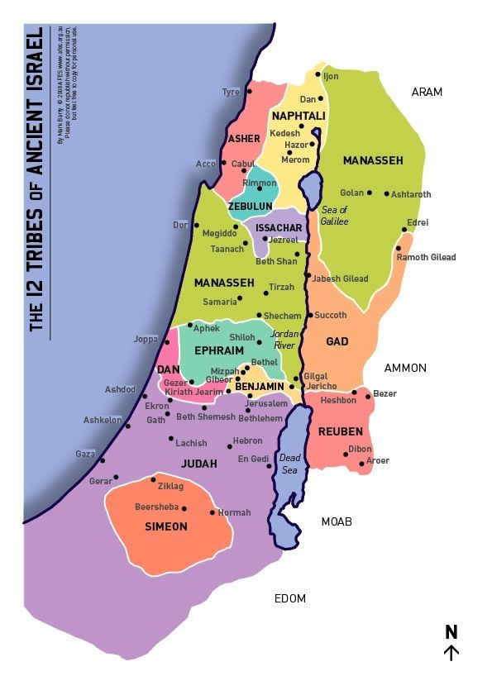
Reuben
Jacob’s first-born
Strength and the beginning of might
Excellence of dignity and strength, but you will not excel
Not suitable for leadership
Unstable, Seething , unbridled license
Unable to rescue Joseph from the other brothers (Gen 37:22)
Unable to persuade Jacob to send Benjamin (Gen 42:37)
Censured for defiling his Father’s bed (Gen 35:22 Bilhah)
Did not receive the double portion (1 Chron 5:1)
Later days
No prominent leader came from Reuben
They settled east of the Jordan

Slide 6
Simeon and Levi
They are brothers
Not just sons of the same parents, but of the same mind
Censured for destroying Canaanite city in Gen 34:30
Their violence condemned
Jacob disavowed their act doubly
Done in anger and self-will, not righteous indignation
Cursed their anger as “fierce” and “cruel”
They will be “divided” and “scattered”
Perhaps separation will be good for them?
Later days
Simeon’s inheritance was inside Judah, eventually absorbed
Levites were redeemed in Ex 32, after the Golden Calf
They were “scattered in Israel” as priests
Levi ?

Slide 7
Judah
Words of strength and courage
Your brothers will praise you
Your hand shall be on the neck of your enemies (overcoming)
Your father’s children shall bow down
Pictured as a young Lion
Raising from a recent kill
He lies down, and who shall rouse him?
Pictured as a ruler
The scepter shall not depart, nor a lawgiver (ruler’s saff)
Until Shiloh comes (“man of rest”, or “giver of rest”)
Blessed with physical blessings in the land
Later days
Tribe of David, Solomon, and Jesus
Faithful as a nation until the time of Christ

Slide 8
Zebulon and Issachar
Zebulon shall Dwell by (or toward) the sea
His name means “dwelling”
Little is told except a future location
Issacar is a strong donkey
Strong toward burdens
Not strong in initiative

Slide 9
Dan and Gad
Dan shall judge
His name means “vindication” or “administer judgment”
A serpent or viper to those he opposes
Later Days
The mighty judge Samson was from Dan
Gad Shall be trampled, but prevail

Slide 10
Asher and Naphtali
Asher’s food is rish
His name means “fortune”
His land would be among the richest
Naphtali is a deer let loose
He uses beautiful words

Slide 11
Joseph
A picture of a fruitful bough
By a well – to water it
Over a wall – in full growth and well supported
Archers have shot at him, but God Strengthened
Bitterly grieved him, hated him
His bow and his arms remained strong
By the hands of the Mighty God of Jacob
By the God of your Father who will help you
By the Almighty who will bless you with exceedingly rich blessings – from above and below, with children, etc
Superlative physical blessings assured

Slide 12
Benjamin
Pictured as a ravenous wolf
In the morning devours the prey
At night he shall divide the spoil
An image of successful conquest
Later Days
Ehud the second judge of Israel
Israel went to war with Benjamin in Judges 20, nearly destroyed them
Saul, son of Kish. The first King of Israel
Saul of Tarsus (the Apostle Paul) was from Benjamin

Slide 13
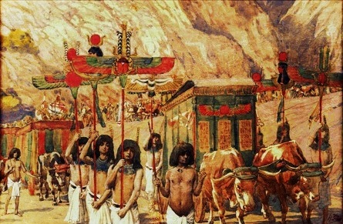
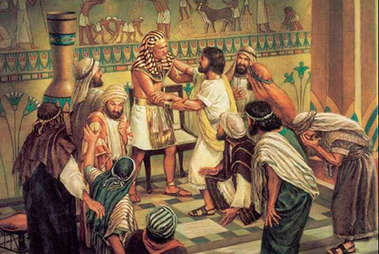
Conclusions
Jacob’s Death and Burial
He would be “gathered to his people”
Commanded to bury him in Canaan with his fathers
Joseph commanded embalming
Egyptians mourned 70 days
Pharaoh commanded Joseph to go bury him in Canaan
Buried with mourning, a great gathering of Egyptians
Joseph Reassures his brothers
Brothers feared that Joseph would repay them their evil
Asked for forgiveness again, received assurances
The Death of Joseph
Joseph lived 110 years, saw his children to 3 generations
Foretold that God would surely bring them out of Egypt, and they should carry his bones out with them

Slide 14
Questions
Were the last words of Jacob a Blessing, a Curse, or a Prophecy?
Which brothers fared worst? Best?
How did Joseph receive a double share of his father’s blessing?
Did Jacob “the trickster” play any final tricks?

